Slide 1
MIT 6.875
Foundations of Cryptography
Lecture 7

Slide 2
Lectures 7-9
Public-key Encryption:
Definition and Properties
Constructions
1: Diffie-Hellman/El Gamal
2: Trapdoor Permutations (RSA, Rabin)
3: Quadratic Residuosity/Goldwasser-Micali
4: Elliptic Curves
5. Learning with Errors/Regev

Slide 3
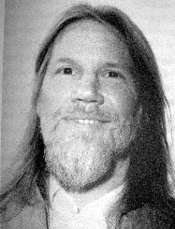
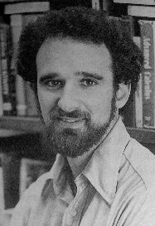
Diffie-Hellman ‘76:
New Directions in Cryptography
Turing Award 2016

Slide 4
Public Key Encryption
Definition: A public-key encryption scheme is a
triple (G,E,D) of PPT algorithms s.t
Key Generation: G(1^{n}) outputs a pair of keys (e,d)
[Notation: (e,d) ∈ G(1^{n}) e is called public-key, d secret key]
Encryption: E takes as input public key e and plaintext message m and outputs ciphertext c
[Notation: c ∈E_{e}(m) ]
Decryption: D takes as input secret key d & ciphertext c and output m‘ s.t. m=m’ when (e,d) ∈G(1^{n}) and c ∈E_{e}(m), (Notation: D_{d}(E_{e}(m))=m for (e,d) ∈G(1^{n})
System is Secure To come...

Slide 5
Public Directory
Each user u in a network generates a
<Public-Key, Secret-key> = < e_{u},d_{u}>
publishes public key e_{u} in a public directory
keeps secret private key d_{u}.
Users Public Directory Secret Files
A e_{A} d_{A}
B e_{B} d_{B}
C e_{C} d_{C}

Slide 6
Using Public Key Encryption (G,E,D)
User u public key User u private key
e_{u} d_{u}
Knows d_{u}
Send c
On message m
Compute c=E(e_{u},m)
On input c
Set m = D(d_{u},c)

Slide 7
Remarks on the Definition
For simplicity assume that messages are length n (the security parameter)
Both E, D are probabilistic which will allow greater flexibility and possibly greater security
The service maintaining the public file cannot decrypt. It is only trusted to publish the right key for the right user
The difference between Public Key Encryption (asymmetric) and Secret Key Encryption (symmetric) is in the adversary capabilities & the security requirement

Slide 8
Power of the Adversary
Passive adversary
Has access to public keys
Can generate (message, cipher text) pairs
Active adversaries = Passive +
Can modify cipher texts
Can request decryption of cipher texts of choice

Slide 9
Computational Indistinguishability (Formal)
Def Say that a PKC (G,E,D) satisfies computational indistinguishability
if ∀ PPT adversary A ∀ppt M (message space), ∀n suff. large
Prob((e,d) ∈ G(1^{n});{m₀,m₁ }∈ M(e, 1^{n}); m ∈ {m₀,m₁};c ∈ E(e,m):
A(e,m₀,m₁,c)=m ) < ½ + neg(n)
Remarks:
Holds even if adversary knows that the message encrypted is one of two messages which he choose himself.
Why not define “for all m₀,m₁ “?
  In general, don’t know how to prove security when m is hard to compute from public key (e.g. m=secret key)
Difference from symmetric-key encryption: A knows e and how to generate c’s for m of choice.

Slide 10

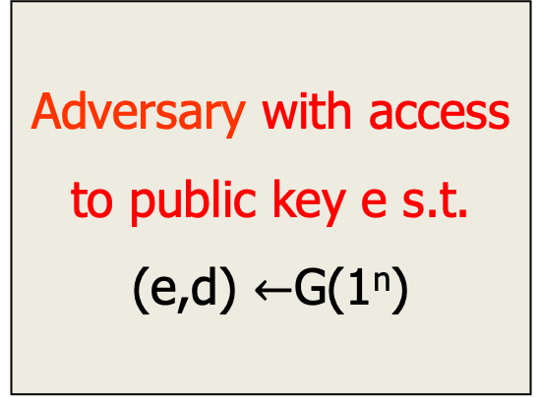
Computational Indistinguishability
No PPT adversary can win the following game:
Challenger
m₀, m₁
Adversary with access
to public key e s.t.
(e,d) $←$G(1^{n})
c=E(e,m_{b}) b∈_{r}{0,1}
Challenge
b’∈{0,1}
  Adversary wins if b=b’
  with probability greater than ½+ non-neg (n)
Clearly, no deterministic E can be secure

Slide 11
Brainstorming (Again):
What Should Security Mean?
Should not be able to recover Secret Key
Should not be able to recover message for any message space that will come up/
Should not be able to recover partial information about messages
Should not be able to recover useful information from traffic of messages
Should be safe to use encryption as a building block in protocol design
With
high
Probability

Slide 12
Semantic Security
An alternative but equivalent definition
Definition: A PKC (G,E,D) is semantically secure if
∀message spaces M, ∀ information functions h: M ⇒V,
∀ PPT adversary A, ∃ PPT adversary B
| Prob( A wins game 1 ) - Prob(B wins game 2)| = neg(n)
Game 1: Choose (e,d) ∈ G(1^{n}) ; m∈ M(1^{n},e);
compute c ∈E(e, m), challenge A(e,c) to compute h(m).
Game 2: Choose (e,d) ∈ G(1^{n}); m∈ M(1^{n},e);
challenge B to compute h(m)
Theorem: Semantic Security ≡ Computational Indistinguishability

Slide 13
Constructing Computationally Indistinguishable Encryption
Tasks
Private Key (Symmetric)
Encryption
Public Key (Asymmetric)
Encryption
Primitives
Pseudo-random Functions
E (m): (r, f(r)⊕m)
Key Exchange Paradigm
Trapdoor Permutations
Trapdoor Predicates
today

Slide 14
Basic Group Theory
Group (G, ⋅) set with binary operation s.t.
Closure: ∀a,b∈G, a⋅b∈G
Identity: ∃ 1∈G s.t ∀a, 1⋅a=a⋅1=a
Inverse: ∀a ∈G, ∃ a⁻¹∈G, a⁻¹ ⋅a=1
Associativity
Let G be a finite group
Order(G) = number of elements= |G| Lemma: ∀a∈G, a^{|G|} =1
Ex: (Z_{N},+) additive modulo N

Slide 15
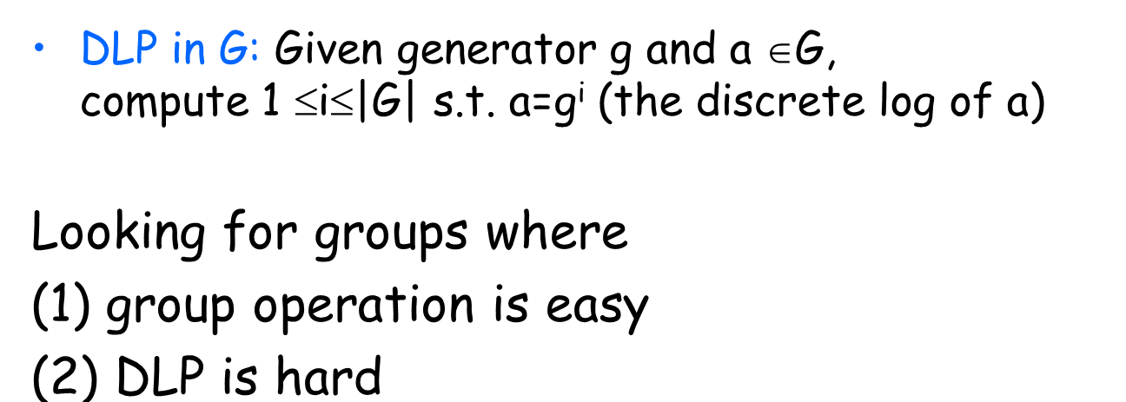
Cyclic Groups
G is cyclic group if ∃ g ∈G s.t. G={g, g², g³,…, g^{|G|}} Say that g is the generator of group G
Fact: Fix g generator for cyclic group G.
∀a∈G, ∃ unique 1≤i≤|G| s.t a = g^{i}
Say that i = discrete log of a w.r.t generator g
Computational Problems Associated with Cyclic Groups

Slide 16

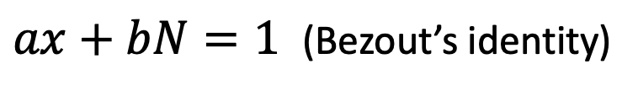
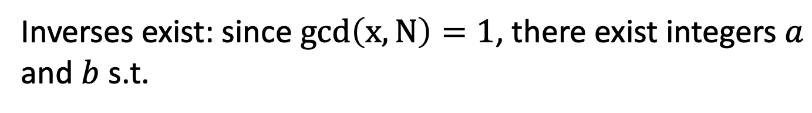
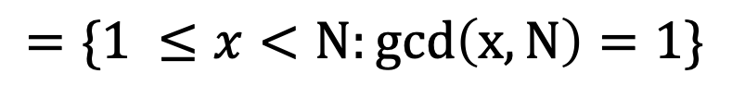
The Multiplicative Group $ℤ_{N}^{∗}$
$$=\{1 ≤x<N:gcd\left(x,N\right)=1\}$$
Theorem: $ℤ_{N}^{∗}$is a group under multiplication mod N.
Inverses exist: since $gcd\left(x,N\right)=1$, there exist integers $a$ and $b$ s.t.
$ax+bN=1$ (Bezout’s identity)
Thus, $ax=1 \left(mod N\right)$ or $a=x^{−1} (mod N)$.

Slide 17
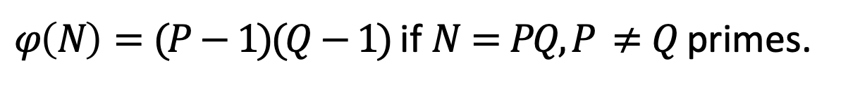

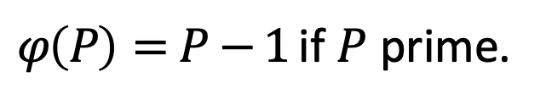
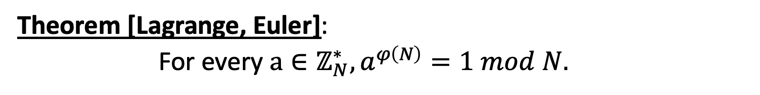
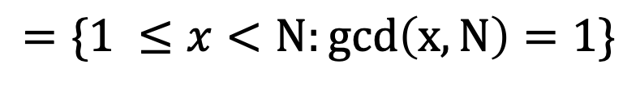
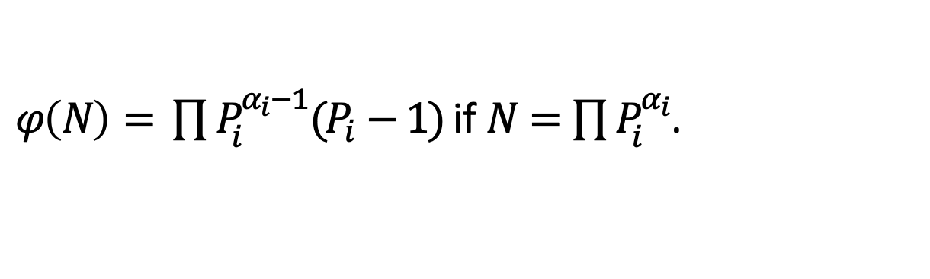
The Order of Multiplicative Group $ℤ_{N}^{∗}$
$$=\{1 ≤x<N:gcd\left(x,N\right)=1\}$$
Theorem: $ℤ_{N}^{∗}$is a group under multiplication mod N.
Order of $ℤ_{N}^{∗}$ = Euler’s totient function $φ(N)$.
$φ\left(P\right)=P−1$ if $P$ prime.
$φ\left(N\right)=(P−1)(Q−1)$ if $N=PQ, P ≠Q$ primes.
$φ\left(N\right)= \prod{P_{i}^{α_{i}−1}(P_{i}−1)}$ if $N=\prod{P_{i}^{α_{i}}}$.
Theorem [Lagrange, Euler]:
For every $a∈ℤ_{N}^{∗}, a^{φ\left(N\right)}=1 mod N.$

Slide 18






Examples
$$ℤ_{2}^{∗}=\{1\}$$
$$ℤ_{3}^{∗}=\{1,2\}$$
$$ℤ_{4}^{∗}=\{1,3\}$$
$$ℤ_{5}^{∗}=\{1,2,3,4\}$$
$$ℤ_{6}^{∗}=\{1,5\}$$
$$ℤ_{7}^{∗}=\{1,2,3,4,5,6\}$$

Slide 19

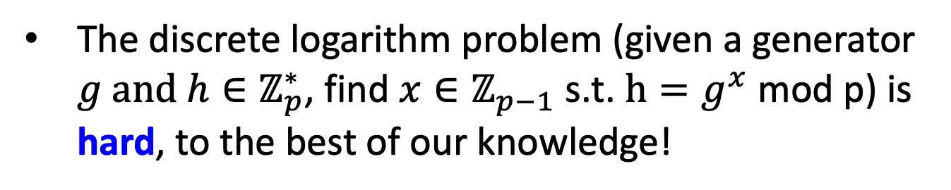
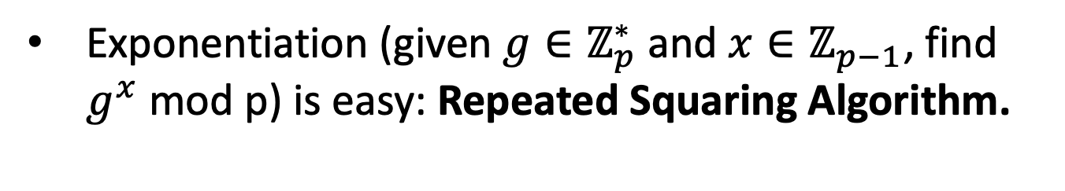
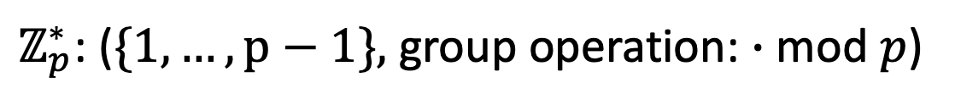
Computationally: Multiplicative Group $ℤ_{p}^{∗}$
$ℤ_{p}^{∗}$: ($\{1,…,p−1\},$ group operation: $∙$ mod $p$)
Computing the group operation is easy.
Computing inverses is easy: Extended Euclid.
Exponentiation (given ${g∈ℤ}_{p}^{∗}$and $x∈ℤ_{p−1}$, find $g^{x}$ mod p) is easy: Repeated Squaring Algorithm.
The discrete logarithm problem (given a generator ${g and h∈ℤ}_{p}^{∗}$, find $x∈ℤ_{p−1}$ s.t. $h=g^{x}$ mod p) is hard, to the best of our knowledge!

Slide 20
Algorithms for Discrete Log
(for Finite Fields)
Index Calculus Algorithm: A sub-exponential algorithm applicable to multiplicative groups of finite fields (𝔽_{p}) It gathers linear relations on a "factor base" of small smooth primes and solves a large linear algebra system to find logs.
Number Field Sieve (NFS): The asymptotically fastest classical method for computing discrete logarithms in large prime fields (𝔽𝑝), running in (better than above) sub-exponential time.
Notes:
Any primes fore whih it is easy? Not known
How about any generators?
Any x?
Random self-reduction
State the discrete log assumption

Slide 21
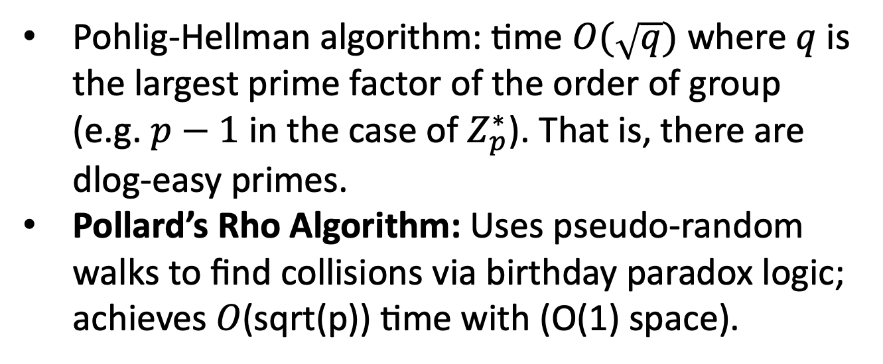

Algorithms for Discrete Log
(for General Groups)
Baby Step-Giant Step algorithm: time --- and space --- $O(\sqrt{p})$ .
Pohlig-Hellman algorithm: time $O(\sqrt{q})$ where $q$ is the largest prime factor of the order of group (e.g. $p−1$ in the case of $Z_{p}^{∗}$). That is, there are dlog-easy primes.
Pollard’s Rho Algorithm: Uses pseudo-random walks to find collisions via birthday paradox logic; achieves 𝑂(sqrt(p)) time with (O(1) space).
Notes:
Any primes fore whih it is easy? Not known
How about any generators?
Any x?
Random self-reduction
State the discrete log assumption

Slide 22
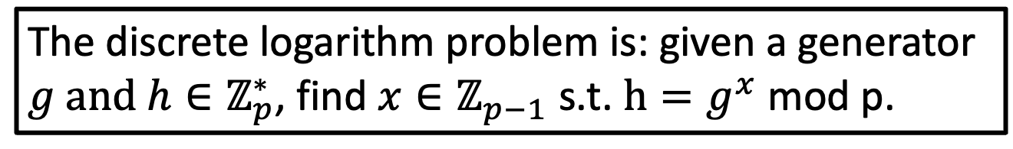
The Discrete Log Assumption
The discrete logarithm problem is: given a generator ${g and h∈ℤ}_{p}^{∗}$, find $x∈ℤ_{p−1}$ s.t. $h=g^{x}$ mod p.
Distributions…
Is the discrete log problem hard for a random p? Could it be easy for some p?
2. Given p: is the problem hard for all generators g?
3. Given p and g: is the problem hard for all x?
Notes:
Any primes fore whih it is easy? Not known
How about any generators?
Any x?
Random self-reduction
State the discrete log assumption

Slide 23
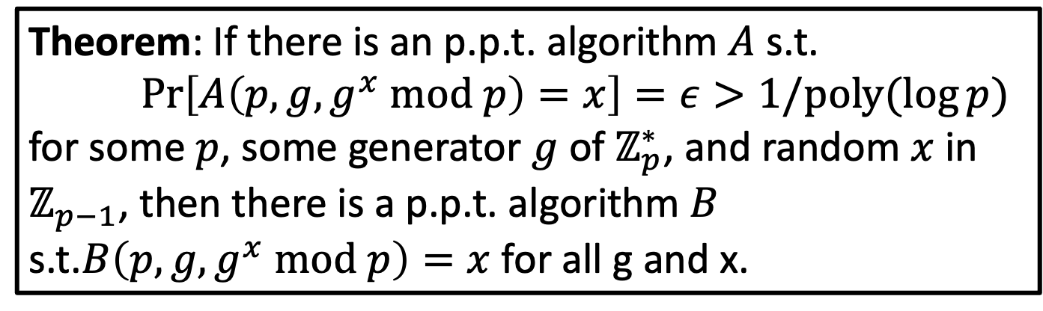
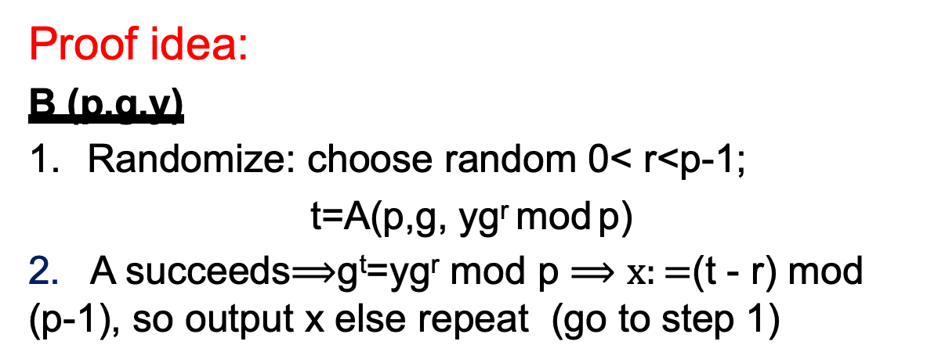
Hardness Anywhere = Hardness Everywhere
Theorem: If there is an p.p.t. algorithm $A$ s.t.
$Pr\left[A\left(p,g,g^{x} mod p\right)=x\right]=ε>1/poly(\log{p)}$
for some $p$, some generator $g$ of $ℤ_{p}^{∗}$, and random $x$ in $ℤ_{p−1}$, then there is a p.p.t. algorithm $B$ s.t.$B\left(p,g,g^{x} mod p\right)=x$ for all g and x.
Proof idea:
B (p,g,y)
Randomize: choose random 0< r<p-1;
t=A(p,g, yg^{r} mod p)
2. A succeeds$⟹$g^{t}=yg^{r} mod p $⟹x:=$(t - r) mod (p-1), so output x else repeat (go to step 1)
In expected 1/ε trials
A will succeed
Corollary: If B doesn’t exist, neither does A. Namely,
if DLP_{p,g} is hard "at all" then DLP_{p,g} (x) is hard for random x.
Notes:
Any primes fore whih it is easy? Not known
How about any generators?
Any x?
Random self-reduction
State the discrete log assumption

Slide 24
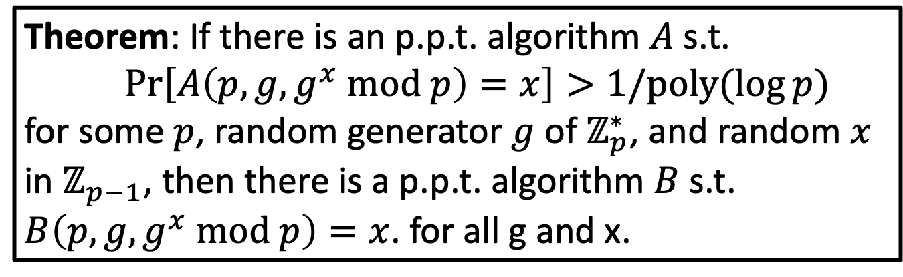
Random Self-Reducibility of DLOG
Theorem: If there is an p.p.t. algorithm $A$ s.t.
$Pr\left[A\left(p,g,g^{x} mod p\right)=x\right]>1/poly(\log{p)}$
for some $p$, random generator $g$ of $ℤ_{p}^{∗}$, and random $x$ in $ℤ_{p−1}$, then there is a p.p.t. algorithm $B$ s.t. $B\left(p,g,g^{x} mod p\right)=x$. for all g and x.
2. Given p: is the problem hard for all generators g?
… as hard for any generator is it for a random one.
3. Given p and g: is the problem hard for all x?
… as hard for any x is it for a random one.
Notes:
Any primes fore whih it is easy? Not known
How about any generators?
Any x?
Random self-reduction
State the discrete log assumption

Slide 25
General Paradigm :
Random Self Reducibility
f(x)
Break into random instances
f(r₁) |  | f(r₂) f(r₃)
Solve random instances
r₁
r₂ r₃
Combine
Corollary: If hard to invert for some f(x),
hard to invert for random f(r)
x

Slide 26
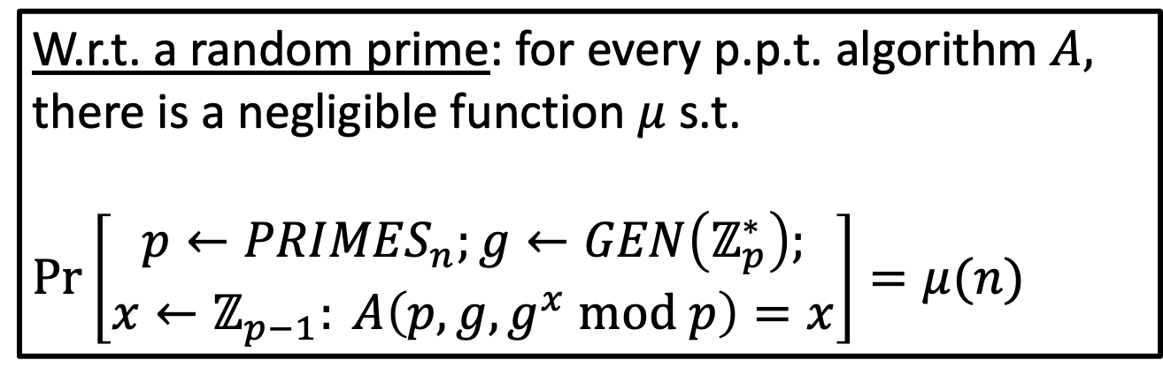
The Discrete Log (DLOG) Assumption
W.r.t. a random prime: for every p.p.t. algorithm $A,$ there is a negligible function $μ$ s.t.
$Pr\left[\begin{aligned}p←{PRIMES}_{n};g←GEN\left(ℤ_{p}^{∗}\right); \\ x←ℤ_{p−1}: A\left(p,g,g^{x} mod p\right)=x\end{aligned}\right]=μ(n)$
Notes:
Any primes fore whih it is easy? Not known
How about any generators?
Any x?
Random self-reduction
State the discrete log assumption

Slide 27
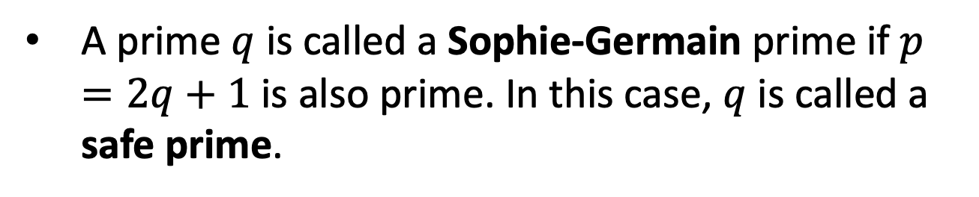
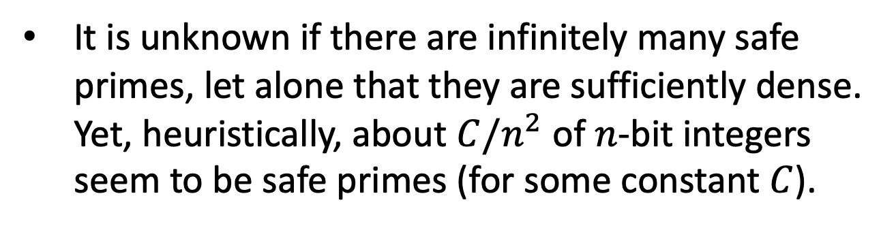
Sophie-Germain Primes and Safe Primes
A prime $q$ is called a Sophie-Germain prime if $p=2q+1$ is also prime. In this case, $q$ is called a safe prime.
Safe primes are maximally hard for the Pohlig-Hellman algorithm and are usually what’s used in cryptographic applications.
It is unknown if there are infinitely many safe primes, let alone that they are sufficiently dense. Yet, heuristically, about $C/n^{2}$ of $n$-bit integers seem to be safe primes (for some constant $C$).
Notes:
Any primes fore whih it is easy? Not known
How about any generators?
Any x?
Random self-reduction
State the discrete log assumption

Slide 28
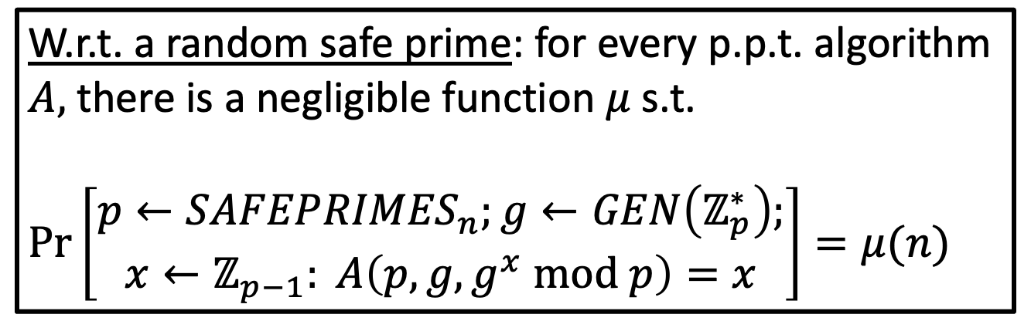
The Discrete Log (DLOG) Assumption
(the “safe prime” version)
W.r.t. a random safe prime: for every p.p.t. algorithm $A,$ there is a negligible function $μ$ s.t.
$Pr\left[\begin{aligned}p←{SAFEPRIMES}_{n};g←GEN\left(ℤ_{p}^{∗}\right); \\ x←ℤ_{p−1}: A\left(p,g,g^{x} mod p\right)=x\end{aligned}\right]=μ(n)$
$${SAFEPRIMES}_{n}=\{p s.t. \left|p\right|=n, p=2q+1 where q is a Sophie Germain data\}$$
Notes:
Any primes fore whih it is easy? Not known
How about any generators?
Any x?
Random self-reduction
State the discrete log assumption

Slide 29
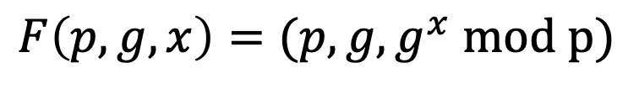
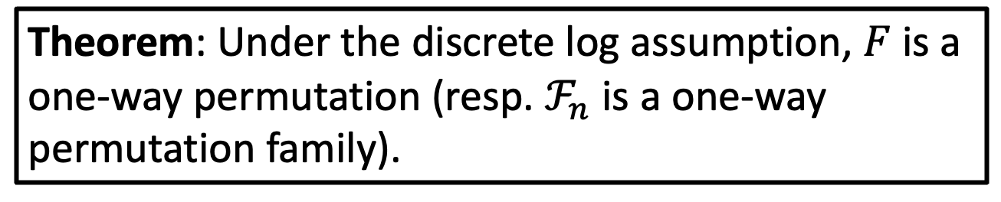
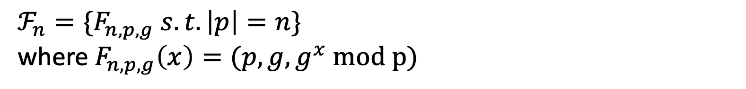
First One-way Permutation (Family)
$$F\left(p,g,x\right)=(p,g,g^{x} mod p)$$
$ℱ_{n}={\{F}_{n,p,g} s.t. \left|p\right|=n\}⁡$
where $F_{n,p,g}\left(x\right)=(p,g,g^{x} mod p)$
Theorem: Under the discrete log assumption, $F$ is a one-way permutation (resp. $ℱ_{n}$ is a one-way permutation family).

Slide 30
Hard Problems related to DLOG
Computational Diffie-Hellman Problem (CDH): given p,g, gª mod p and g^{b} mod p,
compute g^{ab} mod p
Diffie Hellman Decisional Problem (DDH): given gª mod p, g^{b} mod p, and g^{c} mod p distinguish c=ab mod (p-1) from
random 0<c<p-1
Both problems seem hard.
Best solution known: first compute Discrete Log, same running time as Discrete Log.

Slide 31
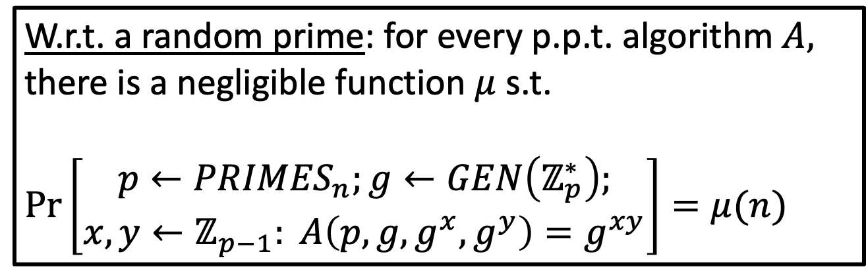
Computational Diffie-Hellman (CDH) Assumption
W.r.t. a random prime: for every p.p.t. algorithm $A,$ there is a negligible function $μ$ s.t.
$Pr\left[\begin{aligned}p←{PRIMES}_{n};g←GEN\left(ℤ_{p}^{∗}\right); \\ x,y←ℤ_{p−1}: A\left(p,g,g^{x},g^{y}\right)=g^{xy}\end{aligned}\right]=μ(n)$
If can solve DLOG can solve CDH
If can solve CDH can solve DLOG?
OPEN
If can solve CDH can solve DDH
If can solve DDH can solve CDH?
OPEN
Notes:
Any primes fore whih it is easy? Not known
How about any generators?
Any x?
Random self-reduction
State the discrete log assumption

Slide 32


Diffie-Hellman Key Exchange
$p,g:$ Generator of our group $Z_{p}^{∗}$
$$g^{x} mod p$$
$$g^{y} mod p$$
Pick a random number $x∈Z_{p−1}^{}$
Pick a random number $y∈Z_{p−1}^{}$
Shared key K = $g^{xy} mod p$
Shared key K = $g^{xy} mod p$
= ${(g}^{y})^{x} mod p$
= ${(g}^{x})^{y} mod p$

Slide 33
Diffie-Hellman/El Gamal PKEncryption
$Gen\left(1^{n}\right):$Generate an $n$-bit prime $p$ and a generator $g$ of $Z_{p}^{∗}$. Choose a random number $x∈Z_{p−1}^{}$
Let $pk=(p,g,g^{x})$ and let $sk=x$.
$Enc\left(pk,m\right)$ where $m∈Z_{p}^{∗}$: Generate random $y∈Z_{p−1}^{}$and output $(g^{y},g^{xy}∙m$)
$Dec\left(sk=x,c\right)$: Compute $g^{xy}$ using $g^{y}$ and $x$ and divide the second component to retrieve $m$.
How to implement this?
Is this Secure?

Slide 34
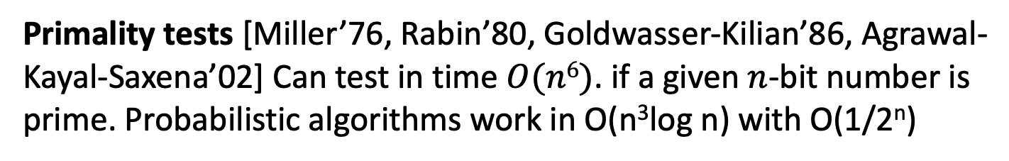
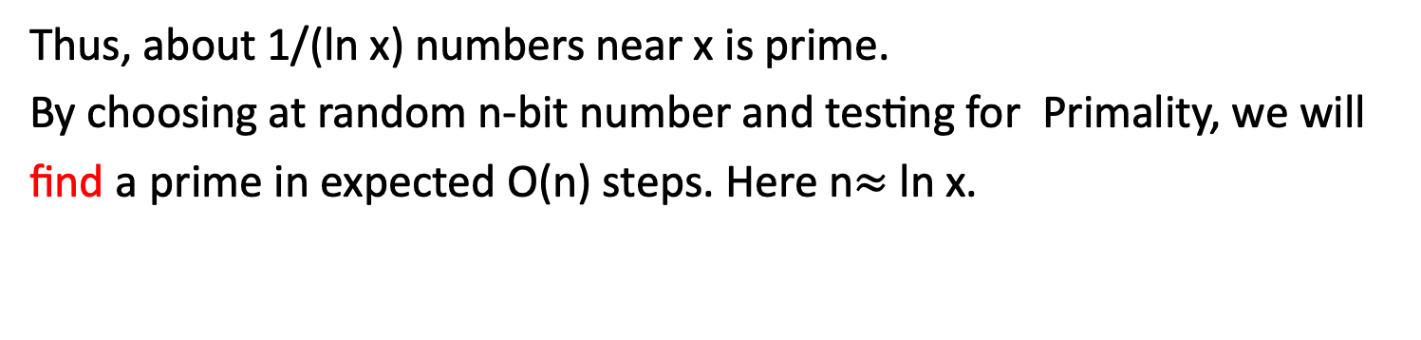
Generating Large Primes
Let π(x) = number of primes < x
Prime Number Theorem: lim π(x)/(x/ln x) = 1
Thus, about 1/(ln x) numbers near x is prime.
By choosing at random n-bit number and testing for Primality, we will find a prime in expected O(n) steps. Here n$≈$ ln x.
Primality tests [Miller’76, Rabin’80, Goldwasser-Kilian’86, Agrawal-Kayal-Saxena’02] Can test in time $O(n6)$. if a given $n$-bit number is prime. Probabilistic algorithms work in O(n³log n) with O(1/2^{n})
Open: Pseudo-deterministic, come up with an n-bit prime, using randomness but produce the same n-bit prime for each n.
Open: Safe Primes?

Slide 35
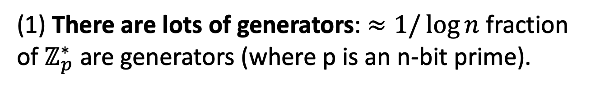
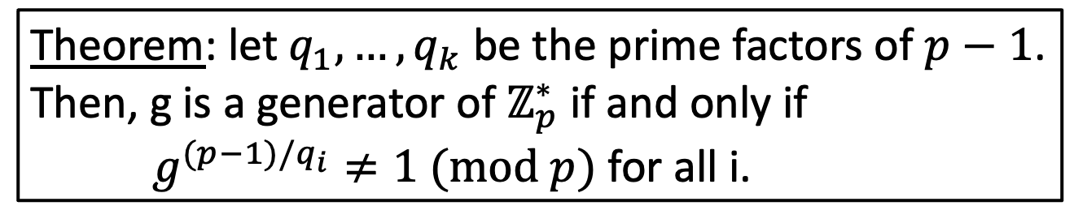
How to come up with a generator g
(1) There are lots of generators: $≈1/\log{n}$ fraction of $ℤ_{p}^{∗}$ are generators (where p is an n-bit prime).
(2) Testing if $g$ is a generator:
Theorem: let $q_{1},…,q_{k}$ be the prime factors of $p−1$. Then, g is a generator of $ℤ_{p}^{∗}$ if and only if $g^{(p−1)/q_{i}}≠1 (mod p)$ for all i.
OPEN: Can you test if g is a generator without knowing the prime factorization of p-1?
OPEN: Pseudo Det can come up with a generator if know factorization of (p-1), how about deterministically?
But do we know the factorization of (p-1)? No.
Idea: Choose prime with p-1 in factored form -

Slide 36
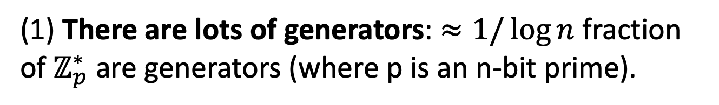
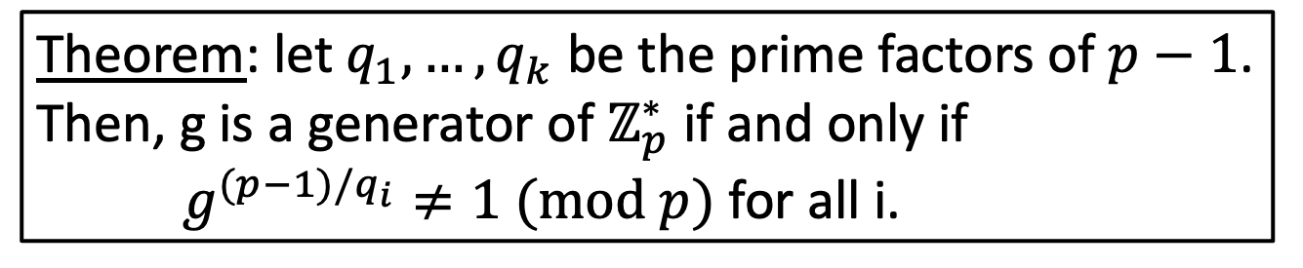
How to come up with a generator g
(1) There are lots of generators: $≈1/\log{n}$ fraction of $ℤ_{p}^{∗}$ are generators (where p is an n-bit prime).
(2) Testing if $g$ is a generator:
Theorem: let $q_{1},…,q_{k}$ be the prime factors of $p−1$. Then, g is a generator of $ℤ_{p}^{∗}$ if and only if $g^{(p−1)/q_{i}}≠1 (mod p)$ for all i.
But do we know the factorization of (p-1)? No.
Idea: Choose prime with p-1 in factored form -

Slide 37


To Summarize
Pick a random safe prime $p.$ Therefore, I know the factorization of $p−1=2q$ automatically!
Pick a random element of $ℤ_{p}^{∗}$ and test if it is a generator (using theorem from last slide).
Continue step 2 until you hit a generator.
To analyze security: we need to take a detour

Slide 38
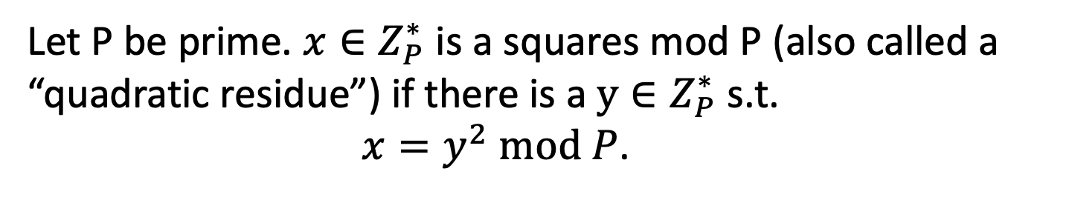
Quadratic Residues: Squares mod P
Let P be prime. $x∈Z_{P}^{∗}$ is a squares mod P (also called a “quadratic residue”) if there is a $y∈Z_{P}^{∗}$ s.t.
$x=y^{2} mod P$.
Theorem: Exactly half of $Z_{P}^{∗}$ are squares mod P.
Ex: p=7, x mod p 1 2 3 4 5 6 squares ={1,2,4}
x² mod p 1 4 2 2 4 1 non-squares={3,5,6}
Let QR_{p} = quadratic residues mod p
Claim: QR_{p} is subgroup of Z_{p}* of order (p-1)/2

Slide 39
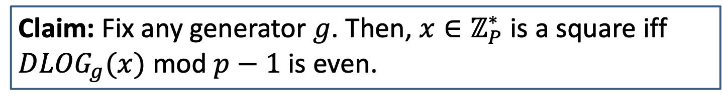
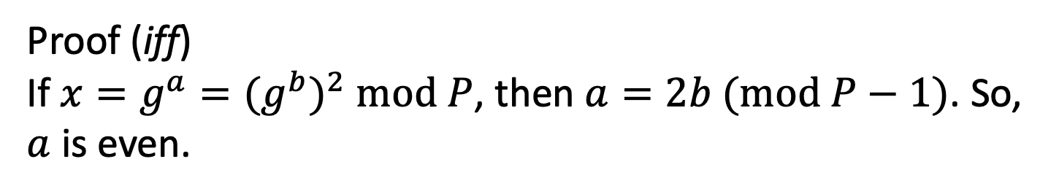
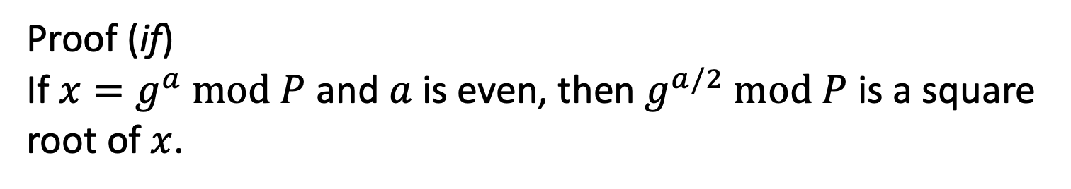
Squares mod P: A Characterization
Claim: Fix any generator $g$. Then, $x∈ℤ_{P}^{∗}$ is a square iff ${DLOG}_{g}(x)$ mod $p−1$ is even.
Proof (if)
If $x=g^{a} mod P$ and $a$ is even, then $g^{a/2} mod P$ is a square root of $x$.
Proof (iff)
If $x=g^{a}={(g^{b})}^{2} mod P$, then $a=2b (mod P−1)$. So, $a$ is even.

Slide 40
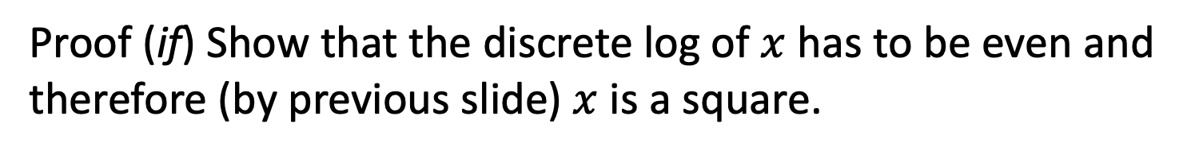
Can test if x is a square Efficiently
Claim: $x$ mod P is a square iff $x^{(P−1)/2}=1 mod P$
Proof (iff) If $x=y^{2} mod P,x^{(P−1)/2}=y^{(P−1)}=1 mod P.$
Proof (if) Show that the discrete log of $x$ has to be even and therefore (by previous slide) $x$ is a square.
So, it is easy to detect whether a number mod P is a square.
Claim 2: y=x² mod p has 0 or 2 solutions when p is prime.
Proof: ∃solution x ⇒∃at least 2 solutions x & –x=p-x mod p.
Suppose ∃another z ≠ x,-x mod p, z²=x² mod p & z²-x²= (z-x)(z+x)=0
mod p. Then, p|(z-x)(z+x). As p is prime, it must divide
either (z-x) or (z+x) ⇒z=x mod p or z=-x mod p. Contradiction

Slide 41
Computing Square Roots mod P
Let P be prime. Exactly half of $Z_{P}^{∗}$ are squares mod P.
It is easy to compute square roots mod P. We will show it for the case where P = 3 (mod 4).
Claim: The square roots of $x$ mod P are ${± x}^{(P+1)/4}$
Proof: $({± x}^{(P+1)/4})^{2}$ $=x^{(P+1)/2}={x∙x}^{(P−1)/2}=x mod P$
How about for p= 1 mod 4?
Claim: Given one y such that y is a non-square mod p
Can compute square roots for any square.
Proof: in class

Slide 42
There exists PPT algorithm for solving y=x² mod p
Solve for x as follows.
Suppose eq. is solvable, then z^{(p-1)/2} = 1 mod p.
Case 1: p=3 mod 4, (p-1)/2 = (4t+2)/2
z ^{(2t+1)} = 1 mod p
(z ^{(2t+1)})z = z mod p
(z ^{(t+1)})² = z mod p
output x=z ^{(t+1)} mod p
Case 2: p= 1 mod 4, Harder, uses randomization, homework
Note: found both roots, x and –x=p-x.
For x=g^{i} mod p, -x=g^{i}(-1)=g^{i}g^{(p-1)/2} = g^{i+(p-1)/2} mod p
x is principal square root when i <(p-1)/2, otherwise –x is

Slide 43
Pr _{y,Pred} [Pred(p,g,y)=MSB_{p,g} (x)]>1/2+α
Claim: For special y=g^{x} mod p , m =1/4(α/2)²(δ/2),δ=1/4n
Prob [PRED’[p,g,y] =MSB_{p,g}(x)] >1-1/2n
Proof of Claim: Prob [PRED’[p,g,y] =MSB_{p,g}(x)] =
Prob [PRED’[p,g,y] =MSB_{p,g}(x) and MSB_{p,g}(x)=0] +Prob [PRED’[p,g,y] =MSB_{p,g}(x) and MSB_{p,g}(x)=1] = Prob [PRED’[p,g,y] =MSB_{p,g}(x) |MSB_{p,g}(x)=0] Prob(MSB_{p,g}(x)=0) +
Prob [PRED’[p,g,y] =MSB_{p,g}(x) |MSB_{p,g}(x)=1] Prob(MSB_{p,g}(x)=1)
= Prob [|est_{y}-est_{p0}|< α+1/2n|MSB_{p,g}(x)=0] Prob(MSB_{p,g}(x)=0) +
Prob [|est_{y}-est_{p1}|< α+1/2n |MSB_{p,g}(x)=1] Prob(MSB_{p,g}(x)=1)
> 1/2Prob (|est_{y}-p0|< α/2 +1/2n and |est_{p0}-p0|<α/2 |MSB_{p,g}(x)=0)+
1/2Prob (|est_{y}-p1|< α/2+1/2n and |est_{p1}-p1|<α/2 |MSB_{p,g}(x)=1) (by symmetry)
= Prob (|est_{y}-p0|< α/2 +1/2n and |est_{p0}-p0|<α/2 |MSB_{p,g}(x)=0) = (by independence)
Prob (|est_{y}-p0|< α/2+1/2n |MSB_{p,g}(x)=0) Prob( |est_{p0}-p0| |<α/2).> (by LLN)
Prob (|est_{y}-p0|< α/2+1/2n |MSB_{p,g}(x)=0)(1-δ/2) > (by Fact below)
(1-δ/2)² >1−1/2n for ,δ=1/2n
Fact: Pr(|est_{y}-p0|< α/2 |MSB_{p,g}(x)=0)>(1-δ/2)
Pf: Let p0’=Pr [Pred(p,g,g^{r})=1 | (p-1)/4n<r<(p-1)/2+(p-1)/4n] .
Then |p0-p0’|<1/2n (since the 2 distributions are at most 1/2n apart)
Furthermore, Prob (|est_{y}-p0’|< α/2 |MSB_{p,g}(x)=0)>(1-δ/2) (by LLN)
Thus, by triangle inequality Pr(|est_{y}-p0|< α/2 +1/2n |MSB_{p,g}(x)=0)>(1-δ/2) QED
Notes:
1/2Pr[Pred is correct on y s.t. MSB(p,g,y)=0]+
1/2Pr[Pred is correct on y s.t. MSB(p,gy)=1]=

Slide 44
Bit Security of g^{x} mod p
Which information about x leaks from g^{x} mod p,
0<x<p?
A: can compute LSB(x) from g^{x} mod p, by
computing the Legendre symbol of g^{x} mod p,
Which information, if any, about x is well hidden by g^{x} mod p?
There must be some bit of x which is hard to compute,
but which one?
Is there any bit of x which is hard to predict better than 50-50?

Slide 45
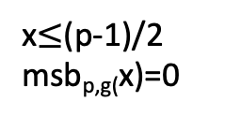
Theorem[Most Significant Bit is Hard Core Bit]:
Let msb_{p,g}(x) = 0 if x<(p-1)/2 and 1 otherwise.
if ∃ PPT PRED, c>0 s.t.
Prob[PRED(g^{x} mod p)=msb_{p,g}(x)] >½+1/n^{c}
then ∃ PPT that solves the discrete log problem mod p.
0
p-z
z
x>(p-1)/2
Msb_{p,g}(x)=1
x$≤$(p-1)/2
msb_{p,g(}x)=0
(P-1)/2

Slide 46
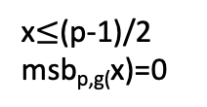
Proof Warm up: y=g^{x} mod p, 0<x<p
,
Suppose PRED(p,g,y)=MSB_{p,g} (x) for all y
LSB(p,g,y) =1 if x is odd, 0 if x is even
IDEA: Will use LSB and the “oracle”
PRED for MSB to reconstruct x= b_{n}…b₁ bit by bit.
Discrete-Logarithm(p.g,y):
0. Initialize z:=y mod p( =g^{x} mod p), n=|p|,i=1
Compute b_{i}:=LSB(p, g, z)
2. If b_{i}=0, then z=SQRT_{p}(z), else z=SQRT_{p}(zg⁻¹)
3. If PRED(p,g,z)=1 then set z=p-z.
4. If i< n, let i=i+1,goto 1,
else output b_{n}…b₁
0
p-z
z
x>(p-1)/2
Msb_{p,g}(x)=1
x$≤$(p-1)/2
msb_{p,g(}x)=0
(P-1)/2
There are 2 square roots of g^{2i}
For g^{i} and –g^{i/2}=g^{i/2}(-1)=g^{i}g^{(p-1)/2} = g^{i+(p-1)/2} mod p
g^{i} is principal square root when i <(p-1)/2, otherwise –i is

Slide 47
Proof Warm up 2: y=g^{x} mod p
Suppose ∀y: Pr [Pred(p,g,y)=MSB_{p,g} (x)]>1-1/2n
Then, ∀y: Prob[DiscreteLogarithm (p,g,y) succeeds]=
Prob [Pred always succeeds]= (1-1/2n)^{n} > 1/2
Algorithm Discrete-Logarithm’(p,g,y)
Choose random 0<r<p ,
If Discrete-Logarithm(p, g, yg^{r} mod p) succeeds,
then x= Discrete-Logarithm(p, g, yg^{r} mod p) – r =x+r-r
Expected number of iterations =2

Slide 48
General Case:
Pr _{y,Pred} [Pred(p,g,y)=MSB_{p,g} (y)]>1/2+α
How to collect a statistical advantage:
Let p₀=Pr [Pred(p,g,g^{r})=1 | MSB(r)=0]
Let p₁=Pr [Pred(p,g,g^{r})=1 | MSB(r)=1 ]
Claim 1: Prob[Pred(p,g,g^{r}) correct]= ½ (1-p₀)+ ½ p₁ >1/2+α
⇒ (1−p₀)+p₁ >1+α⇒ (p₁ –p₀)>2α
Can estimate p₁ and p₀ by letting
est_{p0}= 1/m ∑_{i}^{m}Pred(p,g,g^{ri}) for random r_{i} s.t. MSB_{p,g}(r_{i})=0
est_{p1}=1/m ∑_{i}^{m}Pred(p,g,g^{ri}) for random r_{i} s.t. MSB_{p,g}(r_{i})=1
Claim 2: m>1/4(α/2)²δ/2⇒ Prob |p₀ – est_{p0}|< α/2] >1-δ/2 &
Prob |p₁ – est_{p1}| < α/2] >1-δ/2
Pf: By Law of large numbers (LLN).
Notes:
1/2Pr[Pred is correct on y s.t. MSB(p,g,y)=0]+
1/2Pr[Pred is correct on y s.t. MSB(p,gy)=1]=

Slide 49
Pr_{y,Pred} [Pred(p,g,y)=MSB_{p,g} (x)]>1/2+α
PRED’(p,g,y)
Let m =1/4(α/2)²(δ/2)
Est_{y}:= 1/mΣ_{0<i<m} Pred(p,g,yg^{ri} mod p) for random r_{i}<(p-1)/2
If |est_{y}-est_{p0}|<α+1/2n output 0.
If |est_{y}-est_{p1}|< α +1/2n output 1.
Analysis of PRED’ for special y=g^{x} mod p s.t.
either 1<x<(p-1)/2n or (p-1)/2<x<(p-1)/2+(p-1)/2n
CLAIM: For special y=g^{x} mod p , m =1/4(α/2)²(δ/2),δ=1/4n
Prob _{r<(p-1)/2} [MSB_{p,g}(x)] ≠MSB_{p,g}(x+r) ] <1/n,
2. Prob [PRED’[p,g,y] =MSB_{p,g}(x)] >1-1/2n
To finish: map your y to special y=yg^{r}=g^{x+r} mod p for 0<r<p; run DiscreteLogarithm(p,g,y) replacing calls to Pred with calls to Pred’ -- All calls to Pred’ will be on special z’s !
Notes:
1/2Pr[Pred is correct on y s.t. MSB(p,g,y)=0]+
1/2Pr[Pred is correct on y s.t. MSB(p,gy)=1]=

Slide 50
Coin Flip over the Phone
A and B want to flip a coin over the telephone, but they don’t trust each other
Idea 1: Alice flips a coin, tells Bob…BAD idea☹
Idea 2: Let p prime, g generator function
  A flips a coin c;
  If c=0, A chooses even 0<x <p
  If c=1, A chooses odd 0<x<p
  Sends g^{x} mod p to B
  B guesses if x is even or odd
  A sends x to B. If guess is correct, then B wins, else A wins
  Is this a good idea? No, how about ix <(p-1)/2 or not?

Slide 51
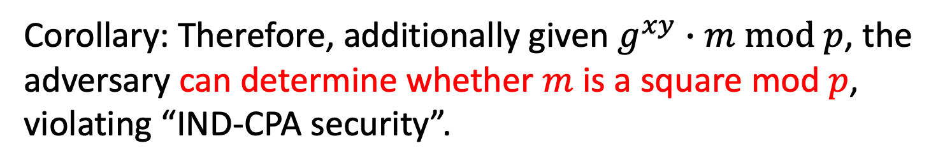
Back to Key Exchange/El Gamal
Claim: Given $p,g, g^{x} mod p and$ $g^{y} mod p,$ adversary can
compute some information about $g^{xy} mod p.$
determine if $g^{xy} mod p$ is a square $mod p$.
Corollary: Therefore, additionally given $g^{xy}∙m mod p$, the adversary can determine whether $m$ is a square mod $p$, violating “IND-CPA security”.

Slide 52
The Problem
Claim: Given $p,g, g^{x} mod p and$ $g^{y} mod p,$ adversary can
determine if $g^{xy} mod p$ is a square $mod p$.
$g^{xy} mod p$ is a square $⟺xy (mod p−1)$ is even
$⟺$ $xy$is even
$⟺$ $x$is even or $y$ is even
$⟺$ $x (mod p−1)$is even or $y (mod p−1)$is even
$⟺$ $g^{x} mod p$ or $g^{y} mod p$is a square
This can be checked in poly time!

Slide 53
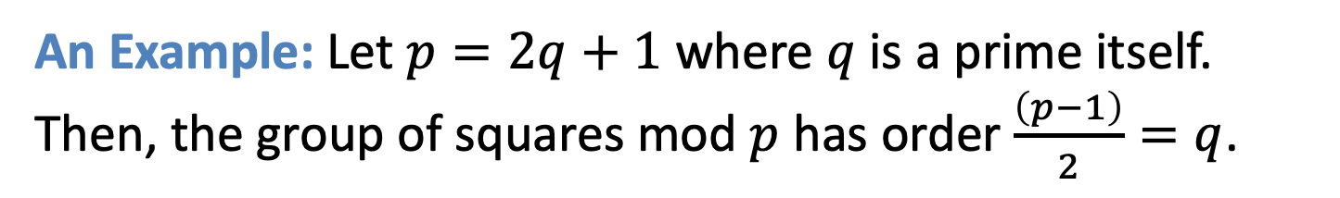
Insecurity of Plain Diffie-Hellman/El Gamal Encryption
Claim: Given $p,g, g^{x} mod p and$ $g^{y} mod p,$ adversary can
determine if $g^{xy} mod p$ is a square $mod p$.
More generally, dangerous to work with groups that have non-trivial subgroups (in our case, the subgroup of all squares mod p)
Lesson: Best to work over a group of prime order.
Such groups have no non-trivial subgroups.
An Example: Let $p=2q+1$ where $q$ is a prime itself. Then, the group of squares mod $p$ has order $\frac{\left(p−1\right)}{2}=q$.

Slide 54
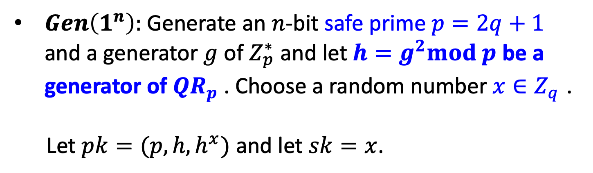
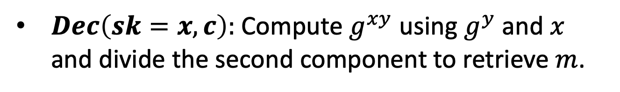
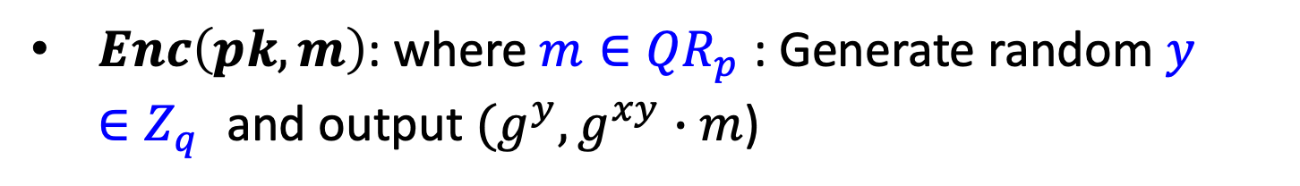
Diffie-Hellman/El Gamal* Encryption
$Gen\left(1^{n}\right):$Generate an $n$-bit safe prime $p=2q+1$ and a generator $g$ of $Z_{p}^{∗}$ and let $h=g^{2}mod p$ be a generator of ${QR}_{p}^{}$. Choose a random number $x∈Z_{q}^{}$.
Let $pk=(p,h,h^{x})$ and let $sk=x$.
$Enc\left(pk,m\right)$: where $m∈{QR}_{p}^{}$: Generate random $y∈Z_{q}^{}$and output $(g^{y},g^{xy}∙m$)
$Dec\left(sk=x,c\right):$ Compute $g^{xy}$ using $g^{y}$ and $x$ and divide the second component to retrieve $m$.

Slide 55
Recall Decisional Diffie-Hellman Assumption
Decisional Diffie-Hellman Assumption (DDHA):
Hard to distinguish between $g^{xy}$ and a uniformly random group element, given ${g,g}^{x}$ and $g^{y}$
That is, the following two distributions are computationally indistinguishable:
$$(g,g^{x},g^{y},g^{xy})≈(g,g^{x},g^{y},u)$$
DH/El Gamal is IND-secure under the DDH assumption on the given group.
Notes:
Pf: QNR*QNR = QR.

Slide 56
Summary: Hard vs. Easy
Z_{p}* = {x < p and gcd(x,p) =1} for n-bit prime p
Let a,b in Z_{p*}
operation Complexity
a mod p O(n²)
a+b mod p O(n)
ab mod p O(n²)
a⁻¹ mod p O(n²⁾
a^{b} mod p O(n³)
Square or non-Square O(n³)
Solving Quadratic Equations mod p O(n³)
Lsb(x) from g^{x} mod p
DL,DDH, DHP HARD?
MSB
easy

Slide 57
What about other cyclic groups?
Elliptic Curve Cryptosystems

Slide 58
Elliptic Curves
Let a,b ∈F_{p} be s.t. gcd(4a³+27b²,p)=1
An elliptic curve denoted as E_{a,b} over finite field Z_{p}
is the set of points (x,y) satisfying
y²=x³+ax +b mod p PLUS a special identity point
Under Addition of two points (see next slide) as group operation
E_{a,b} is a commutative group.
Elliptic Curve Discrete Log Problem (EDLP):
Given two points Q and P on the curve E,
find integer m s.t. Q = mP
Best Algorithm: exponential time O(2^{n}) for general curve.
OWF candidate: f (m, P) = mP [Koblitz, Miller]
Notes:
Let a,b be whatever… Consider the following elliptic cruve over finite field.
It is well known that the set of points (x,y) satisfying the curve equation
dorm an abelian group. The group operation which adds two points can be expressed as a simple algebraic formula is efficient to compute.
The elliptic curves used in analogs of discrete logarithm cryptosystems are of the form y²=x³+ax+b(mod p), p prime.
The hard problem (analogues to the discrete logarithm) is the elliptic curve logarithm problem: given a point G on an elliptic curve with order r (number of points on the curve) and another point Y on the curve, find a unique x such that Y=mG, i.e., Y is the mth multiple of G.
How Hard is it? Until recently, the best attacks on elliptic curve logarithm problems had a running time of about a constant times the square root of r on average, which is much slower than attacks on general discrete log. This means that shorter key sizes for elliptic cryptosystems give the same security as larger keys in cryptosystems that are based on discrete logarithm problem .
Recently, [MOV] reduced the elliptic logarithm problem to a discrete logarithm problem for certain elliptic curves. Possibly algorithm development in this area will make equalize the security
of elliptic curve logarithm cryptosystems to that of discrete logarithm cryptosystems.
OPEN QUESTION

Slide 59
Summary: Groups Used
$(1)$ ${QR}_{P}$ for a safe prime $P=2Q+1$ where $Q$ is prime. The order of the group is Q.
Discrete log can be broken in sub-exponential time $2^{\sqrt{\log{P\log{\log{P}}}}}$ (better than $poly(P)$ but worse than $poly(\log{P).)}$
$\left(2\right)$ Elliptic Curve Groups. The set of solutions $(x,y)$ to the equation $y^{2}=x^{3}+ax+b$ (mod P) together with a very cool group addition law.
Best known Discrete log algorithm: $O(\sqrt{P})$ time!
Much smaller keys: 160-bit P suffices for “80-bit security”.
Notes:
Pf: QNR*QNR = QR.

