Slide 1
MIT 6.875
Foundations of Cryptography
Lecture 8

Slide 2
Last Lecture
Public-key Encryption:
Definition and Properties
Constructions
1: The cyclic group Z_{p}*, safe primes
2: The discrete-log problem(DLOG), CDH, DDH
3. Diffie-Hellman Key Exchange
4. El Gamal Public Key Cryptosystem
5: Quadratic Residues mod p

Slide 3
Today
The Bit Security of DLOG
The Elliptic Curve Group
Trapdoor Permutations
RSA,
Rabin
The Factoring Problem

Slide 4
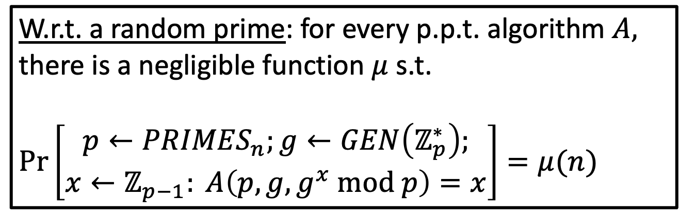
Recall: The Discrete Log (DLOG) Assumption
Dlog_{p,g}(g^{x} mod p) = x for p prime, g generator, 1$≤x≤p−1$
W.r.t. a random prime: for every p.p.t. algorithm $A,$ there is a negligible function $μ$ s.t.
$Pr\left[\begin{aligned}p←{PRIMES}_{n};g←GEN\left(ℤ_{p}^{∗}\right); \\ x←ℤ_{p−1}: A\left(p,g,g^{x} mod p\right)=x\end{aligned}\right]=μ(n)$
Notes:
Any primes fore whih it is easy? Not known
How about any generators?
Any x?
Random self-reduction
State the discrete log assumption

Slide 5
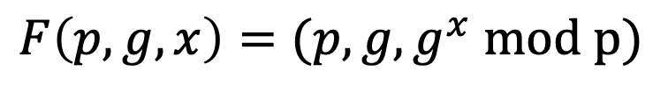
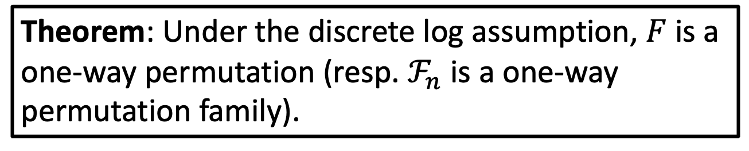
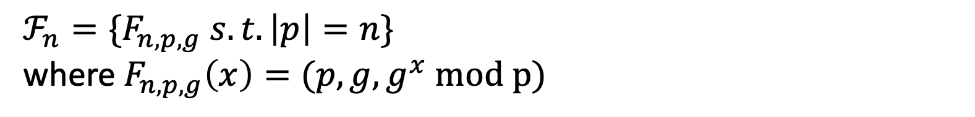
Recall: First One-way Permutation (Family)
$$F\left(p,g,x\right)=(p,g,g^{x} mod p)$$
$ℱ_{n}={\{F}_{n,p,g} s.t. \left|p\right|=n\}⁡$
where $F_{n,p,g}\left(x\right)=(p,g,g^{x} mod p)$
Theorem: Under the discrete log assumption, $F$ is a one-way permutation (resp. $ℱ_{n}$ is a one-way permutation family).

Slide 6
Recall: El Gamal PKEncryption
$Gen\left(1^{n}\right):$Generate an $n$-bit prime $p$ and a generator $g$ of $Z_{p}^{∗}$. Choose a random number $x∈Z_{p−1}^{}$
Let $pk=(p,g,g^{x})$ and let $sk=x$.
$Enc\left(pk,m\right)$ where $m∈Z_{p}^{∗}$: Generate random $y∈Z_{p−1}^{}$and output $(g^{y},g^{xy}∙m$)
$Dec\left(sk=x,c\right)$: Compute $g^{xy}$ using $g^{y}$ and $x$ and divide the second component to retrieve $m$.
Is this IND Secure?

Slide 7
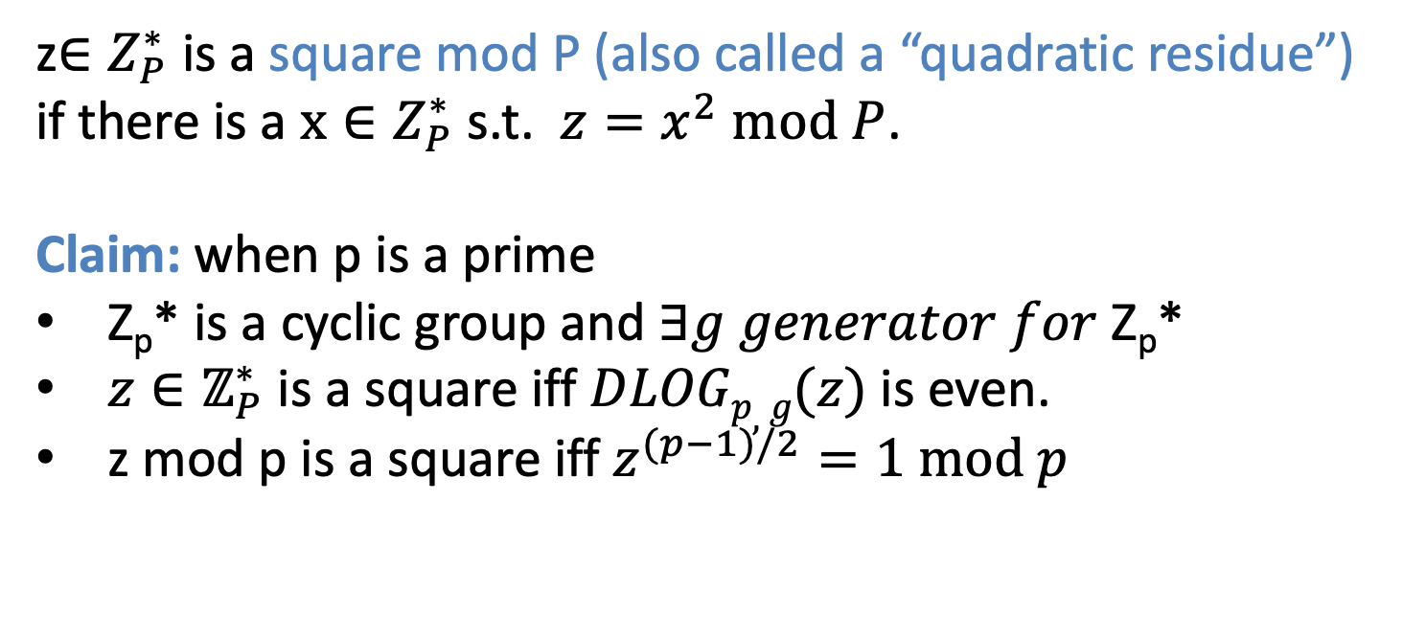
Recall: Quadratic Residues (Squares) mod P
z$∈Z_{P}^{∗}$ is a square mod P (also called a “quadratic residue”) if there is a $x∈Z_{P}^{∗}$ s.t. $z=x^{2} mod P$.
Claim: when p is a prime
Z_{p}* is a cyclic group and $∃g generator for$ Z_{p}*
$z∈ℤ_{P}^{∗}$ is a square iff $DLOGp,g(z)$ is even.
z mod p is a square iff $z^{(p−1)/2}=1 mod p$
Exercise: Prove all these claims

Slide 8
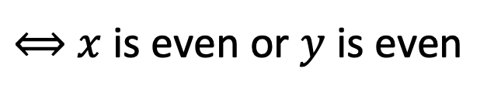
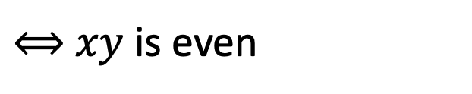
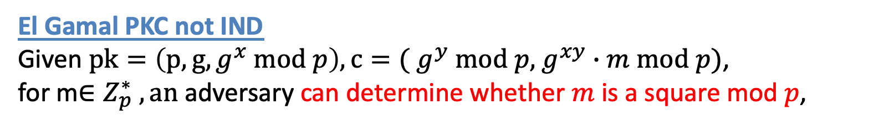
Partial Information about g^{xy} mod p
Claim: Given $p,g, g^{x} mod p and$ $g^{y} mod p,$ adversary can
determine if $g^{xy} mod p$ is a square $mod p$.
$g^{xy} mod p$ is a square $⟺xy (mod p−1)$ is even
$⟺$ $xy$is even
$⟺$ $x$is even or $y$ is even
$⟺$ $x (mod p−1)$is even or $y (mod p−1)$is even
$⟺$ $g^{x} mod p$ or $g^{y} mod p$is a square
This can be checked in poly time!
El Gamal PKC not IND
Given $pk=\left(p,g, g^{x} mod p\right), c=($ $g^{y} mod p,$ $g^{xy}∙m mod p)$,
for m$∈Z_{p}^{∗} , an$ adversary can determine whether $m$ is a square mod $p$,

Slide 9
Safer Groups for El Gamal Encryption
More general Lesson: dangerous to work with groups that have non-trivial subgroups (in our case, the subgroup of all squares mod p)
Best to work over a group of prime order.
Such groups have no non-trivial subgroups.
An Example: Let $p=2q+1$ where $q$ is a prime itself.
Let QR_{p} = squares mod p
QR_{p} is a subgroup of order q=(p-1)/2
Choose m in QR_{p}

Slide 10
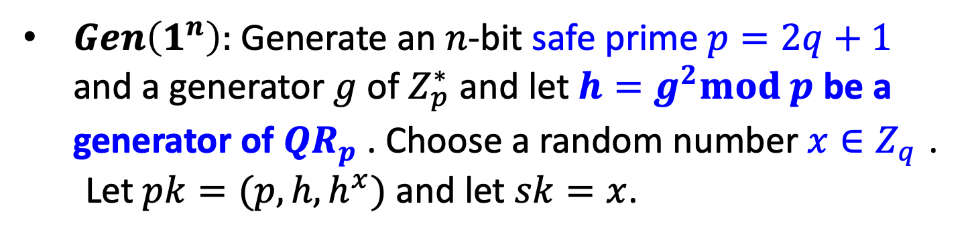
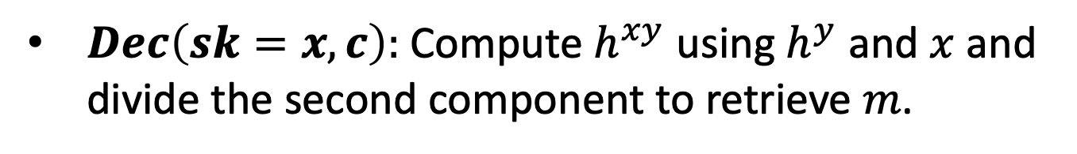
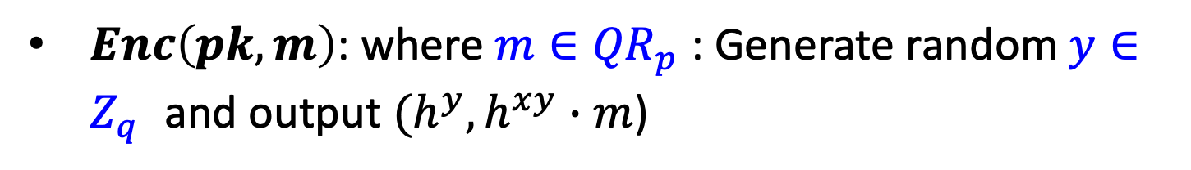
El Gamal* Encryption
$Gen\left(1^{n}\right):$Generate an $n$-bit safe prime $p=2q+1$ and a generator $g$ of $Z_{p}^{∗}$ and let $h=g^{2}mod p$ be a generator of ${QR}_{p}^{}$. Choose a random number $x∈Z_{q}^{}$.
Let $pk=(p,h,h^{x})$ and let $sk=x$.
$Enc\left(pk,m\right)$: where $m∈{QR}_{p}^{}$: Generate random $y∈Z_{q}^{}$and output $(h^{y},h^{xy}∙m$)
$Dec\left(sk=x,c\right):$ Compute $h^{xy}$ using $h^{y}$ and $x$ and divide the second component to retrieve $m$.
Secure? Based on what assumption?

Slide 11
Decisional Diffie-Hellman Assumption
Decisional Diffie-Hellman Assumption (DDHA):
Hard to distinguish between $g^{xy}$ and a uniformly random group element, given ${g,g}^{x}$ and $g^{y}$
That is, the following two distributions are computationally indistinguishable:
$$(g,g^{x},g^{y},g^{xy})≈(g,g^{x},g^{y},u)$$
Theorem: El Gamal* is IND-secure under the DDH assumption on the given group.
Notes:
Pf: QNR*QNR = QR.

Slide 12
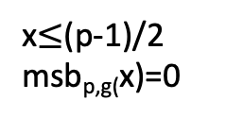
Bit Security of g^{x} mod p
So, the lsb_{p,g}(x) is easy to compute from g^{x} mod p
Theorem[Most Significant Bit is Hard Core Bit]:
Let msb_{p,g}(x) = 0 if x<(p-1)/2 and 1 otherwise if ∃ PPT Pred, c>0 s.t. for fixed p, g of length n
Prob_{x}[Pred(g^{x} mod p)=msb_{p,g}(x)] >½+1/n^{c}
then ∃ PPT that solves the Dlog problem mod p.
0
p-z
z
x>(p-1)/2
Msb_{p,g}(x)=1
x$≤$(p-1)/2
msb_{p,g(}x)=0
(P-1)/2

Slide 13
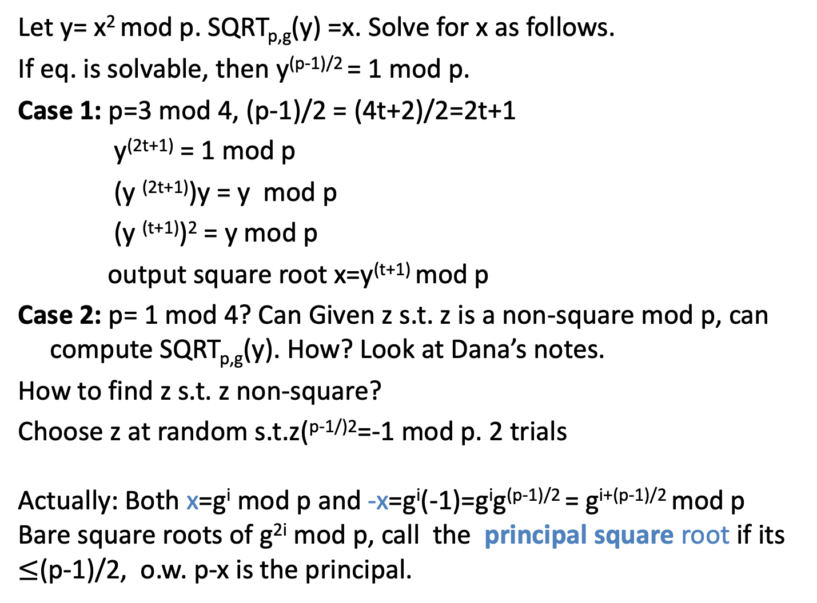
First: Computing Square Roots mod P
Let y= x² mod p. SQRT_{p,g}(y) =x. Solve for x as follows.
If eq. is solvable, then y^{(p-1)/2} = 1 mod p.
Case 1: p=3 mod 4, (p-1)/2 = (4t+2)/2=2t+1
y^{(2t+1)} = 1 mod p
(y ^{(2t+1)})y = y mod p
(y ^{(t+1)})² = y mod p
output square root x=y^{(t+1)} mod p
Case 2: p= 1 mod 4? Can Given z s.t. z is a non-square mod p, can compute SQRT_{p,g}(y). How? Look at Dana’s notes.
How to find z s.t. z non-square?
Choose z at random s.t.z(^{p-1/)2}=-1 mod p. 2 trials
Actually: Both x=g^{i} mod p and -x=g^{i}(-1)=g^{i}g^{(p-1)/2} = g^{i+(p-1)/2} mod p
Bare square roots of g^{2i} mod p, call the principal square root if its $≤$(p-1)/2, o.w. p-x is the principal.

Slide 14
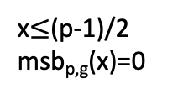
MSB Theorem Proof Warm up: y=g^{x} mod p, 0<x<p
,
Suppose for contradiction PPT
PRED(p,g,y)=msb_{p,g} (x) for all y
LSB_{p,g}(y) =1 if x is odd, 0 if x is even
IDEA: Will use routines for LSB, SQRT and (presumed) PRED
to reconstruct x= b_{n}…b₁ bit by bit. And reach contradiction to DLA.
Discrete-Logarithm(p.g,y):
0. Initialize z:=y mod p( =g^{x} mod p), n=|p|,i=1
Compute b_{i}:=LSB_{p, g}( z)
2. If b_{i}=0, then z=SQRT_{p,g}(z), else z=SQRT_{p,g}(zg⁻¹)
3. If PRED(p,g,z)=1 then set z=p-z.
4. If i< n, let i=i+1,goto 1,
else output b_{n}…b₁
0
p-z
z
x>(p-1)/2
msb_{p,g}(x)=1
x$≤$(p-1)/2
msb_{p,g}(x)=0
(p-1))/2

Slide 15
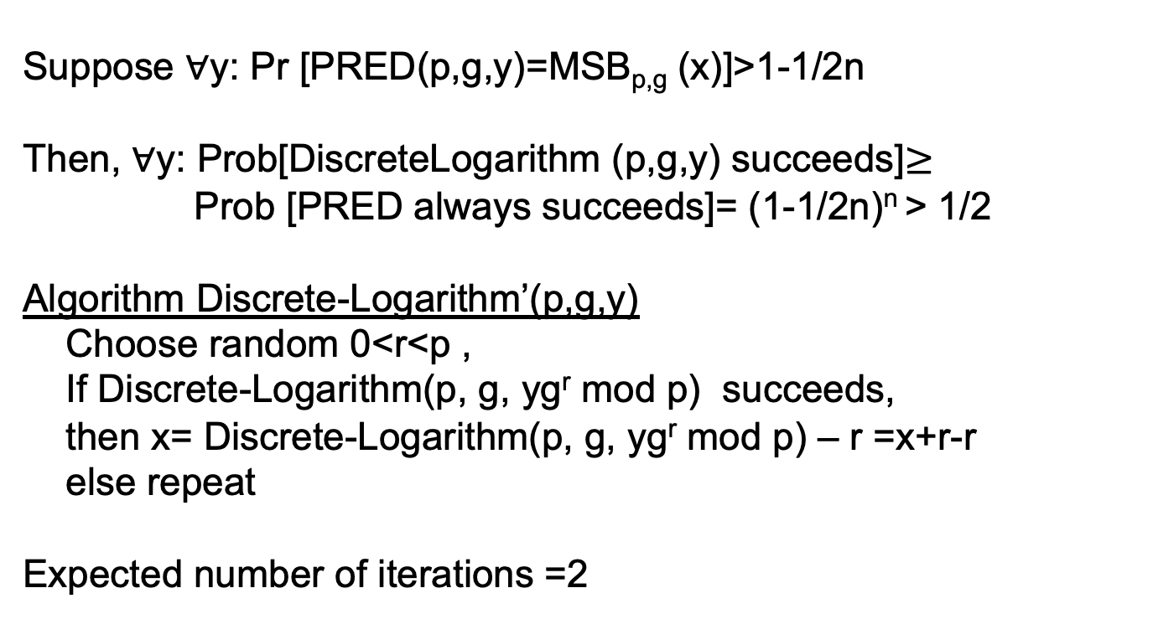
Proof Warm up 2: y=g^{x} mod p
Suppose ∀y: Pr [PRED(p,g,y)=MSB_{p,g} (x)]>1-1/2n
Then, ∀y: Prob[DiscreteLogarithm (p,g,y) succeeds]$≥$
Prob [PRED always succeeds]= (1-1/2n)^{n} > 1/2
Algorithm Discrete-Logarithm’(p,g,y)
Choose random 0<r<p ,
If Discrete-Logarithm(p, g, yg^{r} mod p) succeeds,
then x= Discrete-Logarithm(p, g, yg^{r} mod p) – r =x+r-r
else repeat
Expected number of iterations =2

Slide 16
General Case:
Pr _{y,Pred} [PRED(p,g,y)=MSB_{p,g} (y)]>1/2+α
How to collect a statistical advantage:
Let p₀=Pr [PRED(p,g,g^{r})=1 | MSB(r)=0]
Let p₁=Pr [PRED(p,g,g^{r})=1 | MSB(r)=1 ]
Claim 1: Prob[PRED(p,g,g^{r}) correct]= ½ (1-p₀)+ ½ p₁ >1/2+α
⇒ (1−p₀)+p₁ >1+α⇒ (p₁ –p₀)>2α
Can estimate p₁ and p₀ by letting
est_{p0}= 1/m ∑_{i}^{m}PREDp,g,g^{ri}) for random r_{i} s.t. MSB_{p,g}(r_{i})=0
est_{p1}=1/m ∑_{i}^{m}PRED(p,g,g^{ri}) for random r_{i} s.t. MSB_{p,g}(r_{i})=1
Claim 2: m>1/4(α/2)²δ/2⇒ Prob |p₀ – est_{p0}|< α/2] >1-δ/2 &
Prob |p₁ – est_{p1}| < α/2] >1-δ/2
Pf: By Law of large numbers (LLN).
Notes:
1/2Pr[Pred is correct on y s.t. MSB(p,g,y)=0]+
1/2Pr[Pred is correct on y s.t. MSB(p,gy)=1]=

Slide 17
Pr_{y,Pred} [PRED(p,g,y)=MSB_{p,g} (x)]>1/2+α
PRED’(p,g,y)
Let m =1/4(α/2)²(δ/2)
Est_{y}:= 1/mΣ_{0<i<m} PRED(p,g,yg^{ri} mod p) for random r_{i}<(p-1)/2
If |est_{y}-est_{p0}|<α+1/2n output 0.
If |est_{y}-est_{p1}|< α +1/2n output 1.
Analysis of PRED’
Claim: For special y=g^{x} mod p s.t. 1<x<(p-1)/2n or (p-1)/2<x<(p-1)/2+(p-1)/2n
m =1/4(α/2)²(δ/2),δ=1/4n
Prob _{r<(p-1)/2} [MSB_{p,g}(x)] ≠MSB_{p,g}(x+r) ] <1/n,
2. Prob [PRED’[p,g,y] =MSB_{p,g}(x)] >1-1/2n
Final step:
Try to map your y to special z=yg^{r}=g^{x+r} mod p for 0<r<p by choosing r at random..
Run DiscreteLogarithm(p,g,z) replacing calls to PRED with calls to PRED’ .
Eventually (p-1)/2n<(x+r) or (x+r)<(p-1)/2n for I =1…n, then success!
Notes:
1/2Pr[Pred is correct on y s.t. MSB(p,g,y)=0]+
1/2Pr[Pred is correct on y s.t. MSB(p,gy)=1]=

Slide 18
Coin Flip over the Phone
A and B want to flip a coin over the telephone, but they don’t trust each other
Idea 1: Alice flips a coin, tells Bob…BAD idea☹
Idea 2: Let p prime, g generator function
  A flips a coin c;
  If c=0, A chooses even 0<x <p
  If c=1, A chooses odd 0<x<p
  Sends g^{x} mod p to B to commit to the value of x
  B sends guess=1 for x is even and guess= 0 for x odd.
  A sends x to B. If guess is correct, then B wins, else A wins
  Is this a good idea? No. how about guess = “x <(p-1)/2”?

Slide 19
What about other cyclic groups?
Elliptic Curve Cryptosystems

Slide 20
Elliptic Curves
Let a,b ∈F_{p} be s.t. gcd(4a³+27b²,p)=1
An elliptic curve denoted as E_{a,b} over finite field Z_{p}
is the set of points (x,y) satisfying
y²=x³+ax +b mod p PLUS a special identity point
Under Addition of two points (see next slide) as group operation
E_{a,b} is a commutative group.
Elliptic Curve Discrete Log Problem (EDLP):
Given two points Q and P on the curve E,
find integer m s.t. Q = mP
Best Algorithm: exponential time O(2^{n}) for general curve.
OWF candidate: f (m, P) = mP [Koblitz, Miller]
Notes:
Let a,b be whatever… Consider the following elliptic cruve over finite field.
It is well known that the set of points (x,y) satisfying the curve equation
dorm an abelian group. The group operation which adds two points can be expressed as a simple algebraic formula is efficient to compute.
The elliptic curves used in analogs of discrete logarithm cryptosystems are of the form y²=x³+ax+b(mod p), p prime.
The hard problem (analogues to the discrete logarithm) is the elliptic curve logarithm problem: given a point G on an elliptic curve with order r (number of points on the curve) and another point Y on the curve, find a unique x such that Y=mG, i.e., Y is the mth multiple of G.
How Hard is it? Until recently, the best attacks on elliptic curve logarithm problems had a running time of about a constant times the square root of r on average, which is much slower than attacks on general discrete log. This means that shorter key sizes for elliptic cryptosystems give the same security as larger keys in cryptosystems that are based on discrete logarithm problem .
Recently, [MOV] reduced the elliptic logarithm problem to a discrete logarithm problem for certain elliptic curves. Possibly algorithm development in this area will make equalize the security
of elliptic curve logarithm cryptosystems to that of discrete logarithm cryptosystems.
OPEN QUESTION

Slide 21
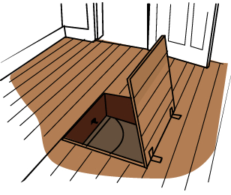
Trapdoor One-way Functions
One-way Functions
Trapdoor One-way Permutations
F
Easy to
compute
Hard to
invert
Easy to
invert
domain
range
given a trapdoor
range
Domain = Range

Slide 22
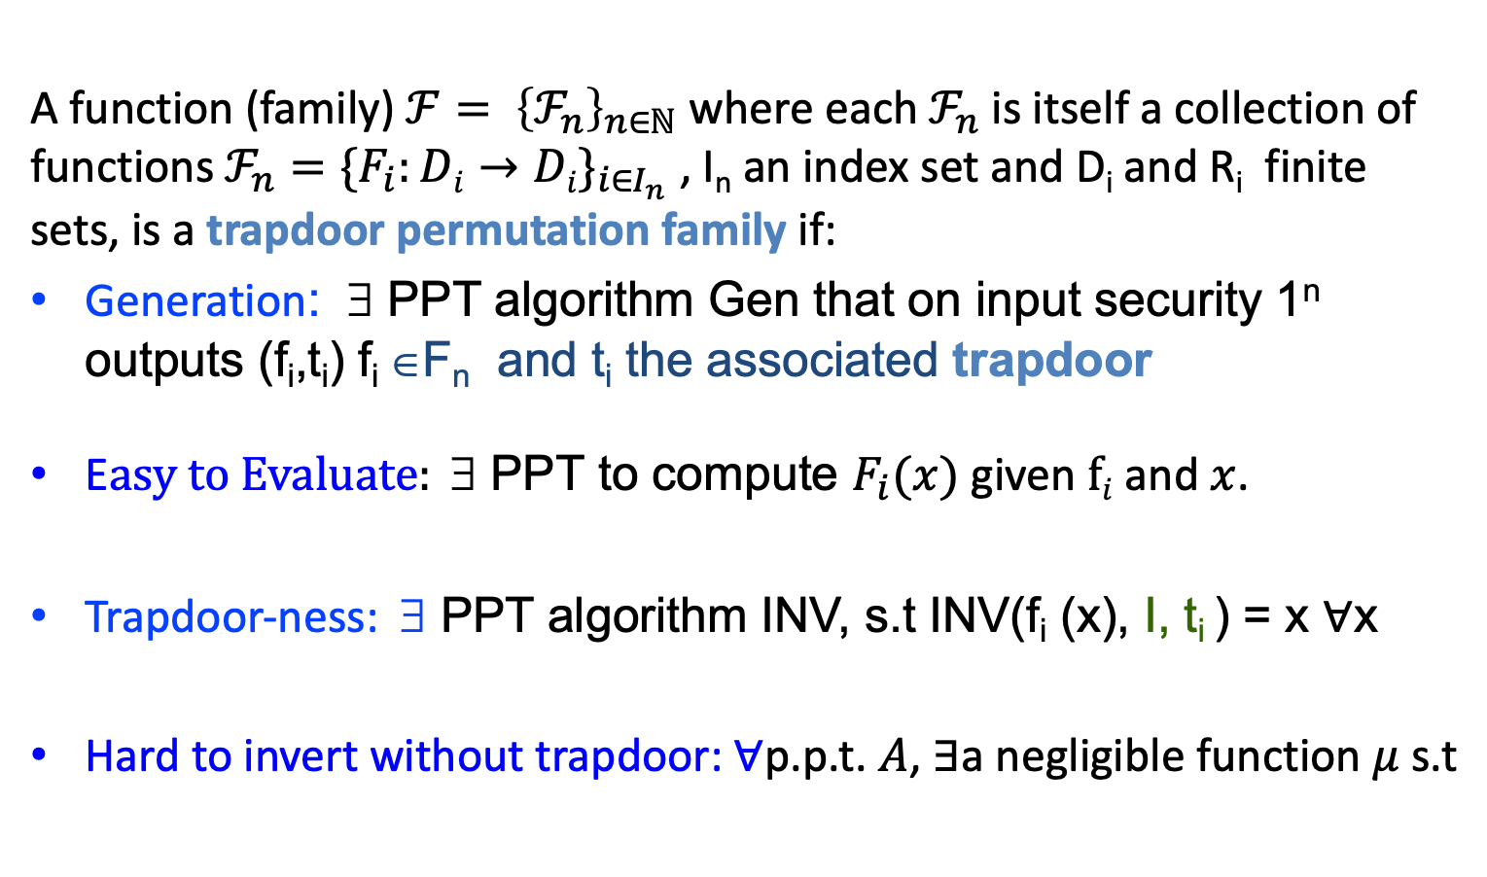

Family of Trapdoor Permutations
A function (family${\text{) }ℱ= \left\{ℱ_{n}\right\}}_{n∈ℕ}$ where each $ℱ_{n}$ is itself a collection of functions $ℱ_{n}=\{F_{i}:Di→Di\}_{i∈I_{n}}$ , I_{n} an index set and D_{i} and R_{i} finite sets, is a trapdoor permutation family if:
Generation: ∃ PPT algorithm Gen that on input security 1^{n} outputs (f_{i},t_{i}) f_{i} ∈F_{n} and t_{i} the associated trapdoor
E$asy to Evaluate: \text{∃}\text{ PPT}\text{ to compute }F_{i}(x)$ given $fi$ and $x$.
Trapdoor-ness: ∃ PPT algorithm INV, s.t INV(f_{i} (x), I, t_{i} ) = x $∀$x
Hard to invert without trapdoor: $∀$p.p.t. $A$, $∃$a negligible function $μ$ s.t
$$\operatorname{Pr}\left[\begin{aligned}\left(i,t\right)←Gen\left(1^{n}\right); x←Di;y=F_{i}\left(x\right); \\ A\left(1^{n},i,y\right)=x^{′}:y=F_{i}\left(x^{′}\right)\end{aligned}\right]≤μ(n)$$

Slide 23
Diffie-Hellman Proposal:
Let F be trapdoor Permutation collection
User public key User private key
f_{u} t_{u} G(1^{n}) outputs
(f_{u},t_{u}) in F
Knows f_{u}⁻¹
Send c
On message m
Compute c=f_{u}(m)
On input c
let m = f⁻¹_{u}(c) =f⁻¹_{u}(f_{u}(m))

Slide 24
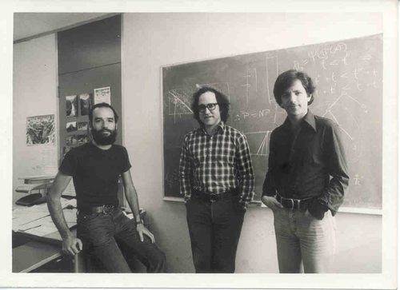
RSA:
The first example of Trapdoor permutation
Rivest-Shamir-Adelman
Turing Award 2002

Slide 25
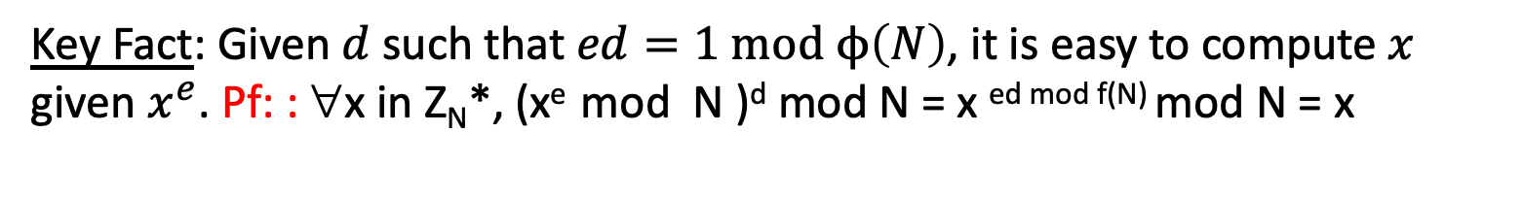
The RSA Trapdoor Permutation
Let N=pq for p,q large primes. Order of Z_{N}* φ(N) =(p-1)(q-1)
Let 1<e <φ(N) such that gcd(e,φ(N))=1 Ex: N=3*7=21, e=5, gcd(5,12)=1
Let d s.t. ed=1 mod f(N). Ex: N=3*7=21, e=5, gcd(5,12)=1, d=5. check:25 mod 12 =1
How to compute d: Use Euclidean-gcd(e,φ(N)) to compute d,c s.t.
de+cφ(N)=1. Thus de=1 mod φ(N)
Define RSA _{N,e}(x) = x^{e} mod N Ex: 2⁵ mod 21 = 11
RSA ⁻¹_{N,e}(y) = y^{d} mod N
Key Fact: Given $d$ such that $ed=1 mod ϕ\left(N\right)$, it is easy to compute $x$ given $x^{e}$. Pf: : ∀x in Z_{N}*, (x^{e} mod N )^{d} mod N = x ^{ed mod f(N)} mod N = x

Slide 26
Candidate Trapdoor Permutations
Define RSA = { RSA_{N,e} } _{N,e} where N=pq, for p,q primes s.t.|p|=|q|, (e,φ(N))=1}
Theorem: Under RSA assumption,
RSA is a collection of trapdoor functions
Generation:
Choose at random n-bit p,q and test them for primality. If prime, set N=pq
2. Choose at random odd e<φ(N), check that gcd(e,φ(N))=1
3. Compute d=e⁻¹ mod φ(N). d is the trapdoor_{N,e}
Evaluation: computing RSA_{N,e}(x) [ O(n³) ]
Trapdoor: Given N and d computing x= (RSA⁻¹_{N,e}(x)) [O(n³)]
Hard to Invert: by RSA-Assumption

Slide 27
Candidate Trapdoor Permutations
Define RSA = { RSA_{N,e} } _{N,e} where N=pq, for p,q primes s.t.|p|=|q|, (e,φ(N))=1}
Theorem: Under RSA assumption,
RSA is a collection of trapdoor functions
Generation:
Choose at random n-bit p,q and test them for primality. If prime, set N=pq
2. Choose at random odd e<φ(N), check that gcd(e,φ(N))=1
3. Compute d=e⁻¹ mod φ(N). d is the trapdoor_{N,e}
Evaluation: computing RSA_{N,e}(x) [ O(n³) ]
Trapdoor: Given N and d computing x= (RSA⁻¹_{N,e}(x)) [O(n³)]
Hard to Invert: by RSA-Assumption
RSA Assumption:
∀PPT A
Prob(p,q primes, |p|=|q|=n-bit, N=pq, gcd(e,φ(N))=1, x∈ Z_{N}*: A(N,e,x^{e} mod N) = x)<neg (n)

Slide 28
The Difficulty of inverting RSA
With Factorization of N, can invert:
compute φ(N = (p-1)(q-1): Run Euclid gcd(e,φ(N)) algorithm to compute d and c s.t. de+cφ(N)=1. Then de=1 mod φ(N)
Without factorization:
Computing d is as hard as factoring:
If can compute d, given N and e s.t.
ed=1 mod φ(N), then can factor N. Why?
Q: Does this mean that inverting RSA is as hard as Factoring?
A: Not necessarily. It may be possible to invert RSA without learning d or φ(N) and without factoring.
Major Open Problem: Are factoring and RSA equivalent?

Slide 29
Random Self Reducability:
If RSA is hard to invert in the worst case, it is hard to invert with non-neg probability
Claim: Fix N, 1<e<f(n), 0<ε,δ<1
If ∃ PPT B s.t. prob_{x}(B(N,e,RSA_{N,e}(x))=x)> ε then ∃ PPT algorithm A to invert RSA_{N,e} (x) for all x with prob > 1-δ.
Proof:
Given y= x^{e} mod N, choose random r in Z_{N}* and map y
to z=y r^{e} mod N. Now, run B(z).
If successful, i.e. B(z)=xr mod N, output x = B(z)/r mod N,
else choose another r.
In expected (1/ε)^{k} trials will be successful w. prob >1-(1/e)^{k}
Set k s.t. (1/e)^{k} <δ QED

Slide 30
The RSA Public Key Cryptosystem 77
Invented by Rivest-Shamir-Adelman in 1977
RSA = { RSA _{N,e}: Z_{N}* Z_{N}*,
RSA _{N,e}(x) = x^{e} mod N }_{<N,e>}
Key Generation: User A chooses random primes p,q and e s.t. gcd(e, φ(N))=1, sets N=pq, computes d s.t. ed=1 mod φ(N), and publishes (N,e) in public directory, keeps d in secret file.
Enc((N,e),m): To send to user A, look up (N,e) and compute c = m^{e} mod N
Dec((N,e), d,c): Let m:=c^{d} mod N = m^{ed} mod N

Slide 31
Security
Cannot use for small message spaces
Partial Information on x from (N,e) and RSA_{(N,e)}(x)
Fact (Dana’s notes): Easy to compute Jacobi Symbol (x/N)=(x/p)(x/q)
from x and N
Corollary: RSA(x) leaks (x/N) =(x/p)(x/q), mental poker example
Low Exponent Attacks 1: Say e=3 (popular choice)
Suppose that two cipher texts are sent c₁=m³ mod N & c₂=(m+1)³ mod N.
Can solve for m = (c₂ +2 c₁ -1) / (c₂ -c₁ +2)
This attack can be generalized to messages m and am+b,
e >3, and for k messages related via higher degree Polynomial.

Slide 32
Low Exponent Attack 2
Suppose everyone in system chooses e=3 (e=2 for Squaring)
Suppose same encrypted m is sent to 3 distinct users with public keys <n₁,3>,<n₂,3>,<n₃,3>, i.e. adversary sees c₁=m³ mod n₁, c₂=m³ mod n₂, c₃=m³ mod n₃.
By CRT adversary can compute a unique u mod n₁n₂n₃ s.t. u = m³ mod n_{i} for all i=1,2,3.
Thus u = m³ mod n₁n₂n_{3 ,} and in fact as m <min(n₁ ,n ₂,n₃), then m³ < n₁n₂n₃ , and u = m³ over the integers. So, by taking cubic roots (high school) can recover m.

Slide 33
Implementation attacks on RSA
Timing attack: (Kocher 97).
Let c=x^{e} mod N. The time it takes to compute c^{d} (mod N)
can expose d.
Power attack: (Kocher 99)
The power consumption of a smartcard while it is computing c^{d} (mod N) can expose d.
Faults attack: (BDL 97)
A computer error during c^{d} (mod N)
can expose d.

Slide 34
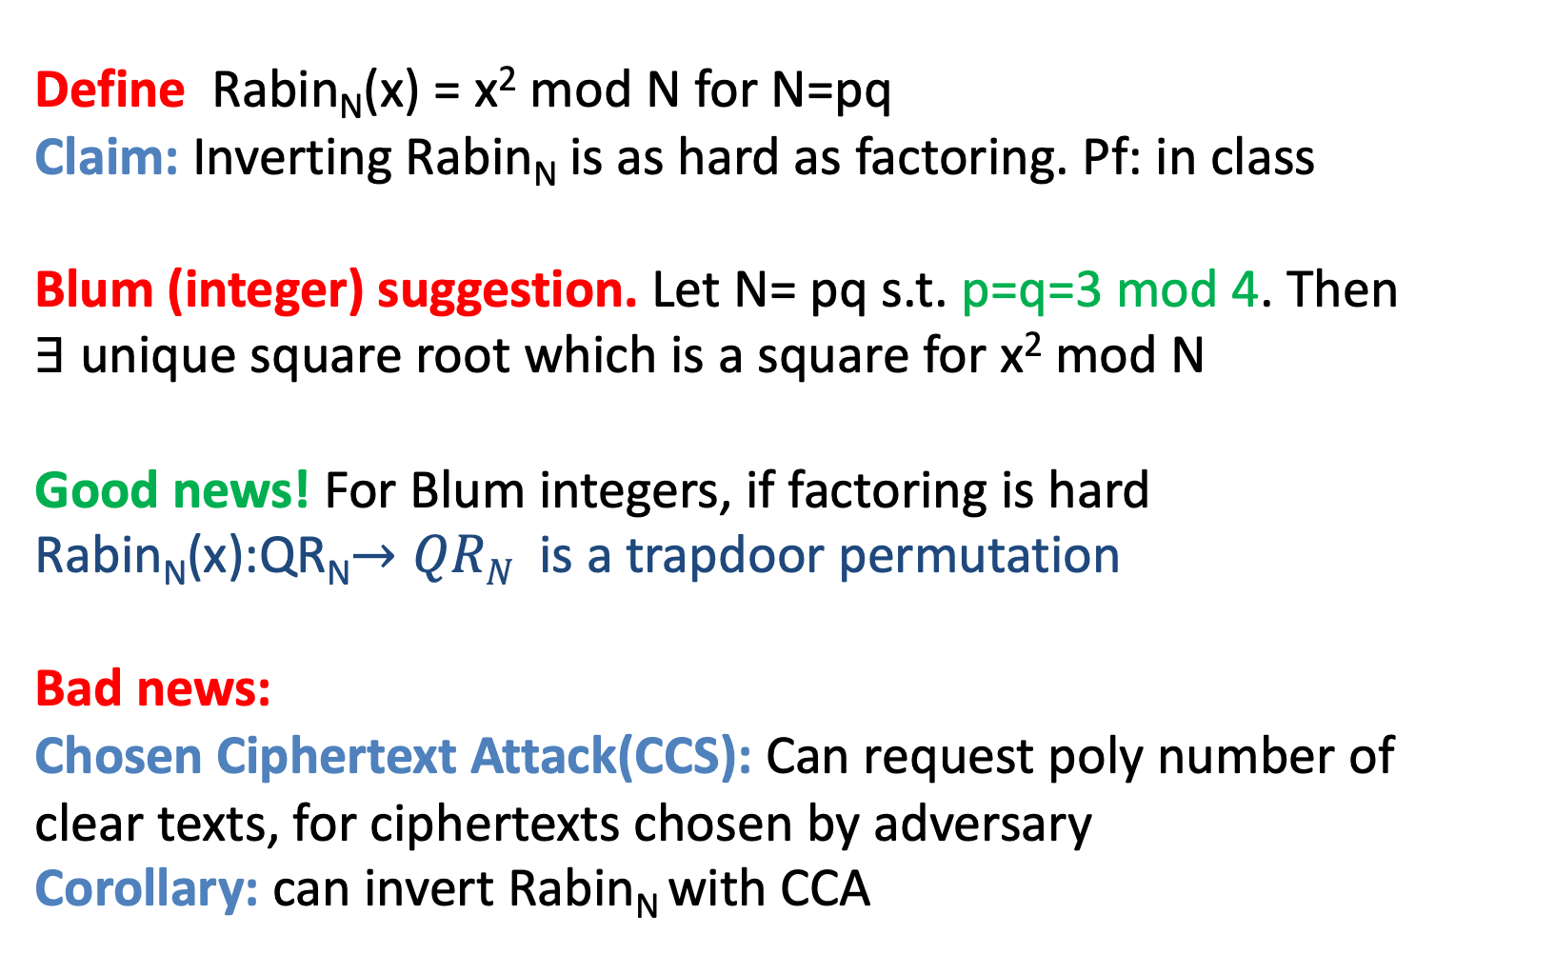
The Rabin Trapdoor Function
Define Rabin_{N}(x) = x² mod N for N=pq
Claim: Inverting Rabin_{N} is as hard as factoring. Pf: in class
Blum (integer) suggestion. Let N= pq s.t. p=q=3 mod 4. Then
$∃$ unique square root which is a square for x² mod N
Good news! For Blum integers, if factoring is hard
Rabin_{N}(x):QR_{N}$→QRN$ is a trapdoor permutation
Bad news:
Chosen Ciphertext Attack(CCS): Can request poly number of
clear texts, for ciphertexts chosen by adversary
Corollary: can invert Rabin_{N} with CCA

Slide 35
The Rabin Trapdoor Function
Define Rabin_{N}(x) = x² mod N for N=pq
Claim: Inverting Rabin_{N} is as hard as factoring. Pf: in class
Blum (integer) suggestion. Let N= pq s.t. p=q=3 mod 4. Then
$∃$ unique square root which is a square for x² mod N
Good news! For Blum integers, if factoring is hard
Rabin_{N}(x):QR_{N}$→QRN$ is a trapdoor permutation
Bad news:
Chosen Ciphertext Attack(CCS): Can request poly number of
clear texts, for ciphertexts chosen by adversary
Corollary: can invert Rabin_{N} with CCA
Factoring Assumption:
∀PPT A
Prob(p,q primes, |p|=|q|=n-bit, N=pq, gcd(e,φ(N))=1, x∈ Z_{N}*: A(N) = p)<neg (n)

