Slide 1
MIT 6.875
Foundations of Cryptography
Lecture 17

Slide 2
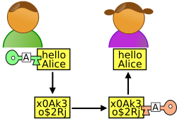
Beyond Secure Communication
x
y
Alice
Bob
Much more than communicating securely.
Complex Interactions: proofs, computations, games.
Complex Adversaries: Alice or Bob, adaptively chosen.
Complex Properties: Correctness, Privacy, Fairness.
Many Parties: this class, MIT, the internet.

Slide 3
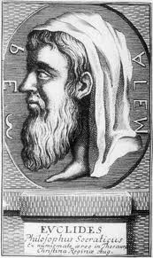
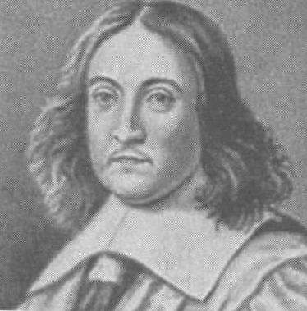
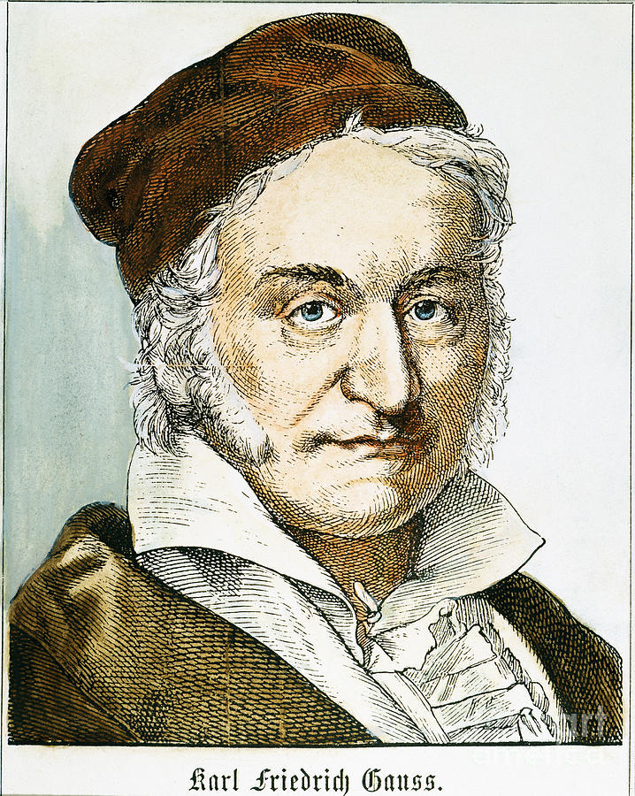
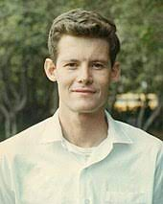
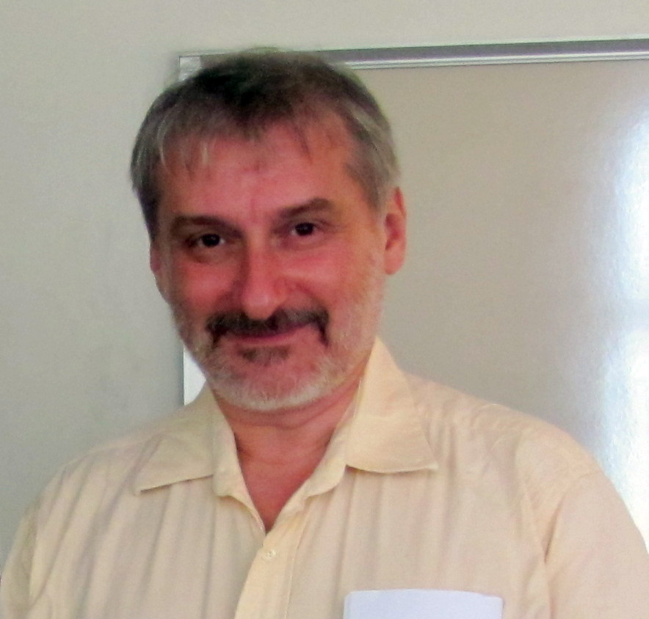
Classical Proofs
Steve Cook
Leonid Levin
Prover writes down a string (proof); Verifier checks.
Axiom 1
Axiom 2
Axiom 1⇒A
A⇒B
QED
a²+b²
a
b

Slide 4
Proofs
Claim/Theorem
accept/reject
proof
Prover
Verifier

Slide 5

Efficiently Verifiable Proofs: $𝓝𝓟$
Claim/Theorem
accept/reject
proof
Prover
Verifier
Works hard
Polynomial-time

Slide 6

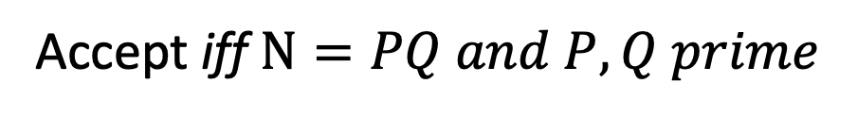
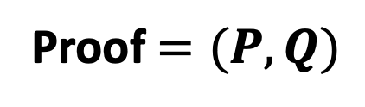
Theorem: $N$ is a product of two prime numbers
Proof $=(P,Q)$
Verifier
Prover
Accept iff $N=PQ and P, Q prime$

Slide 7
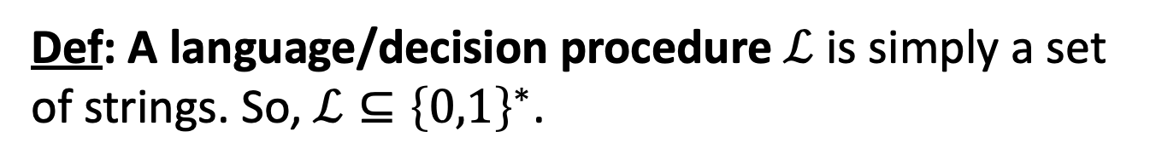
Efficiently Verifiable Proofs: $𝓝𝓟$
Claim/Theorem
accept/reject
proof
Prover
Verifier
Works hard
Polynomial-time
Def: A language/decision procedure $ℒ$ is simply a set of strings. So, $ℒ⊆{\left\{0,1\right\}}^{∗}$.

Slide 8
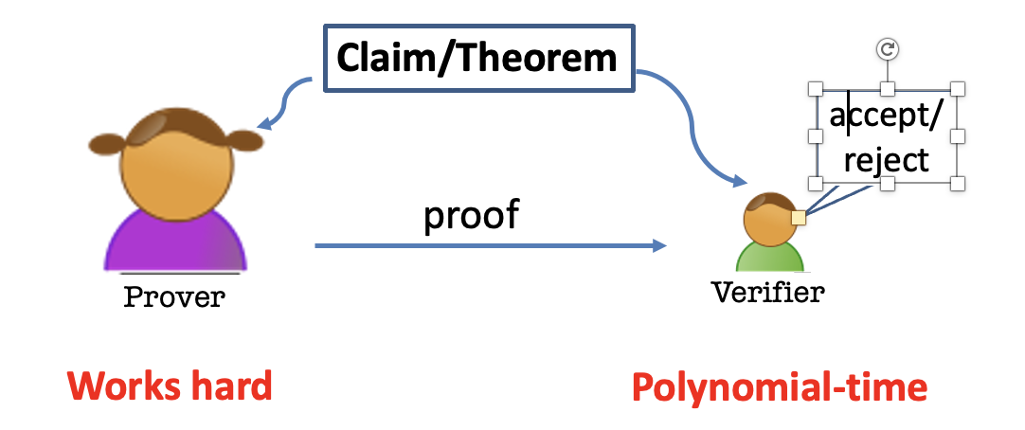
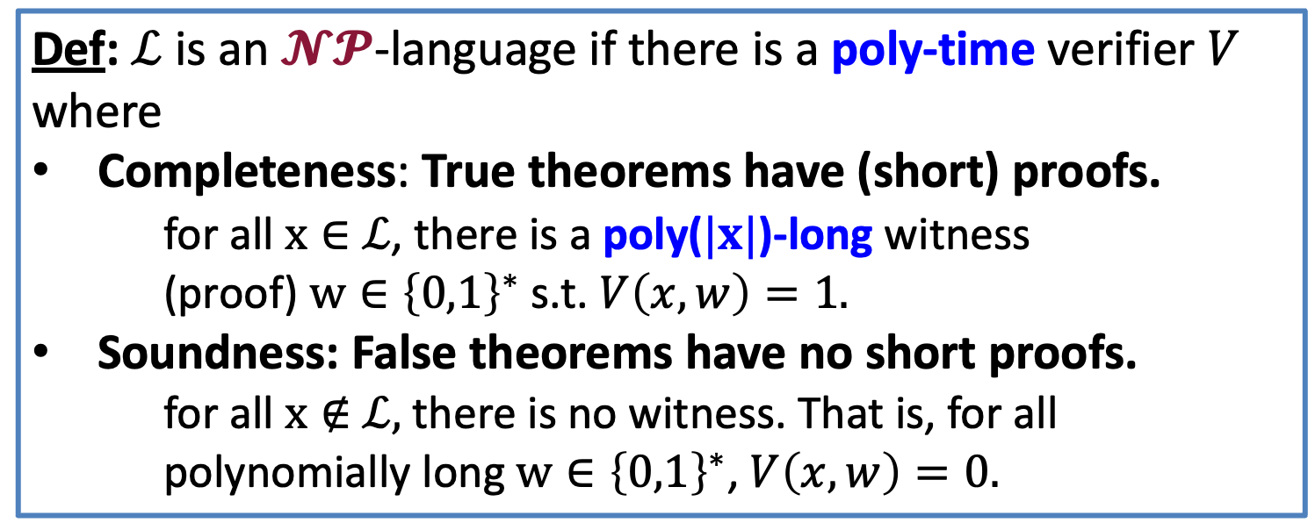
Efficiently Verifiable Proofs: $𝓝𝓟$
Def: $ℒ$ is an $𝓝𝓟$-language if there is a poly-time verifier $V$ where
Completeness: True theorems have (short) proofs.
  for all $x∈$ $ℒ$, there is a poly($|x|$)-long witness
  (proof) $w∈{\left\{0,1\right\}}^{∗}$ s.t. $V\left(x,w\right)=1.$
Soundness: False theorems have no short proofs.
  for all $x∉$ $ℒ,$there is no witness. That is, for all polynomially long $w∈{\left\{0,1\right\}}^{∗}$, $V\left(x,w\right)=0.$

Slide 9
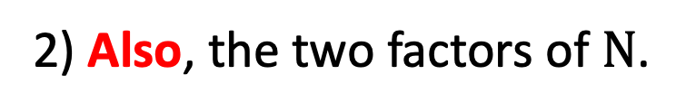
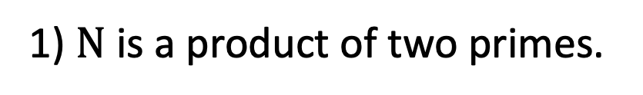
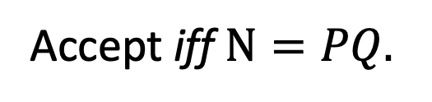
Theorem: $N$ is a product of two prime numbers
Proof $=(P,Q)$
Verifier
Prover
Accept iff $N=PQ.$
After interaction, Bob the Verifier knows:
1) $N$ is a product of two primes.
2) Also, the two factors of $N$.

Slide 10
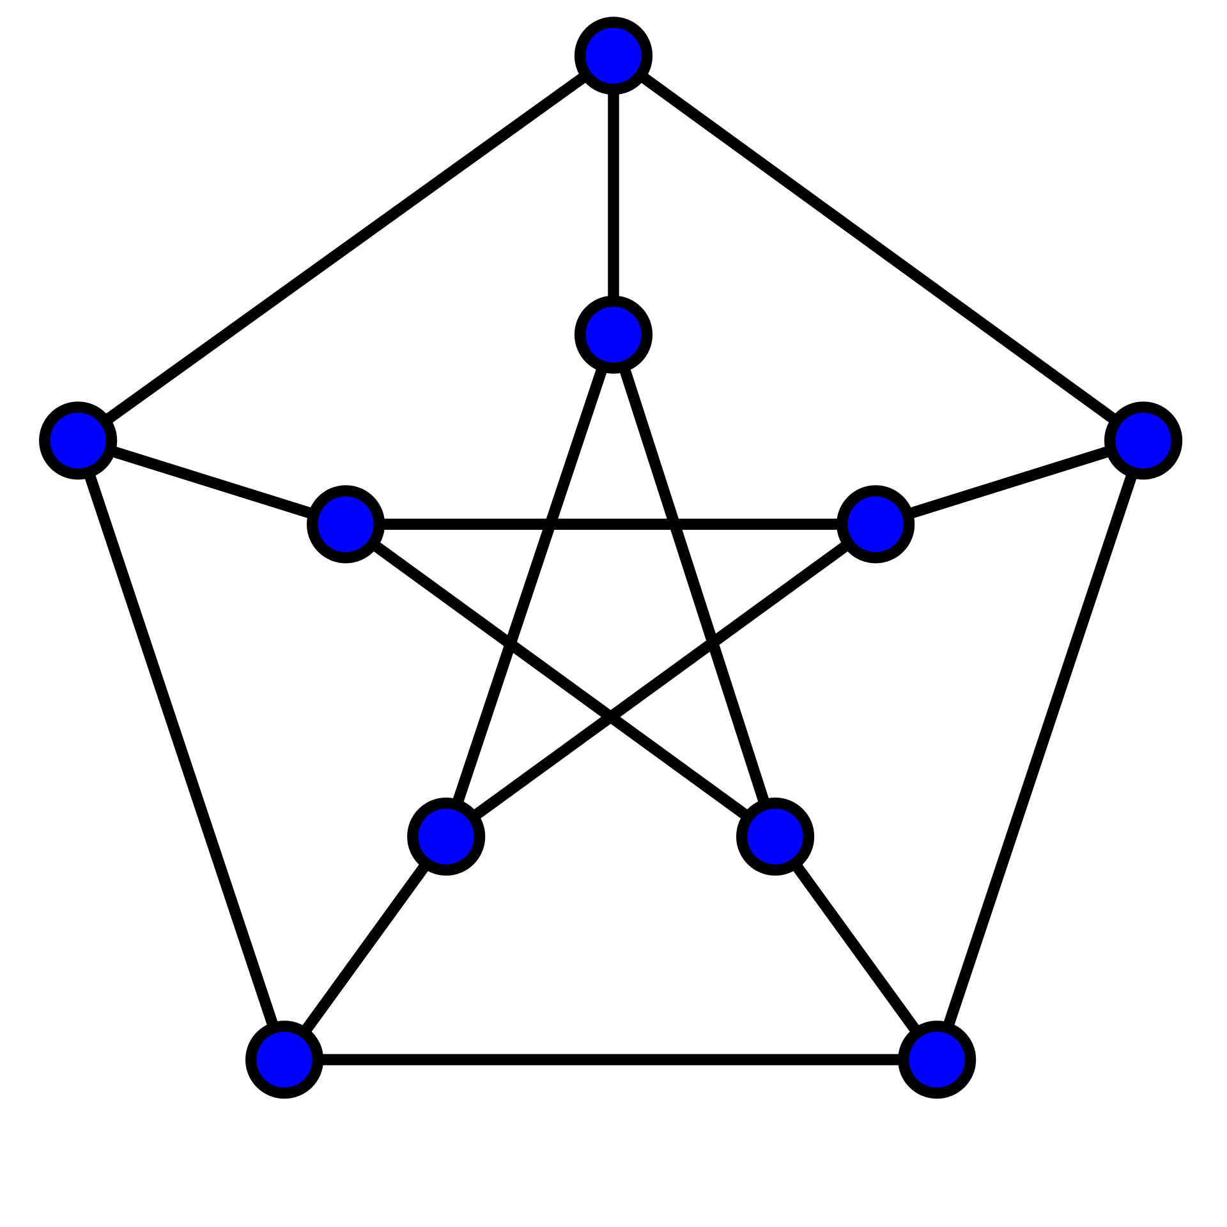
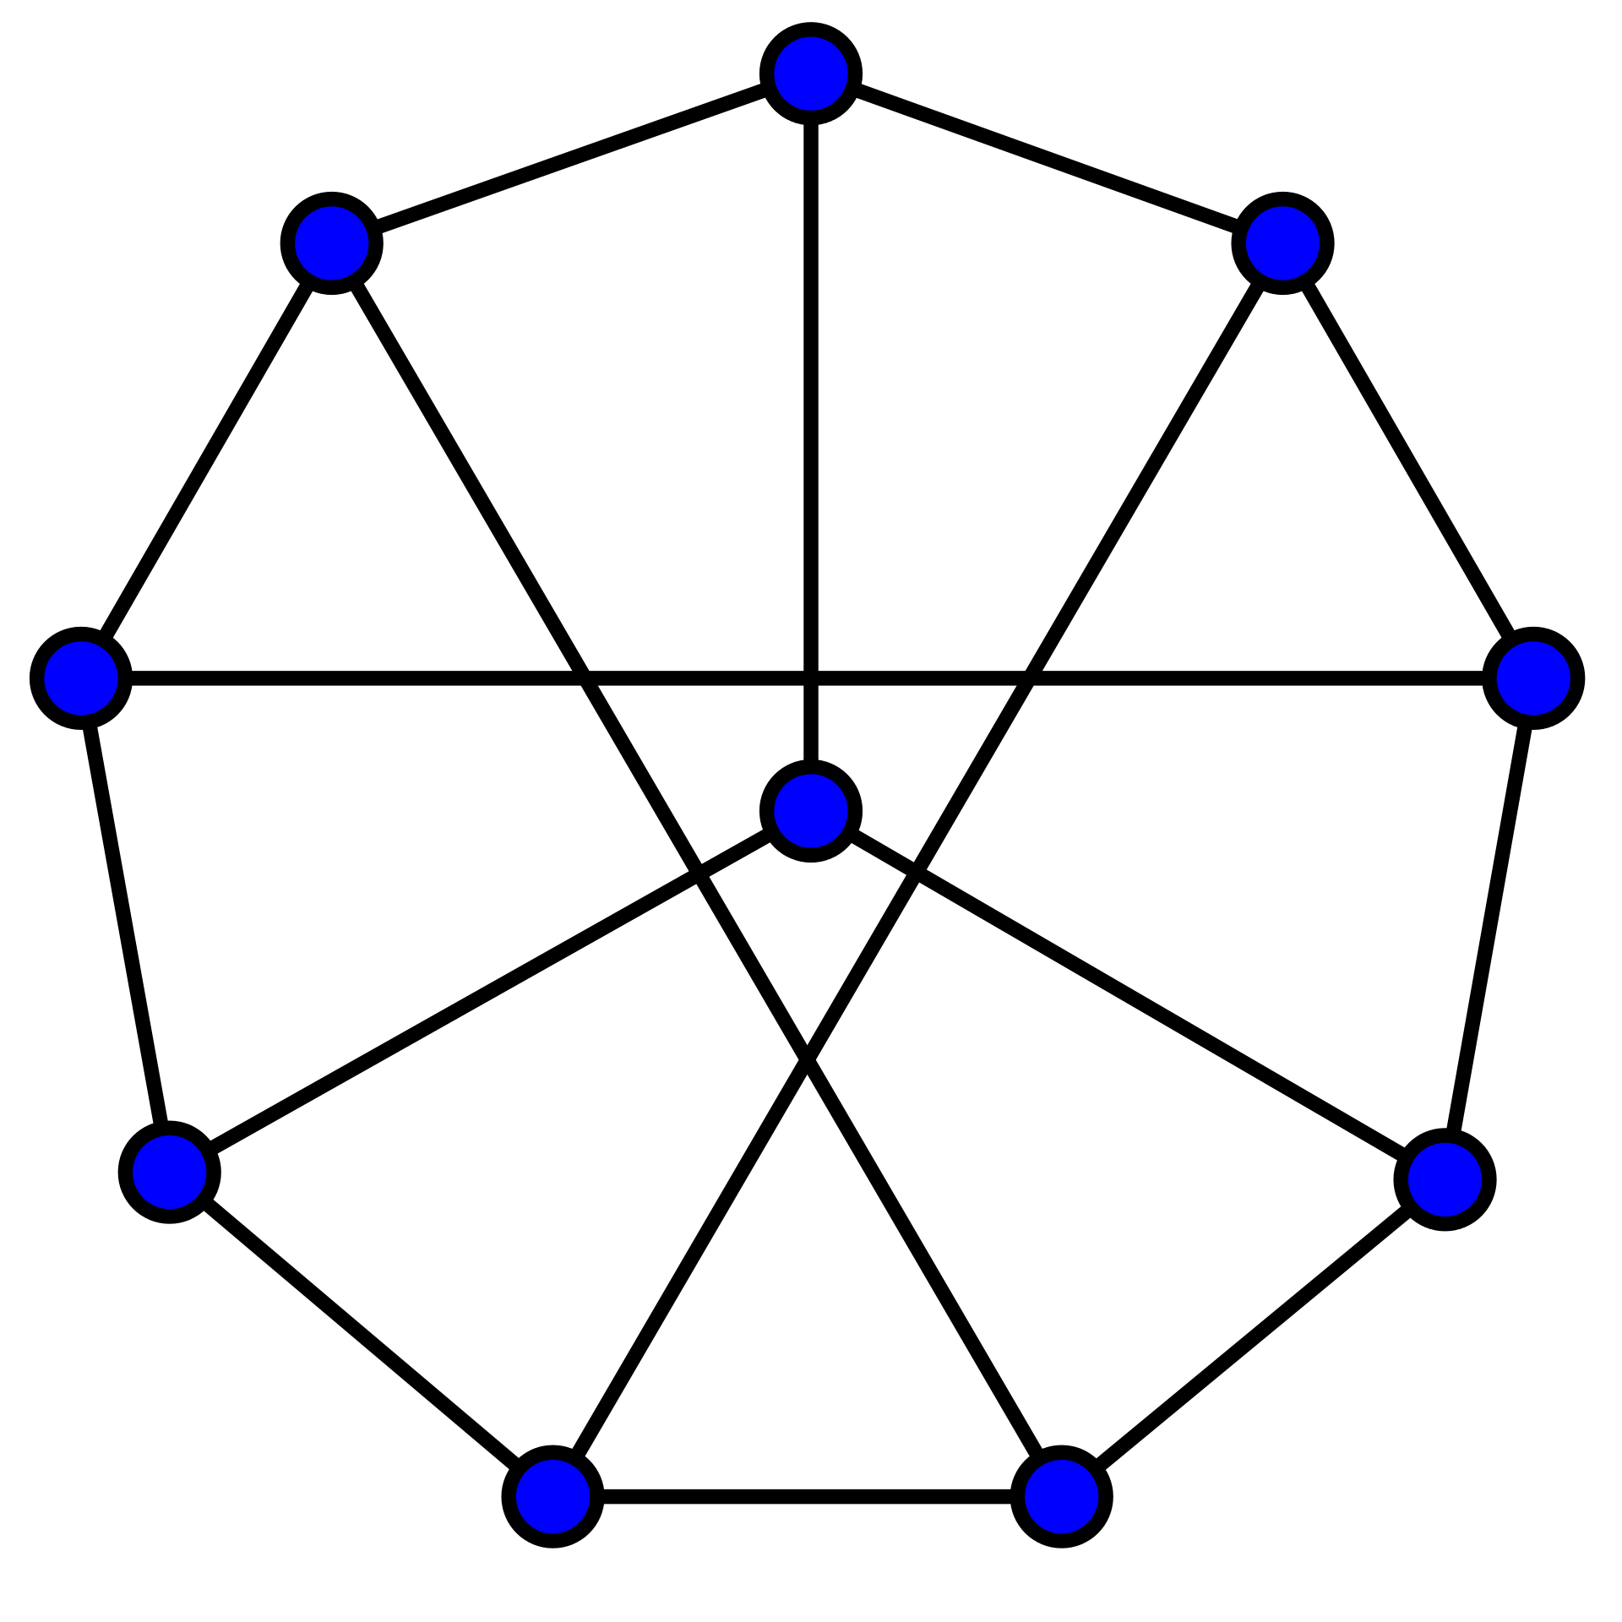
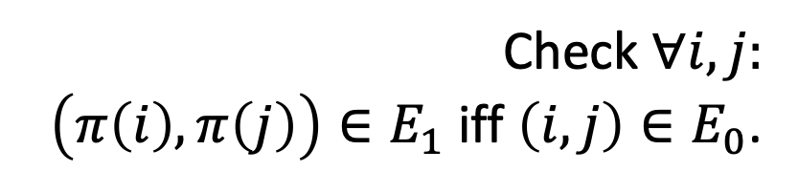

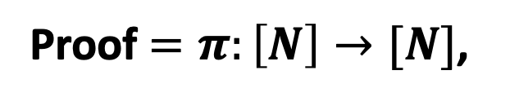
Theorem: Graphs $G_{0}$ and $G_{1}$ are isomorphic.
1
1
2
6
2
6
5
7
10
3
5
8
8
9
4
10
3
4
9
7
Proof $=π:\left[N\right]→[N]$,
the isomorphism
Verifier
Prover
Check $∀i,j:$
$\left(π\left(i\right),π\left(j\right)\right)∈E_{1}$ iff $\left(i,j\right)∈E_{0}$.

Slide 11
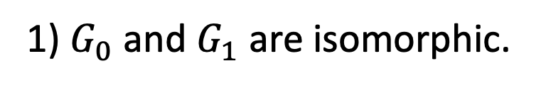
Theorem: Graphs $G_{0}$ and $G_{1}$ are isomorphic.
1
1
2
6
2
6
5
7
10
3
8
5
8
9
4
10
3
4
9
7
Proof $=π:\left[N\right]→[N]$,
the isomorphism
Verifier
Prover
After interaction, Bob the Verifier knows:
1) $G_{0}$ and $G_{1}$ are isomorphic.
2) Also, the isomorphism.

Slide 12
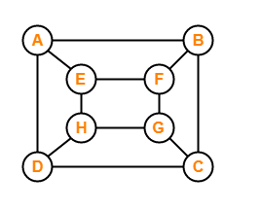

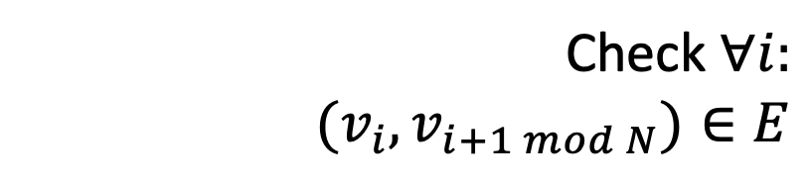
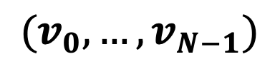
Theorem: Graphs $G$ has a Hamiltonian cycle.
Proof = Hamiltonian cycle
$$(v_{0},…,v_{N−1})$$
Verifier
Prover
Check $∀i:$
$$(v_{i},v_{i+1 mod N})∈E$$

Slide 13
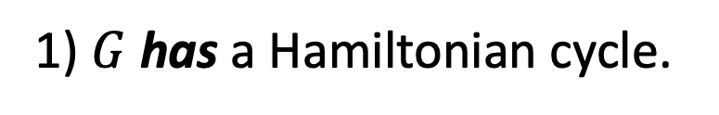
Theorem: Graphs $G$ has a Hamiltonian cycle.
Proof = Hamiltonian cycle
$$(v_{0},…,v_{N−1})$$
Verifier
Prover
After interaction, Bob the Verifier knows:
1) $G$ has a Hamiltonian cycle.
2) Also, the Hamiltonian cycle itself.

Slide 14
Theorem: Graphs $G$ has a Hamiltonian cycle.
Proof = Hamiltonian cycle
$$(v_{0},…,v_{N−1})$$
Verifier
Prover
NP-Complete Problem:
Every one of the other problems can be reduced to it

Slide 15


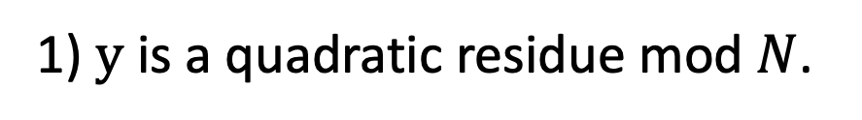
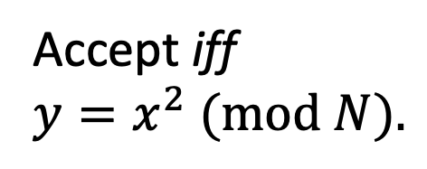
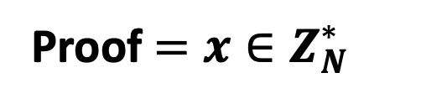
Theorem: $y$ is a quadratic residue mod $N$
Proof $=x∈Z_{N}^{∗}$
Verifier
Prover
Accept iff
$y=x^{2} (mod N).$
After interaction, Bob the Verifier knows:
1) $y$ is a quadratic residue mod $N$.
2) Also, the square root of $y$.

Slide 16
Is there any other way?

Slide 17
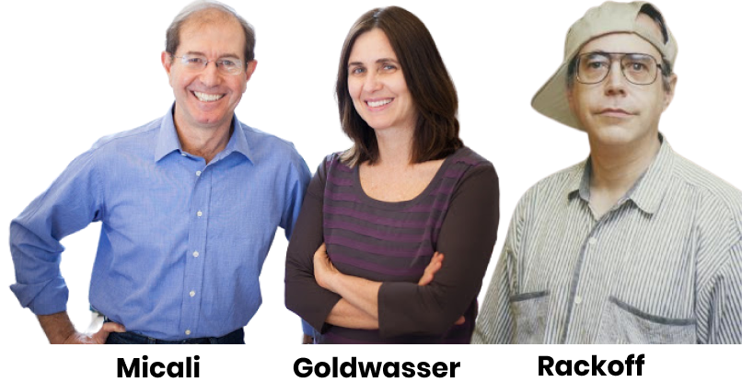
Zero Knowledge Proofs
“I will not give you the square root, but I will prove to you that I could provide one if I wanted to.”
Prover

Slide 18
Two (Necessary) New Ingredients
1. Interaction: Rather than passively reading the proof, the verifier engages in a conversation with the prover.
2. Randomness: The verifier is randomized and can make a mistake with a (exponentially small) probability.

Slide 19






Interactive Proofs for a Language $ℒ$
Claim/Theorem
$$a_{1}$$
accept/reject
$$q_{1}$$
$$a_{2}$$
$$q_{2}$$
Verifier
Prover
$$…$$
Probabilistic
Polynomial-time
Comp. Unbounded

Slide 20





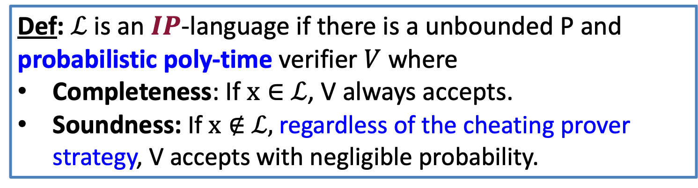
Interactive Proofs for a Language $ℒ$
Claim/Theorem
$$a_{1}$$
accept/reject
$$q_{1}$$
$$a_{2}$$
$$…$$
Verifier
Prover
Def: $ℒ$ is an $IP$-language if there is a unbounded P and probabilistic poly-time verifier $V$ where
Completeness: If $x∈$ $ℒ$, V always accepts.
Soundness: If $x∉$ $ℒ,$ regardless of the cheating prover strategy, V accepts with negligible probability.

Slide 21
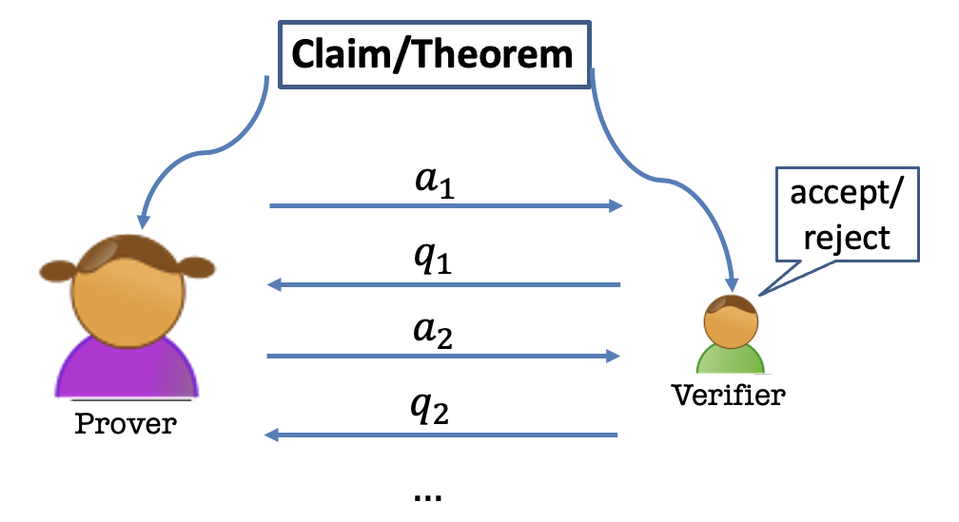
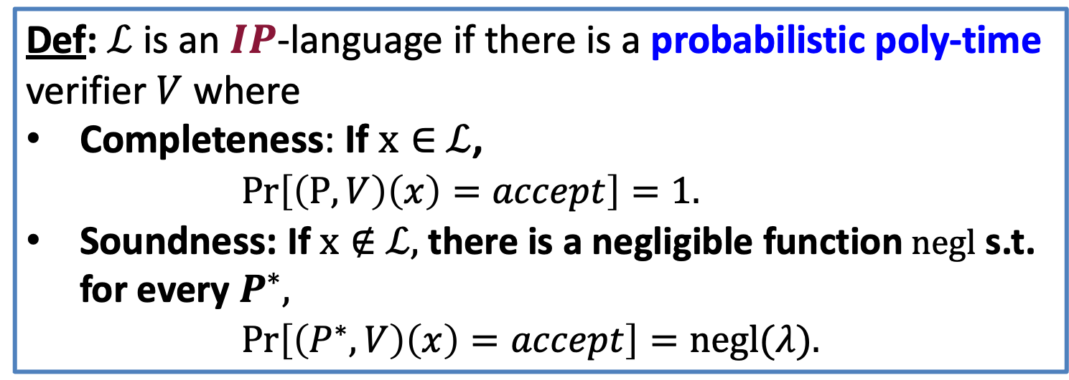
Interactive Proofs for a Language $ℒ$
Def: $ℒ$ is an $IP$-language if there is a probabilistic poly-time verifier $V$ where
Completeness: If $x∈$ $ℒ$,
$Pr\left[\left(P,V\right)\left(x\right)=accept\right]=1.$
Soundness: If $x∉$ $ℒ,$ there is a negligible function $negl$ s.t. for every $P^{∗},$
  $Pr\left[\left(P^{∗},V\right)\left(x\right)=accept\right]=negl(λ).$

Slide 22
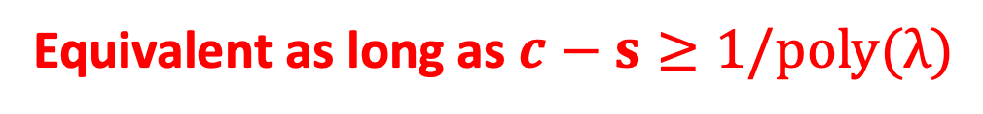
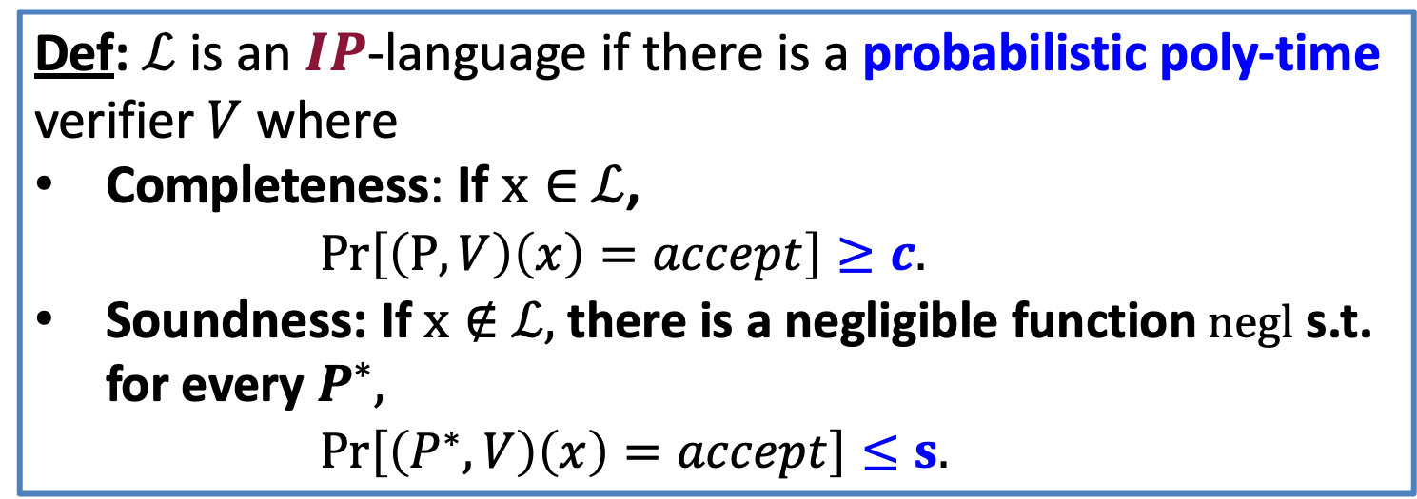
Interactive Proofs for a Language $ℒ$
Def: $ℒ$ is an $IP$-language if there is a probabilistic poly-time verifier $V$ where
Completeness: If $x∈$ $ℒ$,
$Pr\left[\left(P,V\right)\left(x\right)=accept\right]≥c.$
Soundness: If $x∉$ $ℒ,$ there is a negligible function $negl$ s.t. for every $P^{∗},$
  $Pr\left[\left(P^{∗},V\right)\left(x\right)=accept\right]≤s.$
Equivalent as long as $c−s≥1/poly(λ)$

Slide 23
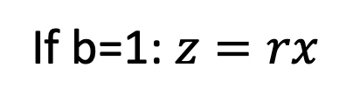
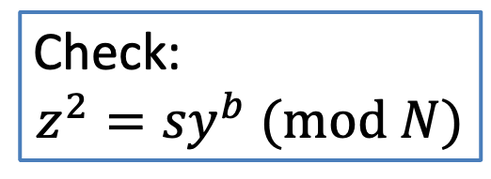
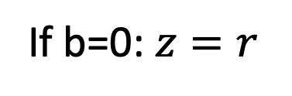



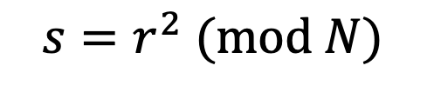
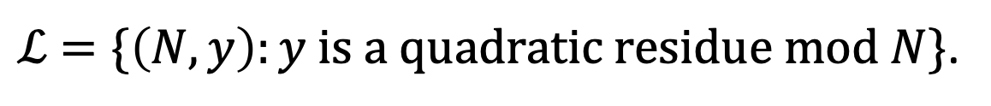
Interactive Proof for QR
$ℒ$ $=\{\left(N,y\right):y is a quadratic residue mod N\}$.
$${s=r}^{2} (mod N)$$
$$\left(N,y\right)$$
$$\left(N,y\right)$$
$$b←\{0,1\}$$
If b=0: $z=r$
Check:
$${z^{2}=sy}^{b} (mod N)$$
If b=1: $z=rx$

Slide 24
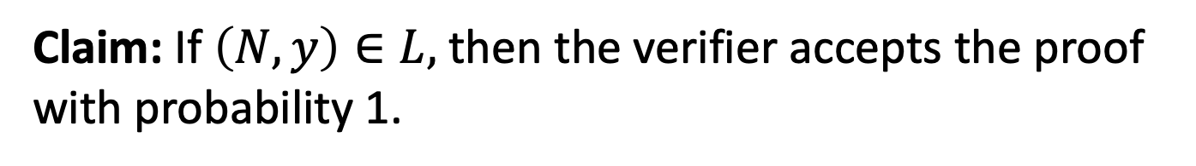
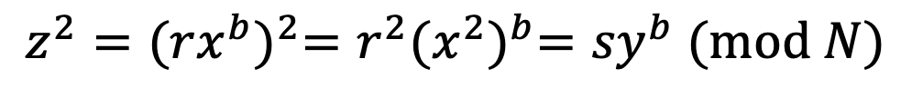
Completeness
Claim: If $\left(N,y\right)∈L,$ then the verifier accepts the proof with probability 1.
Proof:
$${z^{2}={(rx^{b})}^{2}=r^{2}{(x^{2})}^{b}=sy}^{b} (mod N)$$
So, the verifier’s check passes and he accepts.

Slide 25
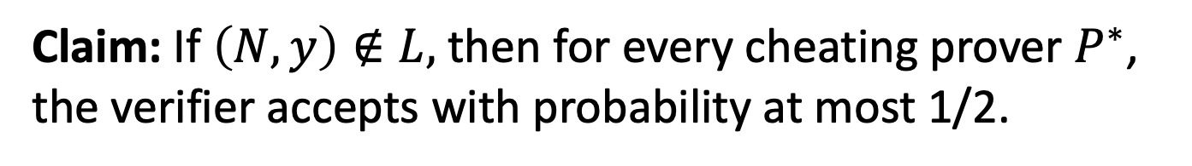
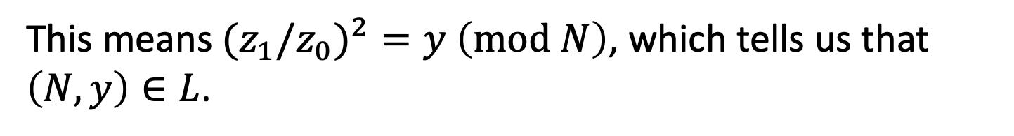
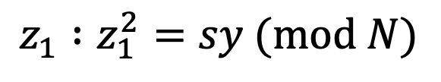
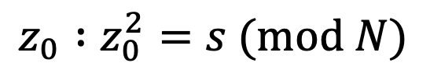
Soundness
Claim: If $\left(N,y\right)∉L,$ then for every cheating prover $P^{∗}$, the verifier accepts with probability at most 1/2.
Proof:
Suppose the verifier accepts with probability > 1/2.
Then, there is some $s∈Z_{N}^{∗}$ s.t. the prover produces
$$z_{0} :z_{0}^{2}=s (mod N)$$
$$z_{1} :z_{1}^{2}=sy (mod N)$$
This means${(z}_{1}/z_{0})^{2}=y$ $\left(mod N\right)$, which tells us that $\left(N,y\right)∈L$.

Slide 26
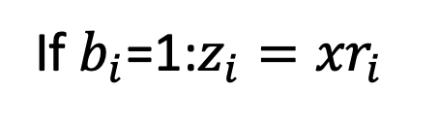
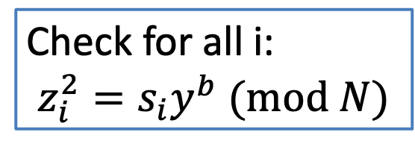
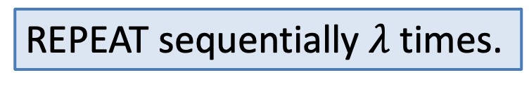
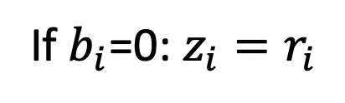



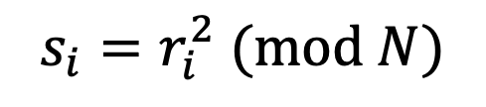
Interactive Proof for QR
$ℒ$ $=\{\left(N,y\right):y is a quadratic residue mod N\}$.
$$s_{i}=r_{i}^{2} (mod N)$$
$$\left(N,y\right)$$
$$\left(N,y\right)$$
$$b_{i}←\{0,1\}$$
If $b_{i}$=0: $z_{i}=r_{i}$
Check for all i:
$$z_{i}^{2}=s_{i}y^{b} (mod N)$$
If $b_{i}$=1:$z_{i}={xr}_{i}$
REPEAT sequentially $λ$ times.

Slide 27
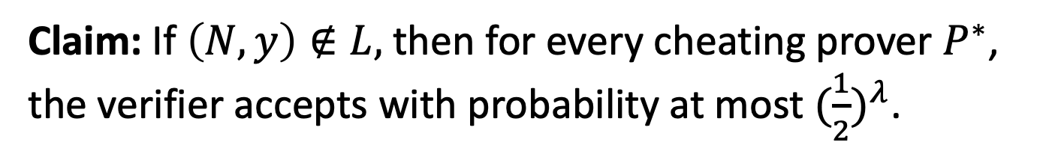
Soundness
Claim: If $\left(N,y\right)∉L,$ then for every cheating prover $P^{∗}$, the verifier accepts with probability at most ${(\frac{1}{2})}^{λ}$.
Proof:
Exercise.

Slide 28
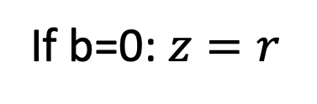
This is Zero-Knowledge.
But what does that mean?
$${s=r}^{2} (mod N)$$
$$\left(N,y\right)$$
$$\left(N,y\right)$$
$$b←\{0,1\}$$
If b=0: $z=r$
Check:
$${z^{2}=sy}^{b} (mod N)$$
If b=1: $z=rx$

Slide 29


How to Define Zero-Knowledge?
After the interaction, $V$ knows:
The theorem is true; and
A view (sample) of the interaction
  (= transcript + coins of V)
$P$ gives zero knowledge to $V$:
When the theorem is true, the view gives V nothing that he couldn’t have obtained on his own without interacting with P.

Slide 30

How to Define Zero-Knowledge?
$(P,V)$ is zero-knowledge if $V$ can generate his VIEW = samples of the interaction all by himself in probabilistic (expected) polynomial time.

Slide 31

How to Define Zero-Knowledge?
$(P,V)$ is zero-knowledge if $V$ can “simulate” his VIEW of the interaction all by himself in probabilistic (expected) polynomial time.

Slide 32








The Simulation Paradigm
PPT “simulator” $S$
$${sim}_{S}:$$
$$\left(s,b,z\right)$$
$$\left(N,y\right)$$
$${view}_{V}\left(P,V\right):$$
$Transcript= \left(s,b,z\right),$
Coins = $b$
$${view}_{V}\left(P,V\right):$$
$$\left(s,b,z\right)$$

Slide 33



Zero Knowledge: Definition
An Interactive Protocol (P,V) is zero-knowledge for a language $L$if there exists a PPT algorithm S (a simulator) such that for every $x∈L$, the following two distributions are indistinguishable:
1. ${view}_{V}(P,V)(x)$
2. $S(x,1^{λ})$
(P,V) is a zero-knowledge interactive protocol if it is complete, sound and zero-knowledge.

Slide 34



Perfect Zero Knowledge: Definition
An Interactive Protocol (P,V) is perfect zero-knowledge for a language $L$if there exists a PPT algorithm S (a simulator) such that for every $x∈L$, the following two distributions are identical:
1. ${view}_{V}(P,V)(x)$
2. $S(x,1^{λ})$
(P,V) is a zero-knowledge interactive protocol if it is complete, sound and zero-knowledge.

Slide 35




Zero Knowledge
Claim: The QR protocol is zero knowledge.
Simulator S works as follows:
1. First pick a random bit b.
2. pick a random $z∈Z_{N}^{∗}$.
3. compute $s=z^{2}/y^{b}$.
$${view}_{V}\left(P,V\right):$$
$$\left(s,b,z\right)$$
4. output $(s,b,z)$.
Exercise: The simulated transcript is identically distributed as the real transcript in the interaction (P,V).

Slide 36






What if V is NOT HONEST.
OLD DEF
An Interactive Protocol (P,V) is honest-verifier perfect zero-knowledge for a language $L$if there exists a PPT simulator S such that for every $x∈L$, the following two distributions are identical:
1. ${view}_{V}(P,V)$
2. $S(x,1^{λ})$
REAL DEF
An Interactive Protocol (P,V) is perfect zero-knowledge for a language $L$if for every PPT $V^{∗}$, there exists a (expected) poly time simulator S s.t. for every $x∈L$, the following two distributions are identical:
1. ${view}_{V^{∗}}(P,V^{∗})$
2. $S(x,1^{λ})$

Slide 37



NOW: (Malicious Ver) Zero Knowledge
Theorem: The QR protocol is (malicious verifier) zero knowledge.
Simulator S works as follows:
1. First pick a random s and “feed it to” $V^{∗}$.
2. Let $b=V^{∗}(s)$.
$${view}_{V^{∗}}\left(P,V^{∗}\right):$$
$$\left(s,b,z\right)$$
Now what???

Slide 38


(Malicious Ver) Zero Knowledge
Theorem: The QR protocol is (malicious verifier) zero knowledge.
Simulator S works as follows:
1. First set $s=\frac{z^{2}}{y^{b}}$ for a random z and b and feed s to $V^{∗}$.
2. Let $b′=V^{∗}(s)$.
3. If $b^{′}=b$, output $(s,b,z)$ and stop.
4. Otherwise, go back to step 1 and repeat. (also called “rewinding”).

Slide 39


Simulator S works as follows:
1. First set $s=\frac{z^{2}}{y^{b}}$ for a random z and feed s to $V^{∗}$.
2. Let $b′=V^{∗}(s)$.
3. If $b^{′}=b$, output $(s,b,z)$ and stop.
4. Otherwise, go back to step 1 and repeat. (also called “rewinding”).
Lemma:
S runs in expected polynomial-time.
When S outputs a view, it is identically distributed to the view of $V^{∗}$ in a real execution.

Slide 40



Statistical Zero Knowledge: Definition
An Interactive Protocol (P,V) is statistical zero-knowledge for a language $L$if there exists a PPT algorithm S (a simulator) such that for every $x∈L$, the following two distributions are statistically indistinguishable:
1. ${view}_{V}(P,V)(x)$
2. $S(x,1^{λ})$
| Σ_{σ}|prob[σ∈View(P,V) (x) – prob[σ∈S(x $1^{λ})$)]| < neg(|λ|)
(P,V) is a zero-knowledge interactive protocol if it is complete, sound and zero-knowledge.

Slide 41
Open Questions
Find natural complete problem for PZK
Does SZK = PZK?

Slide 42



Computational Zero Knowledge: Definition
An Interactive Protocol (P,V) is computational zero-knowledge for a language $L$if there exists a PPT algorithm S (a simulator) such that for every $x∈L$, the following two distributions are computationally indistinguishable:
1. ${view}_{V}(P,V)$
2. $S(x,1^{λ})$
(P,V) is a zero-knowledge interactive protocol if it is complete, sound and zero-knowledge.

Slide 43



Zero Knowledge Proofs
An Interactive Protocol (P,V) is a perfect/statistical/computational zero-knowledge proof system for a language $L$if it is
Complete
Sound and
Zero knowledge: for every PPT $V^{∗}$, there exists a (expected) poly time simulator S s.t. for every $x∈L$, the following two distributions are identical/statistically close/computationally close:
1. ${view}_{V^{∗}}(P,V^{∗})$
2. $S(x,1^{λ})$

Slide 44






ZK Proof for Graph Isomorphism
1
1
2
6
2
6
5
7
10
3
8
5
8
9
4
10
3
4
Graph G
9
7
Graph H
$K=ρ(G)$
$$H=π(G)$$
where $ρ$ is a random permutation
random challenge bit $b$
Verifier
Prover
$b=0:$ send $π_{0}$ s.t. $K=π_{0}(G)$
$b=1:$ send $π_{1}$ s.t. $H=π_{1}(K)$

Slide 45


ZK Proof for Graph Isomorphism
Completeness?
$K=ρ(G)$
$$H=π(G)$$
where $ρ$ is a random permutation
random challenge bit $b$
Verifier
Prover
$b=0:$ send $π_{0}=ρ$
$b=1:$ send $π_{1}=π∘ρ^{−1}$

Slide 46

ZK Proof for Graph Isomorphism
Soundness: Suppose G and H are non-isomorphic, and a prover could answer both the verifier challenges. Then, $K=π_{0}(G)$ and $H=π_{1}\left(K\right).$
In other words, $H{=π}_{1}∘π_{0}(G)$, a contradiction!
$K=ρ(G)$
$$H=π(G)$$
where $ρ$ is a random permutation
random challenge bit $b$
Verifier
Prover
$b=0:$ send $π_{0}=ρ$
$b=1:$ send $π_{1}=π∘ρ^{−1}$

Slide 47
ZK Proof for Graph Isomorphism
Zero Knowledge?
$K=ρ(G)$
$$H=π(G)$$
where $ρ$ is a random permutation
random challenge bit $b$
Verifier
Prover
$b=0:$ send $π_{0}=ρ$
$b=1:$ send $π_{1}=π∘ρ^{−1}$

Slide 48
What Made it Possible?
1. Each statement had multiple proofs of which the prover chooses one at random.
2. Each such proof is made of two parts: seeing either one on its own gives the verifier no knowledge; seeing both imply 100% correctness.
3. Verifier chooses to see either part, at random. The prover’s ability to provide either part on demand convinces the verifier.

Slide 49


Efficient Prover (given a Witness)
In both these protocols for quadratic residuosity and for graph isomorphism, the (honest) prover is actually polynomial-time given the NP witness (the square root of $y$ in the case of QR, and the isomorphism in the case of graph-iso.)
Soundness is nevertheless against any, even computationally unbounded, prover $P^{∗}$.

