Slide 1
Foundation of Cryptography
Lecture 11

Slide 2

Authentication Problem
Alice
Bob
k
k
message M
Eve is Active:
Can alter messages
Can insert new messages

Slide 3
Authentication Problem
Integrity of the message may be even more important for applications. An Active adversary may
  alter messages in transit
  inject new messages
  remove messages

Slide 4
Recall: Message Authentication Codes
A way to associate a tag with each message which is hard to produce without knowing the secret key
Formal:
A Triplet of algorithms (Gen, MAC, Verify)
Gen(1^{n}) produces key kEK_{n}
MAC (k,M): on key k and message M, outputs tag t
Verify(k,M,t) on key k, message M & tag t
outputs {Accept, Reject} where
Correctness: for all m, Verify( k, m, MAC(k,m)) = Accept
Hard to Forge hard to generate new (m, t) s.t. Verify(k,m,t)=accept

Slide 5
Today: Digital Signatures

Slide 6
Wish List for Digital Signatures
Associate documents with a signer (user in a computer network)
Computationally easy to verify by everyone, but hard to forge for all except for the legal signer
Non-refutable: if Alice signs a document, then she cannot deny it.
– In particular, should not be able to change document once it is signed
⇒Legally binding

Slide 7
Wish List for Handwritten Signatures
Associate documents with a signer (individual)
To verify need to compare against other signatures
Signatures are legally binding
Should be hard to forge
Should be hard to change the document once its signed

Slide 8
Digital Signatures vs. MAC
Digital signatures are the public-key (or asymmetric) analogue of MACs
  Publicly Verifiable
  Transferable: can show the signature to a third party who can verify that the signature is valid
  Can not be refuted: if Alice signs a document for Bob, she cannot deny it.
  Require 2n keys for n users, whereas MAC requires n² keys for n users.

Slide 9
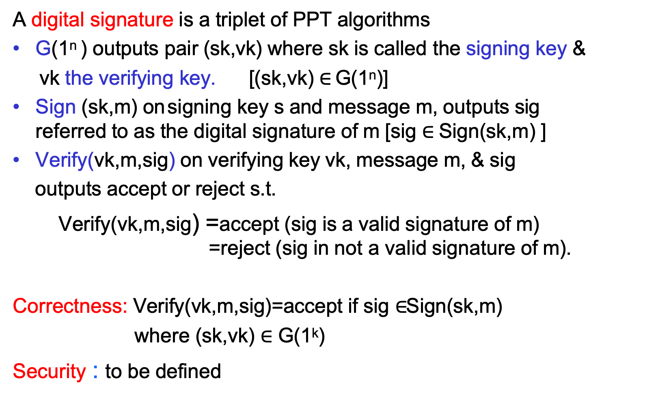
Digital Signature: Definition
A digital signature is a triplet of PPT algorithms
G(1^{n} ) outputs pair (sk,vk) where sk is called the signing key &
vk the verifying key. [(sk,vk) $∈$ G(1^{n})]
Sign (sk,m) on signing key s and message m, outputs sig referred to as the digital signature of m [sig $∈$ Sign(sk,m) ]
Verify(vk,m,sig) on verifying key vk, message m, & sig outputs accept or reject s.t.
Verify(vk,m,sig) =accept (sig is a valid signature of m)
=reject (sig in not a valid signature of m).
Correctness: Verify(vk,m,sig)=accept if sig $∈$Sign(sk,m) where (sk,vk) $∈$ G(1^{k})
Security : to be defined

Slide 10
Power of the adversary/forger?
Forger can:
Key Only Attack: see only the public verifying key
Known Message Attack: see the public key and pairs of (m, Sign(s,m)) for m signed in the past
Chosen Message Attack: Forger can request to see signatures of messages of his choice
Adaptively Chosen Message Attack: Forger can request to see signatures of messages of his choice which may be chosen in a way dependent on previous signatures seen

Slide 11
Successful Forgery
Total Break: Forger recovers the secret signing key
Universal Forgery: for any message m Forger can come up with a string sig which will be accepted as a valid signature of m by the Verify algorithm
Existential Break: There exist some message for which the forger can produce a valid signature

Slide 12
Security w.r.t adversary/success
Require that an adversary which is ”key-only, kma,cma, adaptive cma” succeeds “in total break, universal forgery, existential break” with at most negligible probability
Literature has considered adversaries which are:
Polynomial time in n=|secret key|
Exact security: (T,ε) – secure if for all adversary A who can make T calls to Sign(s,) succeeds with probability < ε

Slide 13





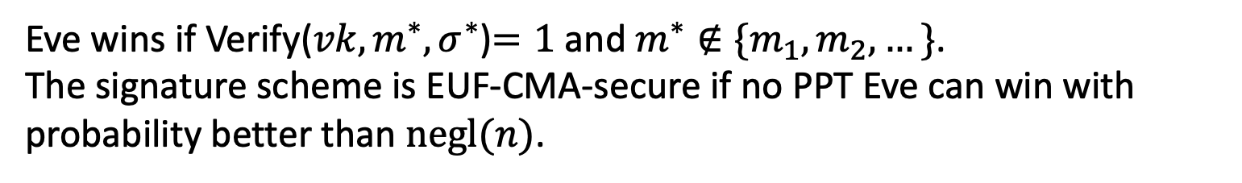



EUF-CMA* Security
(Existentially Unforgeable against a Chosen Message Attack)
Challenger
Eve
$$\left(sk,vk\right)←Gen\left(1^{n}\right)$$
$$vk$$
$$m_{i}$$
poly many times
$$σ_{i}$$
$$σ_{i}←Sign(sk,m_{i})$$
$$m^{∗},σ^{∗}$$
Eve wins if Verify(${vk,m}^{∗},σ^{∗}$)$=1$ and $m^{∗}∉\{m_{1},m_{2},…\}$.
The signature scheme is EUF-CMA-secure if no PPT Eve can win with probability better than $negl(n)$.
Notes:
Encryption has to be probabilistic.

Slide 14
Could you make it any stronger?
Yes. How?
Do not allow forger to produce any different signature for the same message signed in the past

Slide 15
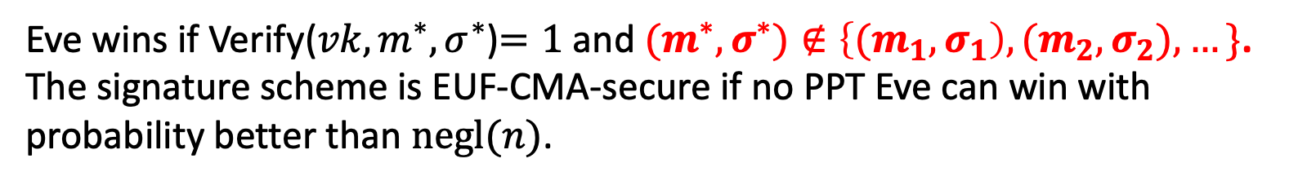

Strong EUF-CMA Security
(Existentially Unforgeable against a Chosen Message Attack)
Challenger
Eve
$$\left(sk,vk\right)←Gen\left(1^{n}\right)$$
$$vk$$
$$m_{i}$$
poly many times
$$σ_{i}$$
$$σ_{i}←Sign(sk,m_{i})$$
$$m^{∗},σ^{∗}$$
Eve wins if Verify(${vk,m}^{∗},σ^{∗}$)$=1$ and ${(m}^{∗},σ^{∗})∉\left\{{(m}_{1},σ_{1}\right),{(m}_{2},σ_{2}),…\}$.
The signature scheme is EUF-CMA-secure if no PPT Eve can win with probability better than $negl(n)$.
Notes:
Encryption has to be probabilistic.

Slide 16
Digital Signatures: Primary Usages
Authenticity of documents: A digital signature provides a way for each user in a network to sign messages so that signatures can later be verified by anyone.
Integrity of signed documents: Anyone can verify that the content of a document that have been signed has not been altered.
Certificates

Slide 17
Certificates
If the directory of public keys is accessed over the network, one needs to protect the users from fraudulent public keys.
Certificates -- a user’s public key digitally signed by the public key directory manager (as a trusted party) is one solution to this problem.
Each user can transmit this certificate along with his public key with any message he signs removing the need for a central directory.
The only thing that need be trusted is that the directory manager’s public key is authentic.

Slide 18
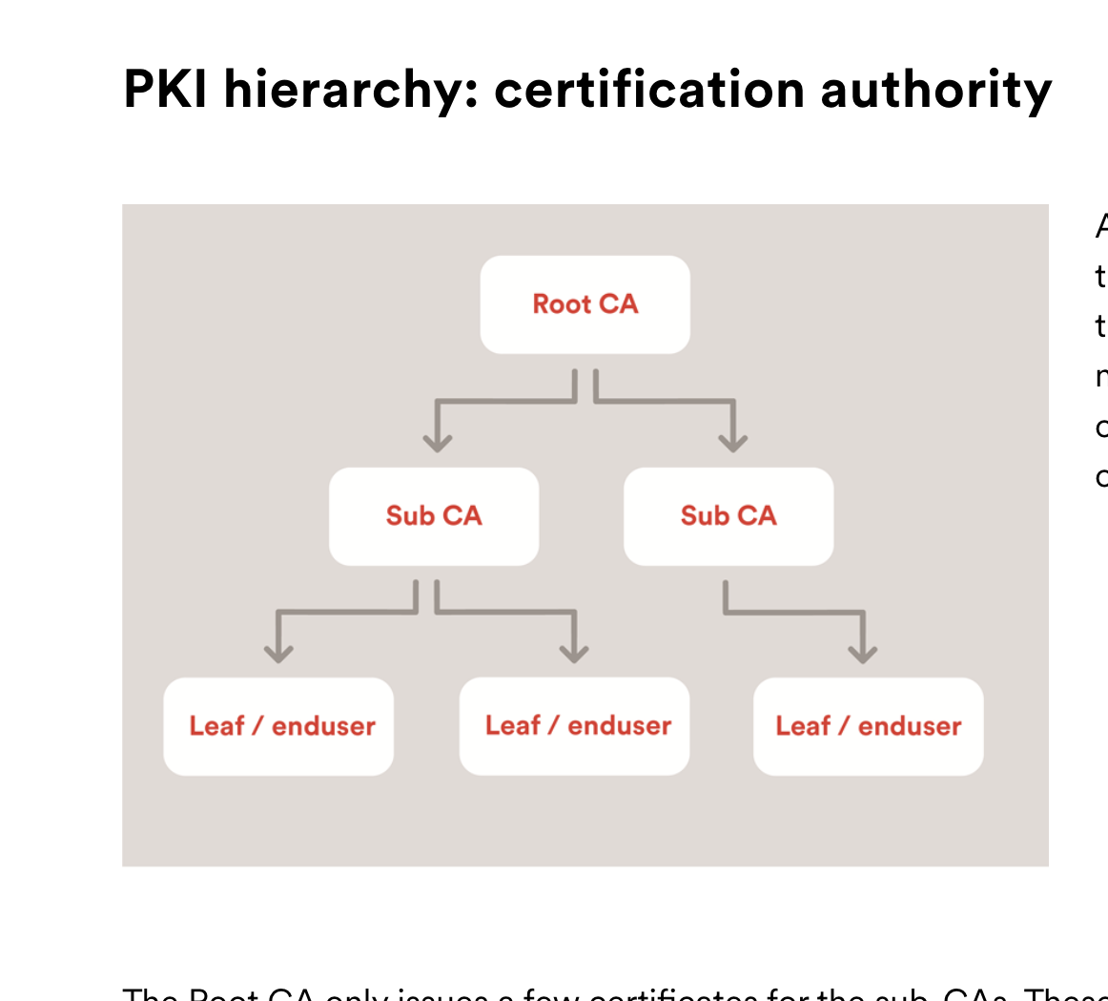
Public-Key Infrastructure (PKI)
Trusted root authority (VeriSign, IBM, United Nations)
  Everyone knows the verification key of root authority
Root authority can sign certificates
Certificates identify others, including other authorities
Leads to certificate chains

Slide 19
Digital Signatures: Trapdoor Function Model
Diffie Hellman 76 proposal in our notation is: given a collection of trapdoor collection F define signature scheme:
Gen: On input security parameter 1^{n}, pick a function f in F_{n} and its associated trapdoor t. Make the signing key t and the verifying key is f.
Sign(t,m) = f⁻¹(m) [deterministic, unique]
Verify(f,m,sig) = accept if f(sig) =m
and reject otherwise Why is it correct?
Since Verify(f,m,sig) = f(Sign(t,m)) =f (f⁻¹(m))= m when sig computed by the legal signing algorithm.

Slide 20
Important Remark
Diffie Hellman in their work linked the tasks of public-key encryption and digital signatures.
They observed that for pair of (E,D) (from public-key encryption) you can use s=D(m) as a signature and E(s) =? M as the verifying algorithm.
This of course fails when E is a probabilistic scheme and is not true in general for any encryption scheme.
We explicitly separate the two tasks to achieve greater security.

Slide 21
Existential Forgery is Possible
Even though F is a collection of trapdoor functions, the scheme is trivial to “existentially forge” under a “key only” attack as follows
On public key f in F,
Adversary A chooses at random x in the domain of f and sets message=f(x),
signature=x.
Another critic: How about signing single bit messages ?

Slide 22
Instantiation:
The RSA Digital Signature Scheme
The first example of a digital signature scheme was proposed by the RSA in 77.
Key Generation: choose N=pq and e, d s.t. ed=1 mod φ(N) Set (N,e) the public verifying key and d the private signing key.
Sign(d,m)
Set sig = m^{d} mod n to be the signature of m
Verify ((N,e), sig,m):
output 1 if and only if (sig)^{e} mod N = m.
Correct: sig=m^{d} mod n implies sig^{e} mod n =(m^{de} )=
_{m}ed mod φ(n) _{=m mod N}

Slide 23
Security of RSA signatures
Claim: RSA is existentially forgeable under a Key only attack.
Proof: Let pk=(N,e) and sk =d s.t. ed=1 mod phi(N). Simply choose x in Z_{N}* at random, and set m=x^{e} mod N,
and sig=x, then Verify((N,e),sig, m)=accept. Namely, x is a legal signature of m.
Claim: RSA is universally forgeable under chosen message attack(CMA)
Proof: Suppose interested in forging the signature of m. Choose a random r in Z_{N}*. Let m₁=r and m₂=m/r mod N. Get signatures s₁ =(m₁)^{d}
mod N, s₂=(m₂)^{d} mod N of m₁, m₂ from Sign (during the CMA). Now, it is easy to compute the signature of m,
set s=s₁*s₂ mod N=(m₁)^{d} (m₂)^{d} mod N=(m₁*m₂)^{d} mod N =m^{d} mod N.

Slide 24
Remedy, Hash-then-Sign
Let H:{0,1}*⇒{0,1}^{n} be a collision resistant hash function
  Function which can be evaluated by all
  Function which compresses arbitrary length messages to n bit strings
  Hard to find collisions
∀ppt A, Prob[A(H)=(x,x’) s.t. H(x)=H(x’)] < neg(n)
Not known to follow from one-way permutation
Known constructions from DLP, Factoring, LWE
Real life implementations: MD5, SHA-1

Slide 25
Hash-then-Sign RSA
Hash-then-Sign paradigm
Gen: PK = ((n, e), H), SK = (p,q)
Signing: On input signing key d and message m output sig = H(m)^{d} mod n.
Verifying: On input (n,e), sig, and m,
  Compute H(m)
  if sig^{e} mod n = H(m) output 1 (accept signature)
Note: can try to forge either by breaking
RSA or by looking for collisions, i.e m’ s.t. H(m)=H(m’) for previously signed m. Both are hard.
Note: has the added advantage of handling long messages
“for free”

Slide 26
Security of hashed RSA
Theorem: if H is a random oracle, then Hashed RSA signatures is existentially secure against chosen message attack under the RSA assumption.
Variants of hashed RSA have been standardized, and are used in practice
Problem: H is not really a random oracle is

Slide 27
In Practice: Using RSA
Hash-then-Sign probabilistic paradigm
Generation: PK = ((n, e), H), SK = (p,q)
Signing: On input signing key d and message m output (s,r )
where s = H(r|| m)^{d} mod n
And r is randomly chosen each time, |r| = |m|
Verifying: On input (n,e), (s,r) and m, output 1 if and only if s^{e} mod n = H(r||m)

Slide 28
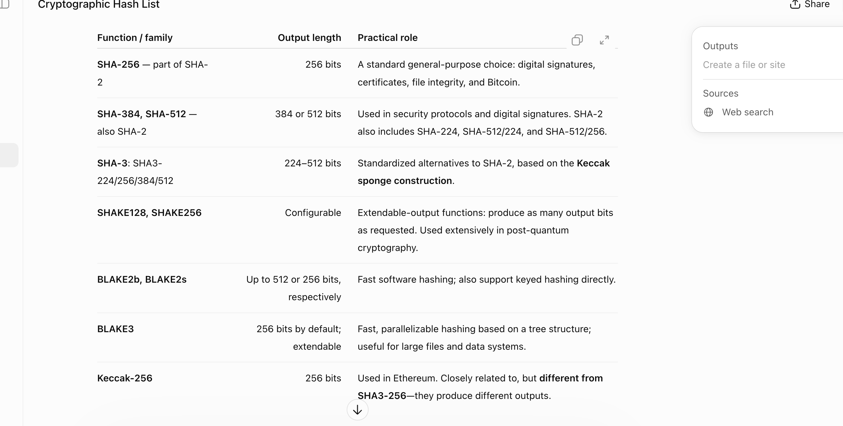
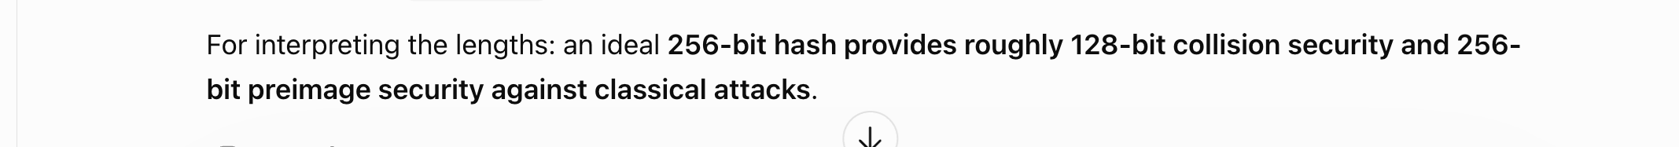
Cryptogarphic Hash Used in Practice

Slide 29
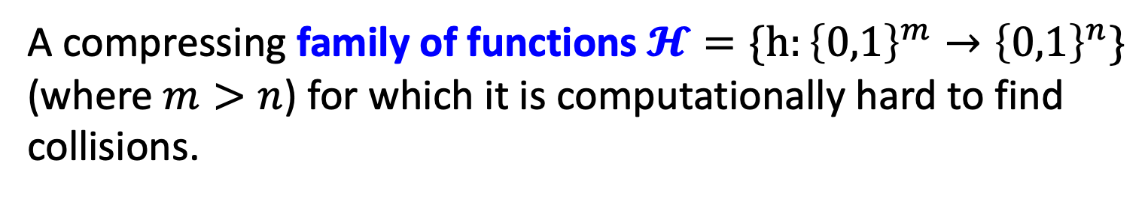
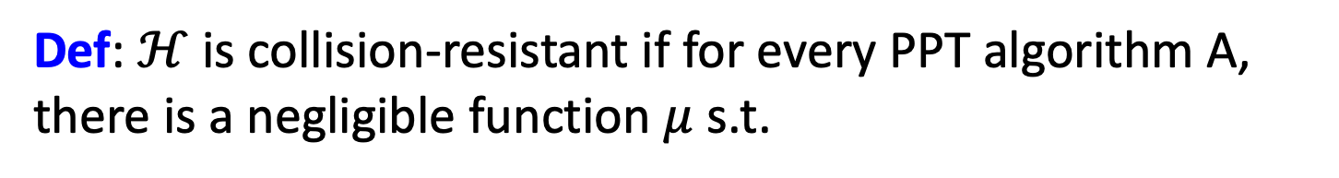
Formally, Families of CRH Functions
A compressing family of functions $𝓗=\{h:{\left\{0,1\right\}}^{m}→{\left\{0,1\right\}}^{n}\}$ (where $m>n$) for which it is computationally hard to find collisions.
Def: $ℋ$ is collision-resistant if for every PPT algorithm A, there is a negligible function $μ$ s.t.
$${Pr}_{h←ℋ}\left[A\left(1^{n},h\right)=\left(x,y\right):x≠y, h\left(x\right)=h\left(y\right)\right]=μ(n)$$

Slide 30
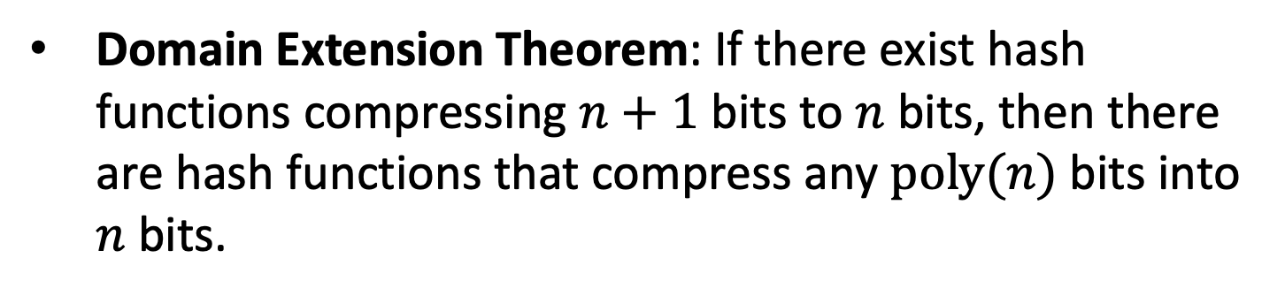
Do CRHFs exist?
Theoretical Constructions: assuming discrete logarithms (as well as under several other number-theoretic assumptions)
Domain Extension Theorem: If there exist hash functions compressing $n+1$ bits to $n$bits, then there are hash functions that compress any $poly(n)$bits into $n$bits.

Slide 31
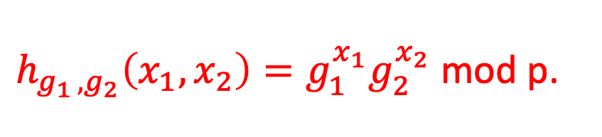
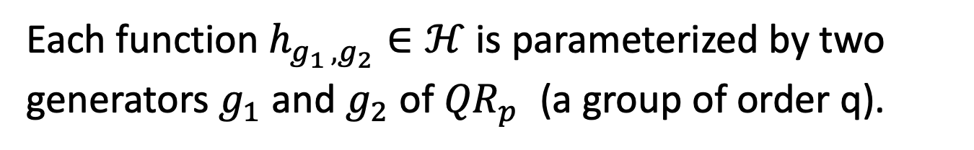
Discrete Log Based CRHF
$p=2q+1$ is a “safe” prime.
$$ℋ=\{h:{(ℤ_{q})}^{2}→{QR}_{p}^{}\}$$
Each function $h_{g_{1 },g_{2}}∈ℋ$ is parameterized by two generators $g_{1}$ and $g_{2}$ of ${QR}_{p}^{}$ (a group of order q).
$h_{g_{1 },g_{2}}\left(x_{1},x_{2}\right)=g_{1}^{x_{1}}g_{2}^{x_{2}}$ mod p.
This compresses 2 log q bits into log p $≈$ log q + 1 bits.

Slide 32
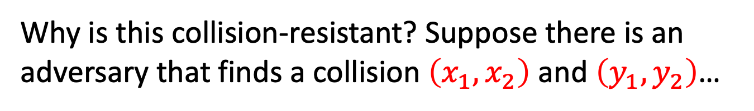
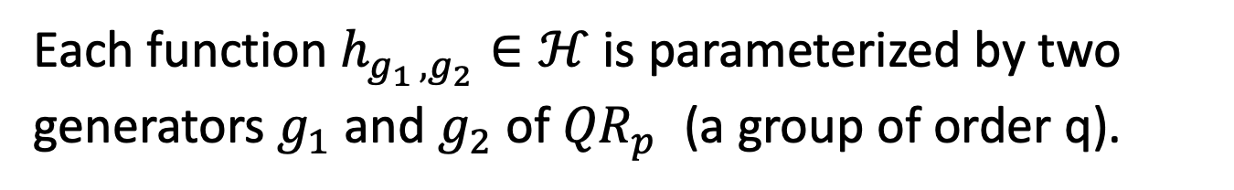
Discrete Log Based CRHF
$p=2q+1$ is a “safe” prime.
$$ℋ=\{h:{(ℤ_{q})}^{2}→{QR}_{p}^{}\}$$
Each function $h_{g_{1 },g_{2}}∈ℋ$ is parameterized by two generators $g_{1}$ and $g_{2}$ of ${QR}_{p}^{}$ (a group of order q).
$h_{g_{1 },g_{2}}\left(x_{1},x_{2}\right)=g_{1}^{x_{1}}g_{2}^{x_{2}}$ mod p.
Why is this collision-resistant? Suppose there is an adversary that finds a collision $\left(x_{1},x_{2}\right)$ and $\left(y_{1},y_{2}\right)$…

Slide 33
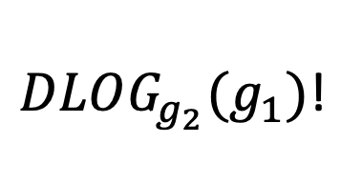
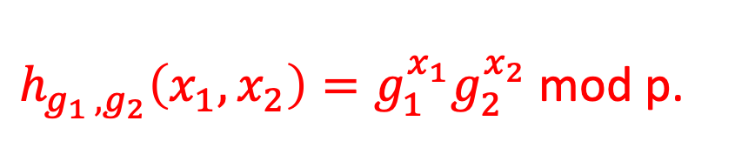
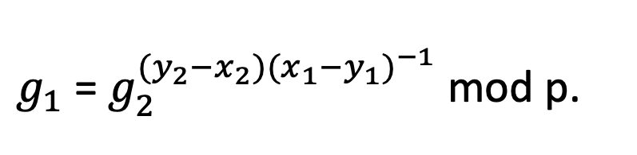
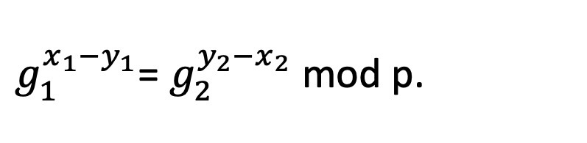
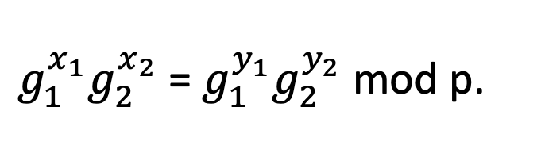
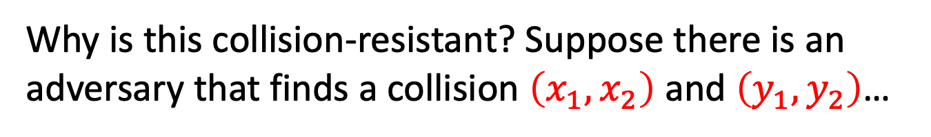
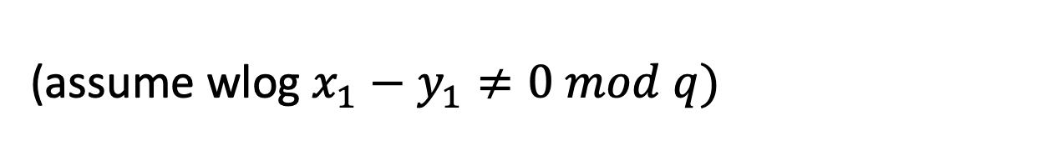
Discrete Log Based CRHF
$h_{g_{1 },g_{2}}\left(x_{1},x_{2}\right)=g_{1}^{x_{1}}g_{2}^{x_{2}}$ mod p.
Why is this collision-resistant? Suppose there is an adversary that finds a collision $\left(x_{1},x_{2}\right)$ and $\left(y_{1},y_{2}\right)$…
$g_{1}^{x_{1}}g_{2}^{x_{2}}$ = $g_{1}^{y_{1}}g_{2}^{y_{2}}$ mod p.
$g_{1}^{x_{1}−y_{1}}$= $g_{2}^{y_{2}−x_{2}}$ mod p.
(assume wlog $x_{1}−y_{1}≠0 mod q)$
$g_{1}$= $g_{2}^{{(y}_{2}−x_{2}){(x_{1}−y_{1})}^{−1}}$ mod p.
$DLOG_{g_{2}}(g_{1})$!

Slide 34
Other Constructions of CRHFs
From the hardness of factoring, lattice problems etc.
Not known to follow from the existence of one-way functions or even one-way permutations…
“Black-box separations”: Certain ways of constructing CRHF from OWF/OWP cannot work.
“Finding collisions on a one-way street”, Daniel Simon, Eurocrypt 1998.
Nevertheless, big open problem: OWF/OWP $⟹^{?}$ CRHF?

Slide 35
OWF implies EUF CMA Secure
Signature Scheme
Theorem [Naor-Yung’89, Rompel’90]
(EUF-CMA-secure) Signature schemes exist assuming that one-way functions exist.
Next Time:
(EUF-CMA-secure) Signature schemes exist assuming that collision-resistant hash functions exist.

