Slide 1
MIT 6.875
Foundations of Cryptography
Lecture 22

Slide 2


Complexity of the 2PC protocols
Number of OT protocol invocations $=2 ∗ \#AND$ gates
Can be made into O(#inputs $∙λ$): Yao’s garbled circuits
Number of rounds = AND-depth of the circuit
Can be made into O(1) rounds: Yao’s garbled circuits
Communication in bits = $$O(\#AND∙λ+\#outputs)$$
Can be made into O($λ$ #inputs) using FHE: but FHE is computationally more expensive concretely.

Slide 3
Homomorphic Encryption

Slide 4


Application 1. Secure Outsourcing
Input: x
Program: P
Enc(x)
x
Enc(P(x))
P(x)
Client
Server (the Cloud)
A Special Case: Encrypted Database Lookup
also called “private information retrieval” (we’ll see in two lectures)

Slide 5


Application 2. Secure Collaboration
Hospital
ID
Genome
ID
Phenotype
“Parties learn the genotype-phenotype correlations and nothing else”

Slide 6
Homomorphic Encryption: Syntax
(can be either secret-key or public-key enc)
4-tuple of PPT algorithms $(Gen,Enc,Dec,Eval)$ s.t.
$\left(sk,ek\right)←Gen\left(1^{n}\right).$
PPT Key generation algorithm generates a secret key as well as a (public) evaluation key.
$c←Enc\left(sk,m\right).$
Encryption algorithm uses the secret key to encrypt message $m$.
$c′←Eval\left(ek,f,c\right).$
Homomorphic evaluation algorithm uses the evaluation key to produce an “evaluated ciphertext” $c′$.
$m←Dec\left(sk,c\right).$
Decryption algorithm uses the secret key to decrypt ciphertext $c$.

Slide 7
Homomorphic Encryption: Correctness
$Dec(sk,Eval\left(ek,f,Enc(x))\right)=f(x).$
Plaintext world
$$x$$
$$f(x)$$
$${Enc}_{pk}$$
$${Enc}_{sk}$$
$$c$$
$$c′$$
$${Eval}_{f}$$
Ciphertext world

Slide 8
Homomorphic Encryption: Security
Input: x
Function: f
Enc(sk,x)
$$x$$
Enc(f(x))
Client
Server (the Cloud)
Security against the “curious cloud” = standard IND-security of secret-key encryption
Key Point: Eval is an entirely public algorithm with public inputs.

Slide 9
Here is a homomorphic encryption scheme…
$\left(sk,−\right)←Gen\left(1^{n}\right).$
Use any old secret key enc scheme.
$c←Enc\left(sk,m\right).$
Just the secret key encryption algorithm…
$c′←Eval\left(ek,f,c\right).$
Output $c′$ = $c || f$. So Eval is basically the identity function!!
$m←Dec\left(sk,c′\right).$
Parse $c^{′}=c||f$ as a ciphertext concatenated with a function description. Decrypt $c$ and compute the function $f$.
This is correct and it is IND-secure.

Slide 10
Homomorphic Encryption: Compactness
The size (bit-length) of the evaluated ciphertext and the runtime of the decryption is independent of the complexity of the evaluated function.
A Relaxation: The size (bit-length) of the evaluated ciphertext and the runtime of the decryption depends sublinearly on the complexity of the evaluated function.

Slide 11

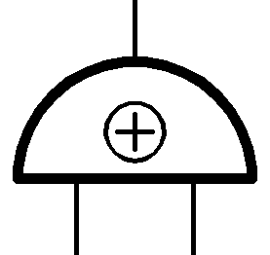
How to Compute Arbitrary Functions
For us, programs = functions = Boolean circuits with XOR ($+ mod 2$) and AND ($× mod 2$) gates.
$$Enc({(x_{1}+x_{2})x}_{3}x_{4})$$
X
$$Enc(x_{1}+x_{2})$$
$$Enc(x_{3}x_{4})$$
X
+
$$Enc(x_{3})$$
$$Enc(x_{4})$$
$$Enc(x_{2})$$
$$Enc(x_{1})$$
Takeaway: If you can compute XOR and AND on encrypted bits, you can compute everything.

Slide 12
How to Compute Arbitrary Functions
For us, programs = functions = Boolean circuits with XOR ($+ mod 2$) and AND ($× mod 2$) gates.
$$Enc({(x_{1}+x_{2})x}_{3}x_{4})$$
X
$$Enc(x_{1}+x_{2})$$
$$Enc(x_{3}x_{4})$$
X
+
$$Enc(x_{3})$$
$$Enc(x_{4})$$
$$Enc(x_{2})$$
$$Enc(x_{1})$$
We already know how to add (XOR), can we multiply?? Next lecture…

Slide 13
Homomorphic Encryption: Syntax
(can be either secret-key or public-key enc)
4-tuple of PPT algorithms $(Gen,Enc,Dec,Eval)$ s.t.
$\left(sk,ek\right)←Gen\left(1^{n}\right).$
PPT Key generation algorithm generates a secret key as well as a (public) evaluation key.
$c←Enc\left(sk,m\right).$
Encryption algorithm uses the secret key to encrypt message $m$.
$c′←Eval\left(ek,f,c\right).$
Homomorphic evaluation algorithm uses the evaluation key to produce an “evaluated ciphertext” $c′$.
$m←Dec\left(sk,c\right).$
Decryption algorithm uses the secret key to decrypt ciphertext $c$.

Slide 14

Homomorphic Encryption: Correctness
$Dec(sk,Eval\left(ek,f,Enc(x))\right)=f(x).$
Plaintext world
$$x$$
$$f(x)$$
$${Enc}_{pk}$$
$${Dec}_{sk}$$
$$c$$
$$c′$$
$${Eval}_{f}$$
Ciphertext world

Slide 15
Homomorphic Encryption: Security
Input: x
Function: f
Enc(sk,x)
$$x$$
Enc(f(x))
Client
Server (the Cloud)
Security against the “curious cloud” = standard IND-security of secret-key encryption
Key Point: Eval is an entirely public algorithm with public inputs.

Slide 16
Here is a homomorphic encryption scheme…
$\left(sk,−\right)←Gen\left(1^{n}\right).$
Use any old secret key enc scheme.
$c←Enc\left(sk,m\right).$
Just the secret key encryption algorithm…
$c′←Eval\left(ek,f,c\right).$
Output $c′$ = $c || f$. So Eval is basically the identity function!!
$m←Dec\left(sk,c′\right).$
Parse $c^{′}=c||f$ as a ciphertext concatenated with a function description. Decrypt $c$ and compute the function $f$.
This is correct and it is IND-secure.

Slide 17
Homomorphic Encryption: Compactness
The size (bit-length) of the evaluated ciphertext is independent of the complexity of the evaluated function.
A Relaxation: The size (bit-length) of the evaluated ciphertext and the runtime of the decryption depends sublinearly on the complexity of the evaluated function.

Slide 18
Big Picture: Two Steps to FHE
Leveled Secret-key Homomorphic Encryption:
Evaluate circuits of a-priori bounded depth d
“you give me a depth bound d, I will give you a homomorphic scheme that handles depth-d circuits…”
Bootstrapping Theorem:
From “circular secure” Leveled FHE to Pure FHE (at the cost of an additional assumption)
“I will give you homomorphic scheme that handles circuits of ANY size/depth”
Notes:
n is a security parameter

Slide 19
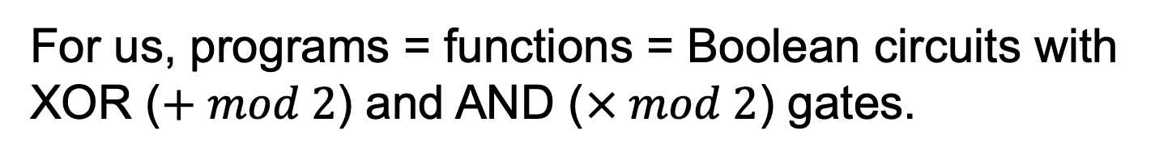
How to Compute Arbitrary Functions
For us, programs = functions = Boolean circuits with XOR ($+ mod 2$) and AND ($× mod 2$) gates.
$$Enc({(x_{1}+x_{2})x}_{3}x_{4})$$
X
$$Enc(x_{1}+x_{2})$$
$$Enc(x_{3}x_{4})$$
X
+
$$Enc(x_{3})$$
$$Enc(x_{4})$$
$$Enc(x_{2})$$
$$Enc(x_{1})$$
Takeaway: If you can compute XOR and AND on encrypted bits, you can compute everything.

Slide 20
How to Compute Arbitrary Functions
For us, programs = functions = Boolean circuits with XOR ($+ mod 2$) and AND ($× mod 2$) gates.
$$Enc({(x_{1}+x_{2})x}_{3}x_{4})$$
X
$$Enc(x_{1}+x_{2})$$
$$Enc(x_{3}x_{4})$$
X
+
$$Enc(x_{3})$$
$$Enc(x_{4})$$
$$Enc(x_{2})$$
$$Enc(x_{1})$$
We already know how to add (XOR), can we multiply??

Slide 21

New (Secret-key) Encryption: Take 1
Private key: a vector s ${∈Z}_{q}^{n}$
Private-key Encryption of a bit $m∈\{0,1\}$:
C = $\left[\begin{matrix}A \\ sA\end{matrix}\right]+m I$
($A$is random (n) X (n+1) matrix)
Decryption:
[s || -1] C = m [s || -1] (mod q)
= Eigenvector
Ciphertext matrix
Message
= Eigenvalue
Priv key
🙁 INSECURE! Easy to solve linear equations.

Slide 22
New (Secret-key) Encryption: Take 1
t . C = m . t (mod q)
t = [s || -1]
Homomorphic addition: C₁ + C₂
t is an eigenvector of C₁+C₂ with eigenvalue m₁+m₂
Homomorphic multiplication: C₁C₂
t is an eigenvector of C₁C₂ with eigenvalue m₁m₂
Proof: t . C₁ C₂ = (m₁ . t) . C₂ = m₁ . m₂ . t
But, remember, the scheme is insecure?
Key idea: fix insecurity while retaining homomorphism.

Slide 23


New (Secret-key) Encryption: Take 2
Private key: a vector s ${∈Z}_{q}^{n}$
Private-key Encryption of a bit $m∈\{0,1\}$:
C = $\left[\begin{matrix}A \\ sA+e\end{matrix}\right]+m I$
($A$is random (n+1) X n matrix)
Decryption:
[s || -1] C ≈ m [s || -1] (mod q)
Priv key
Ciphertext matrix
Message
= Approx Eigenvalue
= Approx Eigenvector
🙂 CPA-secure by LWE.

Slide 24

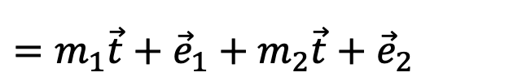

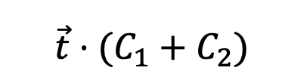
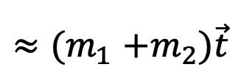
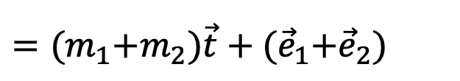
New (Secret-key) Encryption: Take 2
t . C = m . t + e (mod q)
t = [s || -1]
Homomorphic addition: C₁ + C₂
$${\vec{t}⋅(C}_{1}+C_{2})$$
$$={\vec{t}C}_{1}+{\vec{t}C}_{2}$$
$=m_{1}\vec{t}+{\vec{e}}_{1}+m_{2}\vec{t}+{\vec{e}}_{2}$
Noise grows a little
$={(m}_{1}+m_{2})\vec{t}+{(\vec{e}}_{1}+{\vec{e}}_{2})$
$${≈(m}_{1}+m_{2})\vec{t}$$

Slide 25
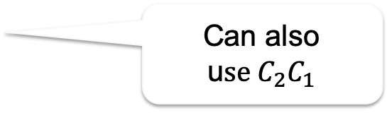
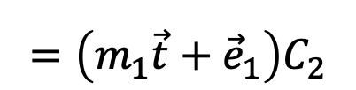
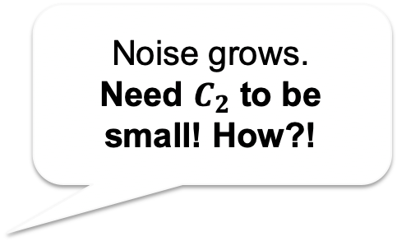
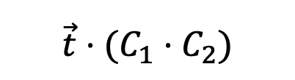

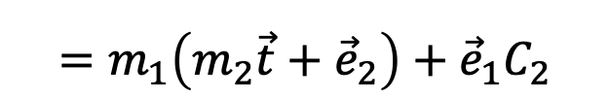


New (Secret-key) Encryption: Take 2
t . C = m . t + e (mod q)
t = [s || -1]
Homomorphic multiplication: C₁ C₂
Can also u$se C_{2}C_{1}$
$${\vec{t}⋅(C}_{1}⋅C_{2})$$
$$=\left(m_{1}\vec{t}+{\vec{e}}_{1}\right)C_{2}$$
Noise grows.
Need $C_{2}$ to be small! How?!
$$=m_{1}{\vec{t}C}_{2}+{\vec{e}}_{1}C_{2}$$
$$=m_{1}\left(m_{2}\vec{t}+{\vec{e}}_{2}\right)+{\vec{e}}_{1}C_{2}$$
$$=m_{1}m_{2}\vec{t}+m_{1}{\vec{e}}_{2}+{\vec{e}}_{1}C_{2}$$
$${\vec{e}}_{mult}$$

Slide 26
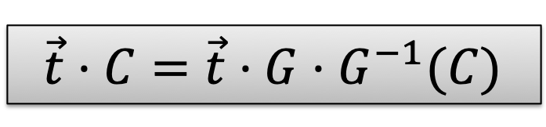
Aside: Binary Decomposition
Break each entry in $C$ into its binary representation
$bits\left(C\right)=\left[\begin{matrix}\begin{matrix}0 \\ 1 \\ 1\end{matrix} & \begin{matrix}1 \\ 0 \\ 1\end{matrix} \\ \begin{matrix}0 \\ 0 \\ 1\end{matrix} & \begin{matrix}1 \\ 0 \\ 0\end{matrix}\end{matrix}\right] (mod 8)$
$$C=\left[\begin{matrix}3 & 5 \\ 1 & 4\end{matrix}\right] (mod 8)$$
⇒
Small entries like we wanted!
Consider the “reverse” operation:
$$k\log{q}$$
$$\left[\begin{matrix}4 2 1 & 0 0 0 \\ 0 0 0 & 4 2 1\end{matrix}\right]⋅bits\left(C\right)=C$$
⇒
$$\vec{t}⋅C=\vec{t}⋅G⋅G^{−1}(C)$$
$$k$$
$$G$$
Denote: $G^{−1}\left(C\right)$ which has “small” entries

Slide 27


New (Secret-key) Encryption: Take 3
Private key: a vector s ${∈Z}_{q}^{n}$
Private-key Encryption of a bit $m∈\{0,1\}$:
C = $\left[\begin{matrix}A \\ sA+e\end{matrix}\right]+m G$
($A$is random (n+1) X n log q matrix)
Decryption:
[s || -1] C ≈ m [s || -1] G (mod q)
Priv key
Ciphertext matrix
Message
= Approx “Eigenvalue”
= Approx Eigenvector
🙂 Still CPA-secure by LWE.

Slide 28

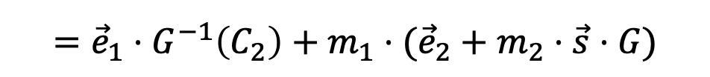
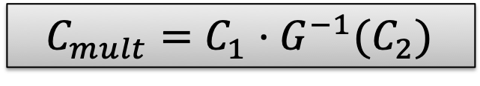



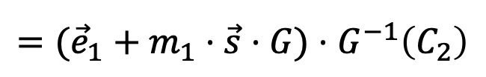
New (Secret-key) Encryption: Take 3
t . C = m . t . G + e (mod q)
t = [s || -1]
$$C_{mult}=C_{1}⋅G^{−1}(C_{2})$$
Homomorphic multiplication:
$$\vec{s}⋅C_{1}⋅G^{−1}\left(C_{2}\right)$$
$$=({\vec{e}}_{1}+m_{1}⋅\vec{s}⋅G)⋅G^{−1}\left(C_{2}\right)$$
$$={\vec{e}}_{1}⋅G^{−1}\left(C_{2}\right)+m_{1}⋅\vec{s}⋅G⋅G^{−1}\left(C_{2}\right)$$
$$={\vec{e}}_{1}⋅G^{−1}\left(C_{2}\right)+m_{1}⋅\vec{s}⋅C_{2}$$
$$={\vec{e}}_{1}⋅G^{−1}\left(C_{2}\right)+m_{1}⋅({\vec{e}}_{2}+m_{2}⋅\vec{s}⋅G)$$
$$=\left({\vec{e}}_{1}⋅G^{−1}\left(C_{2}\right)+m_{1}⋅{\vec{e}}_{2}\right)+m_{1}m_{2}⋅\vec{s}⋅G$$
$${\vec{e}}_{mult}$$
$$\left\|{\vec{e}}_{mult}\right\|≤n log q⋅\left\|{\vec{e}}_{1}\right\|+m_{1}⋅\left\|{\vec{e}}_{2}\right\|≤\left(n log q+1\right)⋅\max{\{\left\|{\vec{e}}_{1}\right\|,\left\|{\vec{e}}_{2}\right\|\}}$$

Slide 29
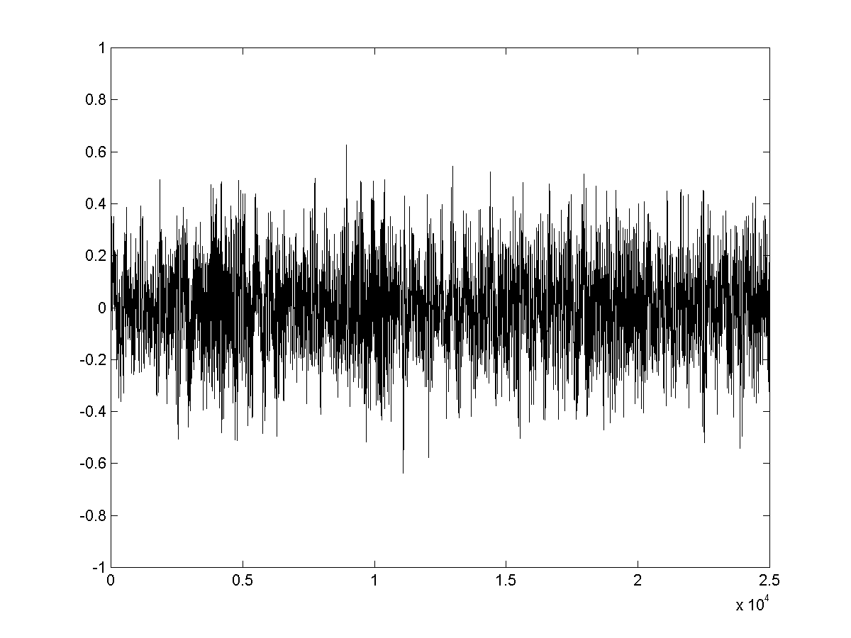

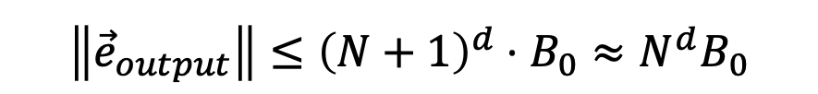


Homomorphic Circuit Evaluation
$$Let N=n log q$$
Noise grows during homomorphic eval
Depth $d$
$${\vec{e}}_{output}$$
$$\left\|{\vec{e}}_{output}\right\|≤{\left(N+1\right)}^{d}⋅B_{0}≈N^{d}B_{0}$$
⇒ Decryptable if $q≫N^{d}B_{0}$.
(for security: $q≪2^{n}$)
So this can support $d≈n^{0.99}$
…
$$\left\|{\vec{e}}_{i+1}\right\|≤(N+1)\left\|{\vec{e}}_{i}\right\|$$
$$\left\|{\vec{e}}_{input}\right\|≤B_{0}$$
$${\vec{e}}_{input}$$

Slide 30
Big Picture: Two Steps to FHE
Leveled Secret-key Homomorphic Encryption:
Evaluate circuits of a-priori bounded depth d
“you give me a depth bound d, I will give you a homomorphic scheme that handles depth-d circuits…”
Bootstrapping Theorem:
From “circular secure” Leveled FHE to Pure FHE (at the cost of an additional assumption)
“I will give you homomorphic scheme that handles circuits of ANY size/depth”
Notes:
n is a security parameter

Slide 31

From Leveled to Fully Homomorphic
Input: x
Function: f
Enc(sk,x)
$$x$$
Client
Server (the Cloud)
The cloud keeps homomorphically computing, but after a certain depth, the ciphertext is too noisy to be useful. What to do?
Idea: “Bootstrapping”!

Slide 32


Bootstrapping: How
But the evaluator/cloud
does not have SK!
“Best Possible” Noise Reduction
= Decryption!
m
“Noiseless ciphertext”
$$Dec(∙,CT)$$
“Very Noisy” ciphertext
SK
Decryption Circuit

Slide 33


Bootstrapping, Concretely
Next Best
= Homomorphic Decryption!
*
Assume server knows ek = Enc_{SK}(SK).
(OK assuming the scheme is “circular secure”)
Enc_{SK}(m)
$$Dec(∙,CT)$$
Enc_{SK}(SK)

Slide 34
Bootstrapping, Concretely
Next Best
= Homomorphic Decryption!
B_{dec} Independent of B_{input}
*
Assume server knows ek = Enc_{SK}(SK).
(OK assuming the scheme is “circular secure”)
Enc_{SK}(m)
Noise = B_{dec}
$$Dec(∙,CT)$$
Noise = B_{input}
Enc_{SK}(SK)

Slide 35
Wrap Up: Bootstrapping
Assume Circular Security:
Function f
Evaluation key is Enc_{SK}(SK)
g

Slide 36


Wrap Up: Bootstrapping
Assume Circular Security:
Function f
Evaluation key is Enc_{SK}(SK)
g
Each Gate g → Gadget G:
g(a,b)
g
g(a,b)
a
b
g
$$Dec(∙,c_{a})$$
$$Dec(∙,c_{b})$$
a
b
sk
sk

Slide 37
Wrap Up: Bootstrapping
Assume Circular Security:
Function f
Evaluation key is Enc_{SK}(SK)
g
Each Gate g → Gadget G:
Enc(g(a,b))
g
g(a,b)
a
b
g
$$Dec(∙,c_{a})$$
$$Dec(∙,c_{b})$$
a
b
Enc(sk)
Enc(sk)

Slide 38

Major Open Problem
Is circular security necessary?
(or)
Fully Homomorphic Encryption from LWE

Slide 39














Subsequent Work: FHE in Practice
[Gentry-Halevi-Smart’12]: “FHE with Polylog Overhead”
$$x_{1}$$
$$x_{2}$$
$$x_{3}$$
$$…$$
$$x_{n}$$
Homomorphic computations “in place”.
$$y_{1}$$
$$y_{2}$$
$$y_{3}$$
$$…$$
$$y_{n}$$
SIMD computation + slot permutations (automorphisms)
“HELib”:
The first homomorphic encryption library.
SEAL
PALISADE
HEEAN
FHEW
TFHE
Concrete
NFLLib
$$Λ∘λ$$
Lattigo
cuFHE

Slide 40












FHE Bounty #1:
We have “leveled” FHE from the LWE assumption
$${Enc}_{{pk}_{2}}({sk}_{1})$$
$${Enc}_{{pk}_{3}}({sk}_{2})$$
$${Enc}_{{pk}_{4}}({sk}_{3})$$
$$…$$
$${Enc}_{{pk}_{L}}({sk}_{L−1})$$
$${sk}_{1}$$
$${sk}_{2}$$
$${sk}_{3}$$
$${sk}_{L}$$
and “unbounded” FHE under a “circular secure” LWE assumption.
$${Enc}_{pk}(sk)$$
$$sk$$

Slide 41
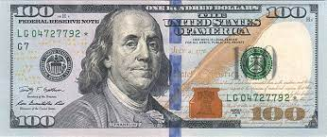
FHE Bounty #1: Why Circular Security?
Partial Answer:
[CLTV’15]: Unbounded FHE from indistinguishability obfuscation (IO).
+ [JLS’22]: Unbounded FHE from LPN + PRG in NC0 + Bilinear maps.
(Unbounded) FHE from LWE.

Slide 42

FHE Bounty #2:
Why Lattices/LWE?
FHE from the Diffie-Hellman assumption.

Slide 43


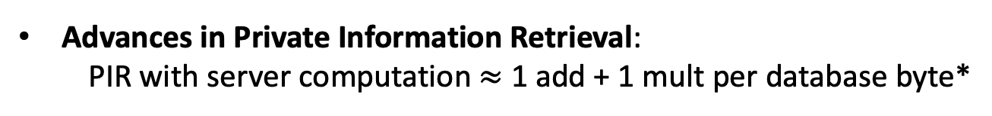
FHE Bounty #3: FHE $≈$ as efficient as plaintext computation.
Advances in Rate-1 FHE: FHE with $≈0$ communication overhead
[GH’19, BDGM’19]
Advances in Private Information Retrieval:
PIR with server computation $≈$ 1 add + 1 mult per database byte*
[CHHV’22]
If you solve truly practical FHE, you don’t need my $100(0). ☺

Slide 44
Unresolved Issue 1: Function Privacy
Input: x
Function: f
Enc(sk,x)
$$x$$
Enc(sk, f(x))
Client
Server (the Cloud)
Security against the curious cloud = standard IND-security of secret-key encryption
Security against a curious user?

Slide 45
Unresolved Issue 1: Function Privacy
Input: x
Function: f
Enc(sk,x)
$$x$$
Enc(f(x))
Client
Server (the Cloud)
Function Privacy: Enc(f(x)) reveals no more information (about f) than f(x).
Function privacy via noise-flooding (on the board)

Slide 46

Unresolved Issue 2: Malicious Client
Input: x
Function: f
Enc(sk,x)
$$x$$
Enc(f(x))
Client
Server (the Cloud)
Idea: Use zero knowledge proofs.

Slide 47
Unresolved Issue 3: Malicious Cloud
Input: x
Function: f
Enc(sk,x)
$$x$$
Enc(f(x))
Client
Server (the Cloud)
Idea: “Succinct Interactive Proofs”. [Kilian92]

