Slide 1
MIT 6.875
Foundations of Cryptography
Lecture 14

Slide 2
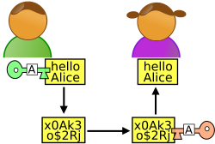
Beyond Secure Communication
x
y
Alice
Bob
Much more than communicating securely.
Complex Interactions: proofs, computations, games.
Complex Adversaries: Alice or Bob, adaptively chosen.
Complex Properties: Correctness, Privacy, Fairness.
Many Parties: this class, MIT, the internet.

Slide 3
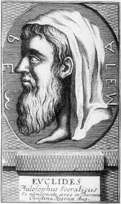
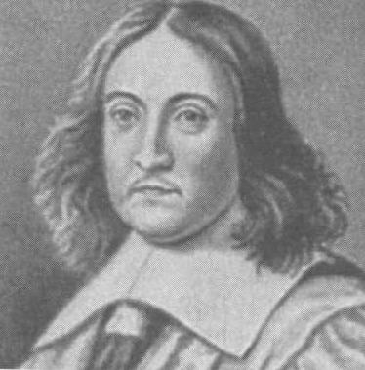
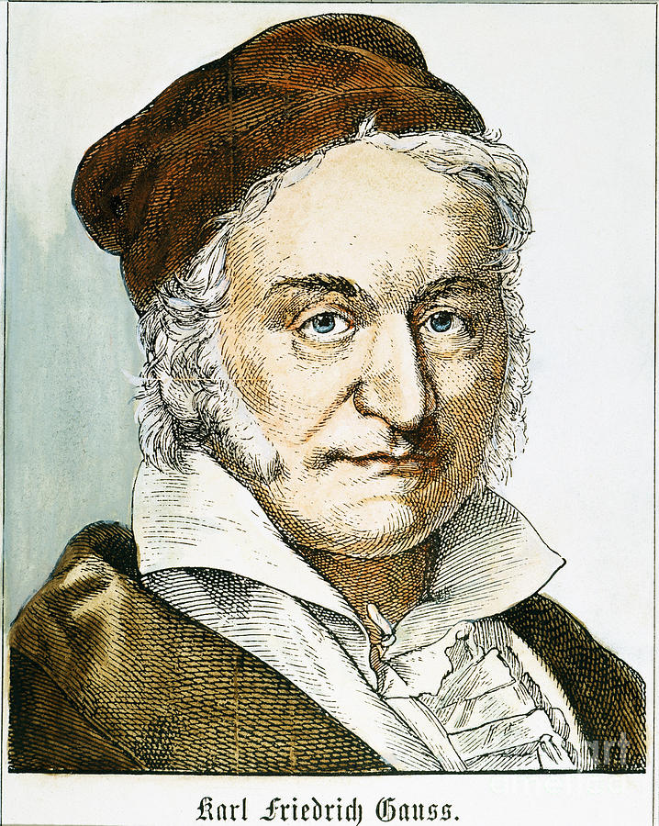
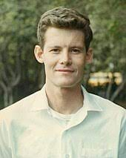
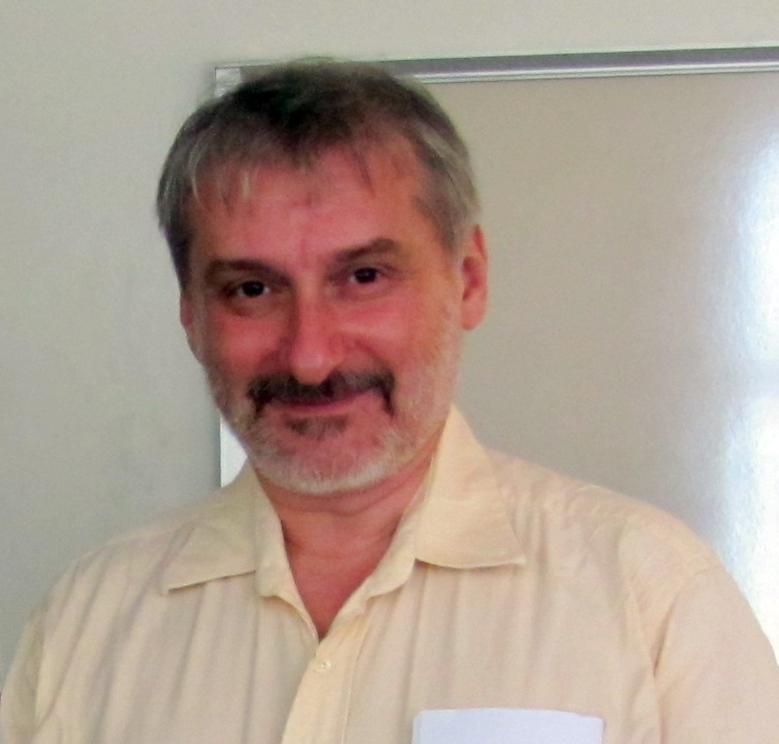
Classical Proofs
Steve Cook
Leonid Levin
Prover writes down a string (proof); Verifier checks.
Axiom 1
Axiom 2
Axiom 1⇒A
A⇒B
QED
a²+b²
a
b

Slide 4
Proofs
Claim/Theorem
accept/reject
proof
Prover
Verifier

Slide 5

Efficiently Verifiable Proofs: $𝓝𝓟$
Claim/Theorem
accept/reject
proof
Prover
Verifier
Works hard
Polynomial-time

Slide 6

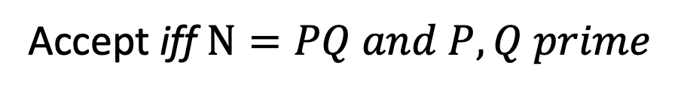
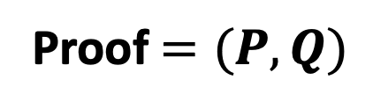
Theorem: $N$ is a product of two prime numbers
Proof $=(P,Q)$
Verifier
Prover
Accept iff $N=PQ and P, Q prime$

Slide 7
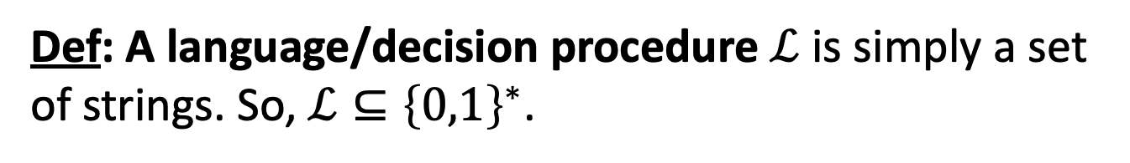
Efficiently Verifiable Proofs: $𝓝𝓟$
Claim/Theorem
accept/reject
proof
Prover
Verifier
Works hard
Polynomial-time
Def: A language/decision procedure $ℒ$ is simply a set of strings. So, $ℒ⊆{\left\{0,1\right\}}^{∗}$.

Slide 8
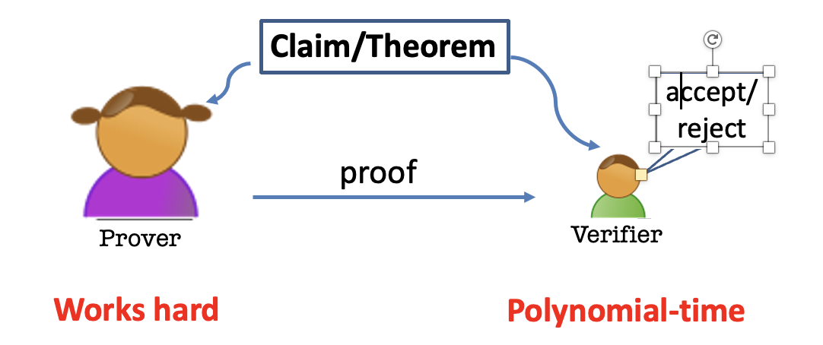
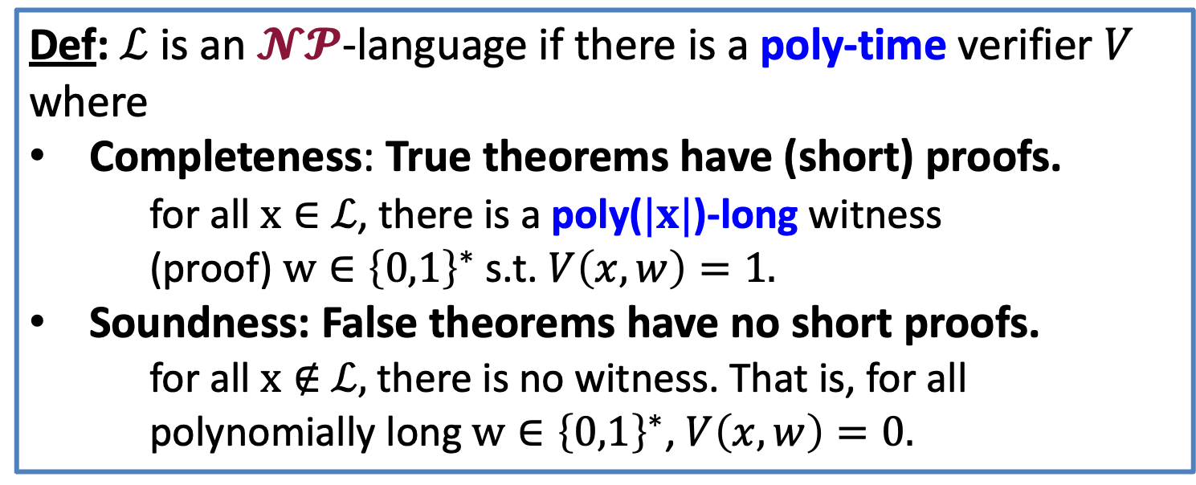
Efficiently Verifiable Proofs: $𝓝𝓟$
Def: $ℒ$ is an $𝓝𝓟$-language if there is a poly-time verifier $V$ where
Completeness: True theorems have (short) proofs.
for all $x∈$ $ℒ$, there is a poly($|x|$)-long witness (proof) $w∈{\left\{0,1\right\}}^{∗}$ s.t. $V\left(x,w\right)=1.$
Soundness: False theorems have no short proofs.
for all $x∉$ $ℒ,$there is no witness. That is, for all polynomially long $w∈{\left\{0,1\right\}}^{∗}$, $V\left(x,w\right)=0.$

Slide 9
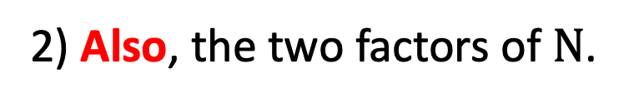
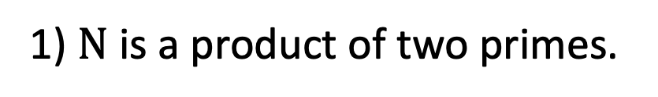
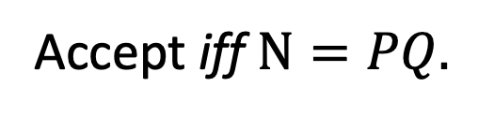
Theorem: $N$ is a product of two prime numbers
Proof $=(P,Q)$
Verifier
Prover
Accept iff $N=PQ.$
After interaction, Bob the Verifier knows:
1) $N$ is a product of two primes.
2) Also, the two factors of $N$.

Slide 10


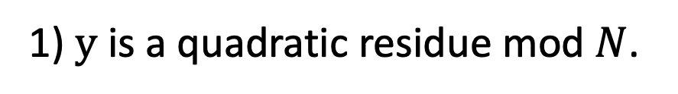
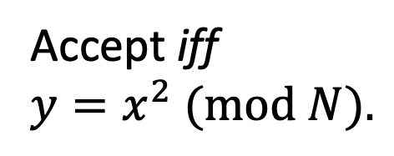
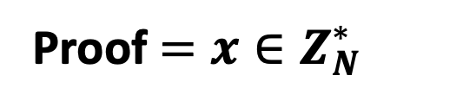
Theorem: $y$ is a quadratic residue mod $N$
Proof $=x∈Z_{N}^{∗}$
Verifier
Prover
Accept iff
$y=x^{2} (mod N).$
After interaction, Bob the Verifier knows:
1) $y$ is a quadratic residue mod $N$.
2) Also, the square root of $y$.

Slide 11
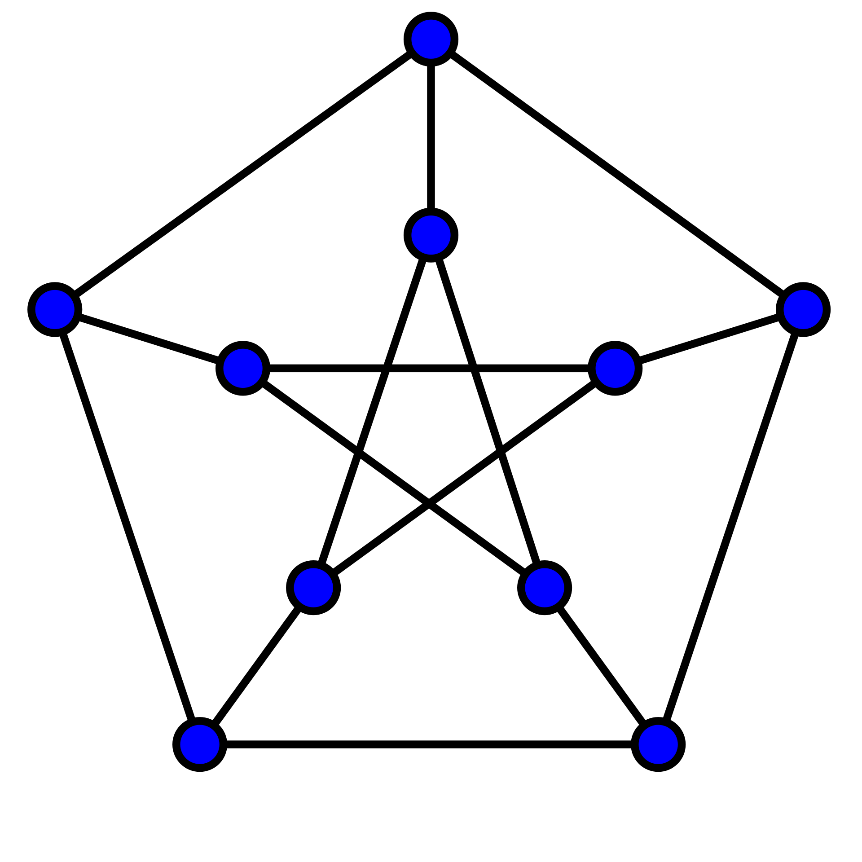
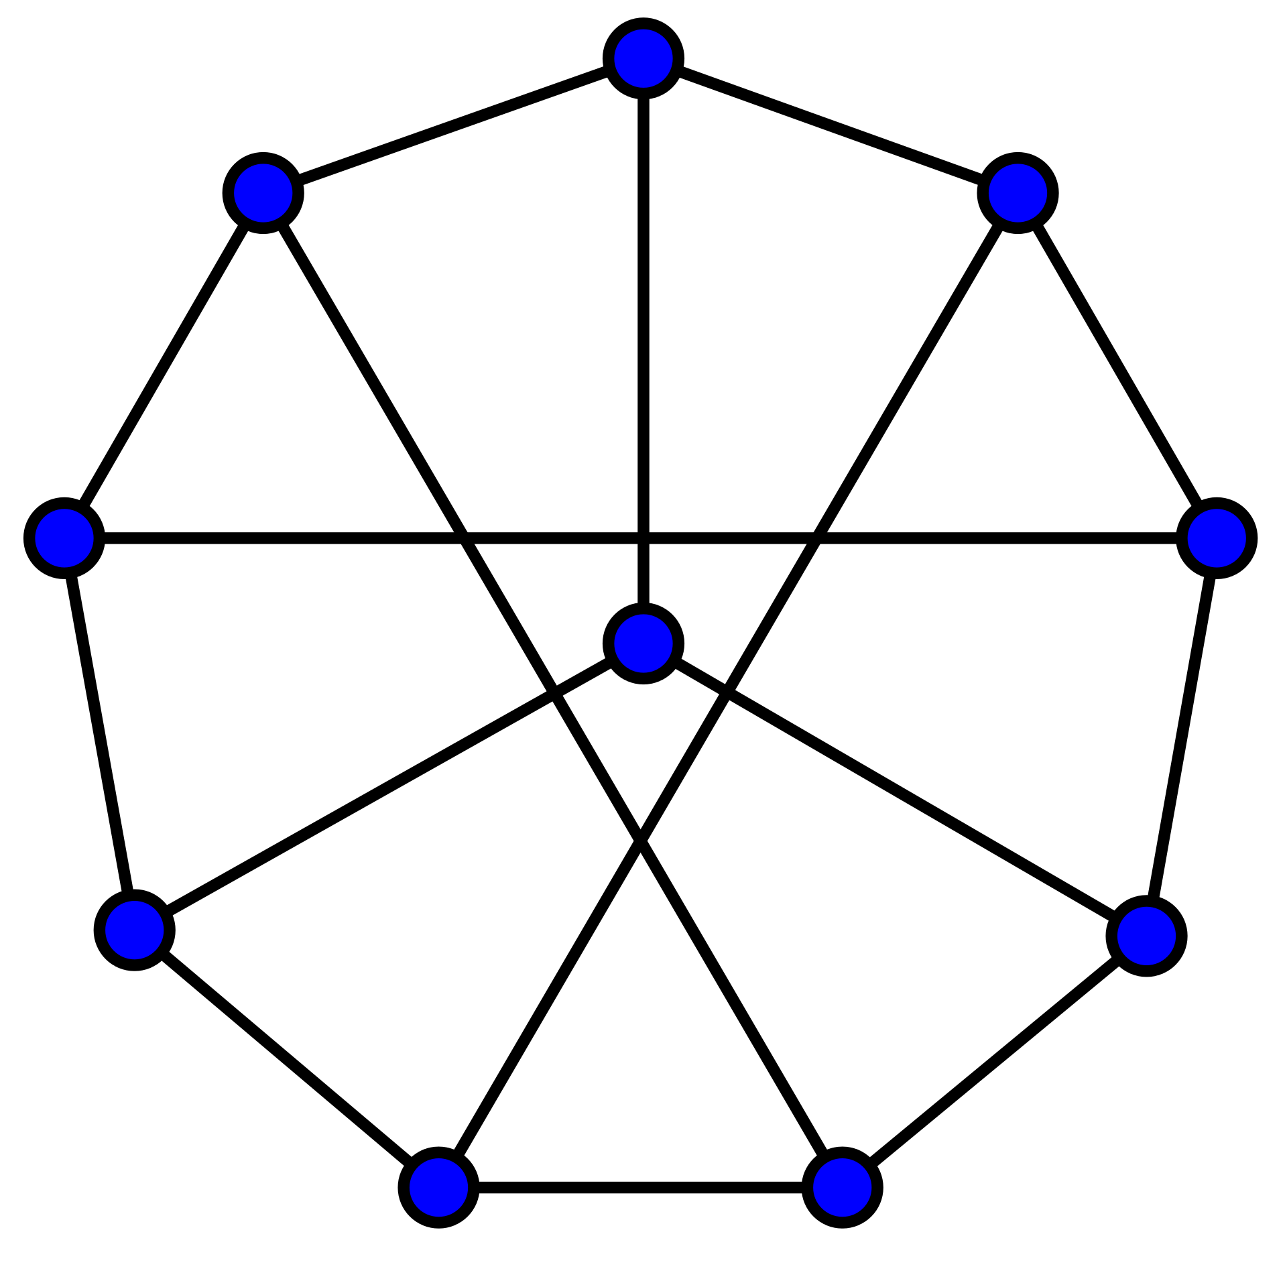
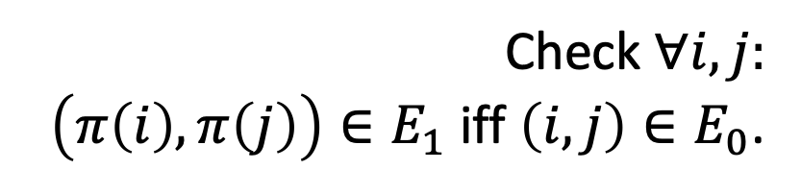

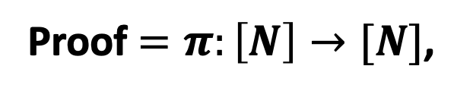
Theorem: Graphs $G_{0}$ and $G_{1}$ are isomorphic.
1
1
2
6
2
6
5
7
10
3
5
8
8
9
4
10
3
4
9
7
Proof $=π:\left[N\right]→[N]$,
the isomorphism
Verifier
Prover
Check $∀i,j:$
$\left(π\left(i\right),π\left(j\right)\right)∈E_{1}$ iff $\left(i,j\right)∈E_{0}$.

Slide 12
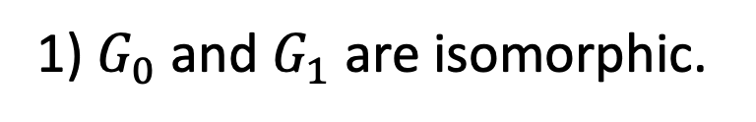
Theorem: Graphs $G_{0}$ and $G_{1}$ are isomorphic.
1
1
2
6
2
6
5
7
10
3
8
5
8
9
4
10
3
4
9
7
Proof $=π:\left[N\right]→[N]$,
the isomorphism
Verifier
Prover
After interaction, Bob the Verifier knows:
1) $G_{0}$ and $G_{1}$ are isomorphic.
2) Also, the isomorphism.

Slide 13
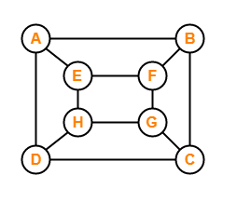

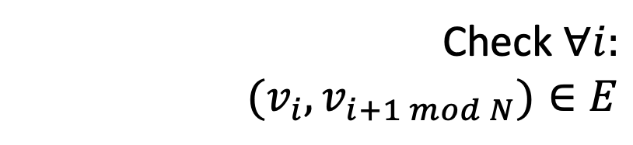
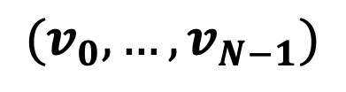
Theorem: Graphs $G$ has a Hamiltonian cycle.
Proof = Hamiltonian cycle
$$(v_{0},…,v_{N−1})$$
Verifier
Prover
Check $∀i:$
$$(v_{i},v_{i+1 mod N})∈E$$

Slide 14
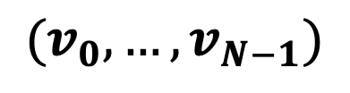
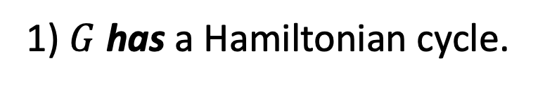
Theorem: Graphs $G$ has a Hamiltonian cycle.
Proof = Hamiltonian cycle
$$(v_{0},…,v_{N−1})$$
Verifier
Prover
After interaction, Bob the Verifier knows:
1) $G$ has a Hamiltonian cycle.
2) Also, the Hamiltonian cycle itself.

Slide 15
Theorem: Graphs $G$ has a Hamiltonian cycle.
Proof = Hamiltonian cycle
$$(v_{0},…,v_{N−1})$$
Verifier
Prover
NP-Complete Problem:
Every one of the other problems can be reduced to it

Slide 16
Theorem: $y$ is a quadratic residue mod $N$
Proof $=x∈Z_{N}^{∗}$
Verifier
Prover
Accept iff
$y=x^{2} (mod N).$
After interaction, Bob the Verifier knows:
1) $y$ is a quadratic residue mod $N$.
2) Also, the square root of $y$.

Slide 17
Is there any other way?

Slide 18
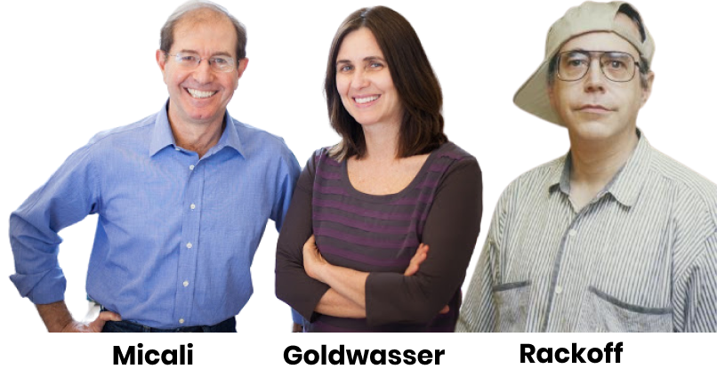
Zero Knowledge Proofs
“I will prove to you that I could’ve sent you a proof if I felt like it.”
Prover

Slide 19
Zero Knowledge Proofs
“I will not give you the square root, but I will prove to you that I could provide one if I wanted to.”
Prover

Slide 20
Two (Necessary) New Ingredients
1. Interaction: Rather than passively reading the proof, the verifier engages in a conversation with the prover.
2. Randomness: The verifier is randomized and can make a mistake with a (exponentially small) probability.

Slide 21
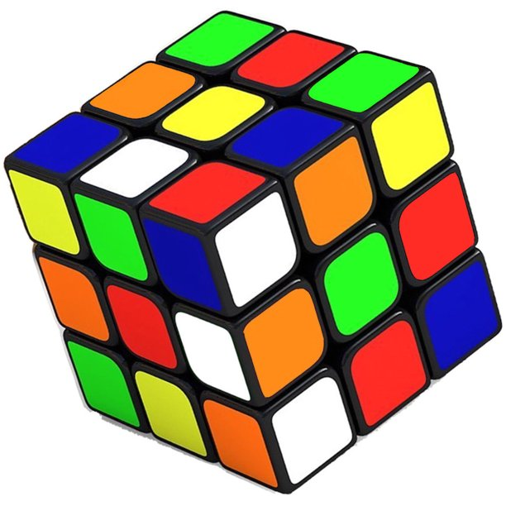

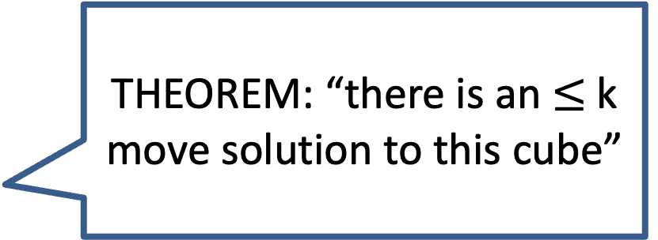
Here is the idea.
THEOREM: “there is an $≤$k move solution to this cube”
Prover

Slide 22
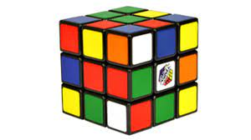
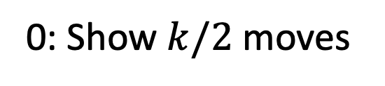
Here is the idea.
“Random” config
Challenge (0 or 1)
0: Show $k/2$ moves
Verifier
Prover

Slide 23
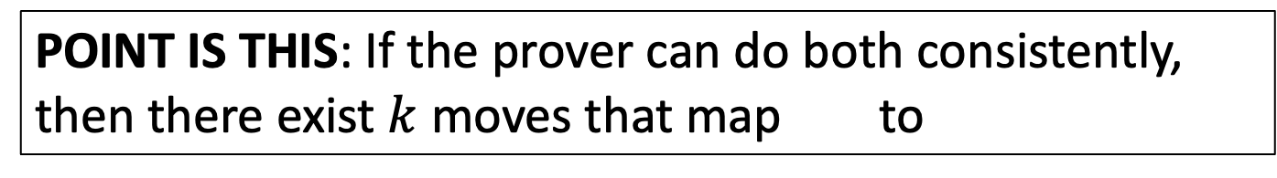
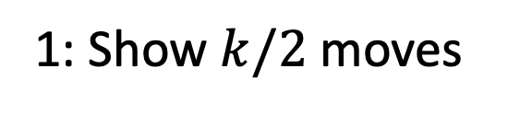
Here is the idea.
“Random” config
Challenge (0 or 1)
1: Show $k/2$ moves
Verifier
Prover
POINT IS THIS: If the prover can do both consistently, then there exist $k$ moves that map to

Slide 24






Interactive Proofs for a Language $ℒ$
Claim/Theorem
$$a_{1}$$
accept/reject
$$q_{1}$$
$$a_{2}$$
$$q_{2}$$
Verifier
Prover
$$…$$
Probabilistic Polynomial-time
Comp. Unbounded

Slide 25





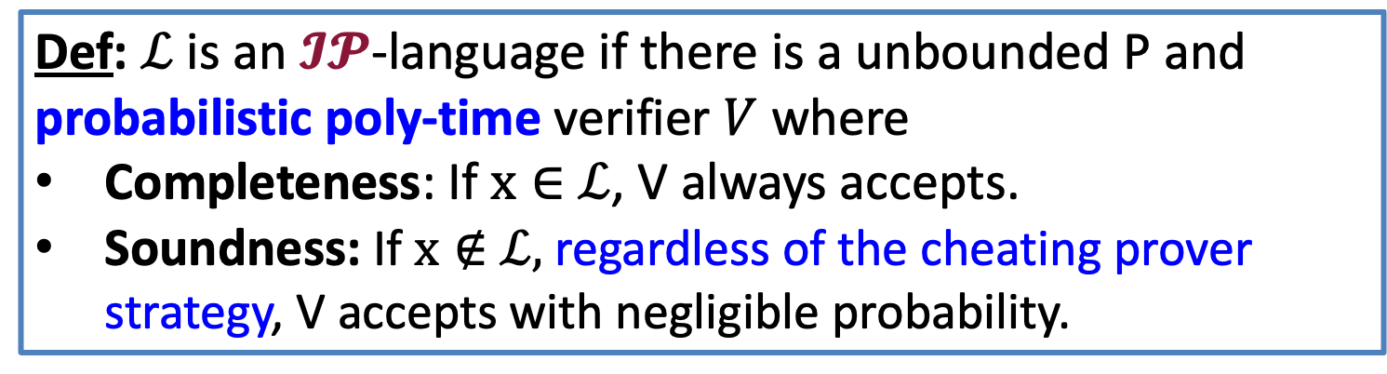
Interactive Proofs for a Language $ℒ$
Claim/Theorem
$$a_{1}$$
accept/reject
$$q_{1}$$
$$a_{2}$$
$$…$$
Verifier
Prover
Def: $ℒ$ is an $𝓘𝓟$-language if there is a unbounded P and probabilistic poly-time verifier $V$ where
Completeness: If $x∈$ $ℒ$, V always accepts.
Soundness: If $x∉$ $ℒ,$ regardless of the cheating prover strategy, V accepts with negligible probability.

Slide 26
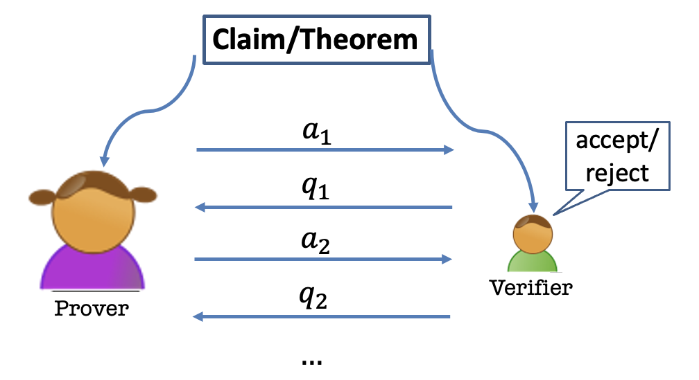
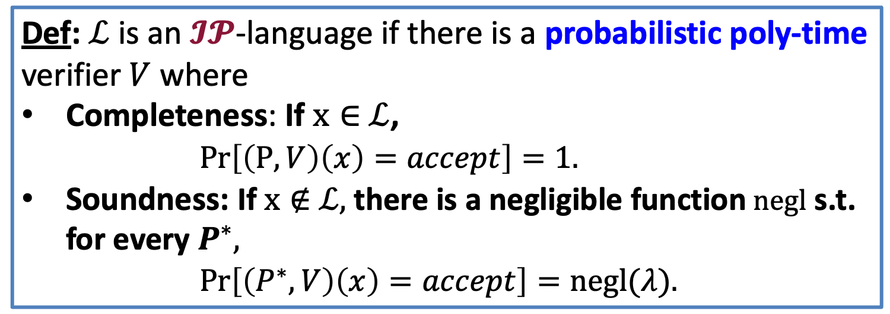
Interactive Proofs for a Language $ℒ$
Def: $ℒ$ is an $𝓘𝓟$-language if there is a probabilistic poly-time verifier $V$ where
Completeness: If $x∈$ $ℒ$,
$Pr\left[\left(P,V\right)\left(x\right)=accept\right]=1.$
Soundness: If $x∉$ $ℒ,$ there is a negligible function $negl$ s.t. for every $P^{∗},$
$Pr\left[\left(P^{∗},V\right)\left(x\right)=accept\right]=negl(λ).$

Slide 27
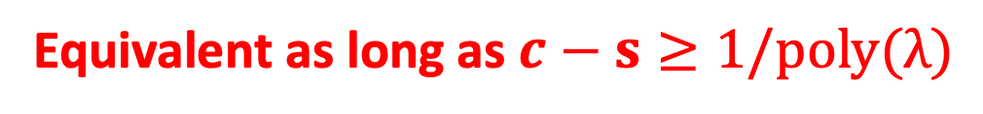
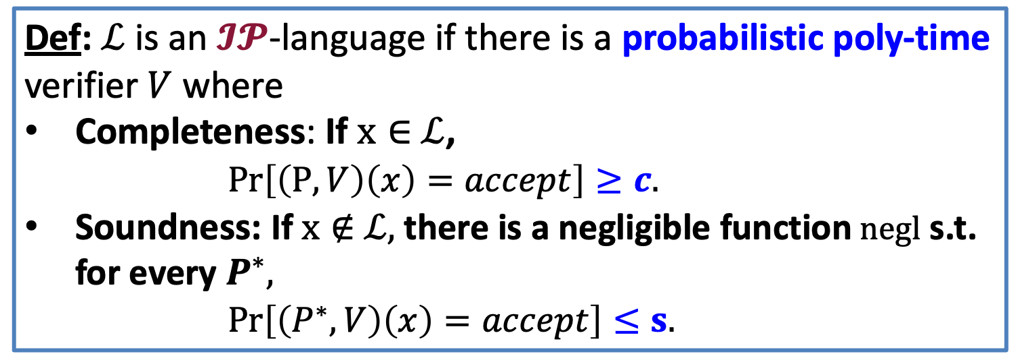
Interactive Proofs for a Language $ℒ$
Def: $ℒ$ is an $𝓘𝓟$-language if there is a probabilistic poly-time verifier $V$ where
Completeness: If $x∈$ $ℒ$,
$Pr\left[\left(P,V\right)\left(x\right)=accept\right]≥c.$
Soundness: If $x∉$ $ℒ,$ there is a negligible function $negl$ s.t. for every $P^{∗},$
$Pr\left[\left(P^{∗},V\right)\left(x\right)=accept\right]≤s.$
Equivalent as long as $c−s≥1/poly(λ)$

Slide 28
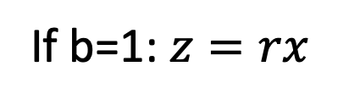
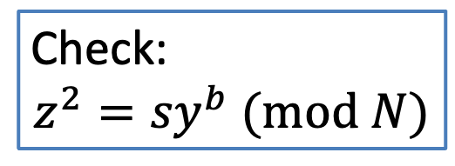
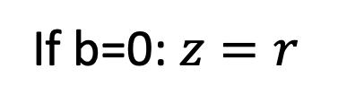



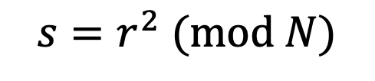
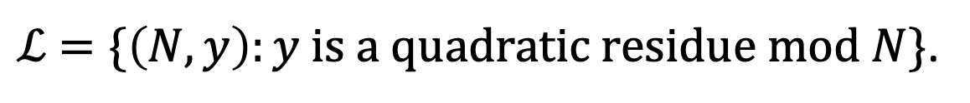
Interactive Proof for QR
$ℒ$ $=\{\left(N,y\right):y is a quadratic residue mod N\}$.
$${s=r}^{2} (mod N)$$
$$\left(N,y\right)$$
$$\left(N,y\right)$$
$$b←\{0,1\}$$
If b=0: $z=r$
Check:
$${z^{2}=sy}^{b} (mod N)$$
If b=1: $z=rx$

Slide 29
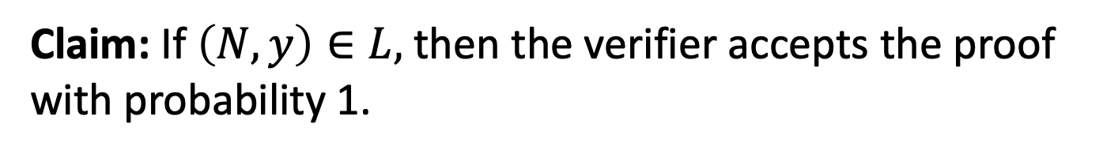
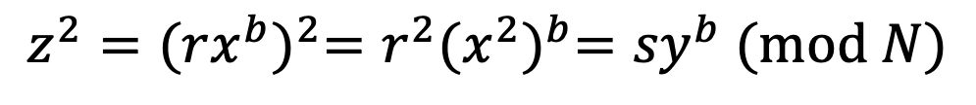
Completeness
Claim: If $\left(N,y\right)∈L,$ then the verifier accepts the proof with probability 1.
Proof:
$${z^{2}={(rx^{b})}^{2}=r^{2}{(x^{2})}^{b}=sy}^{b} (mod N)$$
So, the verifier’s check passes and he accepts.

Slide 30
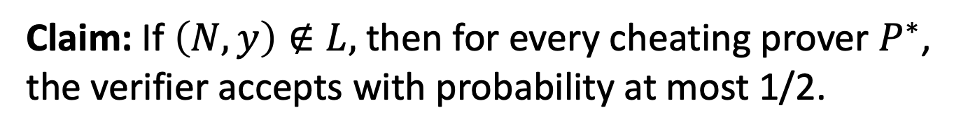
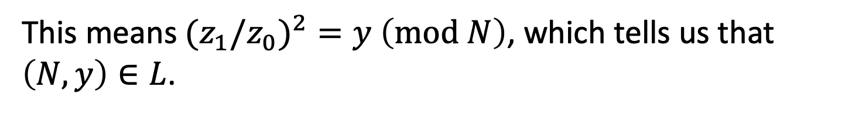
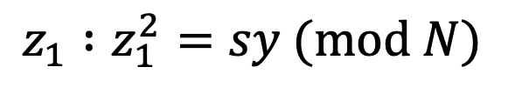
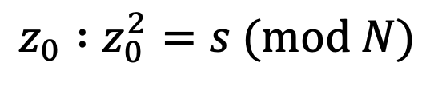
Soundness
Claim: If $\left(N,y\right)∉L,$ then for every cheating prover $P^{∗}$, the verifier accepts with probability at most 1/2.
Proof:
Suppose the verifier accepts with probability > 1/2.
Then, there is some $s∈Z_{N}^{∗}$ s.t. the prover produces
$$z_{0} :z_{0}^{2}=s (mod N)$$
$$z_{1} :z_{1}^{2}=sy (mod N)$$
This means${(z}_{1}/z_{0})^{2}=y$ $\left(mod N\right)$, which tells us that $\left(N,y\right)∈L$.

Slide 31








Interactive Proof for QR
$ℒ$ $=\{\left(N,y\right):y is a quadratic residue mod N\}$.
$$s_{i}=r_{i}^{2} (mod N)$$
$$\left(N,y\right)$$
$$\left(N,y\right)$$
$$b_{i}←\{0,1\}$$
If $b_{i}$=0: $z_{i}=r_{i}$
Check for all i:
$$z_{i}^{2}=s_{i}y^{b} (mod N)$$
If $b_{i}$=1:$z_{i}={xr}_{i}$
REPEAT sequentially $λ$ times.

Slide 32

Soundness
Claim: If $\left(N,y\right)∉L,$ then for every cheating prover $P^{∗}$, the verifier accepts with probability at most ${(\frac{1}{2})}^{λ}$.
Proof:
Exercise.

Slide 33
This is Zero-Knowledge.
But what does that mean?
$${s=r}^{2} (mod N)$$
$$\left(N,y\right)$$
$$\left(N,y\right)$$
$$b←\{0,1\}$$
If b=0: $z=r$
Check:
$${z^{2}=sy}^{b} (mod N)$$
If b=1: $z=rx$

Slide 34


How to Define Zero-Knowledge?
After the interaction, $V$ knows:
The theorem is true; and
A view of the interaction
(= transcript + coins of V)
$P$ gives zero knowledge to $V$:
When the theorem is true, the view gives V nothing that he couldn’t have obtained on his own without interacting with P.

Slide 35

How to Define Zero-Knowledge?
$(P,V)$ is zero-knowledge if $V$ can generate his VIEW of the interaction all by himself in probabilistic polynomial time.

Slide 36

How to Define Zero-Knowledge?
$(P,V)$ is zero-knowledge if $V$ can “simulate” his VIEW of the interaction all by himself in probabilistic polynomial time.

Slide 37








The Simulation Paradigm
PPT “simulator” $S$
$${sim}_{S}:$$
$$\left(s,b,z\right)$$
$$\left(N,y\right)$$
$${view}_{V}\left(P,V\right):$$
$Transcript= \left(s,b,z\right),$
Coins = $b$
$${view}_{V}\left(P,V\right):$$
$$\left(s,b,z\right)$$

Slide 38



Zero Knowledge: Definition
An Interactive Protocol (P,V) is zero-knowledge for a language $L$if there exists a PPT algorithm S (a simulator) such that for every $x∈L$, the following two distributions are indistinguishable:
1. ${view}_{V}(P,V)$
2. $S(x,1^{λ})$
(P,V) is a zero-knowledge interactive protocol if it is complete, sound and zero-knowledge.

Slide 39

Perfect Zero Knowledge: Definition
An Interactive Protocol (P,V) is perfect zero-knowledge for a language $L$if there exists a PPT algorithm S (a simulator) such that for every $x∈L$, the following two distributions are identical:
1. ${view}_{V}(P,V)$
2. $S(x,1^{λ})$
(P,V) is a zero-knowledge interactive protocol if it is complete, sound and zero-knowledge.

Slide 40



Statistical Zero Knowledge: Definition
An Interactive Protocol (P,V) is statistical zero-knowledge for a language $L$if there exists a PPT algorithm S (a simulator) such that for every $x∈L$, the following two distributions are statistically indistinguishable:
1. ${view}_{V}(P,V)$
2. $S(x,1^{λ})$
(P,V) is a zero-knowledge interactive protocol if it is complete, sound and zero-knowledge.

Slide 41

Computational Zero Knowledge: Definition
An Interactive Protocol (P,V) is computational zero-knowledge for a language $L$if there exists a PPT algorithm S (a simulator) such that for every $x∈L$, the following two distributions are computationally indistinguishable:
1. ${view}_{V}(P,V)$
2. $S(x,1^{λ})$
(P,V) is a zero-knowledge interactive protocol if it is complete, sound and zero-knowledge.

Slide 42




Zero Knowledge
Claim: The QR protocol is zero knowledge.
Simulator S works as follows:
1. First pick a random bit b.
2. pick a random $z∈Z_{N}^{∗}$.
3. compute $s=z^{2}/y^{b}$.
$${view}_{V}\left(P,V\right):$$
$$\left(s,b,z\right)$$
4. output $(s,b,z)$.
Exercise: The simulated transcript is identically distributed as the real transcript in the interaction (P,V).

Slide 43






What if V is NOT HONEST.
OLD DEF
An Interactive Protocol (P,V) is honest-verifier perfect zero-knowledge for a language $L$if there exists a PPT simulator S such that for every $x∈L$, the following two distributions are identical:
1. ${view}_{V}(P,V)$
2. $S(x,1^{λ})$
REAL DEF
An Interactive Protocol (P,V) is perfect zero-knowledge for a language $L$if for every PPT $V^{∗}$, there exists a (expected) poly time simulator S s.t. for every $x∈L$, the following two distributions are identical:
1. ${view}_{V^{∗}}(P,V^{∗})$
2. $S(x,1^{λ})$

Slide 44


Interaction is Necessary for ZK
Suppose there were a non-interactive ZK proof system for 3COL.
Graph G
Graph G
$$π$$
Step 1. When G is in 3COL, V accepts the proof $π$.
(Completeness)

Slide 45

Interaction is Necessary for ZK
Suppose there were a non-interactive ZK proof system for 3COL.
Graph G
Graph G
$$\tilde{π }$$
Step 2. PPT Simulator S, given only G in 3COL, produces an indistinguishable proof $\tilde{π}$ (Zero Knowledge).
In particular, V accepts $\tilde{π}$.

Slide 46
Interaction is Necessary for ZK
Suppose there were a non-interactive ZK proof system for 3COL.
Graph G
Graph G
$$\tilde{π }$$
Step 3. Imagine running the Simulator S on a $G∉$3COL. It produces a proof $\tilde{π}$ which the verifier still accepts!
(WHY?! Because S and V are PPT. They together cannot tell if the input graph is 3COL or not)

Slide 47
Interaction is Necessary for ZK
Suppose there were a non-interactive ZK proof system for 3COL.
Graph G
Graph G
$$π$$
Step 4. Therefore, S is a cheating prover!
Produces a proof for a $G∉$3COL that the verifier nevertheless accepts.
Ergo, the proof system is NOT SOUND!

