Slide 1
MIT 6.875
Foundations of Cryptography
Lecture 7

Slide 2

Recap + Today
Define one-way functions (OWF).
Define Hardcore bits (HCB).
Show that one-way functions* + HCB $⇒$ PRG
Goldreich-Levin Theorem: “every OWF has a HCB.”

Slide 3
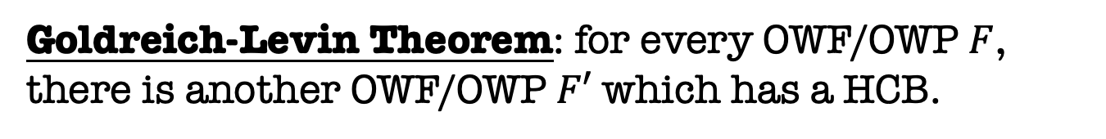
Recap + Today
Define one-way functions (OWF).
Define Hardcore bits (HCB).
Show that one-way functions* + HCB $⇒$ PRG
Goldreich-Levin Theorem: for every OWF/OWP $F$, there is another OWF/OWP $F′$ which has a HCB.

Slide 4
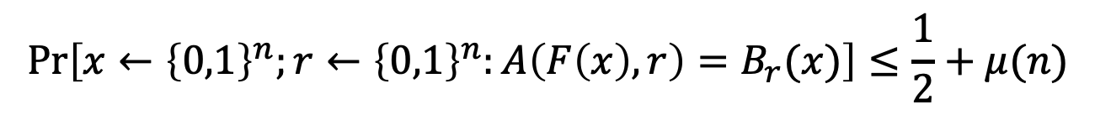
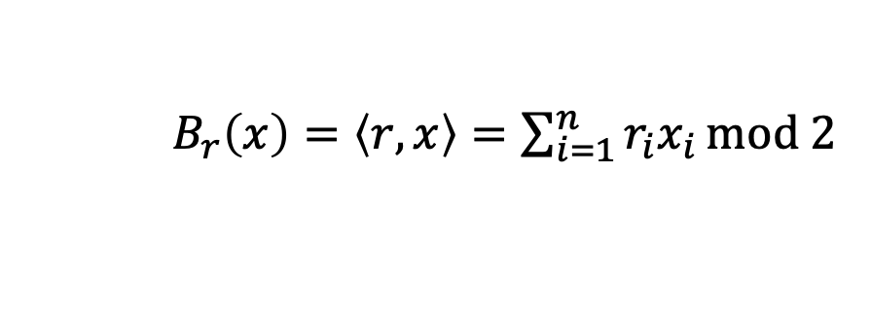
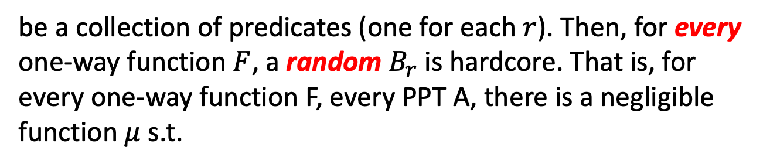
Goldreich-Levin (GL) Theorem: Version 1
Let ${\{B}_{r}:{\{0,1\}}^{n}→\{0,1\}\}$ where
$B_{r}\left(x\right)=\left\langle r,x\right\rangle =\sum_{i=1}^{n}{r_{i}x_{i}}mod 2$
be a collection of predicates (one for each $r$). Then, for every one-way function $F$, a random $B_{r}$is hardcore. That is, for every one-way function F, every PPT A, there is a negligible function $μ$ s.t.
$$\operatorname{Pr}\left[x←{\left\{0,1\right\}}^{n};r←{\left\{0,1\right\}}^{n}:A\left(F\left(x\right),r\right)=B_{r}(x)\right]≤\frac{1}{2}+μ(n)$$

Slide 5

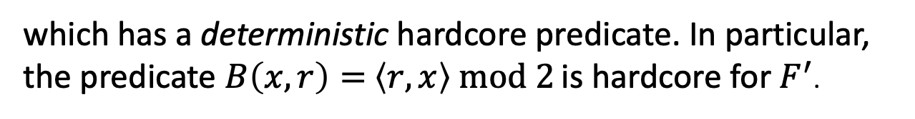

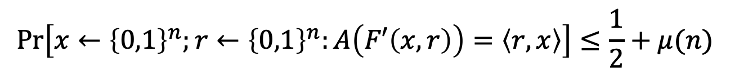
GL Theorem: Version 2
For every one-way function/permutation $F$, there is a related one-way function/permutation
$F^{′}\left(x,r\right)=(F\left(x\right),r)$
which has a deterministic hardcore predicate. In particular, the predicate $B\left(x,r\right)=$ $\left\langle r,x\right\rangle mod 2$ is hardcore for $F^{′}$.
$$\operatorname{Pr}\left[x←{\left\{0,1\right\}}^{n};r←{\left\{0,1\right\}}^{n}:A\left(F′\left(x,r\right)\right)=\left\langle r,x\right\rangle \right]≤\frac{1}{2}+μ(n)$$
Key Point:
This statement is sufficient to construct PRGs from any OWP.

Slide 6
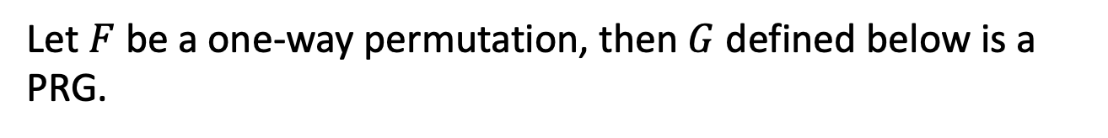
If there are OWPs, then there are PRGs
CONSTRUCTION
Let $F$ be a one-way permutation, then $G$ defined below is a PRG.
Then, define $G\left(x,r\right)=F^{′}\left(x,r\right) || \left\langle r,x\right\rangle = F\left(x\right) || r || \left\langle r,x\right\rangle$ .
Theorem: $G$ is a PRG assuming $F$ is a one-way permutation.

Slide 7
We proved a weaker version in L6:
Let’s assume a pretty good predictor $P$
$$\operatorname{Pr}\left[x←{\left\{0,1\right\}}^{n};r←{\left\{0,1\right\}}^{n}:P\left(F\left(x\right),r\right)=\left\langle r,x\right\rangle \right]≥\frac{3}{4}+1/p(n)$$
Then there is a OWF inverter $A$.
$$\operatorname{Pr}\left[x←{\left\{0,1\right\}}^{n} :A\left(F\left(x\right)\right)∈F^{−1}\left(F\left(x\right)\right)\right]≥1/p′(n)$$

Slide 8
We proved a weaker version in L6:
Let’s assume a pretty good predictor $P$
$$\operatorname{Pr}\left[x←{\left\{0,1\right\}}^{n};r←{\left\{0,1\right\}}^{n}:P\left(F\left(x\right),r\right)=\left\langle r,x\right\rangle \right]≥\frac{3}{4}+1/p(n)$$
First, we used an averaging argument.
Claim: For at least a $1/2p(n)$ fraction of the $x$,
$$\operatorname{Pr}\left[r←{\left\{0,1\right\}}^{n}:P\left(F\left(x\right),r\right)=\left\langle r,x\right\rangle \right]≥\frac{3}{4}+1/2p(n)$$
Call these the good $x.$
Proof: On the board.

Slide 9
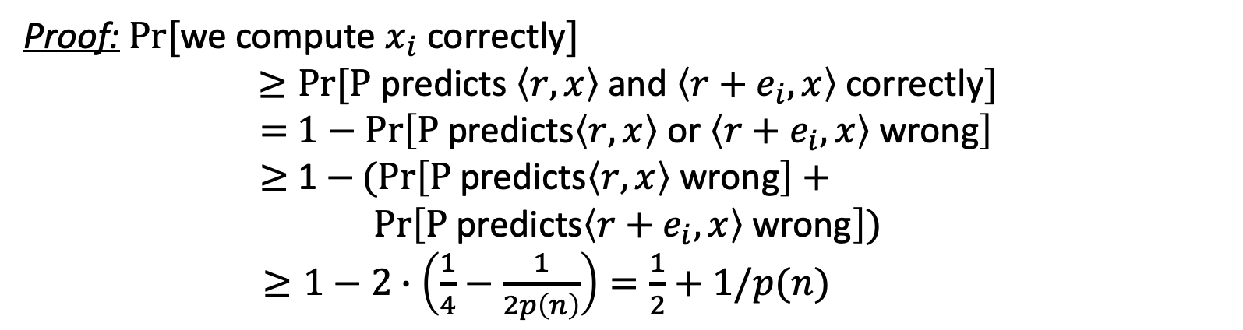
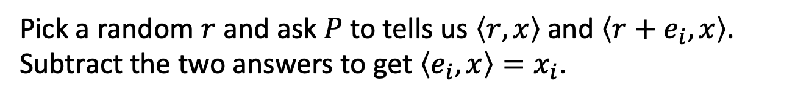
We proved a weaker version in L6:
For at least a $1/2p(n)$ fraction of the $x$,
$$\operatorname{Pr}\left[r←{\left\{0,1\right\}}^{n}:P\left(F\left(x\right),r\right)=\left\langle r,x\right\rangle \right]≥\frac{3}{4}+1/2p(n)$$
Key Idea: Linearity
Pick a random $r$ and ask $P$ to tells us $\left\langle r,x\right\rangle$ and $\left\langle r+e_{i},x\right\rangle$. Subtract the two answers to get $\left\langle e_{i},x\right\rangle =x_{i}$.
Proof: $Pr⁡[$we compute $x_{i}$ correctly$]$
$$≥Pr⁡[\text{P} \text{predicts} \left\langle r,x\right\rangle \text{and} \left\langle r+e_{i},x\right\rangle \text{correctly}]$$
$=$ $1−\operatorname{Pr}\left[\text{P} \text{predicts}\left\langle r,x\right\rangle \text{or} \left\langle r+e_{i},x\right\rangle \text{wrong}\right]$
$≥$ 1 $−(Pr\left[\text{P} \text{predicts}\left\langle r,x\right\rangle \text{wrong}\right]+$
$$\operatorname{Pr}\left[\text{P} \text{predicts}\left\langle r+e_{i},x\right\rangle \text{wrong}\right])$$
$≥1−2∙\left(\frac{1}{4}−\frac{1}{2p\left(n\right)}\right)=\frac{1}{2}+1/p(n)$
(by union bound)

Slide 10
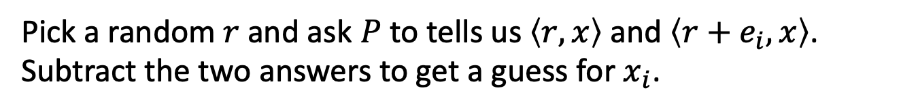
We proved a weaker version in L6:
For at least a $1/2p(n)$ fraction of the $x$,
$$\operatorname{Pr}\left[r←{\left\{0,1\right\}}^{n}:P\left(F\left(x\right),r\right)=\left\langle r,x\right\rangle \right]≥\frac{3}{4}+1/2p(n)$$
Inverter A:
Repeat for each $i∈\left\{1,2,…,n\right\}$:
Repeat $O(log{n}{(p(n))}^{2})$ times:
Pick a random $r$ and ask $P$ to tells us $\left\langle r,x\right\rangle$ and $\left\langle r+e_{i},x\right\rangle$. Subtract the two answers to get a guess for $x_{i}$.
Compute the majority of all such guesses and set the bit as $x_{i}$
Output the concatenation of all $x_{i}$ as $x.$
Analysis: Chernoff + Union Bound

Slide 11
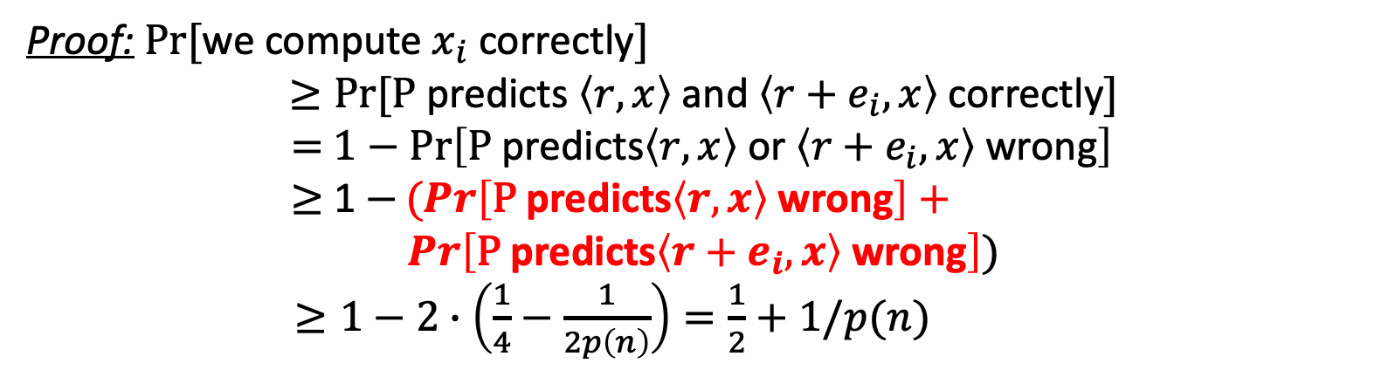
Who’s the culprit here?
For at least a $1/2p(n)$ fraction of the $x$,
$$\operatorname{Pr}\left[r←{\left\{0,1\right\}}^{n}:P\left(F\left(x\right),r\right)=\left\langle r,x\right\rangle \right]≥\frac{3}{4}+1/2p(n)$$
Pick a random $r$ and ask $P$ to tells us $\left\langle r,x\right\rangle$ and $\left\langle r+e_{i},x\right\rangle$. Subtract the two answers to get $\left\langle e_{i},x\right\rangle =x_{i}$.
Proof: $Pr⁡[$we compute $x_{i}$ correctly$]$
$$≥Pr⁡[\text{P} \text{predicts} \left\langle r,x\right\rangle \text{and} \left\langle r+e_{i},x\right\rangle \text{correctly}]$$
$=$ $1−\operatorname{Pr}\left[\text{P} \text{predicts}\left\langle r,x\right\rangle \text{or} \left\langle r+e_{i},x\right\rangle \text{wrong}\right]$
$≥$ 1 $−(Pr\left[\text{P} \text{predicts}\left\langle r,x\right\rangle \text{wrong}\right]+$
$$\operatorname{Pr}\left[\text{P} \text{predicts}\left\langle r+e_{i},x\right\rangle \text{wrong}\right])$$
$≥1−2∙\left(\frac{1}{4}−\frac{1}{2p\left(n\right)}\right)=\frac{1}{2}+1/p(n)$
(by union bound)

Slide 12


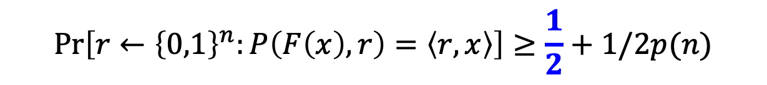
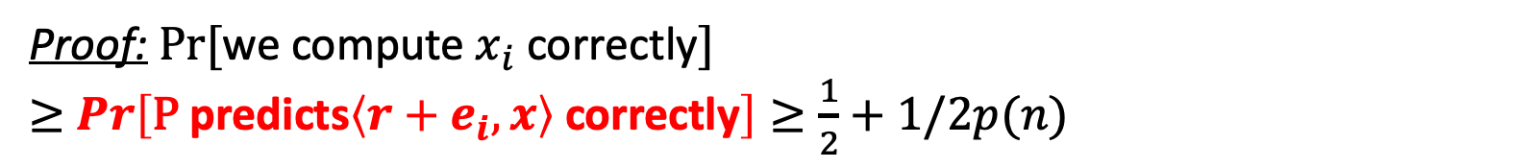
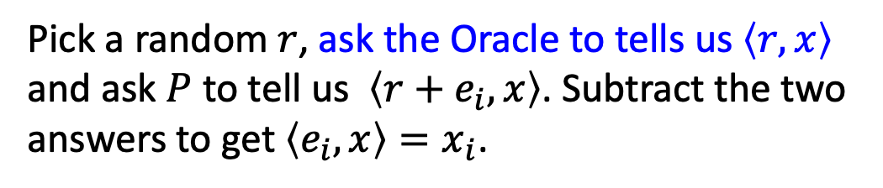
The Real Proof of the GL Theorem
(attributed to Charlie Rackoff)
Assume (after averaging) that for $≥1/2p(n)$ fraction of the $x$,
$$\operatorname{Pr}\left[r←{\left\{0,1\right\}}^{n}:P\left(F\left(x\right),r\right)=\left\langle r,x\right\rangle \right]≥\frac{1}{2}+1/2p(n)$$
For a minute, assume we have a bit of help/advice.
Pick a random $r$, ask the Oracle to tells us $\left\langle r,x\right\rangle$ and ask $P$ to tell us $\left\langle r+e_{i},x\right\rangle$. Subtract the two answers to get $\left\langle e_{i},x\right\rangle =x_{i}$.
Proof: $Pr⁡[$we compute $x_{i}$ correctly$]$
$≥$ $\operatorname{Pr}\left[\text{P} \text{predicts}\left\langle r+e_{i},x\right\rangle \text{correctly}\right]≥\frac{1}{2}+1/2p(n)$

Slide 13
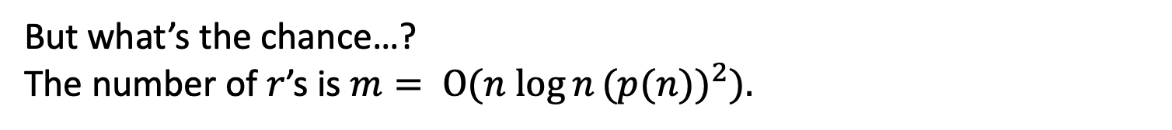
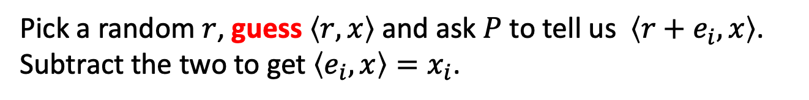
The Real Proof of the GL Theorem
Assume (after averaging) that for $≥1/2p(n)$ fraction of the $x$,
$$\operatorname{Pr}\left[r←{\left\{0,1\right\}}^{n}:P\left(F\left(x\right),r\right)=\left\langle r,x\right\rangle \right]≥\frac{1}{2}+1/2p(n)$$
Pick a random $r$, guess $\left\langle r,x\right\rangle$ and ask $P$ to tell us $\left\langle r+e_{i},x\right\rangle$. Subtract the two to get $\left\langle e_{i},x\right\rangle =x_{i}$.
If our guesses are all correct, then the analysis works out just as before.
But what’s the chance…?
The number of $r$’s is $m= O(n log{n}{(p(n))}^{2}).$

Slide 14
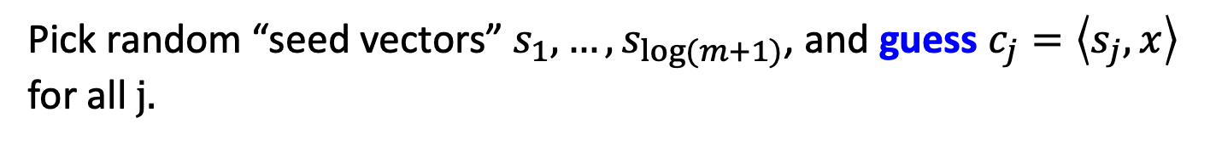
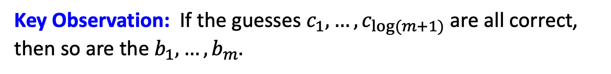
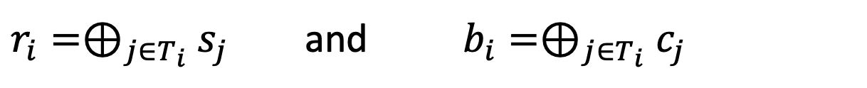
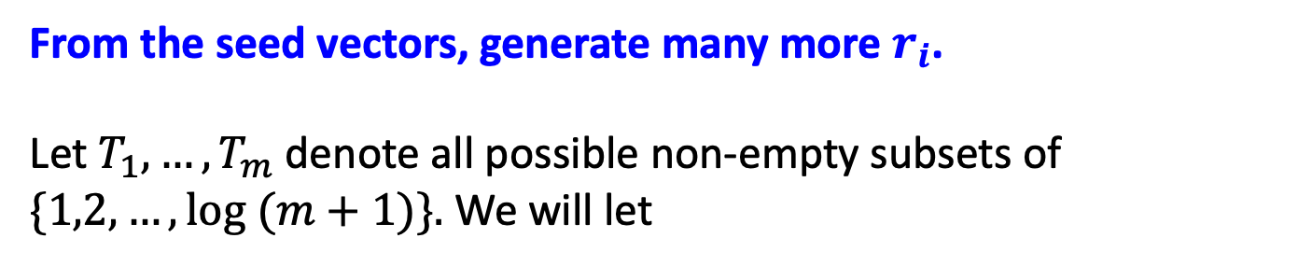
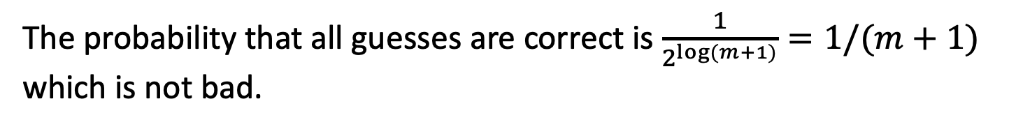
Parsimony in Guessing
Pick random “seed vectors” $s_{1},…,s_{\log{(m+1)}}$, and guess $c_{j}=\left\langle s_{j},x\right\rangle$ for all$j.$
The probability that all guesses are correct is $\frac{1}{2^{\log{(m+1)}}}=1/(m+1)$ which is not bad.
From the seed vectors, generate many more $r_{i}$.
Let $T_{1},…,T_{m}$ denote all possible non-empty subsets of $\{1,2,…,\log{(m+1)\}.}$ We will let
$r_{i}=⊕_{j∈T_{i}}$ $s_{j}$ and $b_{i}=⊕_{j∈T_{i}}$ $c_{j}$
Key Observation: If the guesses $c_{1},…,c_{\log{(m+1)}}$ are all correct, then so are the $b_{1},…,b_{m}.$

Slide 15

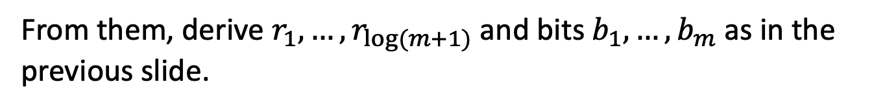
The OWF Inverter
Generate random $s_{1},…,s_{log⁡(m+1)}$ and bits $c_{1},…,c_{log⁡(m+1)}$.
From them, derive $r_{1},…,r_{log⁡(m+1)}$ and bits $b_{1},…,b_{m}$ as in the previous slide.
Repeat for each $i∈\left\{1,2,…,n\right\}$:
Repeat $100n{(p(n))}^{2}$ times:
Ask $P$ to tells us $\left\langle r_{i}+e_{i},x\right\rangle$. XOR P’s reply with $b_{i}$to get a guess for $x_{i}$.
Compute the majority of all such guesses and set the bit as $x_{i}$
Output the concatenation of all $x_{i}$ as $x.$

Slide 16
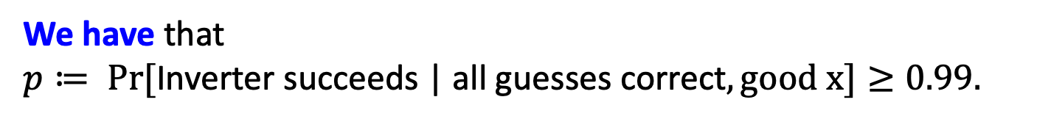
Analysis of the Inverter
Let’s condition on the guesses $c_{1},…,c_{log⁡(m+1)}$ being all correct.
The main issue: The $r_{i}$ are not independent (can’t do Chernoff)
Key Observation: The $r_{i}$ are pairwise independent.
Therefore, can apply Chebyshev!
We have that
$p≔ Pr⁡[\text{Inverter} \text{succeeds}\text{ | }\text{all} \text{guesses} \text{correct}, good x]≥0.99.$
(Pf. on the board, also in the next two slides)

Slide 17
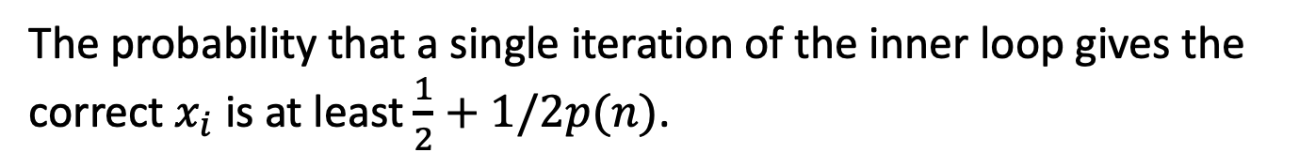

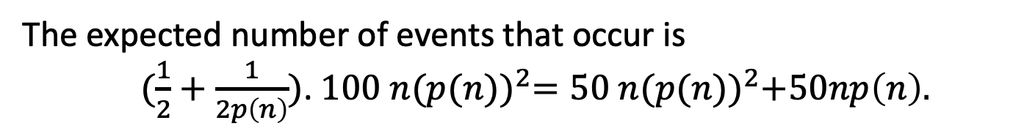
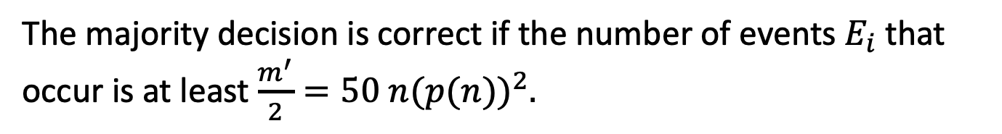
Analysis of the Inverter
The probability that a single iteration of the inner loop gives the correct $x_{i}$ is at least $\frac{1}{2}+1/2p(n)$.
Let this be the good event $E_{i}$ (for the $i^{th}$ iteration of the inner loop).
The majority decision is correct if the number of events $E_{i}$ that occur is at least $\frac{m^{′}}{2}=50 n{(p(n))}^{2}.$
The expected number of events that occur is
$(\frac{1}{2}+\frac{1}{2p\left(n\right)})$. $100 n{(p(n))}^{2}=50 n{(p(n))}^{2}+50np\left(n\right).$
The variance is
$≈\frac{1}{4}∙100 n{\left(p\left(n\right)\right)}^{2}=25n{\left(p\left(n\right)\right)}^{2}$

Slide 18
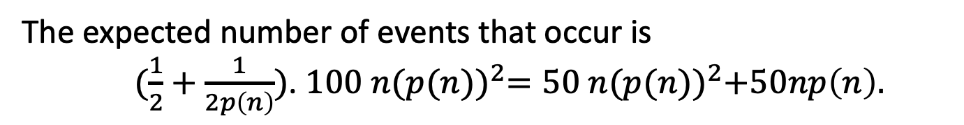
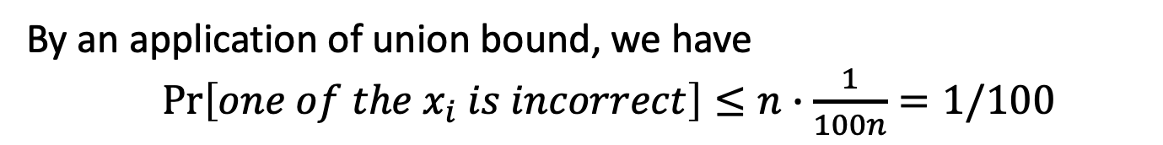
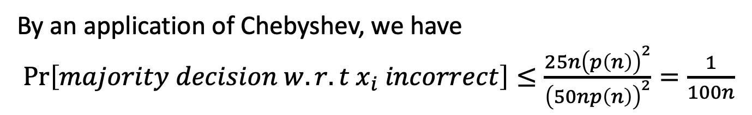
Analysis of the Inverter
The expected number of events that occur is
$(\frac{1}{2}+\frac{1}{2p\left(n\right)})$. $100 n{(p(n))}^{2}=50 n{(p(n))}^{2}+50np\left(n\right).$
The variance is $≈\frac{1}{4}∙100 n{\left(p\left(n\right)\right)}^{2}=25n{\left(p\left(n\right)\right)}^{2}$
By an application of Chebyshev, we have
$\operatorname{Pr}\left[majority decision w.r.t x_{i} incorrect\right]≤\frac{25n{\left(p\left(n\right)\right)}^{2}}{{\left(50np\left(n\right)\right)}^{2}}=\frac{1}{100n}$
By an application of union bound, we have
$\operatorname{Pr}\left[one of the x_{i} is incorrect\right]≤n∙\frac{1}{100n}=1/100$
$∴$ The inverter outputs the correct inverse w.p. $p≥0.99.$

Slide 19
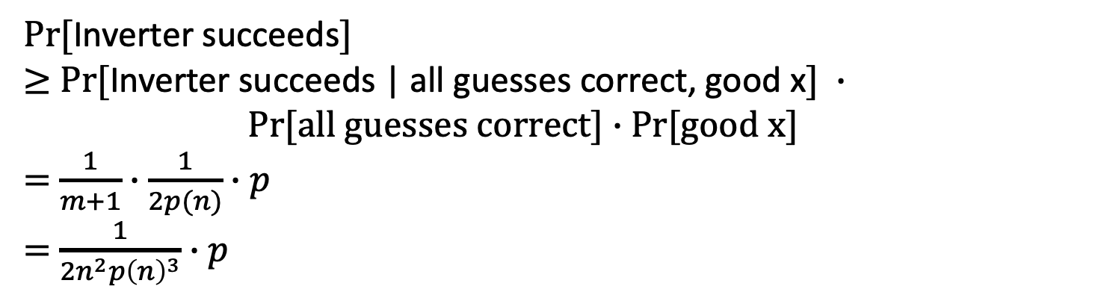
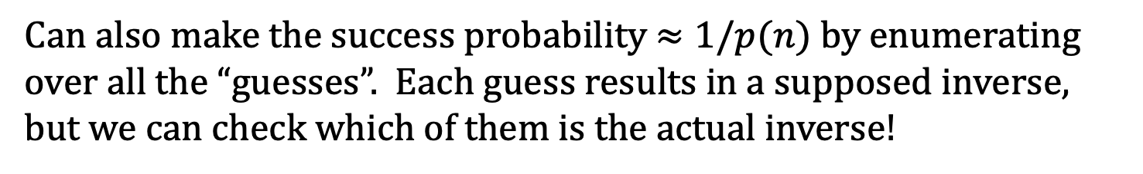
Putting it all together
$Pr⁡[$Inverter succeeds$]$
$≥$ $Pr⁡[$Inverter succeeds | all guesses correct, good x$] ∙$ $Pr[all guesses correct]∙$ Pr[good x]
= $\frac{1}{m+1}∙\frac{1}{2p(n)}∙p$
= $\frac{1}{{2n}^{2}{p\left(n\right)}^{3}}∙p$
So, it suffices to show that $p$is large.
By our calculation (on the board), $p≥0.99$, so we are done.
Can also make the success probability $≈1/p(n)$ by enumerating over all the “guesses”. Each guess results in a supposed inverse, but we can check which of them is the actual inverse!

Slide 20
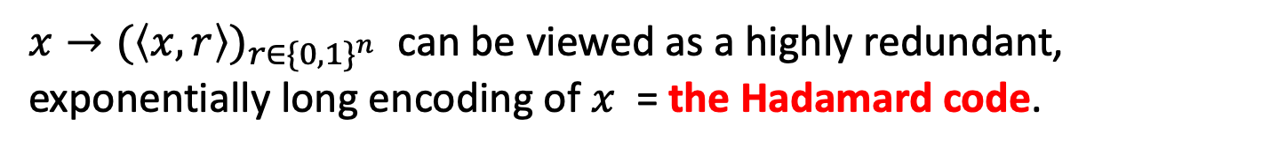
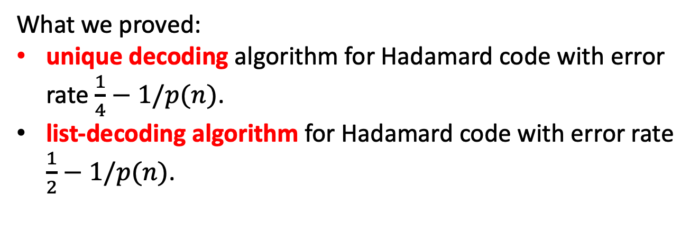
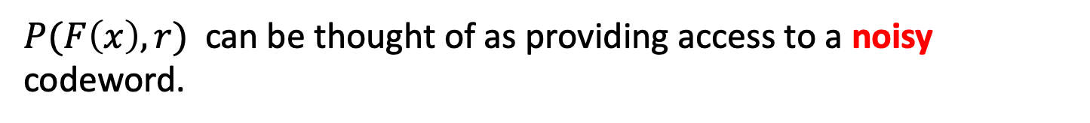
The Coding-Theoretic View of GL
$x→{(\left\langle x,r\right\rangle )}_{r∈{\{0,1\}}^{n}}$ can be viewed as a highly redundant, exponentially long encoding of $x$ = the Hadamard code.
$P(F\left(x\right),r)$ can be thought of as providing access to a noisy codeword.
What we proved:
unique decoding algorithm for Hadamard code with error rate $\frac{1}{4}−1/p(n)$.
list-decoding algorithm for Hadamard code with error rate $\frac{1}{2}−1/p(n)$.

Slide 21


Hardcore Predicates from any
List-Decodable Code
(due to Impagliazzo and Sudan)
$x→C(x)$ is the encoding.
Given a $C(x)$ that is incorrect at $\frac{1}{2}−ε$ fraction of the locations, a list-decoder outputs a list $\{x_{1},…,x_{m}\}$ of possibilities for $x$.
The hardcore predicate is
$$B_{i}\left(x\right)= {C(x)}_{i}.$$
A hardcore-bit predictor gives us access to a corrupted codeword. Running the list-decoder on it gives us the list of possible inverses. The fact that the OWF is easy to compute means that we can filter out the bogus (non-)inverses.

Slide 22
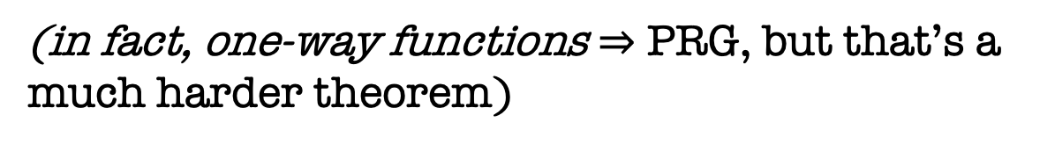
Recap
1. Defined one-way functions (OWF).
2. Defined Hardcore bits (HCB).
3. Goldreich-Levin Theorem: every OWF has a HCB.
(showed proof for an important special case)
4. Show that one-way permutations (OWP) $⇒$ PRG
(in fact, one-way functions $⇒$ PRG, but that’s a much harder theorem)

Slide 23
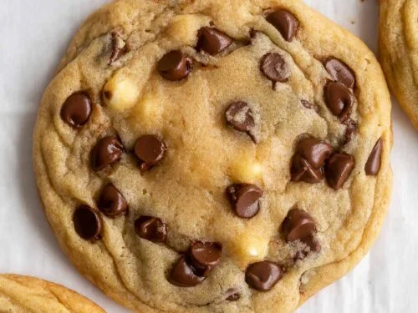
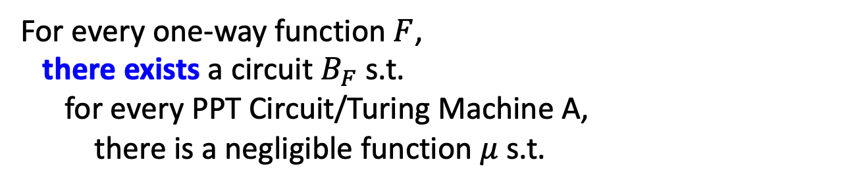
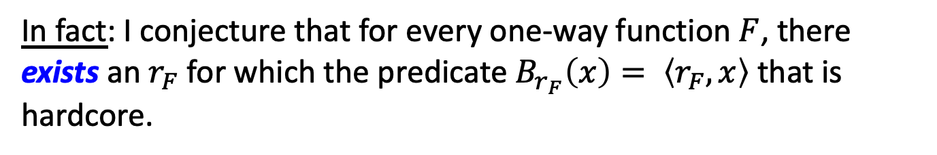

Universal Hardcore Predicate Conjecture 1
For every one-way function $F$, there exists a circuit $B_{F}$ s.t.
for every PPT Circuit/Turing Machine A,
there is a negligible function $μ$ s.t.
$$\operatorname{Pr}\left[x←{\left\{0,1\right\}}^{n} :A\left(F\left(x\right)\right)=B_{F}(x)\right]≤\frac{1}{2}+μ(n)$$
In fact: I conjecture that for every one-way function $F$, there exists an $r_{F}$ for which the predicate $B_{r_{F}}\left(x\right)= \left\langle r_{F},x\right\rangle$ that is hardcore.

Slide 24
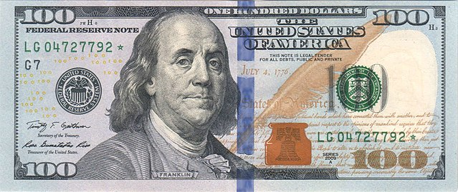
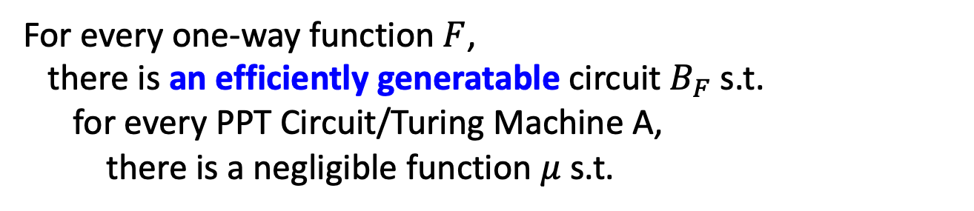
Universal Hardcore Predicate Conjecture 2
For every one-way function $F$, there is an efficiently generatable circuit $B_{F}$ s.t.
for every PPT Circuit/Turing Machine A,
there is a negligible function $μ$ s.t.
$$\operatorname{Pr}\left[x←{\left\{0,1\right\}}^{n} :A\left(F\left(x\right)\right)=B_{F}(x)\right]≤\frac{1}{2}+μ(n)$$

Slide 25
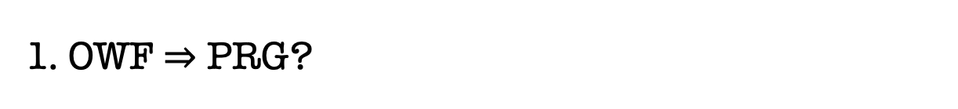
Other Topics (Time permitting)
1. OWF $⇒$ PRG?
2. Pseudorandom Permutations from Pseudorandom Functions
(the Luby-Rackoff construction)

Slide 26
Minicrypt:
Zero-Knowledge proofs
MAC
CCA-secure Secret-key enc.
Digital Signatures
Bit Commitment
PRF
Secret-key encryption
PRG
Hashing
(Stateful) Secret-key encryption
OWF
OWF
Candidate Constructions: from number theory, geometry, combinatorics,…

