Slide 1
MIT 6.875
Foundations of Cryptography
Lecture 18

Slide 2
New Topic:
Secure Computation

Slide 3




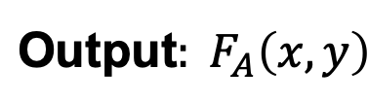
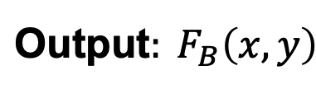
Secure Two-Party Computation
Input: $x$
Input: $y$
Alice
Bob
$$\text{Out}\text{put}: F_{A}\left(x,y\right)$$
$$\text{Out}\text{put}: F_{B}\left(x,y\right)$$

Slide 4
Secure Two-Party Computation
Input: $x$
Input: $y$
Alice
Bob
$$\text{Out}\text{put}: F_{A}\left(x,y\right)$$
$$\text{Out}\text{put}: F_{B}\left(x,y\right)$$
Security:
Semi-honest Security:
Alice should not learn anything more than $x$ and $F_{A}\left(x,y\right).$
Bob should not learn anything more than $y$ and $F_{B}\left(x,y\right).$

Slide 5
Secure Two-Party Computation
Input: $x$
Input: $y$
Alice
Bob
$$\text{Out}\text{put}: F_{A}\left(x,y\right)$$
$$\text{Out}\text{put}: F_{B}\left(x,y\right)$$
Malicious Security:
No (PPT) Alice* can learn anything more than $x^{∗}$ and $F_{A}\left(x^{∗},y\right).$
No (PPT) Bob* can learn anything more than $y^{∗}$ and $F_{B}\left(x,y^{∗}\right).$

Slide 6
Tool 1: Secret Sharing

Slide 7

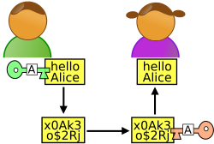



secret b
Secret Sharing
share $s_{1}$
share $s_{2}$
share $s_{3}$
share $s_{4}$
share $s_{n}$
$$…$$
$$P_{1}$$
$$P_{2}$$
$$P_{3}$$
$$P_{4}$$
$$P_{n}$$
Dealer
Any “authorized” subset of players can recover b.
No other subset of players has any info about b.
Threshold (or t-out-of-n) SS [Shamir’79, Blakley’79]:
“authorized” subset = has size $≥$t.
Notes:
Information theoretic privacy
Clearly this has to be monotone

Slide 8
secret b$∈Z_{p}$
$2$-out-of-$n$ Secret Sharing?
$$…$$
$$P_{1}$$
$$P_{2}$$
$$P_{3}$$
$$P_{4}$$
$$P_{n}$$
Dealer
Here is a solution.
Repeat for every two-person subset {$P_{i},P_{j}\}:$
Generate a 2-out-of-2 secret sharing $(s_{i},s_{j})$ of b.
Give $s_{i}$ to $P_{i}$ and $s_{j}$ to $P_{j}$
What is the size of shares each party gets?
How does this scale to t-out-of-n?
Notes:
Information theoretic privacy
Clearly this has to be monotone

Slide 9
Shamir’s t-out-of-n Secret Sharing
Key Idea: Polynomials are Amazing!

Slide 10

Shamir’s 2-out-of-n Secret Sharing
$$s_{1}$$
$$s_{2}$$
random line through (0,b)
$$(3,s_{3})$$
$$(2,s_{2})$$
$$s_{3}$$
$$(1,s_{1})$$
secret $b$
Each share $s_{i}$ is truly
random (independent of secret b)
Any two shares uniquely
determine b.

Slide 11
Shamir’s 2-out-of-n Secret Sharing
The dealer picks a uniformly random line (mod p) whose constant term is the secret $b.$
$f\left(x\right)=ax+b$ where $a$ is uniformly random mod $p$
2. Compute the shares$:$ $$s_{1}=f\left(1\right),s_{2}=f\left(2\right),…,s_{i}=f\left(i\right),{…,s}_{n}=f\left(n\right)$$
Correctness: can recover secret from any two shares.
Proof: Parties $i$ and $j$, given shares $s_{i}=ai+b$ and $s_{j}=aj+b$ can solve for $b (=\frac{js_{i}−is_{j}}{j−i})$.

Slide 12
Shamir’s 2-out-of-n Secret Sharing
The dealer picks a uniformly random line (mod p) whose constant term is the secret $b.$
$f\left(x\right)=ax+b$ where $a$ is uniformly random mod $p$
2. Compute the shares$:$ $$s_{1}=f\left(1\right),s_{2}=f\left(2\right),…,s_{i}=f\left(i\right),{…,s}_{n}=f\left(n\right)$$
Security: any single party has no information about the secret.
Proof: Party $i$’s share $s_{i}=a∗i+b$ is uniformly random, independent of $b,$ as $a$ is random and so is $a∗i$.

Slide 13
Shamir’s t-out-of-n Secret Sharing
Key Idea: Polynomials are Amazing!
The dealer picks a uniformly random degree-(t-1) polynomial (mod p) whose constant term is the secret $b.$
$f\left(x\right)=a_{t−1}x^{t−1}+…+a_{1}x+b$ where $a_{i}$ are uniformly random mod $p$
2. Compute the shares$:$ $$s_{1}=f\left(1\right),s_{2}=f\left(2\right),…,s_{i}=f\left(i\right),{…,s}_{n}=f\left(n\right)$$
Correctness: can recover secret from any $t$ shares.
Security: the distribution of $any t−1$ shares is independent of the secret.
Note: need p to be larger than the number of parties n.

Slide 14
Shamir’s t-out-of-n Secret Sharing
Key Idea: Polynomials are Amazing!
$f\left(x\right)=a_{t−1}x^{t−1}+…+a_{1}x+b$ where $a_{i}$ are uniformly random mod $p$
$$s_{1}=f\left(1\right),s_{2}=f\left(2\right),…,s_{i}=f\left(i\right),{…,s}_{n}=f\left(n\right)$$
Correctness: via Vandermonde matrices.
Let’s look at shares of parties $P_{1},P_{2},…,P_{t}.$
$$\left[\begin{matrix}s_{1} \\ s_{2} \\ s_{3} \\ … \\ s_{t}\end{matrix}\right]=\left[\begin{matrix}1 & 1 & 1 & … & 1 \\ 1 & 2 & 2^{2} & … & 2^{t−1} \\ 1 & 3 & 3^{2} & … & 3^{t−1} \\ 1 & … & … & … & … \\ 1 & t & t^{2} & … & t^{t−1}\end{matrix}\right]\left[\begin{matrix}b \\ a_{1} \\ a_{2} \\ … \\ a_{t−1}\end{matrix}\right](mod p)$$
$t$-by-$t$ Vandermonde matrix which is invertible

Slide 15
Shamir’s t-out-of-n Secret Sharing
Key Idea: Polynomials are Amazing!
$f\left(x\right)=a_{t−1}x^{t−1}+…+a_{1}x+b$ where $a_{i}$ are uniformly random mod $p$
$$s_{1}=f\left(1\right),s_{2}=f\left(2\right),…,s_{i}=f\left(i\right),{…,s}_{n}=f\left(n\right)$$
Correctness: Alternatively, Lagrange interpolation gives an explicit formula that recovers b.
$$b=f\left(0\right)=\sum_{i=1}^{t}{f(i)\left(\prod_{1≤j≤t,j≠i}{\frac{−x_{j}}{x_{i}−x_{j}}}\right)}$$

Slide 16
Shamir’s t-out-of-n Secret Sharing
Key Idea: Polynomials are Amazing!
$f\left(x\right)=a_{t−1}x^{t−1}+…+a_{1}x+b$ where $a_{i}$ are uniformly random mod $p$
$$s_{1}=f\left(1\right),s_{2}=f\left(2\right),…,s_{i}=f\left(i\right),{…,s}_{n}=f\left(n\right)$$
Security:
Let’s look at shares of parties $P_{1},P_{2},…,P_{t−1}.$
$$\left[\begin{matrix}s_{1} \\ s_{2} \\ s_{3} \\ … \\ s_{t−1}\end{matrix}\right]=\left[\begin{matrix}1 & 1 & 1 & … & 1 \\ 1 & 2 & 2^{2} & … & 2^{t−1} \\ 1 & 3 & 3^{2} & … & 3^{t−1} \\ 1 & … & … & … & … \\ 1 & t−1 & {(t−1)}^{2} & … & {(t−1)}^{t−1}\end{matrix}\right]\left[\begin{matrix}b \\ a_{1} \\ a_{2} \\ … \\ a_{t−1}\end{matrix}\right](mod p)$$
$(t−1)$-by-$t$ Vandermonde matrix

Slide 17
Shamir’s t-out-of-n Secret Sharing
Key Idea: Polynomials are Amazing!
$f\left(x\right)=a_{t−1}x^{t−1}+…+a_{1}x+b$ where $a_{i}$ are uniformly random mod $p$
$$s_{1}=f\left(1\right),s_{2}=f\left(2\right),…,s_{i}=f\left(i\right),{…,s}_{n}=f\left(n\right)$$
Security: For every value of $b$ there is a unique polynomial with constant term $b$ and shares $s_{1},s_{2},…,s_{t−1}.$
$$\left[\begin{matrix}s_{1} \\ s_{2} \\ s_{3} \\ … \\ s_{t−1}\end{matrix}\right]=\left[\begin{matrix}1 & 1 & 1 & … & 1 \\ 1 & 2 & 2^{2} & … & 2^{t−1} \\ 1 & 3 & 3^{2} & … & 3^{t−1} \\ 1 & … & … & … & … \\ 1 & t−1 & {(t−1)}^{2} & … & {(t−1)}^{t−1}\end{matrix}\right]\left[\begin{matrix}b \\ a_{1} \\ a_{2} \\ … \\ a_{t−1}\end{matrix}\right](mod p)$$
$(t−1)$-by-$t$ Vandermonde matrix

Slide 18
Shamir’s t-out-of-n Secret Sharing
Key Idea: Polynomials are Amazing!
$f\left(x\right)=a_{t−1}x^{t−1}+…+a_{1}x+b$ where $a_{i}$ are uniformly random mod $p$
$$s_{1}=f\left(1\right),s_{2}=f\left(2\right),…,s_{i}=f\left(i\right),{…,s}_{n}=f\left(n\right)$$
Security: For every value of $b$ there is a unique polynomial with constant term $b$ and shares $s_{1},s_{2},…,s_{t−1}.$
Corollary: for every value of the secret $b$is equally likely given the shares $s_{1},s_{2},…,s_{t−1}.$ In other words, the secret $b$is perfectly hidden given $t−1$ shares.

Slide 19
Tool 2: Oblivious Transfer

Slide 20
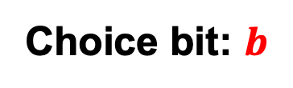


Oblivious Transfer (OT)
$$x_{0}$$
Choice bit: $b$
$$x_{1}$$
Sender
Receiver
Sender holds two bits/strings $x_{0}$ and $x_{1}$.
Receiver holds a choice bit $b$.
Receiver should learn $x_{b}$, sender should learn nothing.
(We will consider honest-but-curious adversaries; formal definition in a little bit…)

Slide 21
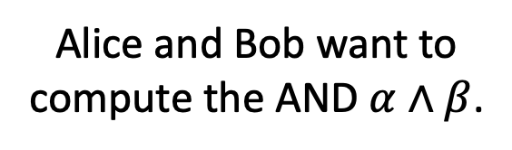
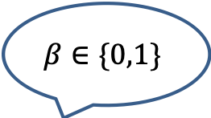
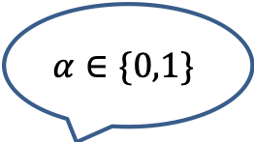
Why OT? The Dating Problem
$$α∈\{0,1\}$$
Alice and Bob want to compute the AND $α∧β$.
$$β∈\{0,1\}$$

Slide 22



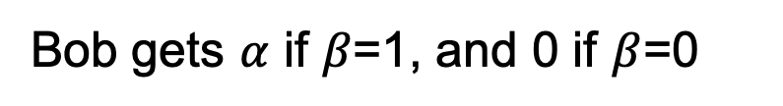
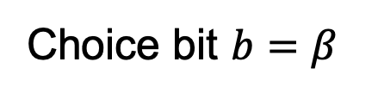

Why OT? The Dating Problem
$$α∈\{0,1\}$$
Alice and Bob want to compute the AND $α∧β$.
$$β∈\{0,1\}$$
$$x_{0}=0$$
Run an OT protocol
Choice bit $b=β$
$$x_{1}=α$$
Bob gets $α$ if $β$=1, and 0 if $β$=0
$$x_{1}b+ x_{0}\left(1−b\right)$$
Here is a way to write the OT selection function:
which, in this case is $=αβ$.

Slide 23
The Billionaires’ Problem
Net worth: $X
Net worth: $Y
Who is richer?

Slide 24
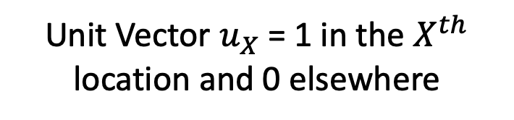









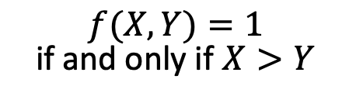
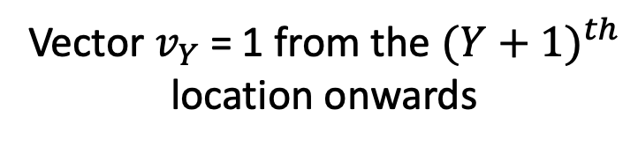
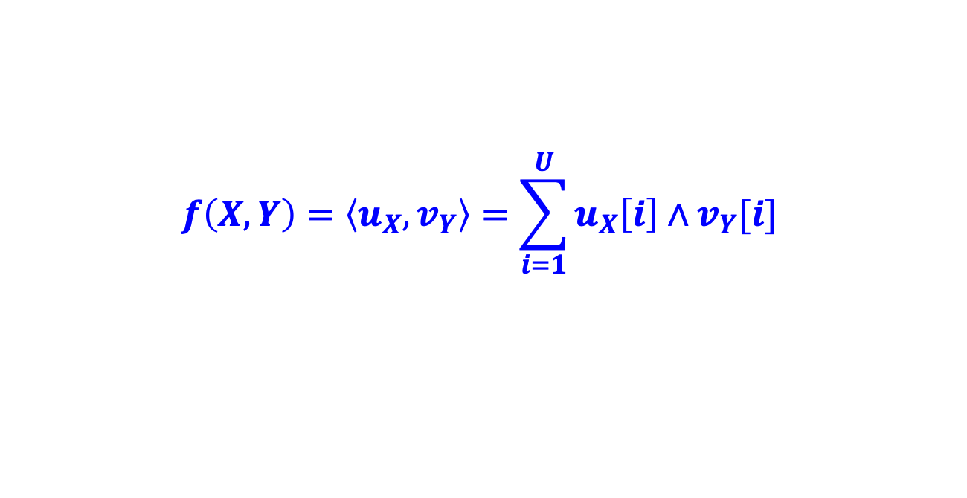






The Billionaires’ Problem
$f(X,Y)=1$ if and only if $X>Y$
$$X$$
$$Y$$
$$…$$
$$…$$
$$…$$
$$0$$
$$1$$
$$0$$
$$1$$
$$1$$
$$1$$
$$1$$
$$1$$
$$1$$
$$0$$
$$0$$
Unit Vector $u_{X}$ = 1 in the $X^{th}$ location and 0 elsewhere
Vector $v_{Y}$ = 1 from the ${(Y+1)}^{th}$ location onwards
$$f\left(X,Y\right)=\left\langle u_{X},v_{Y}\right\rangle =\sum_{i=1}^{U}{u_{X}\left[i\right]∧v_{Y}[i]}$$
Compute each AND individually and sum it up?

Slide 25
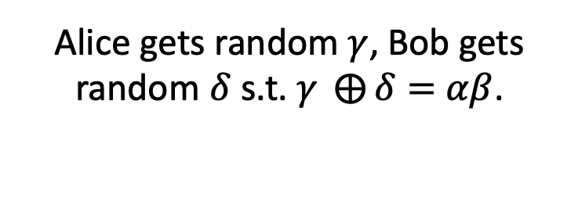
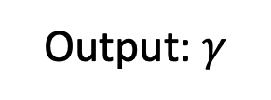


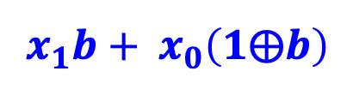





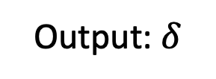
Detour: OT $⇒$ Secret-Shared-AND
$$α∈\{0,1\}$$
Alice gets random $γ$, Bob gets random $δ$ s.t. $γ ⨁{δ}=$ $αβ$.
$$β∈\{0,1\}$$
Output: $γ$
Output: $δ$
$$x_{0}=γ$$
Run an OT protocol
Choice bit $b=β$
$x_{1}=α⨁$ $γ$
Alice outputs $γ$.
$$x_{1}b+ x_{0}\left(1⨁b\right)$$
Bob gets
$=(x_{1}$ $⨁{ x}_{0})b+x_{0}$
$$=αβ⨁γ≔δ$$

Slide 26


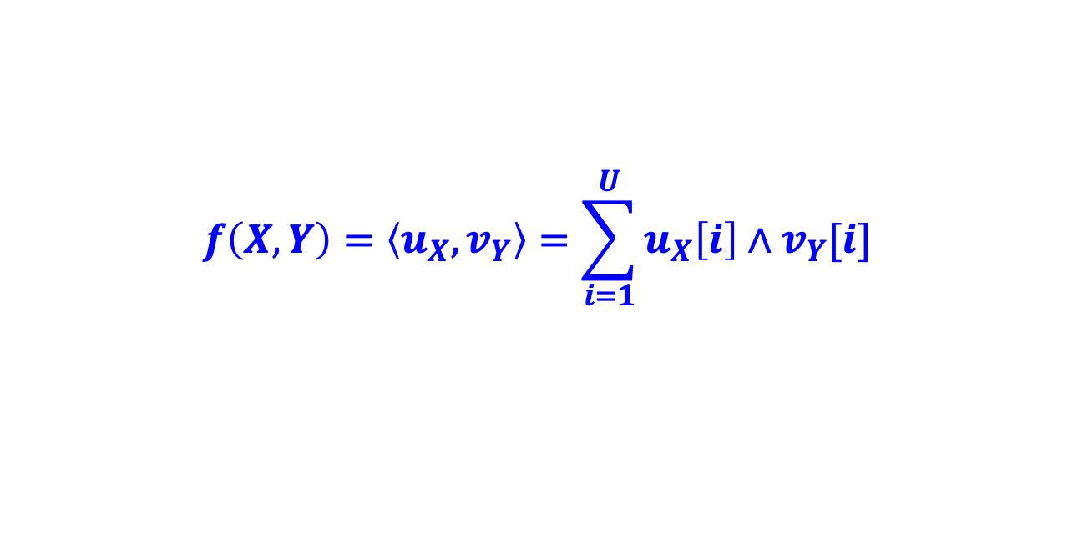


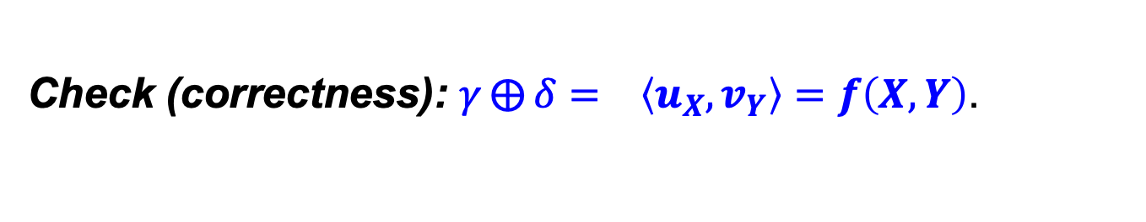






The Billionaires’ Problem
$f(X,Y)=1$ if and only if $X>Y$
$$…$$
$$…$$
$$…$$
$$0$$
$$1$$
$$0$$
$$1$$
$$1$$
$$1$$
$$1$$
$$1$$
$$1$$
$$0$$
$$0$$
Unit Vector $u_{X}$
Vector $v_{Y}$
$$f\left(X,Y\right)=\left\langle u_{X},v_{Y}\right\rangle =\sum_{i=1}^{U}{u_{X}\left[i\right]∧v_{Y}[i]}$$
1. Alice and Bob run many OTs to get $(γ_{i},δ_{i})$ s.t.
$${γ_{i}⨁δ_{i}= u}_{X}\left[i\right]∧v_{Y}[i]$$
2. Alice computes ${γ= ⨁}_{i}{ γ}_{i}$ and Bob computes ${δ= ⨁}_{i}{ δ}_{i}.$
3. Alice reveals $γ$ and Bob reveals $δ.$
Check (correctness): ${γ⨁{δ}= }_{}\left\langle u_{X},v_{Y}\right\rangle =f\left(X,Y\right)$.

Slide 27
The Billionaires’ Problem
$f(X,Y)=1$ if and only if $X>Y$
$$…$$
$$…$$
$$…$$
$$0$$
$$1$$
$$0$$
$$1$$
$$1$$
$$1$$
$$1$$
$$1$$
$$1$$
$$0$$
$$0$$
Unit Vector $u_{X}$
Vector $v_{Y}$
$$f\left(X,Y\right)=\left\langle u_{X},v_{Y}\right\rangle =\sum_{i=1}^{U}{u_{X}\left[i\right]∧v_{Y}[i]}$$
1. Alice and Bob run many OTs to get $(γ_{i},δ_{i})$ s.t.
$${γ_{i}⨁δ_{i}= u}_{X}\left[i\right]∧v_{Y}[i]$$
2. Alice computes ${γ= ⨁}_{i}{ γ}_{i}$ and Bob computes ${δ= ⨁}_{i}{ δ}_{i}.$
Check (privacy): Alice & Bob get a bunch of random bits.

Slide 28

“OT is Complete”
Theorem (lec18-19): OT can solve not just love and money, but any two-party (and multi-party) problem efficiently.

Slide 29
Defining Security: The Ideal/Real Paradigm

Slide 30


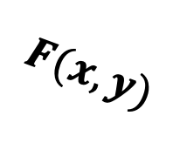
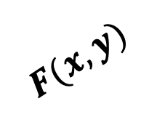
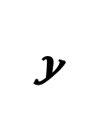
Secure Two-Party Computation
REAL WORLD:
Input: $x$
Input: $y$
Alice
Bob
≈
IDEAL WORLD:
$$y$$
$$x$$
$$F(x,y)$$
$$F(x,y)$$

Slide 31

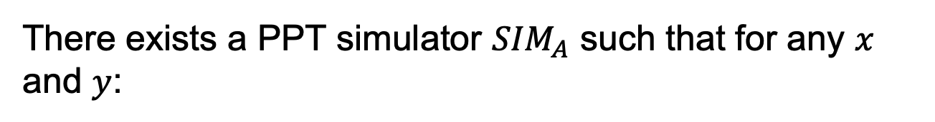
Secure Two-Party Computation
Input: $x$
Input: $y$
Alice
Bob
There exists a PPT simulator ${SIM}_{A}$ such that for any $x$ and $y$:
$${SIM}_{A}(x,F(x,y))≅{View}_{A}(x,y)$$

Slide 32

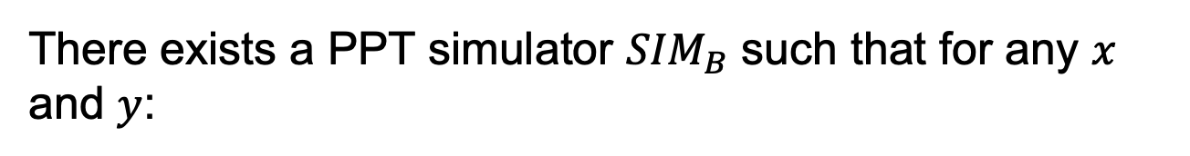
Secure Two-Party Computation
Input: $x$
Input: $y$
Alice
Bob
There exists a PPT simulator ${SIM}_{B}$ such that for any $x$ and $y$:
$${SIM}_{B}(y,F(x,y))≅{View}_{B}(x,y)$$

Slide 33
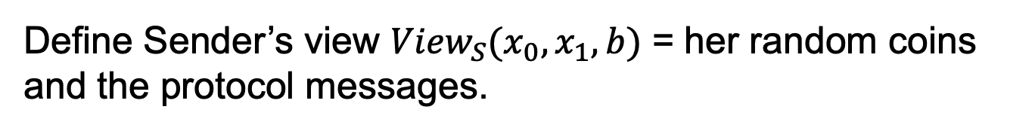
OT Definition
$$x_{0}$$
Choice bit: $b$
$$x_{1}$$
Sender
Receiver
Receiver Security: Sender should not learn b.
Define Sender’s view ${View}_{S}(x_{0},x_{1},b)$ = her random coins and the protocol messages.

Slide 34
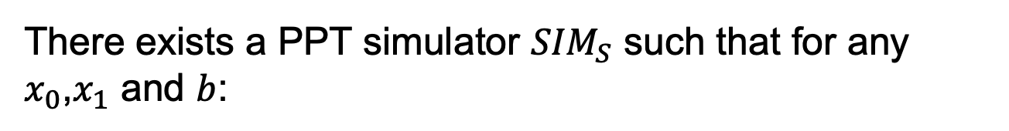

OT Definition
$$x_{0}$$
Choice bit: $b$
$$x_{1}$$
Sender
Receiver
Receiver Security: Sender should not learn b.
There exists a PPT simulator ${SIM}_{S}$ such that for any $x_{0}$,$x_{1}$ and $b$:
$${SIM}_{S}(x_{0},x_{1})≅{View}_{S}(x_{0},x_{1},b)$$

Slide 35
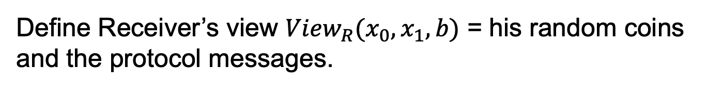
OT Definition
$$x_{0}$$
Choice bit: $b$
$$x_{1}$$
Sender
Receiver
Sender Security: Receiver should not learn $x_{1−b}$.
Define Receiver’s view ${View}_{R}(x_{0},x_{1},b)$ = his random coins and the protocol messages.

Slide 36

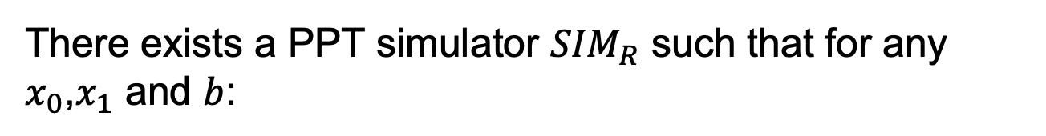
OT Definition
$$x_{0}$$
Choice bit: $b$
$$x_{1}$$
Sender
Receiver
Sender Security: Receiver should not learn $x_{1−b}$.
There exists a PPT simulator ${SIM}_{R}$ such that for any $x_{0}$,$x_{1}$ and $b$:
$${SIM}_{R}(b,x_{b})≅{View}_{R}(x_{0},x_{1},b)$$

Slide 37
OT Protocols

Slide 38

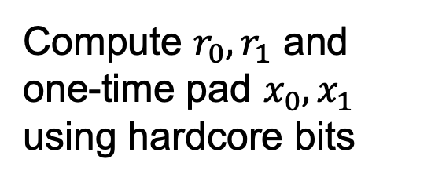
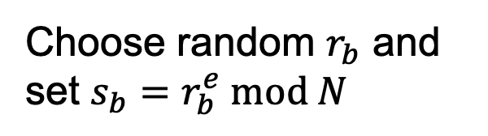
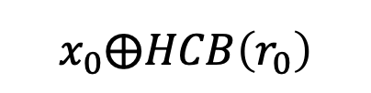
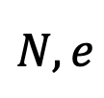

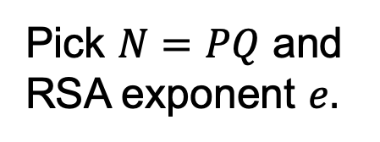
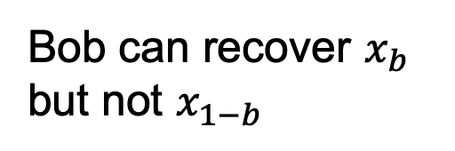
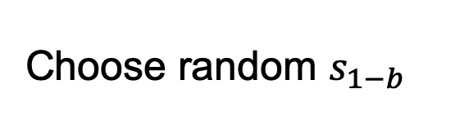
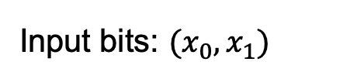
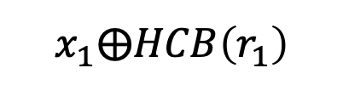
OT Protocol 1: Trapdoor Permutations
For concreteness, let’s use the RSA trapdoor permutation.
Input bits: $(x_{0},x_{1})$
Choice bit: $b$
Pick $N=PQ$ and RSA exponent $e.$
$$N,e$$
Choose random $r_{b}$ and set $s_{b}=r_{b}^{e} mod N$
$$s_{0},s_{1}$$
Choose random $s_{1−b}$
Compute $r_{0},r_{1}$ and one-time pad $x_{0},x_{1}$ using hardcore bits
$$x_{0}⨁HCB\left(r_{0}\right)$$
Bob can recover $x_{b}$ but not $x_{1−b}$
$$x_{1}⨁HCB\left(r_{1}\right)$$

Slide 39

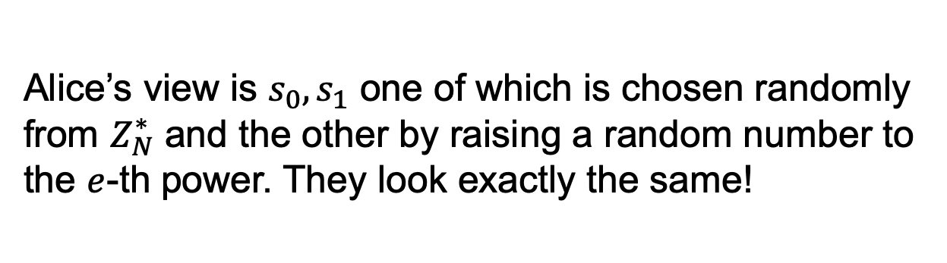
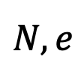
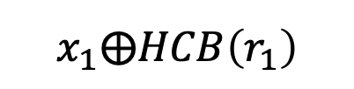
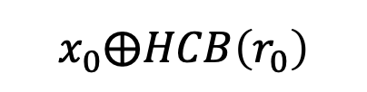
OT Protocol 1: Trapdoor Permutations
$$N,e$$
$$s_{0},s_{1}$$
Input bits: $(x_{0},x_{1})$
Choice bit: $b$
$$x_{0}⨁HCB\left(r_{0}\right)$$
$$x_{1}⨁HCB\left(r_{1}\right)$$
How about Bob’s security (a.k.a. Why does Alice not learn Bob’s choice bit)?
Alice’s view is $s_{0},s_{1}$ one of which is chosen randomly from $Z_{N}^{∗}$ and the other by raising a random number to the $e$-th power. They look exactly the same!

Slide 40
OT Protocol 1: Trapdoor Permutations
$$N,e$$
$$s_{0},s_{1}$$
Input bits: $(x_{0},x_{1})$
Choice bit: $b$
$$x_{0}⨁HCB\left(r_{0}\right)$$
$$x_{1}⨁HCB\left(r_{1}\right)$$
How about Bob’s security (a.k.a. Why does Alice not learn Bob’s choice bit)?
Exercise: Show how to construct the simulator.

Slide 41
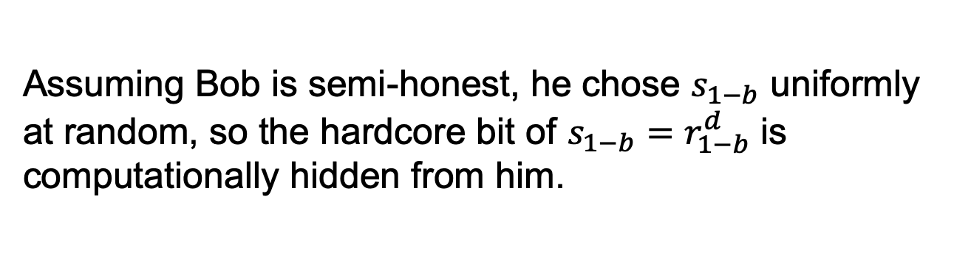
OT Protocol 1: Trapdoor Permutations
$$N,e$$
$$s_{0},s_{1}$$
Input bits: $(x_{0},x_{1})$
Choice bit: $b$
$$x_{0}⨁HCB\left(r_{0}\right)$$
$$x_{1}⨁HCB\left(r_{1}\right)$$
How about Alice’s security (a.k.a. Why does Bob not learn both of Alice’s bits)?
Assuming Bob is semi-honest, he chose $s_{1−b}$ uniformly at random, so the hardcore bit of $s_{1−b}=r_{1−b}^{d}$ is computationally hidden from him.

Slide 42
OT Protocol 1: Trapdoor Permutations
$$N,e$$
$$s_{0},s_{1}$$
Input bits: $(x_{0},x_{1})$
Choice bit: $b$
$$x_{0}⨁HCB\left(r_{0}\right)$$
$$x_{1}⨁HCB\left(r_{1}\right)$$
How about Alice’s security (a.k.a. Why does Bob not learn both of Alice’s bits)?
Exercise: Show how to construct the simulator.

Slide 43
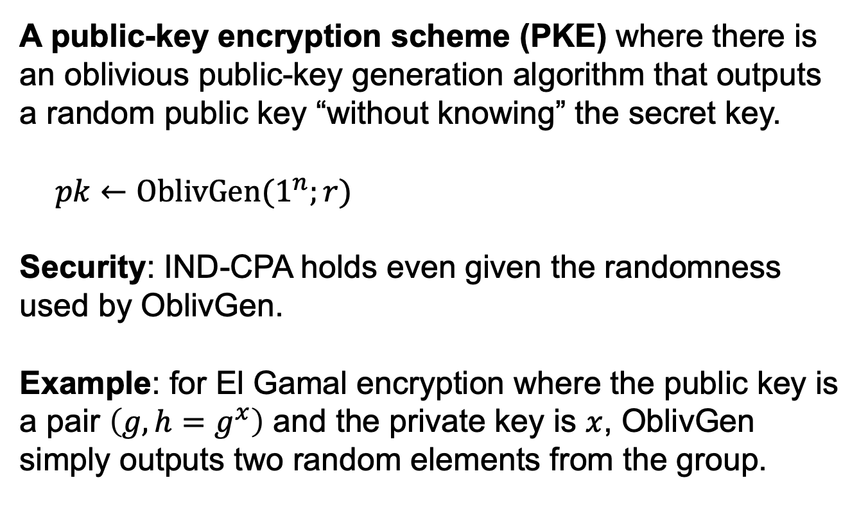
OT Protocol 2: from Oblivious PKE
A public-key encryption scheme (PKE) where there is an oblivious public-key generation algorithm that outputs a random public key “without knowing” the secret key.
$pk←OblivGen(1^{n};r)$
Security: IND-CPA holds even given the randomness used by OblivGen.
Example: for El Gamal encryption where the public key is a pair $\left(g,h=g^{x}\right)$ and the private key is $x$, OblivGen simply outputs two random elements from the group.

Slide 44
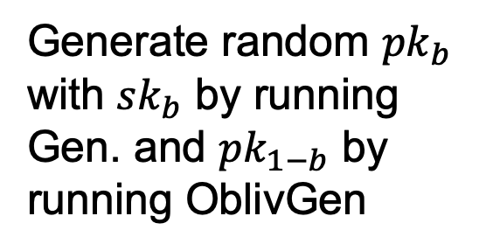

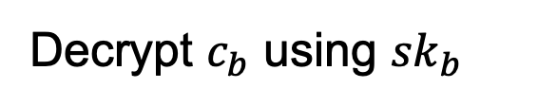
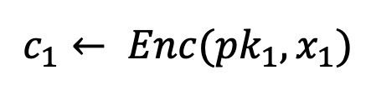

OT Protocol 2: from Oblivious PKE
Input bits: $(x_{0},x_{1})$
Choice bit: $b$
Generate random ${pk}_{b}$ with ${sk}_{b}$ by running Gen. and ${pk}_{1−b}$ by running OblivGen
$${pk}_{0},{pk}_{1}$$
$c_{0}←Enc({pk}_{0}$, $x_{0}$)
$$c_{1}← Enc({pk}_{1},x_{1})$$
Decrypt $c_{b}$ using ${sk}_{b}$

Slide 45
OT Protocol 2: Oblivious PKE
Input bits: $(x_{0},x_{1})$
Choice bit: $b$

Slide 46





OT Protocol 3: Additive HE
Input bits: $(x_{0},x_{1})$
Choice bit: $b$
Encrypt choice bit b
Homomorphically evaluate the selection function
$$c$$
$$c⟵Enc(sk,b)$$
$$c^{′}=Eval({SEL}_{x_{0},x_{1}}(b),c)$$
Decrypt to get $x_{b}$
$${SEL}_{x_{0},x_{1}}\left(b\right)=$$
$(x_{1}$ $⨁{ x}_{0})b ⨁ x_{0}$
Bob’s security: computational, from CPA-security of Enc.
Alice’s security: statistical, from function-privacy of Eval.

Slide 47
Many More Constructions of OT
Theorem: OT protocols can be constructed based on the hardness of the Diffie-Hellman problem, factoring, quadratic residuosity, LWE, elliptic curve isogeny problem etc. etc.

Slide 48
Secure 2PC from OT
Theorem [Goldreich-Micali-Wigderson’87]: OT can solve any two-party computation problem.

Slide 49










How to Compute Arbitrary Functions
For us, programs = functions = Boolean circuits with XOR ($+ mod 2$) and AND ($× mod 2$) gates.
$ab(a′+b′$)
X
$$ab$$
$$a^{′}+b′$$
+
X
$$a$$
$$b$$
$$a′$$
$$b′$$
Want: If you can compute XOR and AND in the appropriate sense, you can compute everything.

Slide 50








Recap: OT $⇒$ Secret-Shared-AND
$$a∈\{0,1\}$$
Alice gets random $γ$, Bob gets random $δ$ s.t. $γ ⨁{δ}=$ $ab$.
$$b∈\{0,1\}$$
Output: $γ$
Output: $δ$
$$x_{0}=γ$$
Run an OT protocol
Choice bit $b$
$x_{1}=a ⨁$ $γ$
Alice outputs $γ$.
$$x_{1}b+ x_{0}\left(1⨁b\right)$$
Bob gets
$=(x_{1}$ $⨁{ x}_{0})b+x_{0}$
$$=ab⨁γ$$
$$≔δ$$

Slide 51









How to Compute Arbitrary Functions
Secret-sharing Invariant: For each wire of the circuit, Alice and Bob each have a bit whose XOR is the value at the wire.
XOR gate: Locally XOR the shares
AND gate??
X
$$a′$$
$$b′$$
+
X
$$a$$
$$0$$
$$a′$$
$$⊕$$
$$0$$
$$0$$
$$b$$
$$0$$
$$⊕$$
$$b′$$
Base Case: Input wires

Slide 52








Recap: XOR gate
$$x⊕x′$$
Alice has $α$ and Bob has $β$ s.t.
+
$$α⊕β=x$$
$$x$$
$$x′$$
Alice has $α′$ and Bob has $β′$ s.t.
$$α′⊕β′=x′$$
Alice computes $α⊕α′$ and Bob computes $β⊕β^{′}.$
So, we have: $(α⊕α′$ $)⊕\left(β⊕β^{′}\right)$ $=\left(α⊕β\right)⊕\left(α^{′}⊕β^{′}\right)=x⊕x′$

Slide 53


AND gate
$$xx′$$
Alice has $α$ and Bob has $β$ s.t.
X
$$α⊕β=x$$
$$x$$
$$x′$$
Alice has $α′$ and Bob has $β′$ s.t.
$$α′⊕β′=x′$$
Desired output (to maintain invariant):
Alice wants $α′′$ and Bob wants $β′′$ s.t. $α^{′′}⊕β^{′′}=xx′$

Slide 54
















AND gate
$$xx′$$
$$xx^{′}=(α⊕β)(α′⊕β′)$$
X
$$γ_{a}$$
$$=αα′⊕βα′⊕αβ′⊕ββ′$$
$$δ_{a}$$
$$x$$
$$x′$$
$$⊕$$
$$γ_{b}$$
$$⊕$$
$$δ_{b}$$
$$β′$$
$$α$$
$$β$$
$$α′$$
ss-AND
ss-AND
$$δ_{a}$$
$$γ_{a}$$
$$δ_{b}$$
$$γ_{b}$$
$$α^{′′}=αα′⊕γ_{a}⊕δ_{a}$$
$$β^{′′}=ββ′⊕γ_{b}⊕δ_{b}$$

Slide 55



How to Compute Arbitrary Functions
Secret-sharing Invariant: For each wire of the circuit, Alice and Bob each have a bit whose XOR is the value at the wire.
Finally, Alice and Bob exchange the shares at the output wire, and XOR the shares together to obtain the output.
$$α$$
$$α⊕β=ab(a^{′}⊕b^{′})$$
$$β$$
X
+
X
$$a$$
$$b$$
$$a′$$
$$b′$$

Slide 56
Security by Composition
Theorem: If protocol $Π$ securely realizes a function $g$ in the “$f$-hybrid model” and protocol $Π′$ securely realizes $f$, then $Π∘Π′$ securely realizes $g$.
$f$-angel
+
Protocol for $g$ in the $f$-hybrid model
Protocol for $f$

Slide 57
Security: Intuition (ss-AND hybrid model)
Imagine that the parties have access to an ss-AND angel.
$$b$$
$$a$$
$$γ$$
$$δ$$
$γ ⨁{δ}=$ $ab$

Slide 58
Security: Intuition (ss-AND hybrid model)
Imagine that the parties have access to an ss-AND angel.
Simulator for Alice’s view:
XOR gate: simulate given Alice’s input shares
X
$$a′$$
$$b′$$
+
X
$$a$$
$$0$$
$$a′$$
$$0$$
$$0$$
$$b$$
$$0$$
$$b′$$
Input wires: can be simulated given Alice’s input

Slide 59

Security: Intuition (ss-AND hybrid model)
Simulator for Alice’s view:
AND gate: simulate given Alice’s input shares & outputs from the ss-AND angel.
Alice’s share $$=a∙0+ssand\left(a,b\right)+ssand(0,0)$$
X
$$a′$$
$$γ_{alice}$$
$$b′$$
$$δ_{alice}$$
+
X
$$a$$
$$0$$
$$a′$$
$$0$$
$$0$$
$$b$$
$$0$$
$$b′$$
$γ_{alice}$ and $δ_{alice}$ are random, independent of $b$

Slide 60
Security: Intuition (ss-AND hybrid model)
Simulator for Alice’s view:
Output wire: need to know both Alice and Bob’s output shares.
Bob’s output share = Alice’s output share $⊕$ function output
X
$$a′$$
$$b′$$
Simulator knows the function output, and can compute Bob’s output share given Alice’s output share.
+
X
$$a$$
$$0$$
$$a′$$
$$0$$
$$0$$
$$b$$
$$0$$
$$b′$$

Slide 61
Secret-Shared AND protocol
Using the RSA trapdoor permutation.
Input bit: $a$
Input bit: $b$
Pick $N=PQ$ and RSA exponent $e.$
$$N,e$$
Choose random $r_{b}$ and set $s_{b}=r_{b}^{e} mod N$
Let $x_{0}$ be random and $x_{1}=x_{0}⨁a.$
$$s_{0},s_{1}$$
Choose random $s_{1−b}$
Compute $r_{0},r_{1}$ and one-time pad $x_{0},x_{1}$ using hardcore bits
$$x_{0}⨁HCB\left(r_{0}\right)$$
$$x_{1}⨁HCB\left(r_{1}\right)$$
Alice outputs $x_{0}$
Bob outputs $x_{b}$

Slide 62
Secret-Shared AND protocol
Using the RSA trapdoor permutation.
Input bit: $a$
Input bit: $b$
Exercise: Construct simulators for Alice and Bob.

Slide 63
In summary: Secure 2PC from OT
Theorem [Goldreich-Micali-Wigderson’87]: Assuming OT exists, there is a protocol that solves any two-party computation problem against semi-honest adversaries.

Slide 64
In fact, GMW does more:
Theorem [Goldreich-Micali-Wigderson’87]: Assuming OT exists, there is a protocol that solves any multi-party computation problem against semi-honest adversaries.

Slide 65
MPC Outline
Secret-sharing Invariant: For each wire of the circuit, the n parties have a bit each, whose XOR is the value at the wire.
Base case: input wires.
XOR gate: given input shares $\left(α_{1},…,α_{n}\right)$ s.t. $⊕_{i=1}^{n}α_{i}=a$ and $\left(β_{1},…,β_{n}\right)$ s.t. $⊕_{i=1}^{n}β_{i}=b$, compute the shares of the output of the XOR gate:
$$\left(α_{1}+β_{1},…,α_{n}+β_{n}\right)$$
AND gate: given input shares as above, compute the shares of the output of the XOR gate:
$$\left(o_{1},…,o_{n}\right) s.t⊕_{i=1}^{n}o_{i}=ab$$
Exercise!

