Slide 1
MIT 6.875
Foundations of Cryptography
Lecture 11

Slide 2
TODAY: Digital Signatures

Slide 3




Message Authentication Codes
m
$$m, t=MAC(sk,m)$$
sk
sk
$$Verify(sk,m,t)$$
Authenticity: Bob wants to ensure that the message came from Alice.
Needs Bob and Alice to share a secret key beforehand.

Slide 4


Digital Signatures: Public-key Analog of MACs
Alice
vk
m
$$m, σ←Sign(sk,m)$$
sk
$$Verify(vk,m,σ)$$
(Public) verification keys are stored in a “directory”.
Only Alice can produce signatures; but Bob (or indeed, anyone else) can verify them.

Slide 5
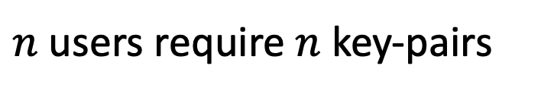
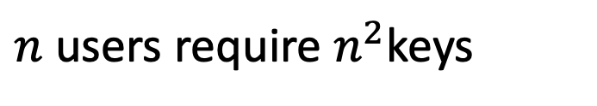
Digital Signatures vs. MACs
Signatures
MACs
$n$ users require $n$ key-pairs
$n$ users require $n^{2}$keys
Publicly Verifiable
Privately Verifiable
Transferable
Not Transferable
Provides Non-Repudiation
Does not provide Non-Rep.
(is this a good thing or a bad thing?)

Slide 6
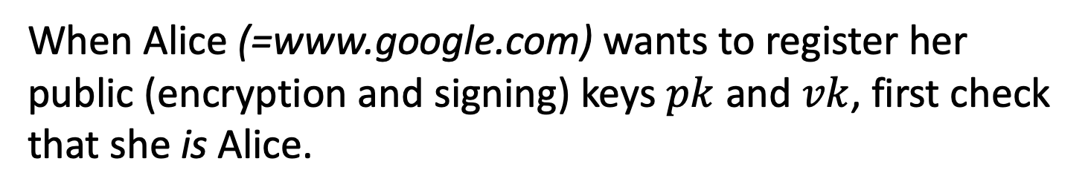

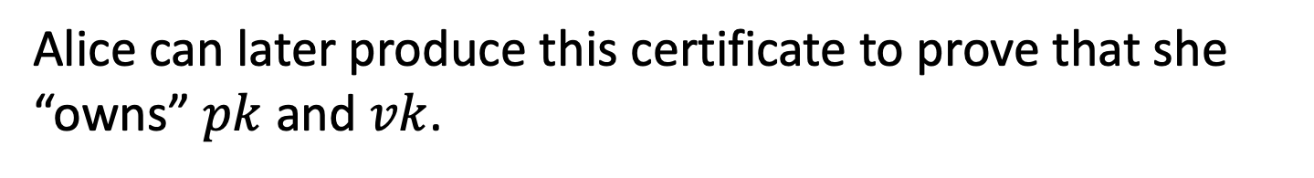
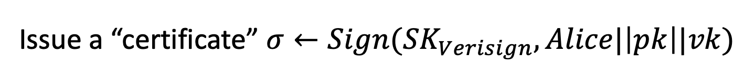
Alice
pk,vk
Other Applications
1. Certificates, or a public-key directory in practice:
Trusted Certificate Authority, e.g. Verisign, Let’s Encrypt.
When Alice (=www.google.com) wants to register her public (encryption and signing) keys $pk$ and $vk$, first check that she is Alice.
Issue a “certificate” $σ←Sign({SK}_{Verisign},Alice|\left|pk\right||vk)$
Alice can later produce this certificate to prove that she “owns” $pk$ and $vk$.
Browsers store ${VK}_{Verisign}$ and check the certificate.

Slide 7
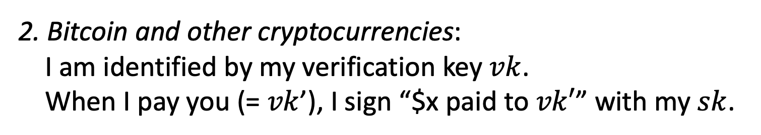
Other Applications
2. Bitcoin and other cryptocurrencies:
I am identified by my verification key $vk$. When I pay you (= $vk$’), I sign “$x paid to $vk′$” with my $sk$.

Slide 8
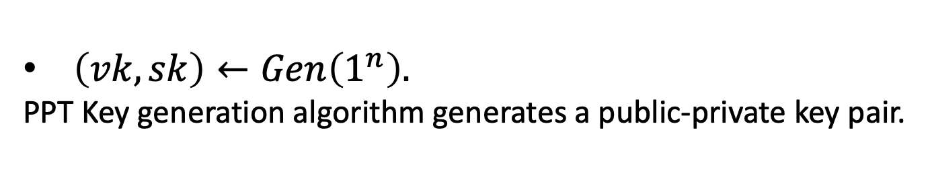
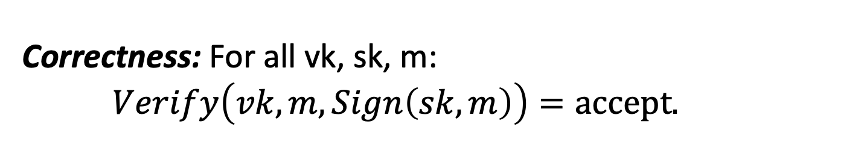
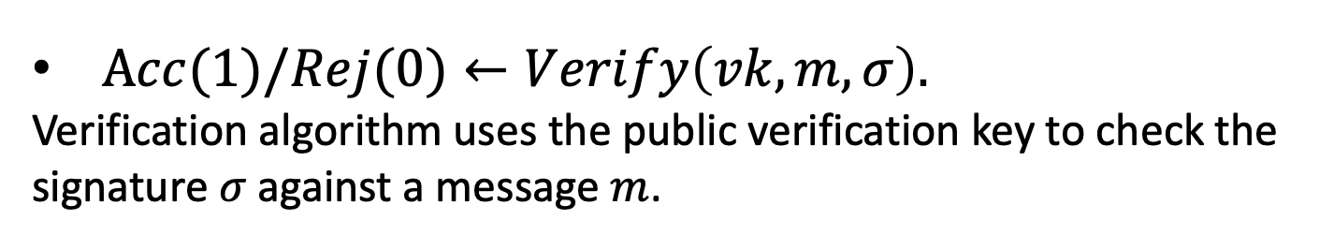
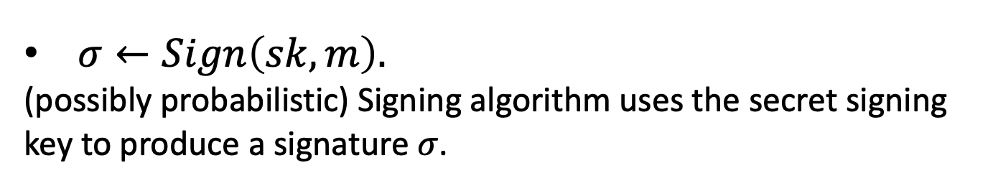
Digital Signatures: Definition
A triple of PPT algorithms $(Gen,Sign,Verify)$ s.t.
$\left(vk,sk\right)←Gen\left(1^{n}\right).$
PPT Key generation algorithm generates a public-private key pair.
$σ←Sign\left(sk,m\right).$
(possibly probabilistic) Signing algorithm uses the secret signing key to produce a signature $σ$.
$Acc(1)/Rej(0)←Verify\left(vk,m,σ\right).$
Verification algorithm uses the public verification key to check the signature $σ$against a message $m$.
Correctness: For all vk, sk, m: $Verify\left(vk,m,Sign\left(sk,m\right)\right)=accept.$

Slide 9
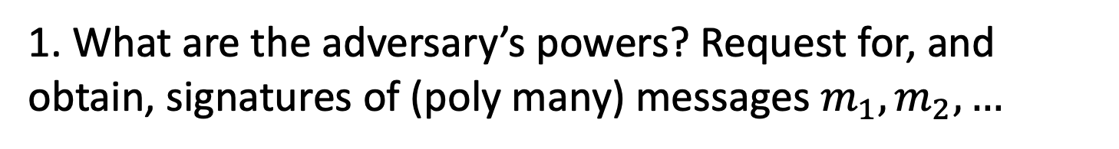
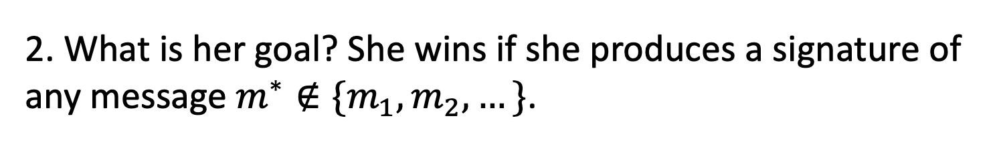
Digital Signatures: Security
“The adversary after seeing signatures of many msgs, should not be able to produce a signature of any new msg.”
1. What are the adversary’s powers? Request for, and obtain, signatures of (poly many) messages $m_{1},m_{2},…$
Chosen-message attack
2. What is her goal? She wins if she produces a signature of any message $m^{∗}∉\{m_{1},m_{2},…\}$.
Existential Forgery

Slide 10





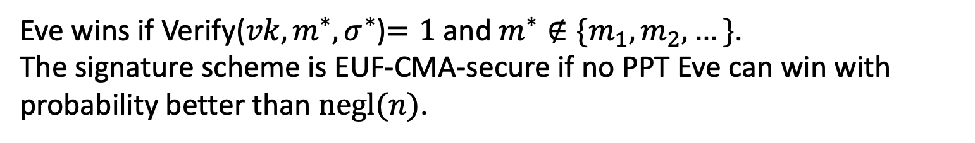



EUF-CMA Security
(Existentially Unforgeable against a Chosen Message Attack)
Challenger
Eve
$$\left(vk,sk\right)←Gen\left(1^{n}\right)$$
$$vk$$
$$m_{i}$$
poly many times
$$σ_{i}$$
$$σ_{i}←Sign(sk,m_{i})$$
$$m^{∗},σ^{∗}$$
Eve wins if Verify(${vk,m}^{∗},σ^{∗}$)$=1$ and $m^{∗}∉\{m_{1},m_{2},…\}$. The signature scheme is EUF-CMA-secure if no PPT Eve can win with probability better than $negl(n)$.
Notes:
Encryption has to be probabilistic.

Slide 11
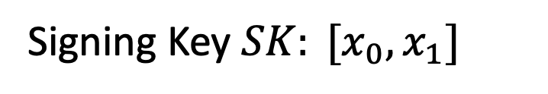
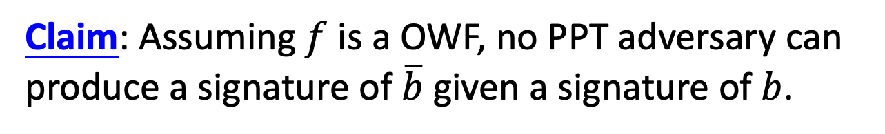

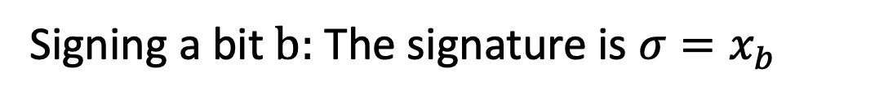
Lamport (One-time) Signatures
How to sign a bit
Signing Key $SK: [x_{0},x_{1}]$
Verification Key $VK: [y_{0}=f(x_{0}),{y_{1}=f(x}_{1})]$
Signing a bit $b:$ The signature is ${σ=x}_{b}$
?
Verifying $(b,σ):$ Check if $f\left(σ\right)=y_{b}$
Claim: Assuming $f$ is a OWF, no PPT adversary can produce a signature of $\overline{b}$ given a signature of $b$.
Notes:
No proof here because we will prove the stronger statement in a few slides

Slide 12



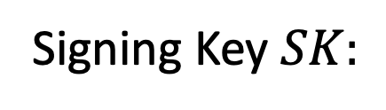




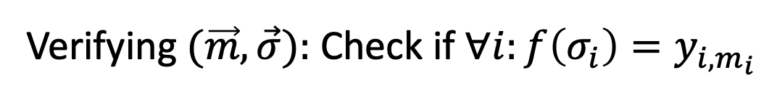


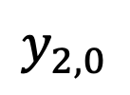


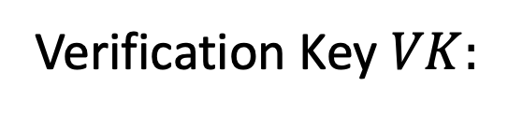

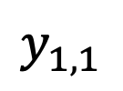
Lamport (One-time) Signatures
How to sign n bits
$$x_{1,0}$$
$$x_{2,0}$$
$$x_{n,0}$$
Signing Key $SK:$
$$x_{1,1}$$
$$x_{2,1}$$
$$x_{n,1}$$
$$y_{1,0}$$
$$y_{2,0}$$
$$y_{n,0}$$
Verification Key $VK:$
$$y_{1,1}$$
$$y_{2,1}$$
$$y_{n,1}$$
where ${y_{i,c}=f(x}_{i,c})$.
Signing an n-bit message $(m_{1},…,m_{n}):$ The signature is $\left(x_{1,m_{1}},…,x_{n,m_{n}}\right).$
?
Verifying $(\vec{m},\vec{σ}):$ Check if $∀i:f\left(σ_{i}\right)=y_{i,m_{i}}$

