Slide 1
MIT 6.875
Foundations of Cryptography
Lecture 6

Slide 2
TODAY
1. Finish up the proof of the Goldreich-Levin Theorem.
2. Secret-key Encryption in Practice
a. Message Authentication Codes
b. Encrypt-then-MAC.
c. The Advanced Encryption Standard (AES)

Slide 3
Goldreich-Levin (GL) Theorem
Let ${\{B}_{r}:{\{0,1\}}^{n}→\{0,1\}\}$ where
$B_{r}\left(x\right)=\left\langle r,x\right\rangle =\sum_{i=1}^{n}{r_{i}x_{i}}mod 2$
be a collection of predicates (one for each $r$). Then, a random $B_{r}$is hardcore for every one-way function $F$. That is, for every one-way function F, every PPT A, there is a negligible function $μ$ s.t.
$$\operatorname{Pr}\left[x←{\left\{0,1\right\}}^{n};r←{\left\{0,1\right\}}^{n}:A\left(F\left(x\right),r\right)=B_{r}(x)\right]≤\frac{1}{2}+μ(n)$$

Slide 4
The Proof
Assume (after averaging) that for $≥1/2p(n)$ fraction of the $x$,
$$\operatorname{Pr}\left[r←{\left\{0,1\right\}}^{n}:P\left(F\left(x\right),r\right)=\left\langle r,x\right\rangle \right]≥\frac{1}{2}+1/2p(n)$$

Slide 5
The Proof Idea: Guess a little
Pick random “seed vectors” $s_{1},…,s_{\log{(m+1)}}$, and guess $c_{j}=\left\langle s_{j},x\right\rangle$ for all$j.$
The probability that all guesses are correct is $\frac{1}{2^{\log{(m+1)}}}=1/(m+1)$ which is not bad.
From the seed vectors, generate many more $r_{i}$.
Let $T_{1},…,T_{m}$ denote all possible non-empty subsets of $\{1,2,…,\log{(m+1)\}.}$ We will let
$r_{i}=⊕_{j∈T_{i}}$ $s_{j}$ and $b_{i}=⊕_{j∈T_{i}}$ $c_{j}$
Key Observation: If the guesses $c_{1},…,c_{\log{(m+1)}}$ are all correct, then so are the $b_{1},…,b_{m}.$

Slide 6
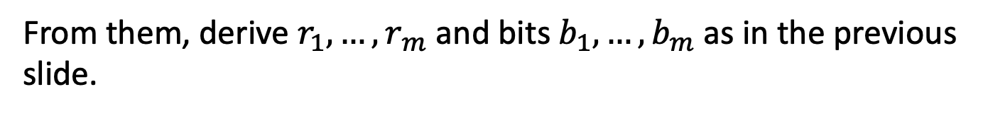
The OWF Inverter
Generate random $s_{1},…,s_{log⁡(m+1)}$ and bits $c_{1},…,c_{log⁡(m+1)}$.
From them, derive $r_{1},…,r_{⁡m}$ and bits $b_{1},…,b_{m}$ as in the previous slide.
Repeat for each $i∈\left\{1,2,…,n\right\}$:
Repeat $100n{(p(n))}^{2}$ times:
Ask $P$ to tells us $\left\langle r_{i}+e_{i},x\right\rangle$. XOR P’s reply with $b_{i}$to get a guess for $x_{i}$.
Compute the majority of all such guesses and set the bit as $x_{i}$
Output the concatenation of all $x_{i}$ as $x.$

Slide 7
Analysis of the Inverter
Let’s condition on the guesses $c_{1},…,c_{log⁡(m+1)}$ being all correct.
The main issue: The $r_{i}$ are not independent (can’t do Chernoff)
Key Observation: The $r_{i}$ are pairwise independent.
Therefore, can apply Chebyshev!
We have that
$p≔ Pr⁡[\text{Inverter} \text{succeeds}\text{ | }\text{all} \text{guesses} \text{correct}, good x]≥0.99.$
(Pf. in the next two slides)

Slide 8
Analysis of the Inverter
The probability that a single iteration of the inner loop gives the correct $x_{i}$ is at least $\frac{1}{2}+1/2p(n)$.
Let this be the good event $E_{j}$ (for the $j^{th}$ iteration of the inner loop).
The majority decision is correct if the number of events $E_{j}$ that occur is at least $\frac{m}{2}=50 n{(p(n))}^{2}.$
The expected number of events that occur is
$(\frac{1}{2}+\frac{1}{2p\left(n\right)})$. $100 n{(p(n))}^{2}=50 n{(p(n))}^{2}+50np\left(n\right).$
The variance is
$≈\frac{1}{4}∙100 n{\left(p\left(n\right)\right)}^{2}=25n{\left(p\left(n\right)\right)}^{2}$

Slide 9
Analysis of the Inverter
The expected number of events that occur is
$(\frac{1}{2}+\frac{1}{2p\left(n\right)})$. $100 n{(p(n))}^{2}=50 n{(p(n))}^{2}+50np\left(n\right).$
The variance is $≈\frac{1}{4}∙100 n{\left(p\left(n\right)\right)}^{2}=25n{\left(p\left(n\right)\right)}^{2}$
By an application of Chebyshev, we have
$\operatorname{Pr}\left[majority decision w.r.t x_{i} incorrect\right]≤\frac{25n{\left(p\left(n\right)\right)}^{2}}{{\left(50np\left(n\right)\right)}^{2}}=\frac{1}{100n}$
By an application of union bound, we have
$\operatorname{Pr}\left[one of the x_{i} is incorrect\right]≤n∙\frac{1}{100n}=1/100$
$∴$ The inverter outputs the correct inverse w.p. $p≥0.99.$

Slide 10
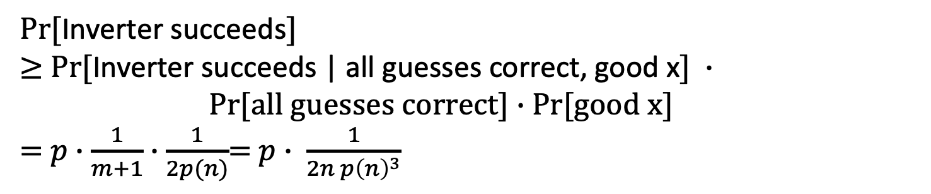
Putting it all together
$Pr⁡[$Inverter succeeds$]$
$≥$ $Pr⁡[$Inverter succeeds | all guesses correct, good x$] ∙$
$Pr[all guesses correct]∙$ Pr[good x]
= $p∙\frac{1}{m+1}∙\frac{1}{2p(n)}$= $p∙ \frac{1}{2n {p\left(n\right)}^{3}}$
So, it suffices to show that $p$is large.
By our calculation (last two slides), $p≥0.99$, so we are done.
Can also make the success probability $≈1/p(n)$ by enumerating over all the “guesses”. Each guess results in a supposed inverse, but we can check which of them is the actual inverse!

Slide 11
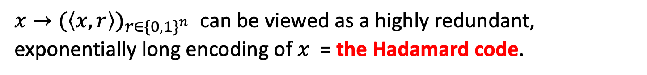

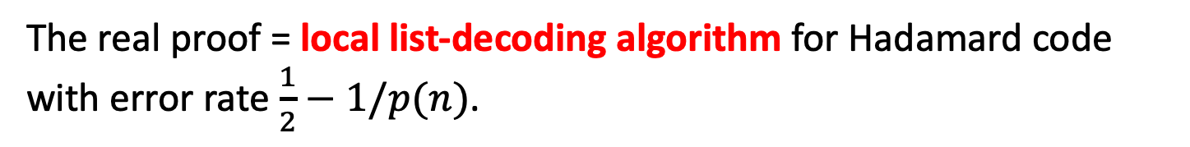
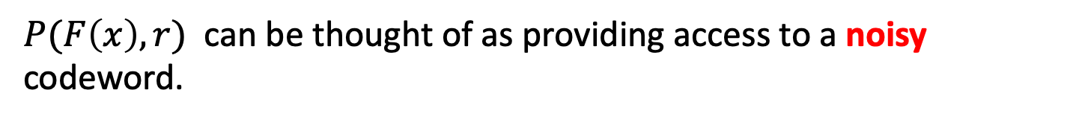
The Coding-Theoretic View of GL
$x→{(\left\langle x,r\right\rangle )}_{r∈{\{0,1\}}^{n}}$ can be viewed as a highly redundant, exponentially long encoding of $x$ = the Hadamard code.
$P(F\left(x\right),r)$ can be thought of as providing access to a noisy codeword.
The baby proof = local decoding algorithm for Hadamard code with no errors.
The toddler proof = local unique decoding algorithm for Hadamard code with error rate $\frac{1}{4}−1/p(n)$.
The real proof = local list-decoding algorithm for Hadamard code with error rate $\frac{1}{2}−1/p(n)$.

Slide 12
Hardcore Predicates from any
List-Decodable Code
(due to Impagliazzo and Sudan)
$x→C(x)$ is the encoding.
Given a $C(x)$ that is incorrect at $\frac{1}{2}−ε$ fraction of the locations, a list-decoder outputs a list $\{x_{1},…,x_{m}\}$ of possibilities for $x$.
The hardcore predicate is
$$B_{i}\left(x\right)= {C(x)}_{i}.$$
A hardcore-bit predictor gives us access to a corrupted codeword. Running the list-decoder on it gives us the list of possible inverses. The fact that the OWF is easy to compute means that we can filter out the bogus (non-)inverses.

Slide 13
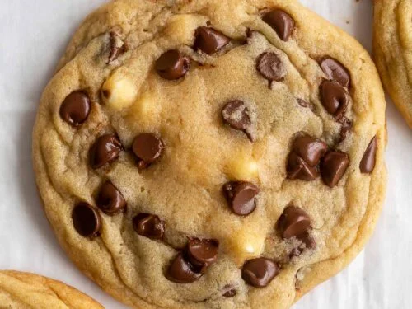
Universal Hardcore Predicate Conjecture 1
For every one-way function $F$,
there exists a circuit $B_{F}$ s.t.
for every PPT Circuit/Turing Machine A,
there is a negligible function $μ$ s.t.
$$\operatorname{Pr}\left[x←{\left\{0,1\right\}}^{n} :A\left(F\left(x\right)\right)=B_{F}(x)\right]≤\frac{1}{2}+μ(n)$$
In fact: I conjecture that for every one-way function $F$, there exists an $r_{F}$ for which the predicate $B_{r_{F}}\left(x\right)= \left\langle r_{F},x\right\rangle$ that is hardcore.

Slide 14
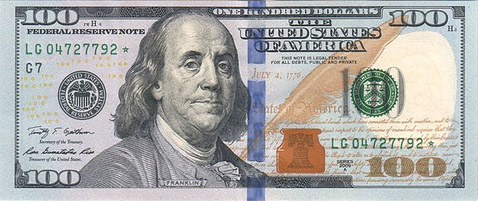
Universal Hardcore Predicate Conjecture 2
For every one-way function $F$,
there is an efficiently generatable circuit $B_{F}$ s.t.
for every PPT Circuit/Turing Machine A,
there is a negligible function $μ$ s.t.
$$\operatorname{Pr}\left[x←{\left\{0,1\right\}}^{n} :A\left(F\left(x\right)\right)=B_{F}(x)\right]≤\frac{1}{2}+μ(n)$$

Slide 15

TODAY
1. Finish up the proof of the Goldreich-Levin Theorem.
2. Secret-key Encryption in Practice
a. Message Authentication Codes
b. Encrypt-then-MAC.
c. The Advanced Encryption Standard (AES)

Slide 16
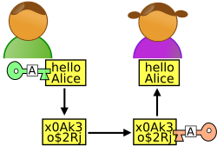




Secure Communication
m
$m⊕k$
$m′⊕k$
Alice
Bob
Can toggle between m and m’
K$ey k$
Key $k$
One-time pad (and encryption schemes in general) are malleable.

Slide 17


Secure Communication
m
$(r,f_{k}(r)⊕m$)
$(r,f_{k}\left(r\right)⊕m^{′})$
Alice
Bob
Can toggle between m and m’
K$ey k$
Key $k$
One-time pad (and encryption schemes in general) are malleable.

Slide 18

Message Authentication Codes
Three Algorithms
m
$$(m,t)$$
Alice
Bob
K$ey k$
Key $k$
1. $KeyGen\left(1^{n}\right):$ Generates a key $k$.
2. $MAC\left(k,m\right):$ Generates a MAC/tag $t$ for the message $m.$
3. $Verify\left(k,m,t\right):$ Checks that $t$is a valid MAC for $m.$
Notes:
Definition

Slide 19

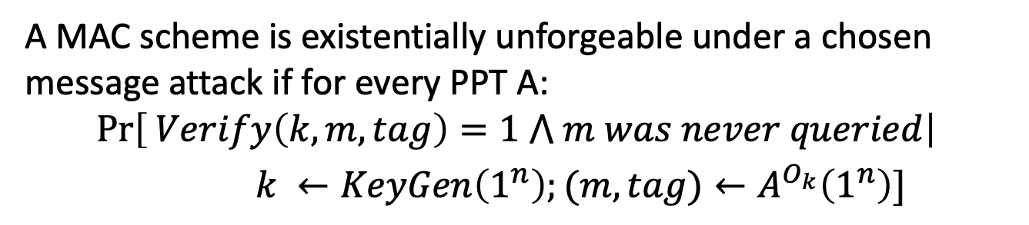
Message Authentication Codes
Security Definition
m
$$(m,tag)$$
Alice
Bob
K$ey k$
Key $k$
Let $O_{k}$ be an oracle that, given $m$, outputs $tag={MAC}_{k}(m)$.
A MAC scheme is existentially unforgeable under a chosen message attack if for every PPT A:
$$\operatorname{Pr}\left[ Verify\left(k,m,tag\right)=1 ⋀ m was never queried\right|$$
$k ←KeyGen\left(1^{n}\right);(m,tag)←A^{O_{k}}\left(1^{n}\right)]$
Notes:
Very complicatd to write down as a prob expression so we will work with security games.

Slide 20
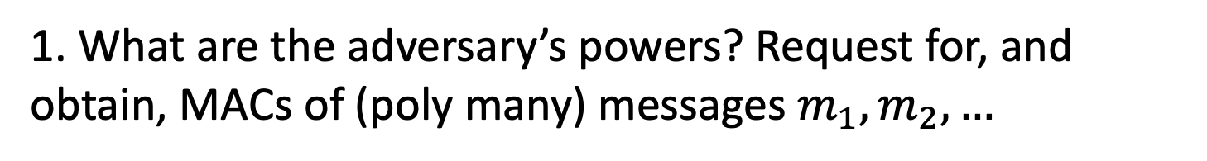
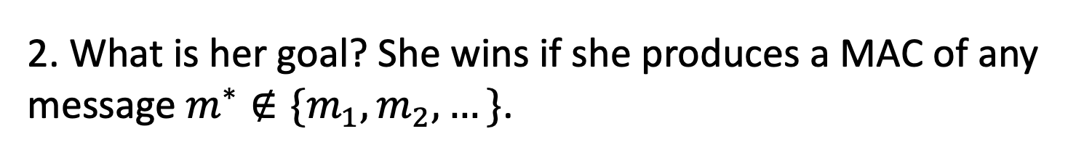
MAC Security
“The adversary after seeing MACs of many msgs, should not be able to produce a MAC of any new msg.”
1. What are the adversary’s powers? Request for, and obtain, MACs of (poly many) messages $m_{1},m_{2},…$
Chosen-message attack
2. What is her goal? She wins if she produces a MAC of any message $m^{∗}∉\{m_{1},m_{2},…\}$.
Existential Forgery

Slide 21






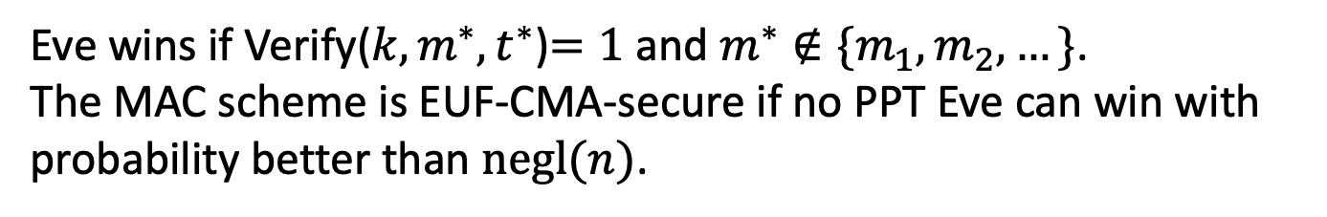

EUF-CMA Security
(Existentially Unforgeable against a Chosen Message Attack)
Challenger
Eve
$$k←Gen\left(1^{n}\right)$$
$$m_{i}$$
poly many times
$$t_{i}$$
$$t_{i}←MAC(k,m_{i})$$
$$m^{∗},t^{∗}$$
Eve wins if Verify(${k,m}^{∗},t^{∗}$)$=1$ and $m^{∗}∉\{m_{1},m_{2},…\}$.
The MAC scheme is EUF-CMA-secure if no PPT Eve can win with probability better than $negl(n)$.
Notes:
Encryption has to be probabilistic.

Slide 22
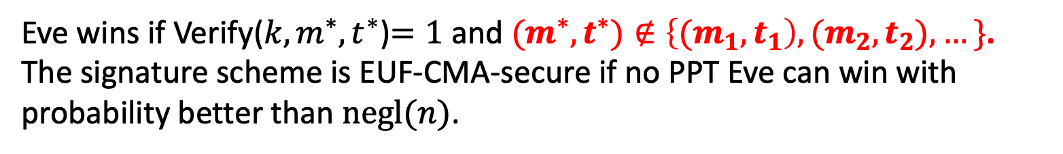
Strong EUF-CMA Security
(Existentially Unforgeable against a Chosen Message Attack)
Challenger
Eve
$$k←Gen\left(1^{n}\right)$$
$$m_{i}$$
poly many times
$$t_{i}$$
$$t_{i}←MAC(k,m_{i})$$
$$m^{∗},t^{∗}$$
Eve wins if Verify(${k,m}^{∗},t^{∗}$)$=1$ and ${(m}^{∗},t^{∗})∉\left\{{(m}_{1},t_{1}\right),{(m}_{2},t_{2}),…\}$.
The signature scheme is EUF-CMA-secure if no PPT Eve can win with probability better than $negl(n)$.
Notes:
Encryption has to be probabilistic.

Slide 23



Message Authentication Codes: Construction
m
${{MAC}_{k}\left(m\right)= f}_{k}(m)$
Alice
Bob
K$ey k$
Key $k$

Slide 24



How to Encrypt
m
${ (c=\left(x,f_{k}\left(x\right)⨁m\right), t=f}_{k′}(c))$
Alice
Bob
K$eys k,k′$
Keys $k,k′$
MACs give us integrity, but not privacy.
Solution: Encrypt, then MAC (more in pset 3)

Slide 25
TODAY
1. Finish up the proof of the Goldreich-Levin Theorem.
2. Secret-key Encryption in Practice
a. Message Authentication Codes
b. Encrypt-then-MAC.
c. The Advanced Encryption Standard (AES)

Slide 26






Pseudorandom Permutations in Practice (also called “block ciphers”)
AES = Advanced Encryption Standard
Most widely-used cryptographic algorithm, by far.
Candidate (fixed-parameter) PRF/PRP
AES
On-chip implementation (e.g., AES-NI)
$$X$$
$$Y$$
Building block for encryption, authentication, authenticated encryption, disk encryption, …
$$K$$
$$\left|X\right|=\left|Y\right|=128$$
$$\left|K\right|∈\{128,192,256\}$$
AES
Notes:
Concretely, what we are concerned with in this work is the security of block cipher algorithms like AES, the advanced encryption standard.
AES is by far the most widely used cryptographic algorithm in practice – the fact that is ia block cipher, meaning an algorithm which encrypts short blocks of length 128 bits using a secret key. It is standardized, implemented on most modern chips, and is used within countless methods for encrypting and authenticating data.
For this reason, AES has a big target on its back - if the security of AES is compromised, this would be a major problem.

Slide 27
How does AES
look like?

Slide 28










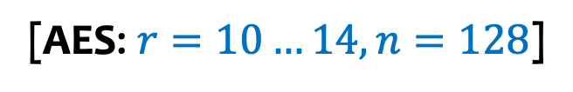
AES is a Key-Alternating Cipher* (KAC)
* = with minor differences
$$K_{0}$$
$$K_{1}$$
$$K_{2}$$
$$K_{r−2}$$
$$K_{r−1}$$
$$K_{r}$$
$$π$$
$$π$$
$$π$$
$$π$$
$n$-bit
$π$ = public, easily invertible permutation of $n$-bit strings
[AES: $r=10…14, n=128$]
Notes:
Let me explain to you the challenge by showing you how AES and similar block ciphers actually work
AES is, at its core something we call a key-alternating cipher – this is a block cipher which encrypts an n-bit block by xoring part of the secret key to the the input, and then applying a permutation \pi, which is a fixed, invertible permutation. Then this is repeated over and over again, and finally part of the key is again added.

Slide 29










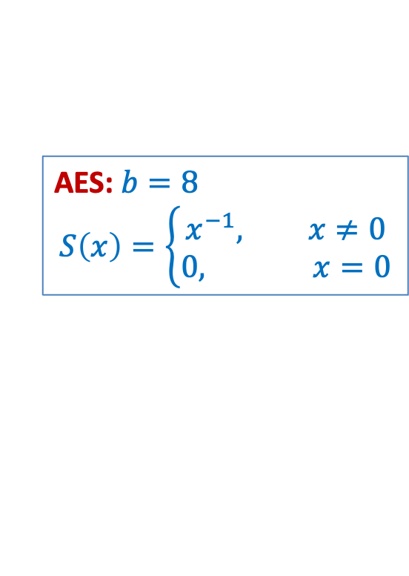












AES is a Substitution-Permutation Network (SPN)
$$K_{0}$$
$$K_{1}$$
$$K_{2}$$
$$K_{8}$$
$$K_{9}$$
$$K_{10}$$
$$π$$
$$π$$
$$π$$
$$π$$
$$n=k×b$$
$S$ = non-linear substitution box
$$π$$
AES: $b=8$
$$S\left(x\right)=x^{2^{b}−2}$$
$$S$$
AES: $b=8$
$$S\left(x\right)=\left\{\begin{aligned}x^{−1}, x≠0 \\ &0, x=0\end{aligned}\right.$$
$b$-bit
$$S$$
$$M$$
[+$𝔽_{2}$-affine function]
…
…
…
[+$𝔽_{2}$-affine function]
$$S$$
$M$ = linear mixing layer
Notes:
In fact, we can be little more precise, and point that AES is a substitution permutation cipher, or SPN – which is a particular way of instantiating the permutation in the block cipher.
An SPN splits the n-bit input into shorter blocks of length b bits, and then each block is first individually substtutited by another value

Slide 30

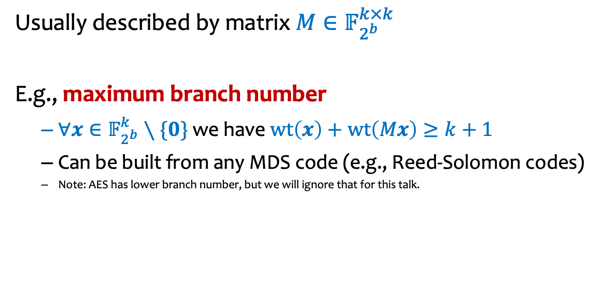





Mixing layers
$$π$$
$b$-bit
$$S$$
$$S$$
$$M$$
Usually described by matrix $M∈𝔽_{2^{b}}^{k×k}$
E.g., maximum branch number
  $∀x∈𝔽_{2^{b}}^{k}∖\{0\}$ we have $wt\left(x\right)+wt\left(Mx\right)≥k+1$
  Can be built from any MDS code (e.g., Reed-Solomon codes)
  Note: AES has lower branch number, but we will ignore that for this talk.
…
…
…
$$S$$

Slide 31


The bottom line
$$π$$
Individual AES rounds are very weak …
$b$-bit
$$S$$
$$S$$
$$M$$
… with no measurable cryptographic security …
…
…
…
$$S$$
… yet, somehow, they become secure when iterated!
Which problem??
AES is a secure pseudorandom permutation
No Proofs of Security!
A Recent Line of Work: Prove Security against a class of well-known (and increasingly powerful) attacks.

Slide 32
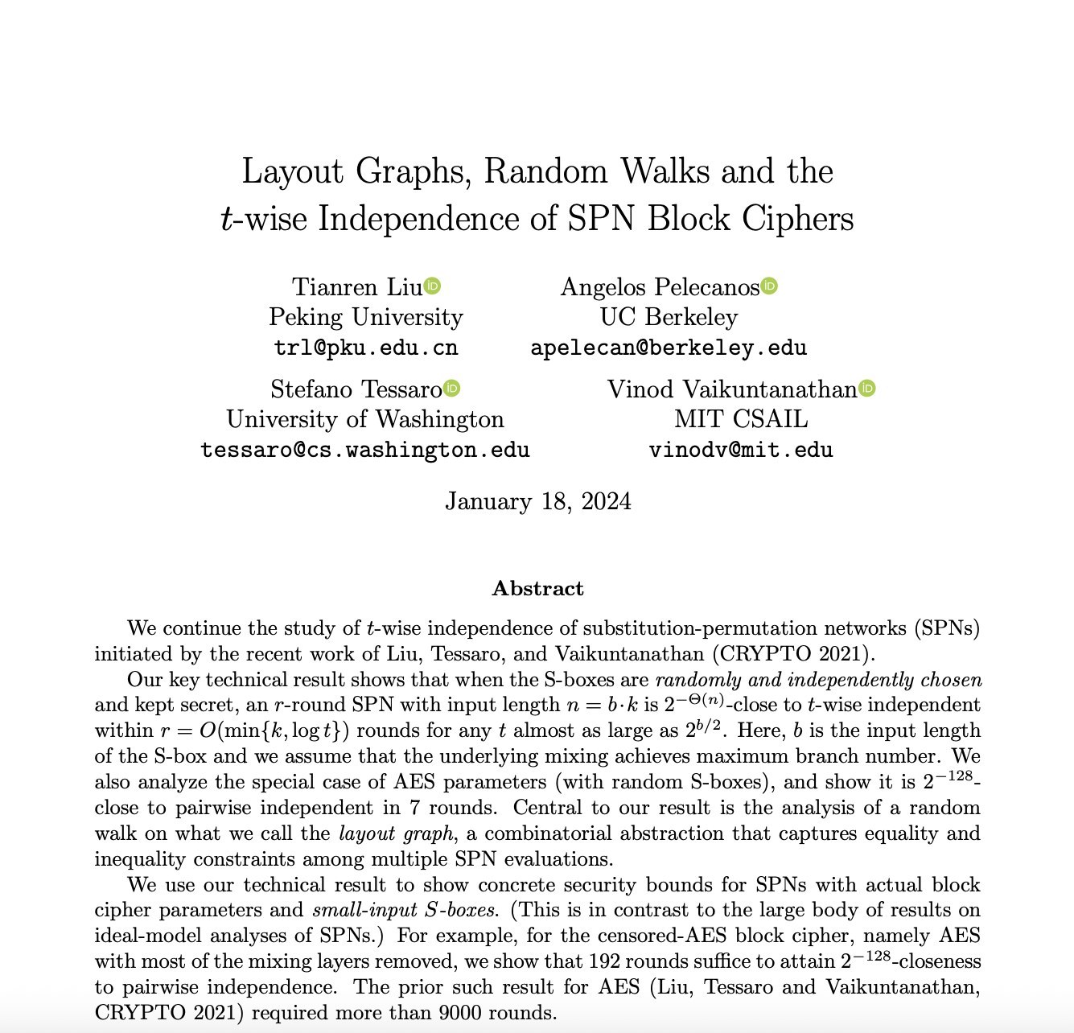
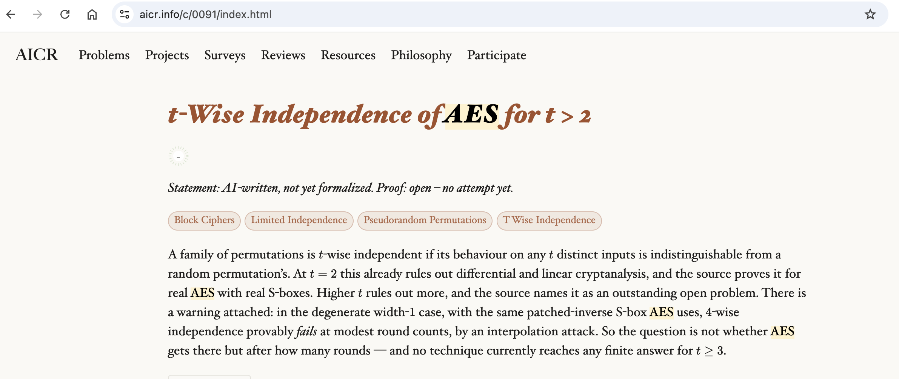
Many Open Problems
https://eprint.iacr.org/2024/083.pdf
https://aicr.info/c/0091/index.html

Slide 33
Fin.

Slide 34
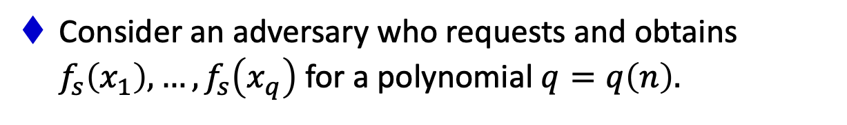
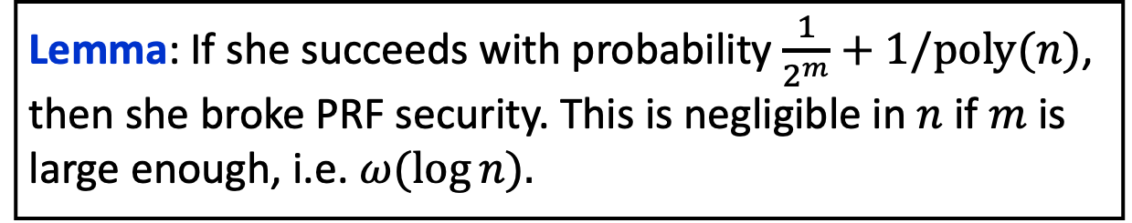
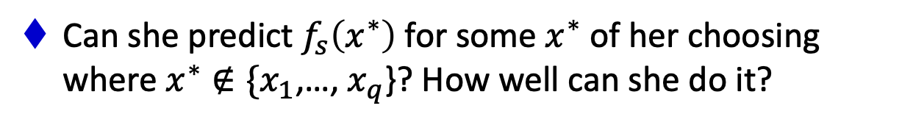
A Simple Lemma about Unpredictability
Let $f_{s}:\{0,1\}^{ℓ}→\{0,1\}^{m}$ be a pseudorandom function.
Consider an adversary who requests and obtains $f_{s}\left(x_{1}\right),…,f_{s}\left(x_{q}\right)$ for a polynomial $q=q\left(n\right).$
Can she predict $f_{s}\left(x^{∗}\right)$ for some $x^{∗}$ of her choosing where $x^{∗}∉\{x_{1}$,…, $x_{q}$}? How well can she do it?
Lemma: If she succeeds with probability $\frac{1}{2^{m}}+1/poly(n)$, then she broke PRF security. This is negligible in $n$ if $m$ is large enough, i.e. $ω(\log{n).}$

Slide 35
A Simple Lemma about Unpredictability
Let $f_{s}:\{0,1\}^{ℓ}→\{0,1\}^{m}$ be a pseudorandom function.
Consider an adversary who requests and obtains $f_{s}\left(x_{1}\right),…,f_{s}\left(x_{q}\right)$ for a polynomial $q=q\left(n\right).$
Can she predict $f_{s}\left(x^{∗}\right)$ for some $x^{∗}$ of her choosing where $x^{∗}∉\{x_{1}$,…, $x_{q}$}? How well can she do it?
Unpredictability $≡$ Indistinguishability for bits (lecture 3)
Indistinguishability $⟹$ Unpredictability (but not vice versa).

Slide 36
Message Authentication Codes: Proof

