Slide 1
MIT 6.875
Foundations of Cryptography
Lecture 16

Slide 2
Interaction is Necessary for ZK
Theorem: If a language L has a non-interactive (one-message) ZK proof system, then L can be decided in probabilistic polynomial time.

Slide 3

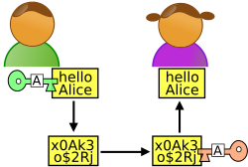
Two Roads to Non-Interactive ZK (NIZK)
1. Random Oracle Model & Fiat-Shamir Transform.
Random Oracle
Graph G
Graph G
$$π$$
2. Common Random String Model.

Slide 4




The Common Random String Model
CRS
010111000101010010
Graph G
Graph G
$$π$$

Slide 5

The Common Reference String Model
$$CRS←D$$
(e.g., CRS = product of two primes)
Graph G
Graph G
$$π$$

Slide 6
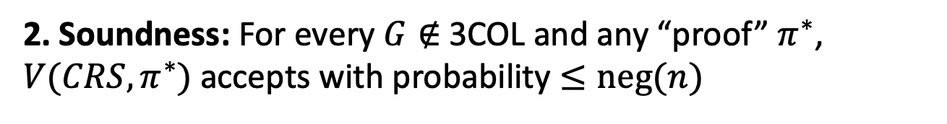
NIZK in the CRS Model
CRS
010111000101010010
Graph G
Graph G
$$π$$
1. Completeness: For every $G∈$3COL, V accepts P’s proof.
2. Soundness: For every $G∉$3COL and any “proof” $π^{∗}$, ${V(CRS,π}^{∗})$ accepts with probability $≤neg(n)$

Slide 7
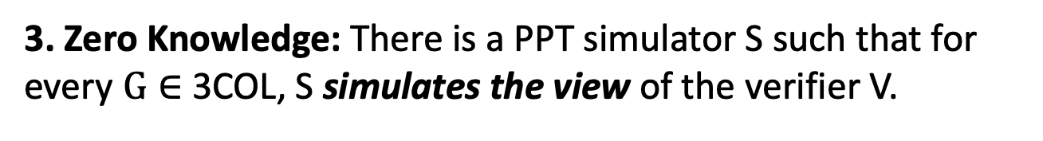
NIZK in the CRS Model
CRS
010111000101010010
Graph G
Graph G
$$π$$
3. Zero Knowledge: There is a PPT simulator S such that for every $G∈$ 3COL, S simulates the view of the verifier V.
$S(G)≈(CRS←D,$ $π←P(G,colors))$

Slide 8
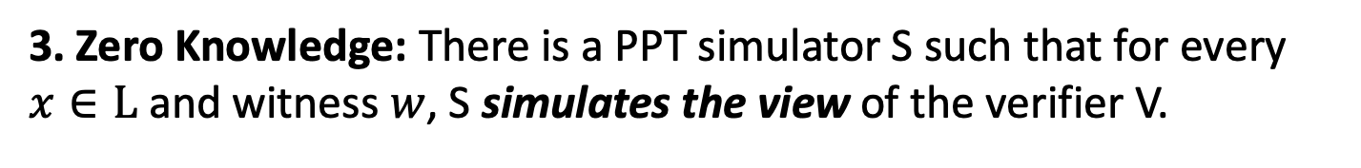
NIZK in the CRS Model
CRS
010111000101010010
Graph G
Graph G
$$π$$
3. Zero Knowledge: There is a PPT simulator S such that for every $x∈L$ and witness $w$, S simulates the view of the verifier V.
$S(x)≈(CRS←D,$ $π←P(x,w))$

Slide 9
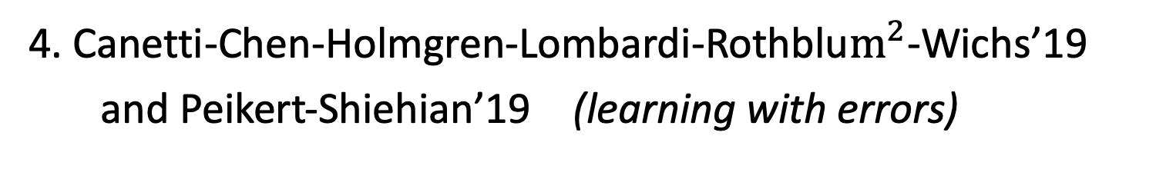
HOW TO CONSTRUCT NIZK IN THE CRS MODEL
1. Blum-Feldman-Micali’88 (quadratic residuosity)
1. Blum-Feldman-Micali’88 (quadratic residuosity)
2. Feige-Lapidot-Shamir’90 (factoring)
3. Groth-Ostrovsky-Sahai’06 (bilinear maps)
4. Canetti-Chen-Holmgren-Lombardi-Rothblu$m^{2}$-Wichs’19
and Peikert-Shiehian’19 (learning with errors)

Slide 10
HOW TO CONSTRUCT NIZK IN THE CRS MODEL
Step 1. Review our number theory hammers & polish them.
Step 2. Construct NIZK for a special NP language, namely quadratic non-residuosity.
Step 3. Bootstrap to NIZK for 3SAT, an NP-complete language.

Slide 11
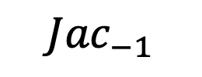
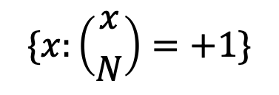
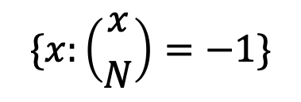

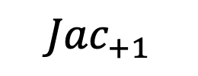
Quadratic Residuosity
Let $N=pq$ be a product of two large primes.
$$Z_{N}^{∗}$$
$${Jac}_{−1}$$
$${Jac}_{+1}$$
$$\{x:\left({x \atop N}\right)=−1\}$$
$$\{x:\left({x \atop N}\right)=+1\}$$

Slide 12
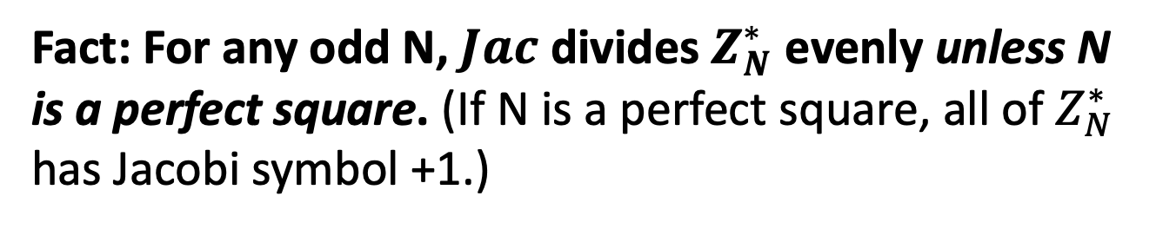
Quadratic Residuosity
Fact: For any odd N, $Jac$ divides $Z_{N}^{∗}$ evenly unless N is a perfect square. (If N is a perfect square, all of $Z_{N}^{∗}$ has Jacobi symbol +1.)
$$Z_{N}^{∗}$$
$${Jac}_{−1}$$
$${Jac}_{+1}$$
$$\{x:\left({x \atop N}\right)=−1\}$$
$$\{x:\left({x \atop N}\right)=+1\}$$

Slide 13
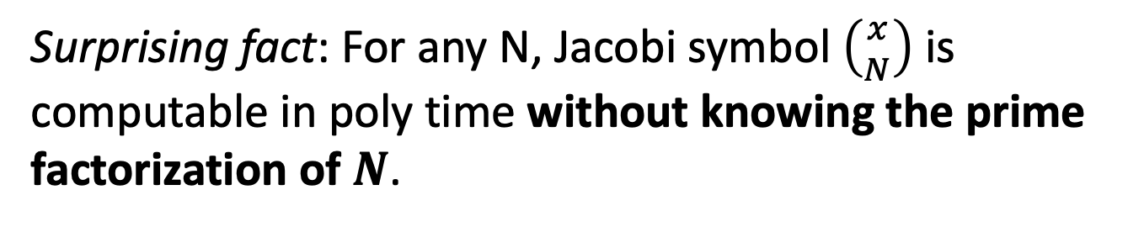
Quadratic Residuosity
Surprising fact: For any N, Jacobi symbol $\left({x \atop N}\right)$ is computable in poly time without knowing the prime factorization of $N$.
$$Z_{N}^{∗}$$
$${Jac}_{−1}$$
$${Jac}_{+1}$$
$$\{x:\left({x \atop N}\right)=−1\}$$
$$\{x:\left({x \atop N}\right)=+1\}$$

Slide 14

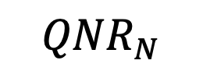
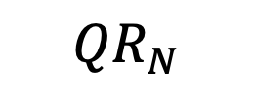
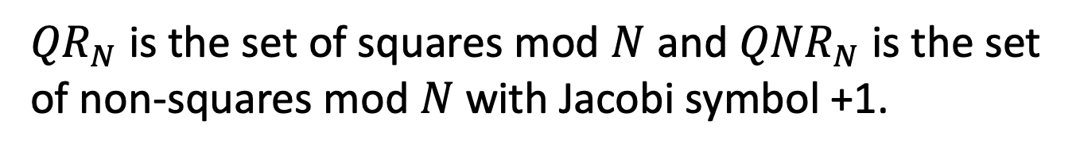
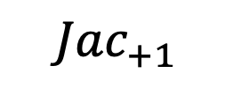

Quadratic Residuosity
Let $N=pq$ be a product of two large primes.
$${Jac}_{+1}$$
So: ${QR}_{N}= \{x:\left({x \atop p}\right)=\left({x \atop q}\right)=+1\}$
$${QR}_{N}$$
${QNR}_{N}= \{x:\left({x \atop p}\right)=\left({x \atop q}\right)=−1\}$
$${QNR}_{N}$$
${QR}_{N}$ is the set of squares mod $N$ and ${QNR}_{N}$ is the set of non-squares mod $N$ with Jacobi symbol +1.

Slide 15
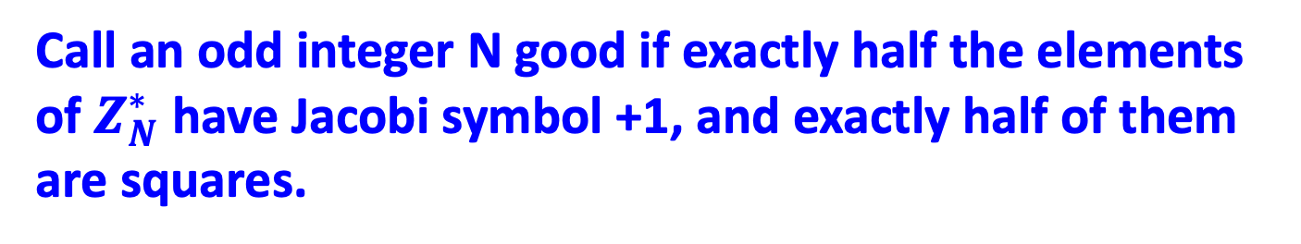
Quadratic Residuosity
Call an odd integer N good if exactly half the elements of $Z_{N}^{∗}$ have Jacobi symbol +1, and exactly half of them are squares.
$${Jac}_{+1}$$
$${QR}_{N}$$
$${QNR}_{N}$$
${QR}_{N}$ is the set of squares mod $N$ and ${QNR}_{N}$ is the set of non-squares mod $N$ with Jacobi symbol +1.

Slide 16

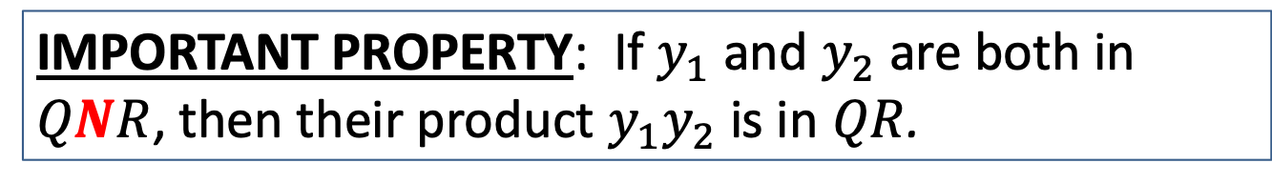
Quadratic Residuosity
Fact: N is good iff $N=p^{i}q^{j} is odd, and i,j≥1, not both even.$
$${Jac}_{+1}$$
$${QR}_{N}$$
$${QNR}_{N}$$
IMPORTANT PROPERTY: If $y_{1}$ and $y_{2}$ are both in $QNR$, then their product $y_{1}y_{2}$ is in $QR$.

Slide 17


Quadratic Residuosity
The fraction of residues smaller if $N$ has three or more prime factors!
$${Jac}_{+1}$$
$${QR}_{N}$$
$${QNR}_{N}$$
IMPORTANT PROPERTY: If $y_{1}$ and $y_{2}$ are both in $QNR$, then their product $y_{1}y_{2}$ is in $QR$.

Slide 18
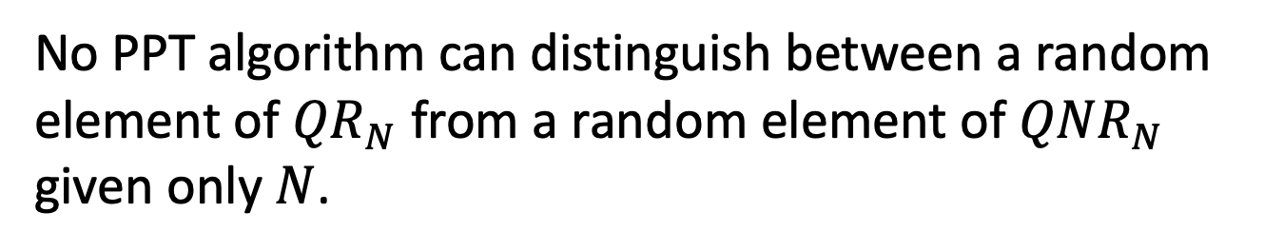
Quadratic Residuosity
Let $N=pq$ be a product of two large primes.
Quadratic Residuosity Assumption (QRA)
No PPT algorithm can distinguish between a random element of ${QR}_{N}$ from a random element of ${QNR}_{N}$ given only $N$.

Slide 19
HOW TO CONSTRUCT NIZK IN THE CRS MODEL
Step 1. Review our number theory hammers & polish them.
Step 2. Construct NIZK for a special NP language, namely quadratic non-residuosity.
Step 3. Bootstrap to NIZK for 3SAT, an NP-complete language.

Slide 20

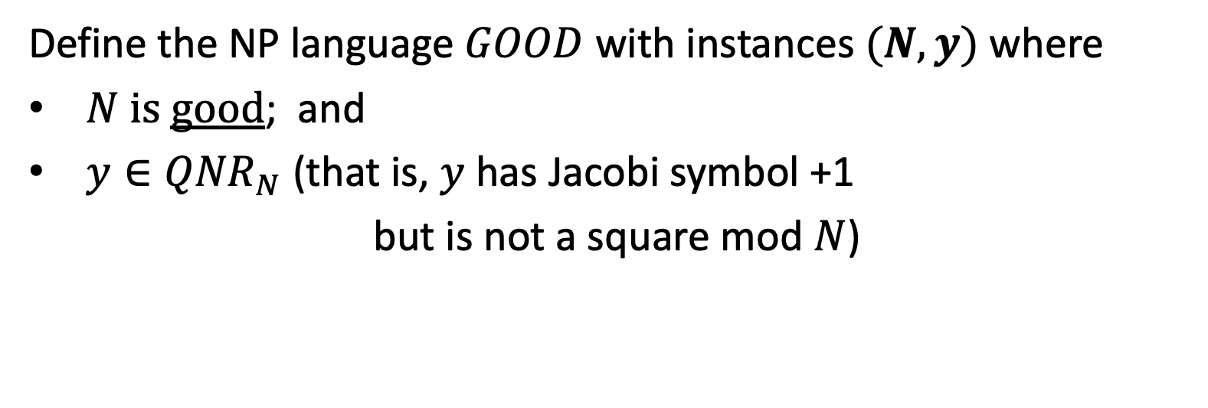




NIZK for Quadratic Non-Residuosity
Define the NP language $GOOD$ with instances $(N,y)$ where
$N$ is good; and
$y∈{QNR}_{N}$ (that is, $y$ has Jacobi symbol +1
but is not a square mod $N$)
$$Z_{N}^{∗}$$
$${QR}_{N}$$
$${Jac}_{−1}$$
$${Jac}_{+1}$$
$${QNR}_{N}$$

Slide 21
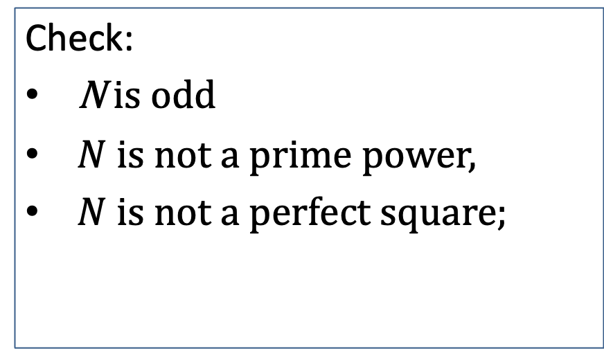
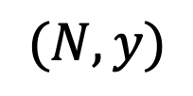
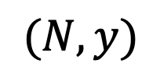
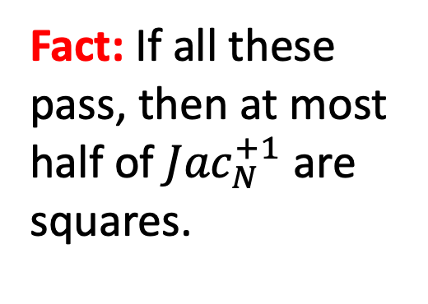
NIZK for Quadratic Non-Residuosity
$$CRS=(r_{1},r_{2},…,r_{m})←{({Jac}_{N}^{+1})}^{m}$$
$$(N,y)$$
$$(N,y)$$
Check:
N is odd
$N$ is not a prime power,
$N$ is not a perfect square;
Fact: If all these pass, then at most half of ${Jac}_{N}^{+1}$ are squares.

Slide 22
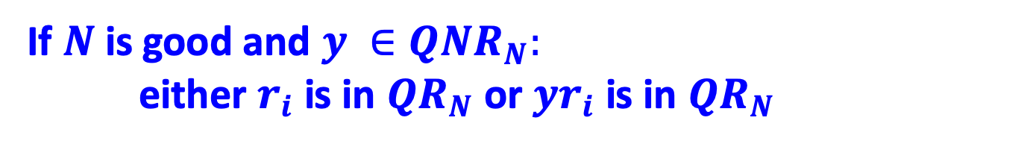

NIZK for Quadratic Non-Residuosity
$$CRS=(r_{1},r_{2},…,r_{m})←{({Jac}_{N}^{+1})}^{m}$$
$$(N,y)$$
$$(N,y)$$
If $N$ is good and $y ∈{QNR}_{N}:$ either $r_{i}$ is in ${QR}_{N}$ or ${yr}_{i}$ is in ${QR}_{N}$
so I can compute $\sqrt{r_{i}}$ or $\sqrt{yr_{i}}$.
If not … I’ll be stuck!

Slide 23
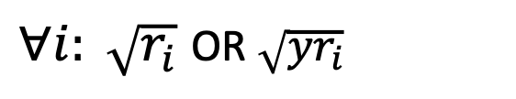
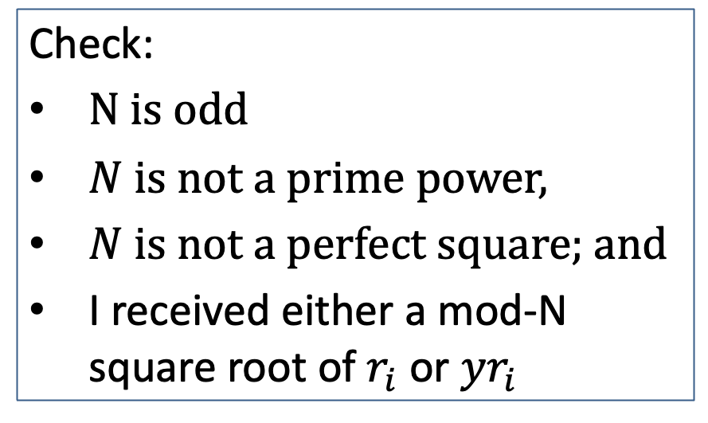
NIZK for Quadratic Non-Residuosity
$$CRS=(r_{1},r_{2},…,r_{m})←{({Jac}_{N}^{+1})}^{m}$$
$$(N,y)$$
$$(N,y)$$
$∀i: \sqrt{r_{i}}$ OR $\sqrt{yr_{i}}$
Check:
N is odd
$N$ is not a prime power,
$N$ is not a perfect square; and
I received either a mod-N square root of $r_{i}$ or ${yr}_{i}$

Slide 24
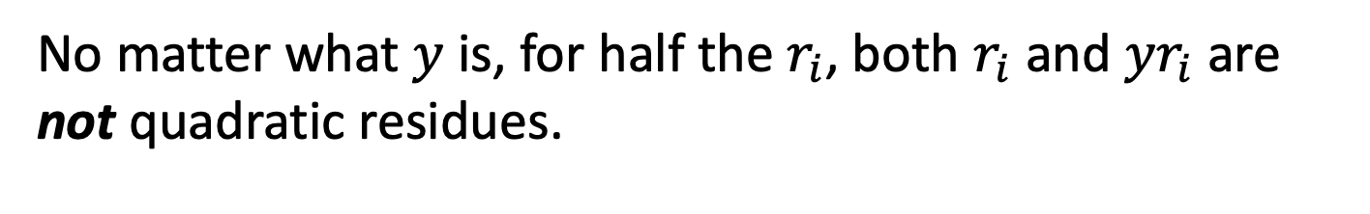
NIZK for Quadratic Non-Residuosity
$$CRS=(r_{1},r_{2},…,r_{m})←{({Jac}_{N}^{+1})}^{m}$$
$$(N,y)$$
$$(N,y)$$
$∀i: \sqrt{r_{i}}$ OR $\sqrt{yr_{i}}$
Soundness (what if $N$ has more than 2 prime factors)
No matter what $y$ is, for half the $r_{i}$, both $r_{i}$ and ${yr}_{i}$ are not quadratic residues.

Slide 25
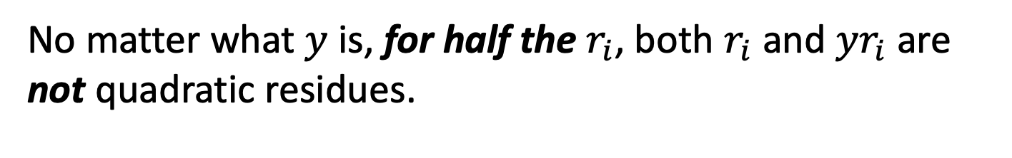
NIZK for Quadratic Non-Residuosity
$$CRS=(r_{1},r_{2},…,r_{m})←{({Jac}_{N}^{+1})}^{m}$$
$$(N,y)$$
$$(N,y)$$
$∀i: \sqrt{r_{i}}$ OR $\sqrt{yr_{i}}$
Soundness (what if $N$ has more than 2 prime factors)
No matter what $y$ is, for half the $r_{i}$, both $r_{i}$ and ${yr}_{i}$ are not quadratic residues.

Slide 26
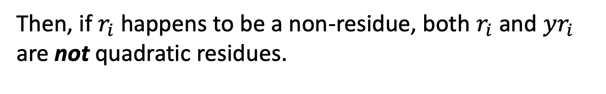
NIZK for Quadratic Non-Residuosity
$$CRS=(r_{1},r_{2},…,r_{m})←{({Jac}_{N}^{+1})}^{m}$$
$$(N,y)$$
$$(N,y)$$
$∀i: \sqrt{r_{i}}$ OR $\sqrt{yr_{i}}$
Soundness (what if $y$ is a residue)
Then, if $r_{i}$ happens to be a non-residue, both $r_{i}$ and ${yr}_{i}$ are not quadratic residues.

Slide 27
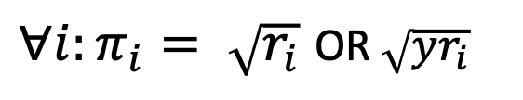
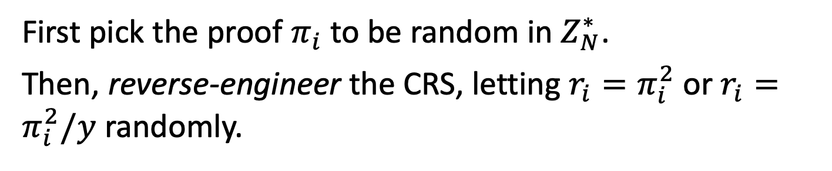
NIZK for Quadratic Non-Residuosity
$$CRS=(r_{1},r_{2},…,r_{m})←{({Jac}_{N}^{+1})}^{m}$$
$$(N,y)$$
$$(N,y)$$
$∀i:π_{i}= \sqrt{r_{i}}$ OR $\sqrt{yr_{i}}$
(Perfect) Zero Knowledge Simulator S:
First pick the proof $π_{i}$ to be random in $Z_{N}^{∗}$.
Then, reverse-engineer the CRS, letting $r_{i}=π_{i}^{2}$ or $r_{i}=π_{i}^{2}/y$ randomly.

Slide 28

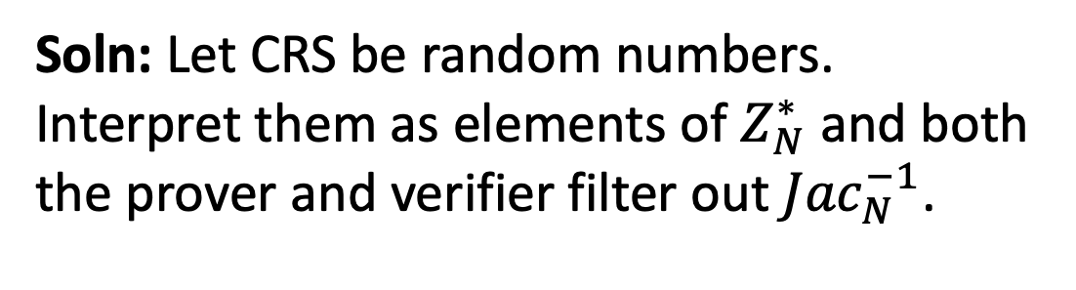
NIZK for Quadratic Non-Residuosity
$$CRS=(r_{1},r_{2},…,r_{m})←{({Jac}_{N}^{+1})}^{m}$$
$$(N,y)$$
$$(N,y)$$
CRS depends on the instance N. Not good.
Soln: Let CRS be random numbers. Interpret them as elements of $Z_{N}^{∗}$ and both the prover and verifier filter out ${Jac}_{N}^{−1}$.

Slide 29
NEXT LECTURE
Step 1. Review our number theory hammers & polish them.
Step 2. Construct NIZK for a special NP language, namely quadratic non-residuosity.
Step 3. Bootstrap to NIZK for 3SAT, an NP-complete language.

Slide 30
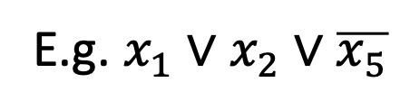
3SAT
Boolean Variables: $x_{i}$ can be either true (1) or false (0)
A Literal is either $x_{i}$ or $\overline{x_{i}}$.
A Clause is a disjunction of literals.
E.g. $x_{1}∨$ $x_{2}∨\overline{x_{5}}$
A Clause is true if any one of the literals is true.

Slide 31
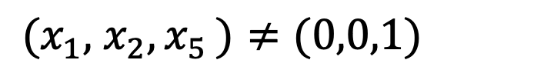
3SAT
Boolean Variables: $x_{i}$ can be either true (1) or false (0)
A Literal is either $x_{i}$ or $\overline{x_{i}}$.
A Clause is a disjunction of literals.
E.g. $x_{1}∨$ $x_{2}∨\overline{x_{5}}$
is true as long as:
${(x}_{1},$ $x_{2}{,x}_{5})≠(0,0,1)$

Slide 32
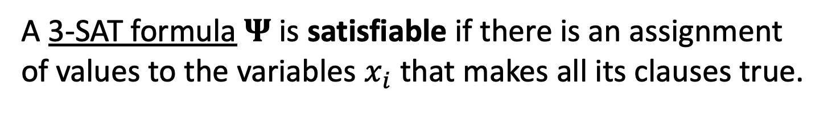
3SAT
Boolean Variables: $x_{i}$ can be either true (1) or false (0)
A Literal is either $x_{i}$ or $\overline{x_{i}}$.
A 3-Clause is a disjunction of 3-literals.
A 3-SAT formula is a conjunction of many 3-clauses.
E.g. $Ψ$ = ($x_{1}∨$ $x_{2}∨\overline{x_{5}})∧$ ($x_{1}∨$ $x_{3}∨x_{4})$ ($\overline{x_{2}}∨$ $x_{3}∨\overline{x_{5}})$
A 3-SAT formula $Ψ$is satisfiable if there is an assignment of values to the variables $x_{i}$ that makes all its clauses true.

Slide 33
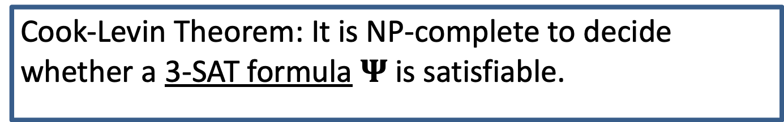
3SAT
Cook-Levin Theorem: It is NP-complete to decide whether a 3-SAT formula $Ψ$is satisfiable.
A 3-SAT formula is a conjunction of many 3-clauses.
E.g. $Ψ$ = ($x_{1}∨$ $x_{2}∨\overline{x_{5}})∧$ ($x_{1}∨$ $x_{3}∨x_{4})$ ($\overline{x_{2}}∨$ $x_{3}∨\overline{x_{5}})$
A 3-SAT formula $Ψ$is satisfiable if there is an assignment of values to the variables $x_{i}$ that makes all its clauses true.

Slide 34
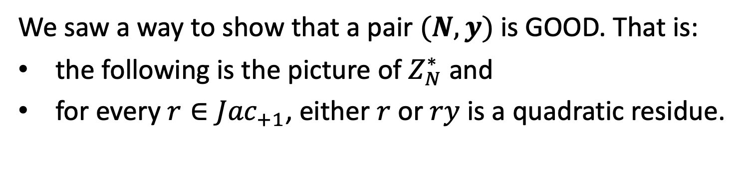
NIZK for 3SAT: Recall…
We saw a way to show that a pair $(N,y)$ is GOOD. That is:
the following is the picture of $Z_{N}^{∗}$ and
for every $r∈{Jac}_{+1}$, either $r$ or $ry$ is a quadratic residue.
$$Z_{N}^{∗}$$
$${QR}_{N}$$
$${Jac}_{−1}$$
$${Jac}_{+1}$$
$${QNR}_{N}$$

Slide 35
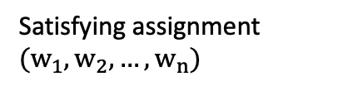

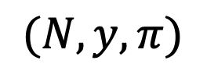
NIZK for 3SAT
$$CRS=(r_{1},r_{2},…,r_{large number})←{({Jac}_{N}^{+1})}^{large number}$$
$$Ψ$$
$$Ψ$$
$(N,y,π)$
Satisfying assignment $(w_{1},w_{2},…,w_{n})$
1. Prover picks an $(N,y)$ and proves that it is GOOD.
Input: $Ψ$ = ($x_{1}∨$ $x_{2}∨\overline{x_{5}})∧$ ($x_{1}∨$ $x_{3}∨x_{4})$ ($\overline{x_{2}}∨$ $x_{3}∨\overline{x_{5}})$
n variables, m clauses.

Slide 36
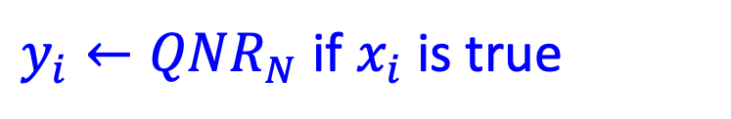
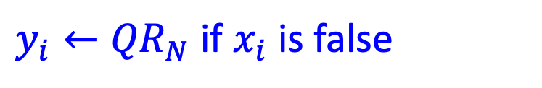
NIZK for 3SAT
$$CRS=(r_{1},r_{2},…,r_{large number})←{({Jac}_{N}^{+1})}^{large number}$$
$$Ψ$$
$$Ψ$$
$(N,y,π)$
Satisfying assignment $(w_{1},w_{2},…,w_{n})$
2. Prover encodes the satisfying assignment
$y_{i}←{QR}_{N}$ if $x_{i}$ is false
$y_{i}←{QNR}_{N}$ if $x_{i}$ is true

Slide 37
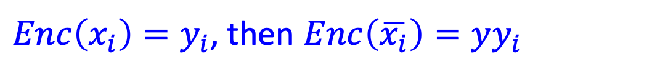
NIZK for 3SAT
$$CRS=(r_{1},r_{2},…,r_{large number})←{({Jac}_{N}^{+1})}^{large number}$$
$$Ψ$$
$$Ψ$$
$(N,y,π)$
Satisfying assignment $(w_{1},w_{2},…,w_{n})$
2. Prover encodes the satisfying assignment & $∴$ the literals
${Enc\left(x_{i}\right)=y}_{i}$, then $Enc\left(\overline{x_{i}}\right)=yy_{i}$
$∴$exactly one of $Enc\left(x_{i}\right) or Enc\left(\overline{x_{i}}\right)$ is a non-residue.

Slide 38
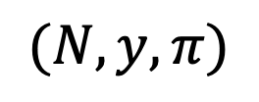

NIZK for 3SAT
$$CRS=(r_{1},r_{2},…,r_{large number})←{({Jac}_{N}^{+1})}^{large number}$$
$$Ψ$$
$(N,y,π)$
$$Ψ$$
Encode vars:
$(y_{1},…,y_{n})$
Satisfying assignment $(w_{1},w_{2},…,w_{n})$
2. Prover encodes the satisfying assignment & $∴$ the literals
${Enc\left(x_{i}\right)=y}_{i}$, then $Enc\left(\overline{x_{i}}\right)=yy_{i}$
$∴$exactly one of $Enc\left(x_{i}\right) or Enc\left(\overline{x_{i}}\right)$ is a non-residue.

Slide 39
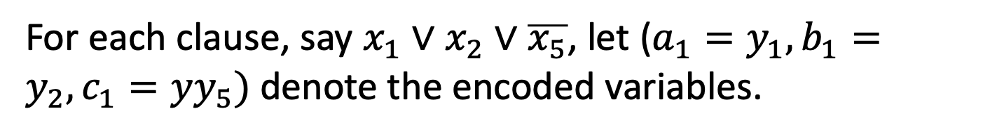
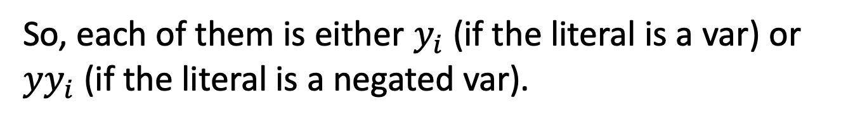
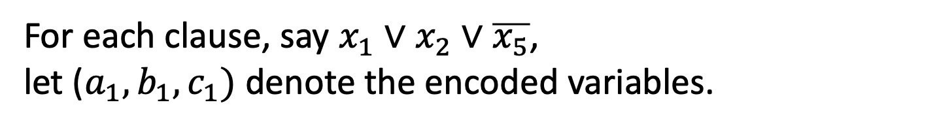
NIZK for 3SAT
$$CRS=(r_{1},r_{2},…,r_{large number})←{({Jac}_{N}^{+1})}^{large number}$$
$$Ψ$$
$(N,y,π)$
$$Ψ$$
Encode vars:
$(y_{1},…,y_{n})$
Satisfying assignment $(w_{1},w_{2},…,w_{n})$
3. Prove that (encoded) assignment satisfies each clause.
For each clause, say $x_{1}∨$ $x_{2}∨\overline{x_{5}}$, let ($a_{1},b_{1},c_{1})$ denote the encoded variables.
For each clause, say $x_{1}∨$ $x_{2}∨\overline{x_{5}}$, let ($a_{1}=y_{1},b_{1}=y_{2},c_{1}={yy}_{5})$ denote the encoded variables.
So, each of them is either $y_{i}$ (if the literal is a var) or ${yy}_{i}$ (if the literal is a negated var).

Slide 40

NIZK for 3SAT
$$CRS=(r_{1},r_{2},…,r_{large number})←{({Jac}_{N}^{+1})}^{large number}$$
$$Ψ$$
$(N,y,π)$
$$Ψ$$
Encode vars:
$(y_{1},…,y_{n})$
Satisfying assignment $(w_{1},w_{2},…,w_{n})$
3. Prove that (encoded) assignment satisfies each clause.
For each clause, say $x_{1}∨$ $x_{2}∨\overline{x_{5}}$, let ($a_{1},b_{1},c_{1})$ denote the encoded variables.
WANT to SHOW: $x_{1} OR$ $x_{2} OR \overline{x_{5}}$ is true.

Slide 41


NIZK for 3SAT
$$CRS=(r_{1},r_{2},…,r_{large number})←{({Jac}_{N}^{+1})}^{large number}$$
$$Ψ$$
$(N,y,π)$
$$Ψ$$
Encode vars:
$(y_{1},…,y_{n})$
Satisfying assignment $(w_{1},w_{2},…,w_{n})$
3. Prove that (encoded) assignment satisfies each clause.
For each clause, say $x_{1}∨$ $x_{2}∨\overline{x_{5}}$, let ($a_{1},b_{1},c_{1})$ denote the encoded variables.
WANT to SHOW: $a_{1} OR$ $b_{1} OR c_{1}$ is a non-residue.

Slide 42








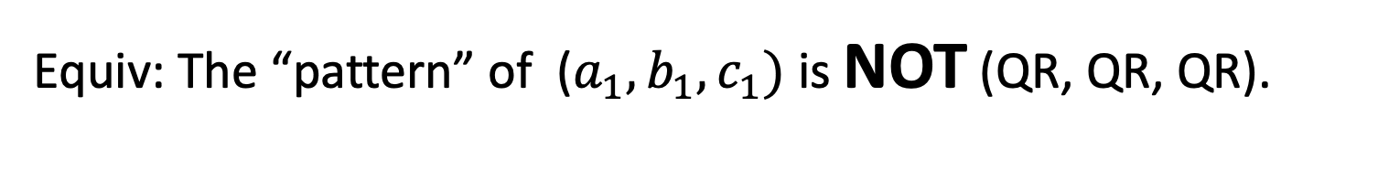

NIZK for 3SAT
Prove that (encoded) assignment satisfies each clause.
WANT to SHOW: $a_{1} OR$ $b_{1} OR c_{1}$ is a non-residue.
Equiv: The “pattern” of ($a_{1}, b_{1},c_{1})$ is NOT (QR, QR, QR).
CLEVER IDEA: Generate seven additional triples
($a_{1}, b_{1},c_{1})$
original triple
($a_{2}, b_{2},c_{2})$
“Proof of Coverage”: show that the 8 triples span all possible QR patterns
show this is a QR: reveal the square roots
($a_{3}, b_{3},c_{3})$
($a_{4}, b_{4},c_{4})$
($a_{5}, b_{5},c_{5})$
($a_{6}, b_{6},c_{6})$
($a_{7}, b_{7},c_{7})$
($a_{8}, b_{8},c_{8})$

Slide 43



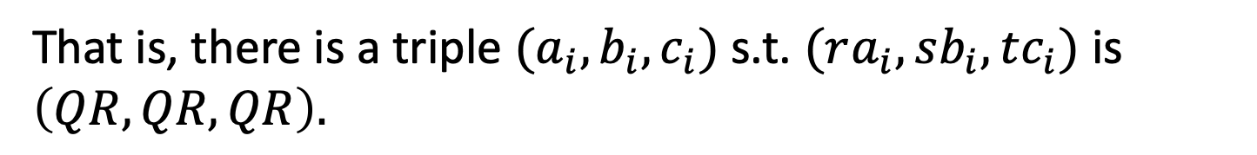

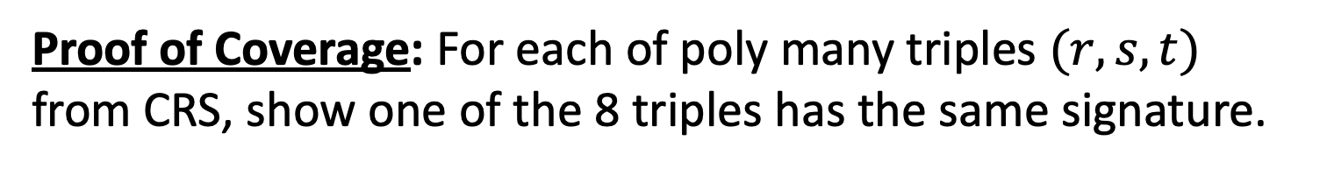




NIZK for 3SAT
CLEVER IDEA: Generate seven additional triples
($a_{1}, b_{1},c_{1})$
original triple
($a_{2}, b_{2},c_{2})$
“Proof of Coverage”: show that the 8 triples span all possible QR signatures
show this is a QR: reveal the square roots
($a_{3}, b_{3},c_{3})$
($a_{4}, b_{4},c_{4})$
($a_{5}, b_{5},c_{5})$
($a_{6}, b_{6},c_{6})$
($a_{7}, b_{7},c_{7})$
($a_{8}, b_{8},c_{8})$
Proof of Coverage: For each of poly many triples $(r,s,t)$ from CRS, show one of the 8 triples has the same signature.
That is, there is a triple $(a_{i},b_{i},c_{i})$ s.t. $(ra_{i},sb_{i},tc_{i})$ is $\left(QR,QR,QR\right).$

Slide 44
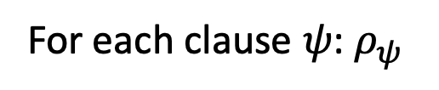

NIZK for 3SAT
$$CRS=(r_{1},r_{2},…,r_{large number})←{({Jac}_{N}^{+1})}^{large number}$$
$$Ψ$$
$(N,y,π)$
$$Ψ$$
Encode vars:
$(y_{1},…,y_{n})$
Satisfying assignment $(w_{1},w_{2},…,w_{n})$
For each clause $ψ$: $ρ_{ψ}$
3. Prove that (encoded) assignment satisfies each clause.
For each clause, construct the proof $ρ$ = (7 additional triples, square root of the second triples, proof of coverage).

Slide 45

NIZK for 3SAT
$$CRS=(r_{1},r_{2},…,r_{large number})←{({Jac}_{N}^{+1})}^{large number}$$
$$Ψ$$
$(N,y,π)$
$$Ψ$$
Encode vars:
$(y_{1},…,y_{n})$
Satisfying assignment $(w_{1},w_{2},…,w_{n})$
For each clause $ψ$: $ρ_{ψ}$
Completeness & Soundness: Exercise.
Zero Knowledge: Simulator picks $(N,y)$ where $y$ is a quadratic residue.
Now, encodings of ALL the literals can be set to TRUE!!

Slide 46
An Application of NIZK: Non-malleable and Chosen Ciphertext Secure Encryption Schemes

Slide 47


Non-Malleability
m $←$ Dec(sk,c)
c $←$ Enc(pk,m)
sk
Public-key directory
Bob
pk

Slide 48

Active Attacks 1: Malleability
c $←$ Enc(pk,$100)
sk
c’ $=$Enc(pk,$101)
ATTACK: Adversary could modify (“maul”) an encryption of m into an encryption of a related message m’.

Slide 49
Active Attacks 2: Chosen-Ciphertext Attack
c* $←$ Enc(pk,m)
sk
ATTACK: Adversary may have access to a decryption “oracle” and can use it to break security of a ”target” ciphertext c* or even extract the secret key!
In fact, Bleichenbacher showed how to extract the entire secret key given only a “ciphertext verification” oracle.

Slide 50

IND-CCA Security
Challenger
Eve
$$pk$$
$$\left(pk,sk\right)←Gen\left(1^{n}\right)$$
$$c_{i}$$
$$Dec(sk,c_{i})$$
$$m_{0}^{∗},m_{1}^{∗}$$
$$s.t. \left|m_{0}^{∗}\right|=|m_{1}^{∗}|$$
$b←\left\{0,1\right\}$;
$$c^{∗}←Enc(pk,m_{b}^{∗})$$
$$c^{∗}$$
$$c_{i}≠c^{∗}$$
$$c_{i}$$
Eve wins if $b^{′}=b$. IND-CCA secure if no PPT Eve can win with prob. > $\frac{1}{2}+negl(n)$.
$$Dec(sk,c_{i})$$
$$Dec(sk,c_{i})$$
$$b′$$
Notes:
This captures the concern of malleability and more.

Slide 51
Constructing CCA-Secure Encryption
(Intuition)
NIZK Proofs of Knowledge should help!
Idea: The encrypting party attaches an NIZK proof of knowledge of the underlying message to the ciphertext.
$$C: (c=CPAEnc\left(m;r\right),proof π that “I know m and r”)$$
This idea will turn out to be useful, but NIZK proofs themselves can be malleable!

Slide 52
Constructing CCA-Secure Encryption
(Intuition)
Digital Signatures should help!
OUR GOAL: Hard to modify an encryption of m into an encryption of a related message, say m+1.
OUR GOAL: Hard to modify an encryption of m into an encryption of a related message, say m+1.

Slide 53

Constructing CCA-Secure Encryption
Let’s start with Digital Signatures.
$$C: (c=CPAEnc\left(pk,m;r\right),{Sign}_{sgk}\left(c\right),vk)$$
$$C: (c=CPAEnc\left(pk,m;r\right),Sign\left(c\right))$$
where the encryptor produces a signing / verification key pair by running $\left(sgk,vk\right)←Sign.Gen(1^{n})$
Is this CCA-secure/non-malleable?
If the adversary changes $vk$, all bets are off!
Lesson: NEED to “tie” the ciphertext $c$ to $vk$ in a “meaningful” way.

Slide 54
Observation: IND-CPA $⟹$ “Different-Key Non-malleability”
Different-Key NM: Given $pk,pk^{′},CPAEnc\left(pk,m;r\right),$ can an adversary produce $CPAEnc\left(pk′,m+1;r\right)?$
NO! Suppose she could. Then, I can come up with a reduction that breaks the IND-CPA security of $CPAEnc\left(pk,m;r\right)$.

Slide 55
Observation: IND-CPA $⟹$ “Different-Key Non-malleability”
Different-Key NM: Given $pk,pk^{′},CPAEnc\left(pk,m;r\right),$ can an adversary produce $CPAEnc\left(pk′,m+1;r\right)?$
Reduction = CPA adversary
$$pk$$
Pick $(pk^{′},sk^{′})$
$$pk,pk′$$
$$CPAEnc(pk,m)$$
$$CPAEnc(pk,m)$$
$$m$$
$$CPAEnc(pk^{′},m+1)$$
Decrypt and
subtract 1.
Diff-Key NM
adversary

Slide 56
Putting it together
CCA Public Key: $2n$ public keys of the CPA scheme (where $n=|vk|)$
$${pk}_{1,0}$$
$${pk}_{2,0}$$
$${pk}_{n,0}$$
$$…$$
$${pk}_{1,1}$$
$${pk}_{2,1}$$
$${pk}_{n,1}$$
CCA Encryption:
First, pick a sign/ver key pair $(sgk,vk)$
$$CT=$$
$${ct}_{1,{vk}_{1}}$$
$${ct}_{2,{vk}_{2}}$$
$$…$$
$${ct}_{n,{vk}_{n}}$$
where ${ct}_{i,j }←CPAEnc({pk}_{i,j},m)$
Output $(CT, vk,σ=Sign(sgk,CT))$.

Slide 57
Putting it together
Non-malleability rationale: Either
Adversary keeps $vk$the same (in which case she has to break the signature scheme); or
She changes the $vk$ in which case she breaks the diff-NM game, and therefore CPA security.
CCA Encryption:
First, pick a sign/ver key pair $(sgk,vk)$
$$CT=$$
$${ct}_{1,{vk}_{1}}$$
$${ct}_{2,{vk}_{2}}$$
$$…$$
$${ct}_{n,{vk}_{n}}$$
where ${ct}_{i,j }←CPAEnc({pk}_{i,j},m)$
Output $(CT, vk,σ=Sign(sgk,CT))$.

Slide 58
Call it a day?
We are not done!! Adversary could create ill-formed ciphertexts (e.g. the different $ct$s encrypt different messages) and uses it for a Bleichenbacher-like attack.
CCA Encryption:
First, pick a sign/ver key pair $(sgk,vk)$
$$CT=$$
$${ct}_{1,{vk}_{1}}$$
$${ct}_{2,{vk}_{2}}$$
$$…$$
$${ct}_{n,{vk}_{n}}$$
where ${ct}_{i,j }←CPAEnc({pk}_{i,j},m)$
Output $(CT, vk,σ=Sign(sgk,CT))$.

Slide 59
NIZK Proofs to the Rescue…
CCA Public Key: $2n$ public keys of the CPA scheme
$${pk}_{1,0}$$
$${pk}_{2,0}$$
$${pk}_{n,0}$$
$$…$$
, $CRS$
$${pk}_{1,1}$$
$${pk}_{2,1}$$
$${pk}_{n,1}$$
NP statement: “there exist $m,r_{i,j}$ such that each ${ct}_{i,j}=CPAEnc({pk}_{i,j},m;r_{i,j})$”
CCA Encryption:
First, pick a sign/ver key pair $(sgk,vk)$
$$CT=$$
$${ct}_{1,{vk}_{1}}$$
$${ct}_{2,{vk}_{2}}$$
$$…$$
$${ct}_{n,{vk}_{n}}$$
where ${ct}_{i,j }←CPAEnc({pk}_{i,j},m;r_{i,j})$
π = NIZK proof that “CT is well-formed”
Output $(CT, vk,σ=Sign(sgk,CT))$.
Output $(CT,\text{π}, vk,σ=Sign(sgk,\left(CT,\text{π}\right)))$.

Slide 60
Are there other attacks?
Did we miss anything else?
Turns out NO. We can prove that this is CCA-secure.

Slide 61
The Encryption Scheme
CCA Keys:
$${pk}_{1,0}$$
$${pk}_{2,0}$$
$${pk}_{n,0}$$
$${sk}_{1,0}$$
PK=
$$…$$
, $CRS$
SK=
$${pk}_{1,1}$$
$${pk}_{2,1}$$
$${pk}_{n,1}$$
$${sk}_{1,1}$$
CCA Encryption:
First, pick a sign/ver key pair $(sgk,vk)$
$$CT=$$
$${ct}_{1,{vk}_{1}}$$
$${ct}_{2,{vk}_{2}}$$
$$…$$
$${ct}_{n,{vk}_{n}}$$
where ${ct}_{i,j }←CPAEnc({pk}_{i,j},m;r_{i,j})$
π = NIZK proof that “CT is well-formed”
Output $(CT,\text{π}, vk,σ=Sign(sgk,\left(CT,\text{π}\right)))$.

Slide 62
The Encryption Scheme
CCA Encryption:
First, pick a sign/ver key pair $(sgk,vk)$
$$CT=$$
$${ct}_{1,{vk}_{1}}$$
$${ct}_{2,{vk}_{2}}$$
$$…$$
$${ct}_{n,{vk}_{n}}$$
where ${ct}_{i,j }←CPAEnc({pk}_{i,j},m;r_{i,j})$
π = NIZK proof that “CT is well-formed”
Output $(CT,\text{π}, vk,σ=Sign(sgk,\left(CT,\text{π}\right)))$.
CCA Decryption:
Check the signature.
Check the NIZK proof.
Decrypt with ${sk}_{1,{vk}_{1}}$.

Slide 63
Proof Sketch
Let’s play the CCA game with the adversary.
We will use her to break either the NIZK soundness/ZK, the signature scheme or the CPA-secure scheme.

Slide 64
Proof Sketch
Let’s play the CCA game with the adversary.
Hybrid 0: Play the CCA game as prescribed.
Hybrid 1: Observe that ${vk}_{i}≠{vk}^{∗}$. (Otherwise break signature)
Observe that this means each query ciphertext-tuple involves a different public-key from the challenge ciphertext. Use the “different private-key” to decrypt. (If the adv sees a difference, she broke NIZK soundness)
Hybrid 2: Now change the CRS/$\text{π}$ into simulated CRS/$\text{π}$! (OK by ZK)
If the Adv wins in this hybrid, she breaks IND-CPA!
Notes:
Hybrid 1 explanation: the real decryption algorithm uses one of the private keys, say either sk_{1,0} or sk_{1,1} to decrypt, depending on whether the first ciphertext was encrypted using pk_{1,0} or pk_{1,1} --- which in turns depends on whether the first bit of the verification key was 0 or 1. in hybrid 1, we are potentially using a different private key to decrypt a different component ciphertext. That’s OK because we know by NIZK soundness that all ciphertexts encrypt the same message!
Hybrid 2 explanation: In the beginning of hybrid 2, the challenge ciphertext contains a NIZK proof of ciphertext well-formedness which uses the randomness underlying those ciphertexts. By changing the NIZK proof into a simulated proof, we remove the dependence on randomness, effectively saying that the proof reveals nothing about the randomness underlying the ciphertexts, in turn paving the way to invoke CPA-security.

