Slide 1
The Evolution of Proofs in Computer Science and the Existence of SNARGs
Lecture 17

Slide 2


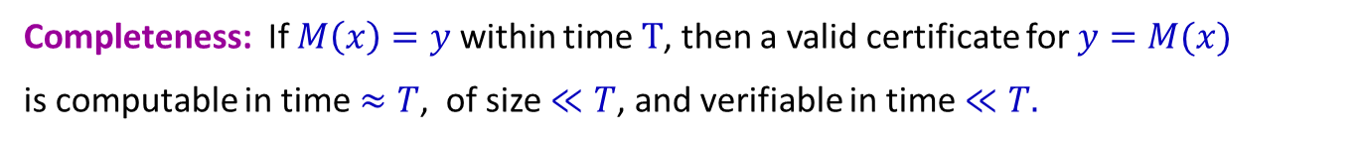

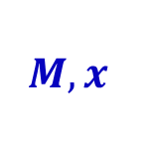
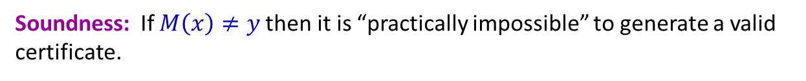
Efficient Verification of Computation
$$M,x$$
$$y$$
$$M\left(x\right)=y$$
Completeness: If $M\left(x\right)=y$within time $T$, then a valid certificate for $y=M(x)$
is computable in time $≈T$, of size $≪T$, and verifiable in time $≪T.$
Soundness: If $M\left(x\right)≠y$then it is “practically impossible” to generate a valid certificate.
If adv succeeds
then it can break a
cryptographic assumption
Notes:
This motivates our goal of efficient verification of computation!
The goal is to provide a method that given a program $M$ and an input $x$, computes the output $y=M(x)$, and in addition computes a “certificate” that certifies the correctness of the output $y.$
Crucially, this certificate should be succinct, efficiency verifiable, and hard to fake.
Formally, these properties are described via the following completeness and soundness guarantees.
Completeness asserts that if indeed $M\left(x\right)=y$then one can generate a valid certificate without too much overhead, in time at most polynomially related to $T,$ideally linear in $T.$
The certificate should be succinct, of size significantly shorter than $T$, ideally $polylog\left(T\right),$and can be verified efficiently in time much less than $T$(ideally depending only polylogarithmically on $T$).
I want to emphasize that the succinct and efficiently verifiability of the certificate is paramount.
Practical infeasible means that fake certificates exist but it takes too long to find them.
Formally, we argue that if an adversary can fake a certificate then he can break a cryptographic assumption, such as factoring large numbers.

Slide 3

Efficient Verification of Computation
$$M,x$$
$$y$$
$$M\left(x\right)=y$$
Completeness: If $M\left(x\right)=y$within time $T$, then a valid certificate for $y=M(x)$
is computable in time $≈T$, of size $≪T$, and verifiable in time $≪T.$
Soundness: If $M\left(x\right)≠y$then it is “practically impossible” to generate a valid certificate.
Needed! Otherwise, such a scheme would
imply $DTIME(T)⊆NTIME(≪T)$
If adv succeeds
then it can break a
cryptographic assumption
Notes:
One might ask: why not require that it is simply impossible to generate a valid certificate, namely, that there do not exist a valid certificates for false computations?
The answer is that this is too much to hope for. We don’t believe that certificates with such statistical soundness exist.
For the complexity experts in the audience, it would imply that any DTIME(T) computation is in NTIME(<<T), which we do not believe is the case.

Slide 4
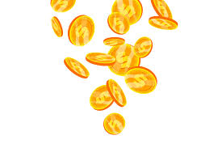
Efficient Verification of Computation
Common Random String (CRS)
$$M,x$$
$$y$$
$$M\left(x\right)=y$$
Completeness: If $M\left(x\right)=y$within time $T$, then a valid certificate for $y=M(x)$
is computable in time $≈T$, of size $≪T$, and verifiable in time $≪T.$
computational
Soundness: If $M\left(x\right)≠y$then it is “practically impossible” to generate a valid certificate.
Needed! Otherwise, such a scheme would
imply $DTIME(T)⊆NTIME(≪T)$
If adv succeeds
then it can break a
cryptographic assumption
Notes:
Moreover, all our schemes assume a shared Common Random String (CRS) that is honestly generated and known to all parties (the device that computes the certificate and the one that verifies it).
This is where the cryptographic assumption is embedded.
This CRS is needed since without it, we hit the same complexity barrier as before (Loosely speaking, without it, we cannot obtain soundness that is computational but not statistical).
Where does this CRS come from?
For the schemes we will see today, this CRS will consist of hash keys, and in practice these are simply SHA256.
For some of the schemes this CRS is structured, and in this case is called a common reference string.
For these schemes agreeing on this structured CRS is quite difficult (in practice) and is often a bottleneck in practice.

Slide 5
Efficient Verification of Computation
Common Random String (CRS)
$$M,x$$
$$y$$
$$M\left(x\right)=y$$
Completeness: If $M\left(x\right)=y$within time $T$, then a valid certificate for $y=M(x)$
is computable in time $≈T$, of size $≪T$, and verifiable in time $≪T.$
computational
Soundness: If $M\left(x\right)≠y$then it is “practically impossible” to generate a valid certificate.
Succinct Non-interactive Argument (SNARG)
Notes:
Such a certification scheme is called a “Succinct Non-interactive Argument”, or SNARG for short.

Slide 6
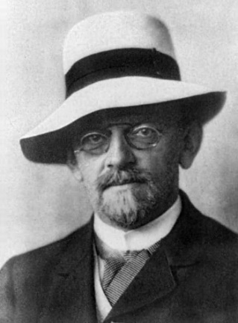
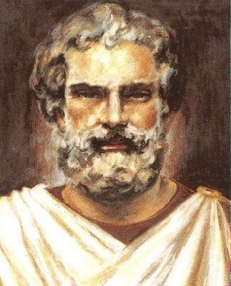
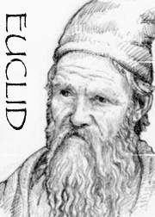
What is a Proof?
Axiomatic approach
Proof Theory
Euclid (300BCE)
Hilbert (19th century)
Thales (600BCE)
Notes:
What is a proof?
The concept of a mathematical proof was developed by the ancient Greek mathematicians.
Euclid 300 BCE introduced the axiomatic approach, and Hilbert in the 19th century initiated a branch of mathematics called “proof theory”.

Slide 7
Zero-Knowledge Proofs [Goldwasser-Micali-Rackoff85]
Proofs that reveal no information
beyond the validity of the statement
This is information

Slide 8
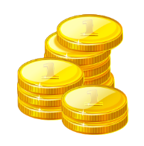
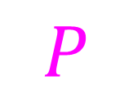
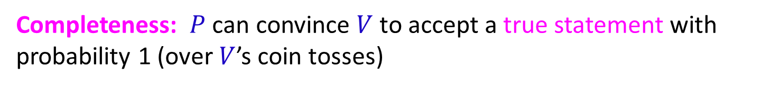
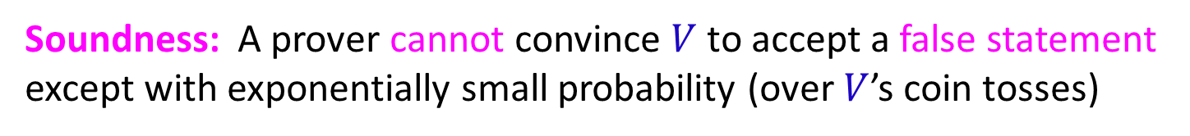
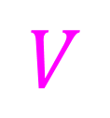
Interactive Proofs [Goldwasser-Micali-Rackoff85]
$$P$$
$$V$$
Completeness: $P$can convince $V$ to accept a true statement with probability 1 (over $V$’s coin tosses)
Soundness: A prover cannot convince $V$ to accept a false statement except with exponentially small probability (over $V$’s coin tosses)
Notes:
Defined the notion of interactive proofs, where the verifier is allowed to be probabilistic, and soundness is only required to hold with high probability.
The point is that now a proof is not transferable, so may, in theory, contain no information

Slide 9
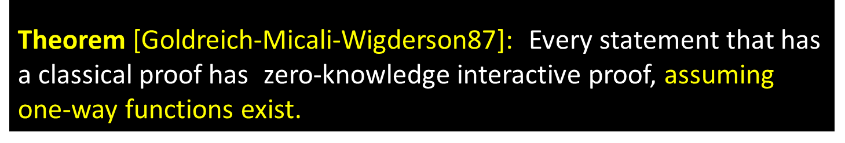
Interactive Proofs [Goldwasser-Micali-Rackoff85]
$$P$$
$$V$$
Theorem [Goldreich-Micali-Wigderson87]: Every statement that has a classical proof has zero-knowledge interactive proof, assuming one-way functions exist.
Notes:
Indeed shortly after, Oded Goldreich, Silvio Mical and Avi Wigderson, showed that every statement that has a classical proof also has a zero-knowledge interactive proof, assuming a mild hardness assumption, that OWF exist.
ZK proofs is one of the most important building blocks in cryptography.

Slide 10
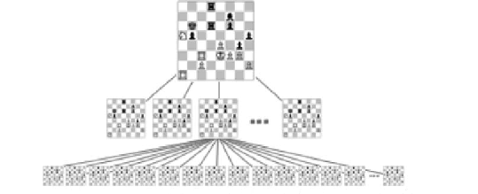
Interactive Proofs are Shorter! [Lund-Fortnow-Karloff-Nissan90, Shamir90]
Example: Chess
Classical proof
Notes:
Shortly after this model was introduced, it was noticed that interactive proofs are very powerful.
Using IP, one can prove the validity of statements that we do not know how to prove using classical proofs.
For example, say I want to prove that the black player has a winning strategy. It is not known how to prove this with a classical proof, but is known how to prove using an IP.

Slide 11



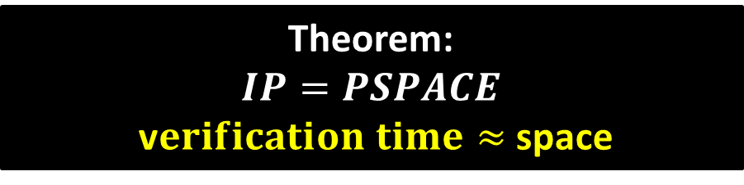
Interactive Proofs are Shorter! [Lund-Fortnow-Karloff-Nissan90, Shamir90]
Example: Chess
Succinct interactive proof
$$P$$
$$V$$
Theorem:
$$IP=PSPACE$$
v$erification time≈$space
Notes:
By proof we mean that verifying the proof should be faster than doing the computation from scratch.
It was shown that any statement has an IP where the time to verifier is proportional to the space (or memory) required to do the computation.
It was shown that any statement has an IP where the time to verifier is proportional to the space (or memory) required to do the computation.

Slide 12
[BenOr-Goldwasser-Kilian-Wigderson]:
Do there exist ZK proofs unconditionally?
(Without assuming one-way functions)
Not in general!
Unless the polynomial hierarchy collapses
Notes:
Statistical ZK is known to be contained in AM \cap coAM

Slide 13

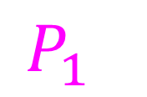


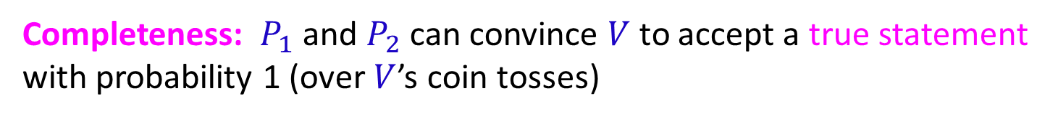
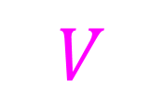
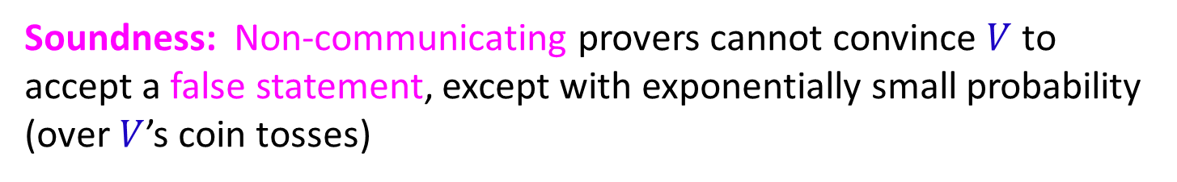
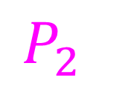

Multi-Prover Interactive Proofs [BenOr-Goldwasser-Kilian-Wigderson88]
$$P_{1}$$
$$P_{2}$$
$$a_{1}$$
$$q_{1}$$
$$q_{2}$$
$$a_{2}$$
$$V$$
Completeness: $P_{1}$and $P_{2}$can convince $V$ to accept a true statement with probability 1 (over $V$’s coin tosses)
Soundness: Non-communicating provers cannot convince $V$ to accept a false statement, except with exponentially small probability
(over $V$’s coin tosses)
Notes:
Shortly after the definition of interactive proofs, BGKW considered the model of multi-prover interactive proofs.

Slide 14
Multi-Prover Interactive Proofs [BenOr-Goldwasser-Kilian-Wigderson88]
$$P_{1}$$
$$P_{2}$$
$$a_{1}$$
$$q_{1}$$
$$q_{2}$$
$$a_{2}$$
$$V$$
Theorem: Every statement that has a proof has an unconditional zero-knowledge proof!

Slide 15
Multi-Prover Interactive Proofs [BenOr-Goldwasser-Kilian-Wigderson88]
$$P_{1}$$
$$P_{2}$$
$$a_{1}$$
$$q_{1}$$
$$q_{2}$$
$$a_{2}$$
$$V$$
Theorem [Babai-Fortnow-Lund90]: Any proof can be made exponentially shorter with a 2-prover interactive proof!

Slide 16

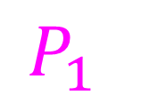



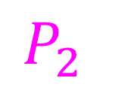

[Fortnow-Rompel-Sipser88]:
$$a_{1}$$
$$P_{1}$$
$$a_{1}$$
$$a_{2}$$
$$a_{3}$$
$$a_{4}$$
$$P_{2}$$
$$a_{2}$$
$$a_{3}$$
$$a_{4}$$
$$V$$
Notes:
Lance Fortnow, John Rompel and Mike Sipser noticed that a multi-prover proof can be converted into an oracle proof.
Their idea is simple: For every prover list the answer corresponding to each possible query. The verifier, instead of interacting with the provers, simply queries these lists, which we can combine into a single list.

Slide 17
Probabilistically Checkable Proofs
$$V$$

Slide 18
Probabilistically Checkable Proofs
[Feige-Goldwasser-Lovasz-Safra-Szegedy91, Babai-Fortnow-Levin-Szegedy91, Arora-Safra92, Arora-Lund-Mutwani-Sudan-Szegedy92]
PCP Theorem:
Every proof can be converted to a probabilistically
checkable one (of almost same size) that can be verified
by reading only constant number of its bits.

Slide 19
Classical Proofs
(zero-knowledge) Interactive
Proofs
Multi-Prover
Interactive Proofs
Probabilistically
Checkable Proofs

Slide 20
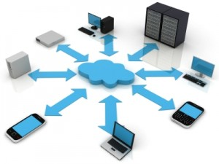
Fast Forward to Today’s Reality
Notes:
Today, with the increasing popularity of cloud platforms, there are many weak computational devices that wish delegate their computation to the cloud.

Slide 21
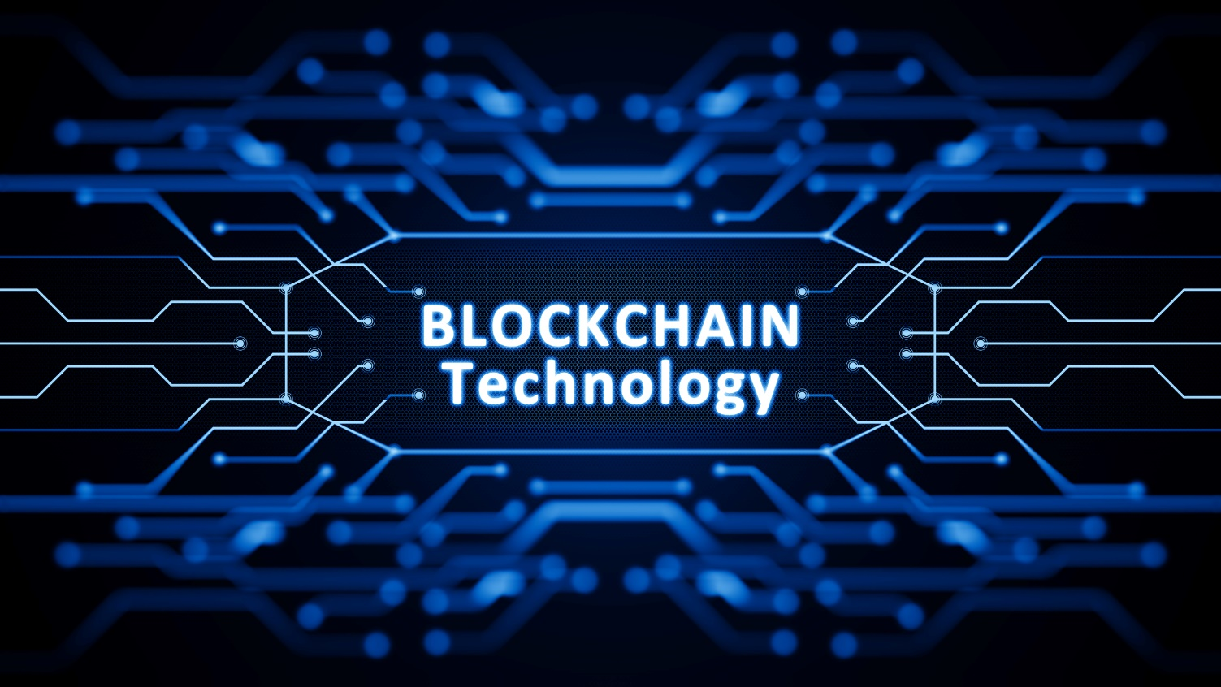
Fast Forward to Today’s Reality

Slide 22


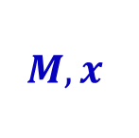
Succinct Non-Interactive Argument (SNARG)
Common Random String (CRS)
$$M,x$$
$$y$$
$$M\left(x\right)=y$$
Notes:
Moreover, all our schemes assume a shared Common Random String (CRS) that is honestly generated and known to all parties (the device that computes the certificate and the one that verifies it).
This is where the cryptographic assumption is embedded.
This CRS is needed since without it, we hit the same complexity barrier as before (Loosely speaking, without it, we cannot obtain soundness that is computational but not statistical).
Where does this CRS come from?
For the schemes we will see today, this CRS will consist of hash keys, and in practice these are simply SHA256.
For some of the schemes this CRS is structured, and in this case is called a common reference string.
For these schemes agreeing on this structured CRS is quite difficult (in practice) and is often a bottleneck in practice.

Slide 23
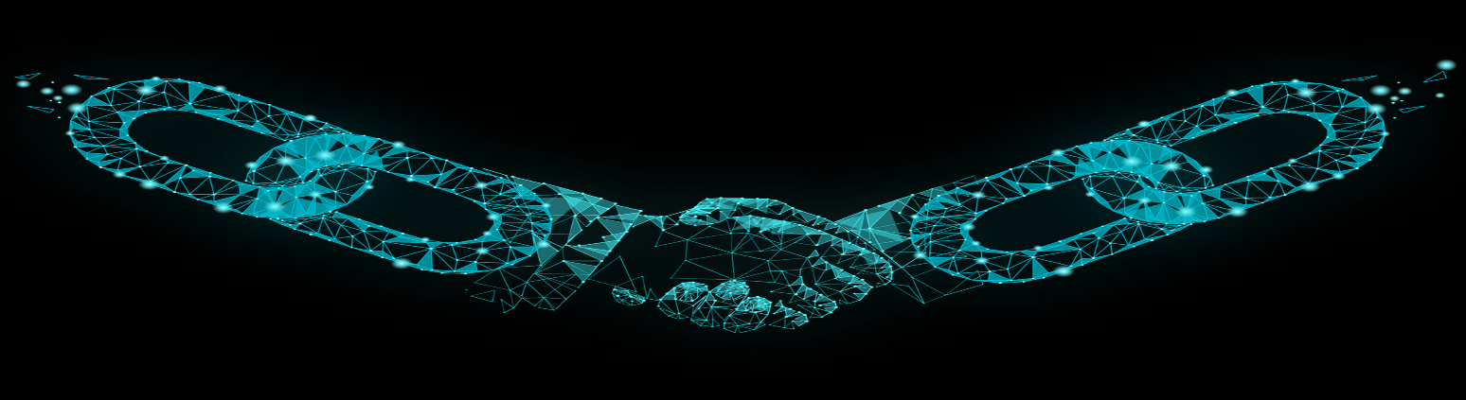

Succinct Proofs
A succinct proof that my transaction is
valid!

Slide 24
Classical proofs
Too long
Is proving much harder than computing
???
Prover’s runtime is huge
Interactive
proofs
Requires non-communicating provers
multi-prover
interactive proofs
Probabilistically
checkable proofs
Too long

Slide 25
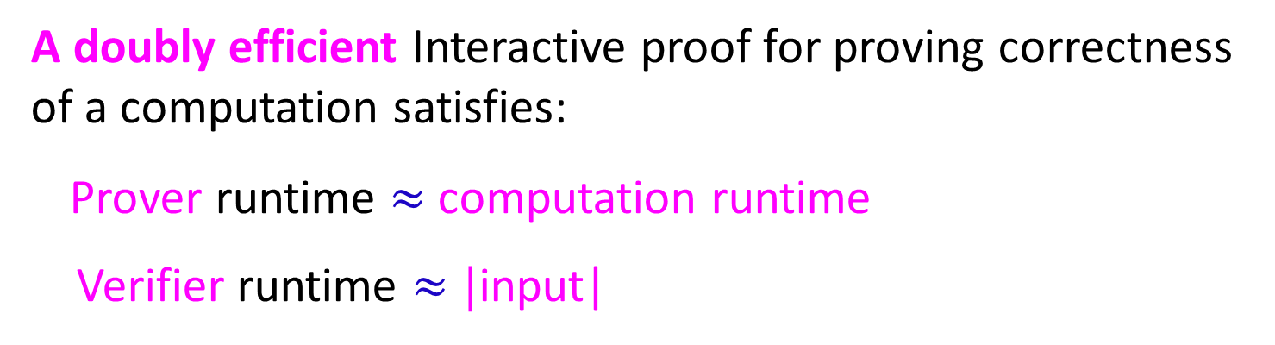
Doubly Efficient Interactive Proofs
A doubly efficient Interactive proof for proving correctness of a computation satisfies:
Prover runtime $≈$computation runtime
Verifier runtime $≈|$input|
Focus: Polynomial-time computations!
Notes:
Doubly efficient proves are ones where the prover is efficient ((ideally, it should be as close as possible to the underlying ``native'' computation) and verifier is very efficient (almost linear time).
Soundness (as in standard IP) is against unbounded provers.

Slide 26
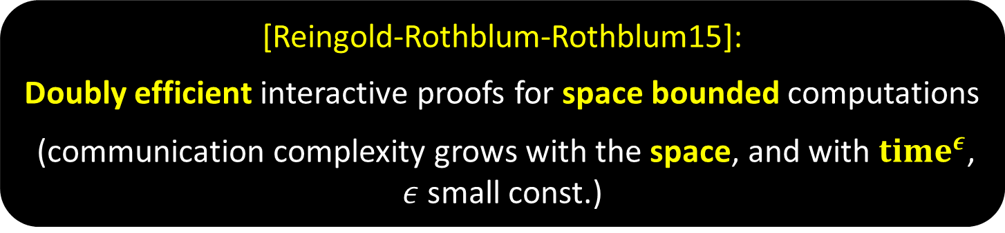
Doubly Efficient Interactive Proofs
[Goldwasser-K-Rothblum08]:
Doubly efficient interactive proofs for depth bounded computations
(communication complexity grows with the depth)
[Reingold-Rothblum-Rothblum15]:
Doubly efficient interactive proofs for space bounded computations
(communication complexity grows with the space, and with ${time}^{ε}$, $ε$small const.)

Slide 27
Non-Interactive Delegation scheme for all functions! d
[Kilian92, Micali94]

Slide 28
Non-Interactive Delegation scheme for all functions! d
[Kilian92, Micali94]
Relax soundness to hold only against
polynomial time adversaries

Slide 29
Interactive Proofs [Goldwasser-Micali-Rackoff85]
$$P$$
$$V$$
Completeness: $P$can convince $V$ to accept a true statement with probability 1 (over $V$’s coin tosses)
Soundness: A prover cannot convince $V$ to accept a false statement except with exponentially small probability (over $V$’s coin tosses)

Slide 30
Computationally-Sound Interactive Proofs [Brassard-Chaum-Creapeau88]
Arguments
$$P$$
$$V$$
Computationally bounded
Completeness: $P$can convince $V$ to accept a true statement with probability 1 (over $V$’s coin tosses)
Soundness: A prover cannot convince $V$ to accept a false statement except with exponentially small probability (over $V$’s coin tosses)

Slide 31

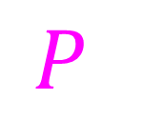
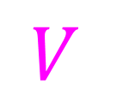
Succinct Interactive Arguments [Kilian92, Micali94]
Convert any PCP into a succinct interactive argument
$$P$$
$$V$$
root
$$H:{\left\{0,1\right\}}^{2k}→{\left\{0,1\right\}}^{k}$$
Succinct
Commitment of PCP
root
PCP queries
PCP
PCP answers + decommitment
Notes:
Used PCP to construct a computationally sound proof for any function.

Slide 32
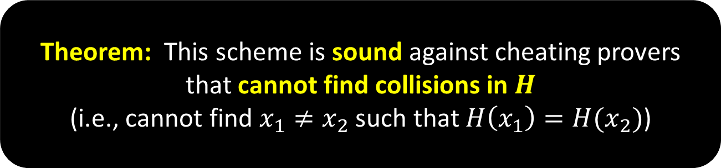
Theorem: This scheme is sound against cheating provers that cannot find collisions in $H$
(i.e., cannot find $x_{1}≠x_{2}$ such that $H\left(x_{1}\right)=H(x_{2})$)
$$P$$
$$V$$
root
$$H:{\left\{0,1\right\}}^{2k}→{\left\{0,1\right\}}^{k}$$
Succinct
Commitment of PCP
root
PCP queries
PCP
PCP answers + decommitment

Slide 33
Succinct Non-Interactive Arguments (SNARGs)
Common random string (CRS)
Guarantee: Given CRS, it is computationally hard to generate a proof of a false statement

Slide 34
Succinct Non-Interactive Arguments (SNARGs)
Apply Fiat-Shamir Paradigm to eliminate interaction from interactive schemes

Slide 35


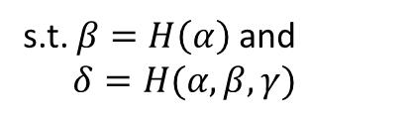





From Succinct Interactive Schemes to SNARGs
$$P$$
$$V$$
Fiat-Shamir heuristic
[FS86]
SNARG
$$α$$
$$(α,β, γ, δ)$$
$$β$$
$$γ$$
Public
coin
s.t. $β=H\left(α\right)$and
$δ=H(α,β,γ)$
$$δ$$

Slide 36


The (In)Security of the Fiat-Shamir Heuristic [FS86]
Proposed as a heuristic for converting identification schemes into signature schemes.
One of the most widely used signature scheme (ECDSA)
is based on this heuristic
In practice:
In theory:
Notes:
BitCoin uses ECDSA, and iphone

Slide 37
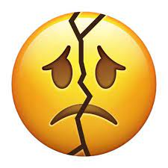


The (In)Security of the Fiat-Shamir Heuristic [FS86]
Proposed as a heuristic for converting identification schemes into signature schemes.
In practice:
In theory:
Computational soundness
First SNARG construction: Kilian92, Micali94
$$P$$
$$V$$
[FS86]
SNARG
[BBHMR19]
Notes:
[Bartusek-Bronfman-Holmgren-Ma-Rothblum19]

Slide 38

The (In)Security of the Fiat-Shamir Heuristic [FS86]
Is this heuristic secure when applied to statistically sound proofs??
Yes, under very strong cryptographic assumptions
Yes, for the GKR protocol under LWE or DDH
Yes, for some specific succinct interactive arguments under LWE!
Notes:
[[Bartusek-Bronfman-Holmgren-Ma-Rothblum19]

Slide 39
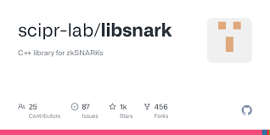
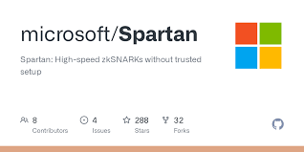
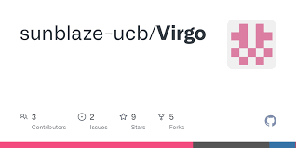
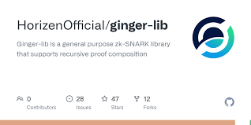
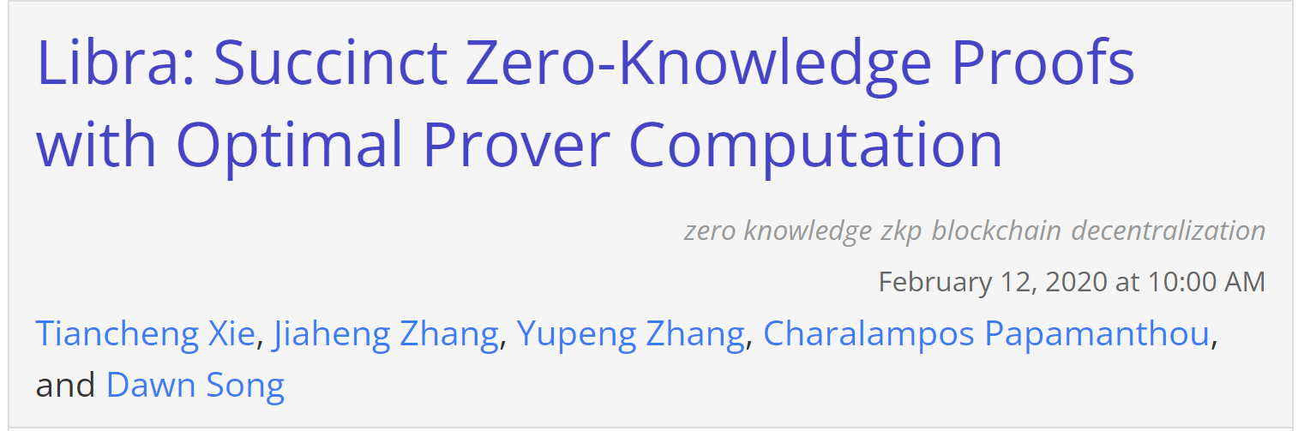
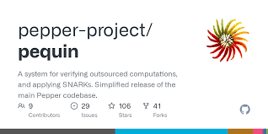
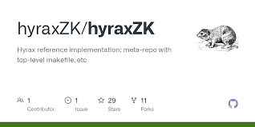
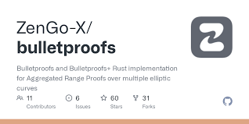
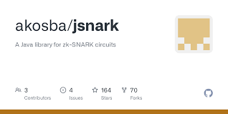
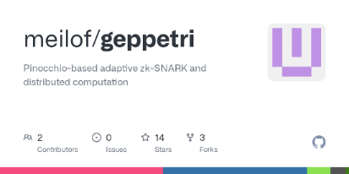
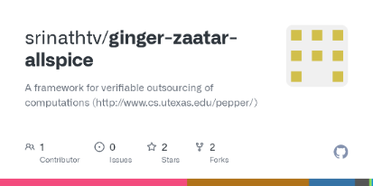
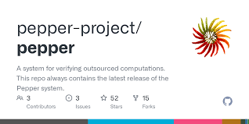
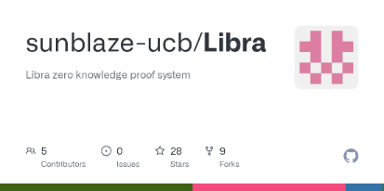






From Theory to Practice
Notes:
Many of the SNARG constructions have been implemented.

Slide 40







From Theory to Deployment
Securing Information for Encrypted
Verification and Evaluation (SIEVE)
Notes:
Beyond all the implementations mentioned above, these SNARGs are currently widely deployed.
Many blockchain companies use these SNARGs, starting with companies who were founded by our friends, such as Zchash and STARKWARE, and culminating with some of the most prominent blockchain companies, such as Ethereum.
In addition, DARPA, which is one of the biggest security funding agencies, has an immense project on SNARGs.

Slide 41
Classical Proofs
(zero-knowledge) Interactive
Proofs
Multi-Prover
Interactive Proofs
Succinct Non-Interactive Arguments
(SNARGs)
Probabilistically
Checkable Proofs

Slide 42


