Slide 1
MIT 6.875/6.5620/18.425
Foundations of Cryptography
Lecture 1
Course website: https://mit6875.github.io/

Slide 2
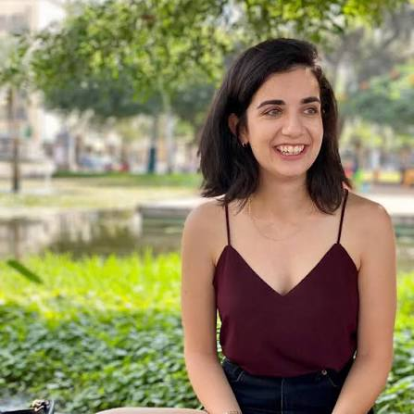


Course Staff
Instructors:
TAs:
Vinod Vaikuntanathan
(vinodv@mit)
Noga Amit
(nogamit@mit)
Shafi Goldwasser
(shafi@csail.mit)
Zoe Xi
(zoexi@mit)

Slide 3
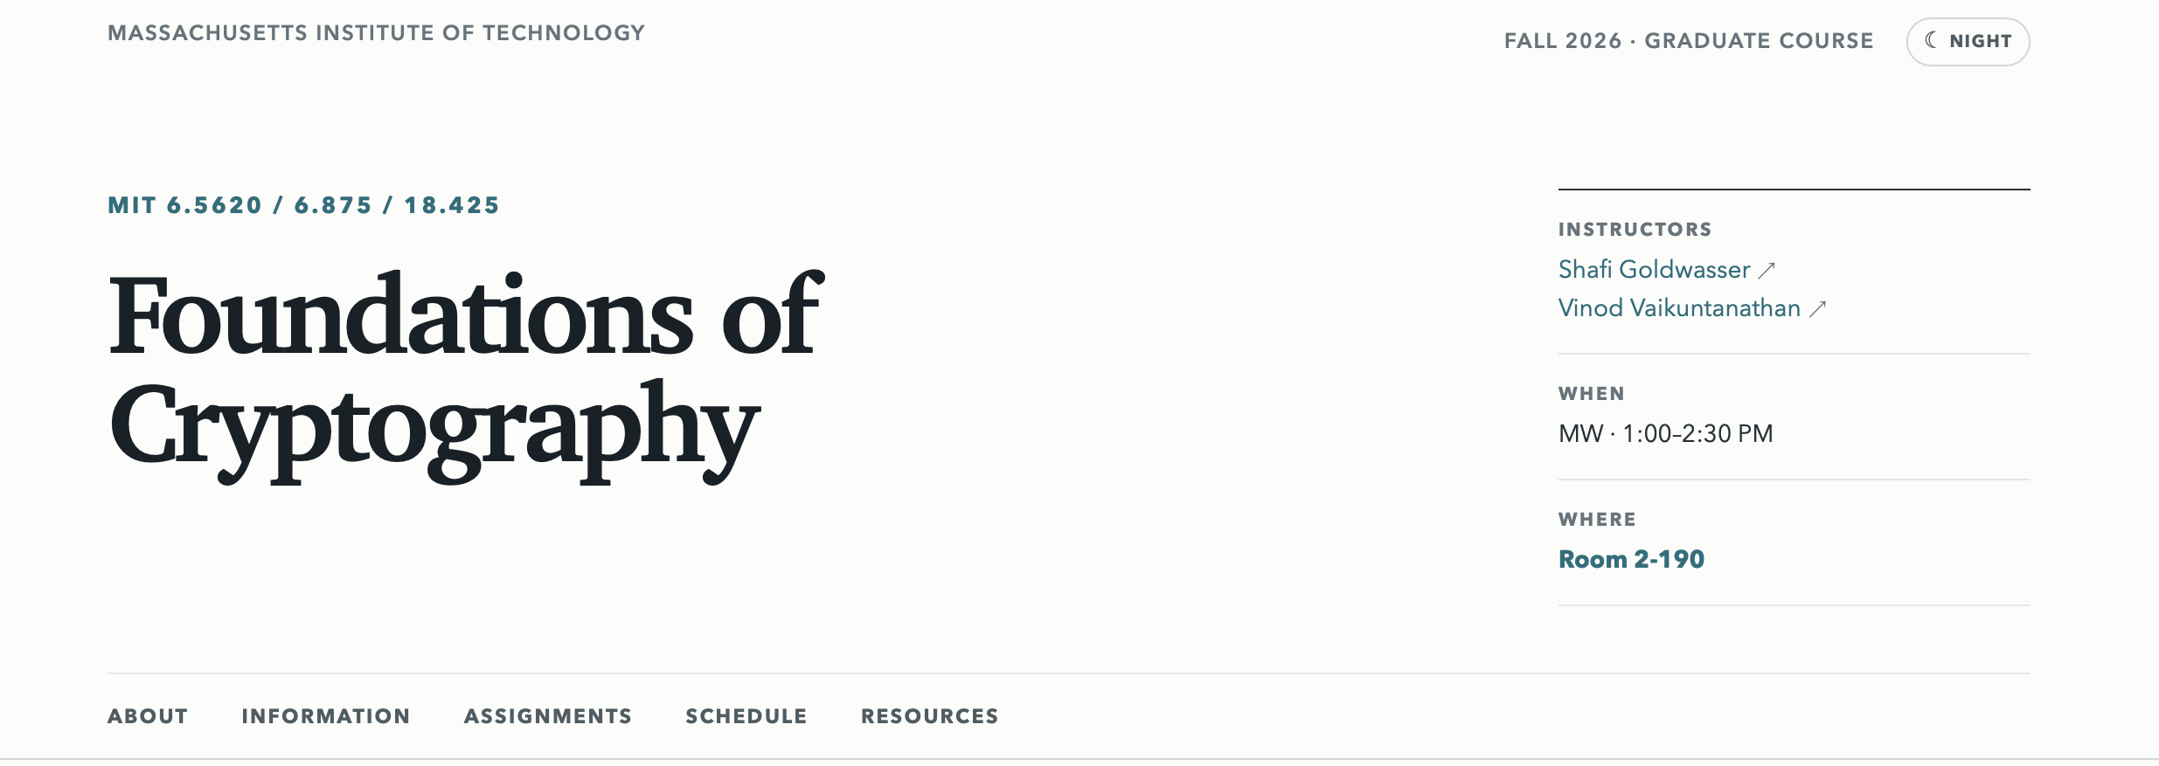
Course Website
https://mit6875.github.io/

Slide 4
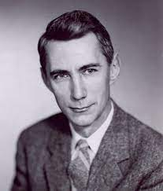
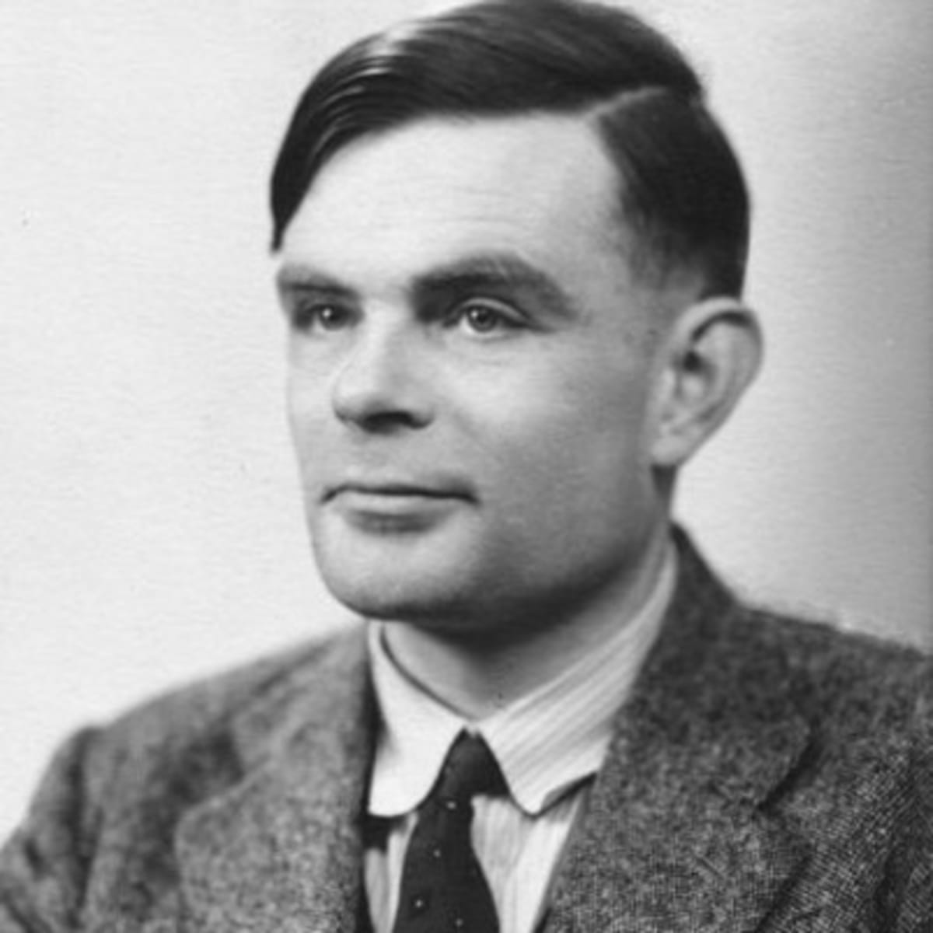
The Intellectual Origins of Cryptography
“Communication Theory of Secrecy Systems” (1945)
preceded
“A Mathematical Theory of Communication” (1948)
which founded Information Theory
Claude E. Shannon
Cryptanalysis of the Enigma Machine (~1938-39)
“On Computable Numbers, with an Application to the Entscheidungsproblem” (1936)
which gave birth to Computer Science
Alan M. Turing

Slide 5
Modern Cryptography:
Practice to Theory and Back
Definitions
Problems
Tools
Math and Theoretical CS
Security, Privacy, Integrity
CRYPTO
Solutions
Ideas
Encryption
Interactive Proofs
Digital Signatures
Probabilistically checkable Proofs
Pseudorandom Functions
Locally decodable Codes
…
…
Notes:
5

Slide 6
6.875/6.5620 Themes
1. The Omnipresent, Worst-case, Adversary.
Central idea. model the adversary: what they know, what they can do, and what their goals are.
Definitions will be our friend.
If you cannot define something, you cannot achieve it.
A key takeaway from 6.5620:
Cryptographic (or, adversarial) thinking.

Slide 7
6.875/6.5620 Themes
2. Computational Hardness will be our enabler. (starting lecture 2)
Central theme: the cryptographic leash. Use computational hardness to “tame” the adversary.
A classical source of hard problems: number theory.
“Both Gauss and lesser mathematicians may be justified in rejoicing that there is one such science [number theory] at any rate, whose very remoteness from ordinary human activities should keep it gentle and clean”
[G. H. Hardy, “A Mathematician’s Apology”]
More recently: geometry, coding theory, combinatorics.
Cryptography is the science of useful hardness.

Slide 8
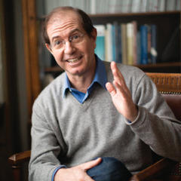
6.875 Themes
3. Security Proofs via Reductions.
“If there is an (efficient) adversary that breaks scheme A w.r.t. definition D, then there is an (efficient) adversary that factors large numbers.”
“Science wins either way”
Our reductions will be probabilistic and significantly more involved than the NP-hardness reductions in, say, 6.1400.

Slide 9
6.5620 Topics
Pseudorandomness
Secret-key Encryption and Authentication
Public-key Encryption and Digital Signatures
Cryptographic Hashing
Zero-knowledge Proofs
Secure Multiparty Computation
Private Information Retrieval
Homomorphic Encryption
Advanced topics: Steganography, Program Obfuscation, Post-Quantum Crypto.

Slide 10
Administrivia
Course website, the central point of reference.
https://mit6875.github.io
Gradescope for psets.
Gradescope code: K8YW6J

Slide 11
Administrivia
Course website, the central point of reference.
https://mit6875.github.io
Gradescope for psets.
Homework (10%): 5 psets.
6.5620 is on https://psetpartners.mit.edu

Slide 12
Administrivia
Course website, the central point of reference.
https://mit6875.github.io
Gradescope for psets.
Homework (10%): 5 psets.
Oral Problem Set Review (10%).
Midterm (30%): Oct 19 (no lecture that day)
Final (40%): date TBD.
- a possible class project (in lieu of the final).
Class Participation (10%): Lectures and office hours: come, be engaged, ask questions.

Slide 13
Administrivia
Course website, the central point of reference.
https://mit6875.github.io
Gradescope for psets.
Prereqs: Algorithms, Probability & Discrete Math, but most of all, “mathematical maturity”.
(Optional) special recitations: 1. probability (this Thursday), 2. basic complexity theory, 3. number theory.

Slide 14
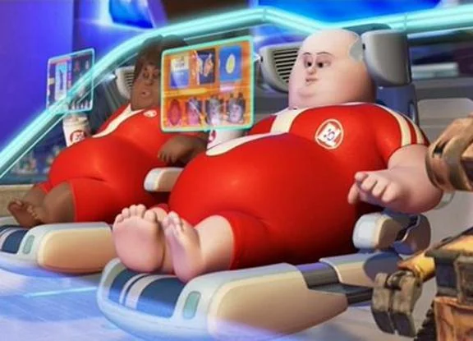
Administrivia
AI USE POLICY
You may use AI tools to assist with the understanding of the class material. However, we strongly recommend not using AI tools to solve your problem sets, which are meant to be a self-assessment mechanism that builds your understanding of the course material and grows your "crypto muscle", if you will. In particular, students are responsible for understanding everything they submit and must be able to explain and justify every part of their solution. The oral problem-set review (10% of the course grade) will evaluate students' understanding of the solutions they submitted.

Slide 15
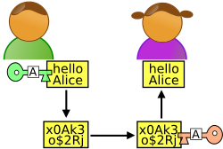
Secure Communication
m
Alice
Bob
Eavesdropper “Eve”
Alice wants to send a message m to Bob without revealing it to Eve.

Slide 16
Secure Communication
m
Key k
Key k
Eavesdropper “Eve”
SETUP: Alice and Bob meet beforehand to agree on a secret key k.

Slide 17
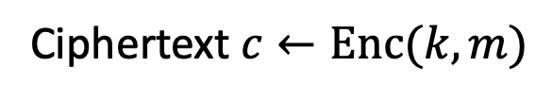


Key Notion: Secret-key Encryption
(or Symmetric-key Encryption)
$m$
Ciphertext $c←Enc(k,m)$
$$m←Dec(k,c)$$
Key k
Key k
Three (possibly probabilistic) algorithms:
Key Generation Algorithm Gen: $k←Gen(1^{n})$
Has to be probabilistic
Encryption Algorithm Enc: $c←Enc(k,m)$
Decryption Algorithm Dec: $m←Dec(k,c)$

Slide 18
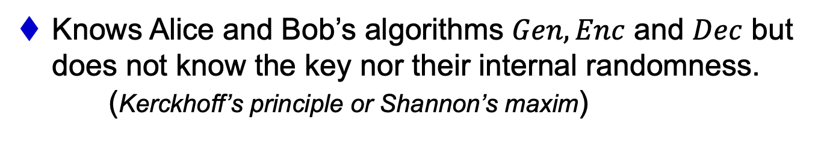
The Worst-case Adversary
An arbitrary computationally unbounded algorithm EVE.*
Knows Alice and Bob’s algorithms $Gen,Enc$ and $Dec$ but does not know the key nor their internal randomness. (Kerckhoff’s principle or Shannon’s maxim)
Can see the ciphertexts going through the channel (but cannot modify them… we will come to that later)
Security Definition: What is she trying to learn?
Notes:
as opposed to “security through obscurity”

Slide 19


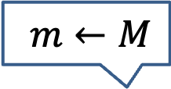

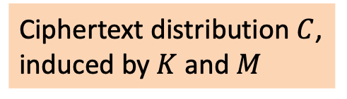


Shannon’s Perfect Secrecy Definition
Message space: $ℳ$, Message distribution: $M$
$m←M$
$$c=Enc(k,m)$$
Ciphertext distribution $C$, induced by $K$ and $M$
Key k $←K$
Key k $←K$
Key distribution $K$
IDEA: A-posteriori = A-priori
$∀M ∀m∈$ $Supp(M)$, $∀c$ $∈Supp(C)$,
$$\operatorname{Pr}\left[M=m|Enc\left(K,M\right)=c\right]=\operatorname{Pr}\left[M=m\right]$$
A-posteriori
A-priori

Slide 20
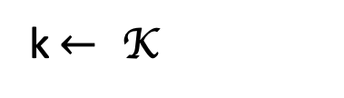
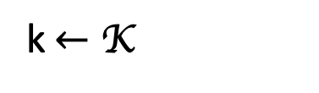



Perfect Indistinguishability Definition
Perfect indistinguishability: a Turing test
$∀m, m^{′}∈ℳ$,$c∈ \text{Supp}(C):$
$$Pr⁡[E\left(\text{K},m\right)=c]=Pr⁡[E\left(\text{K}\text{, }m′\right)=c]$$
World 0:
World 1:
k$←$ K
k$← \text{K}$
$$c=E\left(k,m\right)$$
$$c=E\left(k,m′\right)$$
is a distinguisher (that gets c and tries to guess which world she’s in)

Slide 21
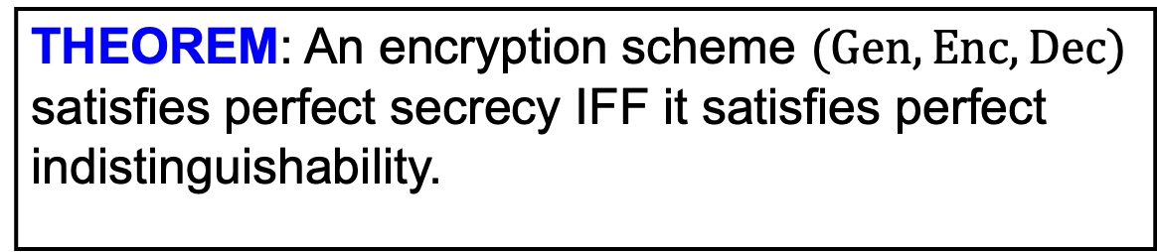
The Two Definitions are Equivalent
THEOREM: An encryption scheme $(Gen,Enc,Dec)$ satisfies perfect secrecy IFF it satisfies perfect indistinguishability.
PROOF: Simple use of conditional probabilities.

Slide 22
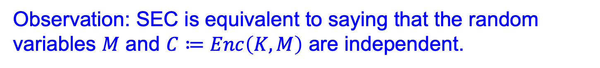
A simple observation
(SEC): $∀M ∀m∈Supp(M)$, $∀c$ $∈$ $Supp(C)$,
$$\operatorname{Pr}\left[M=m|Enc\left(K,M\right)=c\right]=\operatorname{Pr}\left[M=m\right]$$
Observation: SEC is equivalent to saying that the random variables $M$ and $C≔Enc\left(K,M\right)$ are independent.

Slide 23

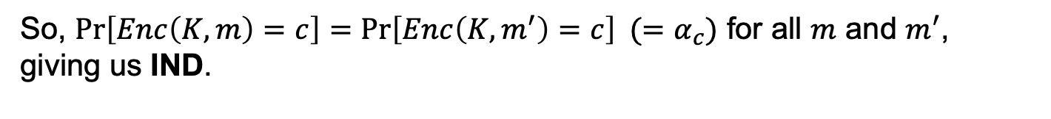
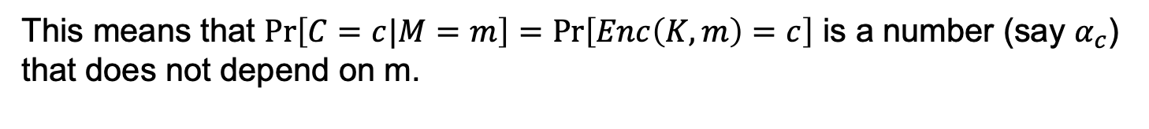
Proof Part 1. Secrecy $⟹$ Indistinguishability
WE KNOW (SEC): $∀M ∀m∈$ $Supp(M)$, $∀c$ $∈Supp(C)$,
$$\operatorname{Pr}\left[M=m|C=c\right]=\operatorname{Pr}\left[M=m\right]$$
WE WANT (IND): $∀m, m′∈ℳ$, $∀c$ $∈𝒞$,
$$\operatorname{Pr}\left[Enc\left(K,m\right)=c\right]=\operatorname{Pr}\left[Enc\left(K,m^{′}\right)=c\right]$$
Proof: By the observation from last slide, SEC is true if and only if $\operatorname{Pr}\left[C=c|M=m\right]=\operatorname{Pr}\left[C=c\right]$ (by independence of $M$ and $C$.)
This means that $\operatorname{Pr}\left[C=c|M=m\right]=Pr⁡\left[Enc\left(K,m\right)=c\right]$ is a number (say $α_{c}$) that does not depend on m.
So, $\operatorname{Pr}\left[Enc\left(K,m\right)=c\right]=\operatorname{Pr}\left[Enc\left(K,m^{′}\right)=c\right] (=α_{c})$ for all $m$ and $m^{′}$, giving us IND.

Slide 24


Proof Part 2. Indistinguishability $⟹$ Secrecy
WE KNOW (IND): $∀m, m′∈ℳ$, $∀c$ $∈$ $𝒞$,
$$\operatorname{Pr}\left[Enc\left(K,m\right)=c\right]=\operatorname{Pr}\left[Enc\left(K,m^{′}\right)=c\right]$$
WE WANT (SEC): $∀M ∀m∈$ $Supp(M)$, $∀c$ $∈$ $Supp(C)$,
$$\operatorname{Pr}\left[M=m|C=c\right]=\operatorname{Pr}\left[M=m\right]$$
Proof: As before, SEC is true if and only if $\operatorname{Pr}\left[C=c|M=m\right]=\operatorname{Pr}\left[C=c\right]$ for all $m$ and $c$.
$$\operatorname{Pr}\left[Enc\left(K,m\right)=c\right]=\operatorname{Pr}\left[C=c | M=m\right]$$
$$=\operatorname{Pr}\left[C=c | M=m′\right]$$
$$=Pr\left[Enc\left(K,m′\right)=c\right]$$

Slide 25
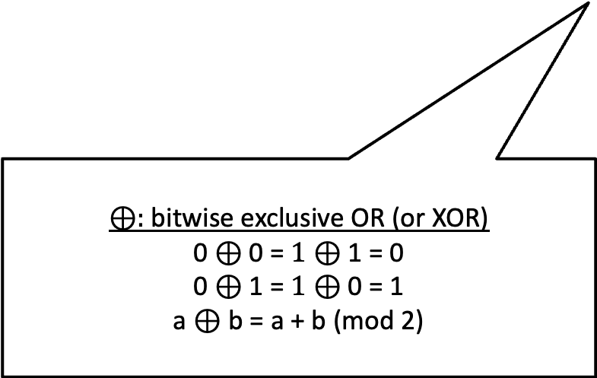
Perfect Secrecy is Achievable
The One-time Pad Construction:
$Gen:$ Choose an $n$-bit string k at random, i.e. $k←\{0,1\}^{n}$
$Enc\left(k,m\right)$, where m is an n-bit message: Output $c=m⨁k$
$Dec(k,c):$ Output $m=c⨁k$
$⊕:$ bitwise exclusive OR (or XOR)
0 $⊕$ 0 = $1⊕$ 1 = 0
0 $⊕$ 1 = $1⊕$ 0 = 1
a $⊕$ b = a + b (mod 2)

Slide 26
Perfect Secrecy is Achievable
The One-time Pad Construction:
$Gen:$ Choose an $n$-bit string k at random, i.e. $k←\{0,1\}^{n}$
$Enc\left(k,m\right)$, where m is an n-bit message: Output $c=m⨁k$
$Dec(k,c):$ Output $m=c⨁k$
Correctness: $c⨁k=\left(m⨁k\right)⨁k=m.$

Slide 27
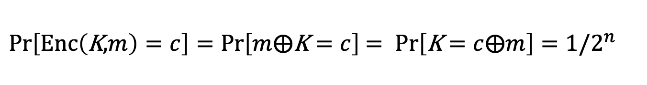
Perfect Secrecy is Achievable
The One-time Pad Construction:
$Gen:$ Choose an $n$-bit string k at random, i.e. $k←\{0,1\}^{n}$
$Enc\left(k,m\right)$, where m is an n-bit message: Output $c=m⨁k$
$Dec(k,c):$ Output $m=c⨁k$
Claim: One-time Pad achieves Perfect Indistinguishability (and therefore perfect secrecy).
Proof: For any $m,c∈\{0,1\}^{n},$
$Pr\left[Enc\left(\text{K}\text{,}m\right)=c\right]=Pr\left[m⨁\text{K}=c\right]$ $= Pr\left[\text{K}=c⨁m\right]=1/2^{n}$

Slide 28
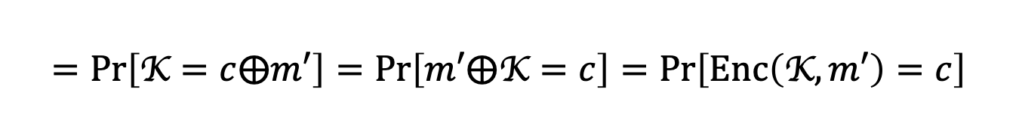
Perfect Secrecy is Achievable
The One-time Pad Construction:
$Gen:$ Choose an $n$-bit string k at random, i.e. $k←\{0,1\}^{n}$
$Enc\left(k,m\right)$, where M is an n-bit message: Output $c=m⨁k$
$Dec(k,c):$ Output $m=c⨁k$
Claim: One-time Pad achieves Perfect Indistinguishability (and therefore perfect secrecy).
Proof: For any$m,m^{′},c∈\{0,1\}^{n},$
$Pr\left[Enc\left(\text{K},m\right)=c\right]=Pr\left[m⨁\text{K}=c\right]$ $= Pr\left[\text{K}=c⨁m\right]=1/2^{n}$
$$=Pr\left[\text{K}=c⨁m′\right]=Pr\left[m′⨁\text{K}=c\right]=Pr\left[Enc\left(\text{K},m′\right)=c\right]$$

Slide 29
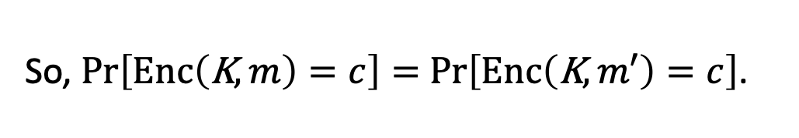
Perfect Secrecy is Achievable
The One-time Pad Construction:
$Gen:$ Choose an $n$-bit string k at random, i.e. $k←\{0,1\}^{n}$
$Enc\left(k,m\right)$, where m is an n-bit message: Output $c=m⨁k$
$Dec(k,c):$ Output $m=c⨁k$
Claim: One-time Pad achieves Perfect Indistinguishability (and therefore perfect secrecy).
Proof: For any m$,m^{′},c∈\{0,1\}^{n},$
So, $Pr\left[Enc\left(\text{K},m\right)=c\right]=$ $Pr\left[Enc\left(\text{K},m′\right)=c\right]$.
QED.

Slide 30

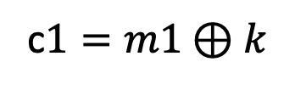
Reusing a One-time Pad?
m0
$$c0=m0⊕k$$
Key k
Key k
A week later:
m1
c$1=m1⊕k$
Is this still perfectly secret?
Super-secure Whisper room

Slide 31
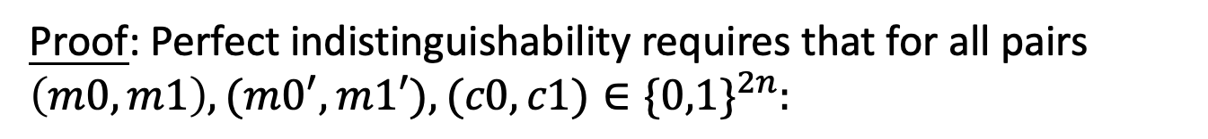
Reusing a One-time Pad?
Claim: Two-time Pad does not achieve Perfect Indistinguishability (and therefore not perfect secrecy).
Proof: Perfect indistinguishability requires that for all pairs $\left(m0,m1\right),{(m0}^{′},m1′),(c0,c1)∈\{0,1\}^{2n}:$
$$Pr[Enc\left(\text{k},m0)=c0 and Enc(\text{k},m1\right)=c1]$$
$$=Pr[Enc\left(k,m0′)=c0 and Enc(k,m1′\right)=c1]$$

Slide 32
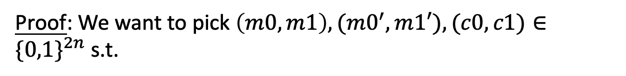
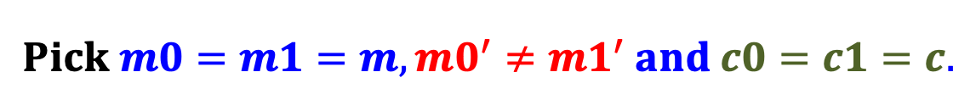
Reusing a One-time Pad?
Claim: Two-time Pad does not achieve Perfect Indistinguishability (and therefore not perfect secrecy).
Proof: We want to pick $\left(m0,m1\right),{(m0}^{′},m1′),(c0,c1)∈\{0,1\}^{2n}$ s.t.
$$Pr[Enc\left(k,m0)=c0 and Enc(k,m1\right)=c1]$$
$$≠Pr[Enc\left(k,m0′)=c0 and Enc(k,m1′\right)=c1]$$
$$Pick m0=m1=m,{m0}^{′}≠m1^{′} and c0=c1=c.$$
$$Pr[Enc\left(k,m0)=c0 and Enc(k,m1\right)=c1]$$
$$=Pr\left[Enc\left(k,m\right)=c\right]=1/2^{n}$$

Slide 33
Reusing a One-time Pad?
Claim: Two-time Pad does not achieve Perfect Indistinguishability (and therefore not perfect secrecy).
Proof: We want to pick $\left(m0,m1\right),{(m0}^{′},m1′),(c0,c1)∈\{0,1\}^{2n}$ s.t.
$$Pr[Enc\left(k,m0)=c0 and Enc(k,m1\right)=c1]$$
$$≠Pr[Enc\left(k,m0′)=c0 and Enc(k,m1′\right)=c1]$$
$$Pick m0=m1=m,{m0}^{′}≠m1^{′} and c0=c1=c.$$
$$Pr[Enc\left(k,m0)=c= Enc(k,m1\right)]=1/2^{n}$$
$$Pr[Enc\left(k,m0′)=c=Enc(k,m1′\right)]=0$$

Slide 34



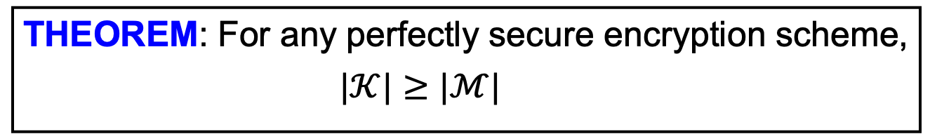

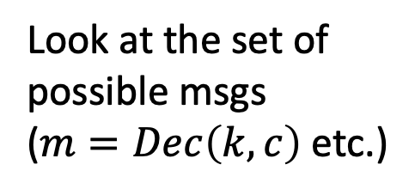









Perfect Secrecy has its Price
THEOREM: For any perfectly secure encryption scheme,
$|𝒦|≥|ℳ|$
PROOF (by picture): Assume for contradiction that $\left|𝒦\right|<\left|ℳ\right|.$
$$ℳ$$
$$𝒞$$
$$k$$
Pick any $c∈𝒞$
$$m$$
$$c$$
$$k′$$
Look at the set of possible msgs
($m=Dec\left(k,c\right)$ etc.)
$$m′$$
$$k′′$$
$$m′′$$
$$k′′′$$
$$≤\left|𝓚\right|<|𝓜|$$
$$\tilde{m}$$
Distinct keys!

Slide 35




Perfect Secrecy has its Price
THEOREM: For any perfectly secure encryption scheme,
$|𝒦|≥|ℳ|$
PROOF (by picture): Assume for contradiction that $\left|𝒦\right|<\left|ℳ\right|.$
$$ℳ$$
$$𝒞$$
$$k$$
$$m$$
$$c$$
$$k′$$
$$\operatorname{Pr}\left[Enc\left(K,m\right)=c\right]>0$$
$$m′$$
$$k′′$$
$$\operatorname{Pr}\left[Enc\left(K,\tilde{m}\right)=c\right]=0$$
$$m′′$$
$$QED.$$
$$≤\left|𝓚\right|<|𝓜|$$
$$\tilde{m}$$

Slide 36

So, what are we to do?
RELAX the definition:
EVE is an arbitrary computationally bounded algorithm.
+ number theory/geometry/combinatorics
the promised crypto land
Fully homomorphic encryption
ZK proofs
Public-key encryption
Pseudorandomness

Slide 37
To Summarize…
Secure Communication: a quintessential problem in cryptography.
We saw two equivalent definitions of security:
Shannon’s perfect indistinguishability and perfect secrecy
One-time pad achieves perfect secrecy.
A Serious Limitation: Any perfectly secure encryption scheme needs keys that are at least as long as the messages.
Next Lecture: Overcoming the limitation with Computationally Bounded Adversaries.

