Slide 1
MIT 6.875
Foundations of Cryptography
Lecture 9

Slide 2
Last Lecture
The Bit Security of DLOG
The Elliptic Curve Group
Z_{N} * when N=pq
Trapdoor Permutations
Ex: RSA permutation
Relation of RSA to the Factoring Problem
RSA PKC
Problems with RSA as a PKC
Rabin squaring function

Slide 3
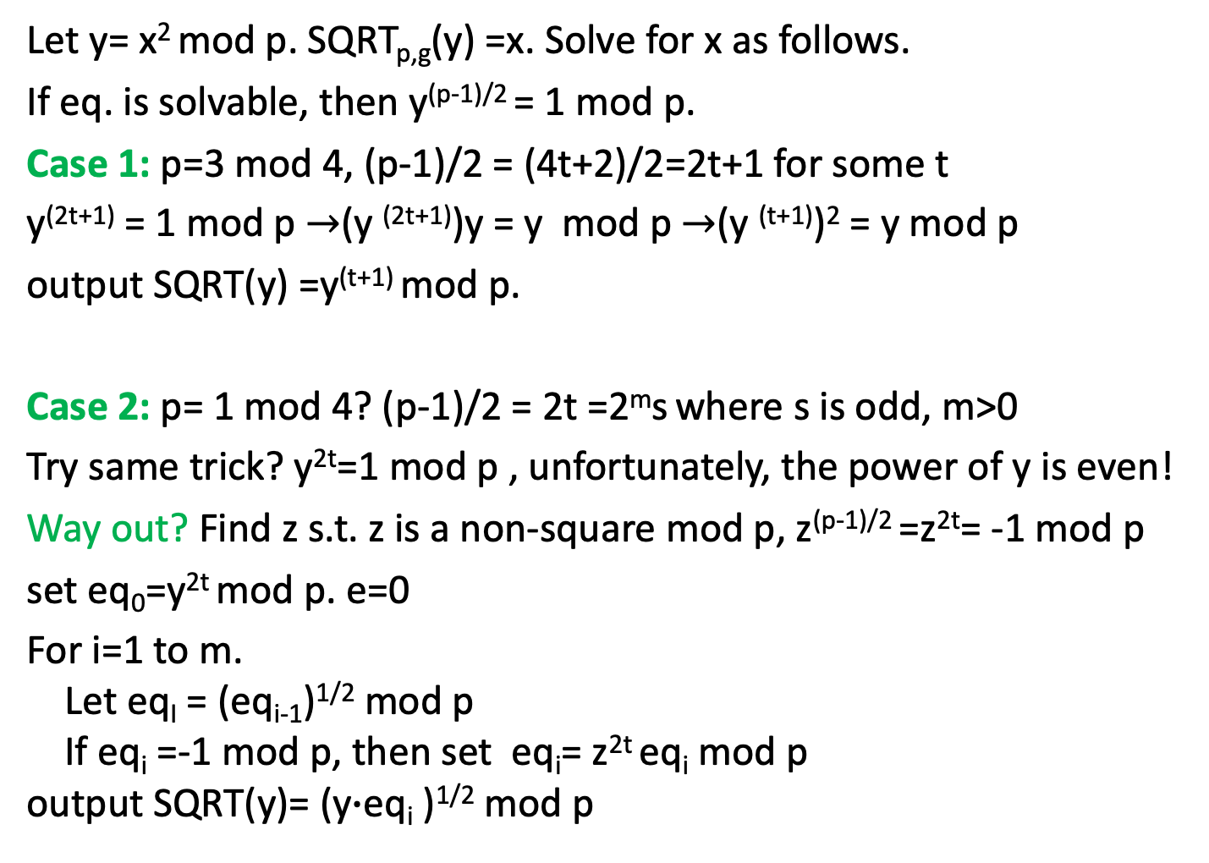
Recall: Computing Square Roots mod P
Let y= x² mod p. SQRT_{p,g}(y) =x. Solve for x as follows.
If eq. is solvable, then y^{(p-1)/2} = 1 mod p.
Case 1: p=3 mod 4, (p-1)/2 = (4t+2)/2=2t+1 for some t
y^{(2t+1)} = 1 mod p $→$(y ^{(2t+1)})y = y mod p $→$(y ^{(t+1)})² = y mod p
output SQRT(y) =y^{(t+1)} mod p.
Case 2: p= 1 mod 4? (p-1)/2 = 2t =2^{m}s where s is odd, m>0
Try same trick? y^{2t}=1 mod p , unfortunately, the power of y is even!
Way out? Find z s.t. z is a non-square mod p, z^{(p-1)/2} =z^{2t}= -1 mod p
set eq₀=y^{2t} mod p. e=0
For i=1 to m.
Let eq_{I} = (eq_{i-1})^{1/2} mod p
If eq_{i} =-1 mod p, then set eq_{i}= z^{2t} eq_{i} mod p
output SQRT(y)= (y$∙$eq_{i} )^{1/2} mod p

Slide 4
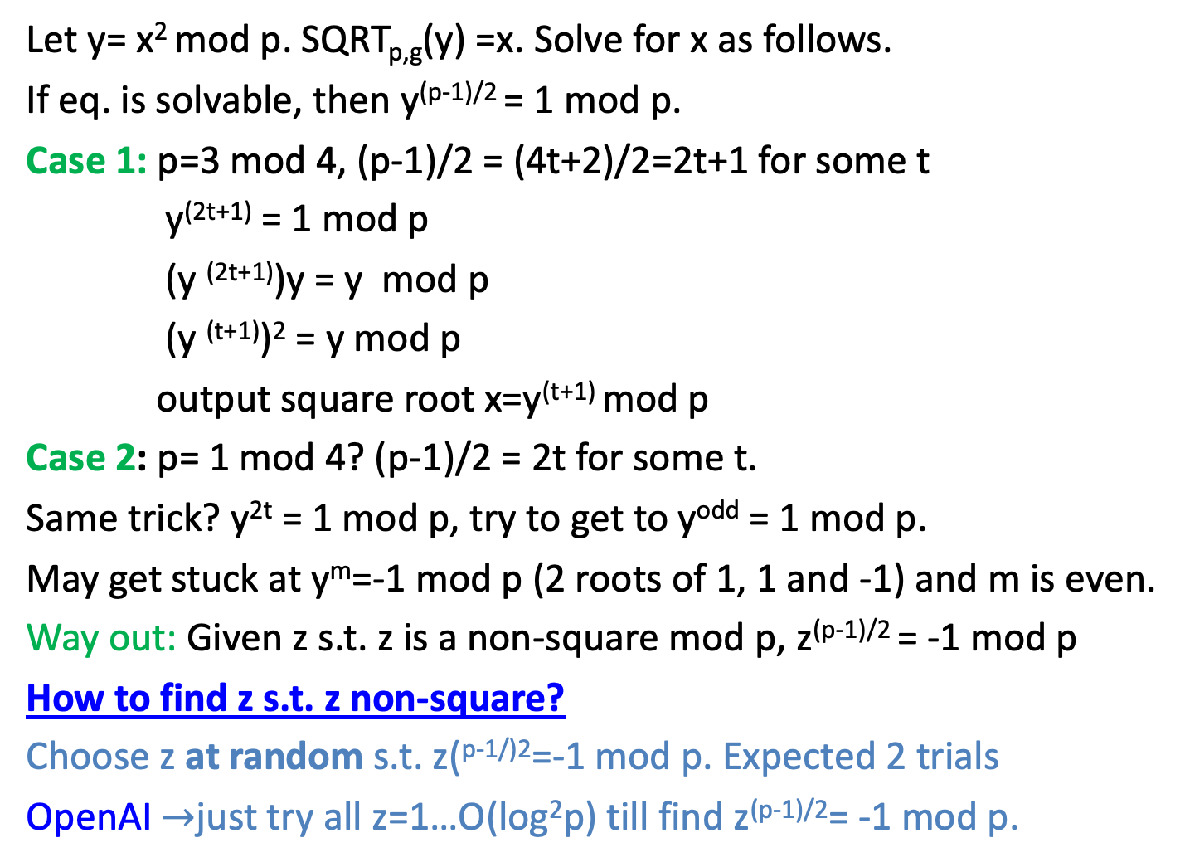
Recall: Computing Square Roots mod P
Let y= x² mod p. SQRT_{p,g}(y) =x. Solve for x as follows.
If eq. is solvable, then y^{(p-1)/2} = 1 mod p.
Case 1: p=3 mod 4, (p-1)/2 = (4t+2)/2=2t+1 for some t
y^{(2t+1)} = 1 mod p
(y ^{(2t+1)})y = y mod p
(y ^{(t+1)})² = y mod p
output square root x=y^{(t+1)} mod p
Case 2: p= 1 mod 4? (p-1)/2 = 2t for some t.
Same trick? y^{2t} = 1 mod p, try to get to y^{odd} = 1 mod p.
May get stuck at y^{m}=-1 mod p (2 roots of 1, 1 and -1) and m is even.
Way out: Given z s.t. z is a non-square mod p, z^{(p-1)/2} = -1 mod p
How to find z s.t. z non-square?
Choose z at random s.t. z(^{p-1/)2}=-1 mod p. Expected 2 trials
OpenAI $→$just try all z=1…O(log²p) till find z^{(p-1)/2}= -1 mod p.

Slide 5
Open AI Solutions
OpenAI claimed to have proven that the least quadratic non-residue is small (https://github.com/openai/math/blob/main/preprints/The-Quasi-Riemann-Hypothesis-September-30-2026/paper.pdf

Slide 6
Today
Bit-by-bit Probabilistic Encryption
Quadratic Residuosity (Goldwasser-Micali)
Bit Security of RSA function
Bit Security of Rabin (Blum-Williams)
Squaring function
PKC Based on Trapdoor Permutations

Slide 7
Diffie-Hellman Proposal:
Let F be trapdoor Permutation collection
User public key User private key
f_{u} t_{u} G(1^{n}) outputs
(f_{u},t_{u}) in F
Knows
t_{u}
Send c
On message m
Compute c=f_{u}(m)
On input c
let m = f⁻¹_{u}(c) =f⁻¹_{u}(f_{u}(m))

Slide 8
How to Build a PKC which can be proved computationally indistinguishable based on the factoring problem?
First Key Step:
How to Build a PKC for 1 bit messages?

Slide 9
A probabilistic ``gadget’’
Easy to sample
E₁(m)
E₂(m)
E₃(m) …
m
E₂¹⁰⁰(m)
Hard to distinguish
Easy if a trapdoor is known
Bob
Knows
trapdoor
Alice
Choose an encryption E_{i}(m) at random

Slide 10

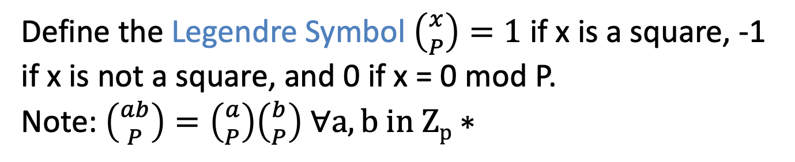
Back to Quadratic Residues mod p (squares)
Let P be prime. We saw that exactly half of $Z_{P}^{∗}$ are squares.
Define the Legendre Symbol $\left({x \atop P}\right)=1$ if x is a square, -1 if x is not a square, and 0 if x = 0 mod P.
Note: $\left({ab \atop P}\right)=\left({a \atop P}\right)\left({b \atop P}\right) ∀a,b in Zp∗$
claim: $\left({x \atop P}\right)=x^{(P−1)/2}$
$${Leg}_{−1}$$
$${Leg}_{+1}$$
$$Z_{P}^{∗}$$
$$\{x:\left({x \atop P}\right)=−1\}$$
$$\{x:\left({x \atop P}\right)=+1\}$$

Slide 11
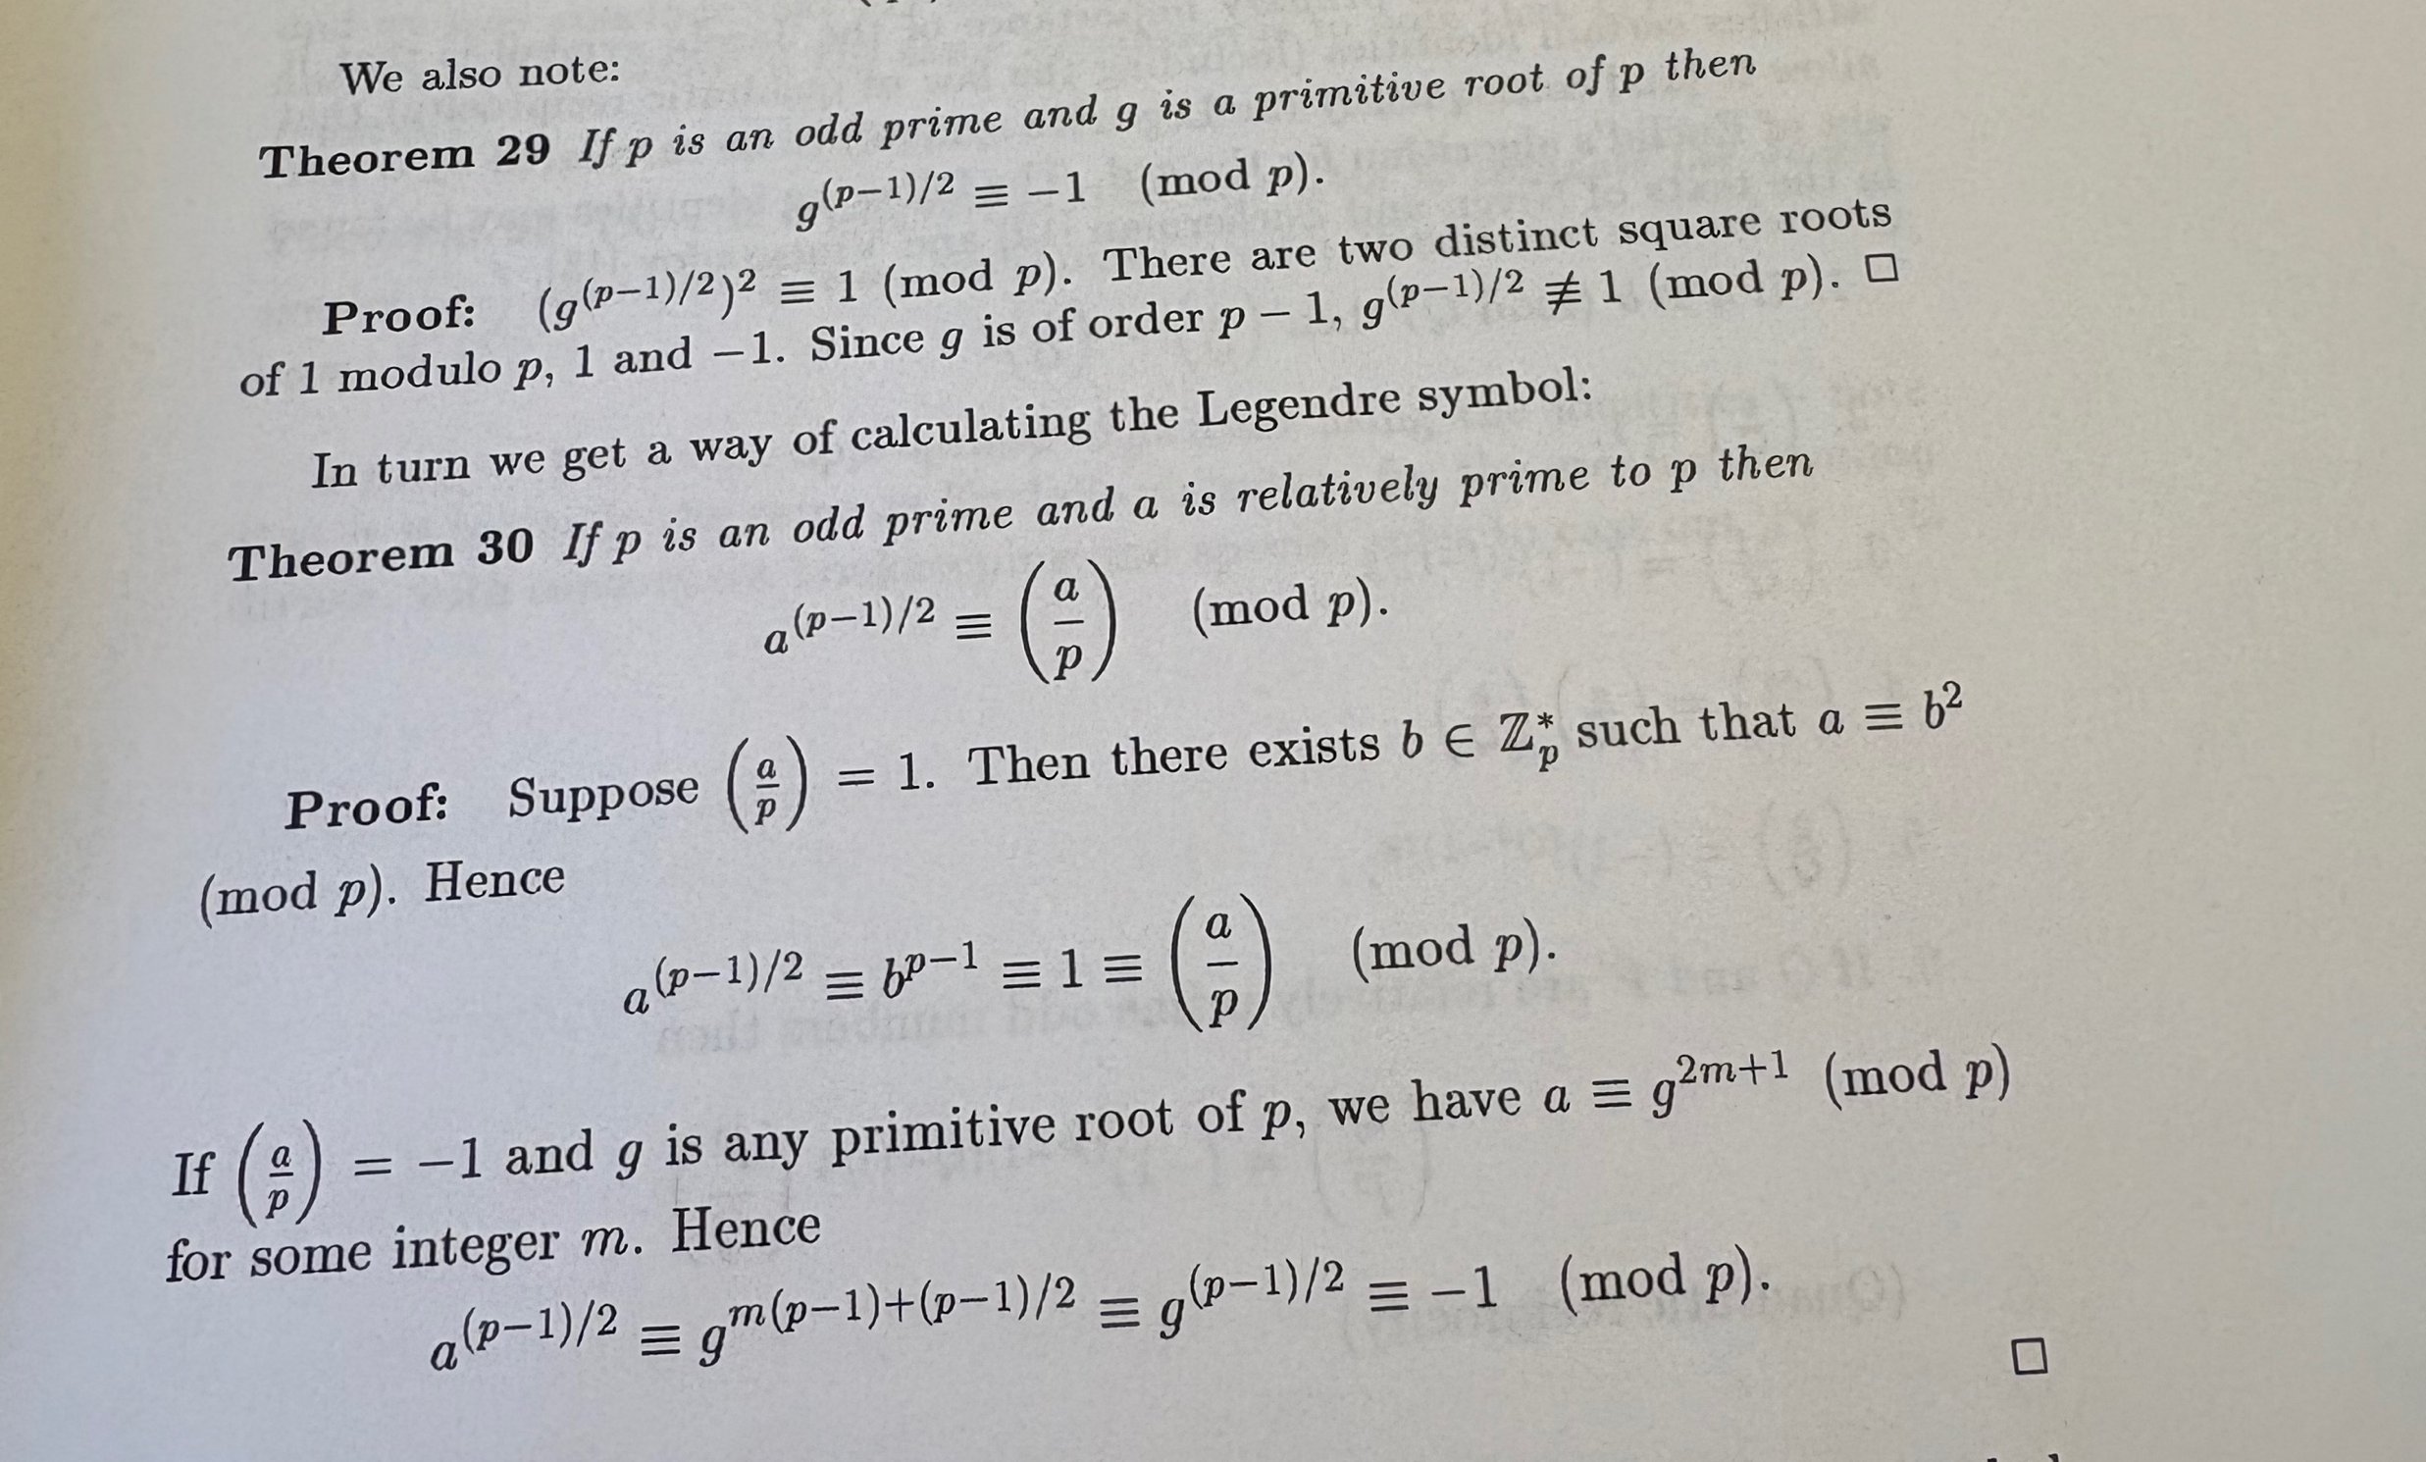
Proof of claim

Slide 12
The Chinese Remainder Theorem
Let p,q > 1 be coprime integers, and N = pq.
For any integers a,b, a unique x ∈ {0,…,N − 1} satisfies
x ≡ a (mod p) and x ≡ b (mod q).
Construction. Find u,v with up + vq = 1 (extended Euclid).
x = (a · vq + b · up) mod N.
Modulo p this is a. Modulo q it is b.
Uniqueness. If x and x′ both work, p and q divide x − x′.
Thus N ∣ (x − x′), so x ≡ x′ (mod N).
Notes:
Chinese Remainder Theorem, two-modulus form. Let p,q>1 be coprime positive integers and N=pq. For every pair of integers a,b, there is exactly one x in {0,...,N-1} satisfying x≡a mod p and x≡b mod q. The factors need not be prime.
Existence and efficient reconstruction: the extended Euclidean algorithm finds integers u,v with up+vq=1. Set x to the least nonnegative residue of a vq+b up modulo N. Reducing the Bezout identity modulo p shows vq≡1 mod p, while up≡0 mod p. Thus x≡a mod p. Likewise, up≡1 mod q and vq≡0 mod q, so x≡b mod q. Equivalently x≡a q(q⁻¹ mod p)+b p(p⁻¹ mod q) mod N.
Uniqueness: for any two solutions x,x′, both p and q divide their difference. Because gcd(p,q)=1, their product N divides the difference, so the solutions are the same residue class modulo N. Choosing representatives in {0,...,N-1} gives equality.
Example for oral explanation: p=3, q=5, a=2, b=1. Take u=2,v=-1, so 2·3−1·5=1. Then x≡2·(-5)+1·6≡11 mod15. Indeed 11≡2 mod3 and 11≡1 mod5.
General form: for pairwise coprime positive moduli m_1,...,m_k, every tuple of residues has a unique simultaneous solution modulo M=∏m_i. With M_i=M/m_i and t_i=M_i⁻¹ mod m_i, x≡Σa_i M_i t_i mod M.
The residue map Z/NZ → Z/pZ × Z/qZ is a ring isomorphism, which is why addition, multiplication, and squaring can be checked separately modulo the two factors. This supports the preceding slide about squares modulo pq.
Source: standard Chinese Remainder Theorem; constructive proof supplied on slide.

Slide 13
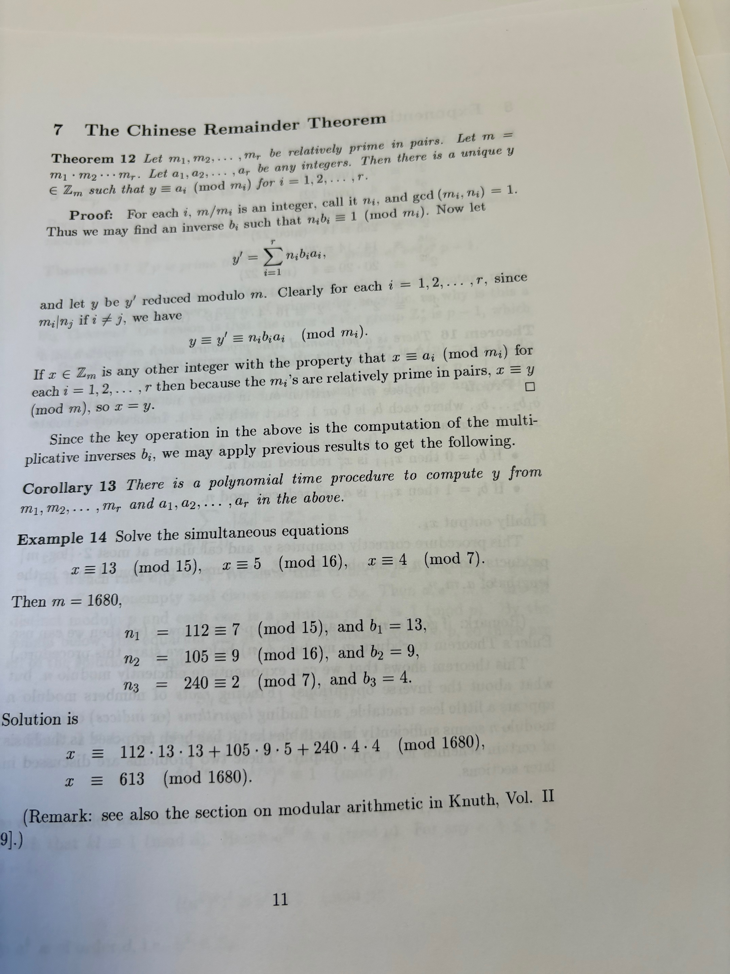
On Board

Slide 14
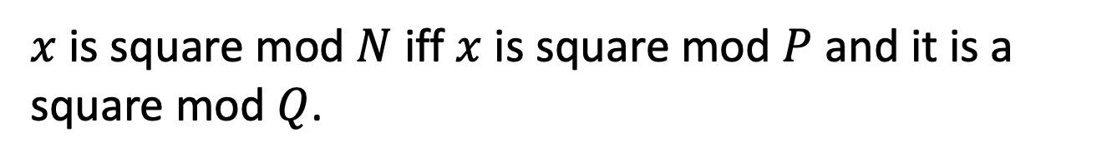
Quadratic Residues mod N
Now, let N = PQ be a product of two primes and look at $Z_{N}^{∗}$
$x$ is square mod $N$ iff $x$ is square mod $P$ and it is a square mod $Q$.
Notes:
For x to be a square mod N, it has to be a square mod P and square mod Q.
And conversely, if x = y1^2 mod P and x = y2^2 mod Q, then x = CRT(y1,y2)^2 mod PQ.

Slide 15
Quadratic Residues modulo N: CRT proof
Let N = pq, where p and q are distinct primes.
y is a square mod N ⇔ y is a square mod p and mod q.
⇒ If x² ≡ y (mod N), reduce modulo p and modulo q.
⇐ Suppose a² ≡ y (mod p) and b² ≡ y (mod q).
By CRT, choose x ≡ a (mod p) and x ≡ b (mod q).
Then p ∣ (x² − y) and q ∣ (x² − y). Since gcd(p,q) = 1,
pq ∣ (x² − y), so x² ≡ y (mod N).
Notes:
Let N=pq with distinct primes p and q. In fact, the proof only needs p and q to be coprime positive integers. An integer y is a square modulo a modulus m if there is an integer x such that x²≡y mod m; this definition includes zero and nonunits.
Forward implication: N divides x²−y, so each of p and q divides x²−y.
Reverse implication: choose roots a modulo p and b modulo q. The Chinese remainder theorem produces a unique residue class x modulo pq satisfying x≡a mod p and x≡b mod q. Explicitly, x≡a q(q⁻¹ mod p)+b p(p⁻¹ mod q) mod N. Then x²−y is divisible by both coprime factors p and q, hence by their product. No Blum-modulus assumption is needed.
The roots a and b can differ; CRT combines any pair of local roots into a global root. The assumption p≠q is essential for the stated argument. For example, y=3 is a square modulo 3 but is not a square modulo 9.
Source: Chinese remainder theorem; complete proof supplied on slide.

Slide 16
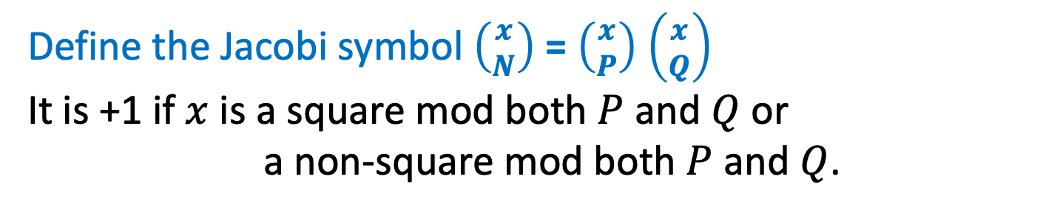
Quadratic Residues mod N
Define the Jacobi symbol $\left({x \atop N}\right)$ = $\left({x \atop P}\right)$ $\left({x \atop Q}\right)$
It is +1 if $x$ is a square mod both $P$ and $Q$ or
a non-square mod both $P$ and $Q$.
$$Z_{N}^{∗}$$
$${Jac}_{−1}$$
$${Jac}_{+1}$$
$$\{x:\left({x \atop N}\right)=−1\}$$
$$\{x:\left({x \atop N}\right)=+1\}$$

Slide 17
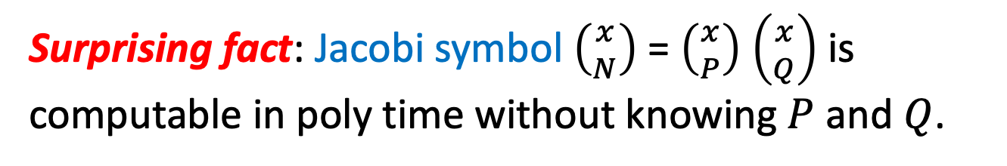
Quadratic Residues mod N
$$Z_{N}^{∗}$$
$${Jac}_{−1}$$
$${Jac}_{+1}$$
$$\{x:\left({x \atop N}\right)=−1\}$$
$$\{x:\left({x \atop N}\right)=+1\}$$
Surprising fact: Jacobi symbol $\left({x \atop N}\right)$ = $\left({x \atop P}\right)$ $\left({x \atop Q}\right)$ is computable in poly time without knowing $P$ and $Q$.
Notes:
Proof sketch on the board. Use the reciprocity law (x/N) = (N/x) (-1)^{(x-1)(N-1)/4} and (x/N) = (x mod N / N) and the supplementary facts (1 // N) = (-1)^{n-1/2} and (2 // N) = (-1)^{n^2-1/8}.

Slide 18
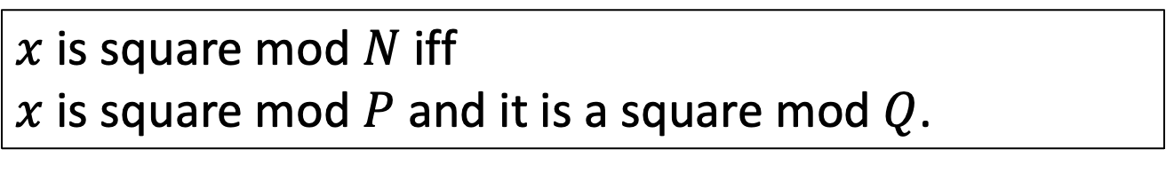
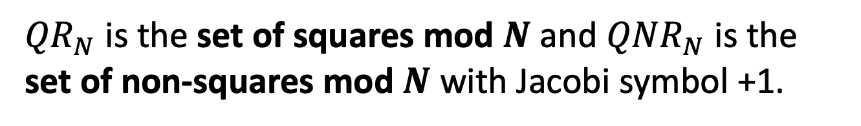
Quadratic Residues mod N
$x$ is square mod $N$ iff
$x$ is square mod $P$ and it is a square mod $Q$.
$${Jac}_{+1}$$
So: ${QR}_{N}= \{x:\left({x \atop P}\right)=\left({x \atop Q}\right)=+1\}$
$${QR}_{N}$$
${QNR}_{N}= \{x:\left({x \atop P}\right)=\left({x \atop Q}\right)=−1\}$
$${QNR}_{N}$$
${QR}_{N}$ is the set of squares mod $N$ and ${QNR}_{N}$ is the set of non-squares mod $N$ with Jacobi symbol +1.
Notes:
For x to be a square mod N, it has to be a square mod P and square mod Q.
And conversely, if x = y1^2 mod P and x = y2^2 mod Q, then x = CRT(y1,y2)^2 mod PQ.

Slide 19
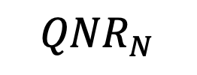
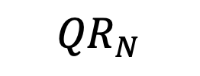
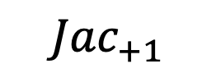
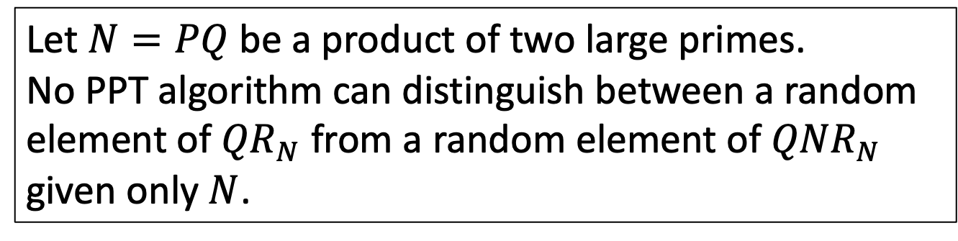
Recognizing Squares mod N
… seems hard
Let $N=PQ$ be a product of two large primes.
Quadratic Residuosity Assumption (QRA)
Let $N=PQ$ be a product of two large primes.
No PPT algorithm can distinguish between a random element of ${QR}_{N}$ from a random element of ${QNR}_{N}$ given only $N$.
$${Jac}_{+1}$$
$${QR}_{N}$$
$${QNR}_{N}$$

Slide 20
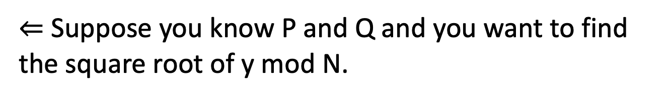
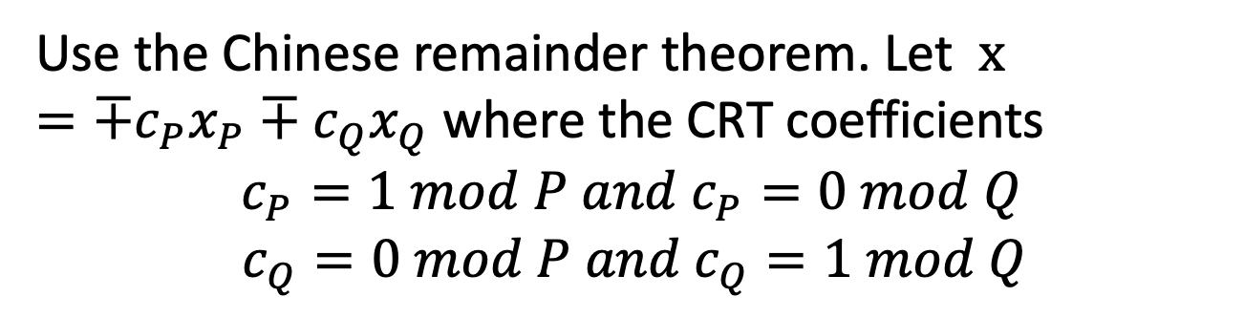
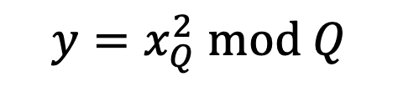
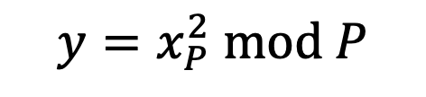
Finding Square Roots Mod N
… is as hard as factoring N
$⇐$ Suppose you know P and Q and you want to find the square root of y mod N.
Find the square roots of y mod P and mod Q.
$$y=x_{P}^{2} mod P$$
$$y=x_{Q}^{2} mod Q$$
Use the Chinese remainder theorem. Let $x={∓c}_{P}x_{P}∓c_{Q}x_{Q}$ where the CRT coefficients
$$c_{P}=1 mod P and{ c}_{P}=0 mod Q$$
$c_{Q}=0 mod P and{ c}_{Q}=1 mod Q$
Then $x$ are the square roots of y mod N.
Notes:
Need CRT. E.g. x = 1 mod 3 and x = 2 mod 5 => x is unique mod 15. x = c_3 * 1 + c_5 * 2. c_3 = 10 is 1 mod 3 and 0 mod 5. c_5 = 6 is 1 mod 5 and 0 mod 3. So x = 10*1+6*2 = 22 = 7 mod 15.
For x to be a square mod N, it has to be a square mod P and square mod Q.
And conversely, if x = y1^2 mod P and x = y2^2 mod Q, then x = CRT(y1,y2)^2 mod PQ.

Slide 21
Goldwasser-Micali (GM) Encryption
$Gen\left(1^{n}\right):$Generate random $n$-bit primes $p$ and $q$ and let $N=pq$. Let $y∈{QNR}_{N}$ be some quadratic non-residue with Jacobi symbol +1.
Let $pk=(N,y)$ and let $sk=(p,q)$.
$Enc\left(pk,b\right)$ where $b$ is a bit:
Generate random $r∈Z_{N}^{∗}$and output $r^{2} mod N$ if $b=0$ and $r^{2}y mod N$ if $b=1$.
$Dec\left(sk,c\right)$: Check if $c∈Z_{N}^{∗}$is a quadratic residue using $p$ and $q$. If yes, output 0 else 1.

Slide 22
Goldwasser-Micali (GM) Encryption
$Enc\left(pk,b\right)$ where $b$ is a bit:
Generate random $r∈Z_{N}^{∗}$and output $r^{2} mod N$ if $b=0$ and $r^{2}y mod N$ if $b=1$.
Computational indistinguishability follows directly from the quadratic residuosity assumption.
Quadratic non-residues
cipher texts
of `1’
Quadratic
Residues
cipher texts
of `0’
≈
More Generally, Hard Decision Problems where can sample Yes and No instances

Slide 23
What about using Trapdoor Permutations?

Slide 24
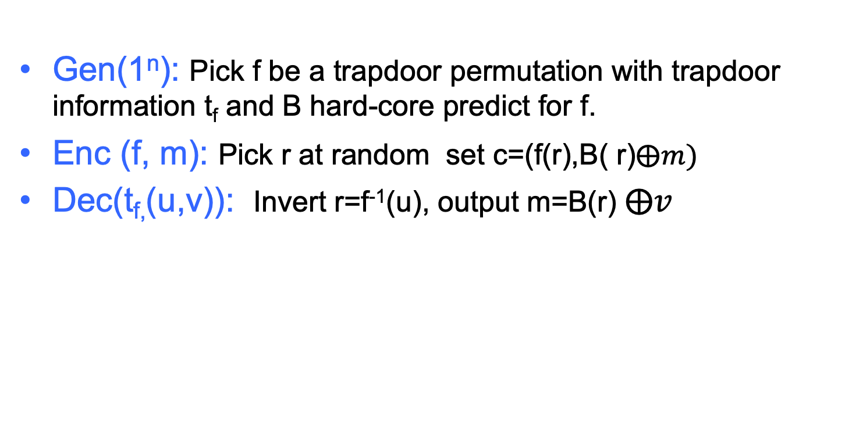
Probabilistic Encryption of 1 bit messages, based on any Trapdoor Permutation
Gen(1^{n}): Pick f be a trapdoor permutation with trapdoor information t_{f} and B hard-core predict for f.
Enc (f, m): Pick r at random set c=(f(r),B( r)$⨁m)$
Dec(t_{f,}(u,v)): Invert r=f⁻¹(u), output m=B(r) $⨁v$
f(r) s.t.
B(r)=0
≈
f(r)s.t. B(r)=1
Claim: If B is a hard-core predicate for f trapdoor permutation, scheme (Gen, Enc, Dec) is computationally indistinguishable
Notes:
Can recognize repeated message
Can compute relationship between messages
Can leak partial information about message

Slide 25
Recall: Trapdoor Permutations Candidates
Two candidates (both need factoring to be hard):
The RSA (Rivest-Shamir-Adleman) Permuation
The Rabin/Blum-Williams Function

Slide 26
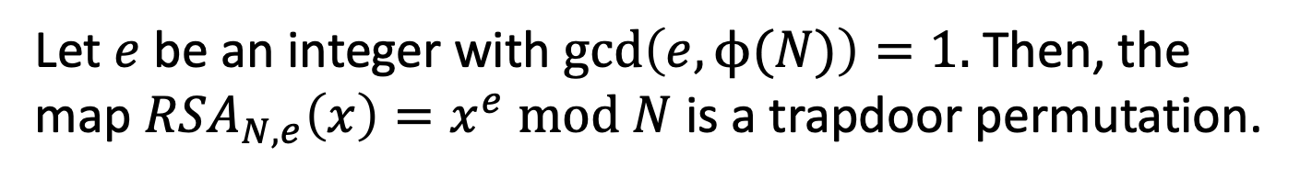
Recall, The RSA Trapdoor Permutation
Let $e$ be an integer with $\gcd\left(e,ϕ(N)\right)=1.$ Then, the map ${RSA}_{N,e}\left(x\right)=x^{e} mod N$ is a trapdoor permutation.
Key Fact: Given $d$ such that $ed=1 mod ϕ\left(N\right)$, it is easy to compute $x$ given $x^{e}$.
Proof: ${(x}^{e})^{d}=x^{kϕ\left(N\right)+1}=(x^{ϕ\left(N\right)})^{k}∙x=x mod N$
(for some integer k)
This gave us the RSA trapdoor permutation collection.
$${\{RSA}_{N,e}:\gcd\left(e,N\right)=1\}$$
Trapdoor for inversion: $d=e^{−1}mod ϕ\left(N\right)$.

Slide 27
The RSA Trapdoor Permutation
Hardcore bits (galore) for the RSA trapdoor one-way perm:
The Goldreich-Levin bit $GL\left(r;r^{′}\right)= \left\langle r,r′\right\rangle mod 2$
The least significant bit $LSB\left(r\right)$
The “most significant bit” ${HALF}_{N}\left(r\right)=1$ iff $r<N/2$
In fact, any single bit of $r$ is hardcore.

Slide 28
LSB is hard bit from RSA:One parity answer halves the interval
Given c = xᵉ mod N.
Assume there exists PRED(tᵉ mod N) =lsb(t) =
t mod 2 for 0 ≤ t < N for all t,
Compute c₁ = 2ᵉ · c mod N = (2x)ᵉ mod N.
The parity of plaintext tells us which half contains x:
PRED(c₁) = 0$→$ 2x mod N = 2x, so x < N/2.
PRED(c₁) = 1$→$ 2x mod N = 2x − N, so x > N/2.
Subtracting the odd number N changes the parity.
1
Notes:
Setup: N=pq is an odd RSA modulus and gcd(e,φ(N))=1. The target plaintext is the unique integer 0≤x<N with c=x^e mod N. The assumed oracle O outputs t mod2 on input t^e mod N for every plaintext t (100% correctness). The ciphertext 2^e c mod N encrypts 2x mod N. If x<N/2, then 2x<N and the new plaintext is 2x, which is even. If x>N/2, the new plaintext is 2x-N, which is odd because N is odd. Equality x=N/2 cannot occur for integer x. Thus one parity query is a comparison of x with N/2. This is exactly the parity/half-interval equivalence in GMT §3.1, Example 2.
References: S. Goldwasser, S. Micali and P. Tong, “Why and How to Establish a Private Code on a Public Network,” FOCS 1982, pp.134–144, §3.1, Examples 1 and 2. DOI:10.1109/SFCS.1982.100. Full text: https://fog.misty.com/perry/Bleichenbacher/Goldwasser-1982-FOCS.pdf
M. Ben-Or, B. Chor and A. Shamir, “On the Cryptographic Security of Single RSA Bits,” STOC 1983, pp.421–430. DOI:10.1145/800061.808773.
The deck presents the elementary exact-oracle reduction using repeated doubling. It does not use the noisy-predictor or GCD machinery.

Slide 29
Repeated doubling reveals the bits of x/N
At step i, query cᵢ = 2^{ei} · c mod N and
let bᵢ = PRED(cᵢ).
Since N is odd and 2ⁱx is even,
b₁,b₂,… are the binary digits of x/N.
RSA inverter [uses ⌈log₂ N⌉ queries]
What if PRED makes mistake? See paper by AGCS88
Notes:
Let n=ceil(log2 N). Define c_i=2^{ie}c mod N and r_i=2^i x mod N in {0,...,N-1}. Writing 2^i x=q_iN+r_i and reducing modulo 2 gives b_i=r_i mod2=q_i mod2 for i≥1, because 2^i x is even and N is odd. Let f=x/N. Then q_i=floor(2^i f), so q_i=2q_{i-1}+b_i with q_0=0. Therefore the concatenation b_1...b_i is the binary representation of q_i, and b_i are successive binary digits of x/N (not the ordinary binary digits of x). Define K_i=2K_{i-1}+b_i with K_0=0. We obtain K_i≤2^i x/N<K_i+1. These nested intervals choose the lower half when b_i=0 and upper half when b_i=1. The argument also works for x=0. All arithmetic can use exact integers or rationals.
References: S. Goldwasser, S. Micali and P. Tong, “Why and How to Establish a Private Code on a Public Network,” FOCS 1982, pp.134–144, §3.1, Examples 1 and 2. DOI:10.1109/SFCS.1982.100. Full text: https://fog.misty.com/perry/Bleichenbacher/Goldwasser-1982-FOCS.pdf
M. Ben-Or, B. Chor and A. Shamir, “On the Cryptographic Security of Single RSA Bits,” STOC 1983, pp.421–430. DOI:10.1145/800061.808773.
The deck presents the elementary exact-oracle reduction using repeated doubling. It does not use the noisy-predictor or GCD machinery.

Slide 30
RSA Bit Encryption
$Gen\left(1^{n}\right):$Let $N=pq$ and $\left(e,d\right)$ be such that $ed=1 mod φ(N)$.
Let $pk=(N,e)$ and let $sk=d$.
$Enc\left(pk,b\right)$ where $b$ is a bit: Generate random $r∈Z_{N}^{∗}$and output $r^{e} mod N$ and $LSB\left(r\right)⨁m$.
$Dec\left(sk,c\right)$: Recover $r$ via RSA inversion.
IND-secure under the RSA assumption: given $N,e$ (as above) and $r^{e}$mod N, hard to compute $r.$

Slide 31
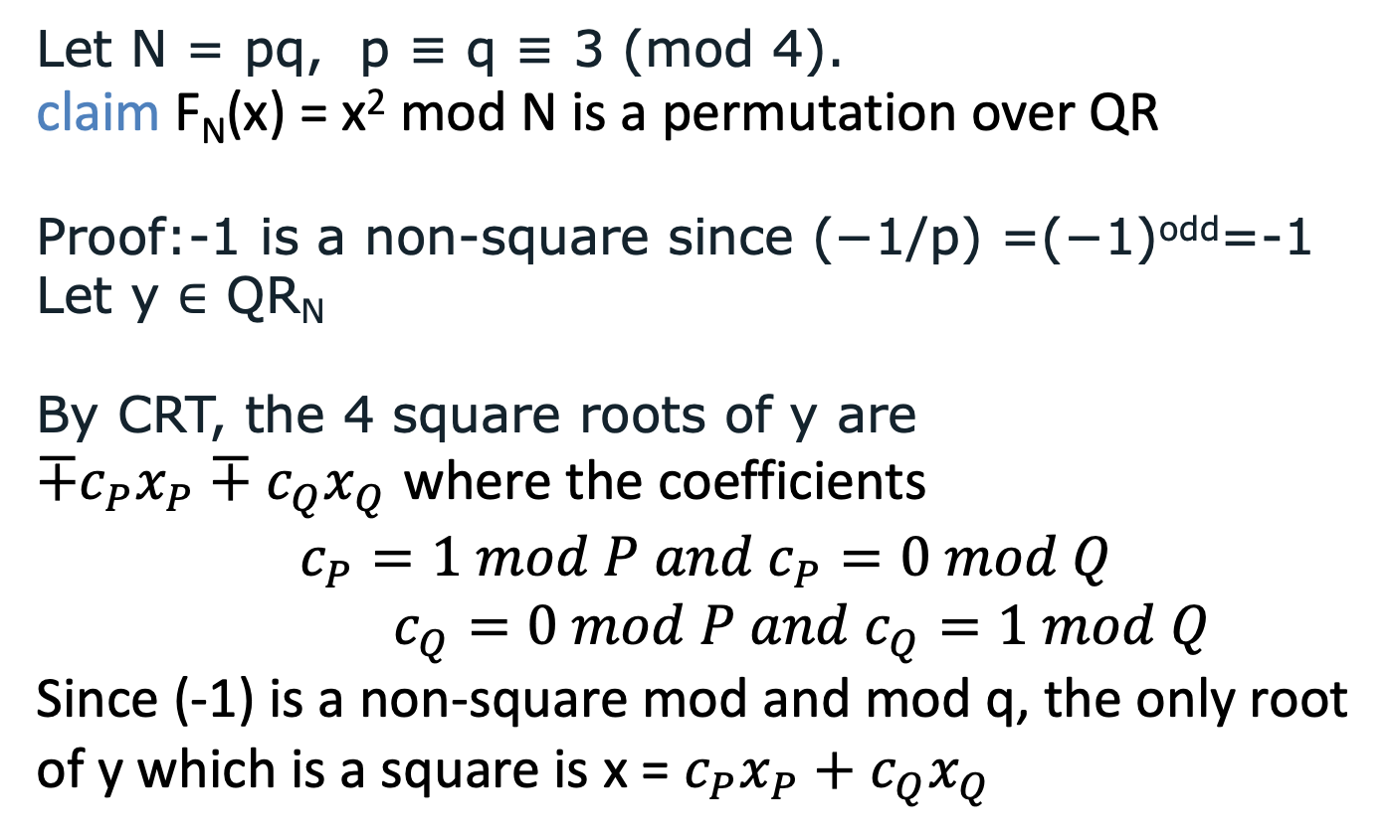
Blum-Williams is a Trapdoor Permutation over the squares
Let N = pq, p ≡ q ≡ 3 (mod 4).
claim F_{N}(x) = x² mod N is a permutation over QR
Proof:-1 is a non-square since (−1/p) =(−1)^{odd}=-1
Let y ∈ QR_{N}
By CRT, the 4 square roots of y are
${∓c}_{P}x_{P}∓c_{Q}x_{Q}$ where the coefficients
$$c_{P}=1 mod P and{ c}_{P}=0 mod Q$$
$c_{Q}=0 mod P and{ c}_{Q}=1 mod Q$
Since (-1) is a non-square mod and mod q, the only root of y which is a square is x = $c_{P}x_{P}+c_{Q}x_{Q}$
$⟶$ F_{N} is a permutation over QR_{N}
1
Notes:
Let N=pq with distinct primes p,q congruent to 3 modulo 4, and write QR_N={a² mod N:a∈Z_N*}. Every y∈QR_N has exactly four roots in Z_N*. Modulo p, choose one root a. The other is -a, and the Legendre symbol (-1/p)=(-1)^((p-1)/2)=-1. Hence (a/p) and (-a/p) have opposite signs: exactly one of the two roots is itself a square modulo p. The same applies modulo q. CRT combines the local root choices independently, so among the four roots modulo N, exactly one has Legendre symbol +1 at both primes. This is exactly the condition of membership in QR_N.
Thus squaring is a permutation of QR_N. An equivalent proof is that QR_N has odd order (p-1)(q-1)/4, so exponentiation by 2 is a bijection on this group. This argument is about the unique root in QR_N, not about the smaller root with Jacobi symbol +1. The unique QR root may be above N/2: for example, modulo 21, the unique QR root of 4 is 16, while the smaller Jacobi +1 root is 5.
Source: W. Alexi, B. Chor, O. Goldreich and C. P. Schnorr, “RSA and Rabin Functions: Certain Parts Are as Hard as the Whole,” SIAM J. Comput. 17(2), 194–209 (1988). User-provided acgs.pdf. https://mit6875.github.io/FA23HANDOUTS/rsa-hardcore-bit.pdf §6.1 records this permutation property. The slide supplies the elementary CRT proof.

Slide 32
The Rabin/Blum-Williams Trapdoor Permutation
Let N=pq,p=q=3 mod 4.
F_{N}(x) = x² mod N is a permutation over QR_{N}
Hardcore bits (galore) for the F:
The Goldreich-Levin bit $GL\left(x;r^{′}\right)= \left\langle x,r′\right\rangle mod 2$
The least significant bit $LSB(x)$
The “most significant bit” ${HALF}_{N}\left(x\right)=1$ iff $x<N/2$
In fact, any single bit of $x$ is hardcore.

Slide 33
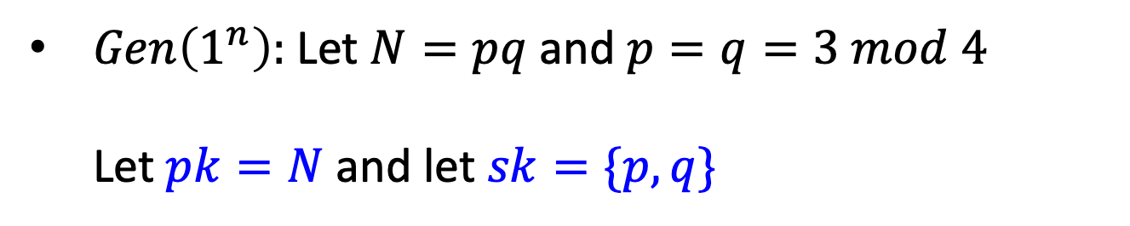
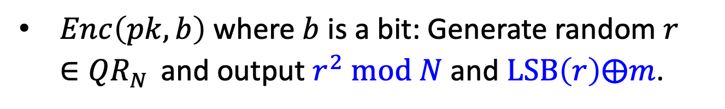
Rabin/BW Bit Encryption
$Gen\left(1^{n}\right):$Let $N=pq$ and $p=q=3 mod 4$
Let $pk=N$ and let $sk=\{p,q\}$
$Enc\left(pk,b\right)$ where $b$ is a bit: Generate random $r∈{QR}_{N}^{}$and output $r^{2} mod N$ and $LSB\left(r\right)⨁m$.
$Dec\left(sk,c\right)$: Recover $r$ via taking square roots mod N

Slide 34
From 1-Bit Messages to Long Messages
Let P=(Gen, Enc, Dec) be a semantically secure
public-key encryption scheme for 1-bit messages.
Define probabilistic Encryption PE_{P}= (G,E,D):
G(1^{k}) = Gen (1^{k})
E(pk,m=m₁…m_{l}): Encrypt bit-by-bit
Output c = (Enc(m₁),Enc(m₂),…Enc(m_{l}))
D(sk,c=c₁…c_{l}):
For 1≤j≤l, compute m_{j}=Dec(sk,c_{j})

Slide 35
Bit by Bit Encryption: a loss of a factor of n in bandwidth, computation, Randomness
Can we do better and maintain computational indistinguishability?
Yes

Slide 36
Recall PSRG G based on one-way permutation f with hard core bit B
Internal Configuration
Input
Output
x
f(x)
B(x)
f⁽²⁾(x)
B(f(x))
f⁽³⁾(x)
B(f ⁽²⁾(x))
f^{(l}(x)
B(f^{(t-1)}(x))
Let G(x) = B(x)….B (f ^{t-1)}(x))
t can be any polynomial in n=|x|

Slide 37
EPE: Efficient Probabilistic Encryption
EPE_{F} , F trapdoor permutation collection
G(1^{n}): choose (f,t) in F where t=trapdoor for f
Enc(f,m): say l=|m|
  choose seed r in domain of f,
  compute G(r) where G is a PSRG based on f
  send (G (r) + m, f^{l+1}(r) )
Dec(t,(a,b)):
  compute r = f^{-(l+1)}(b),
  let m=a + G(r)
Security proof: Trivial

Slide 38
EPE_{RSA} [BG]
Key Generation(1^{n}): Choose (N,e) as in RSA, |N|=n
E(N,e,m): On input message m of length l,
First, choose r in Z_{N}* and compute
pad = lsb(r)lsb(r^{e} mod N) lsb(r^{e} mod N) ….lsb(r ^{e} mod N)
Set c= (pad +m, r^{s} mod N) where s=e^{l+1} mod f(N)
D({p,q},c): On c=(u,v),
compute r= l^{th} root of v mod φ(N) (using factorization),
re-compute pad,
set m = u⊕pad
l+1

Slide 39
Performance comparison of EPE_{RSA} and traditional RSA
Let |m|=n
Size of Public key: O(n) for both
Bandwidth: RSA O(n), EPE O(m+n)
Computation cost: RSA O(n³), EPE O(n⁴)
Security: EPE Win

Slide 40
EPE_{F} based on Factoring[BG]
Key Generation: Choose p,q primes s.t. p=q= 3 mod 4; set N=pq. Public key =N, secret key={p,q}
E(N,m): On input message m of length t,
First, choose r in Z_{n}* and compute
pad = lsb(r)lsb(r² mod N) lsb(r⁴ mod N)
….lsb(r ² mod N)
Set c= (pad+m, r² mod N)
D({p,q},c): On c=(u,v), compute r=l^{th} root of v mod N (using factorization), re-compute pad,
and set m = u+pad.
l+1
l+1

Slide 41
Performance comparison of EPE_{squaring} and traditional RSA
Let |m|=l
Size of Public key: O(n) for both
Bandwidth: RSA O(l+n), EPE O(l+n)
Computation cost: RSA O(n³), EPE O(n³)
Security: EPE Major Win!!

