Slide 1
MIT 6.875
Foundations of Cryptography
Lecture 17

Slide 2
An Application of NIZK: Non-malleable and Chosen Ciphertext Secure Encryption Schemes

Slide 3


Non-Malleability
m $←$ Dec(sk,c)
c $←$ Enc(pk,m)
sk
Public-key directory
Bob
pk

Slide 4

Active Attacks 1: Malleability
c $←$ Enc(pk,$100)
sk
c’ $=$Enc(pk,$101)
ATTACK: Adversary could modify (“maul”) an encryption of m into an encryption of a related message m’.

Slide 5
Active Attacks 2: Chosen-Ciphertext Attack
c* $←$ Enc(pk,m)
sk
ATTACK: Adversary may have access to a decryption “oracle” and can use it to break security of a ”target” ciphertext c* or even extract the secret key!
In fact, Bleichenbacher showed how to extract the entire secret key given only a “ciphertext verification” oracle.

Slide 6

IND-CCA Security
Challenger
Eve
$$pk$$
$$\left(pk,sk\right)←Gen\left(1^{n}\right)$$
$$c_{i}$$
$$Dec(sk,c_{i})$$
$$m_{0}^{∗},m_{1}^{∗}$$
$$s.t. \left|m_{0}^{∗}\right|=|m_{1}^{∗}|$$
$b←\left\{0,1\right\}$;
$$c^{∗}←Enc(pk,m_{b}^{∗})$$
$$c^{∗}$$
$$c_{i}≠c^{∗}$$
$$c_{i}$$
Eve wins if $b^{′}=b$. IND-CCA secure if no PPT Eve can win with prob. > $\frac{1}{2}+negl(n)$.
$$Dec(sk,c_{i})$$
$$Dec(sk,c_{i})$$
$$b′$$
Notes:
This captures the concern of malleability and more.

Slide 7
Constructing CCA-Secure Encryption
(Intuition)
NIZK Proofs of Knowledge should help!
Idea: The encrypting party attaches an NIZK proof of knowledge of the underlying message to the ciphertext.
$$C: (c=CPAEnc\left(m;r\right),proof π that “I know m and r”)$$
This idea will turn out to be useful, but NIZK proofs themselves can be malleable!

Slide 8
Constructing CCA-Secure Encryption
(Intuition)
Digital Signatures should help!
OUR GOAL: Hard to modify an encryption of m into an encryption of a related message, say m+1.
OUR GOAL: Hard to modify an encryption of m into an encryption of a related message, say m+1.

Slide 9
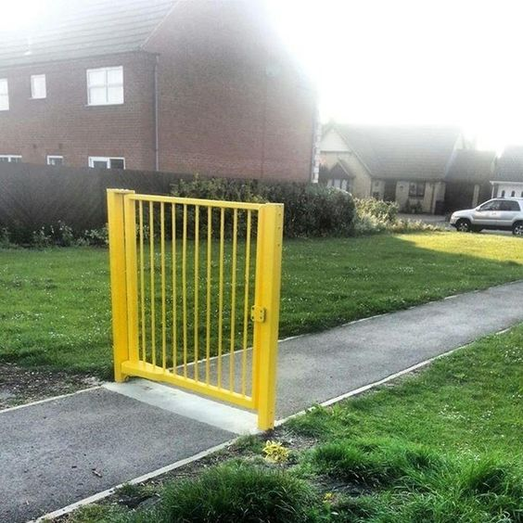
Constructing CCA-Secure Encryption
Let’s start with Digital Signatures.
$$C: (c=CPAEnc\left(pk,m;r\right),{Sign}_{sgk}\left(c\right),vk)$$
$$C: (c=CPAEnc\left(pk,m;r\right),Sign\left(c\right))$$
where the encryptor produces a signing / verification key pair by running $\left(sgk,vk\right)←Sign.Gen(1^{n})$
Is this CCA-secure/non-malleable?
If the adversary changes $vk$, all bets are off!
Lesson: NEED to “tie” the ciphertext $c$ to $vk$ in a “meaningful” way.

Slide 10
Observation: IND-CPA $⟹$ “Different-Key Non-malleability”
Different-Key NM: Given $pk,pk^{′},CPAEnc\left(pk,m;r\right),$ can an adversary produce $CPAEnc\left(pk′,m+1;r\right)?$
NO! Suppose she could. Then, I can come up with a reduction that breaks the IND-CPA security of $CPAEnc\left(pk,m;r\right)$.

Slide 11
Observation: IND-CPA $⟹$ “Different-Key Non-malleability”
Different-Key NM: Given $pk,pk^{′},CPAEnc\left(pk,m;r\right),$ can an adversary produce $CPAEnc\left(pk′,m+1;r\right)?$
Reduction = CPA adversary
$$pk$$
Pick $(pk^{′},sk^{′})$
$$pk,pk′$$
$$CPAEnc(pk,m)$$
$$CPAEnc(pk,m)$$
$$m$$
$$CPAEnc(pk^{′},m+1)$$
Decrypt and
subtract 1.
Diff-Key NM
adversary

Slide 12
Putting it together
CCA Public Key: $2n$ public keys of the CPA scheme (where $n=|vk|)$
$${pk}_{1,0}$$
$${pk}_{2,0}$$
$${pk}_{n,0}$$
$$…$$
$${pk}_{1,1}$$
$${pk}_{2,1}$$
$${pk}_{n,1}$$
CCA Encryption:
First, pick a sign/ver key pair $(sgk,vk)$
$$CT=$$
$${ct}_{1,{vk}_{1}}$$
$${ct}_{2,{vk}_{2}}$$
$$…$$
$${ct}_{n,{vk}_{n}}$$
where ${ct}_{i,j }←CPAEnc({pk}_{i,j},m)$
Output $(CT, vk,σ=Sign(sgk,CT))$.

Slide 13
Putting it together
Non-malleability rationale: Either
Adversary keeps $vk$the same (in which case she has to break the signature scheme); or
She changes the $vk$ in which case she breaks the diff-NM game, and therefore CPA security.
CCA Encryption:
First, pick a sign/ver key pair $(sgk,vk)$
$$CT=$$
$${ct}_{1,{vk}_{1}}$$
$${ct}_{2,{vk}_{2}}$$
$$…$$
$${ct}_{n,{vk}_{n}}$$
where ${ct}_{i,j }←CPAEnc({pk}_{i,j},m)$
Output $(CT, vk,σ=Sign(sgk,CT))$.

Slide 14
Call it a day?
We are not done!! Adversary could create ill-formed ciphertexts (e.g. the different $ct$s encrypt different messages) and uses it for a Bleichenbacher-like attack.
CCA Encryption:
First, pick a sign/ver key pair $(sgk,vk)$
$$CT=$$
$${ct}_{1,{vk}_{1}}$$
$${ct}_{2,{vk}_{2}}$$
$$…$$
$${ct}_{n,{vk}_{n}}$$
where ${ct}_{i,j }←CPAEnc({pk}_{i,j},m)$
Output $(CT, vk,σ=Sign(sgk,CT))$.

Slide 15
NIZK Proofs to the Rescue…
CCA Public Key: $2n$ public keys of the CPA scheme
$${pk}_{1,0}$$
$${pk}_{2,0}$$
$${pk}_{n,0}$$
$$…$$
, $CRS$
$${pk}_{1,1}$$
$${pk}_{2,1}$$
$${pk}_{n,1}$$
NP statement: “there exist $m,r_{i,j}$ such that each ${ct}_{i,j}=CPAEnc({pk}_{i,j},m;r_{i,j})$”
CCA Encryption:
First, pick a sign/ver key pair $(sgk,vk)$
$$CT=$$
$${ct}_{1,{vk}_{1}}$$
$${ct}_{2,{vk}_{2}}$$
$$…$$
$${ct}_{n,{vk}_{n}}$$
where ${ct}_{i,j }←CPAEnc({pk}_{i,j},m;r_{i,j})$
π = NIZK proof that “CT is well-formed”
Output $(CT, vk,σ=Sign(sgk,CT))$.
Output $(CT,\text{π}, vk,σ=Sign(sgk,\left(CT,\text{π}\right)))$.

Slide 16
Are there other attacks?
Did we miss anything else?
Turns out NO. We can prove that this is CCA-secure.

Slide 17
The Encryption Scheme
CCA Keys:
$${pk}_{1,0}$$
$${pk}_{2,0}$$
$${pk}_{n,0}$$
$${sk}_{1,0}$$
PK=
$$…$$
, $CRS$
SK=
$${pk}_{1,1}$$
$${pk}_{2,1}$$
$${pk}_{n,1}$$
$${sk}_{1,1}$$
CCA Encryption:
First, pick a sign/ver key pair $(sgk,vk)$
$$CT=$$
$${ct}_{1,{vk}_{1}}$$
$${ct}_{2,{vk}_{2}}$$
$$…$$
$${ct}_{n,{vk}_{n}}$$
where ${ct}_{i,j }←CPAEnc({pk}_{i,j},m;r_{i,j})$
π = NIZK proof that “CT is well-formed”
Output $(CT,\text{π}, vk,σ=Sign(sgk,\left(CT,\text{π}\right)))$.

Slide 18
The Encryption Scheme
CCA Encryption:
First, pick a sign/ver key pair $(sgk,vk)$
$$CT=$$
$${ct}_{1,{vk}_{1}}$$
$${ct}_{2,{vk}_{2}}$$
$$…$$
$${ct}_{n,{vk}_{n}}$$
where ${ct}_{i,j }←CPAEnc({pk}_{i,j},m;r_{i,j})$
π = NIZK proof that “CT is well-formed”
Output $(CT,\text{π}, vk,σ=Sign(sgk,\left(CT,\text{π}\right)))$.
CCA Decryption:
Check the signature.
Check the NIZK proof.
Decrypt with ${sk}_{1,{vk}_{1}}$.

Slide 19
Proof Sketch
Let’s play the CCA game with the adversary.
We will use her to break either the NIZK soundness/ZK, the signature scheme or the CPA-secure scheme.

Slide 20
Proof Sketch
Let’s play the CCA game with the adversary.
Hybrid 0: Play the CCA game as prescribed.
Hybrid 1: Observe that ${vk}_{i}≠{vk}^{∗}$. (Otherwise break signature)
Observe that this means each query ciphertext-tuple involves a different public-key from the challenge ciphertext. Use the “different private-key” to decrypt. (If the adv sees a difference, she broke NIZK soundness)
Hybrid 2: Now change the CRS/$\text{π}$ into simulated CRS/$\text{π}$! (OK by ZK)
If the Adv wins in this hybrid, she breaks IND-CPA!
Notes:
Hybrid 1 explanation: the real decryption algorithm uses one of the private keys, say either sk_{1,0} or sk_{1,1} to decrypt, depending on whether the first ciphertext was encrypted using pk_{1,0} or pk_{1,1} --- which in turns depends on whether the first bit of the verification key was 0 or 1. in hybrid 1, we are potentially using a different private key to decrypt a different component ciphertext. That’s OK because we know by NIZK soundness that all ciphertexts encrypt the same message!
Hybrid 2 explanation: In the beginning of hybrid 2, the challenge ciphertext contains a NIZK proof of ciphertext well-formedness which uses the randomness underlying those ciphertexts. By changing the NIZK proof into a simulated proof, we remove the dependence on randomness, effectively saying that the proof reveals nothing about the randomness underlying the ciphertexts, in turn paving the way to invoke CPA-security.

Slide 21
New Topic:
Secure Computation

Slide 22


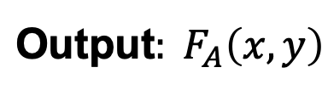
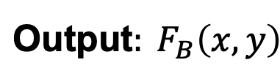
Secure Computation
Input: $x$
Input: $y$
Alice
Bob
$$\text{Out}\text{put}: F_{A}\left(x,y\right)$$
$$\text{Out}\text{put}: F_{B}\left(x,y\right)$$

Slide 23
Secure Two-Party Computation
Input: $x$
Input: $y$
Alice
Bob
$$\text{Out}\text{put}: F_{A}\left(x,y\right)$$
$$\text{Out}\text{put}: F_{B}\left(x,y\right)$$
Security:
Semi-honest Security:
Alice should not learn anything more than $x$ and $F_{A}\left(x,y\right).$
Bob should not learn anything more than $y$ and $F_{B}\left(x,y\right).$

Slide 24
Secure Two-Party Computation
Input: $x$
Input: $y$
Alice
Bob
$$\text{Out}\text{put}: F_{A}\left(x,y\right)$$
$$\text{Out}\text{put}: F_{B}\left(x,y\right)$$
Malicious Security:
No (PPT) Alice* can learn anything more than $x^{∗}$ and $F_{A}\left(x^{∗},y\right).$
No (PPT) Bob* can learn anything more than $y^{∗}$ and $F_{B}\left(x,y^{∗}\right).$

Slide 25
Tool 1: Secret Sharing

Slide 26

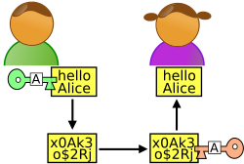



secret b
Secret Sharing
share $s_{1}$
share $s_{2}$
share $s_{3}$
share $s_{4}$
share $s_{n}$
$$…$$
$$P_{1}$$
$$P_{2}$$
$$P_{3}$$
$$P_{4}$$
$$P_{n}$$
Dealer
Any “authorized” subset of players can recover b.
No other subset of players has any info about b.
Threshold (or t-out-of-n) SS [Shamir’79, Blakley’79]:
“authorized” subset = has size $≥$t.
Notes:
Information theoretic privacy
Clearly this has to be monotone

Slide 27
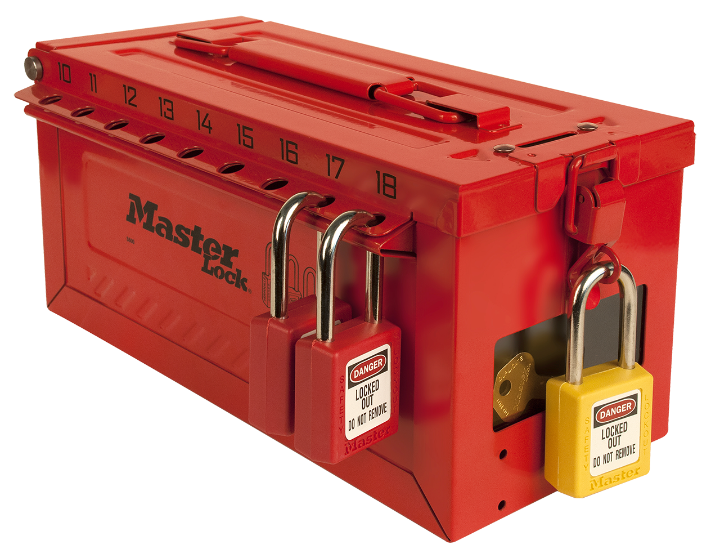
secret b$∈Z_{p}$
$n$-out-of-$n$ Secret Sharing
$$…$$
$$P_{1}$$
$$P_{2}$$
$$P_{3}$$
$$P_{4}$$
$$P_{n}$$
Dealer
share $s_{1}:$ random
share $s_{2}$: random
share $s_{3}$: random
share $s_{4}$: random
$$…$$
share $s_{n}=b−(s_{1}+s_{2}+…+s_{n−1})$ mod p
Notes:
Information theoretic privacy
Clearly this has to be monotone

Slide 28

secret b$∈Z_{p}$
$1$-out-of-$n$ Secret Sharing
$$…$$
$$P_{1}$$
$$P_{2}$$
$$P_{3}$$
$$P_{4}$$
$$P_{n}$$
Dealer
share $s_{1}=b$
share $s_{2}=b$
share $s_{3}=b$
share $s_{4}=b$
$$…$$
share $s_{n}=b$
Notes:
Information theoretic privacy
Clearly this has to be monotone

Slide 29
secret b$∈Z_{p}$
$2$-out-of-$n$ Secret Sharing?
$$…$$
$$P_{1}$$
$$P_{2}$$
$$P_{3}$$
$$P_{4}$$
$$P_{n}$$
Dealer
Here is a solution.
Repeat for every two-person subset {$P_{i},P_{j}\}:$
Generate a 2-out-of-2 secret sharing $(s_{i},s_{j})$ of b.
Give $s_{i}$ to $P_{i}$ and $s_{j}$ to $P_{j}$
What is the size of shares each party gets?
How does this scale to t-out-of-n?
Notes:
Information theoretic privacy
Clearly this has to be monotone

Slide 30
Shamir’s t-out-of-n Secret Sharing
Key Idea: Polynomials are Amazing!

Slide 31

Shamir’s 2-out-of-n Secret Sharing
$$s_{1}$$
$$s_{2}$$
random line through (0,b)
$$(3,s_{3})$$
$$(2,s_{2})$$
$$s_{3}$$
$$(1,s_{1})$$
secret $b$
Each share $s_{i}$ is truly
random (independent of secret b)
Any two shares uniquely
determine b.

Slide 32
Shamir’s 2-out-of-n Secret Sharing
The dealer picks a uniformly random line (mod p) whose constant term is the secret $b.$
$f\left(x\right)=ax+b$ where $a$ is uniformly random mod $p$
2. Compute the shares$:$ $$s_{1}=f\left(1\right),s_{2}=f\left(2\right),…,s_{i}=f\left(i\right),{…,s}_{n}=f\left(n\right)$$
Correctness: can recover secret from any two shares.
Proof: Parties $i$ and $j$, given shares $s_{i}=ai+b$ and $s_{j}=aj+b$ can solve for $b (=\frac{js_{i}−is_{j}}{j−i})$.

Slide 33
Shamir’s 2-out-of-n Secret Sharing
The dealer picks a uniformly random line (mod p) whose constant term is the secret $b.$
$f\left(x\right)=ax+b$ where $a$ is uniformly random mod $p$
2. Compute the shares$:$ $$s_{1}=f\left(1\right),s_{2}=f\left(2\right),…,s_{i}=f\left(i\right),{…,s}_{n}=f\left(n\right)$$
Security: any single party has no information about the secret.
Proof: Party $i$’s share $s_{i}=a∗i+b$ is uniformly random, independent of $b,$ as $a$ is random and so is $a∗i$.

Slide 34
Shamir’s t-out-of-n Secret Sharing
Key Idea: Polynomials are Amazing!
The dealer picks a uniformly random degree-(t-1) polynomial (mod p) whose constant term is the secret $b.$
$f\left(x\right)=a_{t−1}x^{t−1}+…+a_{1}x+b$ where $a_{i}$ are uniformly random mod $p$
2. Compute the shares$:$ $$s_{1}=f\left(1\right),s_{2}=f\left(2\right),…,s_{i}=f\left(i\right),{…,s}_{n}=f\left(n\right)$$
Correctness: can recover secret from any $t$ shares.
Security: the distribution of $any t−1$ shares is independent of the secret.
Note: need p to be larger than the number of parties n.

Slide 35
Shamir’s t-out-of-n Secret Sharing
Key Idea: Polynomials are Amazing!
$f\left(x\right)=a_{t−1}x^{t−1}+…+a_{1}x+b$ where $a_{i}$ are uniformly random mod $p$
$$s_{1}=f\left(1\right),s_{2}=f\left(2\right),…,s_{i}=f\left(i\right),{…,s}_{n}=f\left(n\right)$$
Correctness: via Vandermonde matrices.
Let’s look at shares of parties $P_{1},P_{2},…,P_{t}.$
$$\left[\begin{matrix}s_{1} \\ s_{2} \\ s_{3} \\ … \\ s_{t}\end{matrix}\right]=\left[\begin{matrix}1 & 1 & 1 & … & 1 \\ 1 & 2 & 2^{2} & … & 2^{t−1} \\ 1 & 3 & 3^{2} & … & 3^{t−1} \\ 1 & … & … & … & … \\ 1 & t & t^{2} & … & t^{t−1}\end{matrix}\right]\left[\begin{matrix}b \\ a_{1} \\ a_{2} \\ … \\ a_{t−1}\end{matrix}\right](mod p)$$
$t$-by-$t$ Vandermonde matrix which is invertible

Slide 36
Shamir’s t-out-of-n Secret Sharing
Key Idea: Polynomials are Amazing!
$f\left(x\right)=a_{t−1}x^{t−1}+…+a_{1}x+b$ where $a_{i}$ are uniformly random mod $p$
$$s_{1}=f\left(1\right),s_{2}=f\left(2\right),…,s_{i}=f\left(i\right),{…,s}_{n}=f\left(n\right)$$
Correctness: Alternatively, Lagrange interpolation gives an explicit formula that recovers b.
$$b=f\left(0\right)=\sum_{i=1}^{t}{f(i)\left(\prod_{1≤j≤t,j≠i}{\frac{−x_{j}}{x_{i}−x_{j}}}\right)}$$

Slide 37
Shamir’s t-out-of-n Secret Sharing
Key Idea: Polynomials are Amazing!
$f\left(x\right)=a_{t−1}x^{t−1}+…+a_{1}x+b$ where $a_{i}$ are uniformly random mod $p$
$$s_{1}=f\left(1\right),s_{2}=f\left(2\right),…,s_{i}=f\left(i\right),{…,s}_{n}=f\left(n\right)$$
Security:
Let’s look at shares of parties $P_{1},P_{2},…,P_{t−1}.$
$$\left[\begin{matrix}s_{1} \\ s_{2} \\ s_{3} \\ … \\ s_{t−1}\end{matrix}\right]=\left[\begin{matrix}1 & 1 & 1 & … & 1 \\ 1 & 2 & 2^{2} & … & 2^{t−1} \\ 1 & 3 & 3^{2} & … & 3^{t−1} \\ 1 & … & … & … & … \\ 1 & t−1 & {(t−1)}^{2} & … & {(t−1)}^{t−1}\end{matrix}\right]\left[\begin{matrix}b \\ a_{1} \\ a_{2} \\ … \\ a_{t−1}\end{matrix}\right](mod p)$$
$(t−1)$-by-$t$ Vandermonde matrix

Slide 38
Shamir’s t-out-of-n Secret Sharing
Key Idea: Polynomials are Amazing!
$f\left(x\right)=a_{t−1}x^{t−1}+…+a_{1}x+b$ where $a_{i}$ are uniformly random mod $p$
$$s_{1}=f\left(1\right),s_{2}=f\left(2\right),…,s_{i}=f\left(i\right),{…,s}_{n}=f\left(n\right)$$
Security: For every value of $b$ there is a unique polynomial with constant term $b$ and shares $s_{1},s_{2},…,s_{t−1}.$
$$\left[\begin{matrix}s_{1} \\ s_{2} \\ s_{3} \\ … \\ s_{t−1}\end{matrix}\right]=\left[\begin{matrix}1 & 1 & 1 & … & 1 \\ 1 & 2 & 2^{2} & … & 2^{t−1} \\ 1 & 3 & 3^{2} & … & 3^{t−1} \\ 1 & … & … & … & … \\ 1 & t−1 & {(t−1)}^{2} & … & {(t−1)}^{t−1}\end{matrix}\right]\left[\begin{matrix}b \\ a_{1} \\ a_{2} \\ … \\ a_{t−1}\end{matrix}\right](mod p)$$
$(t−1)$-by-$t$ Vandermonde matrix

Slide 39
Shamir’s t-out-of-n Secret Sharing
Key Idea: Polynomials are Amazing!
$f\left(x\right)=a_{t−1}x^{t−1}+…+a_{1}x+b$ where $a_{i}$ are uniformly random mod $p$
$$s_{1}=f\left(1\right),s_{2}=f\left(2\right),…,s_{i}=f\left(i\right),{…,s}_{n}=f\left(n\right)$$
Security: For every value of $b$ there is a unique polynomial with constant term $b$ and shares $s_{1},s_{2},…,s_{t−1}.$
Corollary: for every value of the secret $b$is equally likely given the shares $s_{1},s_{2},…,s_{t−1}.$ In other words, the secret $b$is perfectly hidden given $t−1$ shares.

Slide 40
Tool 2: Oblivious Transfer

Slide 41
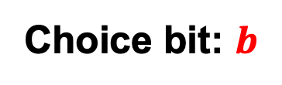


Oblivious Transfer (OT)
$$x_{0}$$
Choice bit: $b$
$$x_{1}$$
Sender
Receiver
Sender holds two bits/strings $x_{0}$ and $x_{1}$.
Receiver holds a choice bit $b$.
Receiver should learn $x_{b}$, sender should learn nothing.
(We will consider honest-but-curious adversaries; formal definition in a little bit…)

Slide 42
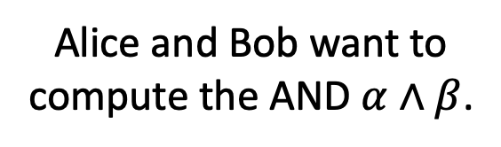
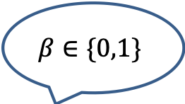
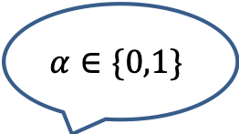
Why OT? The Dating Problem
$$α∈\{0,1\}$$
Alice and Bob want to compute the AND $α∧β$.
$$β∈\{0,1\}$$

Slide 43

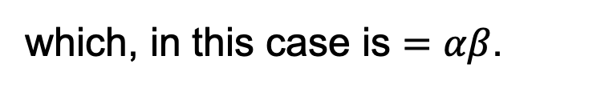

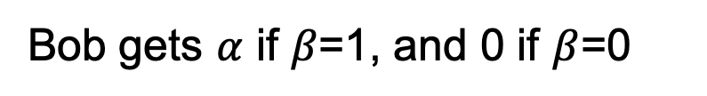
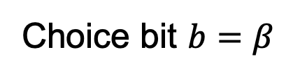

Why OT? The Dating Problem
$$α∈\{0,1\}$$
Alice and Bob want to compute the AND $α∧β$.
$$β∈\{0,1\}$$
$$x_{0}=0$$
Run an OT protocol
Choice bit $b=β$
$$x_{1}=α$$
Bob gets $α$ if $β$=1, and 0 if $β$=0
$$x_{1}b+ x_{0}\left(1−b\right)$$
Here is a way to write the OT selection function:
which, in this case is $=αβ$.

Slide 44
The Billionaires’ Problem
Net worth: $X
Net worth: $Y
Who is richer?

Slide 45
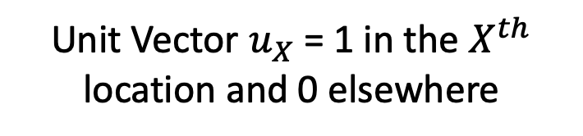









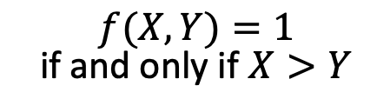
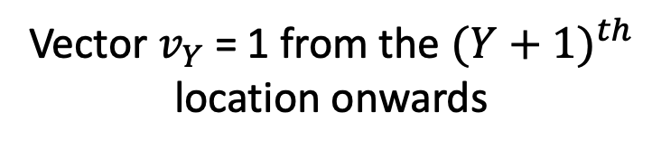
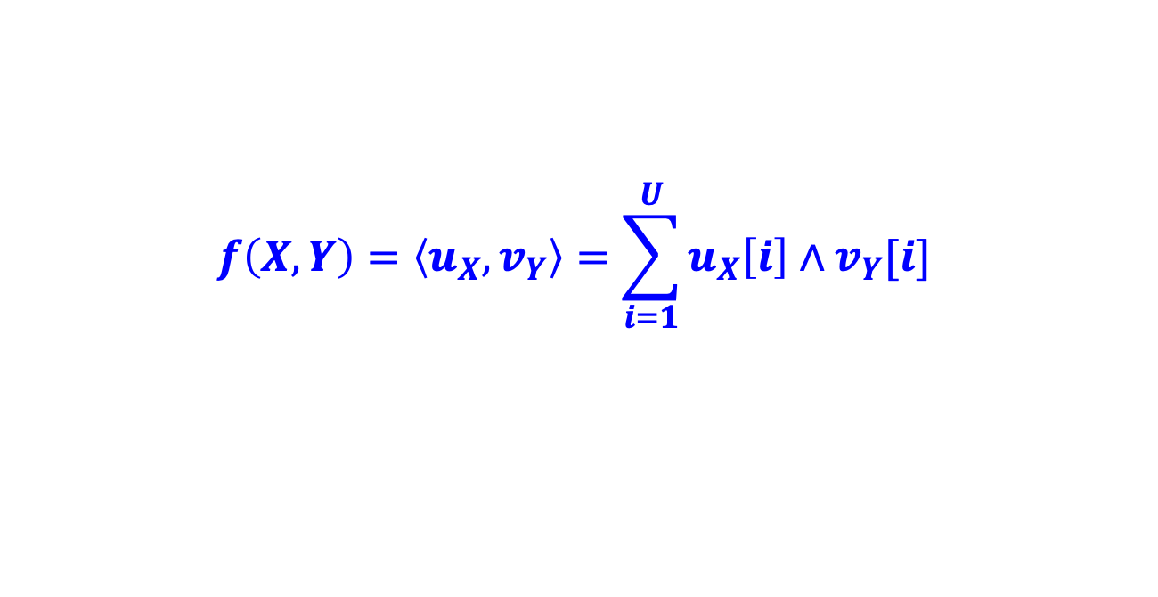






The Billionaires’ Problem
$f(X,Y)=1$ if and only if $X>Y$
$$X$$
$$Y$$
$$…$$
$$…$$
$$…$$
$$0$$
$$1$$
$$0$$
$$1$$
$$1$$
$$1$$
$$1$$
$$1$$
$$1$$
$$0$$
$$0$$
Unit Vector $u_{X}$ = 1 in the $X^{th}$ location and 0 elsewhere
Vector $v_{Y}$ = 1 from the ${(Y+1)}^{th}$ location onwards
$$f\left(X,Y\right)=\left\langle u_{X},v_{Y}\right\rangle =\sum_{i=1}^{U}{u_{X}\left[i\right]∧v_{Y}[i]}$$
Compute each AND individually and sum it up?

Slide 46
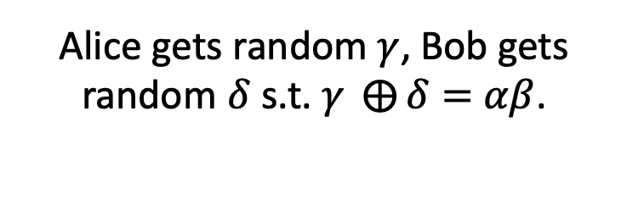
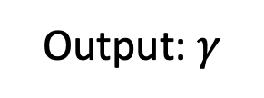


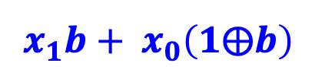





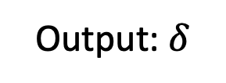
Detour: OT $⇒$ Secret-Shared-AND
$$α∈\{0,1\}$$
Alice gets random $γ$, Bob gets random $δ$ s.t. $γ ⨁{δ}=$ $αβ$.
$$β∈\{0,1\}$$
Output: $γ$
Output: $δ$
$$x_{0}=γ$$
Run an OT protocol
Choice bit $b=β$
$x_{1}=α⨁$ $γ$
Alice outputs $γ$.
$$x_{1}b+ x_{0}\left(1⨁b\right)$$
Bob gets
$=(x_{1}$ $⨁{ x}_{0})b+x_{0}$
$$=αβ⨁γ≔δ$$

Slide 47


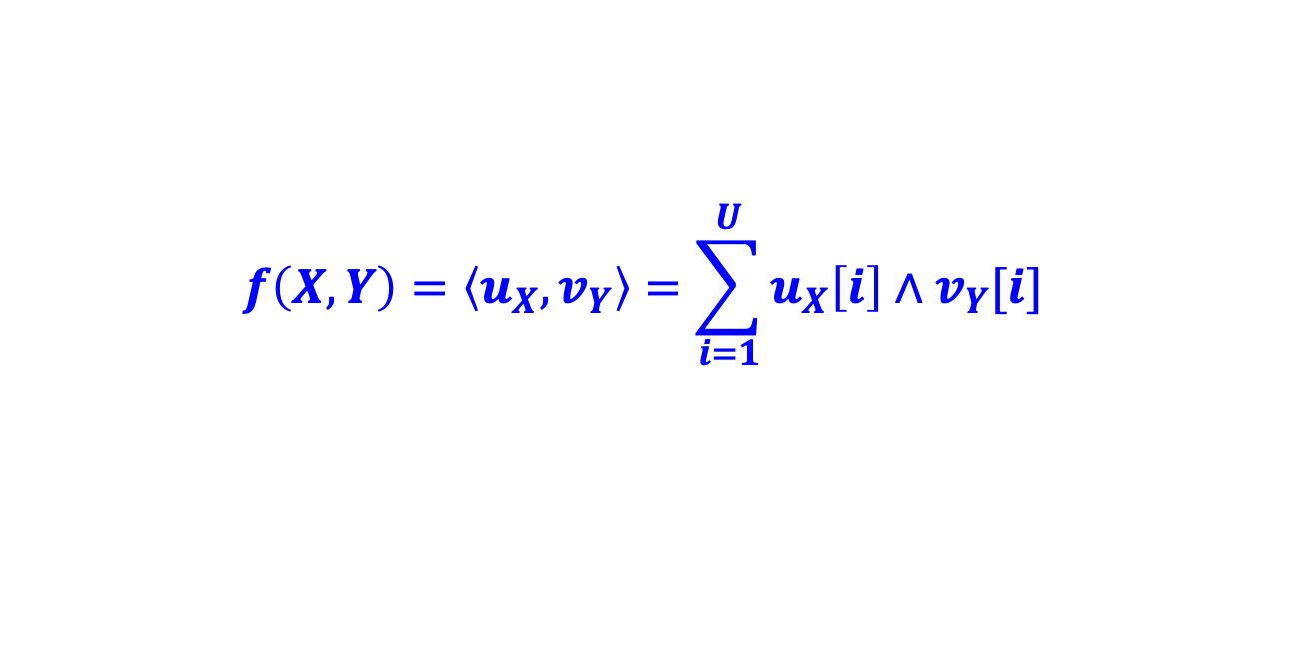


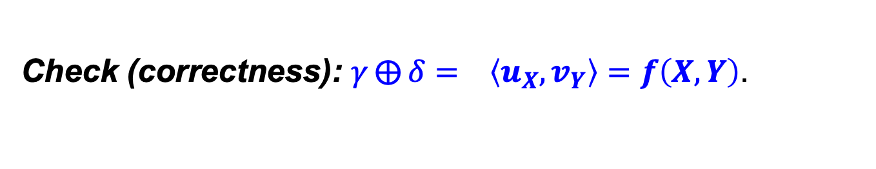






The Billionaires’ Problem
$f(X,Y)=1$ if and only if $X>Y$
$$…$$
$$…$$
$$…$$
$$0$$
$$1$$
$$0$$
$$1$$
$$1$$
$$1$$
$$1$$
$$1$$
$$1$$
$$0$$
$$0$$
Unit Vector $u_{X}$
Vector $v_{Y}$
$$f\left(X,Y\right)=\left\langle u_{X},v_{Y}\right\rangle =\sum_{i=1}^{U}{u_{X}\left[i\right]∧v_{Y}[i]}$$
1. Alice and Bob run many OTs to get $(γ_{i},δ_{i})$ s.t.
$${γ_{i}⨁δ_{i}= u}_{X}\left[i\right]∧v_{Y}[i]$$
2. Alice computes ${γ= ⨁}_{i}{ γ}_{i}$ and Bob computes ${δ= ⨁}_{i}{ δ}_{i}.$
3. Alice reveals $γ$ and Bob reveals $δ.$
Check (correctness): ${γ⨁{δ}= }_{}\left\langle u_{X},v_{Y}\right\rangle =f\left(X,Y\right)$.

Slide 48
The Billionaires’ Problem
$f(X,Y)=1$ if and only if $X>Y$
$$…$$
$$…$$
$$…$$
$$0$$
$$1$$
$$0$$
$$1$$
$$1$$
$$1$$
$$1$$
$$1$$
$$1$$
$$0$$
$$0$$
Unit Vector $u_{X}$
Vector $v_{Y}$
$$f\left(X,Y\right)=\left\langle u_{X},v_{Y}\right\rangle =\sum_{i=1}^{U}{u_{X}\left[i\right]∧v_{Y}[i]}$$
1. Alice and Bob run many OTs to get $(γ_{i},δ_{i})$ s.t.
$${γ_{i}⨁δ_{i}= u}_{X}\left[i\right]∧v_{Y}[i]$$
2. Alice computes ${γ= ⨁}_{i}{ γ}_{i}$ and Bob computes ${δ= ⨁}_{i}{ δ}_{i}.$
Check (privacy): Alice & Bob get a bunch of random bits.

Slide 49

“OT is Complete”
Theorem (lec18-19): OT can solve not just love and money, but any two-party (and multi-party) problem efficiently.

Slide 50
Defining Security: The Ideal/Real Paradigm

Slide 51
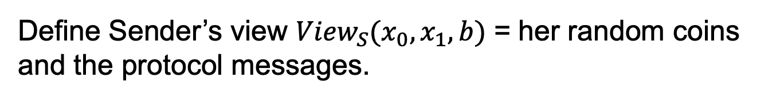
OT Definition
$$x_{0}$$
Choice bit: $b$
$$x_{1}$$
Sender
Receiver
Receiver Security: Sender should not learn b.
Define Sender’s view ${View}_{S}(x_{0},x_{1},b)$ = her random coins and the protocol messages.

Slide 52
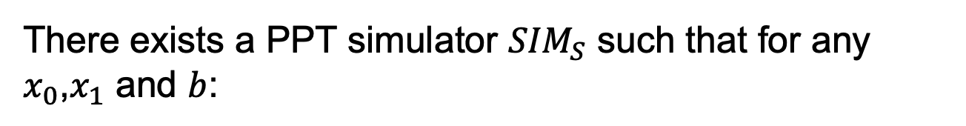

OT Definition
$$x_{0}$$
Choice bit: $b$
$$x_{1}$$
Sender
Receiver
Receiver Security: Sender should not learn b.
There exists a PPT simulator ${SIM}_{S}$ such that for any $x_{0}$,$x_{1}$ and $b$:
$${SIM}_{S}(x_{0},x_{1})≅{View}_{S}(x_{0},x_{1},b)$$

Slide 53
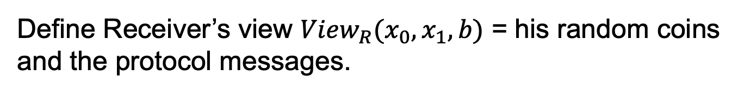
OT Definition
$$x_{0}$$
Choice bit: $b$
$$x_{1}$$
Sender
Receiver
Sender Security: Receiver should not learn $x_{1−b}$.
Define Receiver’s view ${View}_{R}(x_{0},x_{1},b)$ = his random coins and the protocol messages.

Slide 54

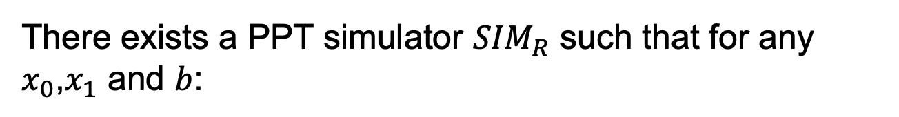
OT Definition
$$x_{0}$$
Choice bit: $b$
$$x_{1}$$
Sender
Receiver
Sender Security: Receiver should not learn $x_{1−b}$.
There exists a PPT simulator ${SIM}_{R}$ such that for any $x_{0}$,$x_{1}$ and $b$:
$${SIM}_{R}(b,x_{b})≅{View}_{R}(x_{0},x_{1},b)$$

Slide 55
OT Protocols

Slide 56

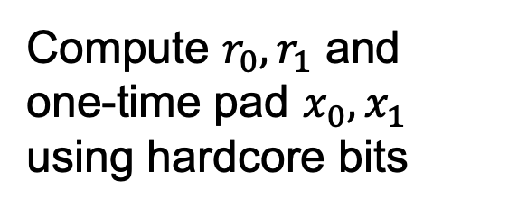
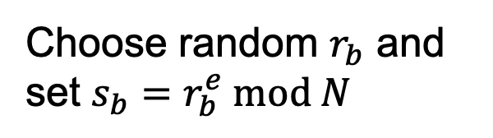
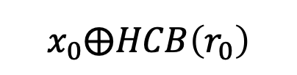
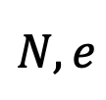

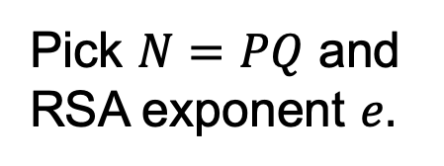
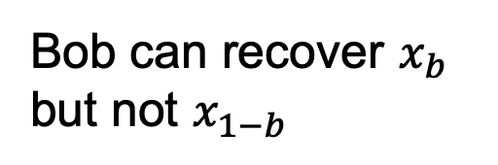
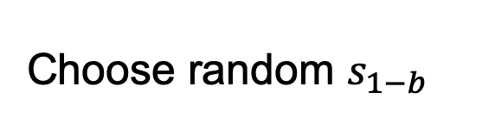
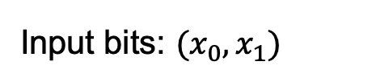
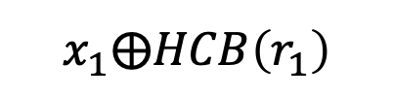
OT Protocol 1: Trapdoor Permutations
For concreteness, let’s use the RSA trapdoor permutation.
Input bits: $(x_{0},x_{1})$
Choice bit: $b$
Pick $N=PQ$ and RSA exponent $e.$
$$N,e$$
Choose random $r_{b}$ and set $s_{b}=r_{b}^{e} mod N$
$$s_{0},s_{1}$$
Choose random $s_{1−b}$
Compute $r_{0},r_{1}$ and one-time pad $x_{0},x_{1}$ using hardcore bits
$$x_{0}⨁HCB\left(r_{0}\right)$$
Bob can recover $x_{b}$ but not $x_{1−b}$
$$x_{1}⨁HCB\left(r_{1}\right)$$

Slide 57

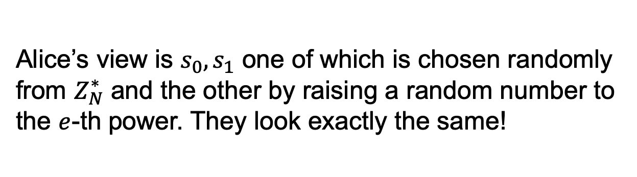
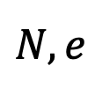
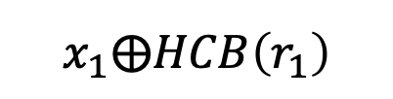
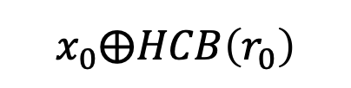
OT Protocol 1: Trapdoor Permutations
$$N,e$$
$$s_{0},s_{1}$$
Input bits: $(x_{0},x_{1})$
Choice bit: $b$
$$x_{0}⨁HCB\left(r_{0}\right)$$
$$x_{1}⨁HCB\left(r_{1}\right)$$
How about Bob’s security (a.k.a. Why does Alice not learn Bob’s choice bit)?
Alice’s view is $s_{0},s_{1}$ one of which is chosen randomly from $Z_{N}^{∗}$ and the other by raising a random number to the $e$-th power. They look exactly the same!

Slide 58
OT Protocol 1: Trapdoor Permutations
$$N,e$$
$$s_{0},s_{1}$$
Input bits: $(x_{0},x_{1})$
Choice bit: $b$
$$x_{0}⨁HCB\left(r_{0}\right)$$
$$x_{1}⨁HCB\left(r_{1}\right)$$
How about Bob’s security (a.k.a. Why does Alice not learn Bob’s choice bit)?
Exercise: Show how to construct the simulator.

Slide 59
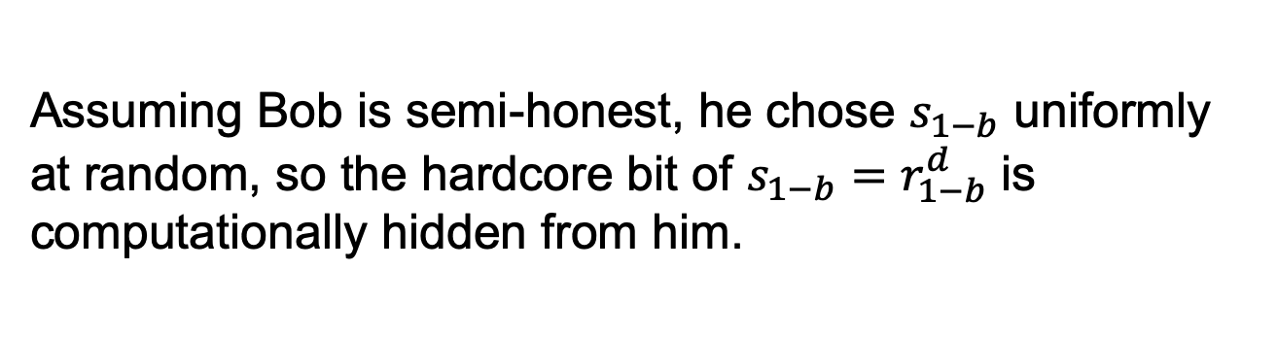
OT Protocol 1: Trapdoor Permutations
$$N,e$$
$$s_{0},s_{1}$$
Input bits: $(x_{0},x_{1})$
Choice bit: $b$
$$x_{0}⨁HCB\left(r_{0}\right)$$
$$x_{1}⨁HCB\left(r_{1}\right)$$
How about Alice’s security (a.k.a. Why does Bob not learn both of Alice’s bits)?
Assuming Bob is semi-honest, he chose $s_{1−b}$ uniformly at random, so the hardcore bit of $s_{1−b}=r_{1−b}^{d}$ is computationally hidden from him.

Slide 60
OT from Trapdoor Permutations
$$N,e$$
$$s_{0},s_{1}$$
Input bits: $(x_{0},x_{1})$
Choice bit: $b$
$$x_{0}⨁HCB\left(r_{0}\right)$$
$$x_{1}⨁HCB\left(r_{1}\right)$$
How about Alice’s security (a.k.a. Why does Bob not learn both of Alice’s bits)?
Exercise: Show how to construct the simulator.

Slide 61
OT Protocol 2: Oblivious PKE
Input bits: $(x_{0},x_{1})$
Choice bit: $b$

Slide 62
OT Protocol 2: Oblivious PKE
Input bits: $(x_{0},x_{1})$
Choice bit: $b$

Slide 63
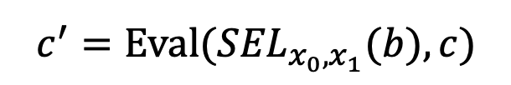

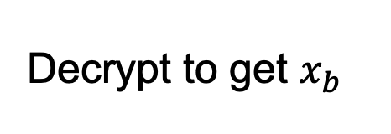
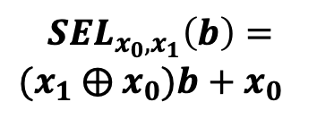

OT Protocol 2: Additive HE
Input bits: $(x_{0},x_{1})$
Choice bit: $b$
Encrypt choice bit b
Homomorphically evaluate the selection function
$$c$$
$$c⟵Enc(sk,b)$$
$$c^{′}=Eval({SEL}_{x_{0},x_{1}}(b),c)$$
Decrypt to get $x_{b}$
$${SEL}_{x_{0},x_{1}}\left(b\right)=$$
$(x_{1}$ $⨁{ x}_{0})b+x_{0}$
Bob’s security: computational, from CPA-security of Enc.
Alice’s security: statistical, from function-privacy of Eval.

Slide 64
Many More Constructions of OT
Theorem: OT protocols can be constructed based on the hardness of the Diffie-Hellman problem, factoring, quadratic residuosity, LWE, elliptic curve isogeny problem etc. etc.

Slide 65
Secure 2PC from OT
Theorem [Goldreich-Micali-Wigderson’87]: OT can solve any two-party computation problem.

