Slide 1
MIT 6.875 & Berkeley CS276
Foundations of Cryptography
Lecture 2

Slide 2
Administrivia
Piazza Time-zone Survey & Office hours
PS1 Released, due Sept 15

Slide 3
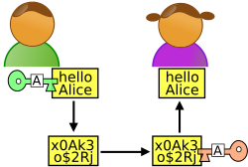
The Secure Communication Problem
m
Key k
Key k
Alice
Bob
Eve
Alice and Bob have a common key k
Algorithms (Gen, Enc, Dec)
Correctness: Dec(k, Enc(k,m)) = m
Security: No Eve learns anything about m.

Slide 4
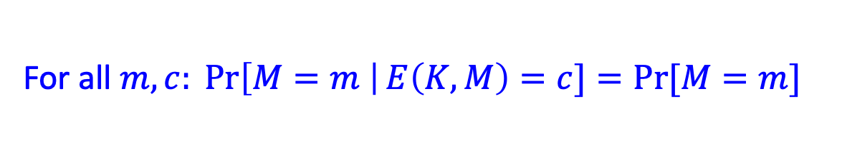
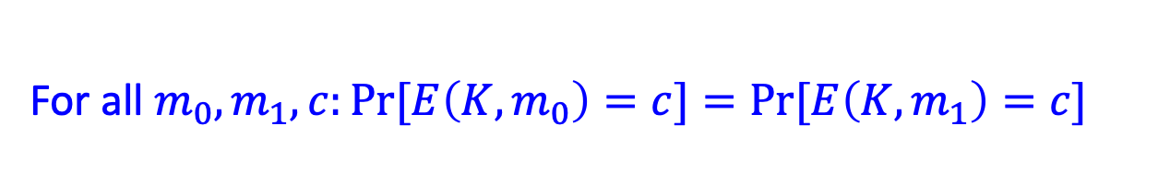
How to Define Security
Perfect secrecy: A Posteriori = A Priori
For all $m,c: \operatorname{Pr}\left[M=m \right|E\left(K,M\right)=c]=Pr⁡[M=m]$
Perfect indistinguishability:
For all $m_{0},m_{1},c:Pr⁡[E\left(K,m_{0}\right)=c]=Pr⁡[E\left(K,m_{1}\right)=c]$
The two definitions are equivalent!

Slide 5

Is there a perfectly secure scheme?
One-time Pad: $E\left(k,m\right)=k⨁m$
However: Keys are as long as Messages
WORSE, Shannon’s theorem: for any perfectly secure scheme, |key|$≥$|message|.
Can we overcome Shannon’s conundrum?

Slide 6
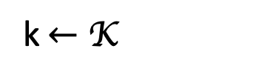
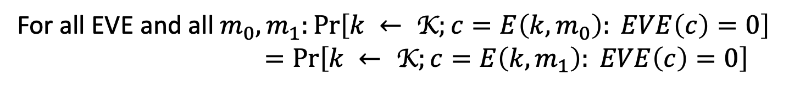


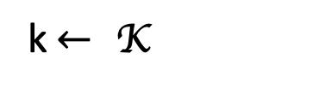
Let’s first rewrite…
Perfect indistinguishability: as a Turing test
For all $m_{0},m_{1},c:Pr⁡[E\left(K,m_{0}\right)=c]=Pr⁡[E\left(K,m_{1}\right)=c]$
World 0:
World 1:
k$←$ K
k$← \text{K}$
$$c=E\left(k,m_{0}\right)$$
$$c=E\left(k,m_{1}\right)$$
is a distinguisher.
For all EVE and all $m_{0},m_{1}:\operatorname{Pr}\left[k ← \text{K};c=E\left(k,m_{0}\right): EVE\left(c\right)=0\right]$ $=\operatorname{Pr}\left[k ← \text{K};c=E\left(k,m_{1}\right): EVE\left(c\right)=0\right]$

Slide 7
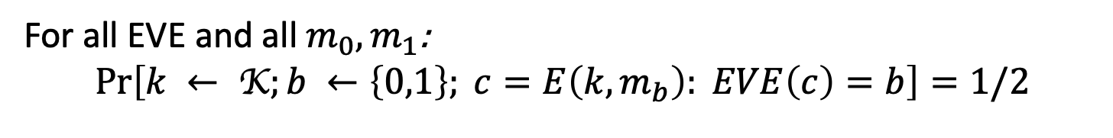
Let’s first rewrite…
Perfect indistinguishability: as a Turing test
For all $m_{0},m_{1},c:Pr⁡[E\left(K,m_{0}\right)=c]=Pr⁡[E\left(K,m_{1}\right)=c]$
World 0:
World 1:
k$←$ K
k$← \text{K}$
$$c=E\left(k,m_{0}\right)$$
$$c=E\left(k,m_{1}\right)$$
is a distinguisher.
For all EVE and all $m_{0},m_{1}$:
$$\operatorname{Pr}\left[k ← \text{K};b ←\left\{0,1\right\}; c=E\left(k,m_{b}\right): EVE\left(c\right)=b\right]=1/2$$

Slide 8
The Axiom of Modern Crypto
Feasible Computation = Probabilistic polynomial-time*
(p.p.t. = Probabilistic polynomial-time)
(polynomial in a security parameter n)
So, Alice and Bob are fixed p.p.t. algorithms. (e.g., run in time n^2)
Eve is any p.p.t. algorithm. (e.g., run in time n^4, or n^100, or n^10000,…)
* in recent years, quantum polynomial-time

Slide 9

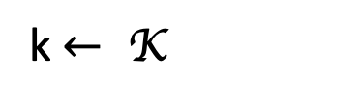

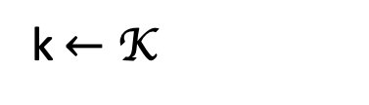
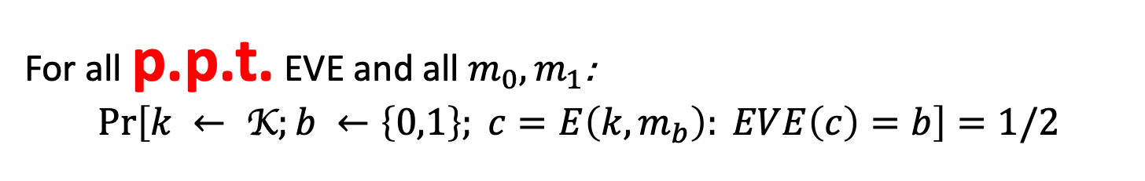

Computational Indistinguishability
(take 1)
World 0:
World 1:
k$←$ K
k$← \text{K}$
$$c=E\left(k,m_{0}\right)$$
$$c=E\left(k,m_{1}\right)$$
is a p.p.t. distinguisher.
For all p.p.t. EVE and all $m_{0},m_{1}$:
$$\operatorname{Pr}\left[k ← \text{K};b ←\left\{0,1\right\}; c=E\left(k,m_{b}\right): EVE\left(c\right)=b\right]=1/2$$
Still subject to Shannon’s impossibility!
Notes:
Question slide

Slide 10

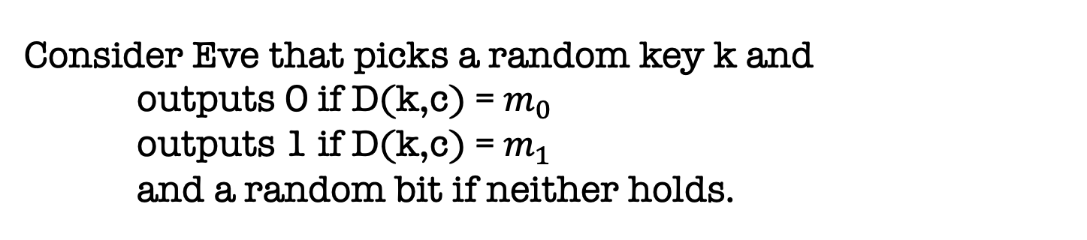


Still subject to Shannon’s impossibility!
Messages n+1 bits
ciphertexts
c
Set of messages consistent with c
= {D(k,c): all k}
$$m_{0}$$
$$m_{1}$$
Consider Eve that picks a random key k and outputs 0 if D(k,c) = $m_{0}$
outputs 1 if D(k,c) = $m_{1}$
and a random bit if neither holds.
w.p $≥$ $1/2^{n}$
w.p = 0
Bottomline: Pr[EVE succeeds] $≥$ 1/2 + $1/2^{n}$
Notes:
Question slide

Slide 11
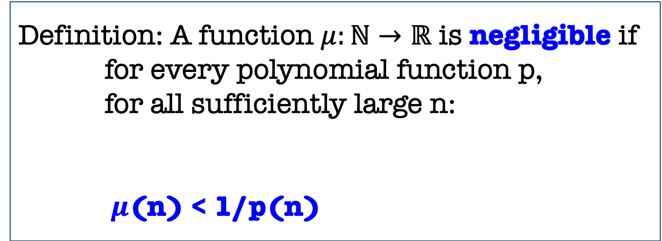

New Notion: Negligible Functions
Functions that grow slower than 1/p(n) for any polynomial p.
Definition: A function $μ:ℕ→ℝ$ is negligible if for every polynomial function p, for all sufficiently large n:
$μ$(n) < 1/p(n)
there exists an $n_{0}$ s.t. for all ${n>n}_{0}:$
Key property: Events that occur with negligible probability look to poly-time algorithms like they never occur.
Notes:
Question slide

Slide 12

New Notion: Negligible Functions
Functions that grow slower than 1/p(n) for any polynomial p.
Definition: A function $μ:ℕ→ℝ$ is negligible if for every polynomial function p, for all sufficiently large n:
$μ$(n) < 1/p(n)
there exists an $n_{0}$ s.t. for all ${n>n}_{0}:$
Question: Let $μ\left(n\right)=1/n^{\log{n}}$. Is $μ$ negligible?
Notes:
Question slide

Slide 13

New Notion: Negligible Functions
Functions that grow slower than 1/p(n) for any polynomial p.
Definition: A function $μ:ℕ→ℝ$ is negligible if for every polynomial function p, for all sufficiently large n:
$μ$(n) < 1/p(n)
there exists an $n_{0}$ s.t. for all ${n>n}_{0}:$
Question: Let $μ\left(n\right)=1/n^{100}$ if n is prime and $μ\left(n\right)=1/2^{n}$ otherwise. Is $μ$ negligible?
Notes:
Question slide

Slide 14

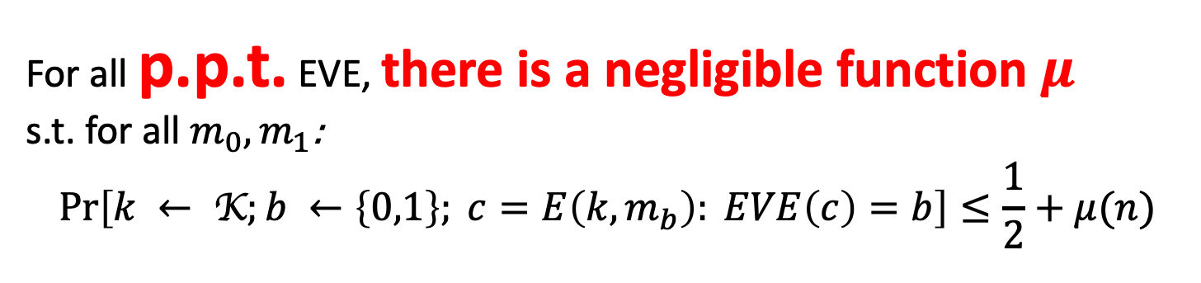
Computational Indistinguishability
World 0:
World 1:
k$←$ K
k$← \text{K}$
$$c=E\left(k,m_{0}\right)$$
$$c=E\left(k,m_{1}\right)$$
is a distinguisher.
For all p.p.t. EVE, there is a negligible function $μ$ s.t. for all $m_{0},m_{1}$:
$$\operatorname{Pr}\left[k ← \text{K};b ←\left\{0,1\right\}; c=E\left(k,m_{b}\right): EVE\left(c\right)=b\right]≤\frac{1}{2}+μ(n)$$

Slide 15
Our First Crypto Tool: Pseudorandom Generators (PRG)

Slide 16
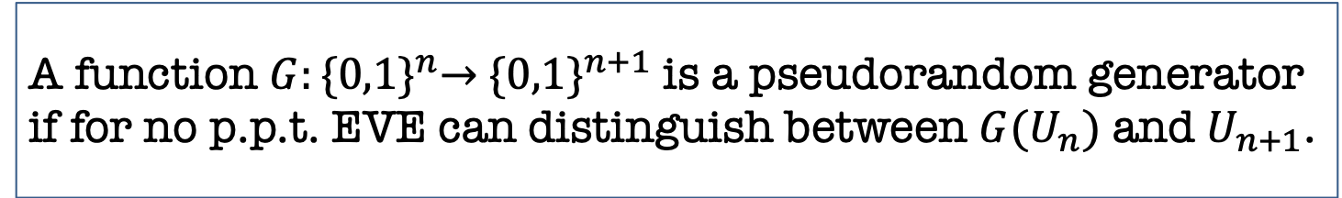
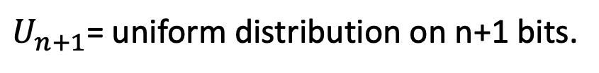
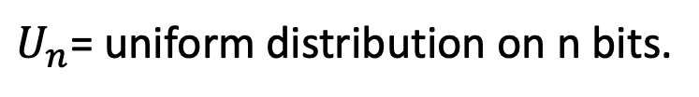
PRG Definition
A function $G:{\{0,1\}}^{n}→$ ${\{0,1\}}^{n+1}$ is a pseudorandom generator if for no p.p.t. EVE can distinguish between ${G(U}_{n})$ and $U_{n+1}$.
$U_{n}$= uniform distribution on n bits.
$U_{n+1}$= uniform distribution on n+1 bits.

Slide 17
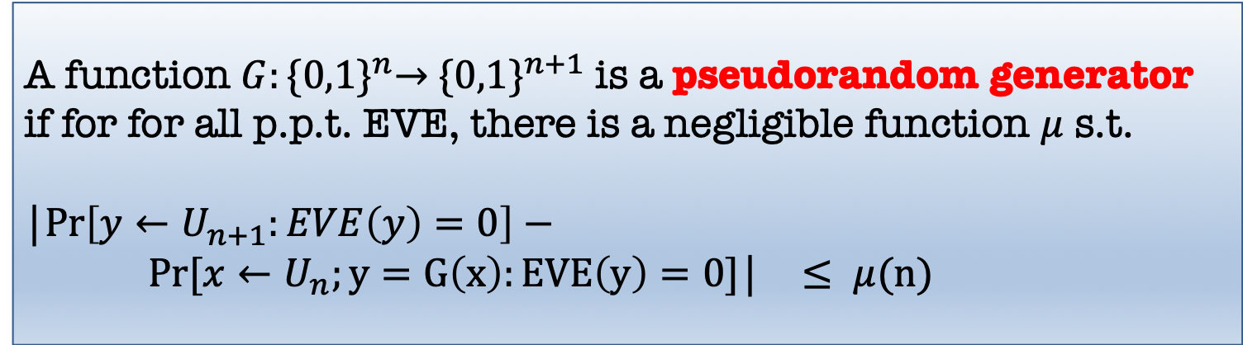
PRG Definition
A function $G:{\{0,1\}}^{n}→$ ${\{0,1\}}^{n+1}$ is a pseudorandom generator if for for all p.p.t. EVE, there is a negligible function $μ$ s.t.
|$\operatorname{Pr}\left[y←U_{n+1}:EVE\left(y\right)=0\right]−$ $Pr⁡[x←U_{n};y=G\left(x\right):EVE\left(y\right)=0]$| $≤ μ(n)$
$$Question: What happens to this definition if EVE is unbounded?$$

Slide 18
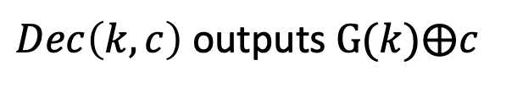

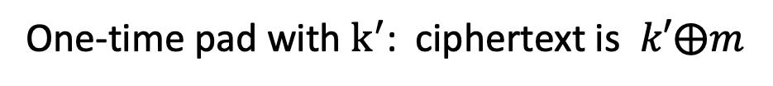
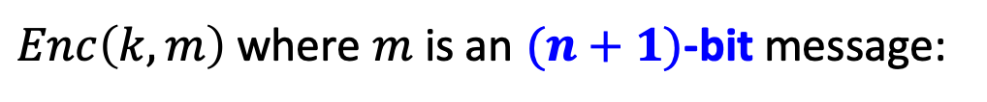
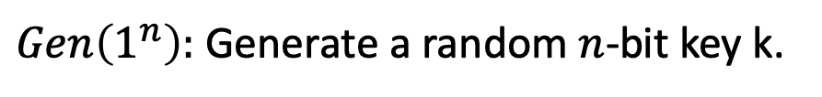

PRG $⟹$ Overcoming Shannon’s Conundrum
(or, How to Encrypt n+1 bits using an n-bit key)
$Gen\left(1^{n}\right):$ Generate a random $n$-bit key k.
$Enc\left(k,m\right)$ where $m$ is an $(n+1)$-bit message:
Expand k into a (n+1)-bit pseudorandom string $k^{′}= G(k)$
One-time pad with $k^{′}$: ciphertext is $k′⨁m$
$Dec\left(k,c\right)$ outputs $G(k)⨁c$
$$Correctness:$$
$Dec\left(k,c\right)$ outputs $G\left(k\right)⨁c=G\left(k\right)⨁G\left(k\right)⨁m=m$

Slide 19
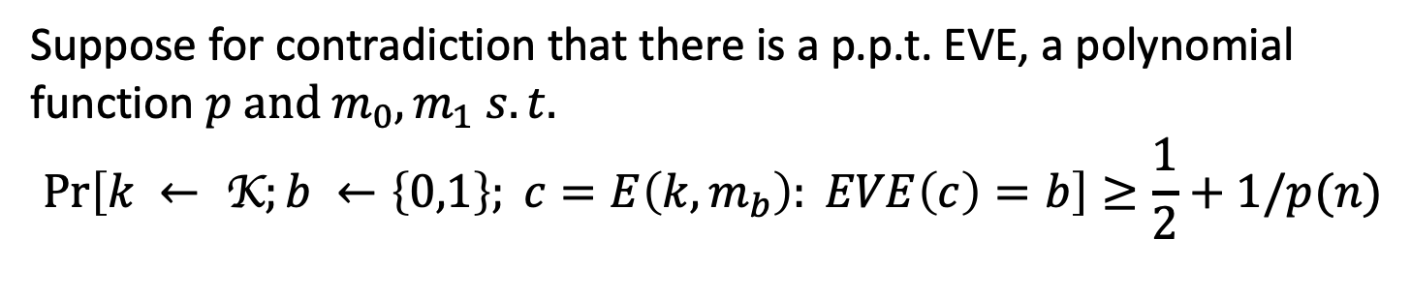
PRG $⟹$ Overcoming Shannon’s Conundrum
Security: by contradiction.
Suppose for contradiction that there is a p.p.t. EVE, a polynomial function $p and m_{0},m_{1} s.t.$
$$\operatorname{Pr}\left[k ← \text{K};b ←\left\{0,1\right\}; c=E\left(k,m_{b}\right): EVE\left(c\right)=b\right]≥\frac{1}{2}+1/p(n)$$

Slide 20
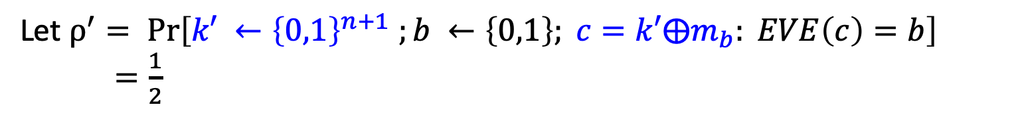
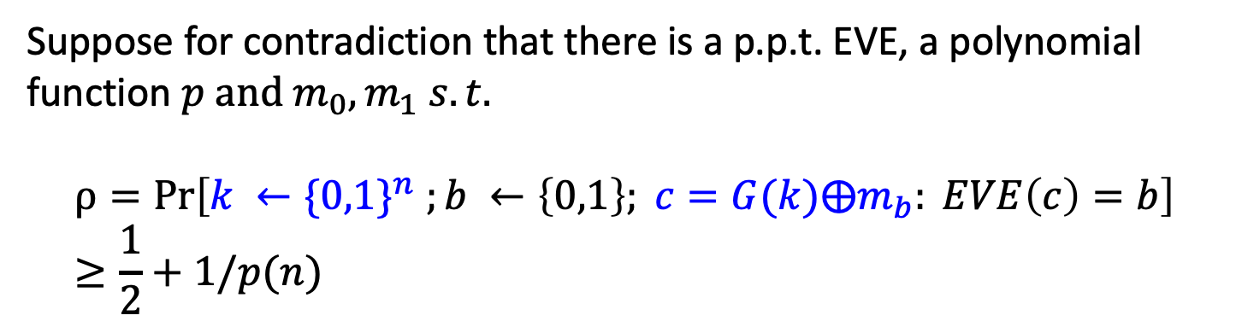
PRG $⟹$ Overcoming Shannon’s Conundrum
Security: by contradiction.
Suppose for contradiction that there is a p.p.t. EVE, a polynomial function $p and m_{0},m_{1} s.t.$
$$ρ=Pr\left[k ←{\{0,1\}}^{n} ;b ←\left\{0,1\right\}; c=G(k)⨁m_{b}: EVE\left(c\right)=b\right]≥\frac{1}{2}+1/p(n)$$
Let $ρ^{′}= \operatorname{Pr}\left[k′ ←{\left\{0,1\right\}}^{n+1} ;b ←\left\{0,1\right\}; c=k′⨁m_{b}: EVE\left(c\right)=b\right]$
$=\frac{1}{2}$
This will give us a distinguisher EVE’ for G, contradicting the assumption that G is a pseudorandom generator. QED.

Slide 21
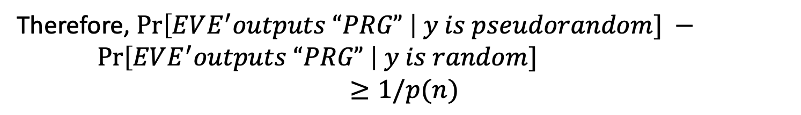
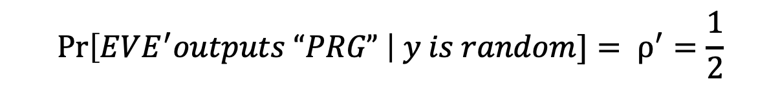
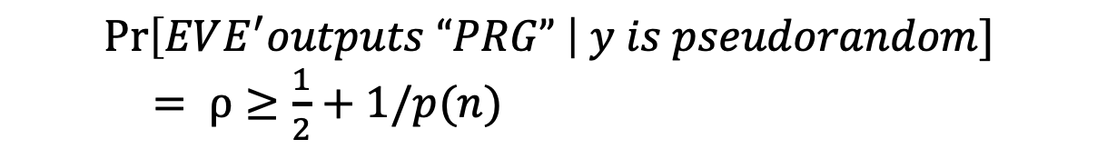

PRG $⟹$ Overcoming Shannon’s Conundrum
Distinguisher EVE’ for G.
Get as input a string y, run EVE($y⨁m_{b}$) for a random b, and let EVE’s output be b’. Output “PRG” if b=b’ and “RANDOM” otherwise.
$$\operatorname{Pr}\left[EVE^{′}outputs “PRG” \right| y is pseudorandom]$$ $= ρ≥\frac{1}{2}+1/p(n)$
$$\operatorname{Pr}\left[EVE^{′}outputs “PRG” \right| y is random]= ρ^{′}=\frac{1}{2}$$
Therefore, $\operatorname{Pr}\left[EVE^{′}outputs “PRG” \right| y is pseudorandom] −$ $\operatorname{Pr}\left[EVE^{′}outputs “PRG” \right| y is random]$
$$≥1/p(n)$$

Slide 22

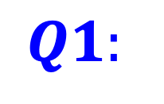
PRG $⟹$ Overcoming Shannon’s Conundrum
(or, How to Encrypt n+1 bits using an n-bit key)
$$Q1:$$
Do PRGs exist?
(Exercise: If P=NP, PRGs do not exist.)
$$Q2:$$
How do we encrypt $n^{100}$ message bits with $n$ key bits?
(Length extension: If there is a PRG that stretches by one bit, there is one that stretches by polynomially many bits)

Slide 23


Constructing PRGs: Two Methodologies
The Practical Methodology
1. Start from a design framework (e.g. “appropriately chosen functions composed appropriately many times look random”)

Slide 24
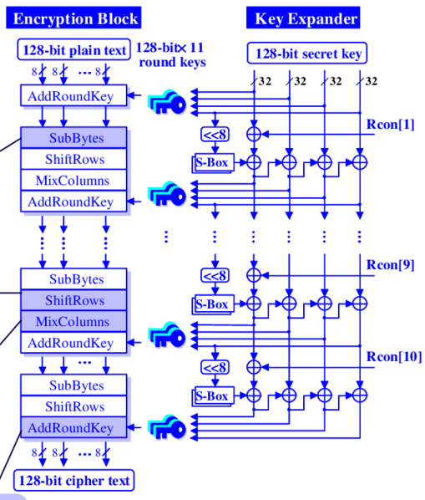

Constructing PRGs: Two Methodologies
The Practical Methodology
1. Start from a design framework (e.g. “appropriately chosen functions composed appropriately many times look random”)
2. Come up with a candidate construction
Rijndael (now the Advanced Encryption Standard)
MATH

Slide 25


Constructing PRGs: Two Methodologies
The Practical Methodology
1. Start from a design framework (e.g. “appropriately chosen functions composed appropriately many times look random”)
2. Come up with a candidate construction
3. Do extensive cryptanalysis.

Slide 26
Constructing PRGs: Two Methodologies
The Foundational Methodology (much of this course)
Reduce to simpler primitives.
“Science wins either way” –Silvio Micali
Digital Signatures
PRF
PRG
Hashing
OWF
well-studied, average-case hard, problems

Slide 27
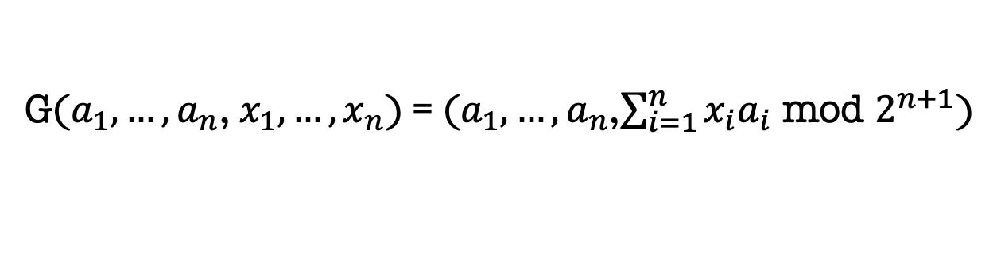
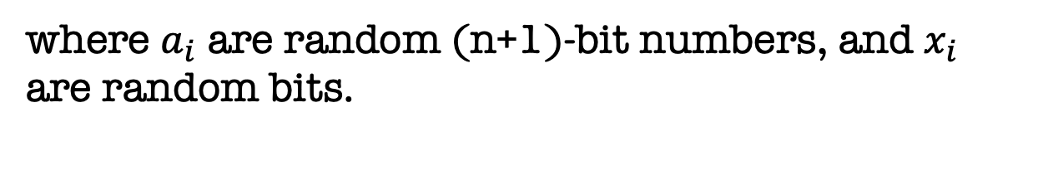
Constructing PRGs: Two Methodologies
The Foundational Methodology (much of this course)
A PRG Candidate from the hardness of Subset-sum:
G($a_{1},…,a_{n}$, $x_{1},…,x_{n}$) = ($a_{1},…,a_{n}$,$\sum_{i=1}^{n}{x_{i}a_{i}}$ mod $2^{n+1}$)
where $a_{i}$ are random (n+1)-bit numbers, and $x_{i}$ are random bits.
Beautiful Function:
If G is a one-way function, then G is a PRG (Pset 1).
If lattice problems are hard on the worst-case, G is a PRG (6.876 Fall18 / CS294-168 Spring20)

Slide 28
PRG $⟹$ Overcoming Shannon’s Conundrum
(or, How to Encrypt n+1 bits using an n-bit key)
$$Q1:$$
Do PRGs exist?
(Exercise: If P=NP, PRGs do not exist.)
$$Q2:$$
How do we encrypt $n^{100}$ message bits with $n$ key bits?
(Length extension: If there is a PRG that stretches by one bit, there is one that stretches by polynomially many bits)

Slide 29

Length extension: One bit to Many bits
Let G: ${\{0,1\}}^{n} →{\{0,1\}}^{n+1}$ be a pseudorandom generator.
Goal: use G to generate many pseudorandom bits.

Slide 30
Length extension: One bit to Many bits
Let G: ${\{0,1\}}^{n} →{\{0,1\}}^{n+1}$ be a pseudorandom generator.
Goal: use G to generate poly many pseudorandom bits.

Slide 31
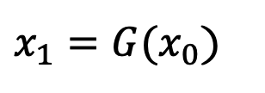

Length extension: One bit to Many bits
Let G: ${\{0,1\}}^{n} →{\{0,1\}}^{n+1}$ be a pseudorandom generator.
Goal: use G to generate poly many pseudorandom bits.
Construction of G’($x_{0}$)
$$x_{0}$$
$x_{1}=G(x_{0}$)
G

Slide 32



Length extension: One bit to Many bits
Let G: ${\{0,1\}}^{n} →{\{0,1\}}^{n+1}$ be a pseudorandom generator.
Goal: use G to generate poly many pseudorandom bits.
Construction of G’($x_{0}$)
$$b_{1}y_{1}$$
$$x_{0}$$
$$x_{1}$$
G

Slide 33











Length extension: One bit to Many bits
Let G: ${\{0,1\}}^{n} →{\{0,1\}}^{n+1}$ be a pseudorandom generator.
Goal: use G to generate poly many pseudorandom bits.
Construction of G’($x_{0}$)
Output $b_{1}$ $b_{2}$ $b_{3}$ $b_{4}$ $b_{5}$ $…y_{L}.$
$$x_{0}$$
$$y_{1}$$
$$y_{2}$$
$$y_{L−1}$$
$$…$$
G
G
G
G
$$b_{1}$$
$$b_{2}$$
$$b_{L−1}$$
$$b_{L}$$
$$y_{L}$$
Also called a stream cipher by the applied people.

Slide 34
Are we all set with encryption?
To encrypt the i-th bit, use the i-th pseudorandom bit.
Two problems:
1. Runtime (an efficiency issue)
2. Need to remember state (a security issue)
In a couple of weeks, Shafi will solve both problems in one shot.

Slide 35

Next Lecture:
Define one-way functions (OWF),
Hardcore bits (HCB),
Goldreich-Levin Theorem: every OWF has a HCB.
Show that OWF $⇒$ PRG (how to construct a PRG from any OWF*)

