Slide 1
6.875 Lecture 4 Spring 2020 Lecturer: Shafi Goldwasser

Slide 2
List Decoding View of Hard Core Predicates <x,r> can be thought of as a highly redundant code for x == Hadamard code PRED(F(x), r) can be thought of as providing access to a noisy code word. THE REDUCTION described can be thought of as (list) decoding of the <x,r> Hadamard code

Slide 3


Cryptography
Randomness is the foundation of cryptography:
Cryptographic keys have to be unpredictable to the adversary
Cryptographic algorithms use additional randomness (beyond the key)
If the random bits are revealed (or are predictable) the entire structure collapses
Randomness

Slide 4
Sources of Randomness
1) Specialized Hardware: e.g., Transistor noise
2) User Input: Every time random number used, user is queried
Usually biased, but can “extract” unbiased bits assuming the source has “some structure and enough entropy” [von Neumann, Elias, Blum]
BUT: True randomness is an expensive commodity.
Notes:
Truly random or biased?
Biased. However, can process the output of sources to get unbiased bit assuming some mathematical model of source [vonNeuman, Elias, Blum]
Pseudo Random Number Generators

Slide 5
If Only there were Random Number Generators…
That is: Deterministic Programs that stretch a truly random seed into a (much) longer sequence of truly random bits.
n-bit truly
random “seed”
G
b1 b2 b3 ...
Can such a G exist?

Slide 6
Pseudo-random Generators
Informally: Deterministic Programs that stretch a “truly random” seed into a (much) longer sequence of “seemingly random” bits.
seed
PRG G
b1 b2 b3 ...
Application for One Time Pads
Enc(m_{i}) = m_{i}⊕pad_{i} where pad_{i} is the ith block output by G

Slide 7
TODAY
NEW NOTION: Pseudo-random Generators (Two different definitions; Equivalence)
CONSTRUCTION [Blum-Micali’82, Yao82]:
One-way Permutations + Hardcore Bits = Pseudorandom Generator.
APPLICATIONS
Notes:
1. So far: one-way functions and permutations.
2. Review definition of one-way function.
3. Example: discrete logarithm, which is in fact a permutation (one-to-one and onto function).

Slide 8
Pseudo-random Generators
Informally: Deterministic Programs that stretch a “truly random” seed into a (much) longer sequence of “seemingly random” bits.
seed
PRG G
b1 b2 b3 ...

Slide 9
How to Define a Strong Pseudo Random Number Generator?
Def 1 [Indistinguishability]
“No polynomial-time algorithm can distinguish between the output of a PRG on a random seed vs. a truly random string”
= “as good as” a truly random string for all practical purposes.
ALL THREE DEFS EQUIVALENT!
Def 2 [Next-bit Unpredictability]
“No polynomial-time algorithm can predict the (i+1)^{th} bit of the output of a PRG given the first i bits”
Def 3 [Incompressibility]
“No polynomial-time algorithm can compress the output of the PRG into a shorter string”

Slide 10
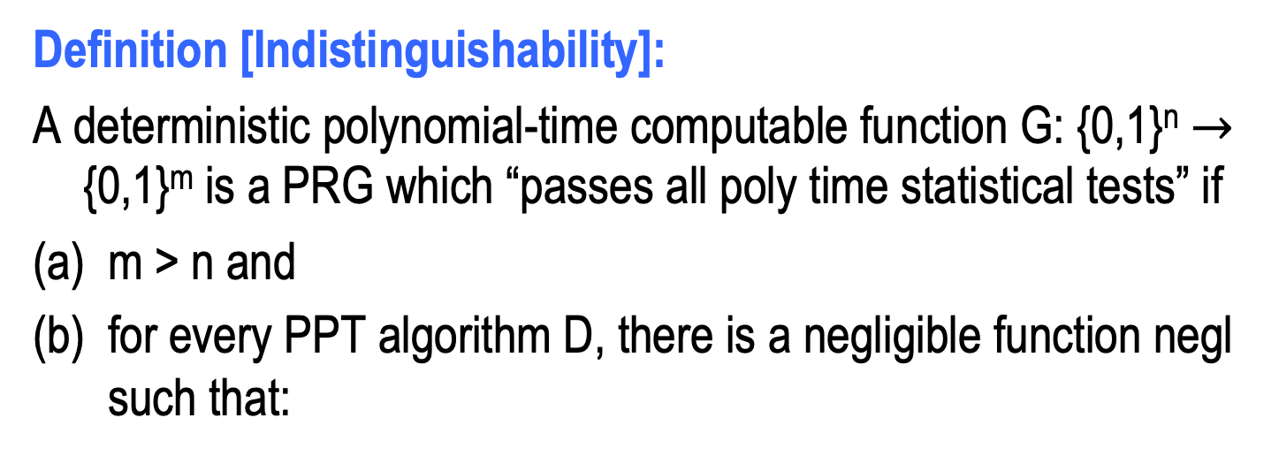
PRG Def 1: Indistinguishability
Definition [Indistinguishability]:
A deterministic polynomial-time computable function G: {0,1}^{n} $→$ {0,1}^{m} is a PRG which “passes all poly time statistical tests” if
m > n and
for every PPT algorithm D, there is a negligible function negl such that:
| Pr[ D(G(U_{n})) = 1 ] – Pr[ D(U_{m}) = 1 ] | = negl(n)
Notation: U_{n} (resp. U_{m}) denotes the random distribution on n-bit (resp. m-bit) strings; m is shorthand for m(n).

Slide 11
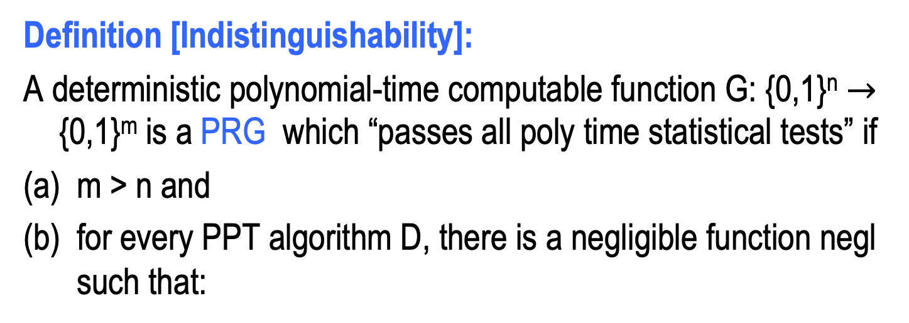
PRG Def 1: Indistinguishability
Definition [Indistinguishability]:
A deterministic polynomial-time computable function G: {0,1}^{n} $→$ {0,1}^{m} is a PRG which “passes all poly time statistical tests” if
m > n and
for every PPT algorithm D, there is a negligible function negl such that:
| Pr[ D(G(U_{n})) = 1 ] – Pr[ D(U_{m}) = 1 ] | = negl(n)
We call D that takes a sequence and outputs 0 or 1
a statistical test..

Slide 12


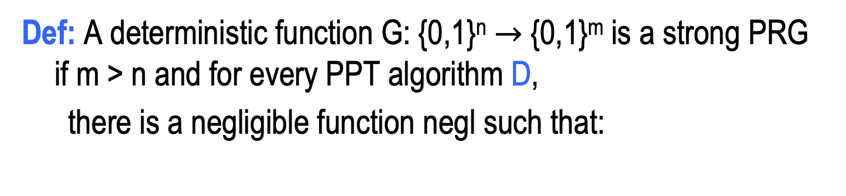

PRG Def 1: Indistinguishability
Def: A deterministic function G: {0,1}^{n} $→$ {0,1}^{m} is a strong PRG if m > n and for every PPT algorithm D,
there is a negligible function negl such that:
| Pr[ D(G(U_{n})) = 1 ] – Pr[ D(U_{m}) = 1 ] | = negl(n)
WORLD 1: The Pseudorandom World
WORLD 2: The Truly Random World
y $←$ G(U_{n})
y $←$ U_{m}
PPT Distinguisher gets y but cannot tell which world she is in

Slide 13
Why is this a good definition
Good for all Applications:
As long as we can find truly random seeds, can replace true randomness by the output of PRG(seed) in ANY “computational” setting.
If it behaves differently,
can convert “application”=statistical test
But: its hard to work with. How do you show that generator G passes ALL statistical tests?

Slide 14
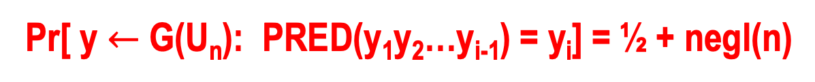
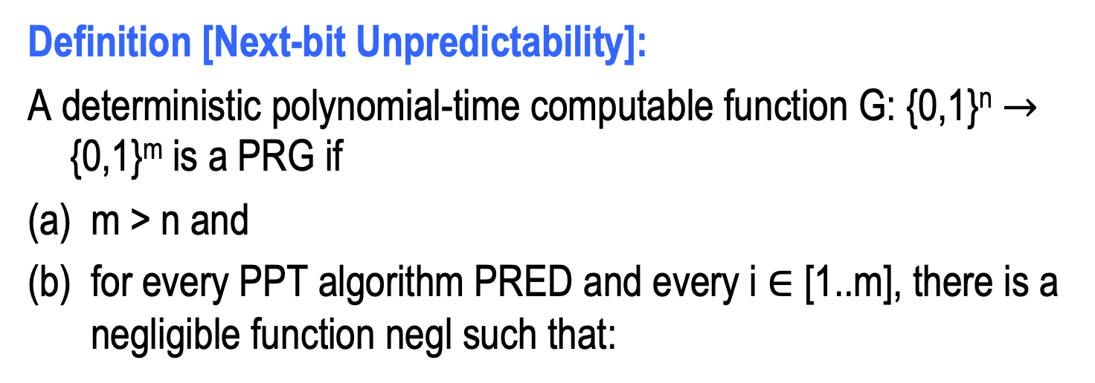
PRG Def 2: (Next-bit) Unpredictability
Definition [Next-bit Unpredictability]:
A deterministic polynomial-time computable function G: {0,1}^{n} $→$ {0,1}^{m} is a PRG if
m > n and
for every PPT algorithm PRED and every i $∈$ [1..m], there is a negligible function negl such that:
Pr[ y $←$ G(U_{n}): PRED(y₁y₂…y_{i-1}) = y_{i}] = ½ + negl(n)
Notation: y_{i} denotes the i-th bit of y. y_{1…i} denotes the first i bits of y.

Slide 15
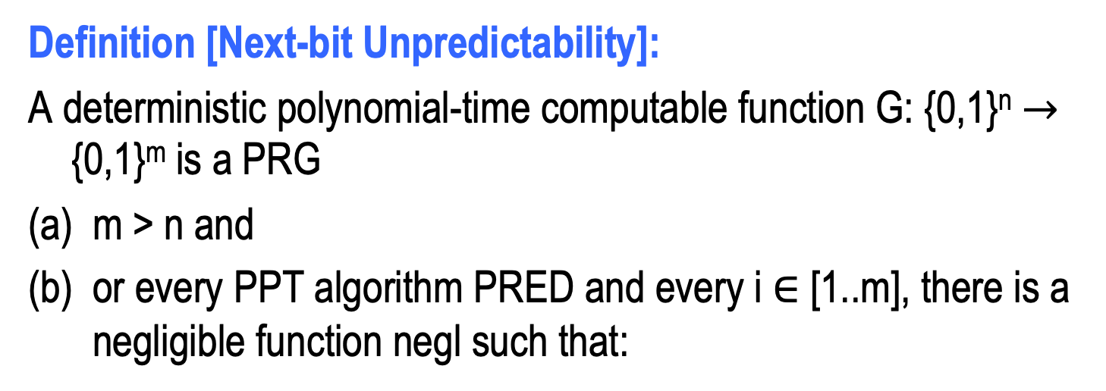
PRG Def 2: (Next-bit) Unpredictability
Definition [Next-bit Unpredictability]:
A deterministic polynomial-time computable function G: {0,1}^{n} $→$ {0,1}^{m} is a PRG
m > n and
or every PPT algorithm PRED and every i $∈$ [1..m], there is a negligible function negl such that:
Pr[ y $←$ G(U_{n}): PRED(y₁y₂…y_{i-1}) = y_{i}] = ½ + negl(n)
Notation: Call PRED a “next-bit test” and if (b) holds, we say that G “passes all next bit tests “

Slide 16
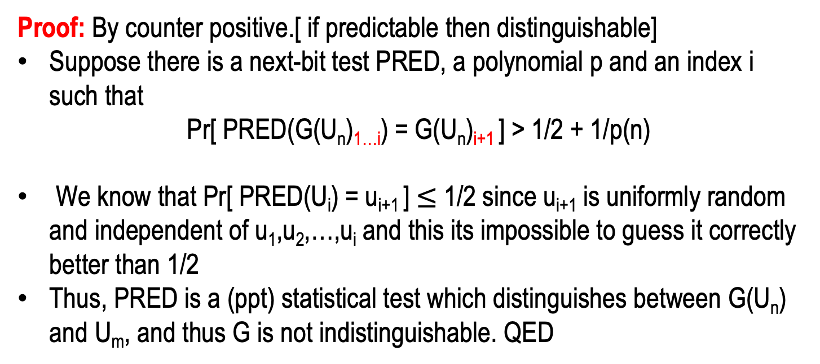
Def 1 and Def 2 are Equivalent
Theorem: A PRG G passes all polynomial time statistical tests if and only if it passes all polynomial time next-bit tests
Proof: By counter positive.[ if predictable then distinguishable]
Suppose there is a next-bit test PRED, a polynomial p and an index i such that
Pr[ PRED(G(U_{n})_{1…i}) = G(U_{n})_{i+1} ] > 1/2 + 1/p(n)
We know that Pr[ PRED(U_{i}) = u_{i+1} ] $≤$ 1/2 since u_{i+1} is uniformly random and independent of u₁,u₂,…,u_{i} and this its impossible to guess it correctly better than 1/2
Thus, PRED is a (ppt) statistical test which distinguishes between G(U_{n}) and U_{m}, and thus G is not indistinguishable. QED

Slide 17
Def 1 and Def 2 are Equivalent
Theorem: A PRG G satisfies all polynomial time statistical tests if and only if it passes all next-bit tests
Proof: By counter positive Suppose now that G does not pass some polynomial time statistical test DIST.
Then we will show that A can be converted into a next bit test PRED.
That is, show the existence of a bit position j s.t. for
sufficiently large n, PRED can predict the value of j-th output bit of G by reading only a prefix of length j-1.

Slide 18
Def 1 and Def 2 are Equivalent
Theorem: A PRG G satisfies the indistinguishability def if and only if it is next-bit unpredictable.
Proof: By contradiction. TWO STEPS.
STEP 1: HYBRID ARGUMENT
STEP 2: From Distinguishing to Predicting

Slide 19
Distinguishers and Predictors
Given a distinguisher algorithm DIST with advantage ε, we have:
| Pr[ DIST(G(U_{n})) = 1] – Pr[DIST(U_{m}) = 1] | > ε
Define m+1 hybrid distributions.

Slide 20
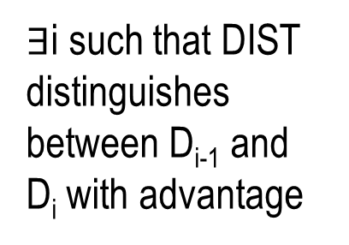
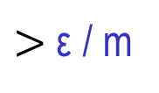
Hybrid Distributions
random
pseudorandom
D₀ = U_{m}:
$∃$i such that DIST distinguishes between D_{i-1} and D_{i} with advantage
...
...
D_{i-1}:
$>$ ε / m
D_{i}:
...
...
D_{m-1}:
D_{m} = G(U_{n}):

Slide 21

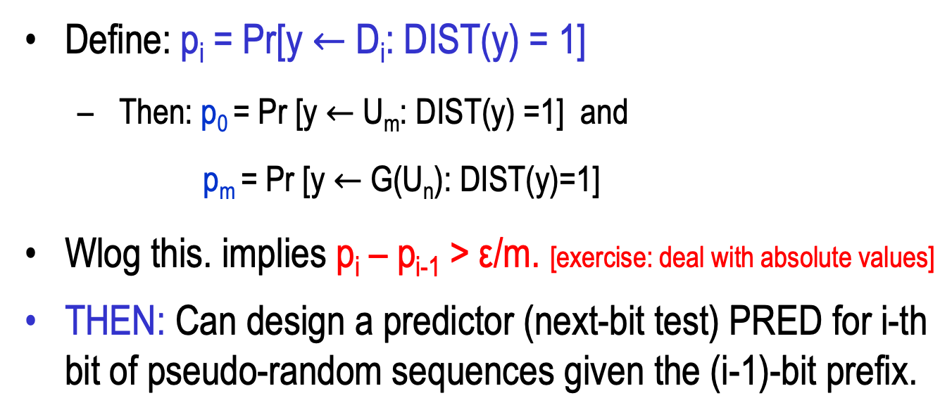
Hybrid Distributions
random
pseudorandom
D_{i-1}:
$>$ ε / m
D_{i}:
Define: p_{i} = Pr[y $←$ D_{i}: DIST(y) = 1]
Then: p₀ = Pr [y $←$U_{m}: DIST(y) =1] and
p_{m} = Pr [y $←$G(U_{n}): DIST(y)=1]
Wlog this. implies p_{i} – p_{i-1} > ε/m. [exercise: deal with absolute values]
THEN: Can design a predictor (next-bit test) PRED for i-th bit of pseudo-random sequences given the (i-1)-bit prefix.

Slide 22
Predictor PRED for i^{th} bit:
On input: y = y₁y₂…y_{i-1}
PRED:
flip a coin: c ∈{0,1}
u = u_{i+1}u_{i+2}…u_{m} ← U_{m-i}
Run DIST(ycu)
if D outputs 1, output c;
if D outputs 0, output ¬c
(intuition: 1 is a vote for psr bit since p_{i} >p_{i-1} )
Claim:
Pr[PRED(y₁…_{i-1}) = y_{i}] > ½ + ε/m.

Slide 23
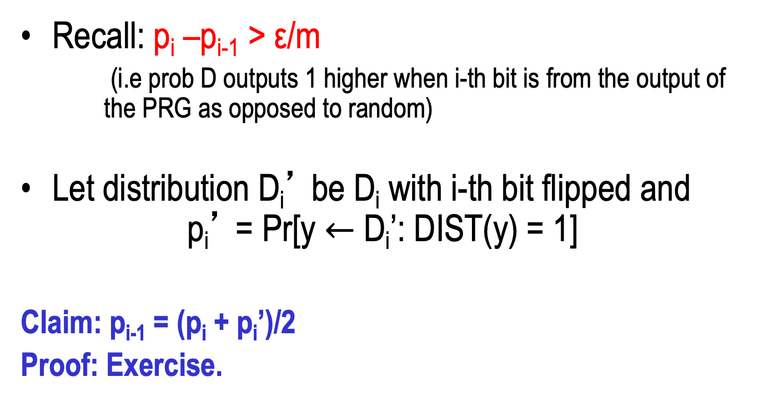



Distinguishing to Prediction: Analysis
Recall: p_{i} –p_{i-1} > ε/m
(i.e prob D outputs 1 higher when i-th bit is from the output of the PRG as opposed to random)
Let distribution D_{i}’ be D_{i} with i-th bit flipped and p_{i}’ = Pr[y $←$ D_{i}’: DIST(y) = 1]
Claim: p_{i-1} = (p_{i} + p_{i}’)/2
Proof: Exercise.
D_{i-1}:
$$u_{i}$$
D_{i}:
$$y_{i}$$
D_{i}’:
$$\overline{y_{i}}$$
Notes:
Write proof for myself.

Slide 24
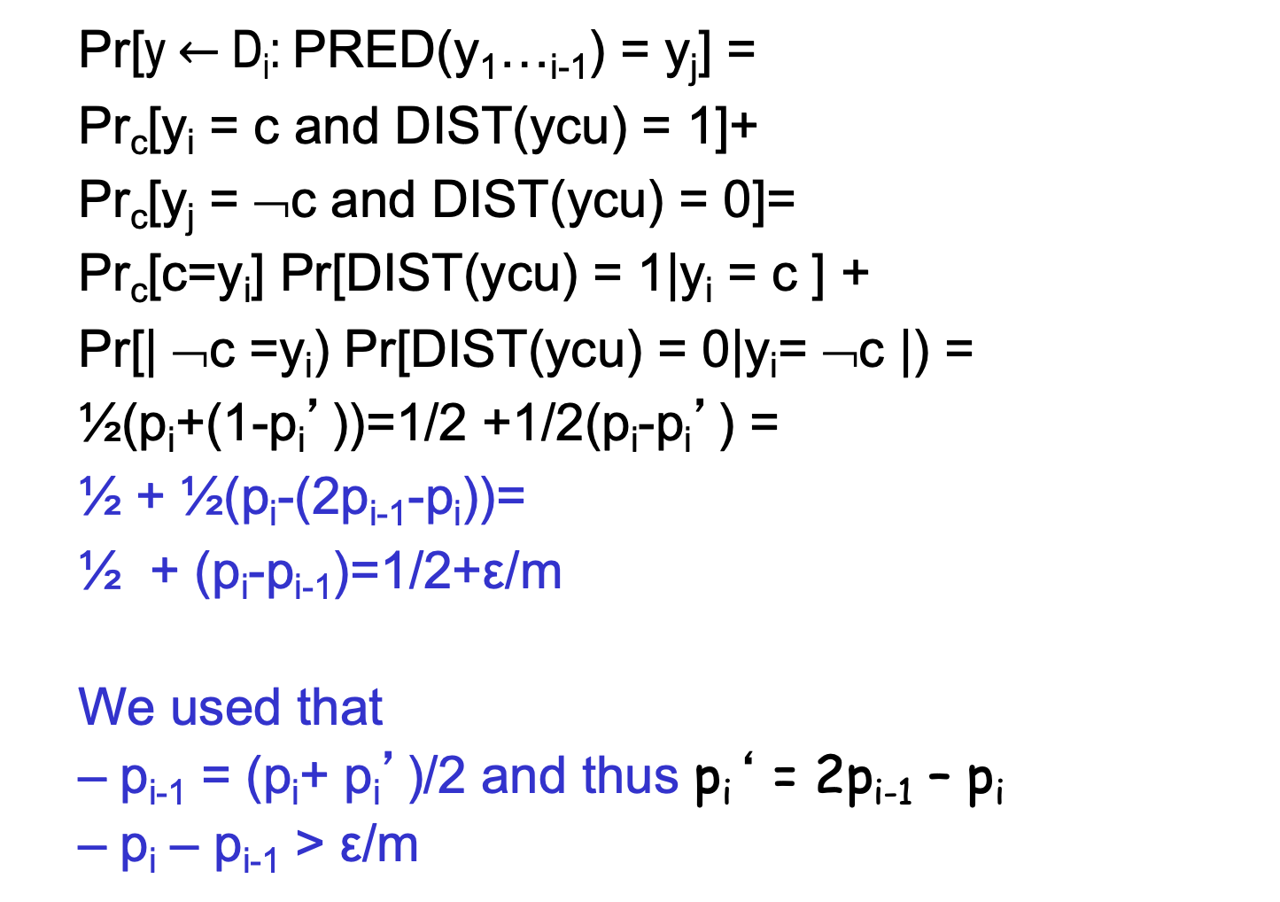
Proof of Claim
y = y₁y₂…y_{j-1}
Pr[y $←$ D_{i}: PRED(y₁…_{i-1}) = y_{j}] =
Pr_{c}[y_{i} = c and DIST(ycu) = 1]+
Pr_{c}[y_{j} = ¬c and DIST(ycu) = 0]=
Pr_{c}[c=y_{i}] Pr[DIST(ycu) = 1|y_{i} = c ] +
Pr[| ¬c =y_{i}) Pr[DIST(ycu) = 0|y_{i}= ¬c |) =
½(p_{i}+(1-p_{i}’))=1/2 +1/2(p_{i}-p_{i}’) =
½ + ½(p_{i}-(2p_{i-1}-p_{i}))=
½ + (p_{i}-p_{i-1})=1/2+ε/m
We used that
p_{i-1} = (p_{i}+ p_{i}’)/2 and thus p_{i}‘ = 2p_{i-1} – p_{i}
p_{i} – p_{i-1} > ε/m
D_{i-1}
D_{i}
D’_{i}

Slide 25
Lets call a PRG that satisfied passes all polynomial time statistical tests a Cryptographically Strong PRG (CSPRG)

Slide 26
Part 2: One-way Permutation + Hardcore Bits = Pseudorandom Generator

Slide 27
Linear Congruential Generators
k₀ truly random seed
x_{i+1} =a x_{i}+ b mod M
(where a,b,M define the generator)
LCG
(a.b.M)
x₀
x₁ x₂ x ₃
Predictable !!! Even if a,b,M unknown [Pl]
Even if truncated [FHLK]
insecurity within any crypto
application as the pseudo random
sequence of x_{i}’s can be hidden
( in particular: can’t use prediction
algorithms) But should raise great
concern
Of course, predictability

Slide 28
Cryptographically Strong- PSRG from one-way permutations
Idea: Let f be one-way permutation.
Choose random seed s in {0,1}^{n}
Compute f(s) f²(s) f³(s) … f ^{m}(s)
Output in reverse order
Intuitively, Why good?
Unpredictable: From f^{i}(s) can’t compute f^{i-1}(s)
Why not so good ?
Even though you cannot predict f^{i-1}(s) some bits of it may be predictable.

Slide 29
Recall: Hard Core Predicates for OWF
DEFINITION: A hard-core predicate for a one-way function F:{0,1}* → {0,1}* is a Boolean predicate B: {0,1}* → {0,1} such that:
Hard
∀ PPT algorithm PRED (“predictor”), there is a negligible function negl(.) such that:
Prob [ PRED(f(x)) = B(x) ]= ½ + negl(n)
X
Easy
F(X)
Easy
Unpredictable
(probability over random x in {0,1}^{n} and P’s coins )
B(X)

Slide 30
Constructing PSRG
Theorem: If there exist one-way-permutations f with hard core bit B, then there exist
CS PRG G:{0,1}^{n}->{0,1}^{m(n)} for any polynomial m.
Proof: Let m be a polynomial function, set m=m(n)
On input seed s from U_{n},
G: (1) compute f(s) f(f(s)) … f(f^{m-1}(s))
(2) compute B(s) B(f(s)) … B(f^{m-1}(s))
output y_{m} y_{m-1} … y₁
Note: Cost of computing i-th bit is
O(i*cost of evaluating f)
=
=
=

Slide 31
Picture Better than 1000 words
Internal Configuration
Input
Output
s
f(s)
B(s)
f⁽²⁾(s)
B(f(s))
f⁽³⁾(s)
B(f ⁽²⁾(s))
f^{m}(s)
B(f ^{(m-1)}(s))
Remark: Can make f^{m}(x) public
But not any other internal state

Slide 32
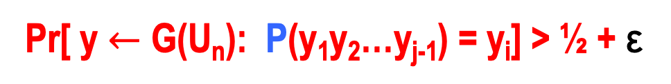
Proof : Show outputs of G pass all next-bit tests.
Suppose, for contradiction, ∃bit location j<m(n) and predictor P s.t.
Then show a predictor PRED for Hard Core B
PRED(f(x)):
1. compute f(x) f(f(x)) … f (f^{j-1}(x))
2. compute B(f(x)) … B(f ^{j-1}(x))
y_{j-1} y₁
3. Output P(y₁ … y_{j-1} )
Pr[ y $←$ G(U_{n}): P(y₁y₂…y_{j-1}) = y_{i}] > ½ + ε
=
=
EUREKA: the next bit y_{I.} in the sequence
should be B(f(x))
And we assumed that P predicts next bit y_{i} with pron. ½+ ε
Notes:
Where did we use the fact that f is a permutation?
That f(x) iterated j times is the same distribution as f(x)
Pr[s∈U_{n}; b_{1,}b_{2,…}b_{Q(n)} = G(s): P(b_{1,}b_{2,…}b_{j-1}) =b_{j})> ½ + ε

Slide 33
Proof : Show outputs of G pass all next-bit tests.
Suppose, for contradiction, ∃bit location j<m(n) and predictor P s.t.
Then show a predictor PRED for Hard Core B
PRED(f(x)):
1. compute f(x) f(f(x)) … f (f^{j-1}(x))
2. compute B(f(x)) … B(f ^{j-1}(x))
y_{j-1} y₁
3. Output P(y₁ … y_{j-1} )
Claim: Pr[PRED(f(x)=B(x)]=Prob[ P(b₁ … b_{j-1} )=b_{j} ]>½ + ε
Essential to Pf: f is a permutation ⇒y₁ … y_{j-1} is the same distribution as P is expecting and will perform well on.
Pr[ y $←$ G(U_{n}): P(y₁y₂…y_{j-1}) = y_{i}] > ½ + ε
=
=
Notes:
Where did we use the fact that f is a permutation?
That f(x) iterated j times is the same distribution as f(x)
Pr[s∈U_{n}; b_{1,}b_{2,…}b_{Q(n)} = G(s): P(b_{1,}b_{2,…}b_{j-1}) =b_{j})> ½ + ε

Slide 34
We just went through A sequence of reductions
Since B is hard-core for one-way function f Pred cannot exist
Next bit test P cannot exist
G passes all next bit tests
G passes all polynomial time statistical tests
G outputs are computationally indistinguishable from random

Slide 35
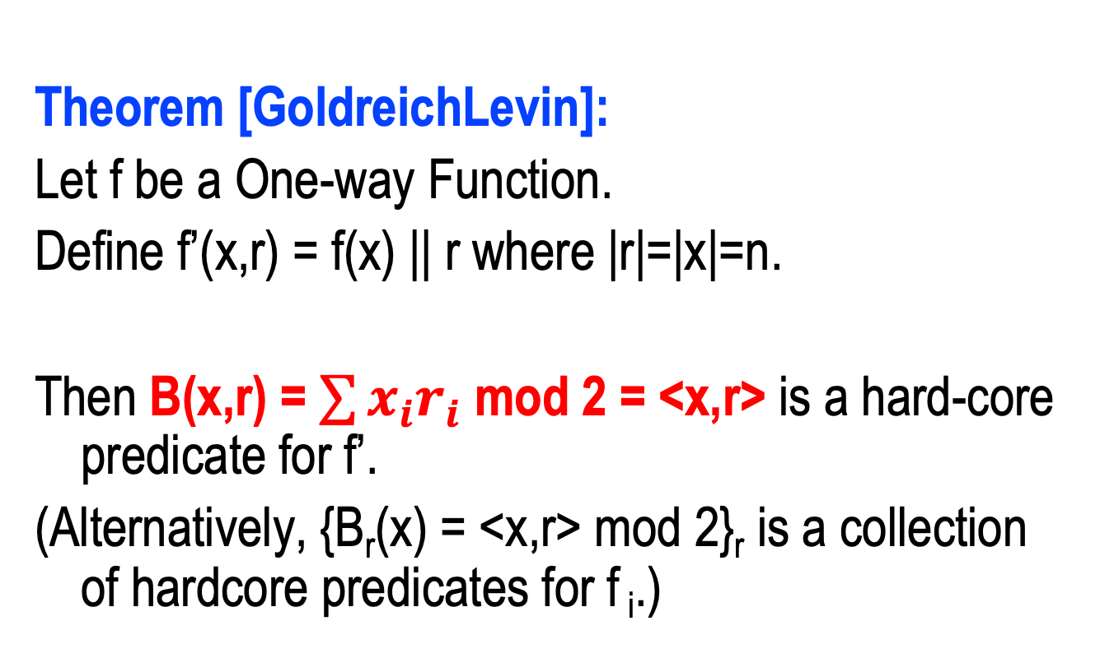
Recall: Every OWF Has an Associated Hard Core Bit
Theorem [GoldreichLevin]:
Let f be a One-way Function.
Define f’(x,r) = f(x) || r where |r|=|x|=n.
Then B(x,r) = $\sum{x_{i}r_{i}}$ mod 2 = <x,r> is a hard-core predicate for f’.
(Alternatively, {B_{r}(x) = <x,r> mod 2}_{r} is a collection of hardcore predicates for f _{i}.)

Slide 36
Example: Any one-way permutation based on Goldreich-Levin Hard Core Bit
Input
Internal Configuration
Output
r
x
f(x)
B(x,r) =<x,r>
f⁽²⁾(x)
B(f(x),r)=<f(x),r>
f⁽³⁾(x)
B(f ⁽²⁾(x),r)=<f(²⁾(x),r>
f^{(t)}(x)
B(f ^{(t-1)}(x),r)=<f^{(t-1)}(x),r>
Use the same r and even can make r public

Slide 37
One Way Functions vs. One Way Permutations
Theorem: If ∃one-way-functions ,
then ∃CS-PSRG
G:{0,1}^{n}->{0,1}^{P(n)} for any polynomial P.
Proof: Much Harder
See web site [HILL]

Slide 38
More Generally: CS PRG with a Single bit extension can be converted to many bit extension (same proof idea)
Internal Configuration
Input
Output
Building Block:
Single Bit Expanding
CS-PSRG
g:{0,1}^{n}  {0,1}^{n+1}
x
x₁ =g(x)|_{n}
g(x)|_{n+1}
x₂ =g(x₁)|_{n}
g(x₁)|_{n+1}
x₃ =g(x₂)|_{n}
g(x₂)|_{n+1}
…
…
x_{m} =g(x_{m-1})|_{n}
g(x_{m})|_{n+1}
Question: what are the hybrids you would define to prove that this works?

Slide 39
Application: De-randomization
Goal: simulate BPP in sub-exponential time
Recall: L ∈ BPP implies ∃algorithm M
x ∈ L ⇒ Pr_{coins y}[M(x,y) accepts] > 2/3
x ∉ L ⇒ Pr_{coins y}[M(x,y) rejects] > 2/3
Use Pseudo-Random Generator (PRG) to generate randomness y:
G
seed
output string y
Run M(x,y)

Slide 40
Theorem: if one way functions exist, then BPP ⊆ ∩_{ε>0}DTIME (2^{nε})
Given L in BPP
Convert BPP algorithm M for L into M‘:
On n-bit input x, say M uses n’ =n^{c} bits of randomness
Let m= n^{ε}
Take CS-PRG G:{0,1}^{m} {0,1}^{n’}
Output majority{M(x,G(s)): s of length m}
Observation 1:
Runtime of M’ is O(2^{nε})
Notes:
Uses the fact that BPP has Poly size circuits

Slide 41
Theorem: if f one-way function, then BPP ⊆ ∩_{ε>0}DTIME (2^{nε})
Convert BPP algorithm M into M‘:
On n-bit input x, say M uses n’ bits of randomness
Let m= n^{ε}
Take CS-PRG G:{0,1}^{m} {0,1}^{n’}
Output the majority{M(x,G(s)): s of length m}
Proof:
Suppose not. ∃L & ε s.t. for inf. many n
Case 1: ∃x in L but M’(x) rejects which means that
M(x,y) behaves differently
when using true randomness y (>2/3 of M(x,y) accept) vs.
when using pseudo-random y= G(s) (<1/2 of M(x,y) accept)
⇒ M(x, ) is a distinguisher between true randomness and G(s)
Case 2: ∃x not in L which is accepted by M’(x), then argue similarly….
Notes:
Uses the fact that BPP has Poly size circuits

Slide 42
Theorem: if f one-way function, then BPP ⊆ ∩_{ε>0}DTIME (2^{nε})
Proof (continued)
Use M as a distinguisher between U_{n’} and G(U_{m}).
Hardwire x to M get distinguisher D_{x} (y)= M(x,y) that
On input y can distinguish if y=G(U_{m}) or y= U_{n’}
x∈L ⇒ Pr[D_{x}(U_{n’})=1] ≥ 2/3, but Pr[D_{x}(G(U_{m})) = 1] <1/2
Namely: if D_{x} (y) =1, conclude y random else pseudo-random
x∉L ⇒ Pr[D_{x}(U_{n’}) = 1] ≤ 1/3, but Pr[D_{x}(U_{m}) = 1] >1/2
Namely, If D_{x} (y)= 1, conclude y pseudo=random else random
Notes:
Uses the fact that BPP has Poly size circuits

Slide 43
Simulating BPP in sub-exponential time
Proof (remarks)
D_{x} is a non-uniform algorithm (also called a circuit)
Sequence of algorithms, one for each length n for which there exists x of length n on which M and M’ behave differently.
Contradicts the fact that f is a one-way function with respect to non-uniform algorithms
Notes:
Uses the fact that BPP has Poly size circuits

Slide 44
Application: Symmetric Encryption for long messages with short keys
Let G be CS-PRG which stretches n to l(n)-bits
based on one-way function f.
Key Generation Gen(1^{n}): randomly chose n-bit seed s in the domain of one-way function f
Encryption Enc(m): for l(n)-bit message m
compute G (s) , Send c=G(s) ⨁m
Decryption D(c):
compute G(s), let m=c⨁G(s)
Claim: Computational Secrecy
Proof: G(s) ≈_{c} uniform implies
c=m⨁G(s) ≈_{c} uniform (for any m you can find)
Notes:
proof

Slide 45
Stateful encryption for many messages:
Let G be CS-PSRG which stretches n to l(n)-bits
based on one-way function f.
Gen(1^{n}): randomly chose n-bit seed s in the domain of one-way function f . Initialize state i=0
Enc(m_{i}):
compute and send c=“ith block of G(s)” ⨁m_{i}
set i=i+1
Dec(c_{i}):
set m_{i}= “ith block of G(s)” ⨁c
Set i=i+1
Need to maintain state. Is that inherent?
Notes:
proof

Slide 46
Questions: Can you access directly the i-th block output of G? Can you do Stateless Encryption of many messages?

