Slide 1
MIT 6.875
Foundations of Cryptography
Lecture 9

Slide 2

Today: Constructions of Public-Key Encryption
1: Trapdoor Permutations (RSA and Rabin)
2: Quadratic Residuosity/Goldwasser-Micali
3: Diffie-Hellman/El Gamal
4: Learning with Errors/Regev

Slide 3
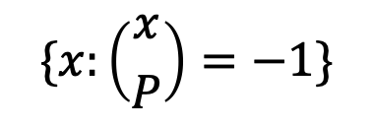

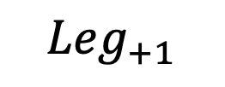
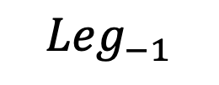
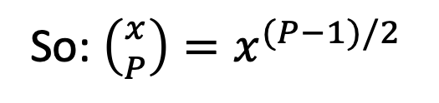
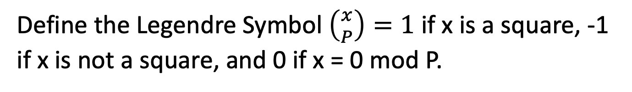
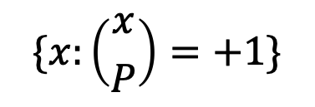
Quadratic Residues mod P
Let P be prime. We saw that exactly half of $Z_{P}^{∗}$ are squares.
Define the Legendre Symbol $\left({x \atop P}\right)=1$ if x is a square, -1 if x is not a square, and 0 if x = 0 mod P.
So: $\left({x \atop P}\right)=x^{(P−1)/2}$
$${Leg}_{−1}$$
$${Leg}_{+1}$$
$$Z_{P}^{∗}$$
$$\{x:\left({x \atop P}\right)=−1\}$$
$$\{x:\left({x \atop P}\right)=+1\}$$

Slide 4
Quadratic Residues mod P
Let P be prime. We saw that exactly half of $Z_{P}^{∗}$ are squares.
It is easy to compute square roots mod P. We will show it for the case where P = 3 (mod 4).
Claim: The square roots of $x$ mod P are ${± x}^{(P+1)/4}$
Proof: $({± x}^{(P+1)/4})^{2}$ $=x^{(P+1)/2}={x∙x}^{(P−1)/2}=x mod P$

Slide 5
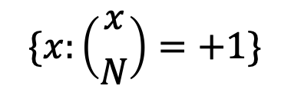
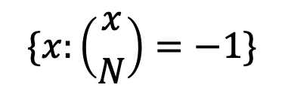

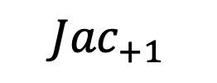

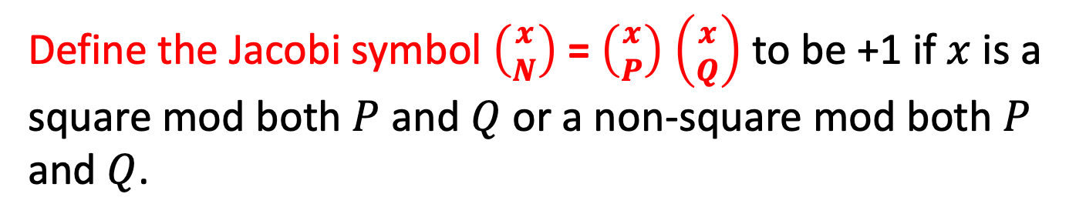
Quadratic Residues mod N
Now, let N = PQ be a product of two primes and look at $Z_{N}^{∗}$
Define the Jacobi symbol $\left({x \atop N}\right)$ = $\left({x \atop P}\right)$ $\left({x \atop Q}\right)$ to be +1 if $x$ is a square mod both $P$ and $Q$ or a non-square mod both $P$ and $Q$.
$$Z_{N}^{∗}$$
$${Jac}_{−1}$$
$${Jac}_{+1}$$
$$\{x:\left({x \atop N}\right)=−1\}$$
$$\{x:\left({x \atop N}\right)=+1\}$$

Slide 6
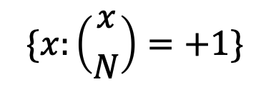
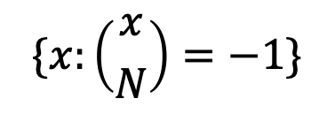

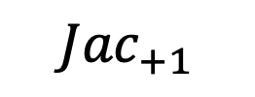
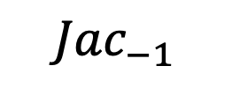
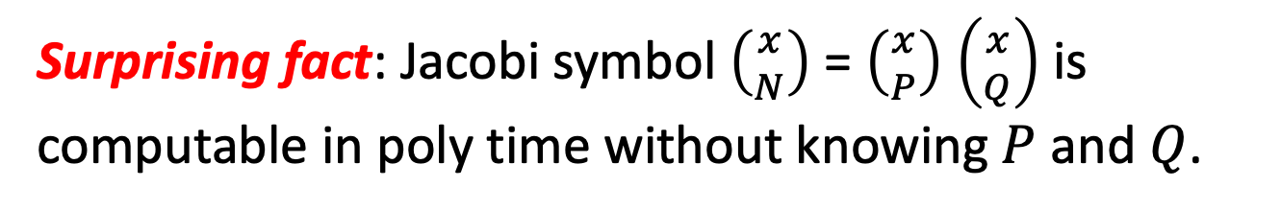
Quadratic Residues mod N
Let $N=PQ$ be a product of two large primes.
$$Z_{N}^{∗}$$
$${Jac}_{−1}$$
$${Jac}_{+1}$$
$$\{x:\left({x \atop N}\right)=−1\}$$
$$\{x:\left({x \atop N}\right)=+1\}$$
Surprising fact: Jacobi symbol $\left({x \atop N}\right)$ = $\left({x \atop P}\right)$ $\left({x \atop Q}\right)$ is computable in poly time without knowing $P$ and $Q$.
Notes:
Proof sketch on the board. Use the reciprocity law (x/N) = (N/x) (-1)^{(x-1)(N-1)/4} and (x/N) = (x mod N / N) and the supplementary facts (1 // N) = (-1)^{n-1/2} and (2 // N) = (-1)^{n^2-1/8}.

Slide 7

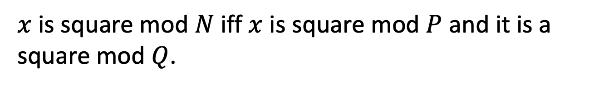
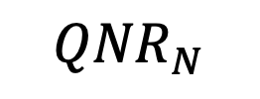
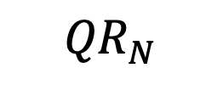
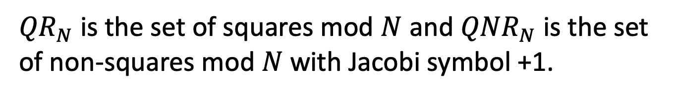
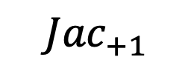

Quadratic Residues mod N
$x$ is square mod $N$ iff $x$ is square mod $P$ and it is a square mod $Q$.
$${Jac}_{+1}$$
So: ${QR}_{N}= \{x:\left({x \atop P}\right)=\left({x \atop Q}\right)=+1\}$
$${QR}_{N}$$
${QNR}_{N}= \{x:\left({x \atop P}\right)=\left({x \atop Q}\right)=−1\}$
$${QNR}_{N}$$
${QR}_{N}$ is the set of squares mod $N$ and ${QNR}_{N}$ is the set of non-squares mod $N$ with Jacobi symbol +1.
Notes:
For x to be a square mod N, it has to be a square mod P and square mod Q.
And conversely, if x = y1^2 mod P and x = y2^2 mod Q, then x = CRT(y1,y2)^2 mod PQ.

Slide 8
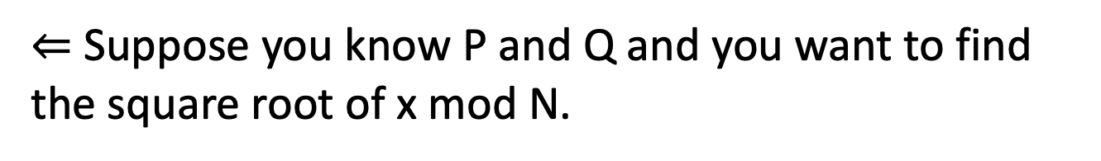
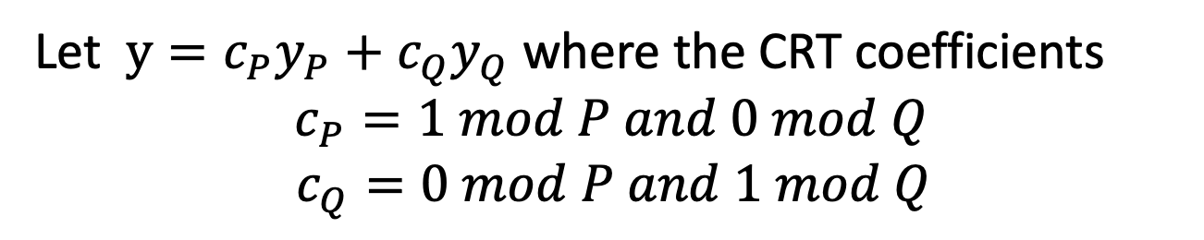
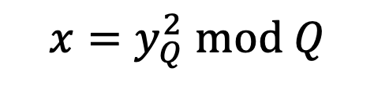
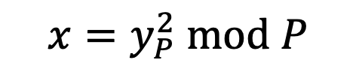
Finding Square Roots Mod N
… is as hard as factoring N
$⇐$ Suppose you know P and Q and you want to find the square root of x mod N.
Find the square roots of y mod P and mod Q.
$$x=y_{P}^{2} mod P$$
$$x=y_{Q}^{2} mod Q$$
Let $y=c_{P}y_{P}+c_{Q}y_{Q}$ where the CRT coefficients
$$c_{P}=1 mod P and 0 mod Q$$
$c_{Q}=0 mod P and 1 mod Q$
Then $y$ is a square root of x mod N.
Notes:
Need CRT. E.g. x = 1 mod 3 and x = 2 mod 5 => x is unique mod 15. x = c_3 * 1 + c_5 * 2. c_3 = 10 is 1 mod 3 and 0 mod 5. c_5 = 6 is 1 mod 5 and 0 mod 3. So x = 10*1+6*2 = 22 = 7 mod 15.
For x to be a square mod N, it has to be a square mod P and square mod Q.
And conversely, if x = y1^2 mod P and x = y2^2 mod Q, then x = CRT(y1,y2)^2 mod PQ.

Slide 9
Finding Square Roots Mod N
… is as hard as factoring N
Suppose you know P and Q and you want to find the square root of x mod N.
Find the square roots of y mod P and mod Q.
$$x=y_{P}^{2} mod P$$
$$x=y_{Q}^{2} mod Q$$
Let $y=c_{P}y_{P}+c_{Q}y_{Q}$ where the CRT coefficients
$$c_{P}=1 mod P and 0 mod Q$$
$c_{Q}=0 mod P and 1 mod Q$
So, if x is a square, it has 4 distinct square roots mod N.
Notes:
For x to be a square mod N, it has to be a square mod P and square mod Q.
And conversely, if x = y1^2 mod P and x = y2^2 mod Q, then x = CRT(y1,y2)^2 mod PQ.

Slide 10
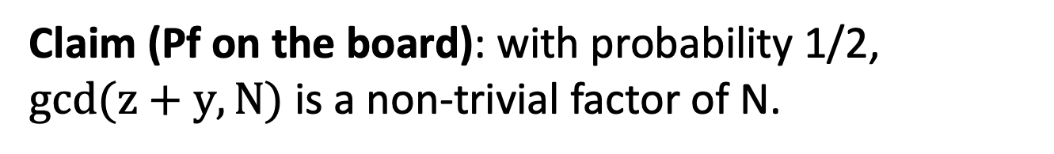
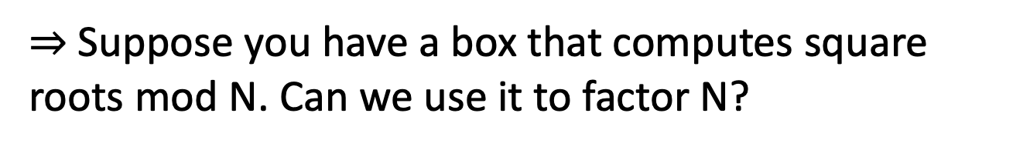
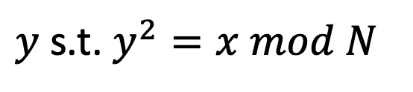

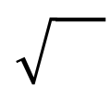
Finding Square Roots Mod N
… is as hard as factoring N
$⇒$Suppose you have a box that computes square roots mod N. Can we use it to factor N?
$$x$$
$y$ s.t. $y^{2}=x mod N$
Feed the box $x=z^{2} mod N$ for a random z.
Claim (Pf on the board): with probability 1/2, $gcd(z+y,N)$ is a non-trivial factor of N.

Slide 11
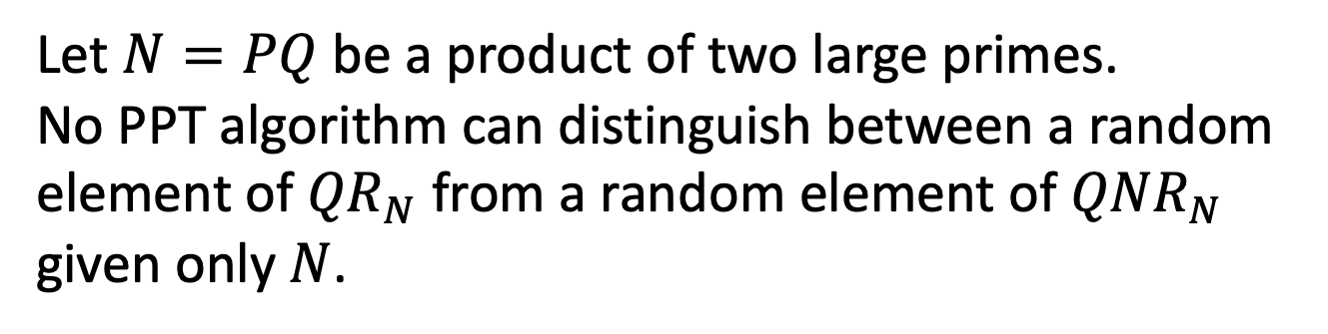
Recognizing Squares mod N
… also seems hard
Let $N=PQ$ be a product of two large primes.
Quadratic Residuosity Assumption (QRA)
Let $N=PQ$ be a product of two large primes. No PPT algorithm can distinguish between a random element of ${QR}_{N}$ from a random element of ${QNR}_{N}$ given only $N$.

Slide 12
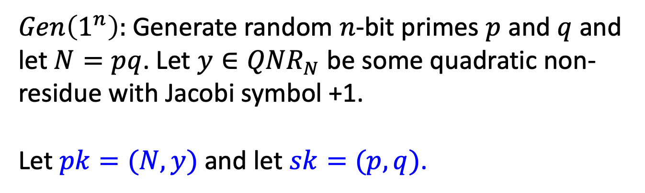
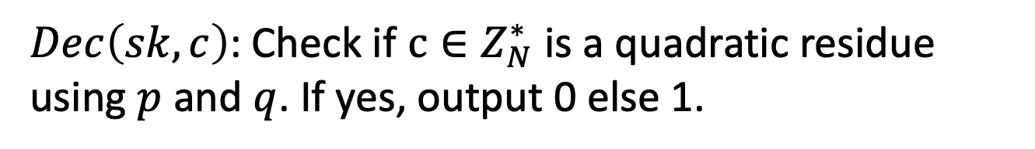
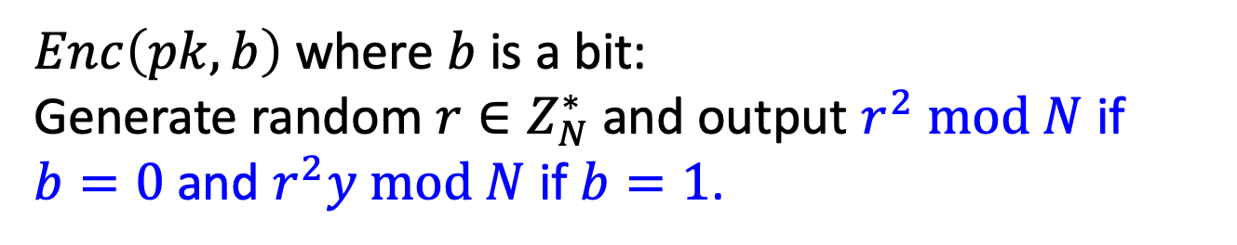
Goldwasser-Micali (GM) Encryption
$Gen\left(1^{n}\right):$Generate random $n$-bit primes $p$ and $q$ and let $N=pq$. Let $y∈{QNR}_{N}$ be some quadratic non-residue with Jacobi symbol +1. Let $pk=(N,y)$ and let $sk=(p,q)$.
$Enc\left(pk,b\right)$ where $b$ is a bit:
Generate random $r∈Z_{N}^{∗}$and output $r^{2} mod N$ if $b=0$ and $r^{2}y mod N$ if $b=1$.
$Dec\left(sk,c\right)$: Check if $c∈Z_{N}^{∗}$is a quadratic residue using $p$ and $q$. If yes, output 0 else 1.

Slide 13

Goldwasser-Micali (GM) Encryption
$Enc\left(pk,b\right)$ where $b$ is a bit:
Generate random $r∈Z_{N}^{∗}$and output $r^{2} mod N$ if $b=0$ and $r^{2}y mod N$ if $b=1$.
IND-security follows directly from the quadratic residuosity assumption.

Slide 14
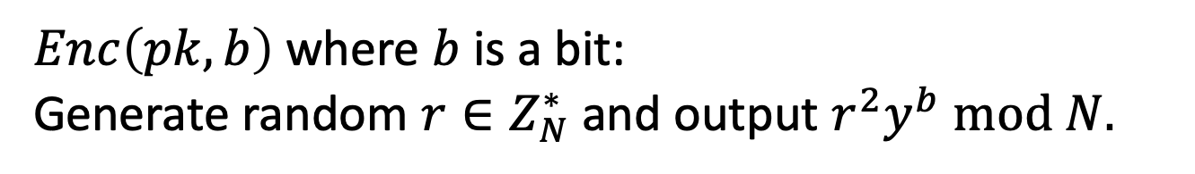
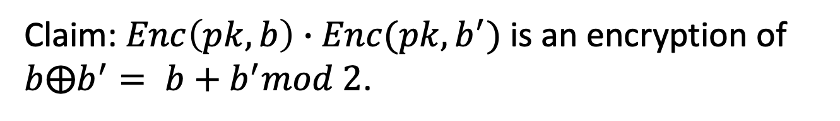
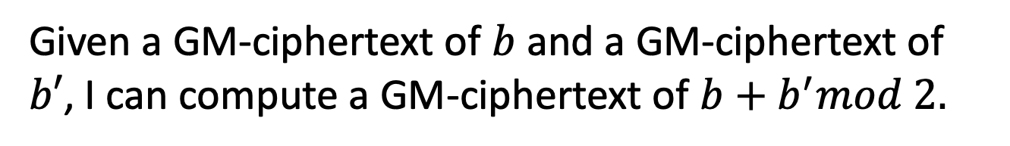
GM is a Homomorphic Encryption
Given a GM-ciphertext of $b$ and a GM-ciphertext of $b′$, I can compute a GM-ciphertext of $b+b^{′}mod 2.$
without knowing anything about $b$ or $b′$!
$Enc\left(pk,b\right)$ where $b$ is a bit:
Generate random $r∈Z_{N}^{∗}$and output $r^{2}y^{b} mod N.$
Claim: $Enc\left(pk,b\right)∙Enc(pk,b^{′})$ is an encryption of $b⨁b^{′}= b+b^{′}mod 2$.
Notes:
Pf: QNR*QNR = QR.

Slide 15
Today: Constructions of Public-Key Encryption
1: Trapdoor Permutations (RSA)
2: Quadratic Residuosity/Goldwasser-Micali
3: Diffie-Hellman/El Gamal
4: Learning with Errors/Regev

Slide 16
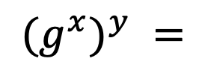
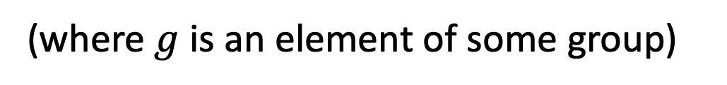
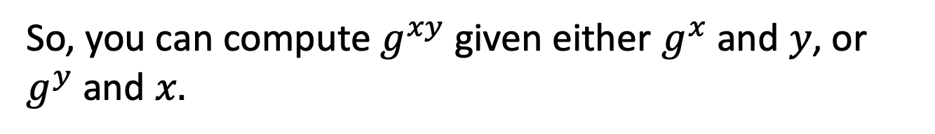
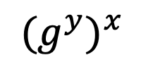
Diffie-Hellman Key Exchange
Commutativity in the exponent:
$$(g^{x})^{y} =$$
$${(g}^{y})^{x}$$
(where $g$ is an element of some group)
So, you can compute $g^{xy}$given either $g^{x}$and $y$, or $g^{y}$and $x.$
Diffie-Hellman Assumption (DHA):
Hard to compute $g^{xy}$ given only ${g, g}^{x}$ and $g^{y}$

Slide 17


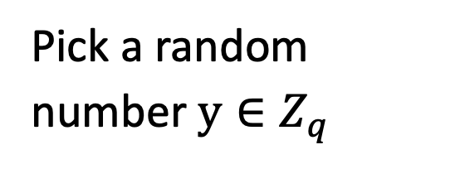
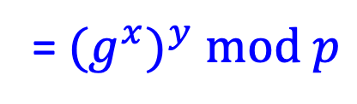
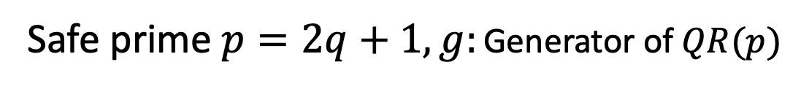
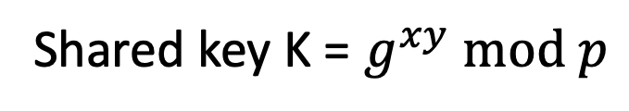
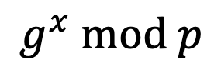
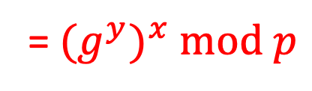
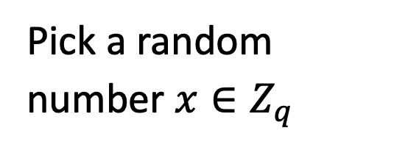
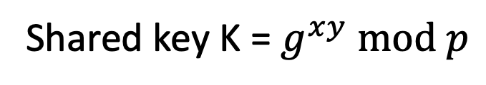
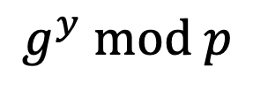
Diffie-Hellman Key Exchange
Safe prime $p=2q+1,g:$ Generator of $QR(p)$
$$g^{x} mod p$$
$$g^{y} mod p$$
Pick a random number $x∈Z_{q}^{}$
Pick a random number $y∈Z_{q}^{}$
Shared key K = $g^{xy} mod p$
Shared key K = $g^{xy} mod p$
= ${(g}^{y})^{x} mod p$
= ${(g}^{x})^{y} mod p$

Slide 18
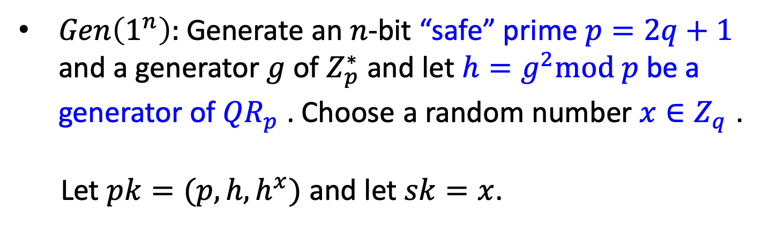
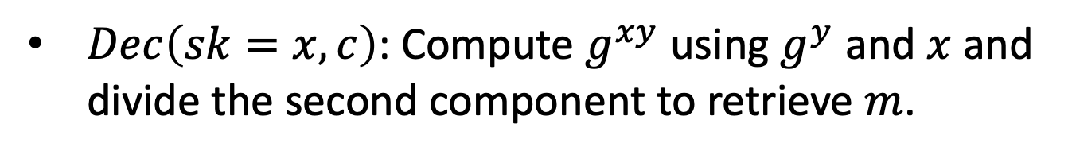

Diffie-Hellman/El Gamal Encryption
$Gen\left(1^{n}\right):$Generate an $n$-bit “safe” prime $p=2q+1$ and a generator $g$ of $Z_{p}^{∗}$ and let $h=g^{2}mod p$ be a generator of ${QR}_{p}^{}$. Choose a random number $x∈Z_{q}^{}$.
Let $pk=(p,h,h^{x})$ and let $sk=x$.
$Enc\left(pk,m\right)$ where $m∈{QR}_{p}^{}$: Generate random $y∈Z_{q}^{}$and output $(g^{y},g^{xy}∙m$)
$Dec\left(sk=x,c\right)$: Compute $g^{xy}$ using $g^{y}$ and $x$ and divide the second component to retrieve $m$.

Slide 19

Decisional Diffie-Hellman Assumption
Decisional Diffie-Hellman Assumption (DDHA):
Hard to distinguish between $g^{xy}$ and a uniformly random group element, given ${g,g}^{x}$ and $g^{y}$
That is, the following two distributions are computationally indistinguishable:
$$(g,g^{x},g^{y},g^{xy})≈(g,g^{x},g^{y},u)$$
DH/El Gamal is IND-secure under the DDH assumption.
Notes:
Pf: QNR*QNR = QR.

Slide 20



Which Group to Use?
$(1)$ ${QR}_{P}$ for a safe prime $P=2Q+1$ where $Q$ is prime. The order of the group is Q.
Discrete log can be broken in sub-exponential time $2^{\sqrt{\log{P\log{\log{P}}}}}$ (better than $poly(P)$ but worse than $poly(\log{P).)}$
$\left(2\right)$ Elliptic Curve Groups. The set of solutions $(x,y)$ to the equation $y^{2}=x^{3}+ax+b$ (mod P) together with a very cool group addition law.
Best known Discrete log algorithm: $O(\sqrt{P})$ time!
Much smaller keys: 160-bit P suffices for “80-bit security”.
Notes:
Pf: QNR*QNR = QR.

Slide 21

Today: Constructions of Public-Key Encryption
1: Trapdoor Permutations (RSA)
2: Quadratic Residuosity/Goldwasser-Micali
3: Diffie-Hellman/El Gamal
4: Learning with Errors/Regev
(post-quantum secure, as far as we know; soon-to-be NIST standard)
(will see more when we do homomorphic encryption)

Slide 22
Practical Considerations
I want to encrypt to Bob. How do I know his public key?
Public-key Infrastructure: a directory of identities together with their public keys.
Needs to be “authenticated”:
otherwise Eve could replace Bob’s pk with her own.

Slide 23

Practical Considerations
Public-key encryption is orders of magnitude slower than secret-key encryption.
We mostly showed (except El Gamal) how to encrypt bit-by-bit! Super-duper inefficient.
Exponentiation takes $O(n^{2})$ time as opposed to typically linear time for secret key encryption (AES).
The $n$ itself is large for PKE (RSA: $n≥2048$) compared to SKE (AES: $n=128$).
(For Elliptic Curve El-Gamal, it’s 320 bits)
Can solve problem 1 and minimize problems 2&3 using hybrid encryption.

Slide 24


Hybrid Encryption
To encrypt a long message $m$ (think 1 GB):
Pick a random key K (think 128 bits) for a secret-key encryption
Encrypt K with the PKE: $PKE.Enc(pk, K)$
Encrypt m with the SKE: $SKE.Enc(K, m)$
To decrypt: recover $K$ using $sk$. Then using $K$, recover $m$

Slide 25
Next Lecture:
Digital Signatures

Slide 26




Solving Linear Equations
Solving Noisy Linear Equations
Easy!
$$\left(s_{1} | s_{2}\right)\left[\begin{matrix}5 & 1 & 3 \\ 6 & 2 & 1\end{matrix}\right]=\left[\begin{matrix}11 & 3 & 9\end{matrix}\right]$$
Find $\left(s_{1} | s_{2}\right)$
How about:
$$\left(s_{1} | s_{2}\right)\left[\begin{matrix}5 & 1 & 3 \\ 6 & 2 & 1\end{matrix}\right]+\left[\begin{matrix}e_{1} & e_{2} & e_{3}\end{matrix}\right]=\left[\begin{matrix}11 & 3 & 9\end{matrix}\right]$$
(e₁,e₂,e₃) are “small” numbers
Very hard!
Find $\vec{s}$
in large dimensions

Slide 27





Learning with Errors (LWE)
[Regev05, following BFKL93, Ale03]
very hard!
LWE:
(A, $s$A+e)
Find $s$
(A $∈Z_{q}^{nXm}$
s ${∈ Z}_{q}^{n}$ random “small” secret vector
$e{∈ Z}_{q}^{n}$: random “small” error vector)
Decisional LWE:
c
≈
(A, b)
(A, sA+$e$)
(b uniformly random)
“Decisional LWE is as hard as LWE”.
Notes:
The same kind of problems with fhe

Slide 28

Basic (Secret-key) Encryption
[Regev05]
n = security parameter, q = “small” prime
Secret key sk = Uniformly random vector s ∈ $Z_{q}^{n}$
Encryption Enc_{s}(m): // m∈ {0,1}
Sample uniformly random a ∈ $Z_{q}^{n}$, “short” noise e ∈ $Z$
The ciphertext c = (a, b = ⟨a, s⟩ + e + m $\left\lfloor q/2\right\rfloor$)
Decryption Dec_{sk}(c): Output Round_{q/2}(b − ⟨a, s⟩ mod q)
// correctness as long as |e| < q/4
Notes:
First iteration is incorrect because you only recover e+m upon decrypting
Solution: “error correct” or “make sure that m is a large number compared to e”

Slide 29




Basic (Secret-key) Encryption
[Regev05]
This is an incredibly cool scheme. In particular, additively homomorphic.
$c$ = (a, b = ⟨a, s⟩ + e + m $\left\lfloor q/2\right\rfloor$)
$$+$$
$c′$ = (a$′$ , b$′$ = ⟨a$′$, s⟩ + e$′$ + m$′$ $\left\lfloor q/2\right\rfloor$)
$c+c′$ = (a+a$′$ , b+ b$′$ = ⟨ a +a$′$, s⟩ + (e+e$′$) + (m+m$′)$ $\left\lfloor q/2\right\rfloor$)
In words: $c+c′$ is an encryption of m+m$′$ (mod 2)
Notes:
First iteration is incorrect because you only recover e+m upon decrypting
Solution: “error correct” or “make sure that m is a large number compared to e”

Slide 30

Public-key Encryption
[Regev05]
Here is a crazy idea. Public key has an encryption of 0 (call it $c_{0}$) and an encryption of 1 (call it $c_{1}$). If you want to encrypt 0, output $c_{0}$and if you want to encrypt 1, output $c_{1}$.
Well, turns out to be a crazy bad idea.
If only we could produce fresh encryptions of 0 or 1 given just the pk…

Slide 31


Public-key Encryption
[Regev05]
Here is another crazy idea. Public key has many encryptions of 0 and an encryption of 1 (call it $c_{1}$).
If you want to encrypt 0, output a random linear combination of the 0-encryptions.
If you want to encrypt 1, output a random linear combination of the 0-encryptions plus $c_{1}$.
This one turns out to be a crazy good idea.

Slide 32


Public-key Encryption
[Regev05]
Secret key sk = Uniformly random vector s ∈ $Z_{q}^{n}$
Public key pk: for $i from 1 to k=poly(n)$
$$\left(c_{0}=(a_{0},\left\langle a_{0},s\right\rangle +e_{0}+\left\lfloor \frac{q}{2}\right\rfloor ),c_{i}=(a_{i},\left\langle a_{i},s\right\rangle +e_{i})\right)$$
Encrypting a bit $m$: pick $k$random bits $r_{1},…,r_{k}$
$$\sum_{i=1}^{k}{r_{i}c_{i}}+m∙c_{0}$$
Correctness: additive homomorphism
Security: decisional LWE + “Leftover Hash Lemma”

Slide 33
We saw: Constructions of Public-Key Encryption
1: Trapdoor Permutations (RSA)
2: Quadratic Residuosity/Goldwasser-Micali
3: Diffie-Hellman/El Gamal
4: Learning with Errors/Regev

