Slide 1
MIT 6.875/6.5620/18.425
Foundations of Cryptography
Lecture 1
Course website: https://mit6875.github.io/

Slide 2



Course Staff
Instructor:
Vinod Vaikuntanathan
(vinodv@mit)
TAs:
Neekon Vafa
(nvafa@mit)
Hanshen Xiao
(hsxiao@mit)
Chirag Falor
(cfalor@mit)

Slide 3
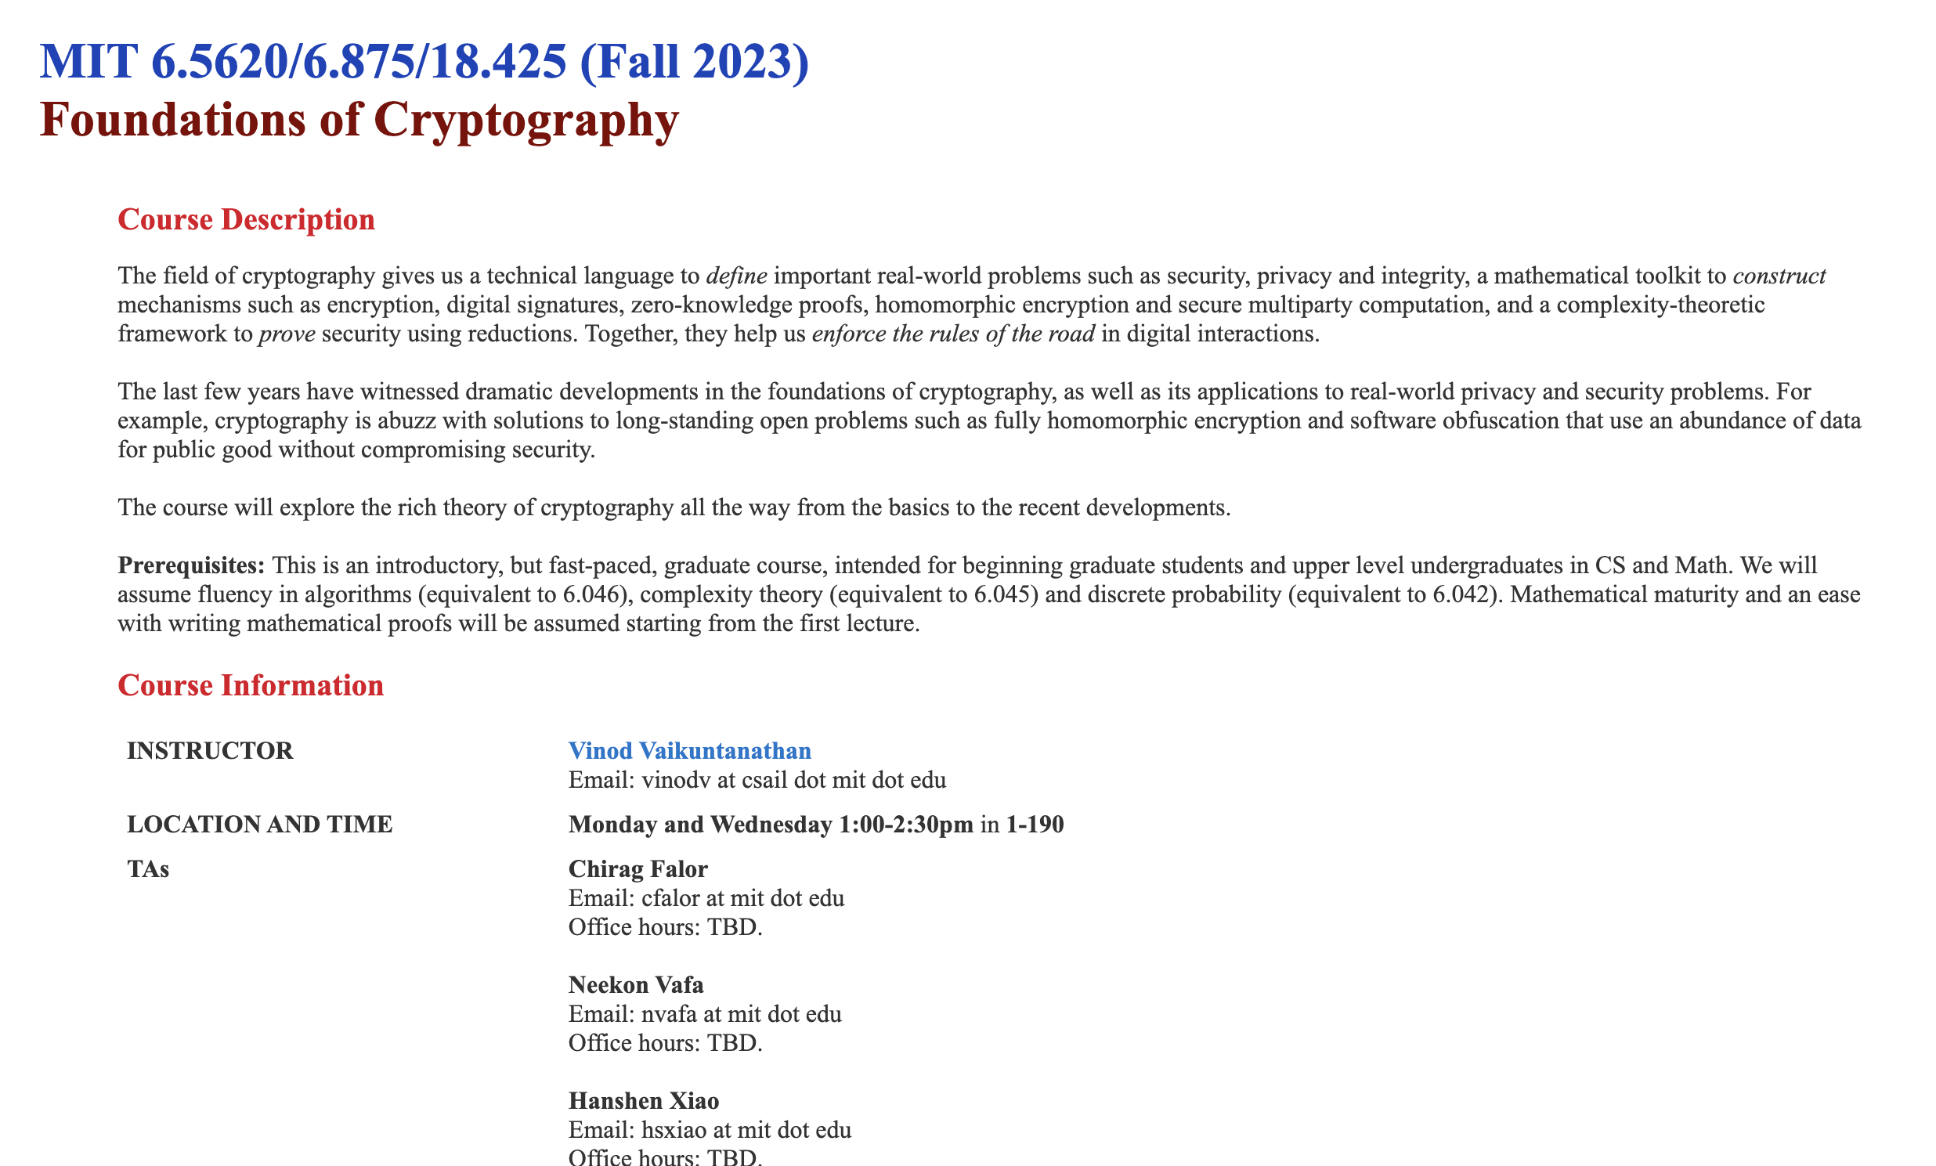
Course Website
https://mit6875.github.io/

Slide 4



Crypto $≠$ Cryptocurrencies
Blockchains/ Cryptocurrencies
“Trustworthy” machine learning
6.5620 is not about
6.5620 is about foundations:
Zero-knowledge Proofs
Public-key Encryption
Digital Signatures
Threshold Cryptography
Pseudorandomness
Homomorphic Encryption

Slide 5
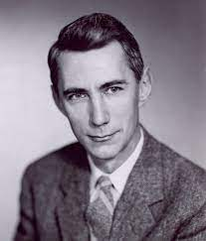
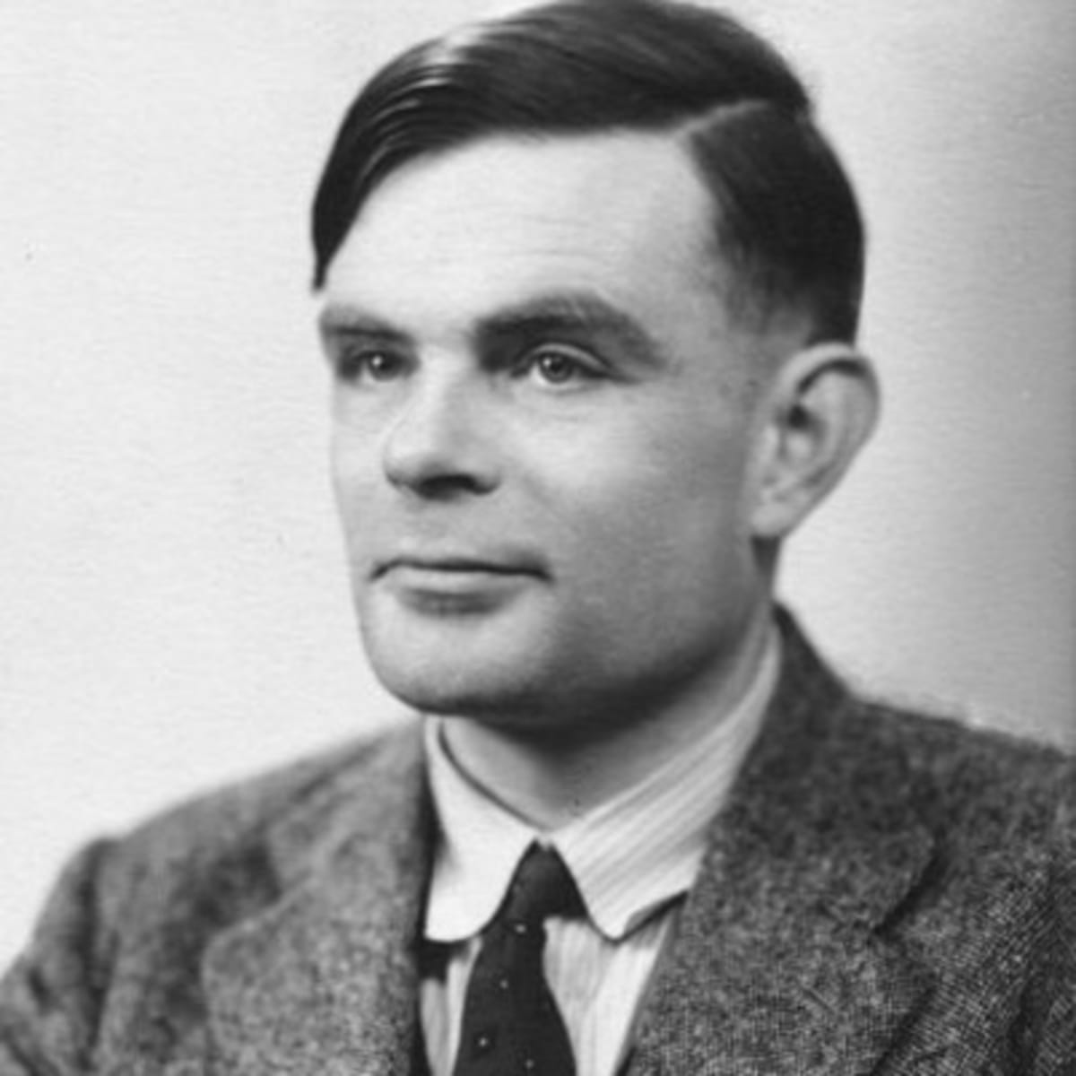
The Intellectual Origins
“Communication Theory of Secrecy Systems” (1945)
preceded
“A Mathematical Theory of Communication” (1948)
which founded Information Theory
Claude E. Shannon
Cryptanalysis of the Enigma Machine (~1938-39)
“On Computable Numbers, with an Application to the Entscheidungsproblem” (1936)
which gave birth to Computer Science
Alan M. Turing

Slide 6
Modern Cryptography:
Practice to Theory and Back
Definitions
Problems
Tools
Math and Theoretical CS
Security, Privacy, Integrity
CRYPTO
Solutions
Ideas
Encryption
Interactive Proofs
Digital Signatures
Probabilistically checkable Proofs
Pseudorandom Functions
Locally decodable Codes
…
…
Notes:
6

Slide 7
6.875/6.5620 Themes
1. The Omnipresent, Worst-case, Adversary.
Central idea. model the adversary: what they know, what they can do, and what their goals are.
Definitions will be our friend.
If you cannot define something, you cannot achieve it.
A key takeaway from 6.875:
Cryptographic (or, adversarial) thinking.

Slide 8
6.875/6.5620 Themes
2. Computational Hardness will be our enabler. (starting lecture 2)
Central theme: the cryptographic leash. Use computational hardness to “tame” the adversary.
A classical source of hard problems: number theory.
“Both Gauss and lesser mathematicians may be justified in rejoicing that there is one such science [number theory] at any rate, whose very remoteness from ordinary human activities should keep it gentle and clean”
[G. H. Hardy, “A Mathematician’s Apology”]
More recently: geometry, coding theory, combinatorics.
Cryptography is the science of useful hardness.

Slide 9
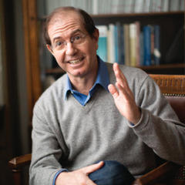
6.875 Themes
3. Security Proofs via Reductions.
“If there is an (efficient) adversary that breaks scheme A w.r.t. definition D, then there is an (efficient) adversary that factors large numbers.”
“Science wins either way”
Our reductions will be probabilistic and significantly more involved than the NP-hardness reductions in, say, 6.045.

Slide 10
6.875 Topics
Pseudorandomness
Secret-key Encryption and Authentication
Public-key Encryption and Digital Signatures
Cryptographic Hashing
Zero-knowledge Proofs
Secure Multiparty Computation
Private Information Retrieval
Homomorphic Encryption
Advanced topics: Threshold Cryptography, Program Obfuscation, Quantum Crypto, …

Slide 11
Administrivia
Course website, the central point of reference.
https://mit6875.github.io
Piazza for questions, Gradescope for psets.
Piazza: https://piazza.com/class/lm5kwnurlj2573/
Gradescope code: B2BRD2

Slide 12
Administrivia
Course website, the central point of reference.
https://mit6875.github.io
Piazza for questions, Gradescope for psets.
Homework (75%): 6 psets, we will count your best 5.
6.875 is on https://psetpartners.mit.edu

Slide 13
Administrivia
Course website, the central point of reference.
https://mit6875.github.io
Piazza for questions, Gradescope for psets.
Homework (75%): 6 psets, we will count your best 5.
Midterm (20%): Oct 25.

Slide 14
Administrivia
Course website, the central point of reference.
https://mit6875.github.io
Piazza for questions, Gradescope for psets.
Homework (75%): 6 psets, we will count your best 5.
Midterm (20%): Oct 25.
Class Participation (5%): Lecture, Piazza.

Slide 15
Administrivia
Course website, the central point of reference.
https://mit6875.github.io
Piazza for questions, Gradescope for psets.
Homework (75%): 6 psets, we will count your best 5.
Midterm (20%): Oct 25.
Class Participation (5%): Lecture, Piazza.
Prereqs: Algorithms, Probability & Discrete Math, but most of all, “mathematical maturity”.
(Optional) special recitations: 1. probability (this Friday), 2. basic complexity theory, 3. number theory.

Slide 16
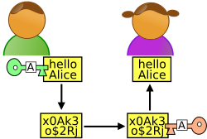
Secure Communication
m
Alice
Bob
Eavesdropper “Eve”
Alice wants to send a message m to Bob without revealing it to Eve.

Slide 17
Secure Communication
m
Key k
Key k
Eavesdropper “Eve”
SETUP: Alice and Bob meet beforehand to agree on a secret key k.

Slide 18
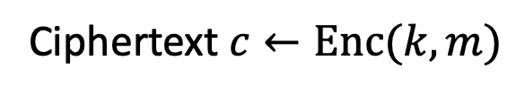


Key Notion: Secret-key Encryption
(or Symmetric-key Encryption)
$m$
Ciphertext $c←Enc(k,m)$
$$m←Dec(k,c)$$
Key k
Key k
Three (possibly probabilistic) polynomial-time algorithms:
Key Generation Algorithm Gen: $k←Gen(1^{n})$
Has to be probabilistic
Encryption Algorithm Enc: $c←Enc(k,m)$
Decryption Algorithm Dec: $m←Dec(k,c)$

Slide 19
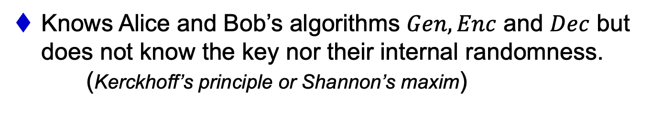
The Worst-case Adversary
An arbitrary computationally unbounded algorithm EVE.*
Knows Alice and Bob’s algorithms $Gen,Enc$ and $Dec$ but does not know the key nor their internal randomness. (Kerckhoff’s principle or Shannon’s maxim)
Can see the ciphertexts going through the channel (but cannot modify them… we will come to that later)
Security Definition: What is she trying to learn?
Notes:
as opposed to “security through obscurity”

Slide 20


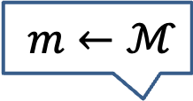




Shannon’s Perfect Secrecy Definition
Message space (probability distribution) $ℳ$
$m←ℳ$
$$c←Enc(k,m)$$
Ciphertext space $𝒞$
Key k $←𝒦$
Key k $←𝒦$
Key space $𝒦$
IDEA: A-posteriori = A-priori
$∀ℳ ∀m∈$ $Supp(ℳ)$, $∀c$ $∈$ $Supp(𝒞)$,
$$\operatorname{Pr}\left[ℳ=m|Enc\left(𝒦,ℳ\right)=c\right]=\operatorname{Pr}\left[ℳ=m\right]$$
A-posteriori
A-priori

Slide 21
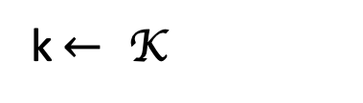
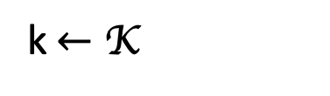



Perfect Indistinguishability Definition
Perfect indistinguishability: a Turing test
$∀ℳ ∀m, m′∈$ $Supp(ℳ)$,$c∈ Supp(𝒞):$
$$Pr⁡[E\left(\text{K},m\right)=c]=Pr⁡[E\left(\text{K},m′\right)=c]$$
World 0:
World 1:
k$←$ K
k$← \text{K}$
$$c=E\left(k,m\right)$$
$$c′=E\left(k,m′\right)$$
is a distinguisher (that gets c and tries to guess which world she’s in)

Slide 22
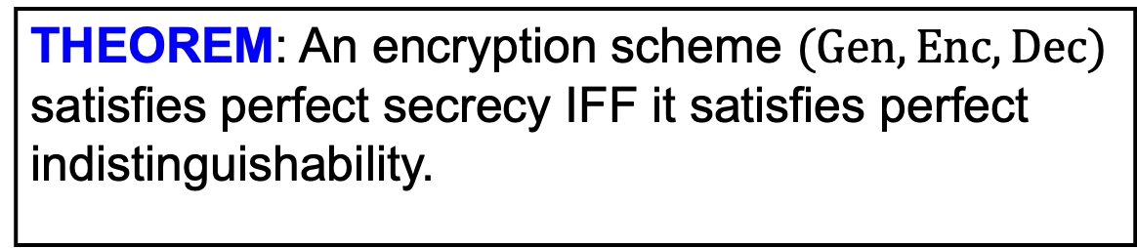
The Two Definitions are Equivalent
THEOREM: An encryption scheme $(Gen,Enc,Dec)$ satisfies perfect secrecy IFF it satisfies perfect indistinguishability.
PROOF: Simple use of conditional probabilities.

Slide 23
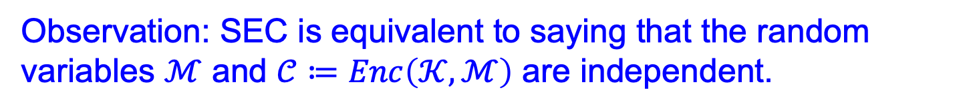
A simple observation
(SEC): $∀ℳ ∀m∈$ $Supp(ℳ)$, $∀c$ $∈$ $Supp(𝒞)$,
$$\operatorname{Pr}\left[ℳ=m|Enc\left(𝒦,ℳ\right)=c\right]=\operatorname{Pr}\left[ℳ=m\right]$$
Observation: SEC is equivalent to saying that the random variables $ℳ$ and $𝒞≔Enc\left(𝒦,ℳ\right)$ are independent.

Slide 24


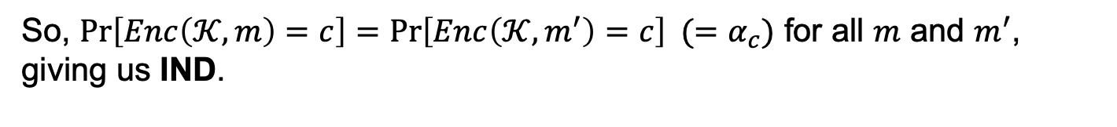
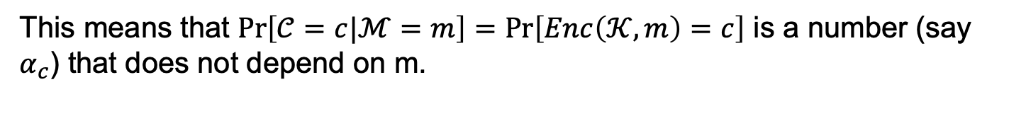
Proof Part 1. Indistinguishability $⟹$ Secrecy
WE KNOW (IND): $∀ℳ ∀m, m′∈$ $Supp(ℳ)$, $∀c$ $∈$ $Supp(𝒞)$,
$$=α$$
$$\operatorname{Pr}\left[Enc\left(𝒦,m\right)=c\right]=\operatorname{Pr}\left[Enc\left(𝒦,m^{′}\right)=c\right]$$
WE WANT (SEC): $∀ℳ ∀m∈$ $Supp(ℳ)$, $∀c$ $∈$ $Supp(𝒞)$,
$$\operatorname{Pr}\left[ℳ=m|𝒞=c\right]=\operatorname{Pr}\left[ℳ=m\right]$$
Proof: By the observation from last slide, SEC is true if and only if $\operatorname{Pr}\left[𝒞=c|ℳ=m\right]=\operatorname{Pr}\left[𝒞=c\right]$ (by independence of $ℳ$ and $𝒞$.)
This means that $\operatorname{Pr}\left[𝒞=c|ℳ=m\right]=Pr⁡\left[Enc\left(𝒦,m\right)=c\right]$ is a number (say $α_{c}$) that does not depend on m.
So, $\operatorname{Pr}\left[Enc\left(𝒦,m\right)=c\right]=\operatorname{Pr}\left[Enc\left(𝒦,m^{′}\right)=c\right] (=α_{c})$ for all $m$ and $m^{′}$, giving us IND.

Slide 25


Proof Part 2. Secrecy $⟹$ Indistinguishability
WE KNOW (SEC): $∀ℳ ∀m∈$ $Supp(ℳ)$, $∀c$ $∈$ $Supp(𝒞)$,
$$\operatorname{Pr}\left[ℳ=m|𝒞=c\right]=\operatorname{Pr}\left[ℳ=m\right]$$
WE WANT (IND): $∀ℳ ∀m, m′∈$ $Supp(ℳ)$, $∀c$ $∈$ $Supp(𝒞)$,
$$\operatorname{Pr}\left[Enc\left(𝒦,m\right)=c\right]=\operatorname{Pr}\left[Enc\left(𝒦,m^{′}\right)=c\right]$$
Proof: As before, SEC is true if and only if $\operatorname{Pr}\left[𝒞=c|ℳ=m\right]=\operatorname{Pr}\left[𝒞=c\right]$ for all $m$ and $c$.
$$\operatorname{Pr}\left[Enc\left(𝒦,m\right)=c\right]=\operatorname{Pr}\left[𝒞=c | ℳ=m\right]$$
$$=\operatorname{Pr}\left[𝒞=c | ℳ=m′\right]$$
$$=Pr\left[Enc\left(𝒦,m′\right)=c\right]$$

Slide 26

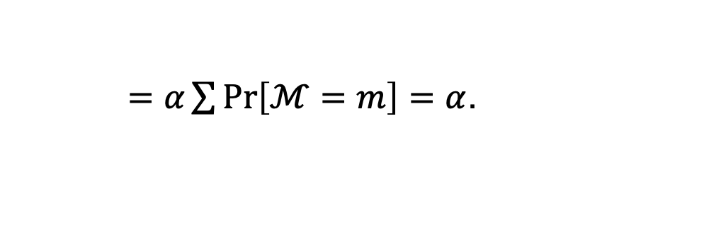
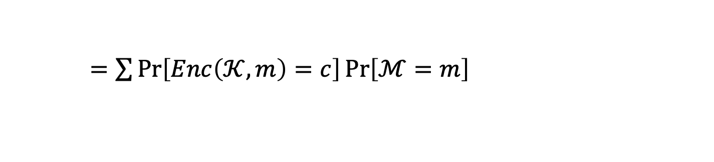
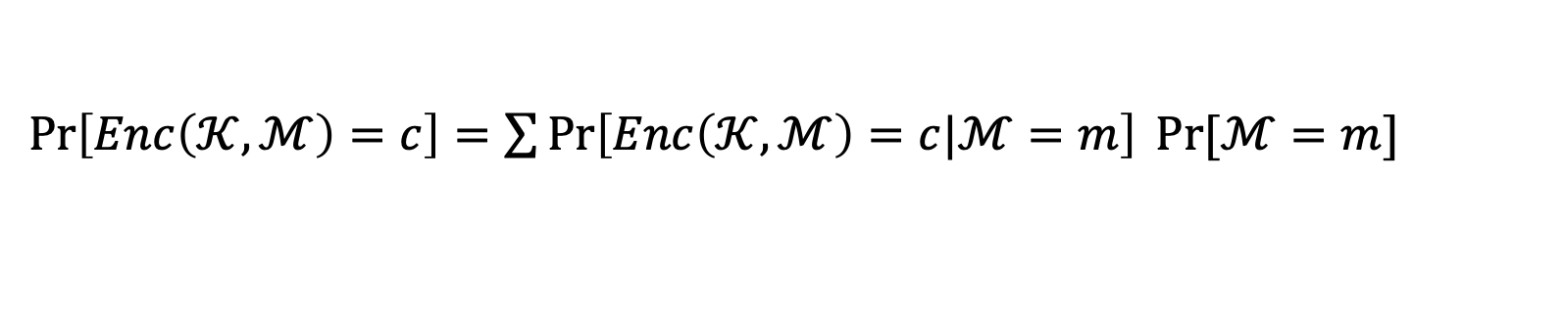
1. Indistinguishability $⟹$ Secrecy
WE KNOW (IND): $∀ℳ ∀m, m′∈$ $Supp(ℳ)$, $∀c$ $∈$ $Supp(𝒞)$,
$$=α$$
$$\operatorname{Pr}\left[Enc\left(𝒦,m\right)=c\right]=\operatorname{Pr}\left[Enc\left(𝒦,m^{′}\right)=c\right]$$
WE WANT (SEC): $∀ℳ ∀m∈$ $Supp(ℳ)$, $∀c$ $∈$ $Supp(𝒞)$,
$$\operatorname{Pr}\left[ℳ=m|Enc\left(𝒦,ℳ\right)=c\right]=\operatorname{Pr}\left[ℳ=m\right]$$
Key Observation: $∀m$ $\operatorname{Pr}\left[Enc\left(𝒦,ℳ\right)=c\right]=Pr⁡[Enc\left(𝒦,m\right)=c]$.
Proof: definition of conditional probability.
$\operatorname{Pr}\left[Enc\left(𝒦,ℳ\right)=c\right]=\sum{\operatorname{Pr}\left[Enc\left(𝒦,ℳ\right)=c|ℳ=m\right] Pr⁡[ℳ=m]}$
$=\sum{\operatorname{Pr}\left[Enc\left(𝒦,m\right)=c\right]\operatorname{Pr}\left[ℳ=m\right]}$
$=α\sum{Pr⁡\left[ℳ=m\right]}=α$.
Notes:
Alternate proof

Slide 27
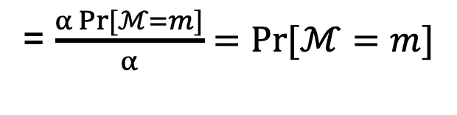
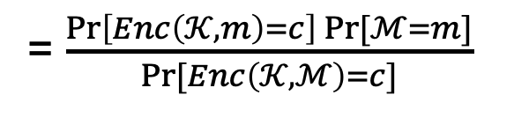
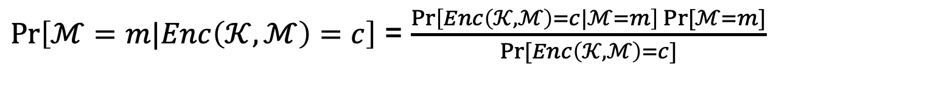
1. Indistinguishability $⟹$ Secrecy
WE KNOW (IND): $∀ℳ ∀m, m′∈$ $Supp(ℳ)$, $∀c$ $∈$ $Supp(𝒞)$,
$$=α$$
$$\operatorname{Pr}\left[Enc\left(𝒦,m\right)=c\right]=\operatorname{Pr}\left[Enc\left(𝒦,m^{′}\right)=c\right]$$
WE WANT (SEC): $∀ℳ ∀m∈$ $Supp(ℳ)$, $∀c$ $∈$ $Supp(𝒞)$,
$$\operatorname{Pr}\left[ℳ=m|Enc\left(𝒦,ℳ\right)=c\right]=\operatorname{Pr}\left[ℳ=m\right]$$
Proof:
$\operatorname{Pr}\left[ℳ=m|Enc\left(𝒦,ℳ\right)=c\right]$ = $\frac{\operatorname{Pr}\left[Enc\left(𝒦,ℳ\right)=c|ℳ=m\right] Pr⁡[ℳ=m]}{Pr⁡[Enc\left(𝒦,ℳ\right)=c]}$
(Bayes)
= $\frac{\operatorname{Pr}\left[Enc\left(𝒦,m\right)=c\right] Pr⁡[ℳ=m]}{Pr⁡[Enc\left(𝒦,ℳ\right)=c]}$
= $\frac{α{Pr⁡[ℳ=m]}}{α}=Pr⁡[ℳ=m]$
(key obs.)

Slide 28


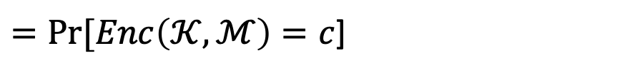
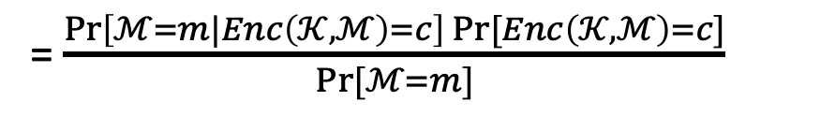
2. Secrecy $⟹$ Indistinguishability
WE KNOW (SEC): $∀ℳ ∀m∈$ $Supp(ℳ)$, $∀c$ $∈$ $Supp(𝒞)$,
$$\operatorname{Pr}\left[ℳ=m|Enc\left(𝒦,ℳ\right)=c\right]=\operatorname{Pr}\left[ℳ=m\right]$$
WE WANT (IND): $∀ℳ ∀m, m′∈$ $Supp(ℳ)$, $∀c$ $∈$ $Supp(𝒞)$,
$$\operatorname{Pr}\left[Enc\left(𝒦,m\right)=c\right]=\operatorname{Pr}\left[Enc\left(𝒦,m^{′}\right)=c\right]$$
Proof:
$$\operatorname{Pr}\left[Enc\left(𝒦,m\right)=c\right]=Pr⁡[Enc\left(𝒦,ℳ\right)=c|ℳ=m]$$
= $\frac{\operatorname{Pr}\left[ℳ=m|Enc\left(𝒦,ℳ\right)=c\right] Pr⁡[Enc\left(𝒦,ℳ\right)=c]}{Pr⁡[ℳ=m]}$
(Bayes)
$=Pr⁡[Enc\left(𝒦,ℳ\right)=c$]
(because of SEC)
$$=Pr\left[Enc\left(𝒦,m′\right)=c\right]$$
(symmetry)

Slide 29
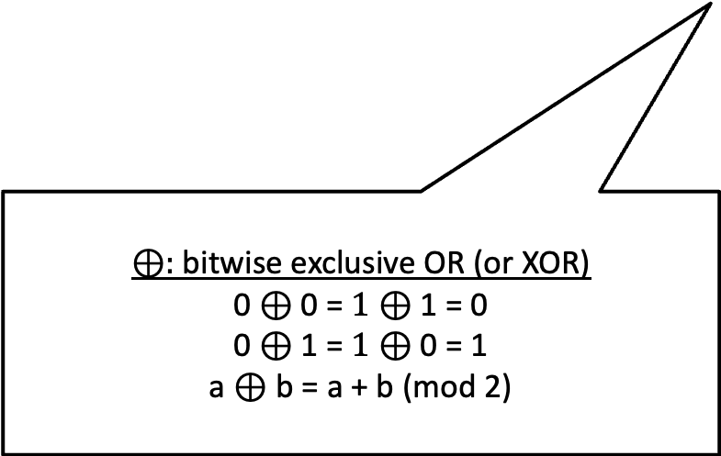
Perfect Secrecy is Achievable
The One-time Pad Construction:
$Gen:$ Choose an $n$-bit string k at random, i.e. $k←\{0,1\}^{n}$
$Enc\left(k,m\right)$, where M is an n-bit message: Output $c=m⨁k$
$Dec(k,c):$ Output $m=c⨁k$
$⊕:$ bitwise exclusive OR (or XOR)
0 $⊕$ 0 = $1⊕$ 1 = 0
0 $⊕$ 1 = $1⊕$ 0 = 1
a $⊕$ b = a + b (mod 2)

Slide 30
Perfect Secrecy is Achievable
The One-time Pad Construction:
$Gen:$ Choose an $n$-bit string k at random, i.e. $k←\{0,1\}^{n}$
$Enc\left(k,m\right)$, where M is an n-bit message: Output $c=m⨁k$
$Dec(k,c):$ Output $m=c⨁k$
Correctness: $c⨁k=\left(m⨁k\right)⨁k=m.$

Slide 31
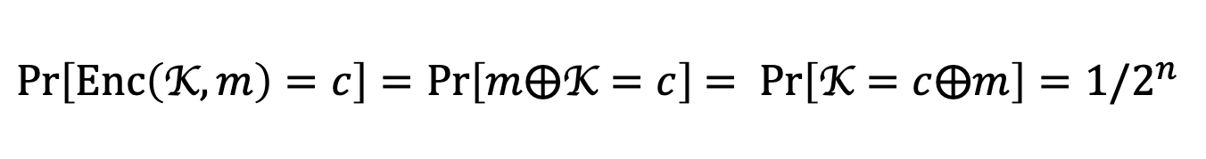
Perfect Secrecy is Achievable
The One-time Pad Construction:
$Gen:$ Choose an $n$-bit string k at random, i.e. $k←\{0,1\}^{n}$
$Enc\left(k,m\right)$, where M is an n-bit message: Output $c=m⨁k$
$Dec(k,c):$ Output $m=c⨁k$
Claim: One-time Pad achieves Perfect Indistinguishability (and therefore perfect secrecy).
Proof: For any $m,c∈\{0,1\}^{n},$
$Pr\left[Enc\left(\text{K},m\right)=c\right]=Pr\left[m⨁\text{K}=c\right]$ $= Pr\left[\text{K}=c⨁m\right]=1/2^{n}$

Slide 32
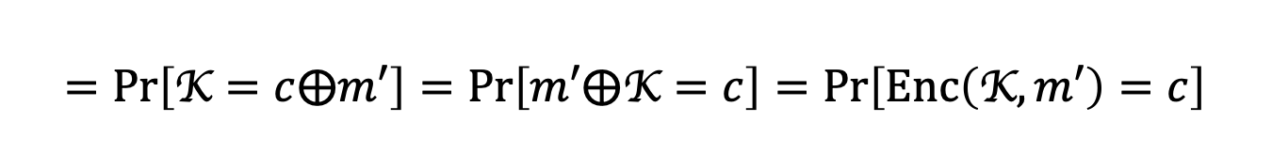
Perfect Secrecy is Achievable
The One-time Pad Construction:
$Gen:$ Choose an $n$-bit string k at random, i.e. $k←\{0,1\}^{n}$
$Enc\left(k,m\right)$, where M is an n-bit message: Output $c=m⨁k$
$Dec(k,c):$ Output $m=c⨁k$
Claim: One-time Pad achieves Perfect Indistinguishability (and therefore perfect secrecy).
Proof: For any$m,m^{′},c∈\{0,1\}^{n},$
$Pr\left[Enc\left(\text{K},m\right)=c\right]=Pr\left[m⨁\text{K}=c\right]$ $= Pr\left[\text{K}=c⨁m\right]=1/2^{n}$
$$=Pr\left[\text{K}=c⨁m′\right]=Pr\left[m′⨁\text{K}=c\right]=Pr\left[Enc\left(\text{K},m′\right)=c\right]$$

Slide 33
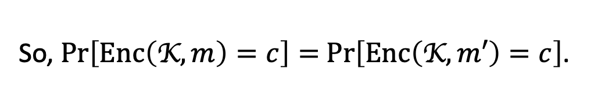
Perfect Secrecy is Achievable
The One-time Pad Construction:
$Gen:$ Choose an $n$-bit string k at random, i.e. $k←\{0,1\}^{n}$
$Enc\left(k,m\right)$, where M is an n-bit message: Output $c=m⨁k$
$Dec(k,c):$ Output $m=c⨁k$
Claim: One-time Pad achieves Perfect Indistinguishability (and therefore perfect secrecy).
Proof: For any m$,m^{′},c∈\{0,1\}^{n},$
So, $Pr\left[Enc\left(\text{K},m\right)=c\right]=$ $Pr\left[Enc\left(\text{K},m′\right)=c\right]$.
QED.

Slide 34

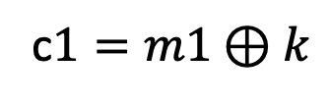
Reusing a One-time Pad?
m0
$$c0=m0⊕k$$
Key k
Key k
A week later:
m1
c$1=m1⊕k$
Is this still perfectly secret?
Super-secure Whisper room

Slide 35
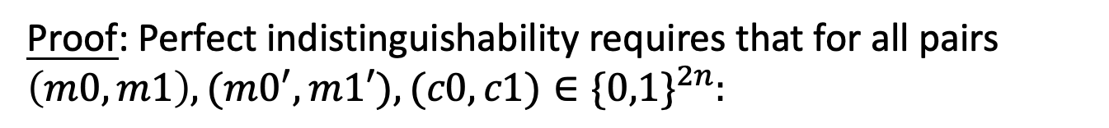
Reusing a One-time Pad?
Claim: Two-time Pad does not achieve Perfect Indistinguishability (and therefore not perfect secrecy).
Proof: Perfect indistinguishability requires that for all pairs $\left(m0,m1\right),{(m0}^{′},m1′),(c0,c1)∈\{0,1\}^{2n}:$
$$Pr[Enc\left(\text{k},m0)=c0 and Enc(\text{k},m1\right)=c1]$$
$$=Pr[Enc\left(k,m0′)=c0 and Enc(k,m1′\right)=c1]$$

Slide 36
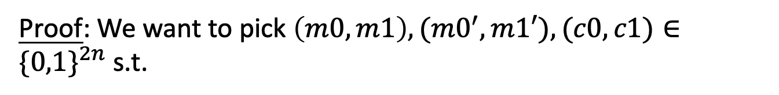
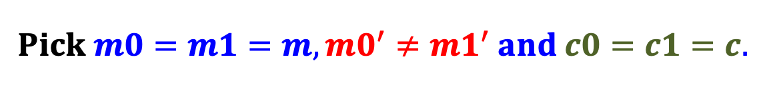
Reusing a One-time Pad?
Claim: Two-time Pad does not achieve Perfect Indistinguishability (and therefore not perfect secrecy).
Proof: We want to pick $\left(m0,m1\right),{(m0}^{′},m1′),(c0,c1)∈\{0,1\}^{2n}$ s.t.
$$Pr[Enc\left(k,m0)=c0 and Enc(k,m1\right)=c1]$$
$$≠Pr[Enc\left(k,m0′)=c0 and Enc(k,m1′\right)=c1]$$
$$Pick m0=m1=m,{m0}^{′}≠m1^{′} and c0=c1=c.$$
$$Pr[Enc\left(k,m0)=c0 and Enc(k,m1\right)=c1]$$
$$=Pr\left[Enc\left(k,m\right)=c\right]=1/2^{n}$$

Slide 37
Reusing a One-time Pad?
Claim: Two-time Pad does not achieve Perfect Indistinguishability (and therefore not perfect secrecy).
Proof: We want to pick $\left(m0,m1\right),{(m0}^{′},m1′),(c0,c1)∈\{0,1\}^{2n}$ s.t.
$$Pr[Enc\left(k,m0)=c0 and Enc(k,m1\right)=c1]$$
$$≠Pr[Enc\left(k,m0′)=c0 and Enc(k,m1′\right)=c1]$$
$$Pick m0=m1=m,{m0}^{′}≠m1^{′} and c0=c1=c.$$
$$Pr[Enc\left(k,m0)=c= Enc(k,m1\right)]=1/2^{n}$$
$$Pr[Enc\left(k,m0′)=c=Enc(k,m1′\right)]=0$$

Slide 38



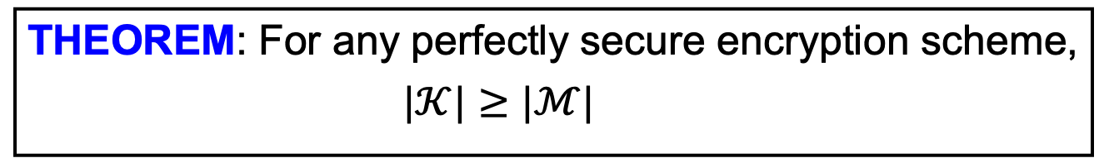

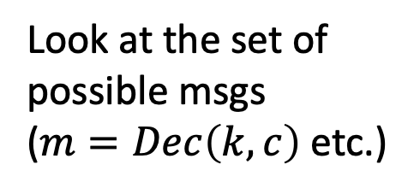



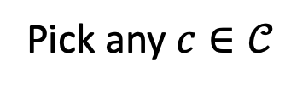





Perfect Secrecy has its Price
THEOREM: For any perfectly secure encryption scheme,
$|𝒦|≥|ℳ|$
PROOF (by picture): Assume for contradiction that $\left|𝒦\right|<\left|ℳ\right|.$
$$ℳ$$
$$𝒞$$
$$k$$
Pick any $c∈𝒞$
$$m$$
$$c$$
$$k′$$
Look at the set of possible msgs
($m=Dec\left(k,c\right)$ etc.)
$$m′$$
$$k′′$$
$$m′′$$
$$k′′′$$
$$≤\left|𝓚\right|<|𝓜|$$
$$\tilde{m}$$
Distinct keys!

Slide 39




Perfect Secrecy has its Price
THEOREM: For any perfectly secure encryption scheme,
$|𝒦|≥|ℳ|$
PROOF (by picture): Assume for contradiction that $\left|𝒦\right|<\left|ℳ\right|.$
$$ℳ$$
$$𝒞$$
$$k$$
$$m$$
$$c$$
$$k′$$
$$\operatorname{Pr}\left[Enc\left(𝒦,m\right)=c\right]>0$$
$$m′$$
$$k′′$$
$$\operatorname{Pr}\left[Enc\left(𝒦,\tilde{m}\right)=c\right]=0$$
$$m′′$$
$$QED.$$
$$≤\left|𝓚\right|<|𝓜|$$
$$\tilde{m}$$

Slide 40

So, what are we to do?
RELAX the definition:
EVE is an arbitrary computationally bounded algorithm.
+ number theory/geometry/combinatorics
the promised crypto land
Fully homomorphic encryption
ZK proofs
Public-key encryption
Pseudorandomness

Slide 41
To Summarize…
Secure Communication: a quintessential problem in cryptography.
We saw two equivalent definitions of security:
Shannon’s perfect indistinguishability and perfect secrecy
One-time pad achieves perfect secrecy.
A Serious Limitation: Any perfectly secure encryption scheme needs keys that are at least as long as the messages.
Next Lecture: Overcoming the limitation with Computationally Bounded Adversaries.

