Slide 1
MIT 6.875
Foundations of Cryptography
Lecture 12

Slide 2
RECAP from L11

Slide 3
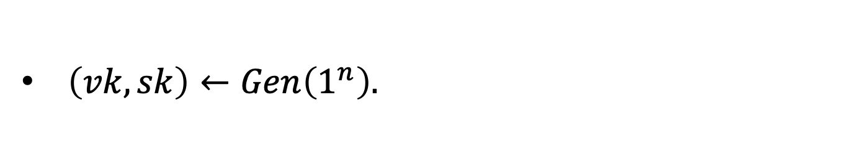
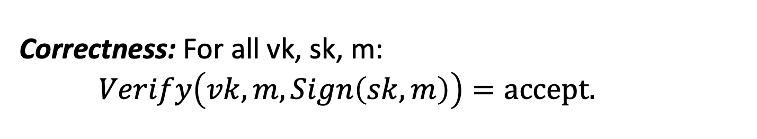
Digital Signatures: Definition
A triple of PPT algorithms $(Gen,Sign,Verify)$ s.t.
$\left(vk,sk\right)←Gen\left(1^{n}\right).$
$σ←Sign\left(sk,m\right).$
$Acc(1)/Rej(0)←Verify\left(vk,m,σ\right).$
Correctness: For all vk, sk, m: $Verify\left(vk,m,Sign\left(sk,m\right)\right)=accept.$

Slide 4





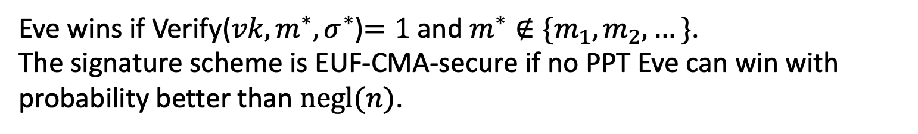



EUF-CMA Security
(Existentially Unforgeable against a Chosen Message Attack)
Challenger
Eve
$$\left(vk,sk\right)←Gen\left(1^{n}\right)$$
$$vk$$
$$m_{i}$$
poly many times
$$σ_{i}$$
$$σ_{i}←Sign(sk,m_{i})$$
$$m^{∗},σ^{∗}$$
Eve wins if Verify(${vk,m}^{∗},σ^{∗}$)$=1$ and $m^{∗}∉\{m_{1},m_{2},…\}$. The signature scheme is EUF-CMA-secure if no PPT Eve can win with probability better than $negl(n)$.
Notes:
Encryption has to be probabilistic.

Slide 5



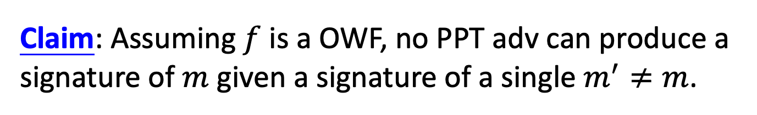
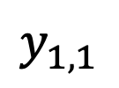
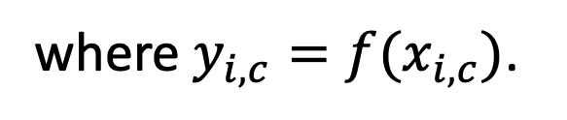


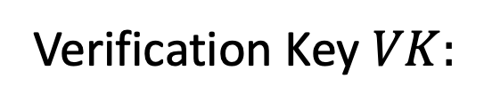
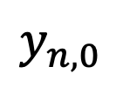
Lamport (One-time) Signatures
How to sign n bits
$$y_{1,0}$$
$$y_{2,0}$$
$$y_{n,0}$$
Verification Key $VK:$
$$y_{1,1}$$
$$y_{2,1}$$
$$y_{n,1}$$
where ${y_{i,c}=f(x}_{i,c})$.
Signing an n-bit message $(m_{1},…,m_{n}):$ The signature is $\left(x_{1,m_{1}},…,x_{n,m_{n}}\right).$
Claim: Assuming $f$ is a OWF, no PPT adv can produce a signature of $m$ given a signature of a single $m^{′}≠m$.
Claim: Can forge signature on any message given the signatures on (some) two messages.
Notes:
Proofs on the board!

Slide 6
TODAY: Digital Signatures, Continued

Slide 7
Constructing a Signature Scheme
Step 0. Still one-time, but arbitrarily long messages.
Step 1. Many-time: Stateful, Growing Signatures.
Step 2. How to Shrink the signatures.
Step 3. How to Shrink Alice’s storage.
Step 4. How to make Alice stateless.
Step 5 (optional). How to make Alice stateless and deterministic.

Slide 8
Step 0: How to Sign Polynomially Many Bits
(with a fixed verification key)

Slide 9
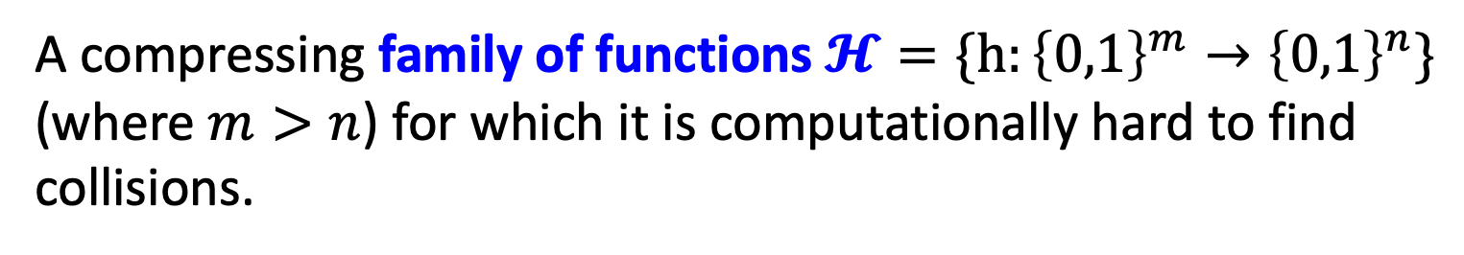
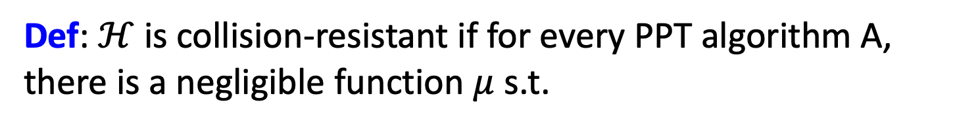
Detour: Collision-Resistant Hash Functions
A compressing family of functions $𝓗=\{h:{\left\{0,1\right\}}^{m}→{\left\{0,1\right\}}^{n}\}$ (where $m>n$) for which it is computationally hard to find collisions.
Def: $ℋ$ is collision-resistant if for every PPT algorithm A, there is a negligible function $μ$ s.t.
$${Pr}_{h←ℋ}\left[A\left(1^{n},h\right)=\left(x,y\right):x≠y, h\left(x\right)=h\left(y\right)\right]=μ(n)$$

Slide 10
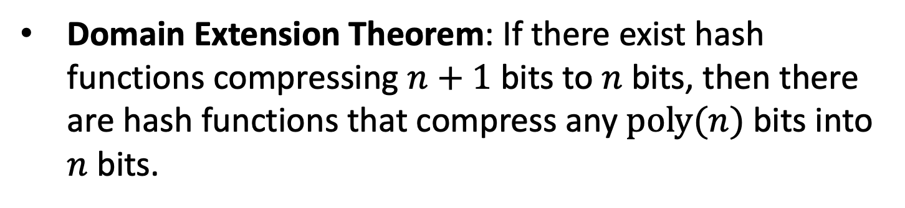
Do CRHFs exist?
Theoretical Constructions: assuming discrete logarithms (as well as under several other number-theoretic assumptions)
Practical Constructions: SHA3.
Domain Extension Theorem: If there exist hash functions compressing $n+1$ bits to $n$bits, then there are hash functions that compress any $poly(n)$bits into $n$bits.

Slide 11

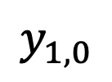
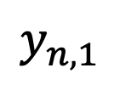
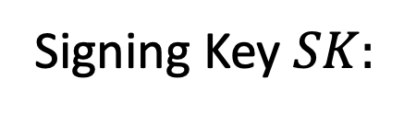




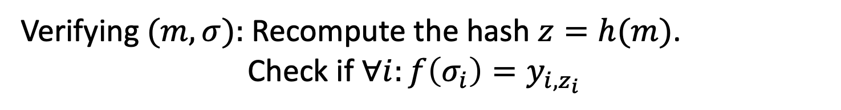

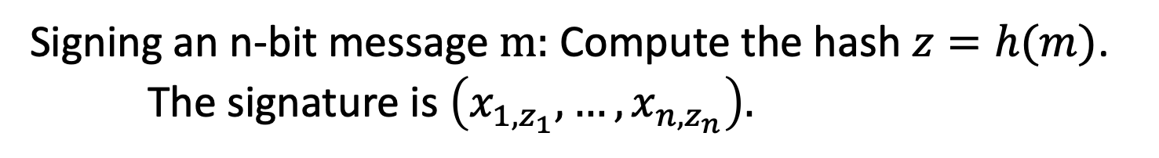



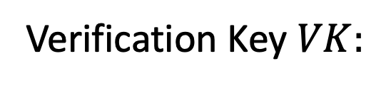


How to Sign Polynomially Many Bits
(with a fixed verification key)
Idea: Hash the message into n bits and sign the hash.
$$x_{1,0}$$
$$x_{2,0}$$
$$x_{n,0}$$
Signing Key $SK:$
$$x_{1,1}$$
$$x_{2,1}$$
$$x_{n,1}$$
$$y_{1,0}$$
$$y_{2,0}$$
$$y_{n,0}$$
Verification Key $VK:$
and $h←𝓗$.
$$y_{1,1}$$
$$y_{2,1}$$
$$y_{n,1}$$
Signing an n-bit message $m:$ Compute the hash $z=h(m)$. The signature is $\left(x_{1,z_{1}},…,x_{n,z_{n}}\right).$
Verifying $(m,σ):$ Recompute the hash $z=h(m)$.
Check if $∀i:f\left(σ_{i}\right)=y_{i,z_{i}}$

Slide 12
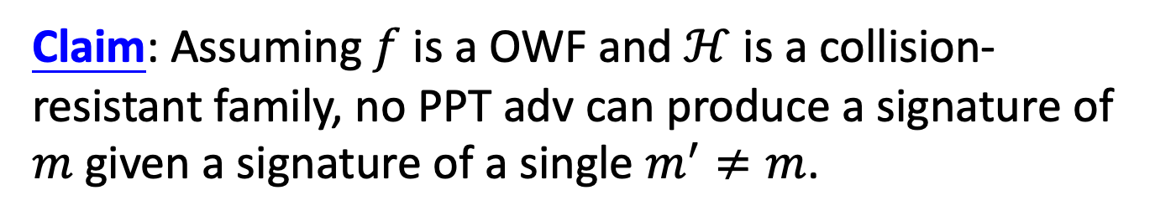
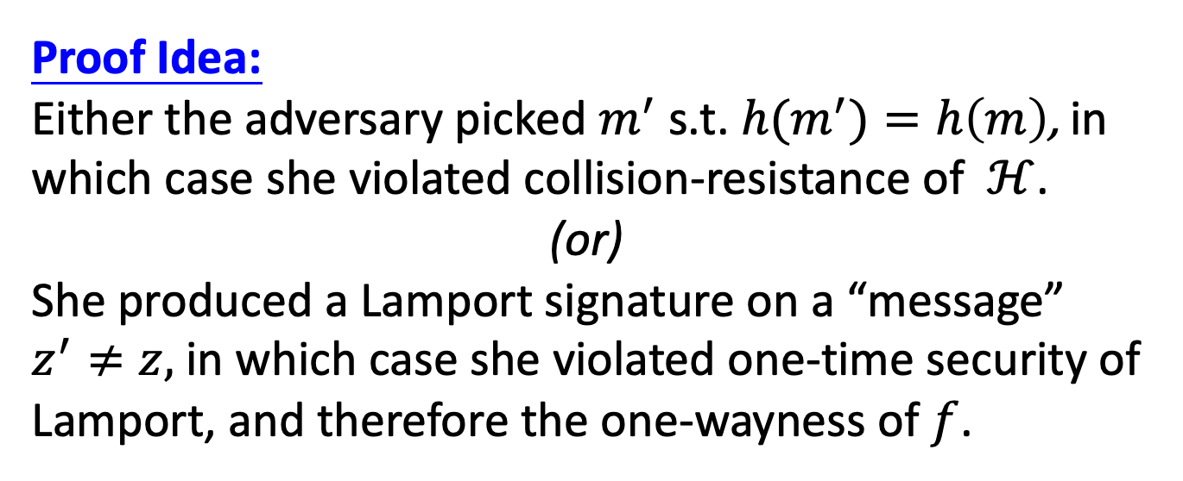
How to Sign Polynomially Many Bits
(with a fixed verification key)
Claim: Assuming $f$ is a OWF and $ℋ$ is a collision-resistant family, no PPT adv can produce a signature of $m$ given a signature of a single $m^{′}≠m$.
Proof Idea:
Either the adversary picked $m^{′}$ s.t. ${h(m}^{′})=h\left(m\right)$, in which case she violated collision-resistance of $ℋ$.
(or)
She produced a Lamport signature on a “message” $z^{′}≠z,$ in which case she violated one-time security of Lamport, and therefore the one-wayness of $f$.

Slide 13
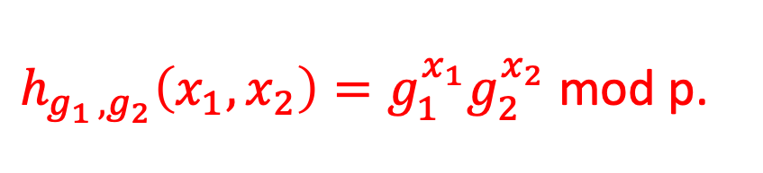
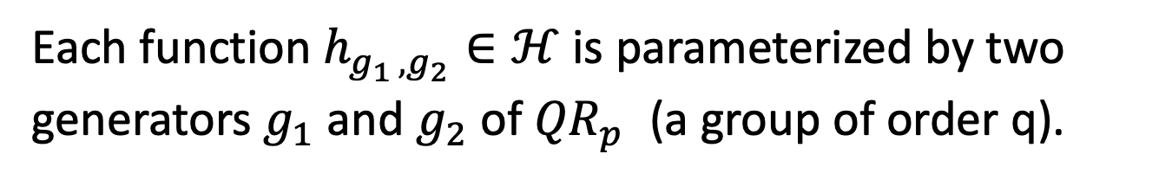
Let’s go back to CRHFs…
$p=2q+1$ is a “safe” prime.
$$ℋ=\{h:{(ℤ_{q})}^{2}→{QR}_{p}^{}\}$$
Each function $h_{g_{1 },g_{2}}∈ℋ$ is parameterized by two generators $g_{1}$ and $g_{2}$ of ${QR}_{p}^{}$ (a group of order q).
$h_{g_{1 },g_{2}}\left(x_{1},x_{2}\right)=g_{1}^{x_{1}}g_{2}^{x_{2}}$ mod p.
This compresses 2 log q bits into log p $≈$ log q + 1 bits.

Slide 14
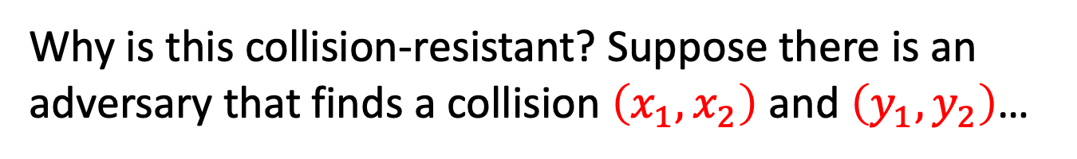
Let’s go back to CRHFs…
$p=2q+1$ is a “safe” prime.
$$ℋ=\{h:{(ℤ_{q})}^{2}→{QR}_{p}^{}\}$$
Each function $h_{g_{1 },g_{2}}∈ℋ$ is parameterized by two generators $g_{1}$ and $g_{2}$ of ${QR}_{p}^{}$ (a group of order q).
$h_{g_{1 },g_{2}}\left(x_{1},x_{2}\right)=g_{1}^{x_{1}}g_{2}^{x_{2}}$ mod p.
Why is this collision-resistant? Suppose there is an adversary that finds a collision $\left(x_{1},x_{2}\right)$ and $\left(y_{1},y_{2}\right)$…

Slide 15
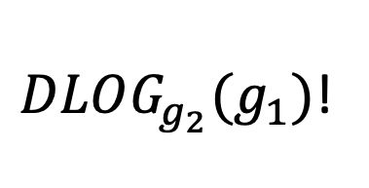
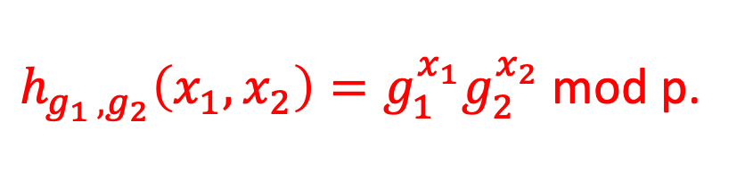
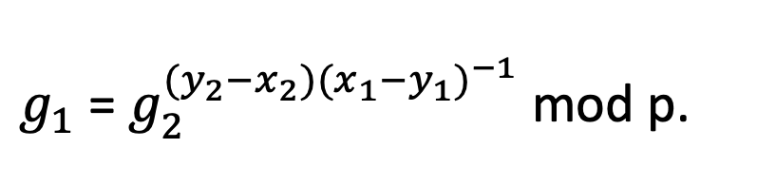
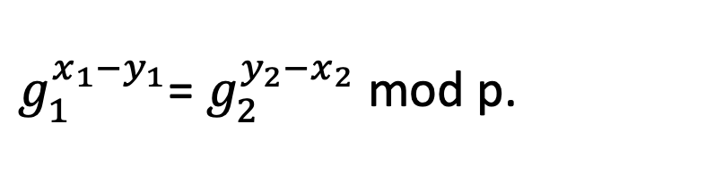
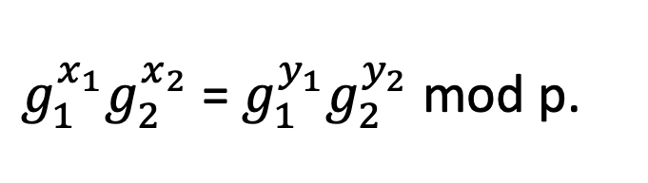
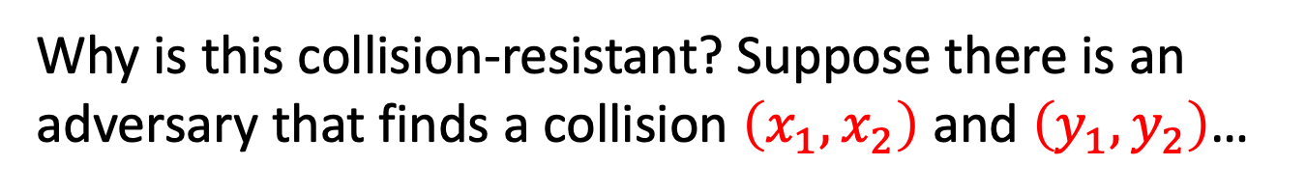
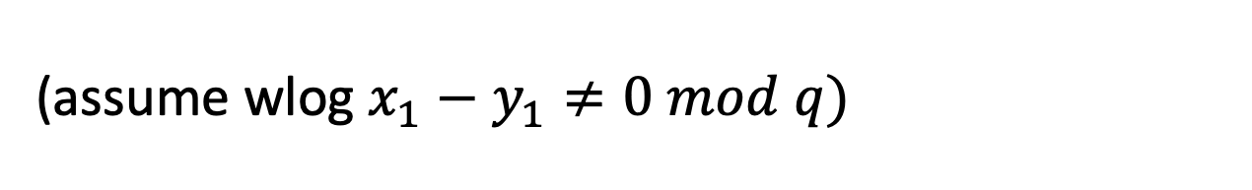
Let’s go back to CRHFs…
$h_{g_{1 },g_{2}}\left(x_{1},x_{2}\right)=g_{1}^{x_{1}}g_{2}^{x_{2}}$ mod p.
Why is this collision-resistant? Suppose there is an adversary that finds a collision $\left(x_{1},x_{2}\right)$ and $\left(y_{1},y_{2}\right)$…
$g_{1}^{x_{1}}g_{2}^{x_{2}}$ = $g_{1}^{y_{1}}g_{2}^{y_{2}}$ mod p.
$g_{1}^{x_{1}−y_{1}}$= $g_{2}^{y_{2}−x_{2}}$ mod p.
(assume wlog $x_{1}−y_{1}≠0 mod q)$
$g_{1}$= $g_{2}^{{(y}_{2}−x_{2}){(x_{1}−y_{1})}^{−1}}$ mod p.
$DLOG_{g_{2}}(g_{1})$!

Slide 16
Other Constructions of CRHFs
From the hardness of factoring, lattice problems etc.
Not known to follow from the existence of one-way functions or even one-way permutations…
“Black-box separations”: Certain ways of constructing CRHF from OWF/OWP cannot work.
“Finding collisions on a one-way street”, Daniel Simon, Eurocrypt 1998.
Nevertheless, big open problem: OWF/OWP $⟹^{?}$ CRHF?

Slide 17
So far, only one-time security…

Slide 18
Constructing a Signature Scheme
Theorem [Naor-Yung’89, Rompel’90] (EUF-CMA-secure) Signature schemes exist assuming that one-way functions exist.
TODAY: (EUF-CMA-secure) Signature schemes exist assuming that collision-resistant hash functions exist.

Slide 19
(Many-time) Signature Scheme
In four+ steps
Step 1. Stateful, Growing Signatures. Idea: Signature Chains
Step 2. How to Shrink the signatures. Idea: Signature Trees
Step 3. How to Shrink Alice’s storage. Idea: Pseudorandom Trees
Step 4. How to make Alice stateless. Idea: Randomization
Step 5 (optional). How to make Alice stateless and deterministic. Idea: PRFs.

Slide 20
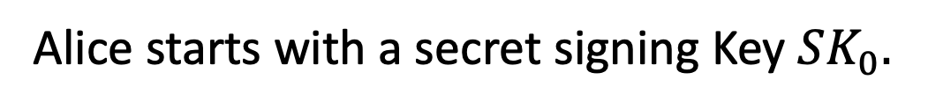

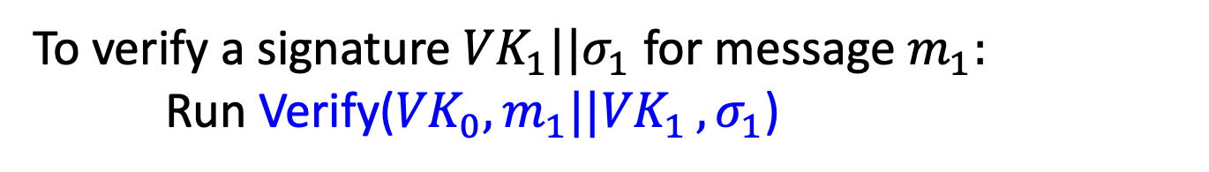
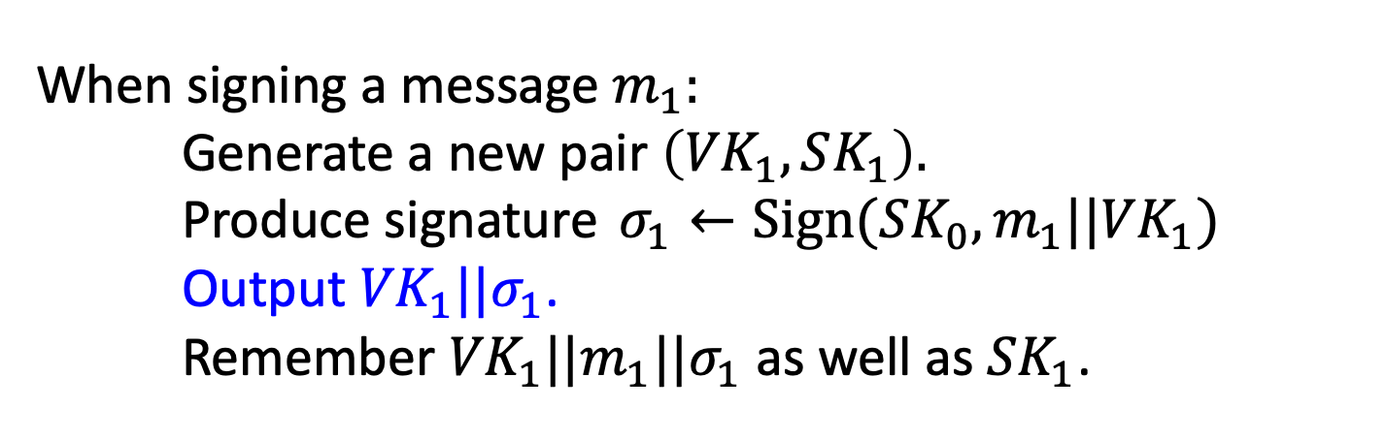
Step 1: Stateful Many-time Signatures
Idea: Signature Chains.
Alice
$$VK_{0}$$
Alice starts with a secret signing Key $SK_{0}.$
When signing a message $m_{1}:$ Generate a new pair $\left({VK}_{1},SK_{1}\right).$
Produce signature $σ_{1}←Sign({SK_{0},m_{1}||VK}_{1})$
Output ${VK}_{1}||σ_{1}$. Remember ${VK}_{1}||{m_{1}||σ}_{1}$ as well as ${SK}_{1}$.
To verify a signature ${VK}_{1}||σ_{1}$ for message $m_{1}:$
Run Verify(${VK}_{0}{,m_{1}||VK}_{1},σ_{1}$)

Slide 21




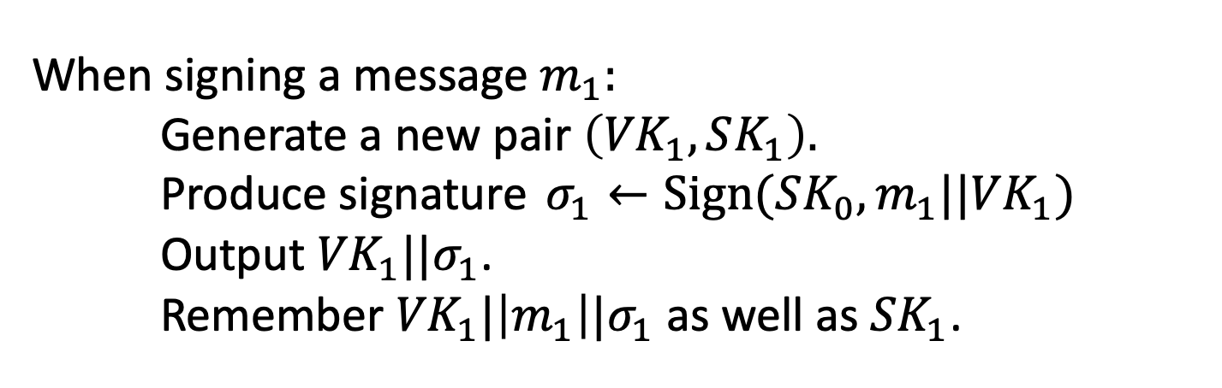
Step 1: Stateful Many-time Signatures
Idea: Signature Chains.
Alice
$$VK_{0}$$
Alice starts with a secret signing Key $SK_{0}.$
When signing a message $m_{1}:$ Generate a new pair $\left({VK}_{1},SK_{1}\right).$
Produce signature $σ_{1}←Sign({SK_{0},m_{1}||VK}_{1})$
Output ${VK}_{1}||σ_{1}$. Remember ${VK}_{1}|\left|m_{1}\right||σ_{1}$ as well as ${SK}_{1}$.
$$m_{1}$$
$$σ_{1}$$
$${VK}_{0}$$
$${VK}_{1}$$

Slide 22
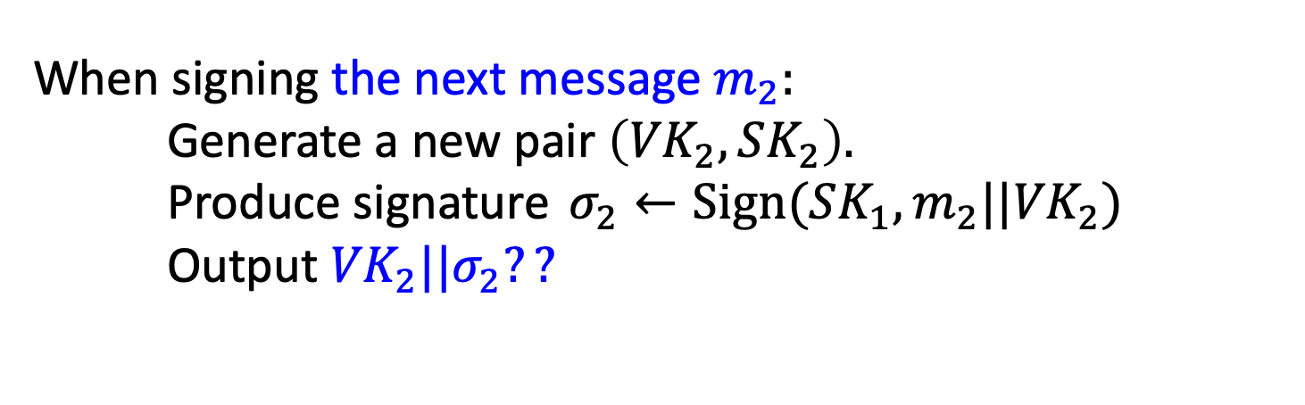
Step 1: Stateful Many-time Signatures
Idea: Signature Chains.
Alice
$$VK_{0}$$
Alice starts with a secret signing Key $SK_{0}.$
When signing the next message $m_{2}:$ Generate a new pair $\left({VK}_{2},SK_{2}\right).$
Produce signature $σ_{2}←Sign({SK_{1},m_{2}||VK}_{2})$
Output ${VK}_{2}||σ_{2}??$
$$m_{1}$$
$$σ_{1}$$
$${VK}_{0}$$
$${VK}_{1}$$

Slide 23
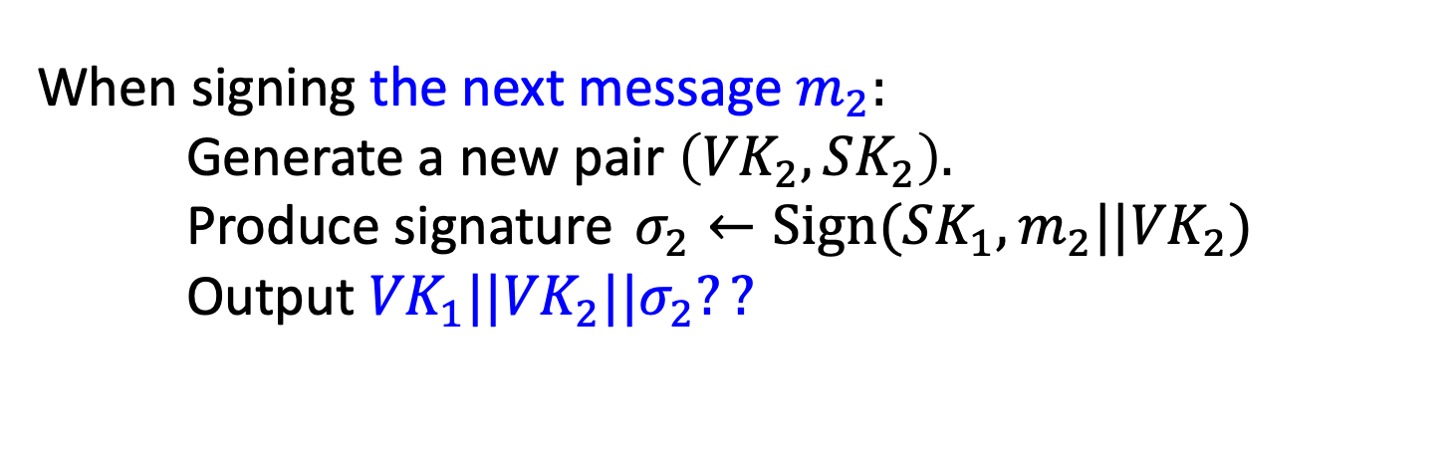
Step 1: Stateful Many-time Signatures
Idea: Signature Chains.
Alice
$$VK_{0}$$
Alice starts with a secret signing Key $SK_{0}.$
When signing the next message $m_{2}:$ Generate a new pair $\left({VK}_{2},SK_{2}\right).$
Produce signature $σ_{2}←Sign({SK_{1},m_{2}||VK}_{2})$
Output ${{VK}_{1}||VK}_{2}||σ_{2}??$
$$m_{1}$$
$$σ_{1}$$
$${VK}_{0}$$
$${VK}_{1}$$

Slide 24








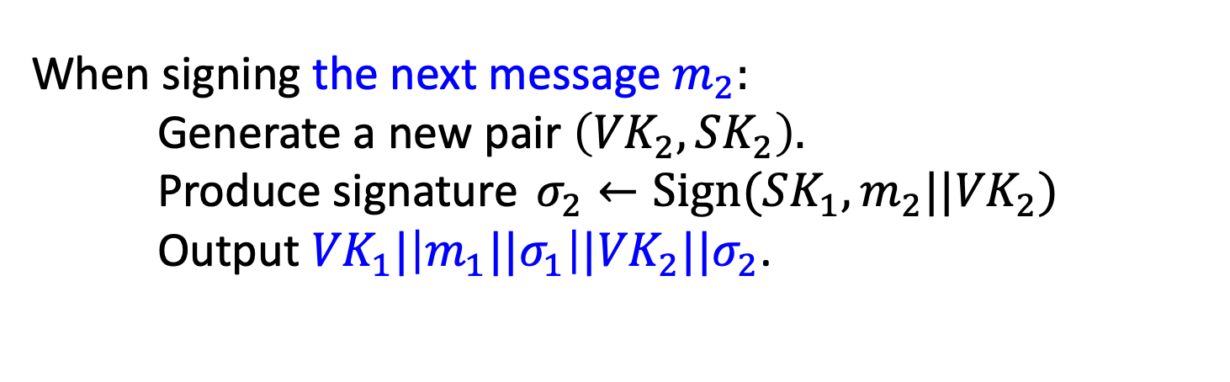


Step 1: Stateful Many-time Signatures
Idea: Signature Chains.
Alice
$$VK_{0}$$
Alice starts with a secret signing Key $SK_{0}.$
When signing the next message $m_{2}:$ Generate a new pair $\left({VK}_{2},SK_{2}\right).$
Produce signature $σ_{2}←Sign({SK_{1},m_{2}||VK}_{2})$
Output ${{VK}_{1}|\left|{m_{1}||σ}_{1}\right||VK}_{2}||σ_{2}$.
$$m_{1}$$
$$m_{2}$$
$$m_{3}$$
$$m_{4}$$
$$σ_{1}$$
$$σ_{2}$$
$$σ_{3}$$
$$σ_{4}$$
$$…$$
$${VK}_{0}$$
$${VK}_{1}$$
$${VK}_{2}$$
$${VK}_{3}$$
$${VK}_{4}$$

Slide 25
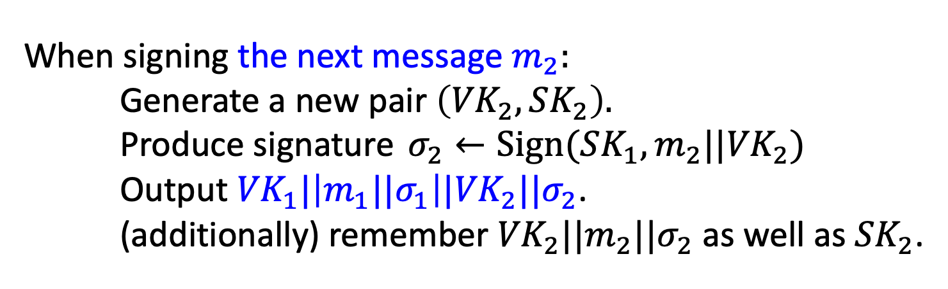
Step 1: Stateful Many-time Signatures
Idea: Signature Chains.
Alice
$$VK_{0}$$
Alice starts with a secret signing Key $SK_{0}.$
When signing the next message $m_{2}:$ Generate a new pair $\left({VK}_{2},SK_{2}\right).$
Produce signature $σ_{2}←Sign({SK_{1},m_{2}||VK}_{2})$
Output ${{VK}_{1}|\left|{m_{1}||σ}_{1}\right||VK}_{2}||σ_{2}$. (additionally) remember ${VK}_{2}||{m_{2}||σ}_{2}$ as well as ${SK}_{2}$.
$$m_{1}$$
$$m_{2}$$
$$m_{3}$$
$$m_{4}$$
$$σ_{1}$$
$$σ_{2}$$
$$σ_{3}$$
$$σ_{4}$$
$$…$$
$${VK}_{0}$$
$${VK}_{1}$$
$${VK}_{2}$$
$${VK}_{3}$$
$${VK}_{4}$$

Slide 26









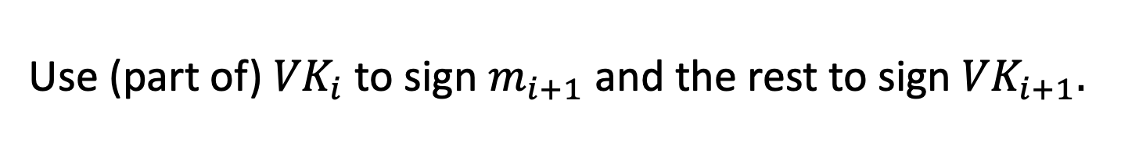
Step 1: Stateful Many-time Signatures
Idea: Signature Chains.
An optimization: Need to remember only the past verification keys, not the past messages.
Use (part of) ${VK}_{i}$ to sign $m_{i+1}$ and the rest to sign ${VK}_{i+1}.$
$$τ_{1}$$
$$m_{1}$$
$$τ_{2}$$
$$m_{2}$$
$$τ_{3}$$
$$m_{3}$$
$$τ_{4}$$
$$m_{4}$$
$$…$$
$$σ_{1}$$
$$σ_{2}$$
$$σ_{3}$$
$$σ_{4}$$
$$…$$
$${VK}_{0}$$
$${VK}_{1}$$
$${VK}_{2}$$
$${VK}_{3}$$
$${VK}_{4}$$

Slide 27
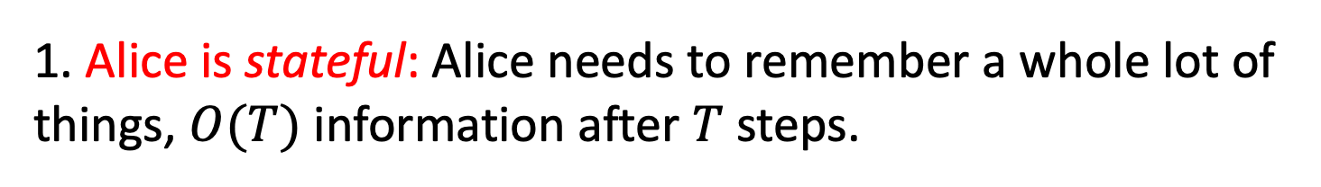
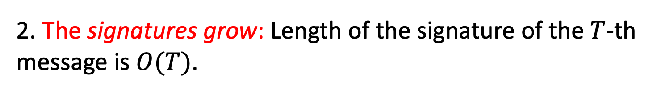
Step 1: Stateful Many-time Signatures
Idea: Signature Chains.
Two major problems:
1. Alice is stateful: Alice needs to remember a whole lot of things, $O(T)$ information after $T$ steps.
2. The signatures grow: Length of the signature of the $T$-th message is $O(T)$.
$$τ_{1}$$
$$m_{1}$$
$$τ_{2}$$
$$m_{2}$$
$$τ_{3}$$
$$m_{3}$$
$$τ_{4}$$
$$m_{4}$$
$$σ_{1}$$
$$σ_{2}$$
$$σ_{3}$$
$$σ_{4}$$
$$…$$
$${VK}_{0}$$
$${VK}_{1}$$
$${VK}_{2}$$
$${VK}_{3}$$
$${VK}_{4}$$

Slide 28
(Many-time) Signature Scheme
In four+ steps
Step 1. Stateful, Growing Signatures. Idea: Signature Chains
Step 2. How to Shrink the signatures. Idea: Signature Trees

Slide 29


Alice
$$VK_{ε}$$
Step 2.
How to Shrink the signatures.
$${VK}_{ε}$$

Slide 30


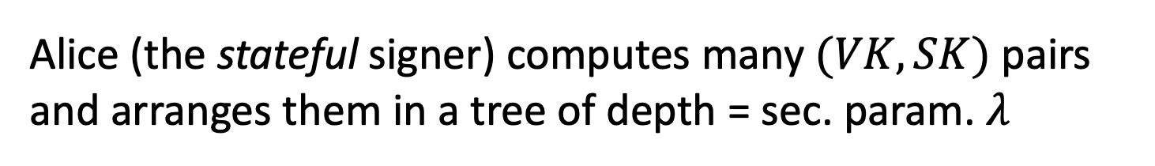











Alice
$$VK_{ε}$$
Step 2.
How to Shrink the signatures.
$${VK}_{ε}$$
$${VK}_{0}$$
$${VK}_{1}$$
$${VK}_{00}$$
$${VK}_{01}$$
$${VK}_{10}$$
$${VK}_{11}$$
$${VK}_{000}$$
$${VK}_{001}$$
$${VK}_{010}$$
$${VK}_{011}$$
$${VK}_{100}$$
$${VK}_{101}$$
$${VK}_{110}$$
$${VK}_{111}$$
Alice (the stateful signer) computes many $(VK,SK)$ pairs and arranges them in a tree of depth = sec. param. $λ$

Slide 31
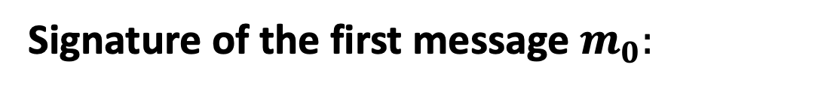





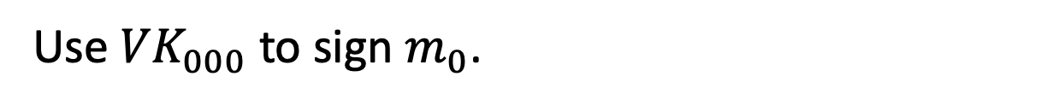
Step 2.
How to Shrink the signatures.
$${VK}_{ε}$$
$${VK}_{0}$$
$$σ_{ε}$$
$${VK}_{1}$$
$$σ_{0}$$
$${VK}_{00}$$
$${VK}_{01}$$
$${VK}_{10}$$
$${VK}_{11}$$
$$σ_{00}$$
$${VK}_{000}$$
$${VK}_{001}$$
$${VK}_{010}$$
$${VK}_{011}$$
$${VK}_{100}$$
$${VK}_{101}$$
$${VK}_{110}$$
$${VK}_{111}$$
$$τ_{0}$$
$$m_{0}$$
Signature of the first message $m_{0}:$
Use ${VK}_{000}$ to sign $m_{0}$.
“Authenticate” ${VK}_{000}$ using the “signature path”.

Slide 32
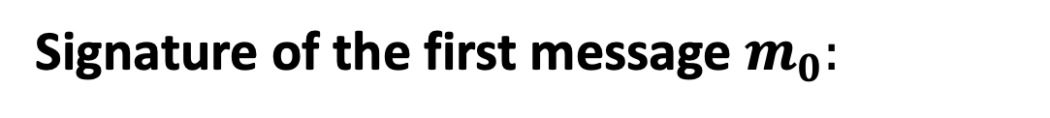
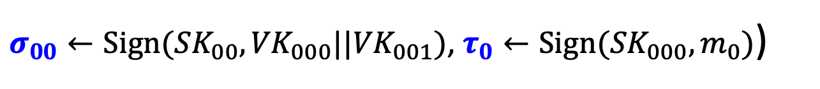
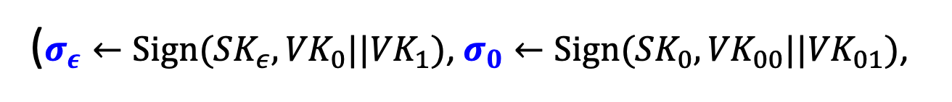
Step 2.
How to Shrink the signatures.
$${VK}_{ε}$$
$${VK}_{0}$$
$$σ_{ε}$$
$${VK}_{1}$$
$$σ_{0}$$
$${VK}_{00}$$
$${VK}_{01}$$
$${VK}_{10}$$
$${VK}_{11}$$
$$σ_{00}$$
$${VK}_{000}$$
$${VK}_{001}$$
$${VK}_{010}$$
$${VK}_{011}$$
$${VK}_{100}$$
$${VK}_{101}$$
$${VK}_{110}$$
$${VK}_{111}$$
$$τ_{0}$$
$$m_{0}$$
Signature of the first message $m_{0}:$
($σ_{ε}←Sign({SK}_{ε},{VK}_{0}||{VK}_{1})$, $σ_{0}←Sign({SK}_{0},{VK}_{00}||{VK}_{01})$,
$σ_{00}←Sign({SK}_{00},{VK}_{000}||{VK}_{001})$, $τ_{0}←Sign({SK}_{000},m_{0})$)

Slide 33

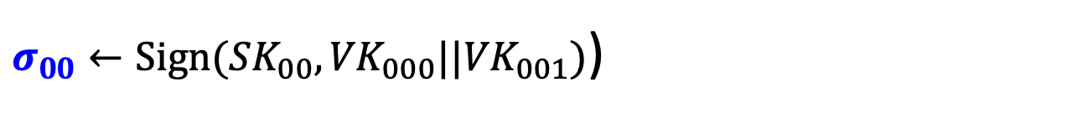
Step 2.
How to Shrink the signatures.
$${VK}_{ε}$$
$${VK}_{0}$$
$$σ_{ε}$$
$${VK}_{1}$$
$$σ_{0}$$
$${VK}_{00}$$
$${VK}_{01}$$
$${VK}_{10}$$
$${VK}_{11}$$
$$σ_{00}$$
$${VK}_{000}$$
$${VK}_{001}$$
$${VK}_{010}$$
$${VK}_{011}$$
$${VK}_{100}$$
$${VK}_{101}$$
$${VK}_{110}$$
$${VK}_{111}$$
$$τ_{0}$$
$$m_{0}$$
Authentication Path for ${VK}_{000}$:
($σ_{ε}←Sign({SK}_{ε},{VK}_{0}||{VK}_{1})$, $σ_{0}←Sign({SK}_{0},{VK}_{00}||{VK}_{01})$,
$σ_{00}←Sign({SK}_{00},{VK}_{000}||{VK}_{001})$)

Slide 34
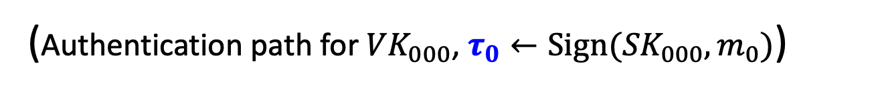
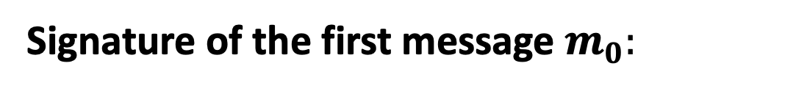
Step 2.
How to Shrink the signatures.
$${VK}_{ε}$$
$${VK}_{0}$$
$$σ_{ε}$$
$${VK}_{1}$$
$$σ_{0}$$
$${VK}_{00}$$
$${VK}_{01}$$
$${VK}_{10}$$
$${VK}_{11}$$
$$σ_{00}$$
$${VK}_{000}$$
$${VK}_{001}$$
$${VK}_{010}$$
$${VK}_{011}$$
$${VK}_{100}$$
$${VK}_{101}$$
$${VK}_{110}$$
$${VK}_{111}$$
$$τ_{0}$$
$$m_{0}$$
Signature of the first message $m_{0}:$
(Authentication path for ${VK}_{000}$, $τ_{0}←Sign({SK}_{000},m_{0})$)

Slide 35


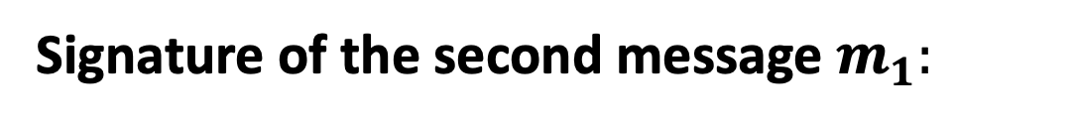

Step 2.
How to Shrink the signatures.
$${VK}_{ε}$$
$${VK}_{0}$$
$$σ_{ε}$$
$${VK}_{1}$$
$$σ_{0}$$
$${VK}_{00}$$
$${VK}_{01}$$
$${VK}_{10}$$
$${VK}_{11}$$
$$σ_{00}$$
$${VK}_{000}$$
$${VK}_{001}$$
$${VK}_{010}$$
$${VK}_{011}$$
$${VK}_{100}$$
$${VK}_{101}$$
$${VK}_{110}$$
$${VK}_{111}$$
$$τ_{1}$$
$$m_{1}$$
Signature of the second message $m_{1}:$
(Authentication path for ${VK}_{001}$, $τ_{0}←Sign({SK}_{001},m_{1})$)

Slide 36




Step 2.
How to Shrink the signatures.
$${VK}_{ε}$$
$${VK}_{0}$$
$$σ_{ε}$$
$${VK}_{1}$$
$$σ_{0}$$
$${VK}_{00}$$
$${VK}_{01}$$
$${VK}_{10}$$
$${VK}_{11}$$
$$σ_{01}$$
$${VK}_{000}$$
$${VK}_{001}$$
$${VK}_{010}$$
$${VK}_{011}$$
$${VK}_{100}$$
$${VK}_{101}$$
$${VK}_{110}$$
$${VK}_{111}$$
$$τ_{2}$$
$$m_{2}$$
Signature of the third message $m_{2}:$
(Authentication path for ${VK}_{010}$, $τ_{2}←Sign({SK}_{010},m_{2})$)

Slide 37

Step 2.
How to Shrink the signatures.
$${VK}_{ε}$$
$${VK}_{0}$$
$$σ_{ε}$$
$${VK}_{1}$$
$$σ_{0}$$
$${VK}_{00}$$
$${VK}_{01}$$
$${VK}_{10}$$
$${VK}_{11}$$
$$σ_{01}$$
$${VK}_{000}$$
$${VK}_{001}$$
$${VK}_{010}$$
$${VK}_{011}$$
$${VK}_{100}$$
$${VK}_{101}$$
$${VK}_{110}$$
$${VK}_{111}$$
$$τ_{2}$$
$$m_{2}$$
GOOD NEWS:
Each verification key (incl. at the leaves) is used only once, so one-time security suffices!

Slide 38

Step 2.
How to Shrink the signatures.
$${VK}_{ε}$$
$${VK}_{0}$$
$$σ_{ε}$$
$${VK}_{1}$$
$$σ_{0}$$
$${VK}_{00}$$
$${VK}_{01}$$
$${VK}_{10}$$
$${VK}_{11}$$
$$σ_{01}$$
$${VK}_{000}$$
$${VK}_{001}$$
$${VK}_{010}$$
$${VK}_{011}$$
$${VK}_{100}$$
$${VK}_{101}$$
$${VK}_{110}$$
$${VK}_{111}$$
$$τ_{2}$$
$$m_{2}$$
GOOD NEWS:
Signatures consist of $λ$ one-time signatures and do now grow with time!

Slide 39


Step 2.
How to Shrink the signatures.
$${VK}_{ε}$$
$${VK}_{0}$$
$$σ_{ε}$$
$${VK}_{1}$$
$$σ_{0}$$
$${VK}_{00}$$
$${VK}_{01}$$
$${VK}_{10}$$
$${VK}_{11}$$
$$σ_{01}$$
$${VK}_{000}$$
$${VK}_{001}$$
$${VK}_{010}$$
$${VK}_{011}$$
$${VK}_{100}$$
$${VK}_{101}$$
$${VK}_{110}$$
$${VK}_{111}$$
$$τ_{2}$$
$$m_{2}$$
BAD NEWS:
Signer generates and keeps the entire ($≈ 2^{λ}$-size) signature tree in memory!

Slide 40
(Many-time) Signature Scheme
In four+ steps
Step 1. Stateful, Growing Signatures. Idea: Signature Chains
Step 2. How to Shrink the signatures. Idea: Signature Trees
Step 3. How to Shrink Alice’s storage. Idea: Pseudorandom Trees

Slide 41























Step 3.
Pseudorandom Signature Trees.
$$r_{ε}$$
$({VK}_{ε}$,${SK}_{ε})$
$$r_{0}$$
$$r_{1}$$
$({VK}_{1}$,${SK}_{1})$
$({VK}_{0}$,${SK}_{0})$
$$r_{00}$$
$$…$$
$$r_{01}$$
$$…$$
$$r_{10}$$
$$…$$
$$r_{11}$$
$$…$$
$$r_{000}$$
$$r_{001}$$
$$r_{010}$$
$$r_{011}$$
$$r_{100}$$
$$r_{101}$$
$$r_{110}$$
$$r_{111}$$
Tree of pseudorandom values:
The signing key is a PRF key $K$.
Populate the nodes with $r_{x}=PRF(K,x)$.
Use $r_{x}$ to derive the keys $({VK}_{x},{SK}_{x})←Gen(1^{λ};r_{x})$.

Slide 42















Step 3.
Pseudorandom Signature Trees.
$$r_{ε}$$
$${VK}_{ε}$$
$$r_{0}$$
$$r_{1}$$
$${VK}_{1}$$
$${VK}_{0}$$
$$r_{00}$$
$$r_{01}$$
$$r_{10}$$
$$r_{11}$$
$${VK}_{00}$$
$${VK}_{01}$$
$${VK}_{10}$$
$${VK}_{11}$$
$$r_{000}$$
$$r_{001}$$
$$r_{010}$$
$$r_{011}$$
$$r_{100}$$
$$r_{101}$$
$$r_{110}$$
$$r_{111}$$
$${VK}_{000}$$
$${VK}_{001}$$
$${VK}_{010}$$
$${VK}_{011}$$
$${VK}_{100}$$
$${VK}_{101}$$
$${VK}_{110}$$
$${VK}_{111}$$
Tree of pseudorandom values:
The signing key is a PRF key $K$.
Populate the nodes with $r_{x}=PRF(K,x)$.
Use $r_{x}$ to derive the keys $({VK}_{x},{SK}_{x})←Gen(1^{λ};r_{x})$.

Slide 43
Step 3.
Pseudorandom Signature Trees.
$${VK}_{ε}$$
$${VK}_{0}$$
$${VK}_{1}$$
$${VK}_{00}$$
$${VK}_{01}$$
$${VK}_{10}$$
$${VK}_{11}$$
$${VK}_{000}$$
$${VK}_{001}$$
$${VK}_{010}$$
$${VK}_{011}$$
$${VK}_{100}$$
$${VK}_{101}$$
$${VK}_{110}$$
$${VK}_{111}$$
GOOD NEWS:
Short signatures and small storage for the signer

Slide 44
Step 3.
Pseudorandom Signature Trees.
$${VK}_{ε}$$
$${VK}_{0}$$
$${VK}_{1}$$
$${VK}_{00}$$
$${VK}_{01}$$
$${VK}_{10}$$
$${VK}_{11}$$
$${VK}_{000}$$
$${VK}_{001}$$
$${VK}_{010}$$
$${VK}_{011}$$
$${VK}_{100}$$
$${VK}_{101}$$
$${VK}_{110}$$
$${VK}_{111}$$
$$τ_{2}$$
$$m_{2}$$
BAD NEWS:
Signer needs to keep a counter indicating which leaf (which tells her which secret key) to use next.

Slide 45
(Many-time) Signature Scheme
In four+ steps
Step 1. Stateful, Growing Signatures. Idea: Signature Chains
Step 2. How to Shrink the signatures. Idea: Signature Trees
Step 3. How to Shrink Alice’s storage. Idea: Pseudorandom Trees
Step 4. How to make Alice stateless. Idea: Randomization

Slide 46










Step 4.
Statelessness via Randomization
$${VK}_{ε}$$
$$σ_{ε}$$
$${VK}_{0}$$
$$σ_{ε}$$
$${VK}_{1}$$
$$σ_{0}$$
$$σ_{1}$$
$${VK}_{00}$$
$${VK}_{01}$$
$${VK}_{10}$$
$${VK}_{11}$$
$$σ_{01}$$
$$σ_{10}$$
$${VK}_{000}$$
$${VK}_{001}$$
$${VK}_{010}$$
$${VK}_{011}$$
$${VK}_{010}$$
$${VK}_{100}$$
$${VK}_{101}$$
$${VK}_{101}$$
$${VK}_{110}$$
$${VK}_{111}$$
Signature of a message $m:$
Pick a random leaf $r$. Use ${VK}_{r}$ to sign $m$.
$$σ_{r}←Sign({SK}_{r},m)$$
Output $(r, σ_{r},$ authentication path for ${VK}_{r})$

Slide 47
Step 4.
Statelessness via Randomization
$${VK}_{ε}$$
$${VK}_{0}$$
$$σ_{ε}$$
$${VK}_{1}$$
$$σ_{0}$$
$${VK}_{00}$$
$${VK}_{01}$$
$${VK}_{10}$$
$${VK}_{11}$$
$$σ_{01}$$
$${VK}_{000}$$
$${VK}_{001}$$
$${VK}_{010}$$
$${VK}_{011}$$
$${VK}_{010}$$
$${VK}_{100}$$
$${VK}_{101}$$
$${VK}_{110}$$
$${VK}_{111}$$
GOOD NEWS:
No need to keep state.

Slide 48

Step 4.
Statelessness via Randomization
$${VK}_{ε}$$
$${VK}_{0}$$
$$σ_{ε}$$
$${VK}_{1}$$
$$σ_{0}$$
$${VK}_{00}$$
$${VK}_{01}$$
$${VK}_{10}$$
$${VK}_{11}$$
$$σ_{01}$$
$${VK}_{000}$$
$${VK}_{001}$$
$${VK}_{010}$$
$${VK}_{011}$$
$${VK}_{010}$$
$${VK}_{100}$$
$${VK}_{101}$$
$${VK}_{110}$$
$${VK}_{111}$$
Key Idea:
If the signer produces $q$ signatures, the probability she picks the same leaf twice is ${≤q}^{2}/2^{λ}$.

Slide 49
(Many-time) Signature Scheme
In four+ steps
Step 1. Stateful, Growing Signatures. Idea: Signature Chains
Step 2. How to Shrink the signatures. Idea: Signature Trees
Step 3. How to Shrink Alice’s storage. Idea: Pseudorandom Trees
Step 4. How to make Alice stateless. Idea: Randomization
Step 5 (optional). How to make Alice stateless and deterministic. Idea: PRFs.

Slide 50
Step 5.
Making the Signer Deterministic.
$${VK}_{ε}$$
$${VK}_{0}$$
$$σ_{ε}$$
$${VK}_{1}$$
$$σ_{0}$$
$${VK}_{00}$$
$${VK}_{01}$$
$${VK}_{10}$$
$${VK}_{11}$$
$$σ_{01}$$
$${VK}_{000}$$
$${VK}_{001}$$
$${VK}_{010}$$
$${VK}_{011}$$
$${VK}_{010}$$
$${VK}_{100}$$
$${VK}_{101}$$
$${VK}_{110}$$
$${VK}_{111}$$
Key Idea:
Generate $r$ pseudo-randomly.
Have another PRF key $K′$ and let $r=PRF(K^{′},m)$

Slide 51
That’s it for the construction.

