Slide 1
MIT 6.875/6.5620/18.425
Foundations of Cryptography
Lecture 2
Course website: https://mit6875.github.io/

Slide 2
Lecture 1 Recap

Slide 3
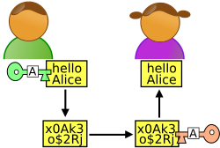

Secure Communication
m
Alice
Bob
Key k
Key k
Eavesdropper “Eve”
Alice and Bob have a common key k
Algorithms $\left(Gen,Enc,Dec\right).$
Correctness: $Dec\left(k,Enc\left(k,m\right)\right)=m.$
Security: Perfect Secrecy = Perfect Indistinguishability.

Slide 4
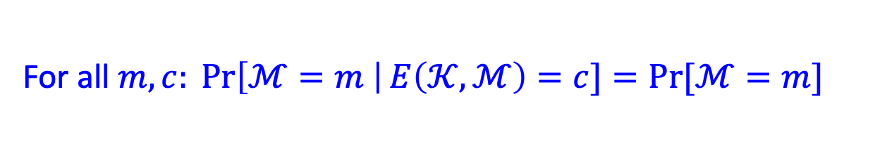
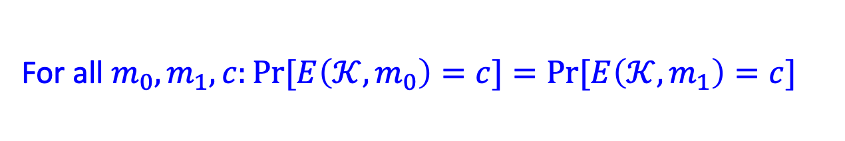
How to Define Security
Perfect secrecy: A Posteriori = A Priori
For all $m,c: \operatorname{Pr}\left[ℳ=m \right|E\left(𝒦,ℳ\right)=c]=Pr⁡[ℳ=m]$
Perfect indistinguishability:
For all $m_{0},m_{1},c:Pr⁡[E\left(𝒦,m_{0}\right)=c]=Pr⁡[E\left(𝒦,m_{1}\right)=c]$
The two definitions are equivalent!

Slide 5

Is there a perfectly secure scheme?
One-time Pad: $E\left(k,m\right)=k⨁m$
However: Keys are as long as Messages
WORSE, Shannon’s theorem: for any perfectly secure scheme, |key|$≥$|message|.
Can we overcome Shannon’s conundrum?

Slide 6
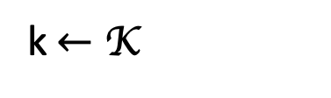
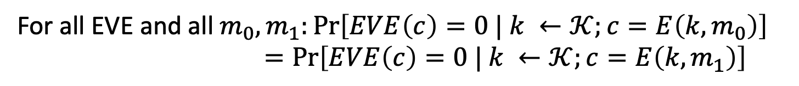


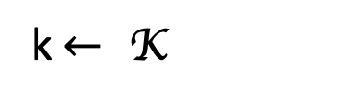
Perfect Indistinguishability: a Turing test
For all $m_{0},m_{1},c:Pr⁡[E\left(𝒦,m_{0}\right)=c]=Pr⁡[E\left(𝒦,m_{1}\right)=c]$
World 0:
World 1:
k$←$ K
k$← \text{K}$
$$c=E\left(k,m_{0}\right)$$
$$c=E\left(k,m_{1}\right)$$
is a distinguisher.
For all EVE and all $m_{0},m_{1}:\operatorname{Pr}\left[EVE\left(c\right)=0 | k ←𝒦;c=E\left(k,m_{0}\right)\right]$ $=\operatorname{Pr}\left[EVE\left(c\right)=0 | k ←𝒦;c=E\left(k,m_{1}\right)\right]$

Slide 7
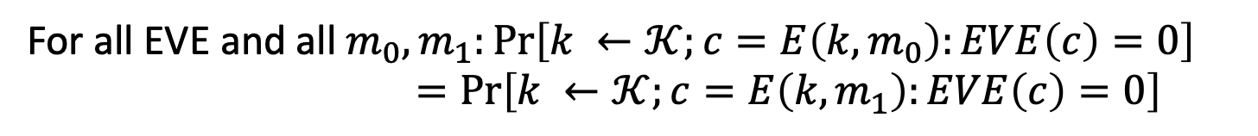
Perfect Indistinguishability: a Turing test
For all $m_{0},m_{1},c:Pr⁡[E\left(𝒦,m_{0}\right)=c]=Pr⁡[E\left(𝒦,m_{1}\right)=c]$
World 0:
World 1:
k$←$ K
k$← \text{K}$
$$c=E\left(k,m_{0}\right)$$
$$c=E\left(k,m_{1}\right)$$
is a distinguisher.
For all EVE and all $m_{0},m_{1}:\operatorname{Pr}\left[k ←𝒦;c=E\left(k,m_{0}\right):EVE\left(c\right)=0\right]$ $=\operatorname{Pr}\left[k ←𝒦;c=E\left(k,m_{1}\right):EVE\left(c\right)=0\right]$

Slide 8

Perfect Indistinguishability: a Turing test
For all $m_{0},m_{1},c:Pr⁡[E\left(𝒦,m_{0}\right)=c]=Pr⁡[E\left(𝒦,m_{1}\right)=c]$
World 0:
World 1:
k$←$ K
k$← \text{K}$
$$c=E\left(k,m_{0}\right)$$
$$c=E\left(k,m_{1}\right)$$
is a distinguisher.
For all EVE and all $m_{0},m_{1}$:
$$\operatorname{Pr}\left[k ←𝒦;b ←\left\{0,1\right\}; c=E\left(k,m_{b}\right): EVE\left(c\right)=b\right]=1/2$$

Slide 9
The Key Idea:
Computationally Bounded Adversaries

Slide 10
Life
The Axiom of Modern Crypto
Feasible Computation = Probabilistic polynomial-time*
(p.p.t. = Probabilistic polynomial-time)
(polynomial in a security parameter n)
So, Alice and Bob are fixed p.p.t. algorithms. (e.g., run in time n^2)
Eve is any p.p.t. algorithm. (e.g., run in time n^4, or n^100, or n^10000,…)
* in recent years, quantum polynomial-time

Slide 11

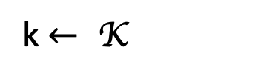

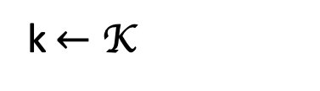
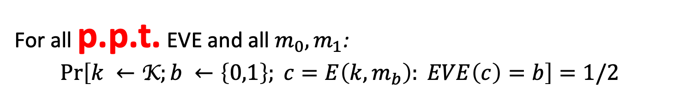

Computational Indistinguishability
(take 1)
World 0:
World 1:
k$←$ K
k$← \text{K}$
$$c=E\left(k,m_{0}\right)$$
$$c=E\left(k,m_{1}\right)$$
is a p.p.t. distinguisher.
For all p.p.t. EVE and all $m_{0},m_{1}$:
$$\operatorname{Pr}\left[k ←\text{K};b ←\left\{0,1\right\}; c=E\left(k,m_{b}\right): EVE\left(c\right)=b\right]=1/2$$
Still subject to Shannon’s impossibility!
Notes:
Question slide

Slide 12

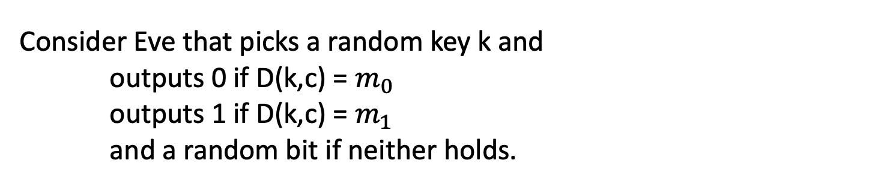


Still subject to Shannon’s impossibility!
Messages n+1 bits
ciphertexts
Keys n bits
c
Set of messages consistent with c
= {D(k,c): all k}
$$m_{0}$$
$$m_{1}$$
Consider Eve that picks a random key k and outputs 0 if D(k,c) = $m_{0}$
outputs 1 if D(k,c) = $m_{1}$
and a random bit if neither holds.
w.p $≥$ $1/2^{n}$
w.p = 0
Bottomline: Pr[EVE succeeds] $≥$ 1/2 + $1/2^{n}$
Notes:
Question slide

Slide 13
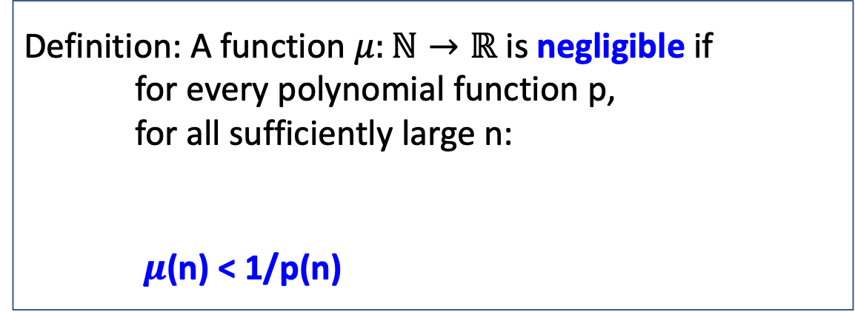

New Notion: Negligible Functions
Functions that grow slower than 1/p(n) for any polynomial p.
Definition: A function $μ:ℕ→ℝ$ is negligible if for every polynomial function p, for all sufficiently large n:
$μ$(n) < 1/p(n)
there exists an $n_{0}$ s.t. for all ${n>n}_{0}:$
Key property: Events that occur with negligible probability look to poly-time algorithms like they never occur.
Notes:
Question slide

Slide 14

New Notion: Negligible Functions
Functions that grow slower than 1/p(n) for any polynomial p.
Definition: A function $μ:ℕ→ℝ$ is negligible if for every polynomial function p, for all sufficiently large n:
$μ$(n) < 1/p(n)
there exists an $n_{0}$ s.t. for all ${n>n}_{0}:$
Question: Let $μ\left(n\right)=1/n^{\log{n}}$. Is $μ$ negligible?
Notes:
Question slide

Slide 15

New Notion: Negligible Functions
Functions that grow slower than 1/p(n) for any polynomial p.
Definition: A function $μ:ℕ→ℝ$ is negligible if for every polynomial function p, for all sufficiently large n:
$μ$(n) < 1/p(n)
there exists an $n_{0}$ s.t. for all ${n>n}_{0}:$
Question: Let $μ\left(n\right)=1/n^{100}$ if n is prime and $μ\left(n\right)=1/2^{n}$ otherwise. Is $μ$ negligible?
Notes:
Question slide

Slide 16

New Notion: Negligible Functions
Functions that grow slower than 1/p(n) for any polynomial p.
Definition: A function $μ:ℕ→ℝ$ is negligible if for every polynomial function p, for all sufficiently large n:
$μ$(n) < 1/p(n)
there exists an $n_{0}$ s.t. for all ${n>n}_{0}:$
Question (PS1) Let $μ\left(n\right)$ be a negligible function and $q\left(n\right)$ a polynomial function. Is $μ\left(n\right)q(n)$ a negligible function?
Notes:
Question slide

Slide 17

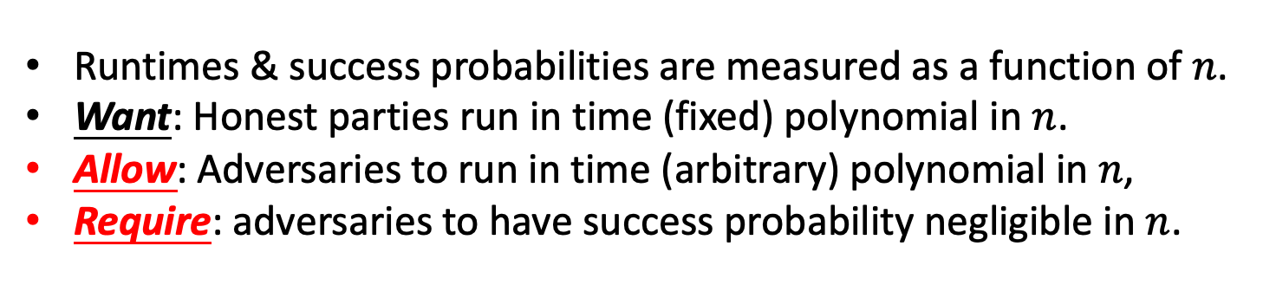

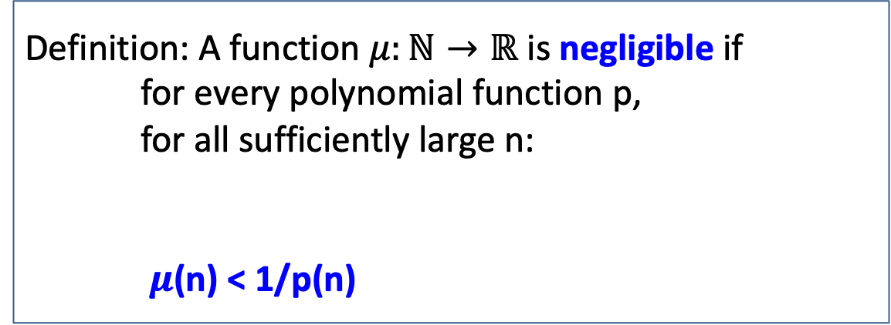
Security Parameter: $n$ (sometimes $λ$)
Definition: A function $μ:ℕ→ℝ$ is negligible if for every polynomial function p, for all sufficiently large n:
$μ$(n) < 1/p(n)
there exists an $n_{0}$ s.t. for all ${n>n}_{0}:$
Runtimes & success probabilities are measured as a function of $n$.
Want: Honest parties run in time (fixed) polynomial in $n$.
Allow: Adversaries to run in time (arbitrary) polynomial in $n$,
Require: adversaries to have success probability negligible in $n$.
Notes:
Question slide

Slide 18

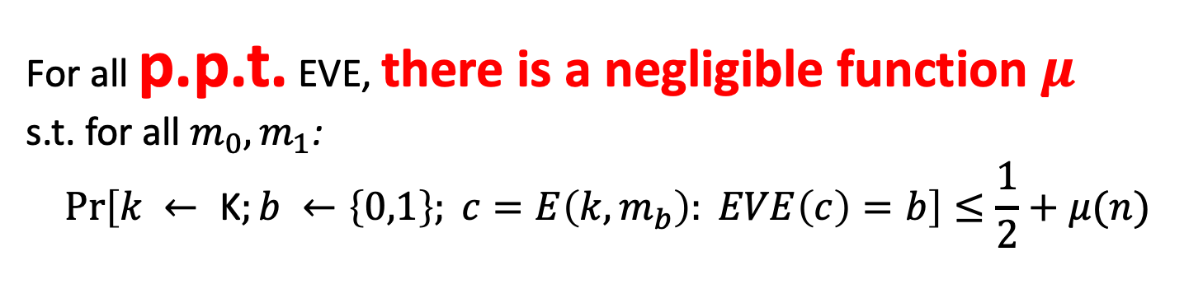
Computational Indistinguishability (take 2)
World 0:
World 1:
k$←$ K
k$← \text{K}$
$$c=E\left(k,m_{0}\right)$$
$$c=E\left(k,m_{1}\right)$$
is a distinguisher.
For all p.p.t. EVE, there is a negligible function $μ$ s.t. for all $m_{0},m_{1}$:
$$\operatorname{Pr}\left[k ← \text{K};b ←\left\{0,1\right\}; c=E\left(k,m_{b}\right): EVE\left(c\right)=b\right]≤\frac{1}{2}+μ(n)$$
Notes:
This is a subtle definition. Think carefully about the order of quantifiers. This says “for every polynomial function p(n), and for every polynomial function q(n) there is an n_0 s.t. for all n > n_0, Pr[p(n)-time EVE distinguishes] <= 1/2 + 1/q(n).” Question to reader: What effect does switching the order of quantifiers have? i.e. in the def above, “There is a negligible function mu s.t. for all p.p.t. EVE,…”?

Slide 19
Our First Crypto Tool: Pseudorandom Generators (PRG)

Slide 20
Pseudo-random Generators
Informally: Deterministic Programs that stretch a “truly random” seed into a (much) longer sequence of “seemingly random” bits.
seed
PRG G
b1 b2 b3 ...
How to define “seemingly random”?
Can such a G exist?

Slide 21
How to Define a Strong Pseudo Random Number Generator?
Def 1 [Indistinguishability]
“No polynomial-time algorithm can distinguish between the output of a PRG on a random seed vs. a truly random string”
= “as good as” a truly random string for all practical purposes.
ALL THREE DEFS EQUIVALENT!
Def 2 [Next-bit Unpredictability]
“No polynomial-time algorithm can predict the (i+1)^{th} bit of the output of a PRG given the first i bits, better than chance”
Def 3 [Incompressibility]
“No polynomial-time algorithm can compress the output of the PRG into a shorter string”

Slide 22
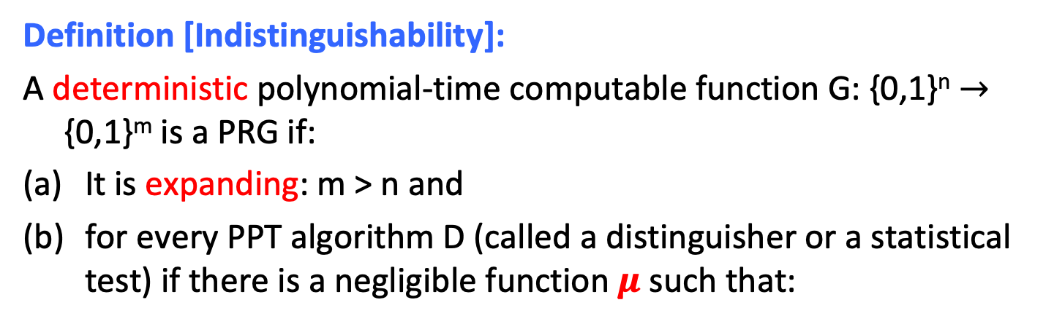
PRG Def 1: Indistinguishability
Definition [Indistinguishability]:
A deterministic polynomial-time computable function G: {0,1}^{n} $→$ {0,1}^{m} is a PRG if:
It is expanding: m > n and
for every PPT algorithm D (called a distinguisher or a statistical test) if there is a negligible function $μ$ such that:
$$| Pr⁡[ D(G(U_{n})) = 1 ] – Pr⁡[ D(Um) = 1 ] | =μ(n)$$
Notation: U_{n} (resp. U_{m}) denotes the random distribution on n-bit (resp. m-bit) strings; m is shorthand for m(n).

Slide 23

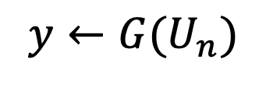

PRG Def 1: Indistinguishability
WORLD 1: The Pseudorandom World
WORLD 2: The Truly Random World
$$y←{G(U}_{n})$$
$$y←U_{m}$$
PPT Distinguisher gets y but cannot tell which world she is in

Slide 24
Why is this a good definition
Good for all Applications:
As long as we can find truly random seeds, can replace true randomness by the output of PRG(seed) in ANY (polynomial-time) application.
If the application behaves differently, then it constitutes a (polynomial-time) statistical test between PRG(seed) and a truly random string.

Slide 25
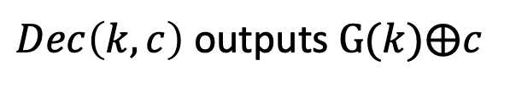

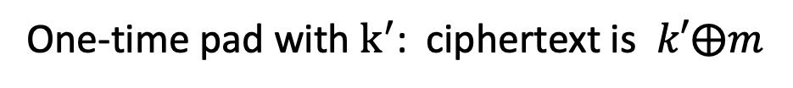
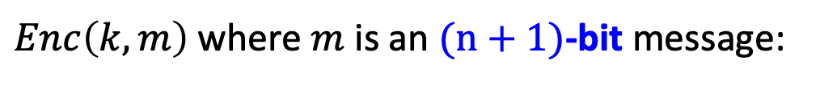
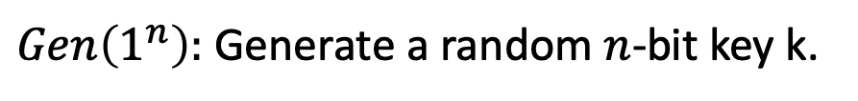

PRG $⟹$ Overcoming Shannon’s Conundrum
(or, How to Encrypt n+1 bits using an n-bit key)
$Gen\left(1^{n}\right):$ Generate a random $n$-bit key k.
$Enc\left(k,m\right)$ where $m$ is an $(n+1)$-bit message:
Expand k into a (n+1)-bit pseudorandom string $k^{′}= G(k)$
One-time pad with $k^{′}$: ciphertext is $k′⨁m$
$Dec\left(k,c\right)$ outputs $G(k)⨁c$
$$Correctness:$$
$Dec\left(k,c\right)$ outputs $G\left(k\right)⨁c=G\left(k\right)⨁G\left(k\right)⨁m=m$

Slide 26
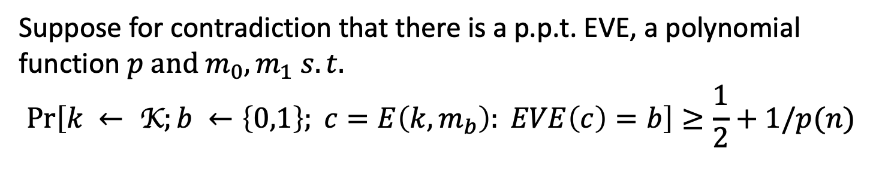
PRG $⟹$ Overcoming Shannon’s Conundrum
Security: your first reduction!
Suppose for contradiction that there is a p.p.t. EVE, a polynomial function $p and m_{0},m_{1} s.t.$
$$\operatorname{Pr}\left[k ← \text{K};b ←\left\{0,1\right\}; c=E\left(k,m_{b}\right): EVE\left(c\right)=b\right]≥\frac{1}{2}+1/p(n)$$

Slide 27
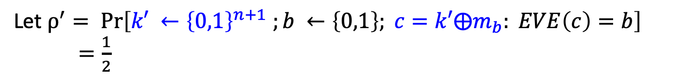
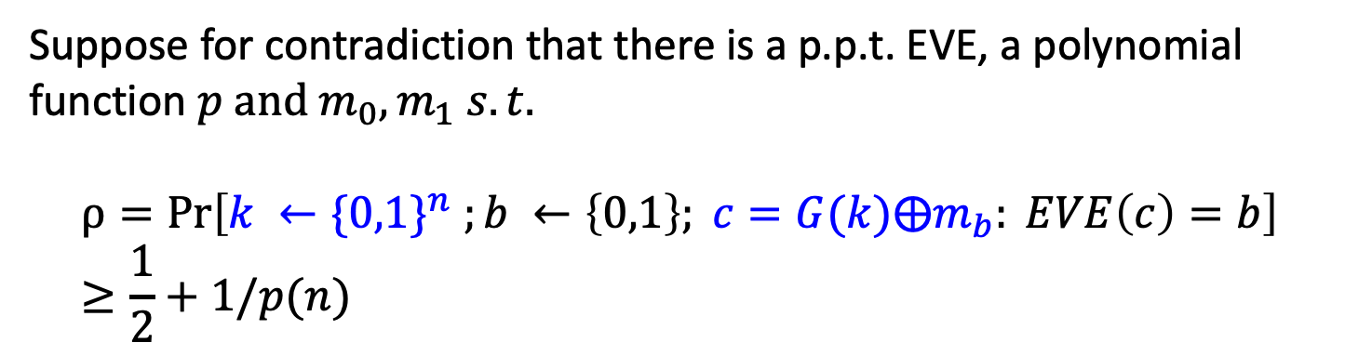
PRG $⟹$ Overcoming Shannon’s Conundrum
Security: your first reduction!
Suppose for contradiction that there is a p.p.t. EVE, a polynomial function $p and m_{0},m_{1} s.t.$
$$ρ=Pr\left[k ←{\{0,1\}}^{n} ;b ←\left\{0,1\right\}; c=G(k)⨁m_{b}: EVE\left(c\right)=b\right]≥\frac{1}{2}+1/p(n)$$
Let $ρ^{′}= \operatorname{Pr}\left[k′ ←{\left\{0,1\right\}}^{n+1} ;b ←\left\{0,1\right\}; c=k′⨁m_{b}: EVE\left(c\right)=b\right]$
$=\frac{1}{2}$
This will give us a distinguisher EVE’ for G, contradicting the assumption that G is a pseudorandom generator. QED.

Slide 28
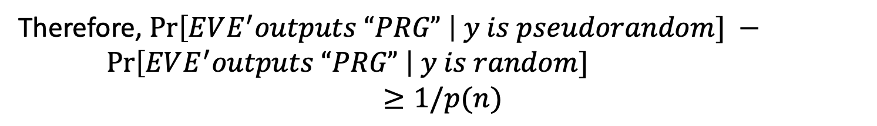
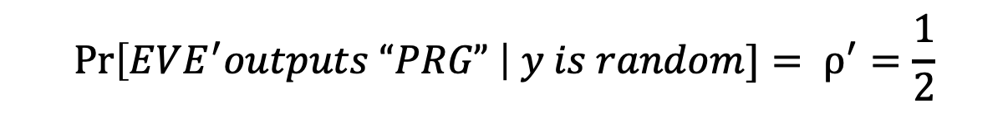
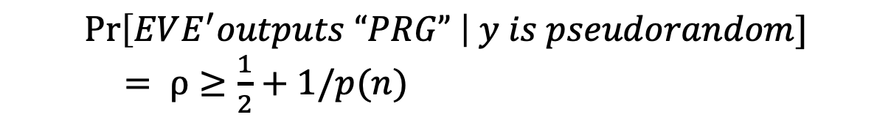

PRG $⟹$ Overcoming Shannon’s Conundrum
Distinguisher EVE’ for G.
Get as input a string y, run EVE($y⨁m_{b}$) for a random b, and let EVE’s output be b’. Output “PRG” if b=b’ and “RANDOM” otherwise.
$$\operatorname{Pr}\left[EVE^{′}outputs “PRG” \right| y is pseudorandom]$$ $= ρ≥\frac{1}{2}+1/p(n)$
$$\operatorname{Pr}\left[EVE^{′}outputs “PRG” \right| y is random]= ρ^{′}=\frac{1}{2}$$
Therefore, $\operatorname{Pr}\left[EVE^{′}outputs “PRG” \right| y is pseudorandom] −$ $\operatorname{Pr}\left[EVE^{′}outputs “PRG” \right| y is random]$
$$≥1/p(n)$$

Slide 29

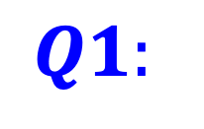
PRG $⟹$ Overcoming Shannon’s Conundrum
(or, How to Encrypt n+1 bits using an n-bit key)
$$Q1:$$
Do PRGs exist?
(Exercise: If P=NP, PRGs do not exist.)
$$Q2:$$
How do we encrypt longer messages or many messages with a fixed key?
(Length extension: If there is a PRG that stretches by one bit, there is one that stretches by polynomially many bits)
(Pseudorandom functions: PRGs with exponentially large stretch and “random access” to the output.)

Slide 30
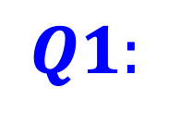
$$Q1:$$
Do PRGs exist?

Slide 31


Constructing PRGs: Two Methodologies
The Practical Methodology
1. Start from a design framework (e.g. “appropriately chosen functions composed appropriately many times look random”)

Slide 32
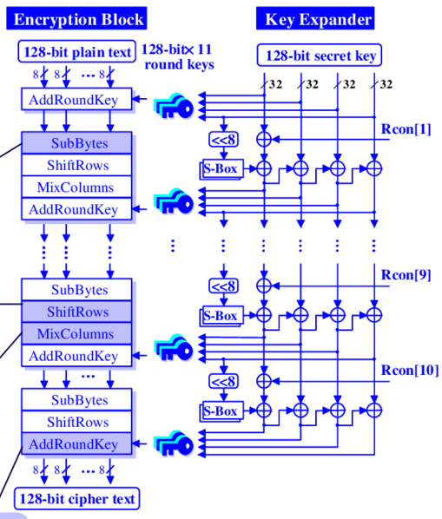

Constructing PRGs: Two Methodologies
The Practical Methodology
1. Start from a design framework (e.g. “appropriately chosen functions composed appropriately many times look random”)
2. Come up with a candidate construction
Rijndael (now the Advanced Encryption Standard)
MATH

Slide 33


Constructing PRGs: Two Methodologies
The Practical Methodology
1. Start from a design framework (e.g. “appropriately chosen functions composed appropriately many times look random”)
2. Come up with a candidate construction
3. Do extensive cryptanalysis.

Slide 34
Constructing PRGs: Two Methodologies
The Foundational Methodology (much of this course)
Reduce to simpler primitives.
“Science wins either way” –Silvio Micali
Digital Signatures
PRF
PRG
Hashing
OWF
well-studied, average-case hard, problems

Slide 35
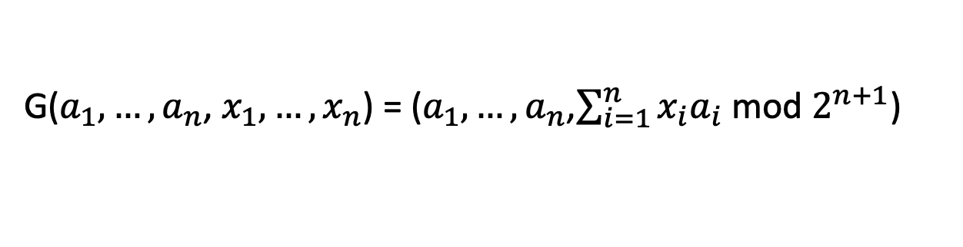

Constructing PRGs: Two Methodologies
The Foundational Methodology (much of this course)
A PRG Candidate from the average-case hardness of Subset-sum:
G($a_{1},…,a_{n}$, $x_{1},…,x_{n}$) = ($a_{1},…,a_{n}$,$\sum_{i=1}^{n}{x_{i}a_{i}}$ mod $2^{n+1}$)
where $a_{i}$ are random (n+1)-bit numbers, and $x_{i}$ are random bits.
Beautiful Function:
If G is a one-way function, then G is a PRG.
If lattice problems are hard on the worst-case, G is a PRG.

Slide 36
Pseudorandom Generators and (T)CS

Slide 37


Cryptography
Randomness is a Fundamental Resource
Simulation/Sampling/MCMC
Distributed Computing
Probabilistic Algorithms
Randomness

Slide 38
Where do we get random bits from?
1) Specialized Hardware: e.g., Transistor noise.
2) User Input: Every time random number used, user is queried.
3) Quantumness (not for much of this class)
Usually biased, but can “extract” unbiased bits assuming the source has “some structure and enough entropy” [randomness extraction: von Neumann,…]
BUT: True randomness is an expensive commodity.
Notes:
Truly random or biased?
Biased. However, can process the output of sources to get unbiased bit assuming some mathematical model of source [vonNeuman, Elias, Blum]
Pseudo Random Number Generators

Slide 39
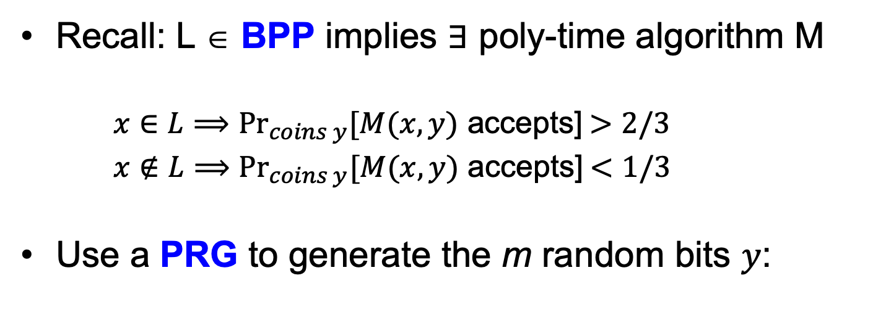
Application of PRGs: De-randomization
Recall: L ∈ BPP implies ∃ poly-time algorithm M
$x∈L⟹{Pr}_{coins y}[M(x,y)$ accepts] $>2/3$
$x∉L⟹{Pr}_{coins y}[M(x,y)$ accepts] $<1/3$
Use a PRG to generate the m random bits $y$:
G
seed
output string y
Run M(x,y)

Slide 40
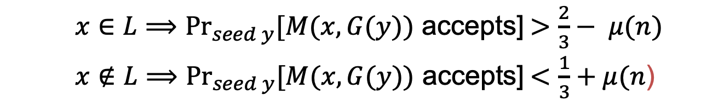
Application of PRGs: De-randomization
Theorem: if PRGs exist, then $BPP⊆ ∩_{ε>0}TIME\left(2^{m^{ε}}\right).$
(in English) if PRGs exist, then every randomized poly-time algorithm can be simulated in deterministic sub-exponential time.
Proof Sketch: use PRG that expands from ${n=m}^{ε}$ bits to $m$ bits.
$x∈L⟹{Pr}_{seed y}[M(x,G(y))$ accepts] $>\frac{2}{3}− μ(n)$
$x∉L⟹{Pr}_{seed y}[M(x,G(y))$ accepts] $<\frac{1}{3}+μ(n$)
Why?
If the above is not true, M is a distinguisher for the PRG!
Note:
M is a (known, fixed, fixed poly-time) distinguisher.

Slide 41
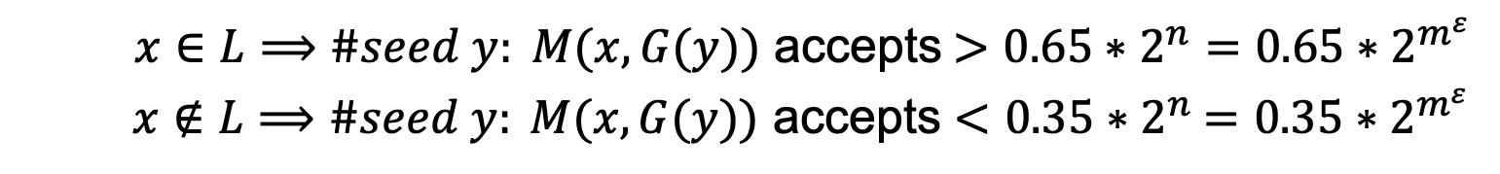

Application of PRGs: De-randomization
Theorem: if PRGs exist, then $BPP⊆ ∩_{ε>0}TIME\left(2^{m^{ε}}\right).$
(in English) if PRGs exist, then every randomized poly-time algorithm can be simulated in deterministic sub-exponential time.
Proof Sketch: use PRG that expands from ${n=m}^{ε}$ bits to $m$ bits.
$x∈L⟹\#seed y: M(x,G(y))$ accepts $>0.65∗2^{n}=0.65∗2^{m^{ε}}$
$x∉L⟹\#seed y: M(x,G(y))$ accepts $<0.35$ $∗2^{n}$ $=0.35∗2^{m^{ε}}$
Here is the deterministic algorithm: enumerate over all seeds $y$and run $M\left(x,G\left(y\right)\right).$ If #accepts $>0.65∗2^{m^{ε}}$, accept else reject.

Slide 42
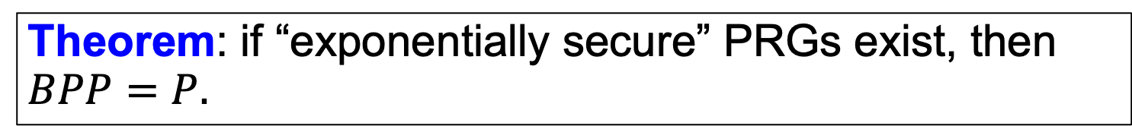
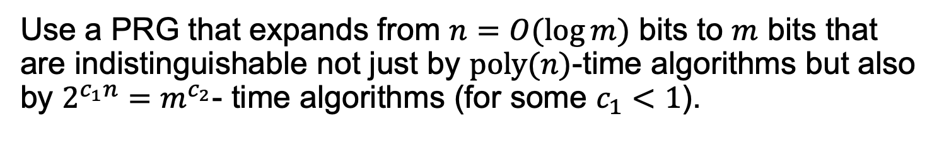
Application of PRGs: De-randomization
Theorem: if “exponentially secure” PRGs exist, then $BPP=P.$
Proof Sketch:
Use a PRG that expands from $n=O(\log{m)}$ bits to $m$ bits that are indistinguishable not just by $poly(n)$-time algorithms but also by $2^{c_{1}n}=m^{c_{2}}$- time algorithms (for some $c_{1}<1$).
The previous proof goes through mutatis mutandis, using crucially the fact that the randomized algorithm (adversary for us) runs in fixed polynomial-time.
Notes:
Of course, the PRG output *can* be distinguished from random by a 2^n time algorithm, so c_1 necessarily has to be < 1.

Slide 43


Next Lecture:
$$Q2:$$
How do we encrypt longer messages or many messages with a fixed key?
PRG length extension,
Pseudorandom functions (PRF) and PRG $⟹$ PRF

