Slide 1
MIT 6.875
Foundations of Cryptography
Lecture 19

Slide 2
TODAY: 1. Public-key Encryption from LWE and 2. Homomorphic Encryption

Slide 3

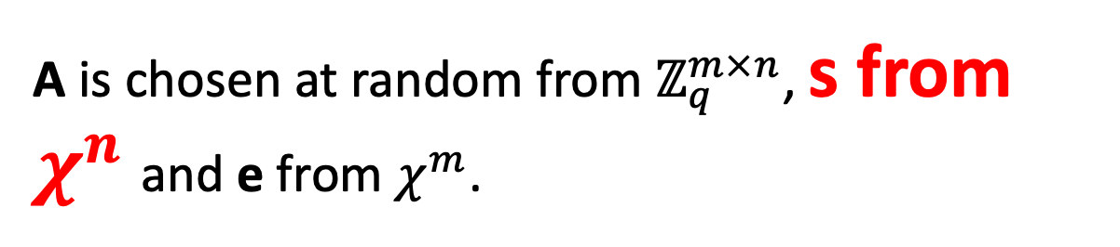
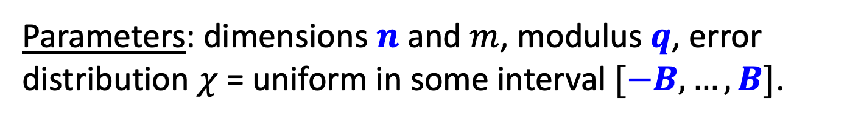
LWE with Small Secrets
s
Given:
A
and
A
+
e
GOAL: Find s.
Parameters: dimensions $n$ and $m$, modulus $q$, error distribution $χ$ = uniform in some interval $[−B,…,B]$.
A is chosen at random from $ℤ_{q}^{m×n}$, s from $χ^{n}$and e from $χ^{m}$.

Slide 4
LWE with Small Secrets
s
Given:
A
and
A
+
e
GOAL: Find (the small secret) s.
Theorem: LWE with small secrets is as hard as LWE.
Proof on the board.

Slide 5

Public-key Encryption
[Regev05, Micciancio’10, Lyubashevsky-Peikert-Regev’10]
Secret key sk = Small secret s from $χ^{n}$
Public key pk: for $i from 1 to n$
$$c_{i}=(a_{i},\left\langle a_{i},s\right\rangle +e_{i})$$

Slide 6


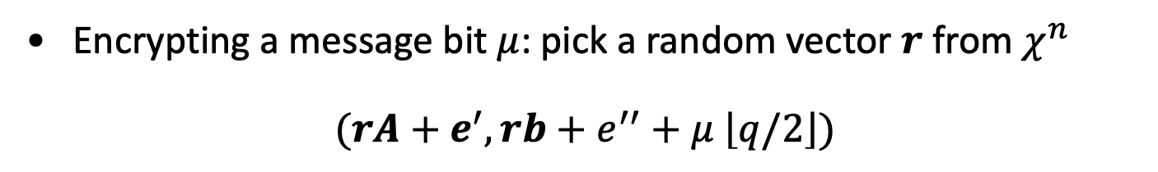
Public-key Encryption
[Regev05, Micciancio’10, Lyubashevsky-Peikert-Regev’10]
Secret key sk = Small secret s from $χ^{n}$
Public key pk: for $i from 1 to n$
$$(A,b=As+e)$$
A
,
s
e
A
+
Encrypting a message bit $μ$: pick a random vector $r$ from $χ^{n}$
$$(rA+e^{′}, rb+e^{′′}+μ \left\lfloor q/2\right\rfloor )$$
Decryption: compute
($rb+e^{′′}+μ \left\lfloor q/2\right\rfloor )−\left(rA+e^{′}\right)s$
and round to nearest multiple of q/2.

Slide 7
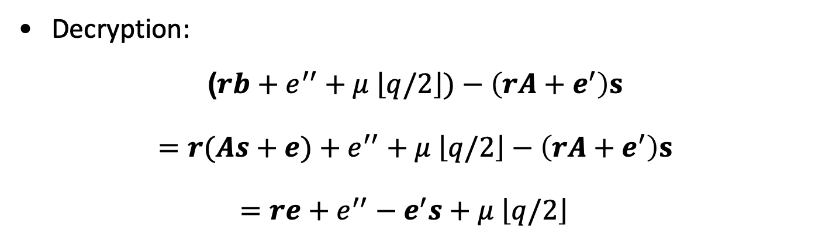
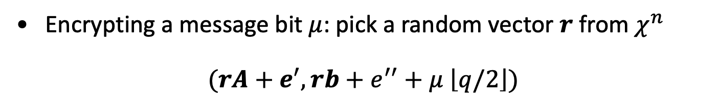

Correctness
Encrypting a message bit $μ$: pick a random vector $r$ from $χ^{n}$
$$(rA+e^{′}, rb+e^{′′}+μ \left\lfloor q/2\right\rfloor )$$
Decryption:
$$\text{(}rb+e^{′′}+μ \left\lfloor q/2\right\rfloor )−\left(rA+e^{′}\right)s$$
$$=r(As+e)+e^{′′}+μ \left\lfloor q/2\right\rfloor −\left(rA+e^{′}\right)s$$
$=re+e^{′′}−e^{′}s+μ \left\lfloor q/2\right\rfloor$
Decryption works as long as |$re−e^{′}s+e′′|<\frac{q}{4}.$

Slide 8
Security
Theorem: under decisional LWE, the scheme is IND-secure. In fact, even more: a ciphertext together with the public key is pseudorandom.
We show this by a hybrid argument.
Let’s stare at a public key, ciphertext pair.
$$pk= \left(A,b=As+e\right), c=Enc\left(pk,μ\right)=rA+e^{′}, rb+e^{′′}+μ \left\lfloor q/2\right\rfloor )$$
Call this distribution Hybrid 0.

Slide 9
Security
Theorem: under decisional LWE, the scheme is IND-secure. In fact, even more: a ciphertext together with the public key is pseudorandom.
Hybrid 1. Change the public key to random (from LWE).
$$\tilde{pk}= \left(A,b\right), \tilde{c}=Enc\left(\tilde{pk},μ\right)=rA+e^{′}, rb+e^{′′}+μ \left\lfloor q/2\right\rfloor )$$
Hybrids 0 and 1 are comp. indist. by decisional LWE.

Slide 10
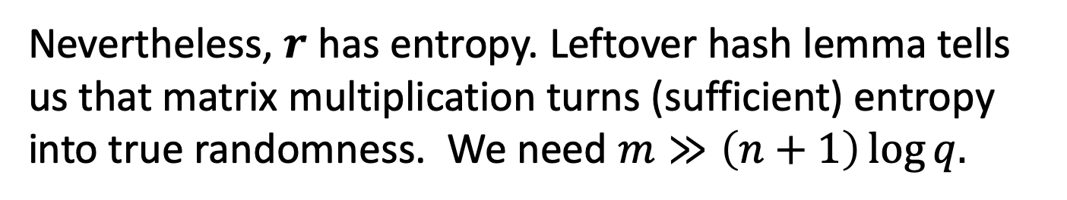










Detour: Leftover Hash Lemma [Impagliazzo-Levin-Luby’90]
We want to understand how $rA, rb=r\left[A \right|b]$ is distributed when $A, b$ is random (and public).
$$r$$
$$c$$
$$a′$$
$$b′$$
$$A$$
$$b$$
$$≈$$
If $r$ is truly random, so is $r\left[A \right|b]$.
But $r$ is NOT truly random! It has small entries.
Nevertheless, $r$ has entropy. Leftover hash lemma tells us that matrix multiplication turns (sufficient) entropy into true randomness. We need $m≫\left(n+1\right)\log{q.}$

Slide 11
Security
Theorem: under decisional LWE, the scheme is IND-secure. In fact, even more: a ciphertext together with the public key is pseudorandom.
Hybrid 1. Change the public key to random (from LWE).
$$\tilde{pk}= \left(A,b\right), \tilde{c}=Enc\left(\tilde{pk},μ\right)=rA, rb+μ \left\lfloor q/2\right\rfloor )$$
Hybrids 0 and 1 are comp. indist. by decisional LWE.

Slide 12
Security
Theorem: under decisional LWE, the scheme is IND-secure. In fact, even more: a ciphertext together with the public key is pseudorandom.
Hybrid 2. Change $rA+e^{′}, rb+e′′$ into random.
$$\tilde{pk}= \left(A,b\right), \tilde{c}=Enc\left(\tilde{pk},μ\right)=a′, b′+μ \left\lfloor q/2\right\rfloor )$$
Hybrids 1 and 2 are comp. indist. by LWE.

Slide 13

Security
Theorem: under decisional LWE, the scheme is IND-secure. In fact, even more: a ciphertext together with the public key is pseudorandom.
Hybrid 2. Change $rA+e^{′}, rb+e′′$ into random.
$$\tilde{pk}= \left(A,b\right), \tilde{c}=Enc\left(\tilde{pk},μ\right)=a′, b′+μ \left\lfloor q/2\right\rfloor )$$
Now, we have the message $μ$ encrypted with a one-time pad which perfectly hides $μ$.

Slide 14
Public-key Encryption
[Regev05]
Secret key sk = Small secret s from $χ^{n}$
Public key pk: for $i from 1 to n$
$$(A,b=As+e)$$
Encrypting a message bit $μ$: pick a random vector $r$ from $χ^{n}$
$$(rA+e^{′}, rb+e^{′′}+μ \left\lfloor q/2\right\rfloor )$$
Decryption: compute
($rb+e^{′′}+μ \left\lfloor q/2\right\rfloor )−\left(rA+e^{′}\right)s$
and round to nearest multiple of q/2.

Slide 15
Homomorphic Encryption

Slide 16


Application 1. Secure Outsourcing
Input: x
Program: P
Enc(x)
x
Enc(P(x))
P(x)
Client
Server (the Cloud)
A Special Case: Encrypted Database Lookup
also called “private information retrieval” (next lec)

Slide 17


Application 2. Secure Collaboration
Hospital
ID
Genome
ID
Phenotype
“Parties learn the genotype-phenotype correlations and nothing else”

Slide 18
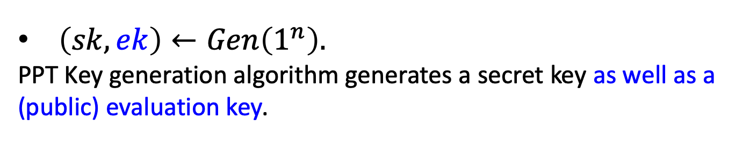
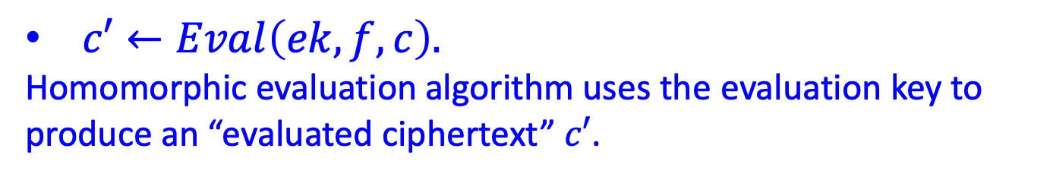
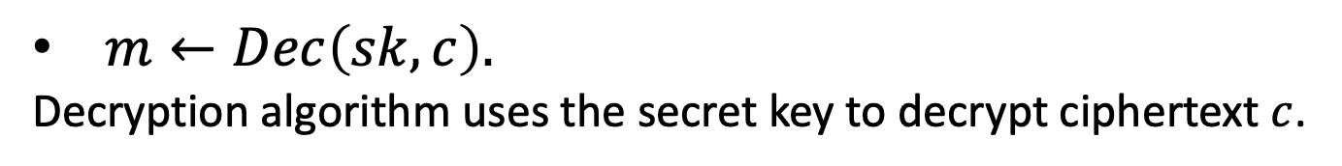
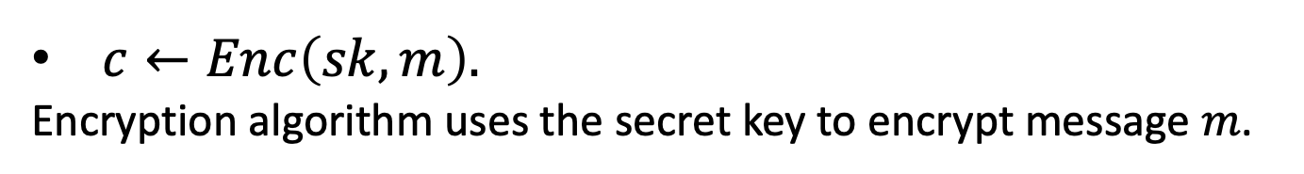
Homomorphic Encryption: Syntax
(can be either secret-key or public-key enc)
4-tuple of PPT algorithms $(Gen,Enc,Dec,Eval)$ s.t.
$\left(sk,ek\right)←Gen\left(1^{n}\right).$
PPT Key generation algorithm generates a secret key as well as a (public) evaluation key.
$c←Enc\left(sk,m\right).$
Encryption algorithm uses the secret key to encrypt message $m$.
$c′←Eval\left(ek,f,c\right).$
Homomorphic evaluation algorithm uses the evaluation key to produce an “evaluated ciphertext” $c′$.
$m←Dec\left(sk,c\right).$
Decryption algorithm uses the secret key to decrypt ciphertext $c$.

Slide 19
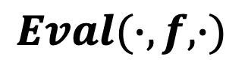




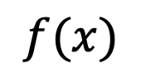


Homomorphic Encryption: Correctness
$Dec(sk,Eval\left(ek,f,Enc(x))\right)=f(x).$
$$x$$
$$f(x)$$
$$Enc$$
$$Dec$$
$$c$$
$$c′$$
$$Eval(∙,f,∙)$$

Slide 20

Homomorphic Encryption: Security
Input: x
Function: f
Enc(sk,x)
$$x$$
Enc(f(x))
Client
Server (the Cloud)
Security against the “curious cloud” = standard IND-security of secret-key encryption
Key Point: Eval is an entirely public algorithm with public inputs.

Slide 21
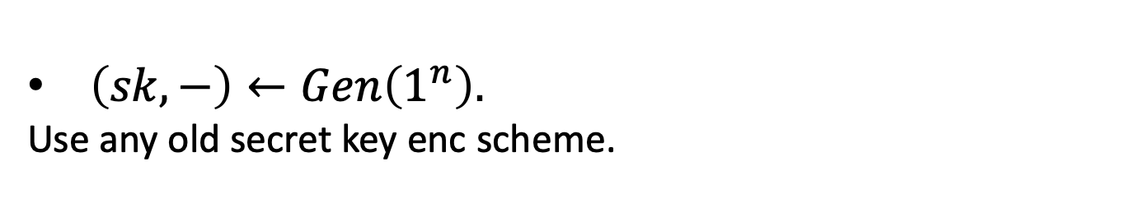
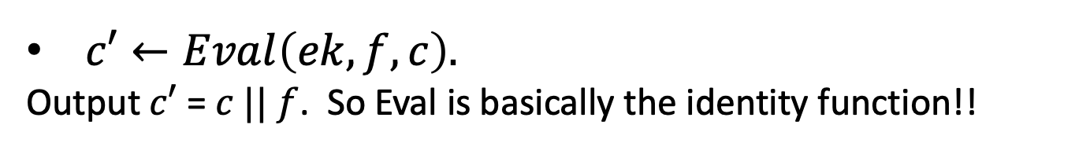
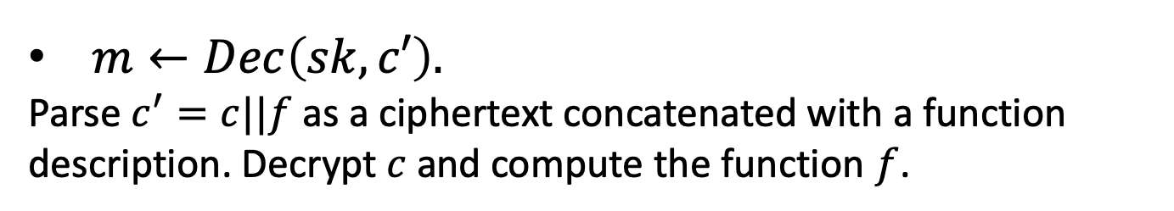

Here is a homomorphic encryption scheme…
$\left(sk,−\right)←Gen\left(1^{n}\right).$
Use any old secret key enc scheme.
$c←Enc\left(sk,m\right).$
Just the secret key encryption algorithm…
$c′←Eval\left(ek,f,c\right).$
Output $c′$ = $c || f$. So Eval is basically the identity function!!
$m←Dec\left(sk,c′\right).$
Parse $c^{′}=c||f$ as a ciphertext concatenated with a function description. Decrypt $c$ and compute the function $f$.
This is correct and it is IND-secure.

Slide 22
Homomorphic Encryption: Compactness
The size (bit-length) of the evaluated ciphertext and the runtime of the decryption is independent of the complexity of the evaluated function.
A Relaxation: The size (bit-length) of the evaluated ciphertext and the runtime of the decryption depends sublinearly on the complexity of the evaluated function.

Slide 23



How to Compute Arbitrary Functions
For us, programs = functions = Boolean circuits with XOR ($+ mod 2$) and AND ($× mod 2$) gates.
$$Enc({(x_{1}+x_{2})x}_{3}x_{4})$$
X
$$Enc(x_{1}+x_{2})$$
$$Enc(x_{3}x_{4})$$
X
+
$$Enc(x_{3})$$
$$Enc(x_{4})$$
$$Enc(x_{2})$$
$$Enc(x_{1})$$
Takeaway: If you can compute XOR and AND on encrypted bits, you can compute everything.

