Slide 1
MIT 6.875
Foundations of Cryptography
Lecture 18

Slide 2
TODAY (and next few lectures): Lattice-based Cryptography

Slide 3
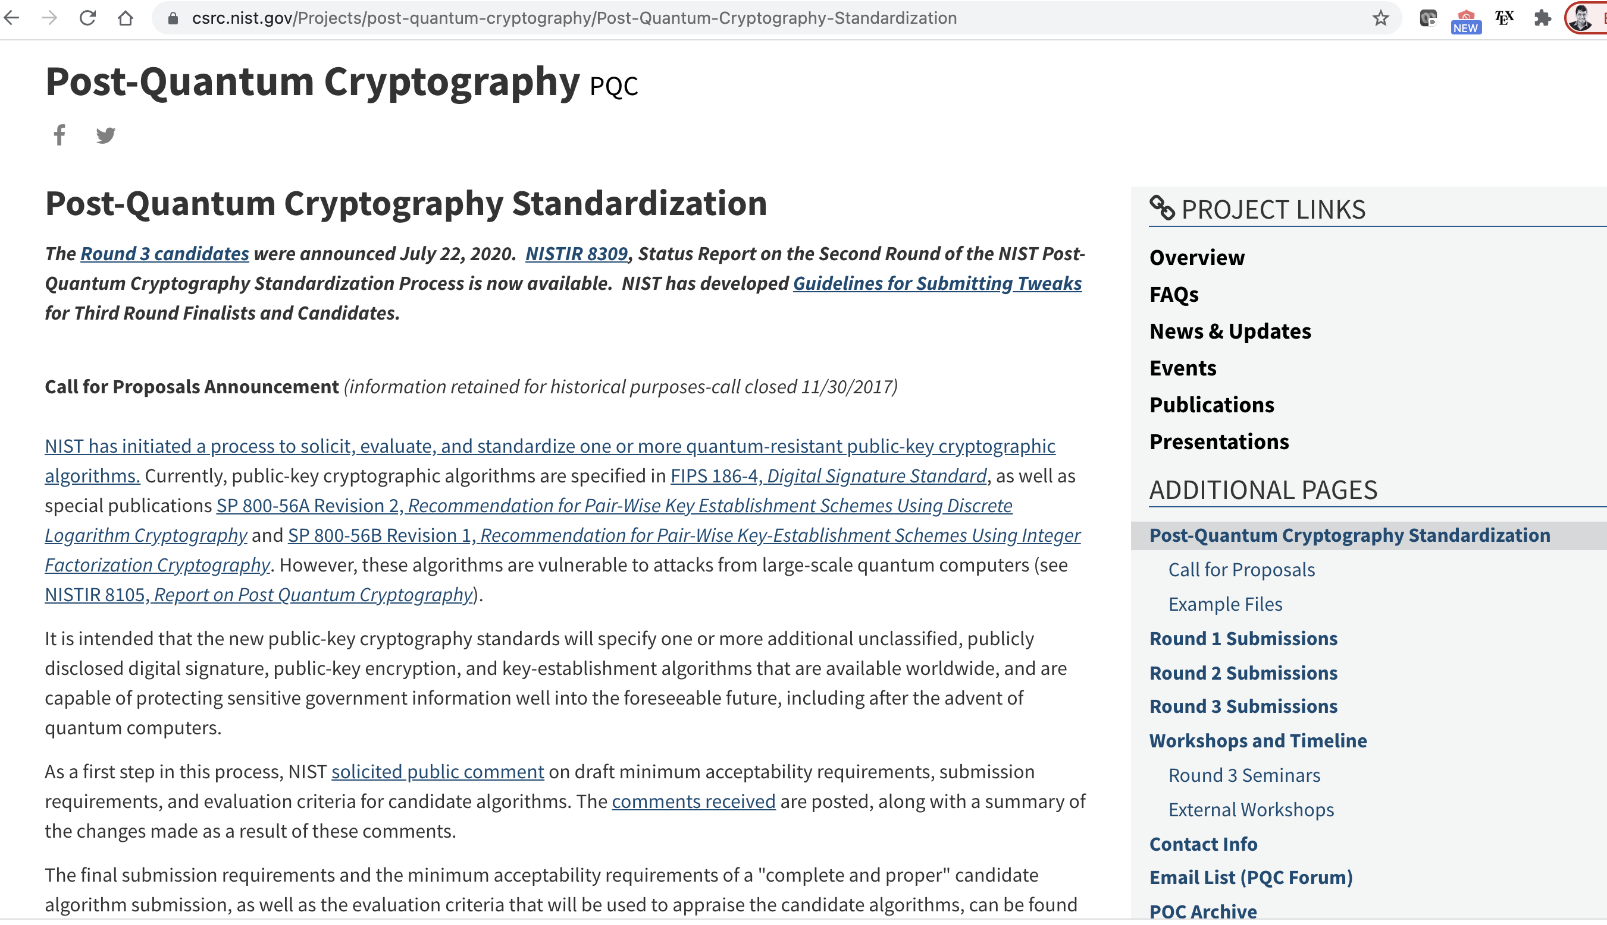
Why Lattice-based Crypto?
Exponentially Hard
(so far)
□ Quantum-Resistant
(so far)

Slide 4
Why Lattice-based Crypto?
Exponentially Hard
(so far)
□ Quantum-Resistant
(so far)
Worst-case hardness
(unique feature of lattice-based crypto)
Simple and Efficient
Enabler of Surprising Capabilities
(Fully Homomorphic Encryption)

Slide 5

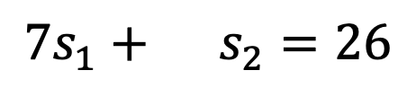
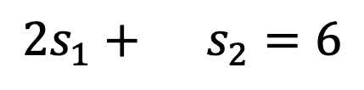
Solving Linear Equations
$$5s_{1}+11s_{2}=2$$
$$2s_{1}+ s_{2}=6$$
$$7s_{1}+ s_{2}=26$$
where all equations are over $ℤ$, the integers

Slide 6
Solving Linear Equations
s
Given:
A
and
A
GOAL: Find s.
More generally, $n$ variables and $m≫n$ equations.

Slide 7

Solving Linear Equations
s
Given:
A
and
A
GOAL: Find s.
EASY! For example, by Gaussian Elimination

Slide 8
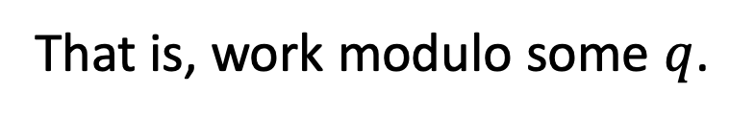

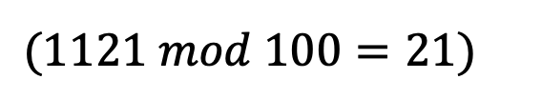
Solving Linear Equations
s
Given:
A
and
A
GOAL: Find s.
How to make it hard:
Chop the head?
That is, work modulo some $q$.
$(1121 mod 100=21)$
Still EASY! Gaussian Elimination mod $q$

Slide 9

Solving Linear Equations
s
Given:
A
and
A
+
e
GOAL: Find s.
How to make it hard: Chop the tail?
Add a small error to each equation.
Still EASY! Linear regression.

Slide 10

Solving Linear Equations
s
Given:
A
and
A
+
e
GOAL: Find s.
How to make it hard: Chop the head and the tail?
Add a small error to each equation and work mod $q$.
Turns out to be very HARD!

Slide 11
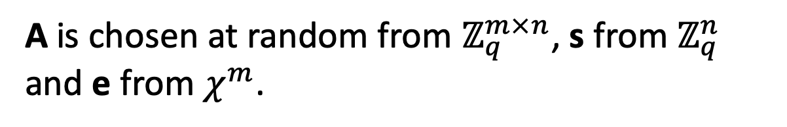
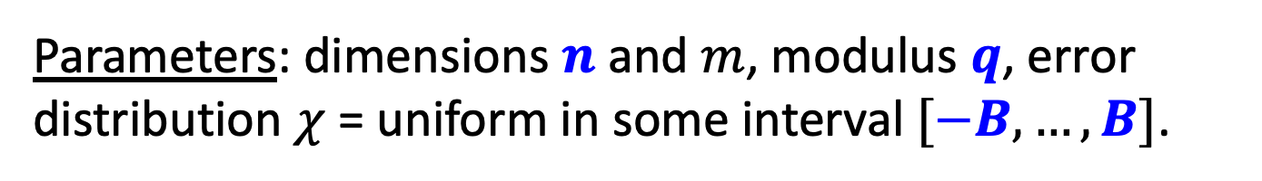
Solving Noisy Modular Linear Equations
Learning with Errors (LWE)
s
Given:
A
and
A
+
e
GOAL: Find s.
Parameters: dimensions $n$ and $m$, modulus $q$, error distribution $χ$ = uniform in some interval $[−B,…,B]$.
A is chosen at random from $ℤ_{q}^{m×n}$, s from $ℤ_{q}^{n}$ and e from $χ^{m}$.

Slide 12

Learning with Errors (LWE)
Decoding Random Linear Codes (over F_{q} with L₁ errors)
Learning Noisy Linear Functions
Worst-case hard Lattice Problems [Regev’05, Peikert’09]
Notes:
The same kind of problems with fhe

Slide 13
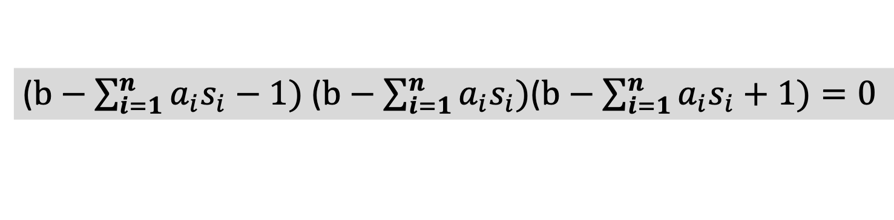

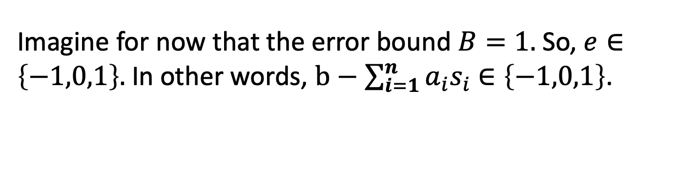
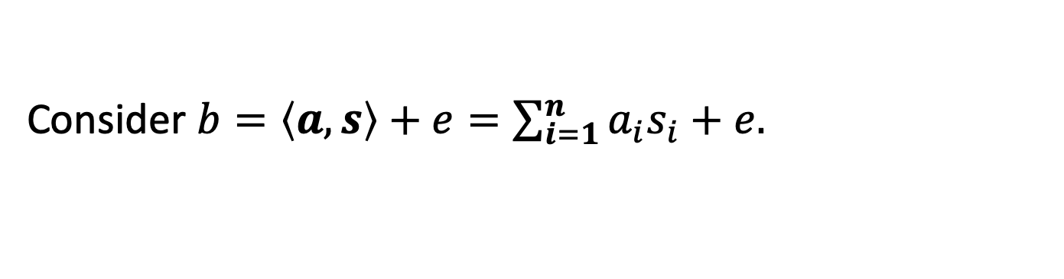
Attack 1: Linearization
Given $A,As+e$, find $s$.
Idea (a) Each noisy linear equation is an exact polynomial eqn.
Consider $b=\left\langle a,s\right\rangle +e=\sum_{i=1}^{n}{a_{i}s_{i}}+e.$
Imagine for now that the error bound $B=1.$ So, $e∈\left\{−1,0,1\right\}.$ In other words, $b−\sum_{i=1}^{n}{a_{i}s_{i}}$ $∈\left\{−1,0,1\right\}$.
So, here is a noiseless polynomial equation on $s_{i}:$
($b−\sum_{i=1}^{n}{a_{i}s_{i}}−1)$ ($b−\sum_{i=1}^{n}{a_{i}s_{i})}$($b−\sum_{i=1}^{n}{a_{i}s_{i}}+1)=0$

Slide 14

Attack 1: Linearization
Given $A,As+e$, find $s$.
BUT: Solving (even degree 2) polynomial equations is NP-hard.
($b−\sum_{i=1}^{n}{a_{i}s_{i}}−1)$ ($b−\sum_{i=1}^{n}{a_{i}s_{i})}$($b−\sum_{i=1}^{n}{a_{i}s_{i}}+1)=0$

Slide 15



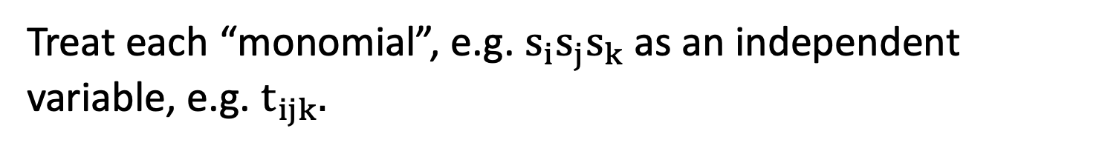
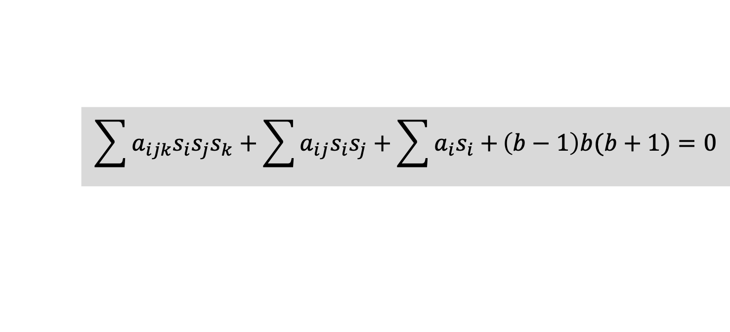
Attack 1: Linearization
($b−\sum_{i=1}^{n}{a_{i}s_{i}}−1)$ ($b−\sum_{i=1}^{n}{a_{i}s_{i})}$($b−\sum_{i=1}^{n}{a_{i}s_{i}}+1)=0$
Idea (b) Easy to solve given sufficiently many equations.
(using a technique called “linearization”)
$$\sum{a_{ijk}s_{i}s_{j}s_{k}}+\sum{a_{ij}s_{i}s_{j}+\sum{a_{i}s_{i}+}}\left(b−1\right)b(b+1)=0$$
Treat each “monomial”, e.g. $s_{i}s_{j}s_{k}$as an independent variable, e.g. $t_{ijk}.$
Now, you have a noiseless linear equation in $t_{ijk}$!!!

Slide 16

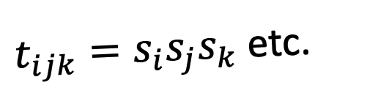
Attack 1: Linearization
$$\sum{a_{ijk}t_{ijk}}+\sum{a_{ij}t_{ij}+\sum{a_{i}t_{i}+}}\left(b−1\right)b(b+1)=0$$
Solution space (with some eqns):
The real solution
$t_{ijk}=s_{i}s_{j}s_{k}$ etc.

Slide 17
Attack 1: Linearization
$$\sum{a_{ijk}t_{ijk}}+\sum{a_{ij}t_{ij}+\sum{a_{i}t_{i}+}}\left(b−1\right)b(b+1)=0$$
Solution space (with more eqns):
The real solution
$t_{ijk}=s_{i}s_{j}s_{k}$ etc.

Slide 18
Attack 1: Linearization
$$\sum{a_{ijk}t_{ijk}}+\sum{a_{ij}t_{ij}+\sum{a_{i}t_{i}+}}\left(b−1\right)b(b+1)=0$$
Solution space (with even more eqns):
The real solution
$t_{ijk}=s_{i}s_{j}s_{k}$ etc.

Slide 19
Attack 1: Linearization
$$\sum{a_{ijk}t_{ijk}}+\sum{a_{ij}t_{ij}+\sum{a_{i}t_{i}+}}\left(b−1\right)b(b+1)=0$$
Solution space (keep going):
The real solution
$t_{ijk}=s_{i}s_{j}s_{k}$ etc.

Slide 20
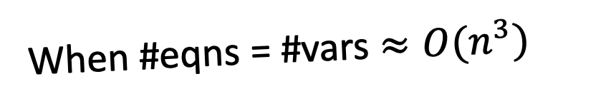
Attack 1: Linearization
$$\sum{a_{ijk}t_{ijk}}+\sum{a_{ij}t_{ij}+\sum{a_{i}t_{i}+}}\left(b−1\right)b(b+1)=0$$
When #eqns = #vars $≈O(n^{3})$
the only surviving solution to the linear system is the real solution.

Slide 21
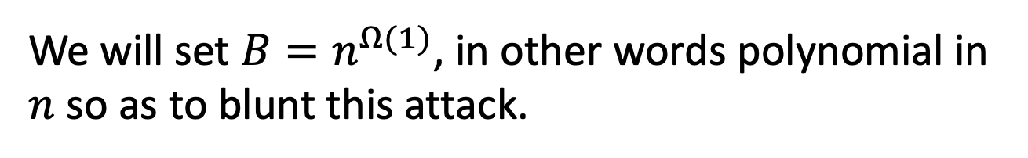

Attack 1: Linearization
Given $A,As+e$, find $s$.
Can solve/break as long as
$$m≫n^{2B+1}$$
We will set $B=n^{Ω(1)}$, in other words polynomial in $n$ so as to blunt this attack.

Slide 22
Attack 2: Lattice Decoding
_{a1*s1+a2*s2}
_{a1*s1+a2*s2+e}
_{a2}
_{a1}
O
The famed Lenstra-Lenstra-Lovasz algorithm decodes
in polynomial time when $q/B>2^{n}$
Notes:
a1 and a2 are columns of A

Slide 23

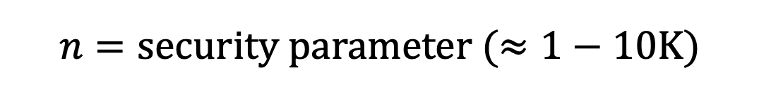
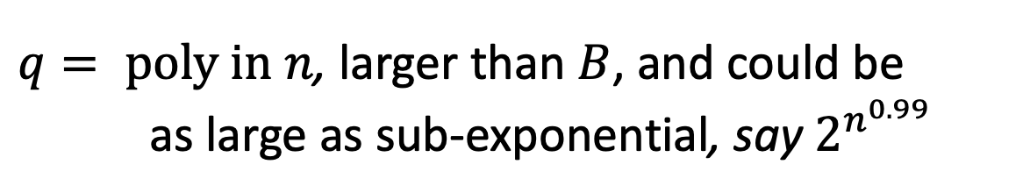


Setting Parameters
Put together, we are safe with:
$$n=security parameter (≈1−10K)$$
$$m=arbitrary poly in n$$
$$B=small poly in n, say \sqrt{n}$$
$q= poly in n$, larger than $B$, and could be as large as sub-exponential, say $2^{n^{0.99}}$
even from quantum computers, AFAWK!

Slide 24
Decisional LWE
Can you distinguish between:
s
and
A
,
A
e
+
,
A
b
Theorem: “Decisional LWE is as hard as LWE”.

Slide 25
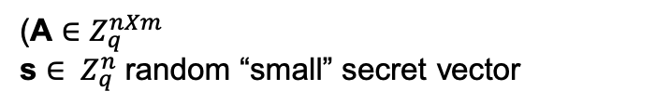

OWF and PRG
g_{A}(s,e) = As+e
(A $∈Z_{q}^{nXm}$
s ${∈ Z}_{q}^{n}$ random “small” secret vector
$e{∈ Z}_{q}^{n}$: random “small” error vector)
g_{A} is a one-way function (assuming LWE)
g_{A} is a pseudo-random generator (decisional LWE)
g_{A} is also a trapdoor function…
also a homomorphic commitment…
Notes:
The same kind of problems with fhe

Slide 26
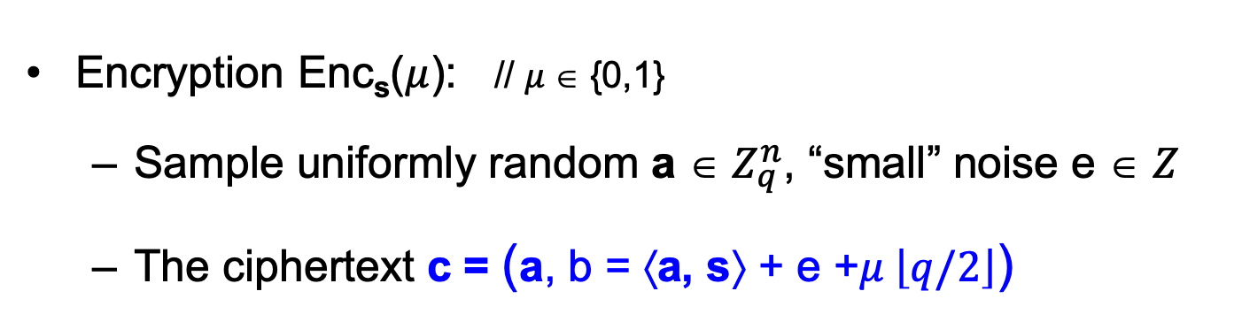
Basic (Secret-key) Encryption
[Regev05]
n = security parameter, q = “small” modulus
Secret key sk = Uniformly random vector s ∈ $Z_{q}^{n}$
Encryption Enc_{s}($μ$): // $μ$∈ {0,1}
Sample uniformly random a ∈ $Z_{q}^{n}$, “small” noise e ∈ $Z$
The ciphertext c = (a, b = ⟨a, s⟩ + e +$μ \left\lfloor q/2\right\rfloor$)
Decryption Dec_{sk}(c): Output Round_{q/2}(b − ⟨a, s⟩ mod q)
// correctness as long as |e| < q/4
Notes:
First iteration is incorrect because you only recover e+m upon decrypting
Solution: “error correct” or “make sure that m is a large number compared to e”

Slide 27
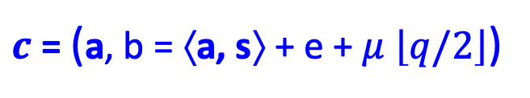

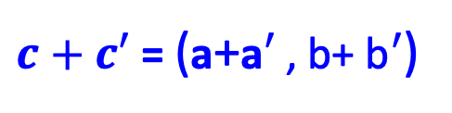
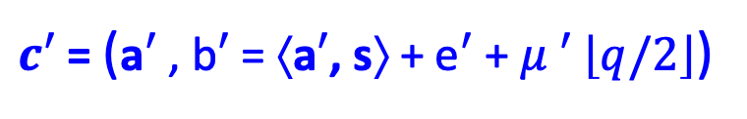
Basic (Secret-key) Encryption
[Regev05]
This scheme is additively homomorphic.
$c$ = (a, b = ⟨a, s⟩ + e + $μ$ $\left\lfloor q/2\right\rfloor$)
$$+$$
Enc_{s}(m)
$c′$ = (a$′$ , b$′$ = ⟨a$′$, s⟩ + e$′$ + $μ ′$ $\left\lfloor q/2\right\rfloor$)
Enc_{s}(m’)
$c+c′$ = (a+a$′$ , b+ b$′$ = ⟨ a +a$′$, s⟩ + (e+e$′$) + ($μ$+ $μ ′)$ $\left\lfloor q/2\right\rfloor$)
$c+c′$ = (a+a$′$ , b+ b$′$)
In words: $c+c′$ is an encryption of $μ$+ $μ ′$ (mod 2)
Notes:
First iteration is incorrect because you only recover e+m upon decrypting
Solution: “error correct” or “make sure that m is a large number compared to e”

Slide 28

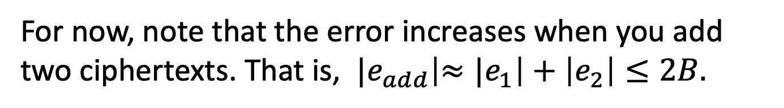
Basic (Secret-key) Encryption
[Regev05]
You can also negate the encrypted bit easily.
We will see how to make this scheme into a fully homomorphic scheme (in the next few lectures)
For now, note that the error increases when you add two ciphertexts. That is, ${|e}_{add}\left|{≈|e}_{1}\right|+\left|e_{2}\right|≤2B.$
Setting $q=n^{\log{n}}$ and $B=\sqrt{n}$ (for example) lets us support any polynomial number of additions.
Notes:
First iteration is incorrect because you only recover e+m upon decrypting
Solution: “error correct” or “make sure that m is a large number compared to e”

Slide 29
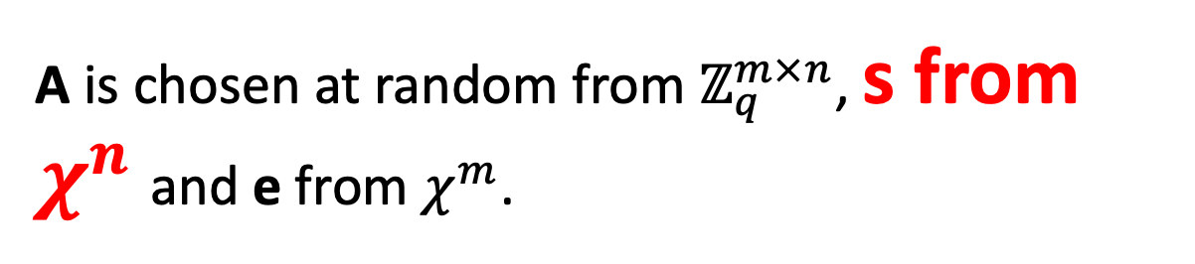
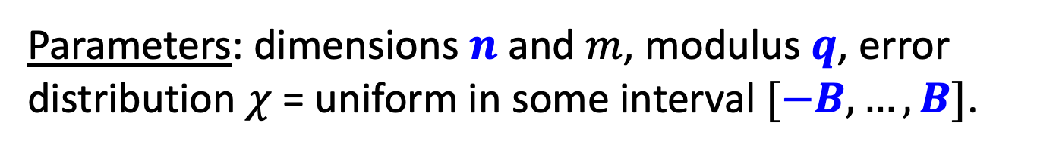
LWE with Small Secrets
s
Given:
A
and
A
+
e
GOAL: Find s.
Parameters: dimensions $n$ and $m$, modulus $q$, error distribution $χ$ = uniform in some interval $[−B,…,B]$.
A is chosen at random from $ℤ_{q}^{m×n}$, s from $χ^{n}$and e from $χ^{m}$.

Slide 30
LWE with Small Secrets
s
Given:
A
and
A
+
e
GOAL: Find (the small secret) s.
Theorem: LWE with small secrets is as hard as LWE.
Proof on the board.

Slide 31

Public-key Encryption
[Regev05]
Secret key sk = Small secret s from $χ^{n}$
Public key pk: for $i from 1 to n$
$$c_{i}=(a_{i},\left\langle a_{i},s\right\rangle +e_{i})$$

Slide 32

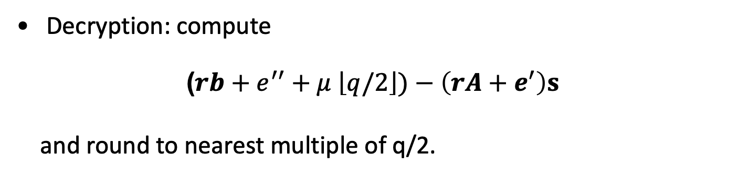
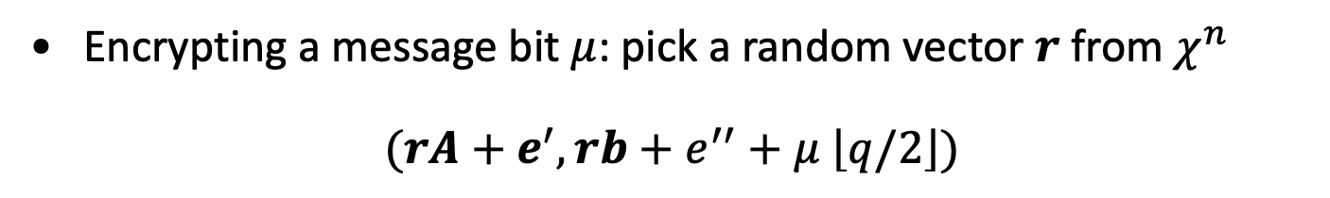
Public-key Encryption
[Regev05]
Secret key sk = Small secret s from $χ^{n}$
Public key pk: for $i from 1 to n$
$$(A,b=As+e)$$
A
,
s
e
A
+
Encrypting a message bit $μ$: pick a random vector $r$ from $χ^{n}$
$$(rA+e^{′}, rb+e^{′′}+μ \left\lfloor q/2\right\rfloor )$$
Decryption: compute
($rb+e^{′′}+μ \left\lfloor q/2\right\rfloor )−\left(rA+e^{′}\right)s$
and round to nearest multiple of q/2.

Slide 33
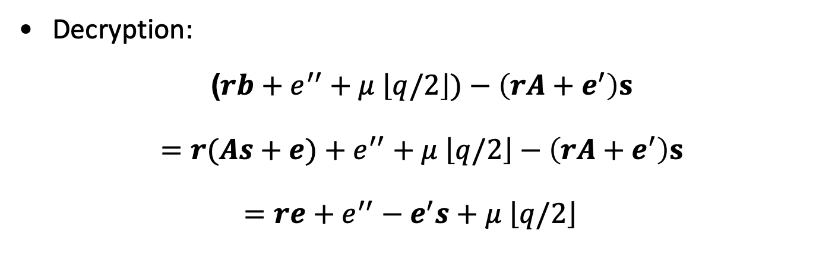
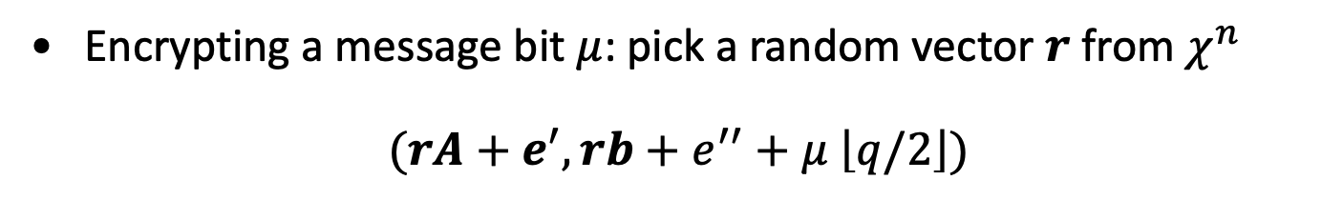
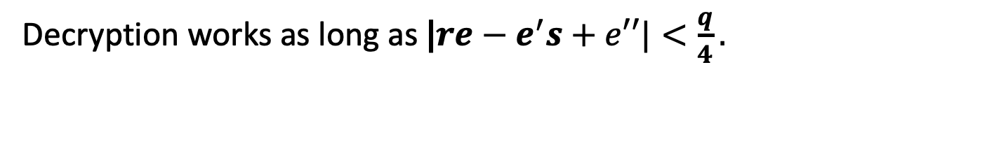
Correctness
Encrypting a message bit $μ$: pick a random vector $r$ from $χ^{n}$
$$(rA+e^{′}, rb+e^{′′}+μ \left\lfloor q/2\right\rfloor )$$
Decryption:
$$\text{(}rb+e^{′′}+μ \left\lfloor q/2\right\rfloor )−\left(rA+e^{′}\right)s$$
$$=r(As+e)+e^{′′}+μ \left\lfloor q/2\right\rfloor −\left(rA+e^{′}\right)s$$
$=re+e^{′′}−e^{′}s+μ \left\lfloor q/2\right\rfloor$
Decryption works as long as |$re−e^{′}s+e′′|<\frac{q}{4}.$

Slide 34
Security
Theorem: under decisional LWE, the scheme is IND-secure. In fact, even more: a ciphertext together with the public key is pseudorandom.
We show this by a hybrid argument.
Let’s stare at a public key, ciphertext pair.
$$pk= \left(A,b=As+e\right), c=Enc\left(pk,μ\right)=rA+e^{′}, rb+e^{′′}+μ \left\lfloor q/2\right\rfloor )$$
Call this distribution Hybrid 0.

Slide 35
Security
Theorem: under decisional LWE, the scheme is IND-secure. In fact, even more: a ciphertext together with the public key is pseudorandom.
Hybrid 1. Change the public key to random (from LWE).
$$\tilde{pk}= \left(A,b\right), \tilde{c}=Enc\left(\tilde{pk},μ\right)=rA+e^{′}, rb+e^{′′}+μ \left\lfloor q/2\right\rfloor )$$
Hybrids 0 and 1 are comp. indist. by decisional LWE.

Slide 36
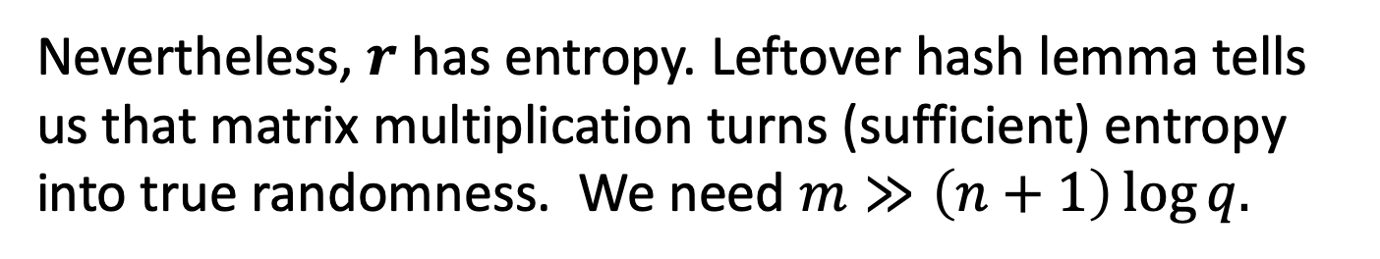




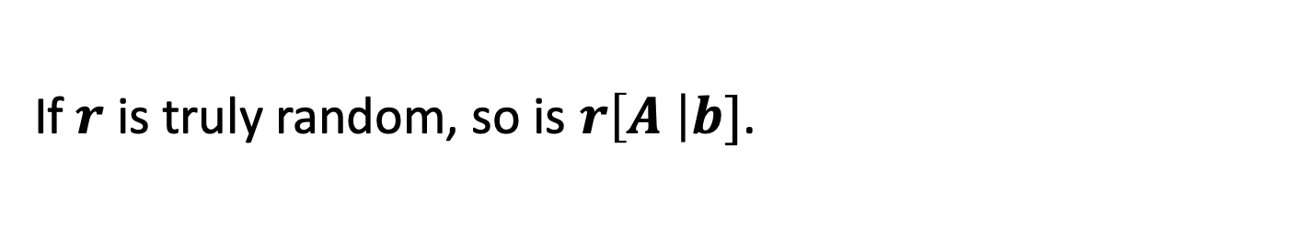





Detour: Leftover Hash Lemma [Impagliazzo-Levin-Luby’90]
We want to understand how $rA, rb=r\left[A \right|b]$ is distributed when $A, b$ is random (and public).
$$r$$
$$c$$
$$a′$$
$$b′$$
$$A$$
$$b$$
$$≈$$
If $r$ is truly random, so is $r\left[A \right|b]$.
But $r$ is NOT truly random! It has small entries.
Nevertheless, $r$ has entropy. Leftover hash lemma tells us that matrix multiplication turns (sufficient) entropy into true randomness. We need $m≫\left(n+1\right)\log{q.}$

Slide 37
Security
Theorem: under decisional LWE, the scheme is IND-secure. In fact, even more: a ciphertext together with the public key is pseudorandom.
Hybrid 1. Change the public key to random (from LWE).
$$\tilde{pk}= \left(A,b\right), \tilde{c}=Enc\left(\tilde{pk},μ\right)=rA, rb+μ \left\lfloor q/2\right\rfloor )$$
Hybrids 0 and 1 are comp. indist. by decisional LWE.

Slide 38
Security
Theorem: under decisional LWE, the scheme is IND-secure. In fact, even more: a ciphertext together with the public key is pseudorandom.
Hybrid 2. Change $rA+e^{′}, rb+e′′$ into random.
$$\tilde{pk}= \left(A,b\right), \tilde{c}=Enc\left(\tilde{pk},μ\right)=a′, b′+μ \left\lfloor q/2\right\rfloor )$$
Hybrids 1 and 2 are comp. indist. by LWE.

Slide 39

Security
Theorem: under decisional LWE, the scheme is IND-secure. In fact, even more: a ciphertext together with the public key is pseudorandom.
Hybrid 2. Change $rA+e^{′}, rb+e′′$ into random.
$$\tilde{pk}= \left(A,b\right), \tilde{c}=Enc\left(\tilde{pk},μ\right)=a′, b′+μ \left\lfloor q/2\right\rfloor )$$
Now, we have the message $μ$ encrypted with a one-time pad which perfectly hides $μ$.

Slide 40
Public-key Encryption
[Regev05]
Secret key sk = Small secret s from $χ^{n}$
Public key pk: for $i from 1 to n$
$$(A,b=As+e)$$
Encrypting a message bit $μ$: pick a random vector $r$ from $χ^{n}$
$$(rA+e^{′}, rb+e^{′′}+μ \left\lfloor q/2\right\rfloor )$$
Decryption: compute
($rb+e^{′′}+μ \left\lfloor q/2\right\rfloor )−\left(rA+e^{′}\right)s$
and round to nearest multiple of q/2.

Slide 41
Next Lecture: Fully Homomorphic Encryption
Notes:
n is a security parameter

