Slide 1
MIT 6.875
Foundations of Cryptography
Lecture 19

Slide 2
Secure 2PC from OT
Theorem [Goldreich-Micali-Wigderson’87]: Assuming OT exists, there is a protocol that solves any two-party computation problem against semi-honest adversaries.

Slide 3
Two-Party Impossibility
Theorem (folklore): There is no perfectly / statistically secure two-party protocol for computing the AND function.

Slide 4
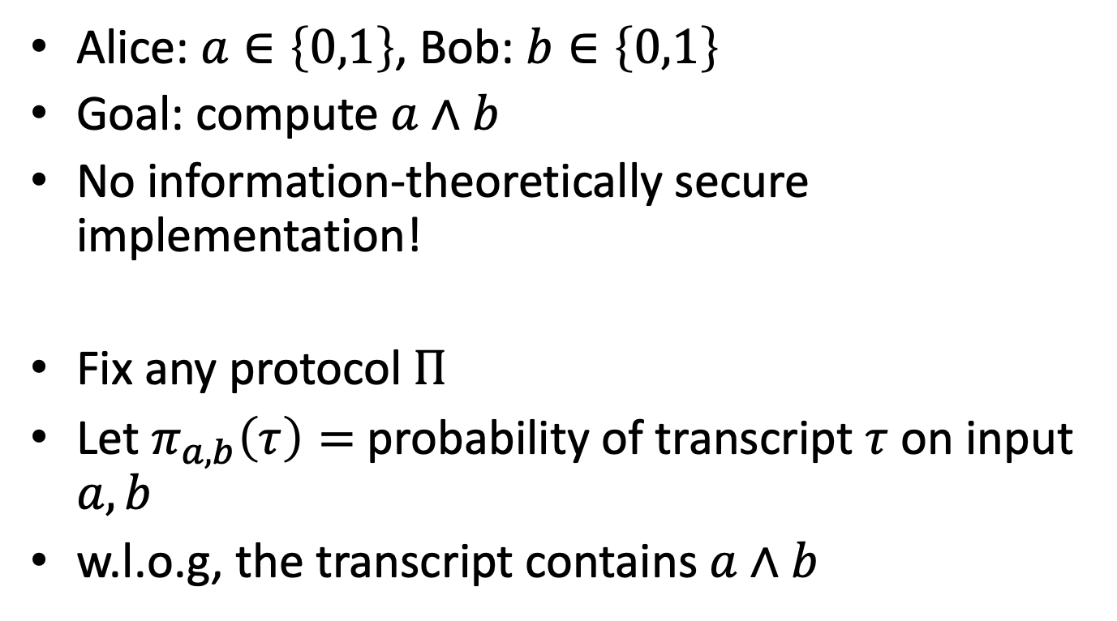
Impossibility of 2-Party Secure MPC
(due to Rotem Oshman)
Alice: $a∈\left\{0,1\right\}$, Bob: $b∈\left\{0,1\right\}$
Goal: compute $a∧b$
No information-theoretically secure implementation!
Fix any protocol $Π$
Let $π_{a,b}\left(τ\right)=$ probability of transcript $τ$ on input $a,b$
w.l.o.g, the transcript contains $a∧b$

Slide 5
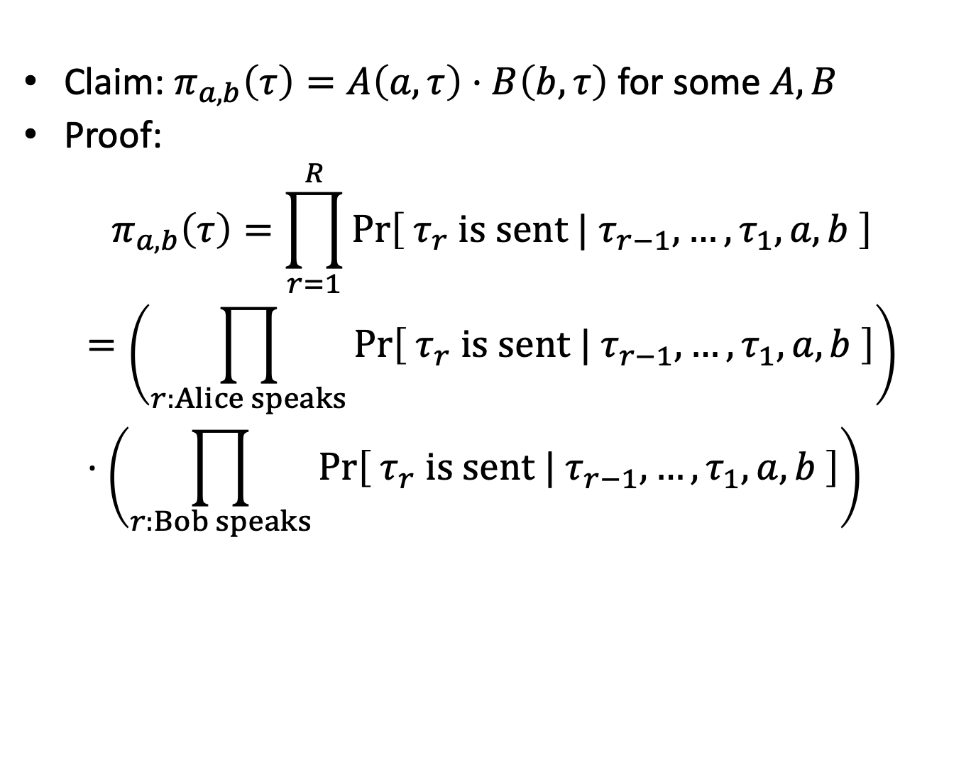
Impossibility of 2-Party Secure MPC
Claim: $π_{a,b}\left(τ\right)=A\left(a,τ\right)⋅B\left(b,τ\right)$ for some $A,B$
Proof:
$$π_{a,b}\left(τ\right)=\prod_{r=1}^{R}{\operatorname{Pr}\left[ τ_{r} is sent | τ_{r−1},…,τ_{1},a,b \right]}$$
$$=\left(\prod_{r:Alice speaks}{\operatorname{Pr}\left[ τ_{r} is sent | τ_{r−1},…,τ_{1},a,b \right]}\right)⋅\left(\prod_{r:Bob speaks}{\operatorname{Pr}\left[ τ_{r} is sent | τ_{r−1},…,τ_{1},a,b \right]}\right)$$
$$A\left(τ,a\right)$$
$$B\left(τ,b\right)$$

Slide 6
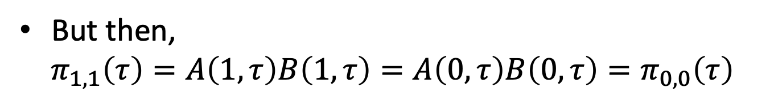



Impossibility of 2-Party Secure MPC
Claim: $π_{a,b}\left(τ\right)=A\left(a,τ\right)⋅B\left(b,τ\right)$ for some $A,B$
From (perfect) security: for every $τ$,
$$π_{1,0}\left(τ\right)=π_{0,0}\left(τ\right)=π_{0,1}\left(τ\right)$$
$$A\left(1,τ\right)B\left(0,τ\right)=A\left(0,τ\right)B\left(0,τ\right)=A\left(0,τ\right)B\left(1,τ\right)$$
$A\left(0,τ\right)=A\left(1,τ\right)$ and
$$B\left(0,τ\right)=B\left(1,τ\right)$$
But then,
$$π_{1,1}\left(τ\right)=A\left(1,τ\right)B\left(1,τ\right)=A\left(0,τ\right)B\left(0,τ\right)=π_{0,0}\left(τ\right)$$
The protocol is incorrect!

Slide 7
Extend to statistical security?
Exercise.

Slide 8
Where to Go From Here?
Option 1: reduce the number of corrupt parties
Option 2: introduce cryptographic assumptions

Slide 9
Secure 2PC from OT
Theorem [Goldreich-Micali-Wigderson’87]: Assuming OT exists, there is a protocol that solves any two-party computation problem against semi-honest adversaries.

Slide 10



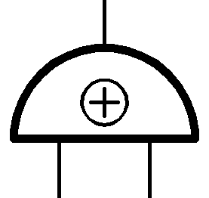



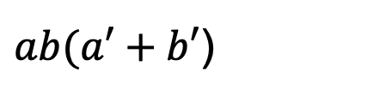

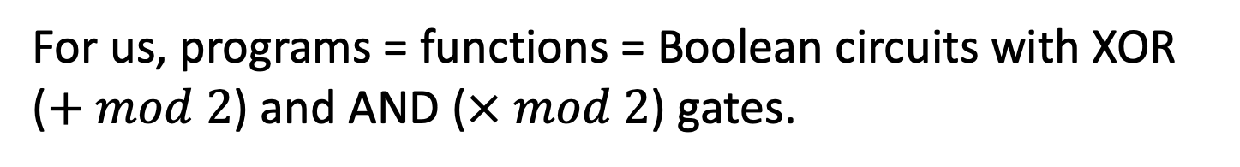

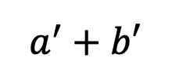
How to Compute Arbitrary Functions
For us, programs = functions = Boolean circuits with XOR ($+ mod 2$) and AND ($× mod 2$) gates.
$ab(a′+b′$)
X
$$ab$$
$$a^{′}+b′$$
+
X
$$a$$
$$b$$
$$a′$$
$$b′$$
Want: If you can compute XOR and AND in the appropriate sense, you can compute everything.

Slide 11
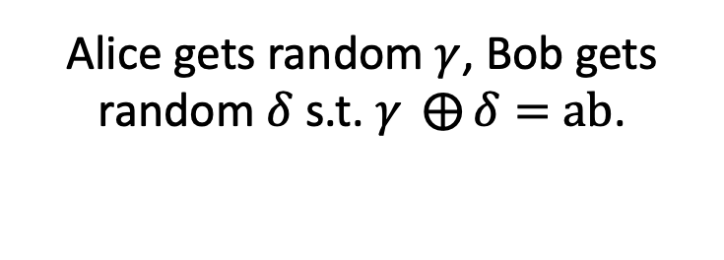






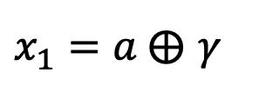
Recap: OT $⇒$ Secret-Shared-AND
$$a∈\{0,1\}$$
Alice gets random $γ$, Bob gets random $δ$ s.t. $γ ⨁{δ}=$ $ab$.
$$b∈\{0,1\}$$
Output: $γ$
Output: $δ$
$$x_{0}=γ$$
Run an OT protocol
Choice bit $b$
$x_{1}=a ⨁$ $γ$
Alice outputs $γ$.
$$x_{1}b+ x_{0}\left(1⨁b\right)$$
Bob gets
$=(x_{1}$ $⨁{ x}_{0})b+x_{0}$
$$=ab⨁γ$$
$$≔δ$$

Slide 12









How to Compute Arbitrary Functions
Secret-sharing Invariant: For each wire of the circuit, Alice and Bob each have a bit whose XOR is the value at the wire.
XOR gate: Locally XOR the shares
AND gate??
X
$$a′$$
$$b′$$
+
X
$$a$$
$$0$$
$$a′$$
$$⊕$$
$$0$$
$$0$$
$$b$$
$$0$$
$$⊕$$
$$b′$$
Base Case: Input wires

Slide 13

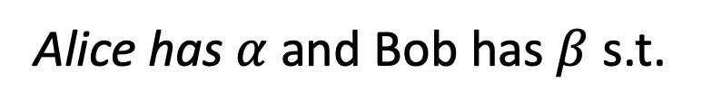
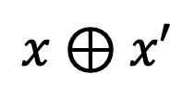
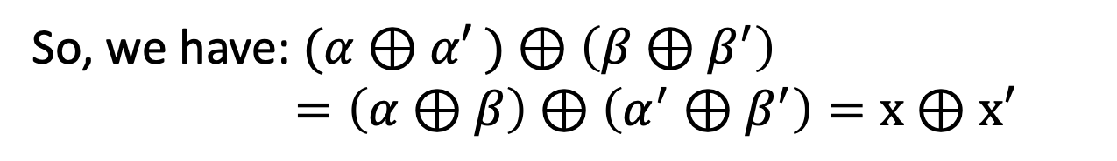




Recap: XOR gate
$$x⊕x′$$
Alice has $α$ and Bob has $β$ s.t.
+
$$α⊕β=x$$
$$x$$
$$x′$$
Alice has $α′$ and Bob has $β′$ s.t.
$$α′⊕β′=x′$$
Alice computes $α⊕α′$ and Bob computes $β⊕β^{′}.$
So, we have: $(α⊕α′$ $)⊕\left(β⊕β^{′}\right)$ $=\left(α⊕β\right)⊕\left(α^{′}⊕β^{′}\right)=x⊕x′$

Slide 14

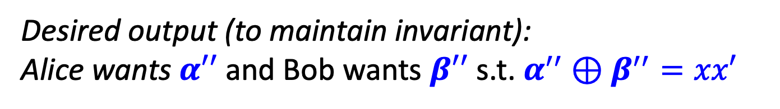
AND gate
$$xx′$$
Alice has $α$ and Bob has $β$ s.t.
X
$$α⊕β=x$$
$$x$$
$$x′$$
Alice has $α′$ and Bob has $β′$ s.t.
$$α′⊕β′=x′$$
Desired output (to maintain invariant):
Alice wants $α′′$ and Bob wants $β′′$ s.t. $α^{′′}⊕β^{′′}=xx′$

Slide 15
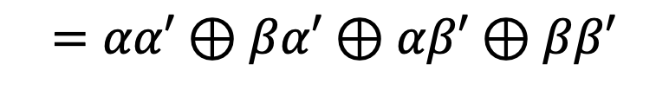



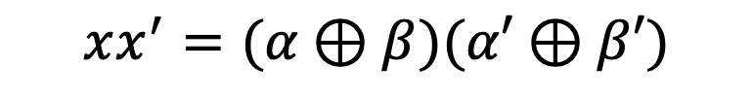

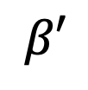
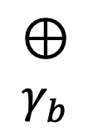







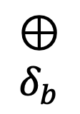
AND gate
$$xx′$$
$$xx^{′}=(α⊕β)(α′⊕β′)$$
X
$$γ_{a}$$
$$=αα′⊕βα′⊕αβ′⊕ββ′$$
$$δ_{a}$$
$$x$$
$$x′$$
$$⊕$$
$$γ_{b}$$
$$⊕$$
$$δ_{b}$$
$$β′$$
$$α$$
$$β$$
$$α′$$
ss-AND
ss-AND
$$δ_{a}$$
$$γ_{a}$$
$$δ_{b}$$
$$γ_{b}$$
$$α^{′′}=αα′⊕γ_{a}⊕δ_{a}$$
$$β^{′′}=ββ′⊕γ_{b}⊕δ_{b}$$

Slide 16



How to Compute Arbitrary Functions
Secret-sharing Invariant: For each wire of the circuit, Alice and Bob each have a bit whose XOR is the value at the wire.
Finally, Alice and Bob exchange the shares at the output wire, and XOR the shares together to obtain the output.
$$α$$
$$α⊕β=ab(a^{′}⊕b^{′})$$
$$β$$
X
+
X
$$a$$
$$b$$
$$a′$$
$$b′$$

Slide 17

Security by Composition
Theorem: If protocol $Π$ securely realizes a function $g$ in the “$f$-hybrid model” and protocol $Π′$ securely realizes $f$, then $Π∘Π′$ securely realizes $g$.
$f$-angel
+
Protocol for $g$ in the $f$-hybrid model
Protocol for $f$

Slide 18
Security: Intuition (ss-AND hybrid model)
Imagine that the parties have access to an ss-AND angel.
$$b$$
$$a$$
$$γ$$
$$δ$$
$γ ⨁{δ}=$ $ab$

Slide 19
Security: Intuition (ss-AND hybrid model)
Imagine that the parties have access to an ss-AND angel.
Simulator for Alice’s view:
XOR gate: simulate given Alice’s input shares
X
$$a′$$
$$b′$$
+
X
$$a$$
$$0$$
$$a′$$
$$0$$
$$0$$
$$b$$
$$0$$
$$b′$$
Input wires: can be simulated given Alice’s input

Slide 20

Security: Intuition (ss-AND hybrid model)
Simulator for Alice’s view:
AND gate: simulate given Alice’s input shares & outputs from the ss-AND angel.
Alice’s share $$=a∙0+ssand\left(a,b\right)+ssand(0,0)$$
X
$$a′$$
$$γ_{alice}$$
$$b′$$
$$δ_{alice}$$
+
X
$$a$$
$$0$$
$$a′$$
$$0$$
$$0$$
$$b$$
$$0$$
$$b′$$
$γ_{alice}$ and $δ_{alice}$ are random, independent of $b$

Slide 21
Security: Intuition (ss-AND hybrid model)
Simulator for Alice’s view:
Output wire: need to know both Alice and Bob’s output shares.
Bob’s output share = Alice’s output share $⊕$ function output
X
$$a′$$
$$b′$$
Simulator knows the function output, and can compute Bob’s output share given Alice’s output share.
+
X
$$a$$
$$0$$
$$a′$$
$$0$$
$$0$$
$$b$$
$$0$$
$$b′$$

Slide 22
Secret-Shared AND protocol
Using the RSA trapdoor permutation.
Input bit: $a$
Input bit: $b$
Pick $N=PQ$ and RSA exponent $e.$
$$N,e$$
Choose random $r_{b}$ and set $s_{b}=r_{b}^{e} mod N$
Let $x_{0}$ be random and $x_{1}=x_{0}⨁a.$
$$s_{0},s_{1}$$
Choose random $s_{1−b}$
Compute $r_{0},r_{1}$ and one-time pad $x_{0},x_{1}$ using hardcore bits
$$x_{0}⨁HCB\left(r_{0}\right)$$
$$x_{1}⨁HCB\left(r_{1}\right)$$
Alice outputs $x_{0}$
Bob outputs $x_{b}$

Slide 23
Secret-Shared AND protocol
Using the RSA trapdoor permutation.
Input bit: $a$
Input bit: $b$
Exercise: Construct simulators for Alice and Bob.

Slide 24
In summary: Secure 2PC from OT
Theorem [Goldreich-Micali-Wigderson’87]: Assuming OT exists, there is a protocol that solves any two-party computation problem against semi-honest adversaries.

Slide 25
In fact, GMW does more:
Theorem [Goldreich-Micali-Wigderson’87]: Assuming OT exists, there is a protocol that solves any multi-party computation problem against semi-honest adversaries.

Slide 26
MPC Outline
Secret-sharing Invariant: For each wire of the circuit, the n parties have a bit each, whose XOR is the value at the wire.
Base case: input wires.
XOR gate: given input shares $\left(α_{1},…,α_{n}\right)$ s.t. $⊕_{i=1}^{n}α_{i}=a$ and $\left(β_{1},…,β_{n}\right)$ s.t. $⊕_{i=1}^{n}β_{i}=b$, compute the shares of the output of the XOR gate:
$$\left(α_{1}+β_{1},…,α_{n}+β_{n}\right)$$
AND gate: given input shares as above, compute the shares of the output of the XOR gate:
$$\left(o_{1},…,o_{n}\right) s.t⊕_{i=1}^{n}o_{i}=ab$$
Exercise!

Slide 27
Security against Malicious (Active) Adversaries

Slide 28


Secure Two-Party Comp: New Def
(possibly randomized) $F\left(x,y;r\right)=(F_{A}\left(x,y;r\right), F_{B}(x,y;r))$
Input: $x$
Input: $y$
Alice
Bob
There exists a PPT simulator ${SIM}_{A}$ such that for any $x$ and $y$:
(${SIM}_{A}\left(x,F_{A}\left(x,y\right)\right),F(x,y)$) $≅$ (${View}_{A}(x,y),F(x,y)$)
i.e. the joint distribution of the view and the output is correct

Slide 29
Counterexample
Randomized functionality $F\left(1^{n},1^{n}\right)=(r,⊥)$.
Protocol:
Alice picks a random $r,$ outputs it and sends it to Bob.
Is this secure?
Secure acc. to old def, insecure acc. to new def.
Ergo, old def is insufficient.

Slide 30
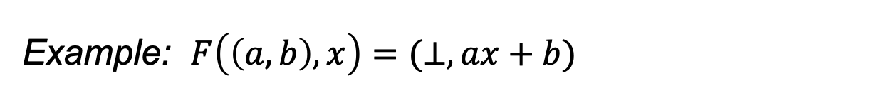
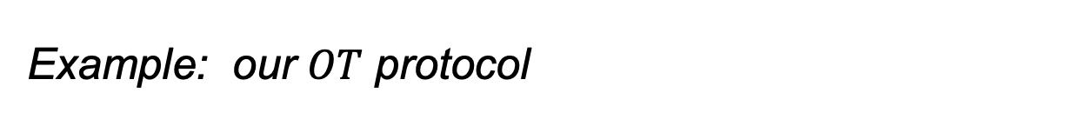
Malicious Parties: Issues to Handle
1. Input (In)dependence: A malicious Alice could choose her input to depend on Bob’s, something she cannot do in the ideal world.
Example: $F\left(\left(a,b\right), x\right)=(⊥,ax+b)$
2. Randomness: A malicious Bob could choose his “random string” in the protocol the way she wants, something she cannot do in the ideal world.
Example: our $OT$ protocol
unavoidable
3. (Un)fairness: A malicious party could block the honest party from learning the output, while learning it herself.
4. Deviate from Other Protocol Instructions.

Slide 31
New (Less) Ideal Model
$$y$$
$$x$$
$$F(x,y)$$
$$abort?$$
If not $abort:$
$$F(x,y)$$

Slide 32
The “GMW Compiler”
Theorem [Goldreich-Micali-Wigderson’87]: Assuming one-way functions exist, there is a general way to transform any semi-honest secure protocol computing a (possibly randomized) function F into a maliciously secure protocol for F.

Slide 33
Input Independence
1. Input (In)dependence: A malicious party could choose her input to depend on Bob’s, something she cannot do in the ideal world.
Solution: Each party commits to their input in sequence, and provides a zero-knowledge proof of knowledge of the underlying input.

Slide 34
Solution: Coin-Tossing Protocol
2. Randomness: A malicious party could choose her “random string” in the protocol the way she wants, something she cannot do in the ideal world.
Def: Realize the functionality $F\left(1^{n},1^{n}\right)=(r,Com(r))$.
$$Com(r_{1})$$
$$r_{2}$$
Output $r=r_{1}⊕r_{2}$
Output $(Com\left(r_{1}\right), r_{2})$

Slide 35
Zero Knowledge Proofs
4. Deviate from Other Protocol Instructions.
Solution: Each message of each party is a deterministic function of their input, their random coins and messages from party B.
When party A sends a message $m=m(x_{A},r_{A},\overline{{msg}_{B}})$, they also prove in zero-knowledge that they did so correctly. That is, they prove in ZK the following NP statement:
$\left(m,\overline{{msg}_{B}},XCom,RCom\right): ∃ x_{A},r_{A}$ s.t. $m=m\left(x_{A},r_{A},\overline{{msg}_{B}}\right) ∧$ $XCom=Com\left(x_{A}\right)∧$
$$RCom=Com\left(r_{A}\right)$$

Slide 36
Optimizations

Slide 37
Optimization 1: Preprocessing OTs
Random OT tuple (or AND tuple, or Beaver tuple after D. Beaver): Alice has $(α,γ_{a})$ and Bob has $(β,γ_{b})$ which are random s.t. $γ_{a}⊕γ_{b}=αβ$.
Theorem: Given O(1) many random OT tuples, we can do OT with information-theoretic security, exchanging O(1) bits.

Slide 38
Optimization 2: OT Extension
Theorem [Beaver’96, Ishai-Kushilevitz-Nissim-Pinkas’03]:
Given O($λ$) many random OT tuples, we can generate $n$ OT tuples exchanging O($n$) bits --- as opposed to the trivial O($nλ$) bits --- and using only symmetric-key crypto.

Slide 39
Complexity of the 2-party solution
Number of OT protocol invocations $=2 ∗ \#AND$ gates
Can be made into O(#inputs $∙λ$): Yao’s garbled circuits
Number of rounds = AND-depth of the circuit
Can be made into O(1) rounds: Yao’s garbled circuits
Communication in bits = $$O(\#AND∙λ+\#outputs)$$
Can be made into O($λ$ #inputs) using FHE: but FHE is computationally more expensive concretely.

