Slide 1
MIT 6.875
Foundations of Cryptography
Lecture 16

Slide 2
Interaction is Necessary for ZK
Theorem: If a language L has a non-interactive (one-message) ZK proof system, then L can be solved in probabilistic polynomial time.
That seems like the end of the road for non-interactive ZK (?)

Slide 3

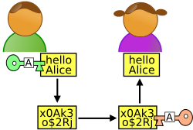
Two Roads to Non-Interactive ZK (NIZK)
1. Random Oracle Model & Fiat-Shamir Transform.
Random Oracle
Graph G
Graph G
$$π$$
2. Common Random String Model.

Slide 4




The Common Random String Model
CRS
010111000101010010
Graph G
Graph G
$$π$$

Slide 5

The Common Reference String Model
$$CRS←D$$
(e.g., CRS = product of two primes)
Graph G
Graph G
$$π$$

Slide 6
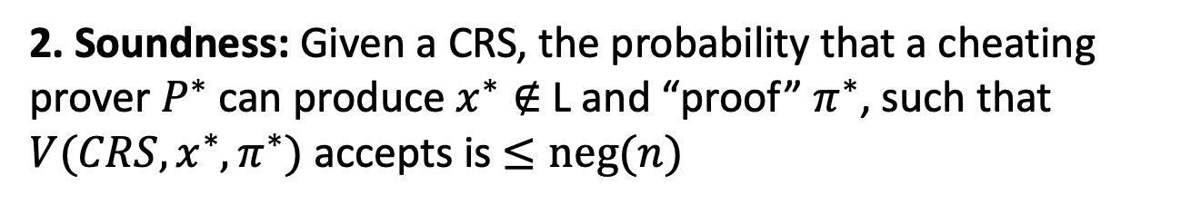
NIZK for a language L in the CRS Model
CRS
010111000101010010
Graph G
Graph G
$$π$$
1. Completeness: For every $x∈$L, V accepts P’s proof.
2. Soundness: Given a CRS, the probability that a cheating prover $P^{∗}$ can produce $x^{∗}∉$L and “proof” $π^{∗}$, such that ${V(CRS,x^{∗},π}^{∗})$ accepts is $≤neg(n)$
Notes:
Need to be careful defining soundness. Non-adaptive (prover P* declares the NO instance G* first and then gets the CRS and produces a “proof” pi*) or adaptive (P* sees the CRS and then gets to choose G* and pi*)?

Slide 7
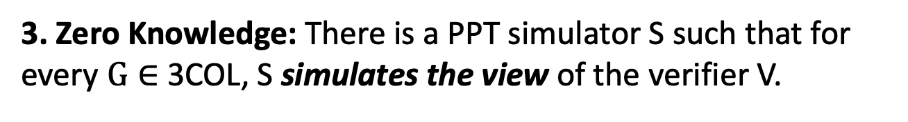
NIZK in the CRS Model
CRS
010111000101010010
Graph G
Graph G
$$π$$
3. Zero Knowledge: There is a PPT simulator S such that for every $G∈$ 3COL, S simulates the view of the verifier V.
$S(G)≈(CRS←D,$ $π←P(G,colors))$

Slide 8
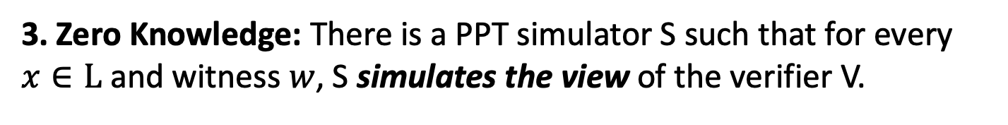
NIZK for a language L in the CRS Model
CRS
010111000101010010
Graph G
Graph G
$$π$$
3. Zero Knowledge: There is a PPT simulator S such that for every $x∈L$ and witness $w$, S simulates the view of the verifier V.
$S(x)≈(CRS←Unif,$ $π←P(CRS,x,w))$

Slide 9
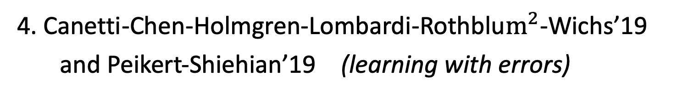
HOW TO CONSTRUCT NIZK IN THE CRS MODEL
1. Blum-Feldman-Micali’88 (quadratic residuosity)
1. Blum-Feldman-Micali’88 (quadratic residuosity)
2. Feige-Lapidot-Shamir’90 (factoring)
3. Groth-Ostrovsky-Sahai’06 (bilinear maps)
4. Canetti-Chen-Holmgren-Lombardi-Rothblu$m^{2}$-Wichs’19
and Peikert-Shiehian’19 (learning with errors)

Slide 10
HOW TO CONSTRUCT NIZK IN THE CRS MODEL
Step 1. Review our number theory hammers & polish them.
Step 2. Construct NIZK for a special NP language, namely quadratic non-residuosity.
Step 3. Bootstrap to NIZK for 3SAT, an NP-complete language.

Slide 11
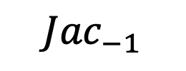
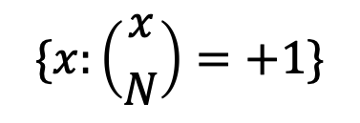
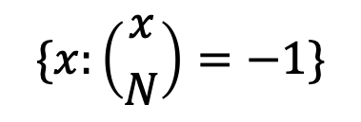

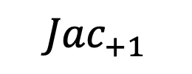
Jacobi Symbol
Let $N=pq$ be a product of two large primes.
$$Z_{N}^{∗}$$
$${Jac}_{−1}$$
$${Jac}_{+1}$$
$$\{x:\left({x \atop N}\right)=−1\}$$
$$\{x:\left({x \atop N}\right)=+1\}$$

Slide 12
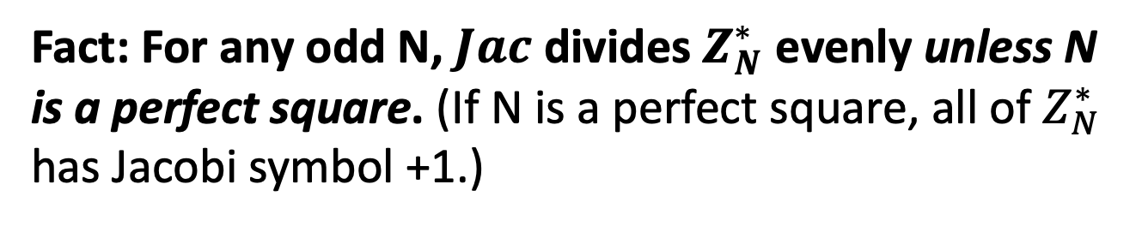
Jacobi Symbol
Fact: For any odd N, $Jac$ divides $Z_{N}^{∗}$ evenly unless N is a perfect square. (If N is a perfect square, all of $Z_{N}^{∗}$ has Jacobi symbol +1.)
$$Z_{N}^{∗}$$
$${Jac}_{−1}$$
$${Jac}_{+1}$$
$$\{x:\left({x \atop N}\right)=−1\}$$
$$\{x:\left({x \atop N}\right)=+1\}$$

Slide 13
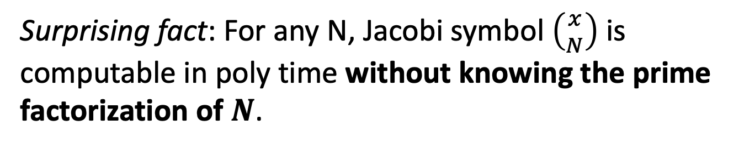
Jacobi Symbol
Surprising fact: For any N, Jacobi symbol $\left({x \atop N}\right)$ is computable in poly time without knowing the prime factorization of $N$.
$$Z_{N}^{∗}$$
$${Jac}_{−1}$$
$${Jac}_{+1}$$
$$\{x:\left({x \atop N}\right)=−1\}$$
$$\{x:\left({x \atop N}\right)=+1\}$$

Slide 14

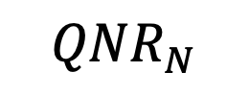
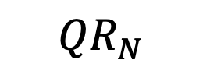
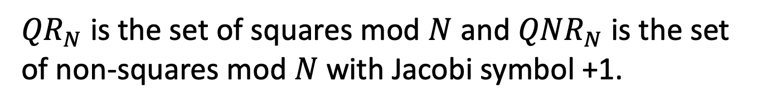
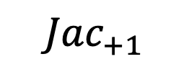

Quadratic Residues / Squares
Let $N=pq$ be a product of two large primes.
$${Jac}_{+1}$$
So: ${QR}_{N}= \{x:\left({x \atop p}\right)=\left({x \atop q}\right)=+1\}$
$${QR}_{N}$$
${QNR}_{N}= \{x:\left({x \atop p}\right)=\left({x \atop q}\right)=−1\}$
$${QNR}_{N}$$
${QR}_{N}$ is the set of squares mod $N$ and ${QNR}_{N}$ is the set of non-squares mod $N$ with Jacobi symbol +1.

Slide 15
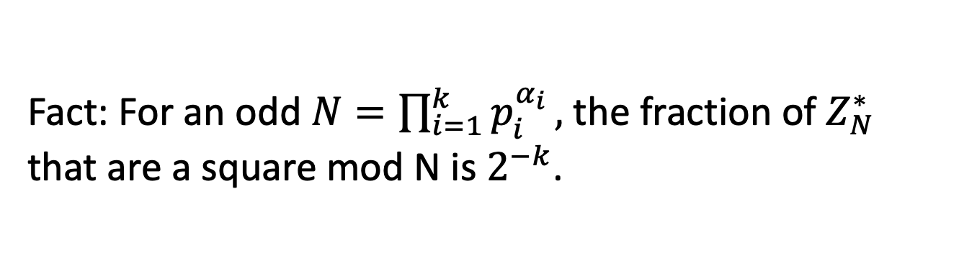
Quadratic Residues / Squares
Fact: For an odd $N=\prod_{i=1}^{k}{p_{i}^{α_{i}}},$ the fraction of $Z_{N}^{∗}$ that are a square mod N is $2^{−k}$.
$${Jac}_{+1}$$
So: ${QR}_{N}= \{x:\left({x \atop p}\right)=\left({x \atop q}\right)=+1\}$
$${QR}_{N}$$
${QNR}_{N}= \{x:\left({x \atop p}\right)=\left({x \atop q}\right)=−1\}$
$${QNR}_{N}$$
${QR}_{N}$ is the set of squares mod $N$ and ${QNR}_{N}$ is the set of non-squares mod $N$ with Jacobi symbol +1.

Slide 16
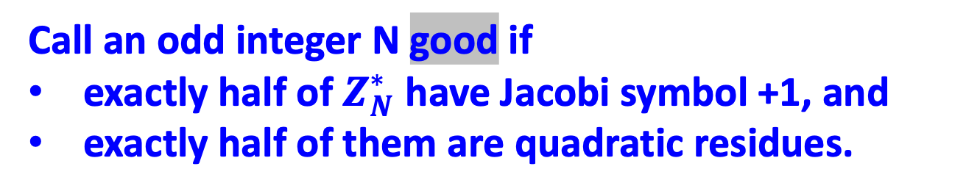
Quadratic Residues
Call an odd integer N good if
exactly half of $Z_{N}^{∗}$ have Jacobi symbol +1, and
exactly half of them are quadratic residues.
$${Jac}_{+1}$$
$${QR}_{N}$$
$${QNR}_{N}$$
${QR}_{N}$ is the set of squares mod $N$ and ${QNR}_{N}$ is the set of non-squares mod $N$ with Jacobi symbol +1.

Slide 17
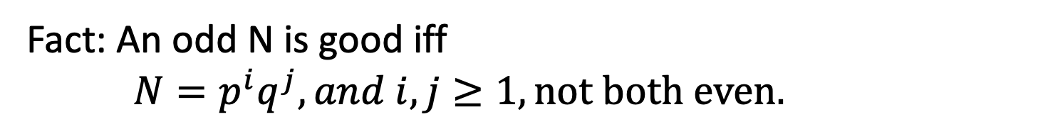
Quadratic Residues
Fact: An odd N is good iff $N=p^{i}q^{j}, and i,j≥1, not both even.$
$${Jac}_{+1}$$
$${QR}_{N}$$
$${QNR}_{N}$$

Slide 18
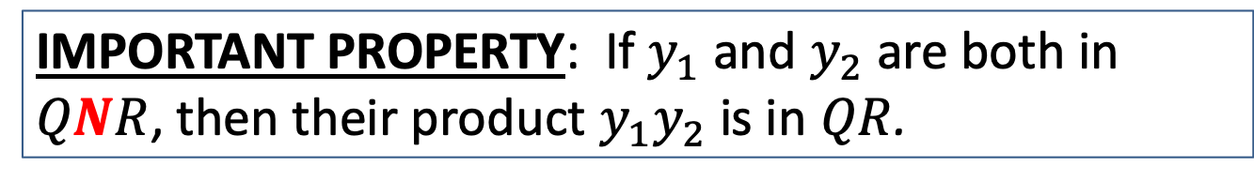
Quadratic Residues
Fact: An odd N is good iff $N=p^{i}q^{j}, and i,j≥1, not both even.$
$${Jac}_{+1}$$
$${QR}_{N}$$
$${QNR}_{N}$$
IMPORTANT PROPERTY: If $y_{1}$ and $y_{2}$ are both in $QNR$, then their product $y_{1}y_{2}$ is in $QR$.

Slide 19
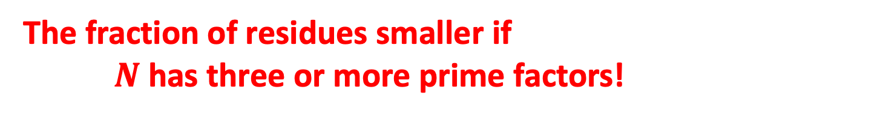

Quadratic Residues
The fraction of residues smaller if $N$ has three or more prime factors!
$${Jac}_{+1}$$
$${QR}_{N}$$
$${QNR}_{N}$$
IMPORTANT PROPERTY: If $y_{1}$ and $y_{2}$ are both in $QNR$, then their product $y_{1}y_{2}$ is in $QR$.

Slide 20
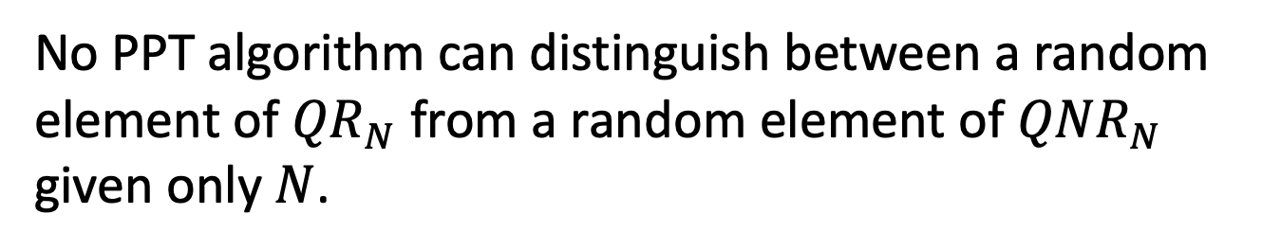
Quadratic Residuosity
Let $N=pq$ be a product of two large primes.
Quadratic Residuosity Assumption (QRA)
No PPT algorithm can distinguish between a random element of ${QR}_{N}$ from a random element of ${QNR}_{N}$ given only $N$.

Slide 21
HOW TO CONSTRUCT NIZK IN THE CRS MODEL
Step 1. Review our number theory hammers & polish them.
Step 2. Construct NIZK for a special NP language, namely quadratic non-residuosity.
Step 3. Bootstrap to NIZK for 3SAT, an NP-complete language.

Slide 22

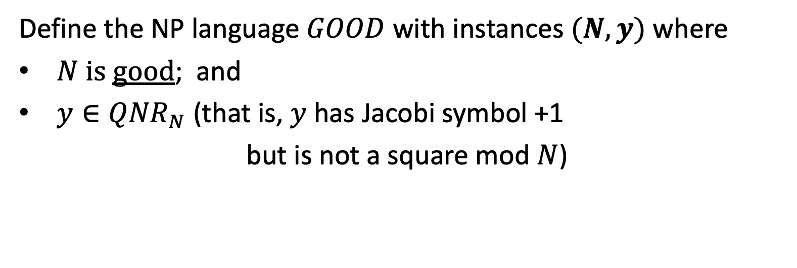




NIZK for Quadratic Non-Residuosity
Define the NP language $GOOD$ with instances $(N,y)$ where
$N$ is good; and
$y∈{QNR}_{N}$ (that is, $y$ has Jacobi symbol +1
but is not a square mod $N$)
$$Z_{N}^{∗}$$
$${QR}_{N}$$
$${Jac}_{−1}$$
$${Jac}_{+1}$$
$${QNR}_{N}$$

Slide 23
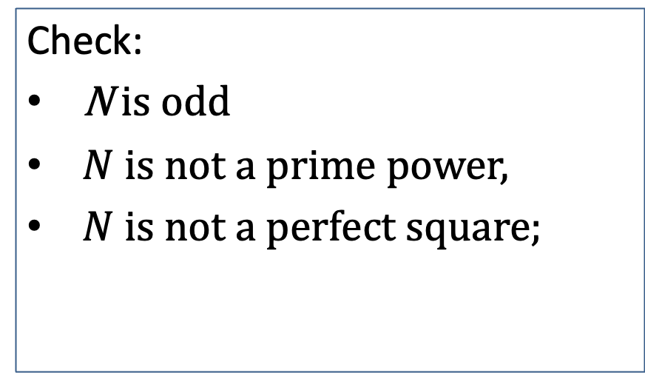
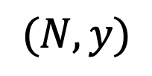
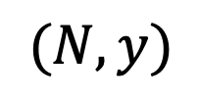
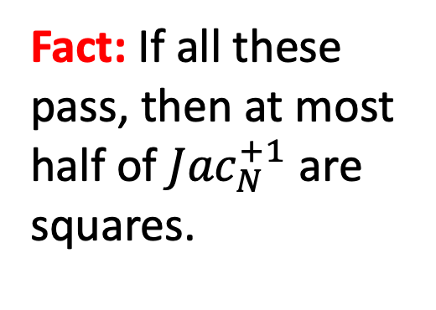
NIZK for Quadratic Non-Residuosity
$$CRS=(r_{1},r_{2},…,r_{m})←{({Jac}_{N}^{+1})}^{m}$$
$$(N,y)$$
$$(N,y)$$
Check:
N is odd
$N$ is not a prime power,
$N$ is not a perfect square;
Fact: If all these pass, then at most half of ${Jac}_{N}^{+1}$ are squares.

Slide 24
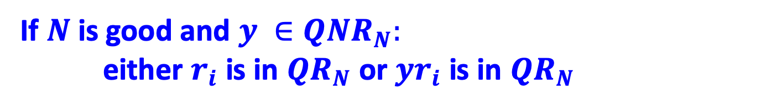

NIZK for Quadratic Non-Residuosity
$$CRS=(r_{1},r_{2},…,r_{m})←{({Jac}_{N}^{+1})}^{m}$$
$$(N,y)$$
$$(N,y)$$
If $N$ is good and $y ∈{QNR}_{N}:$ either $r_{i}$ is in ${QR}_{N}$ or ${yr}_{i}$ is in ${QR}_{N}$
so I can compute $\sqrt{r_{i}}$ or $\sqrt{yr_{i}}$.
If not … I’ll be stuck!

Slide 25
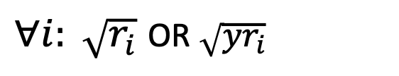
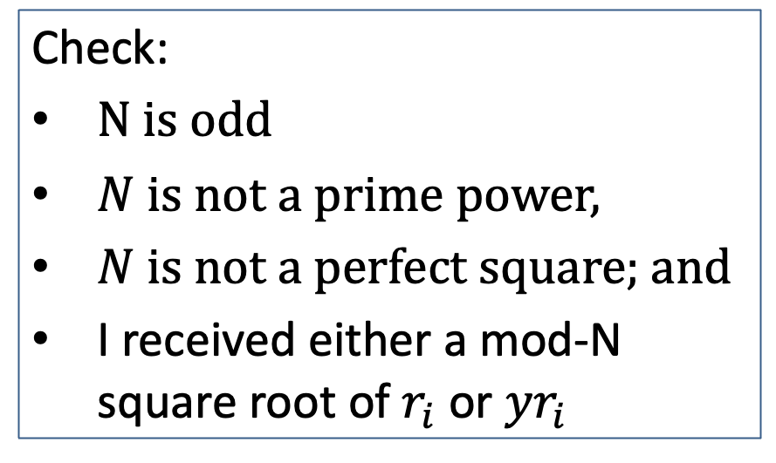
NIZK for Quadratic Non-Residuosity
$$CRS=(r_{1},r_{2},…,r_{m})←{({Jac}_{N}^{+1})}^{m}$$
$$(N,y)$$
$$(N,y)$$
$∀i: \sqrt{r_{i}}$ OR $\sqrt{yr_{i}}$
Check:
N is odd
$N$ is not a prime power,
$N$ is not a perfect square; and
I received either a mod-N square root of $r_{i}$ or ${yr}_{i}$

Slide 26
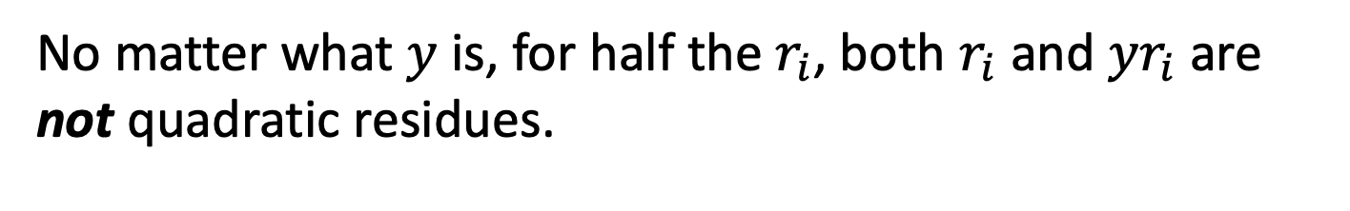
NIZK for Quadratic Non-Residuosity
$$CRS=(r_{1},r_{2},…,r_{m})←{({Jac}_{N}^{+1})}^{m}$$
$$(N,y)$$
$$(N,y)$$
$∀i: \sqrt{r_{i}}$ OR $\sqrt{yr_{i}}$
Soundness (what if $N$ has more than 2 prime factors)
No matter what $y$ is, for half the $r_{i}$, both $r_{i}$ and ${yr}_{i}$ are not quadratic residues.

Slide 27
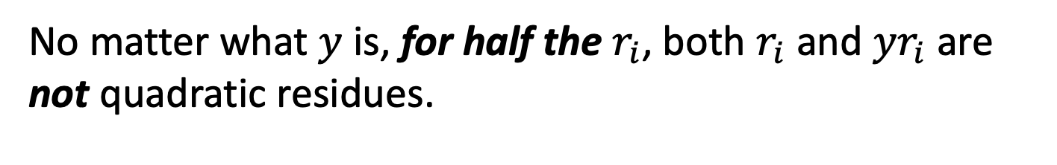
NIZK for Quadratic Non-Residuosity
$$CRS=(r_{1},r_{2},…,r_{m})←{({Jac}_{N}^{+1})}^{m}$$
$$(N,y)$$
$$(N,y)$$
$∀i: \sqrt{r_{i}}$ OR $\sqrt{yr_{i}}$
Soundness (what if $N$ has more than 2 prime factors)
No matter what $y$ is, for half the $r_{i}$, both $r_{i}$ and ${yr}_{i}$ are not quadratic residues.

Slide 28
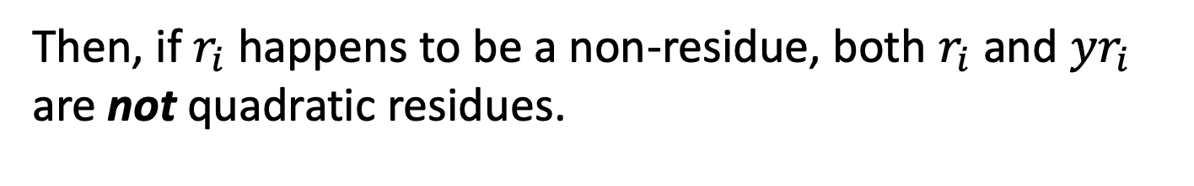
NIZK for Quadratic Non-Residuosity
$$CRS=(r_{1},r_{2},…,r_{m})←{({Jac}_{N}^{+1})}^{m}$$
$$(N,y)$$
$$(N,y)$$
$∀i: \sqrt{r_{i}}$ OR $\sqrt{yr_{i}}$
Soundness (what if $y$ is a residue)
Then, if $r_{i}$ happens to be a non-residue, both $r_{i}$ and ${yr}_{i}$ are not quadratic residues.

Slide 29
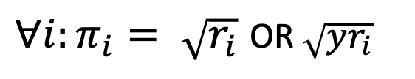
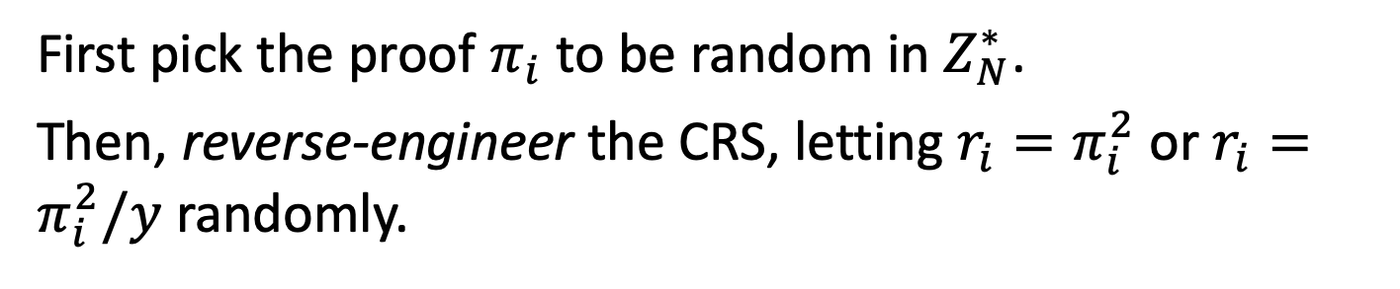
NIZK for Quadratic Non-Residuosity
$$CRS=(r_{1},r_{2},…,r_{m})←{({Jac}_{N}^{+1})}^{m}$$
$$(N,y)$$
$$(N,y)$$
$∀i:π_{i}= \sqrt{r_{i}}$ OR $\sqrt{yr_{i}}$
(Perfect) Zero Knowledge Simulator S:
First pick the proof $π_{i}$ to be random in $Z_{N}^{∗}$.
Then, reverse-engineer the CRS, letting $r_{i}=π_{i}^{2}$ or $r_{i}=π_{i}^{2}/y$ randomly.

Slide 30

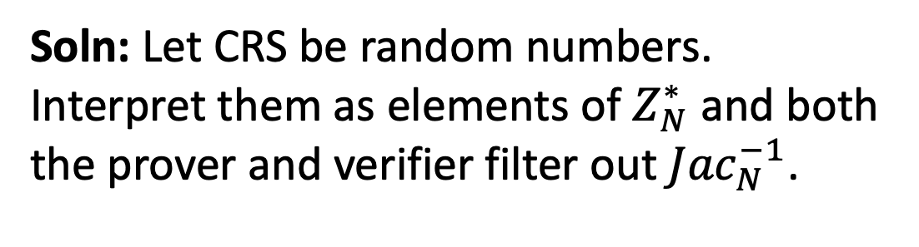
NIZK for Quadratic Non-Residuosity
$$CRS=(r_{1},r_{2},…,r_{m})←{({Jac}_{N}^{+1})}^{m}$$
$$(N,y)$$
$$(N,y)$$
CRS depends on the instance N. Not good.
Soln: Let CRS be random numbers. Interpret them as elements of $Z_{N}^{∗}$ and both the prover and verifier filter out ${Jac}_{N}^{−1}$.

Slide 31
NEXT LECTURE
Step 1. Review our number theory hammers & polish them.
Step 2. Construct NIZK for a special NP language, namely quadratic non-residuosity.
Step 3. Bootstrap to NIZK for 3SAT, an NP-complete language.

Slide 32
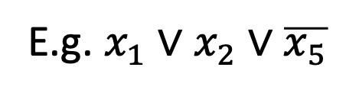
3SAT
Boolean Variables: $x_{i}$ can be either true (1) or false (0)
A Literal is either $x_{i}$ or $\overline{x_{i}}$.
A Clause is a disjunction of literals.
E.g. $x_{1}∨$ $x_{2}∨\overline{x_{5}}$
A Clause is true if any one of the literals is true.

Slide 33
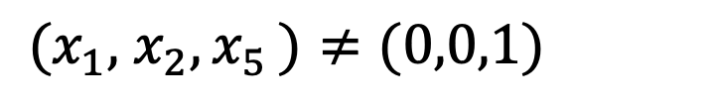
3SAT
Boolean Variables: $x_{i}$ can be either true (1) or false (0)
A Literal is either $x_{i}$ or $\overline{x_{i}}$.
A Clause is a disjunction of literals.
E.g. $x_{1}∨$ $x_{2}∨\overline{x_{5}}$
is true as long as:
${(x}_{1},$ $x_{2}{,x}_{5})≠(0,0,1)$

Slide 34
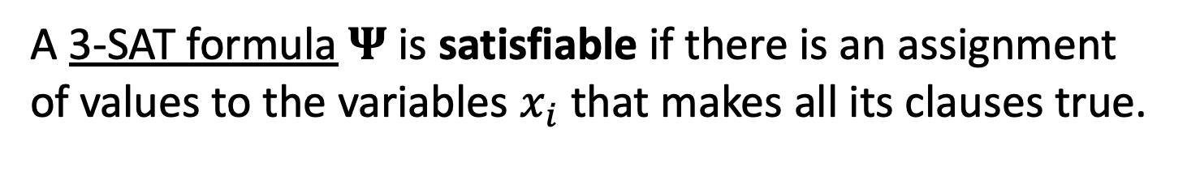
3SAT
Boolean Variables: $x_{i}$ can be either true (1) or false (0)
A Literal is either $x_{i}$ or $\overline{x_{i}}$.
A 3-Clause is a disjunction of 3-literals.
A 3-SAT formula is a conjunction of many 3-clauses.
E.g. $Ψ$ = ($x_{1}∨$ $x_{2}∨\overline{x_{5}})∧$ ($x_{1}∨$ $x_{3}∨x_{4})$ ($\overline{x_{2}}∨$ $x_{3}∨\overline{x_{5}})$
A 3-SAT formula $Ψ$is satisfiable if there is an assignment of values to the variables $x_{i}$ that makes all its clauses true.

Slide 35
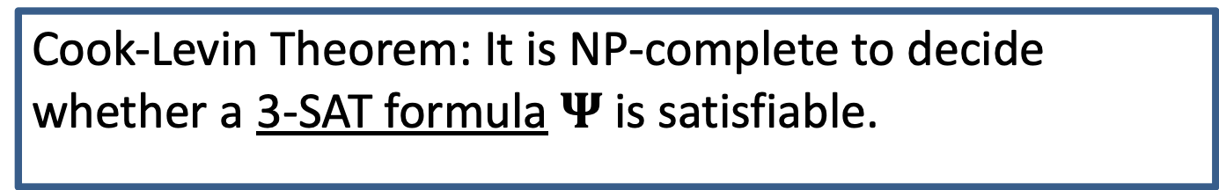
3SAT
Cook-Levin Theorem: It is NP-complete to decide whether a 3-SAT formula $Ψ$is satisfiable.
A 3-SAT formula is a conjunction of many 3-clauses.
E.g. $Ψ$ = ($x_{1}∨$ $x_{2}∨\overline{x_{5}})∧$ ($x_{1}∨$ $x_{3}∨x_{4})$ ($\overline{x_{2}}∨$ $x_{3}∨\overline{x_{5}})$
A 3-SAT formula $Ψ$is satisfiable if there is an assignment of values to the variables $x_{i}$ that makes all its clauses true.

Slide 36
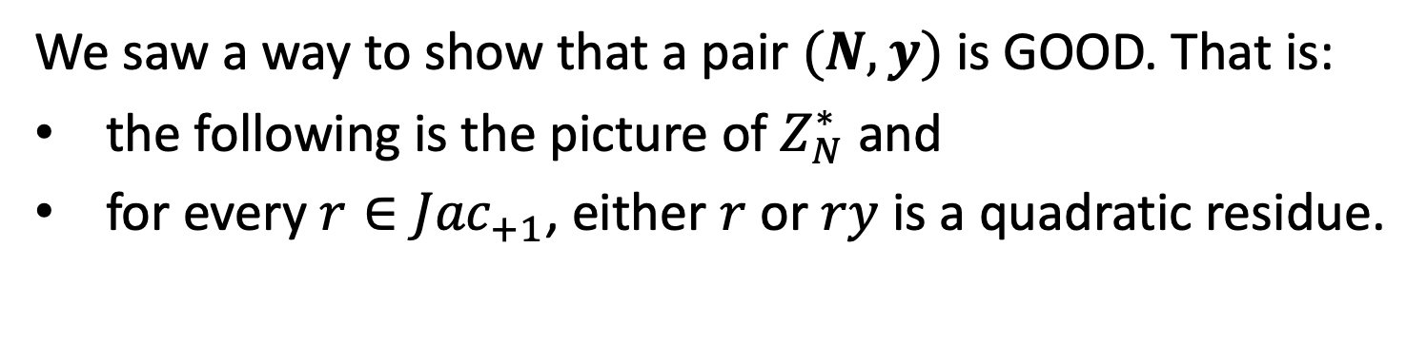
NIZK for 3SAT: Recall…
We saw a way to show that a pair $(N,y)$ is GOOD. That is:
the following is the picture of $Z_{N}^{∗}$ and
for every $r∈{Jac}_{+1}$, either $r$ or $ry$ is a quadratic residue.
$$Z_{N}^{∗}$$
$${QR}_{N}$$
$${Jac}_{−1}$$
$${Jac}_{+1}$$
$${QNR}_{N}$$

Slide 37
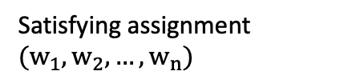

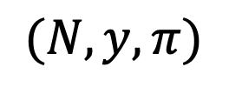
NIZK for 3SAT
$$CRS=(r_{1},r_{2},…,r_{large number})←{({Jac}_{N}^{+1})}^{large number}$$
$$Ψ$$
$$Ψ$$
$(N,y,π)$
Satisfying assignment $(w_{1},w_{2},…,w_{n})$
1. Prover picks an $(N,y)$ and proves that it is GOOD.
Input: $Ψ$ = ($x_{1}∨$ $x_{2}∨\overline{x_{5}})∧$ ($x_{1}∨$ $x_{3}∨x_{4})$ ($\overline{x_{2}}∨$ $x_{3}∨\overline{x_{5}})$
n variables, m clauses.

Slide 38
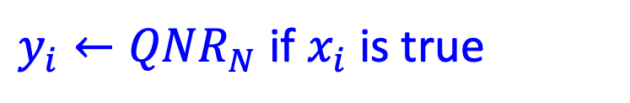
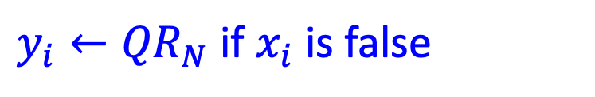
NIZK for 3SAT
$$CRS=(r_{1},r_{2},…,r_{large number})←{({Jac}_{N}^{+1})}^{large number}$$
$$Ψ$$
$$Ψ$$
$(N,y,π)$
Satisfying assignment $(w_{1},w_{2},…,w_{n})$
2. Prover encodes the satisfying assignment
$y_{i}←{QR}_{N}$ if $x_{i}$ is false
$y_{i}←{QNR}_{N}$ if $x_{i}$ is true

Slide 39
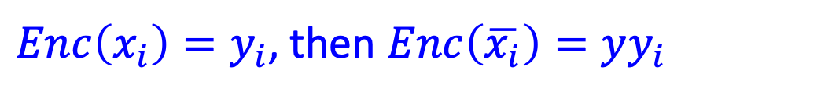
NIZK for 3SAT
$$CRS=(r_{1},r_{2},…,r_{large number})←{({Jac}_{N}^{+1})}^{large number}$$
$$Ψ$$
$$Ψ$$
$(N,y,π)$
Satisfying assignment $(w_{1},w_{2},…,w_{n})$
2. Prover encodes the satisfying assignment & $∴$ the literals
${Enc\left(x_{i}\right)=y}_{i}$, then $Enc\left(\overline{x_{i}}\right)=yy_{i}$
$∴$exactly one of $Enc\left(x_{i}\right) or Enc\left(\overline{x_{i}}\right)$ is a non-residue.

Slide 40
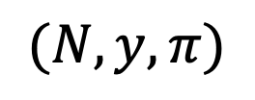

NIZK for 3SAT
$$CRS=(r_{1},r_{2},…,r_{large number})←{({Jac}_{N}^{+1})}^{large number}$$
$$Ψ$$
$(N,y,π)$
$$Ψ$$
Encode vars:
$(y_{1},…,y_{n})$
Satisfying assignment $(w_{1},w_{2},…,w_{n})$
2. Prover encodes the satisfying assignment & $∴$ the literals
${Enc\left(x_{i}\right)=y}_{i}$, then $Enc\left(\overline{x_{i}}\right)=yy_{i}$
$∴$exactly one of $Enc\left(x_{i}\right) or Enc\left(\overline{x_{i}}\right)$ is a non-residue.

Slide 41
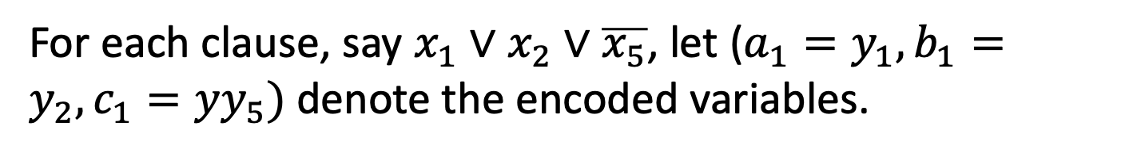
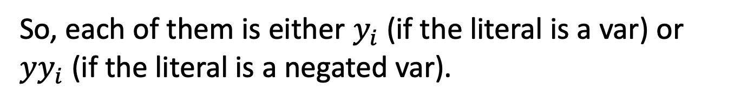
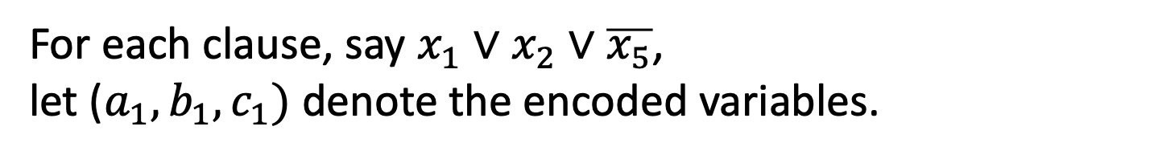
NIZK for 3SAT
$$CRS=(r_{1},r_{2},…,r_{large number})←{({Jac}_{N}^{+1})}^{large number}$$
$$Ψ$$
$(N,y,π)$
$$Ψ$$
Encode vars:
$(y_{1},…,y_{n})$
Satisfying assignment $(w_{1},w_{2},…,w_{n})$
3. Prove that (encoded) assignment satisfies each clause.
For each clause, say $x_{1}∨$ $x_{2}∨\overline{x_{5}}$, let ($a_{1},b_{1},c_{1})$ denote the encoded variables.
For each clause, say $x_{1}∨$ $x_{2}∨\overline{x_{5}}$, let ($a_{1}=y_{1},b_{1}=y_{2},c_{1}={yy}_{5})$ denote the encoded variables.
So, each of them is either $y_{i}$ (if the literal is a var) or ${yy}_{i}$ (if the literal is a negated var).

Slide 42

NIZK for 3SAT
$$CRS=(r_{1},r_{2},…,r_{large number})←{({Jac}_{N}^{+1})}^{large number}$$
$$Ψ$$
$(N,y,π)$
$$Ψ$$
Encode vars:
$(y_{1},…,y_{n})$
Satisfying assignment $(w_{1},w_{2},…,w_{n})$
3. Prove that (encoded) assignment satisfies each clause.
For each clause, say $x_{1}∨$ $x_{2}∨\overline{x_{5}}$, let ($a_{1},b_{1},c_{1})$ denote the encoded variables.
WANT to SHOW: $x_{1} OR$ $x_{2} OR \overline{x_{5}}$ is true.

Slide 43


NIZK for 3SAT
$$CRS=(r_{1},r_{2},…,r_{large number})←{({Jac}_{N}^{+1})}^{large number}$$
$$Ψ$$
$(N,y,π)$
$$Ψ$$
Encode vars:
$(y_{1},…,y_{n})$
Satisfying assignment $(w_{1},w_{2},…,w_{n})$
3. Prove that (encoded) assignment satisfies each clause.
For each clause, say $x_{1}∨$ $x_{2}∨\overline{x_{5}}$, let ($a_{1},b_{1},c_{1})$ denote the encoded variables.
WANT to SHOW: $a_{1} OR$ $b_{1} OR c_{1}$ is a non-residue.

Slide 44








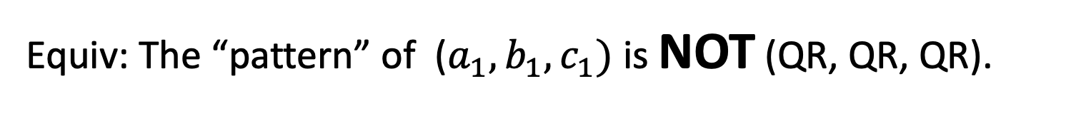

NIZK for 3SAT
Prove that (encoded) assignment satisfies each clause.
WANT to SHOW: $a_{1} OR$ $b_{1} OR c_{1}$ is a non-residue.
Equiv: The “pattern” of ($a_{1}, b_{1},c_{1})$ is NOT (QR, QR, QR).
CLEVER IDEA: Generate seven additional triples
($a_{1}, b_{1},c_{1})$
original triple
($a_{2}, b_{2},c_{2})$
“Proof of Coverage”: show that the 8 triples span all possible QR patterns
show this is a QR: reveal the square roots
($a_{3}, b_{3},c_{3})$
($a_{4}, b_{4},c_{4})$
($a_{5}, b_{5},c_{5})$
($a_{6}, b_{6},c_{6})$
($a_{7}, b_{7},c_{7})$
($a_{8}, b_{8},c_{8})$

Slide 45










NIZK for 3SAT
CLEVER IDEA: Generate seven additional triples
($a_{1}, b_{1},c_{1})$
original triple
($a_{2}, b_{2},c_{2})$
“Proof of Coverage”: show that the 8 triples span all possible QR signatures
show this is a QR: reveal the square roots
($a_{3}, b_{3},c_{3})$
($a_{4}, b_{4},c_{4})$
($a_{5}, b_{5},c_{5})$
($a_{6}, b_{6},c_{6})$
($a_{7}, b_{7},c_{7})$
($a_{8}, b_{8},c_{8})$
Proof of Coverage: For each of poly many triples $(r,s,t)$ from CRS, show one of the 8 triples has the same signature.
That is, there is a triple $(a_{i},b_{i},c_{i})$ s.t. $(ra_{i},sb_{i},tc_{i})$ is $\left(QR,QR,QR\right).$

Slide 46


NIZK for 3SAT
$$CRS=(r_{1},r_{2},…,r_{large number})←{({Jac}_{N}^{+1})}^{large number}$$
$$Ψ$$
$(N,y,π)$
$$Ψ$$
Encode vars:
$(y_{1},…,y_{n})$
Satisfying assignment $(w_{1},w_{2},…,w_{n})$
For each clause $ψ$: $ρ_{ψ}$
3. Prove that (encoded) assignment satisfies each clause.
For each clause, construct the proof $ρ$ = (7 additional triples, square root of the second triples, proof of coverage).

Slide 47

NIZK for 3SAT
$$CRS=(r_{1},r_{2},…,r_{large number})←{({Jac}_{N}^{+1})}^{large number}$$
$$Ψ$$
$(N,y,π)$
$$Ψ$$
Encode vars:
$(y_{1},…,y_{n})$
Satisfying assignment $(w_{1},w_{2},…,w_{n})$
For each clause $ψ$: $ρ_{ψ}$
Completeness & Soundness: Exercise.
Zero Knowledge: Simulator picks $(N,y)$ where $y$ is a quadratic residue.
Now, encodings of ALL the literals can be set to TRUE!!

