Slide 1
MIT 6.875
Foundations of Cryptography
Lecture 21

Slide 2
TODAY: Oblivious Transfer and Private Information Retrieval

Slide 3










Basic Problem: Database Access
Database D
0
$$x_{0}$$
1
$$x_{1}$$
Index: i
2
$$x_{2}$$
3
$$x_{3}$$
4
$$x_{4}$$
5
$$x_{5}$$
6
$$x_{6}$$
Server
Client
7
$$x_{7}$$
Correctness: Client gets $D[i]$.
Privacy (for client): Server gets no information about $i$.

Slide 4
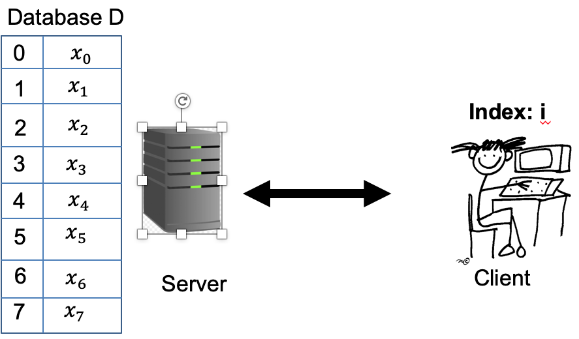
Here is a “solution”. The server sends the DB to the client.
Two ways to overcome the triviality
Oblivious Transfer (OT)
Add’l property: server privacy
Symmetric PIR = Succinctness + Server privacy
Private Information Retrieval (PIR)
Add’l property: succinctness

Slide 5


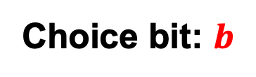


Oblivious Transfer (OT)
$$x_{0}$$
Choice bit: $b$
$$x_{1}$$
Sender
Receiver
Sender holds two bits $x_{0}$ and $x_{1}$.
Receiver holds a choice bit $b$.
Receiver should learn $x_{b}$, sender should learn nothing.
(We will consider honest-but-curious adversaries; formal definition in a little bit…)

Slide 6
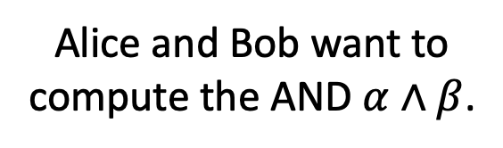
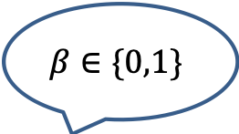
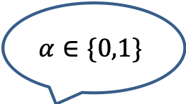
Why OT? The Dating Problem
$$α∈\{0,1\}$$
Alice and Bob want to compute the AND $α∧β$.
$$β∈\{0,1\}$$

Slide 7



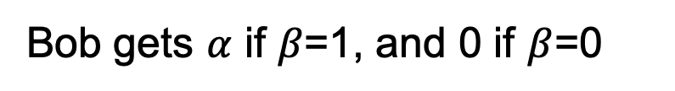
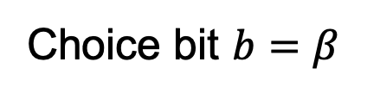

Why OT? The Dating Problem
$$α∈\{0,1\}$$
Alice and Bob want to compute the AND $α∧β$.
$$β∈\{0,1\}$$
$$x_{0}=0$$
Run an OT protocol
Choice bit $b=β$
$$x_{1}=α$$
Bob gets $α$ if $β$=1, and 0 if $β$=0
$$x_{1}b+ x_{0}\left(1−b\right)$$
Here is a way to write the OT selection function:
which, in this case is $=αβ$.

Slide 8
The Billionaires’ Problem
Net worth: $X
Net worth: $Y
Who is richer?

Slide 9
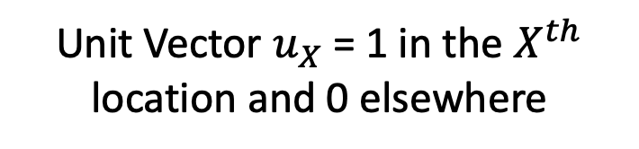









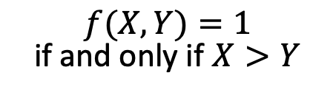
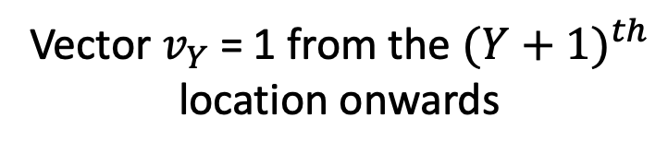
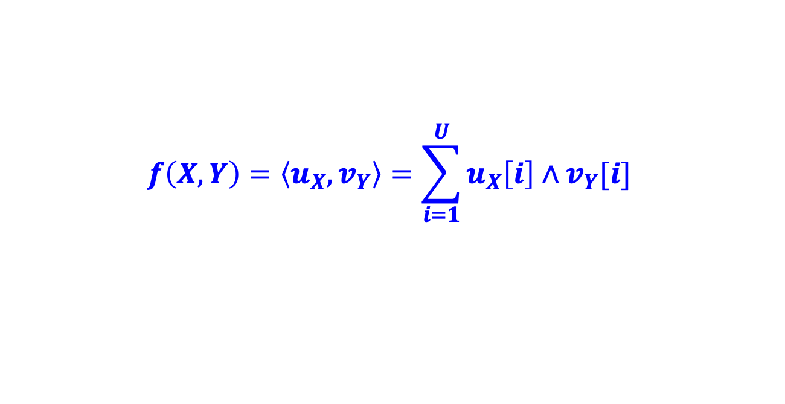






The Billionaires’ Problem
$f(X,Y)=1$ if and only if $X>Y$
$$X$$
$$Y$$
$$…$$
$$…$$
$$…$$
$$0$$
$$1$$
$$0$$
$$1$$
$$1$$
$$1$$
$$1$$
$$1$$
$$1$$
$$0$$
$$0$$
Unit Vector $u_{X}$ = 1 in the $X^{th}$ location and 0 elsewhere
Vector $v_{Y}$ = 1 from the ${(Y+1)}^{th}$ location onwards
$$f\left(X,Y\right)=\left\langle u_{X},v_{Y}\right\rangle =\sum_{i=1}^{U}{u_{X}\left[i\right]∧v_{Y}[i]}$$
Compute each AND individually and sum it up?

Slide 10
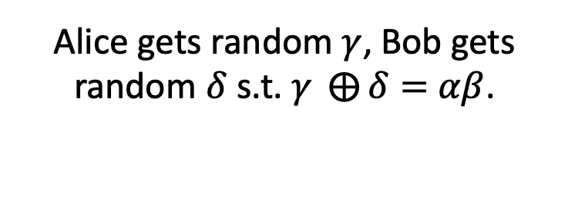
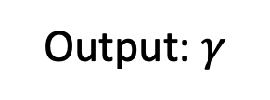


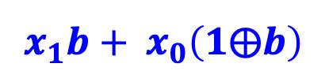





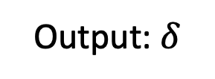
Detour: OT $⇒$ Secret-Shared-AND
$$α∈\{0,1\}$$
Alice gets random $γ$, Bob gets random $δ$ s.t. $γ ⨁{δ}=$ $αβ$.
$$β∈\{0,1\}$$
Output: $γ$
Output: $δ$
$$x_{0}=γ$$
Run an OT protocol
Choice bit $b=β$
$x_{1}=α⨁$ $γ$
Alice outputs $γ$.
$$x_{1}b+ x_{0}\left(1⨁b\right)$$
Bob gets
$=(x_{1}$ $⨁{ x}_{0})b+x_{0}$
$$=αβ⨁γ≔δ$$

Slide 11


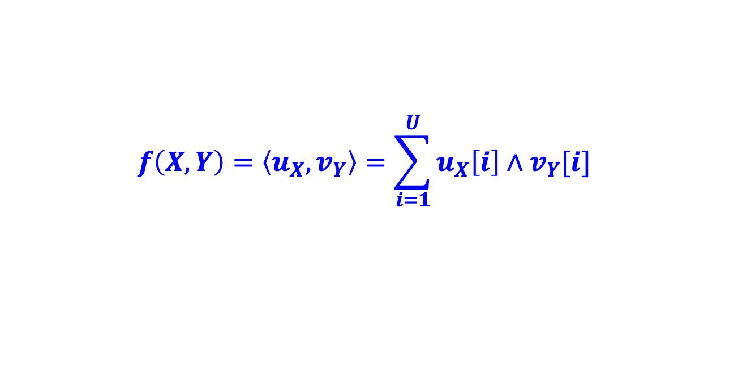


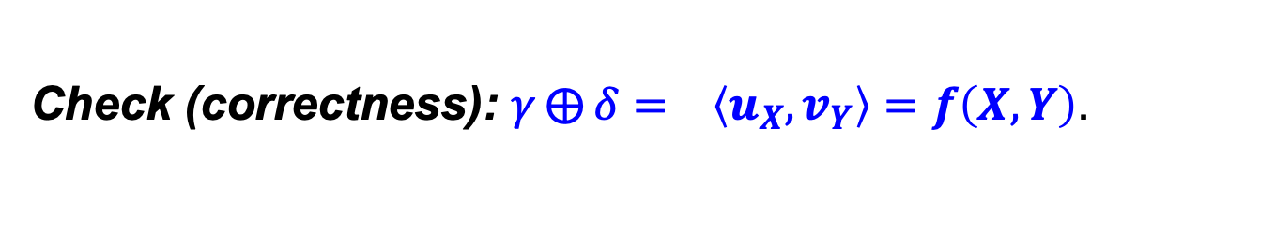






The Billionaires’ Problem
$f(X,Y)=1$ if and only if $X>Y$
$$…$$
$$…$$
$$…$$
$$0$$
$$1$$
$$0$$
$$1$$
$$1$$
$$1$$
$$1$$
$$1$$
$$1$$
$$0$$
$$0$$
Unit Vector $u_{X}$
Vector $v_{Y}$
$$f\left(X,Y\right)=\left\langle u_{X},v_{Y}\right\rangle =\sum_{i=1}^{U}{u_{X}\left[i\right]∧v_{Y}[i]}$$
1. Alice and Bob run many OTs to get $(γ_{i},δ_{i})$ s.t.
$${γ_{i}⨁δ_{i}= u}_{X}\left[i\right]∧v_{Y}[i]$$
2. Alice computes ${γ= ⨁}_{i}{ γ}_{i}$ and Bob computes ${δ= ⨁}_{i}{ δ}_{i}.$
Check (correctness): ${γ⨁{δ}= }_{}\left\langle u_{X},v_{Y}\right\rangle =f\left(X,Y\right)$.

Slide 12
The Billionaires’ Problem
$f(X,Y)=1$ if and only if $X>Y$
$$…$$
$$…$$
$$…$$
$$0$$
$$1$$
$$0$$
$$1$$
$$1$$
$$1$$
$$1$$
$$1$$
$$1$$
$$0$$
$$0$$
Unit Vector $u_{X}$
Vector $v_{Y}$
$$f\left(X,Y\right)=\left\langle u_{X},v_{Y}\right\rangle =\sum_{i=1}^{U}{u_{X}\left[i\right]∧v_{Y}[i]}$$
1. Alice and Bob run many OTs to get $(γ_{i},δ_{i})$ s.t.
$${γ_{i}⨁δ_{i}= u}_{X}\left[i\right]∧v_{Y}[i]$$
2. Alice computes ${γ= ⨁}_{i}{ γ}_{i}$ and Bob computes ${δ= ⨁}_{i}{ δ}_{i}.$
Check (privacy): Alice & Bob get a bunch of random bits.

Slide 13

“OT is Complete”
Theorem (lec23-27): OT can solve not just love and money, but any two-party (and multi-party) problem.

Slide 14
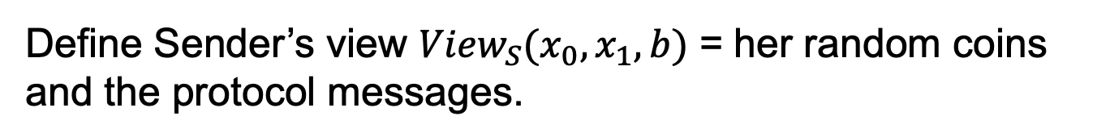
OT Definition
$$x_{0}$$
Choice bit: $b$
$$x_{1}$$
Sender
Receiver
Receiver Security: Sender should not learn b.
Define Sender’s view ${View}_{S}(x_{0},x_{1},b)$ = her random coins and the protocol messages.

Slide 15
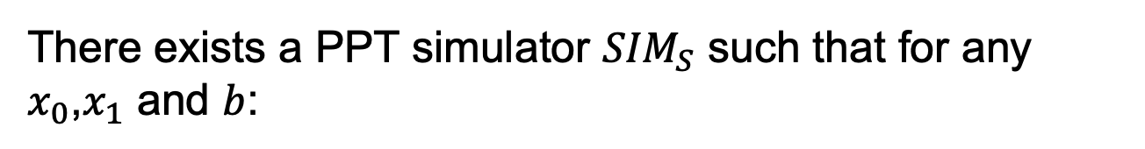

OT Definition
$$x_{0}$$
Choice bit: $b$
$$x_{1}$$
Sender
Receiver
Receiver Security: Sender should not learn b.
There exists a PPT simulator ${SIM}_{S}$ such that for any $x_{0}$,$x_{1}$ and $b$:
$${SIM}_{S}(x_{0},x_{1})≅{View}_{S}(x_{0},x_{1},b)$$

Slide 16
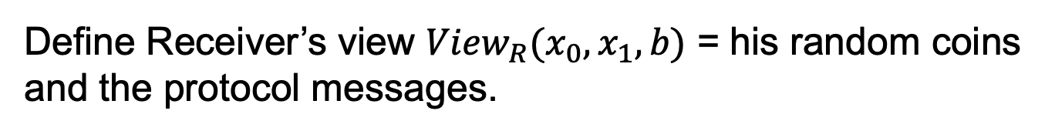
OT Definition
$$x_{0}$$
Choice bit: $b$
$$x_{1}$$
Sender
Receiver
Sender Security: Receiver should not learn $x_{1−b}$.
Define Receiver’s view ${View}_{R}(x_{0},x_{1},b)$ = his random coins and the protocol messages.

Slide 17

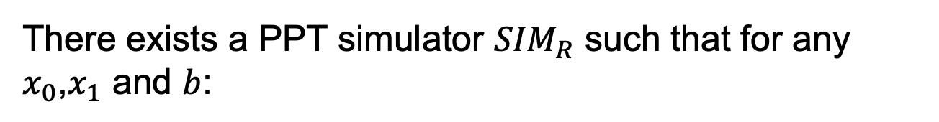
OT Definition
$$x_{0}$$
Choice bit: $b$
$$x_{1}$$
Sender
Receiver
Sender Security: Receiver should not learn $x_{1−b}$.
There exists a PPT simulator ${SIM}_{R}$ such that for any $x_{0}$,$x_{1}$ and $b$:
$${SIM}_{R}(b,x_{b})≅{View}_{S}(x_{0},x_{1},b)$$

Slide 18

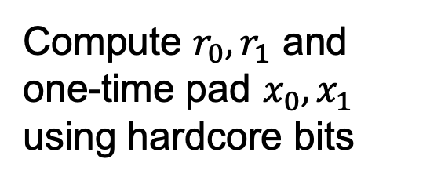
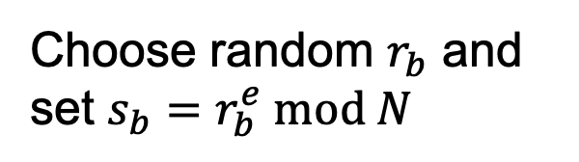
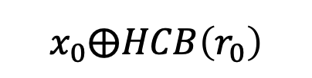
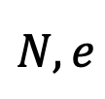

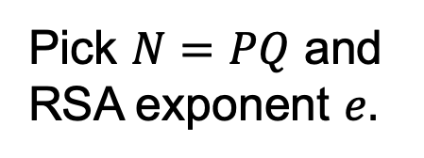
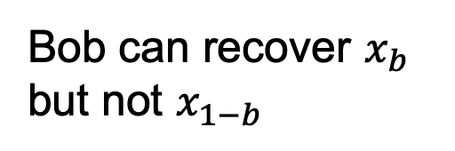
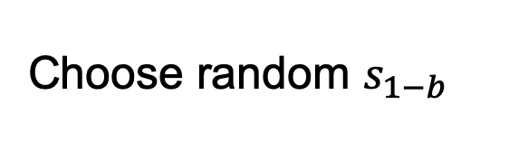

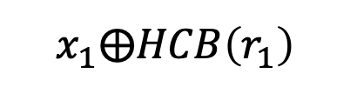
OT Protocol 1: Trapdoor Permutations
For concreteness, let’s use the RSA trapdoor permutation.
Input bits: $(x_{0},x_{1})$
Choice bit: $b$
Pick $N=PQ$ and RSA exponent $e.$
$$N,e$$
Choose random $r_{b}$ and set $s_{b}=r_{b}^{e} mod N$
$$s_{0},s_{1}$$
Choose random $s_{1−b}$
Compute $r_{0},r_{1}$ and one-time pad $x_{0},x_{1}$ using hardcore bits
$$x_{0}⨁HCB\left(r_{0}\right)$$
Bob can recover $x_{b}$ but not $x_{1−b}$
$$x_{1}⨁HCB\left(r_{1}\right)$$

Slide 19

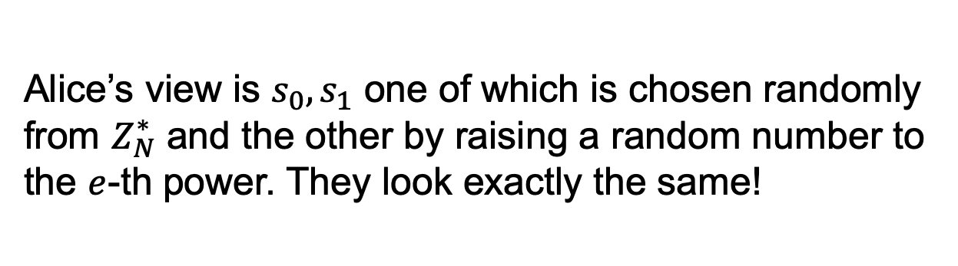
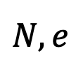
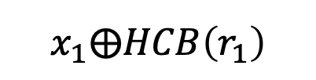
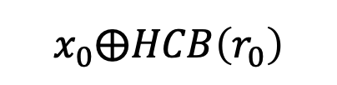
OT Protocol 1: Trapdoor Permutations
$$N,e$$
$$s_{0},s_{1}$$
Input bits: $(x_{0},x_{1})$
Choice bit: $b$
$$x_{0}⨁HCB\left(r_{0}\right)$$
$$x_{1}⨁HCB\left(r_{1}\right)$$
How about Bob’s security (a.k.a. Why does Alice not learn Bob’s choice bit)?
Alice’s view is $s_{0},s_{1}$ one of which is chosen randomly from $Z_{N}^{∗}$ and the other by raising a random number to the $e$-th power. They look exactly the same!

Slide 20
OT Protocol 1: Trapdoor Permutations
$$N,e$$
$$s_{0},s_{1}$$
Input bits: $(x_{0},x_{1})$
Choice bit: $b$
$$x_{0}⨁HCB\left(r_{0}\right)$$
$$x_{1}⨁HCB\left(r_{1}\right)$$
How about Bob’s security (a.k.a. Why does Alice not learn Bob’s choice bit)?
Exercise: Show how to construct the simulator.

Slide 21
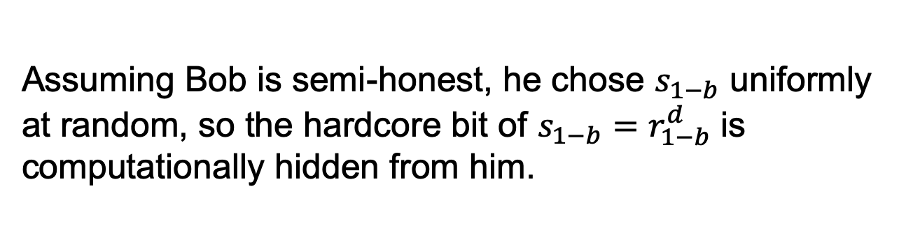
OT Protocol 1: Trapdoor Permutations
$$N,e$$
$$s_{0},s_{1}$$
Input bits: $(x_{0},x_{1})$
Choice bit: $b$
$$x_{0}⨁HCB\left(r_{0}\right)$$
$$x_{1}⨁HCB\left(r_{1}\right)$$
How about Alice’s security (a.k.a. Why does Bob not learn both of Alice’s bits)?
Assuming Bob is semi-honest, he chose $s_{1−b}$ uniformly at random, so the hardcore bit of $s_{1−b}=r_{1−b}^{d}$ is computationally hidden from him.

Slide 22
OT from Trapdoor Permutations
$$N,e$$
$$s_{0},s_{1}$$
Input bits: $(x_{0},x_{1})$
Choice bit: $b$
$$x_{0}⨁HCB\left(r_{0}\right)$$
$$x_{1}⨁HCB\left(r_{1}\right)$$
How about Alice’s security (a.k.a. Why does Bob not learn both of Alice’s bits)?
Exercise: Show how to construct the simulator.

Slide 23
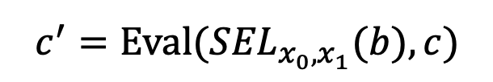

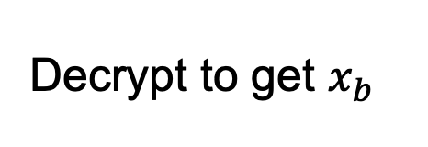
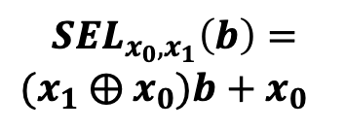

OT Protocol 2: Additive HE
Input bits: $(x_{0},x_{1})$
Choice bit: $b$
Encrypt choice bit b
Homomorphically evaluate the selection function
$$c$$
$$c⟵Enc(sk,b)$$
$$c^{′}=Eval({SEL}_{x_{0},x_{1}}(b),c)$$
Decrypt to get $x_{b}$
$${SEL}_{x_{0},x_{1}}\left(b\right)=$$
$(x_{1}$ $⨁{ x}_{0})b+x_{0}$
Bob’s security: computational, from CPA-security of Enc.
Alice’s security: statistical, from function-privacy of Eval.

Slide 24
Many More Constructions of OT
Theorem: OT protocols can be constructed based on the hardness of the Diffie-Hellman problem, factoring, quadratic residuosity, LWE, elliptic curve isogeny problem etc. etc.

Slide 25
Two ways to overcome the triviality
Oblivious Transfer (OT)
Add’l property: server privacy
Symmetric PIR = Succinctness + Server privacy
Private Information Retrieval (PIR)
Add’l property: succinctness

Slide 26








Private Information Retrieval
0
$$x_{0}$$
1
$$x_{1}$$
Index: i
2
$$x_{2}$$
3
$$x_{3}$$
Query q
4
$$x_{4}$$
Answer a
5
$$x_{5}$$
6
$$x_{6}$$
Client
7
$$x_{7}$$
Privacy (for client): Server gets no information about $i$.
Succinctness: Total communication $<N$ bits, ideally $O(\log{N).}$

Slide 27
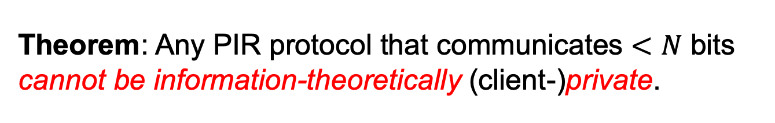
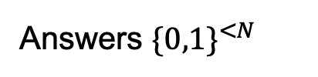
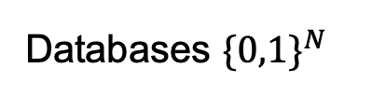
Lower Bound
Theorem: Any PIR protocol that communicates $<N$ bits cannot be information-theoretically (client-)private.
Idea: Pigeon-hole principle.
Consider the function (parameterized by the query) that maps databases to answers.
Answers ${\{0,1\}}^{<N}$
Databases ${\{0,1\}}^{N}$

Slide 28


Lower Bound
Theorem: Any PIR protocol that communicates $<N$ bits cannot be information-theoretically (client-)private.
The two databases differ in at least one index, say $i^{∗}.$
By correctness, the queried index could not have been $i^{∗}.$ This reveals some information about the query. QED.
Answers ${\{0,1\}}^{<N}$
Databases ${\{0,1\}}^{N}$

Slide 29
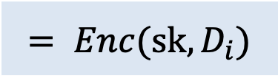

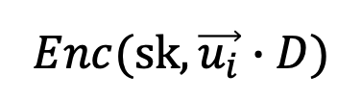
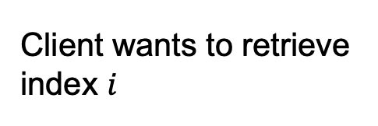



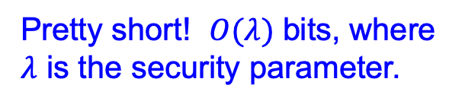
Construction 0: Using Additive HE
Database $D$
Pretty long! $O(Nλ)$ bits.
$$N$$
$$Enc(sk,\vec{u_{i}})$$
Client wants to retrieve index $i$
Homomorphically compute inner product with the database
$$Enc(sk,\vec{u_{i}}∙D)$$
$$= Enc(sk, D_{i})$$
Pretty short! $O(λ)$ bits, where $λ$ is the security parameter.

Slide 30

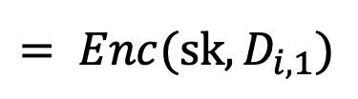
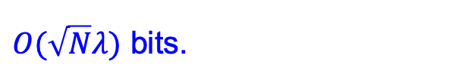













Constr. 1: Using Additive HE (better)
Database $D$
$$\sqrt{N}$$
Database $D$ = $\sqrt{N}$ by $\sqrt{N}$ matrix
$O(\sqrt{N}λ)$ bits.
$$\sqrt{N}$$
$$Enc(sk,\vec{u_{i}})$$
Client wants to retrieve index $\left(i,j\right)$
Homomorphically compute inner product with each column
$$Enc(sk,\vec{u_{i}}∙D_{1})$$
$$= Enc(sk, D_{i,1})$$
$$Enc(sk,\vec{u_{i}}∙D_{2})$$
$$= Enc(sk, D_{i,2})$$
$$…$$
$$= Enc(sk, D_{i,j})$$
$O(\sqrt{N}λ)$ bits.
$$Enc(sk,\vec{u_{i}}∙D_{\sqrt{N}})$$
$$= Enc(sk, D_{i,\sqrt{N}})$$

Slide 31





Construction 2 (The “Ultimate” PIR)
Write the database access function: $$F_{D}\left(x_{1}x_{2}…x_{n}\right)=\sum_{i=i_{1}i_{2}…i_{n}}{D_{i}}∙(x =_{?}i)$$
$$=\sum_{i=i_{1}i_{2}…i_{n}}{D_{i}}∙\prod_{j=1}^{n}{(x_{j}=i_{j})}$$
This is 1 if and only if $x=i$.
Client encrypts $x$. Server homomorphically evaluates $F_{D}$.
$O(\log{N}∙λ)$ bits.

Slide 32

Can we Achieve Unconditionally Secure PIR?
I thought you proved this is impossible?!
Change the model: two or more non-communicating servers!

Slide 33











Two-Server PIR
Database $D$
$$\vec{u_{i}}⨁\vec{r}$$
$N$ bits.
Index: i
$$\left\langle D,\vec{u_{i}}⨁\vec{r}\right\rangle$$
$1$ bit.
$N$ bits.
Database $D$
$$\vec{r}$$
$1$ bit.
Client
$$\left\langle D, \vec{r}\right\rangle$$
$$\left\langle D,\vec{u_{i}}⨁\vec{r}\right\rangle ⨁\left\langle D, \vec{r}\right\rangle =\left\langle D,\vec{u_{i}}\right\rangle =D_{i}$$

Slide 34









Two-Server PIR: Balancing Trick
Database $D=(D_{1},…,D_{\sqrt{N}})$
$$\vec{u_{i}}⨁\vec{r}$$
$\sqrt{N}$ bits.
Index: i
$$\{\left\langle D_{j},\vec{u_{i}}⨁\vec{r}\right\rangle \}$$
$\sqrt{N}$ bits.
$\sqrt{N}$ bits.
$$\vec{r}$$
$\sqrt{N}$ bits.
Client
$$\{\left\langle D_{j}, \vec{r}\right\rangle \}$$
Database $D=(D_{1},…,D_{\sqrt{N}})$
$$\left\langle D_{j},\vec{u_{i}}⨁\vec{r}\right\rangle ⨁\left\langle D_{j}, \vec{r}\right\rangle =\left\langle D_{j},\vec{u_{i}}\right\rangle =D_{ij}$$

Slide 35
WE SAW: Oblivious Transfer and Private Information Retrieval
The rest of the course: How to solve any two-party (and multi-party) problem.

