Slide 1
MIT 6.875
Foundations of Cryptography
Lecture 22

Slide 2
TODAY: Secure Two-Party and Multi-Party Computation

Slide 3




Secure Two-Party Computation
Input: $x$
Input: $y$
Alice
Bob
Alice and Bob want to compute $F\left(x,y\right).$
Semi-honest Security:
Alice should not learn anything more than $x$ and $F\left(x,y\right).$
Bob should not learn anything more than $y$ and $F\left(x,y\right).$

Slide 4


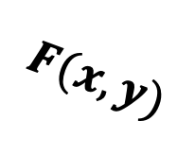
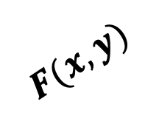
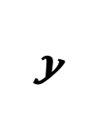
Secure Two-Party Computation
REAL WORLD:
Input: $x$
Input: $y$
Alice
Bob
≈
IDEAL WORLD:
$$y$$
$$x$$
$$F(x,y)$$
$$F(x,y)$$

Slide 5

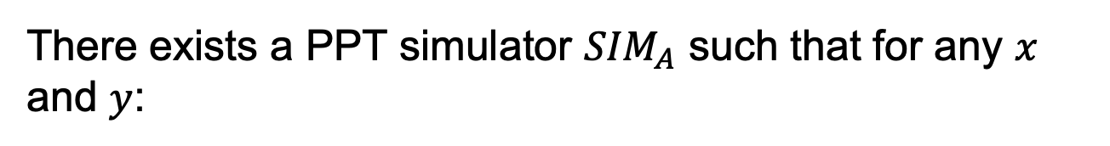
Secure Two-Party Computation
Input: $x$
Input: $y$
Alice
Bob
There exists a PPT simulator ${SIM}_{A}$ such that for any $x$ and $y$:
$${SIM}_{A}(x,F(x,y))≅{View}_{A}(x,y)$$

Slide 6

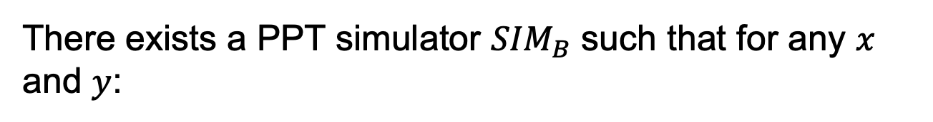
Secure Two-Party Computation
Input: $x$
Input: $y$
Alice
Bob
There exists a PPT simulator ${SIM}_{B}$ such that for any $x$ and $y$:
$${SIM}_{B}(y,F(x,y))≅{View}_{B}(x,y)$$

Slide 7

Secure 2PC from OT
Theorem [Goldreich-Micali-Wigderson’87]: OT can solve any two-party computation problem.

Slide 8
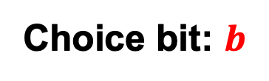


Tool: Oblivious Transfer (OT)
$$x_{0}$$
Choice bit: $b$
$$x_{1}$$
Sender
Receiver
Sender holds two bits $x_{0}$ and $x_{1}$.
Receiver holds a choice bit $b$.
Receiver should learn $x_{b}$, sender should learn nothing.

Slide 9
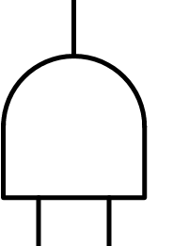
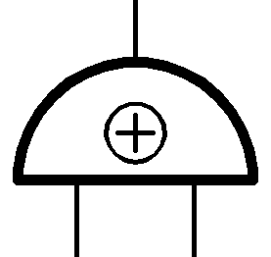



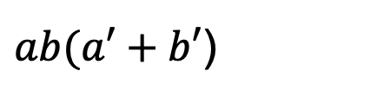

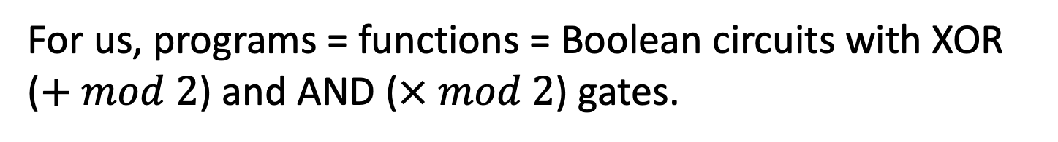

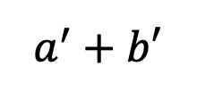
How to Compute Arbitrary Functions
For us, programs = functions = Boolean circuits with XOR ($+ mod 2$) and AND ($× mod 2$) gates.
$ab(a′+b′$)
X
$$ab$$
$$a^{′}+b′$$
+
X
$$a$$
$$b$$
$$a′$$
$$b′$$
Want: If you can compute XOR and AND in the appropriate sense, you can compute everything.

Slide 10
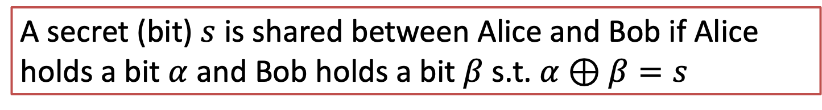
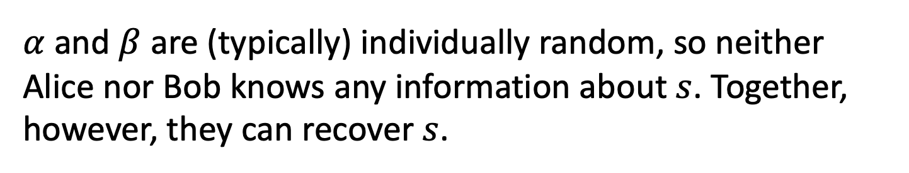
Basic Secret-Sharing
A secret (bit) $s$ is shared between Alice and Bob if Alice holds a bit $α$ and Bob holds a bit $β$ s.t. $α⊕β=s$
$α$ and $β$ are (typically) individually random, so neither Alice nor Bob knows any information about $s$. Together, however, they can recover $s$.

Slide 11
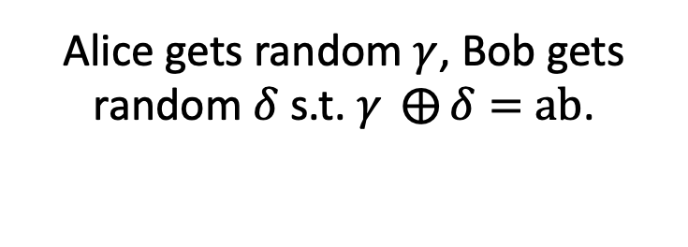






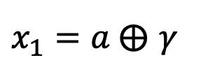
Recap: OT $⇒$ Secret-Shared-AND
$$a∈\{0,1\}$$
Alice gets random $γ$, Bob gets random $δ$ s.t. $γ ⨁{δ}=$ $ab$.
$$b∈\{0,1\}$$
Output: $γ$
Output: $δ$
$$x_{0}=γ$$
Run an OT protocol
Choice bit $b$
$x_{1}=a ⨁$ $γ$
Alice outputs $γ$.
$$x_{1}b+ x_{0}\left(1⨁b\right)$$
Bob gets
$=(x_{1}$ $⨁{ x}_{0})b+x_{0}$
$$=ab⨁γ$$
$$≔δ$$

Slide 12









How to Compute Arbitrary Functions
Secret-sharing Invariant: For each wire of the circuit, Alice and Bob each have a bit whose XOR is the value at the wire.
XOR gate: Locally XOR the shares
AND gate??
X
$$a′$$
$$b′$$
+
X
$$a$$
$$0$$
$$a′$$
$$⊕$$
$$0$$
$$0$$
$$b$$
$$0$$
$$⊕$$
$$b′$$
Base Case: Input wires

Slide 13


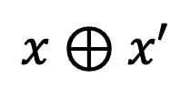
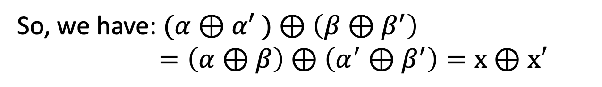




Recap: XOR gate
$$x⊕x′$$
Alice has $α$ and Bob has $β$ s.t.
+
$$α⊕β=x$$
$$x$$
$$x′$$
Alice has $α′$ and Bob has $β′$ s.t.
$$α′⊕β′=x′$$
Alice computes $α⊕α′$ and Bob computes $β⊕β^{′}.$
So, we have: $(α⊕α′$ $)⊕\left(β⊕β^{′}\right)$ $=\left(α⊕β\right)⊕\left(α^{′}⊕β^{′}\right)=x⊕x′$

Slide 14

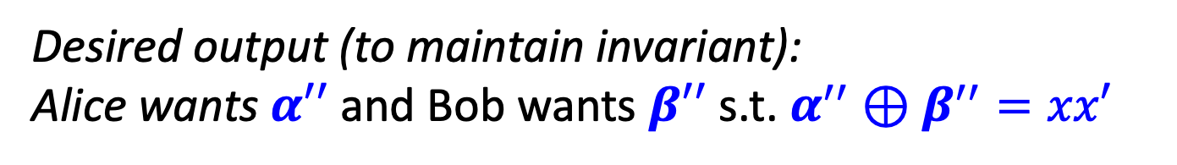
AND gate
$$xx′$$
Alice has $α$ and Bob has $β$ s.t.
X
$$α⊕β=x$$
$$x$$
$$x′$$
Alice has $α′$ and Bob has $β′$ s.t.
$$α′⊕β′=x′$$
Desired output (to maintain invariant):
Alice wants $α′′$ and Bob wants $β′′$ s.t. $α^{′′}⊕β^{′′}=xx′$

Slide 15
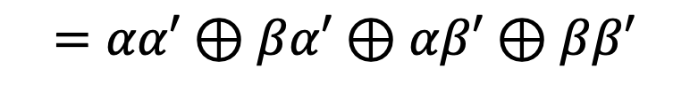



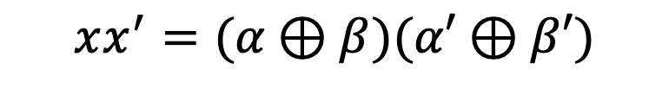

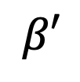
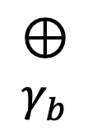







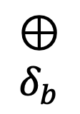
AND gate
$$xx′$$
$$xx^{′}=(α⊕β)(α′⊕β′)$$
X
$$γ_{a}$$
$$=αα′⊕βα′⊕αβ′⊕ββ′$$
$$δ_{a}$$
$$x$$
$$x′$$
$$⊕$$
$$γ_{b}$$
$$⊕$$
$$δ_{b}$$
$$β′$$
$$α$$
$$β$$
$$α′$$
ss-AND
ss-AND
$$δ_{a}$$
$$γ_{a}$$
$$δ_{b}$$
$$γ_{b}$$
$$α^{′′}=αα′⊕γ_{a}⊕δ_{a}$$
$$β^{′′}=ββ′⊕γ_{b}⊕δ_{b}$$

Slide 16



How to Compute Arbitrary Functions
Secret-sharing Invariant: For each wire of the circuit, Alice and Bob each have a bit whose XOR is the value at the wire.
Finally, Alice and Bob exchange the shares at the output wire, and XOR the shares together to obtain the output.
$$α$$
$$α⊕β=ab(a^{′}⊕b^{′})$$
$$β$$
X
+
X
$$a$$
$$b$$
$$a′$$
$$b′$$

Slide 17
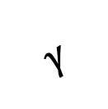
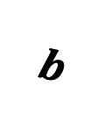
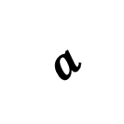
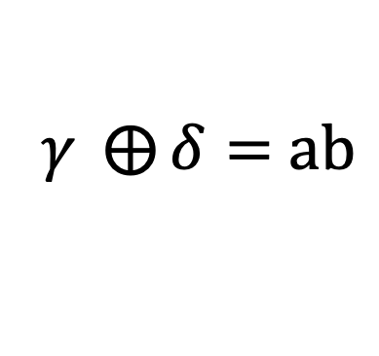
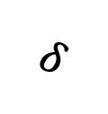
Security: Intuition
Imagine that the parties have access to an ss-AND angel.
$$b$$
$$a$$
$$γ$$
$$δ$$
$γ ⨁{δ}=$ $ab$

Slide 18
Security: Intuition
Imagine that the parties have access to an ss-AND angel.
Simulator for Alice’s view:
XOR gate: simulate given Alice’s input shares
X
$$a′$$
$$b′$$
+
X
$$a$$
$$0$$
$$a′$$
$$0$$
$$0$$
$$b$$
$$0$$
$$b′$$
Input wires: can be simulated given Alice’s input

Slide 19



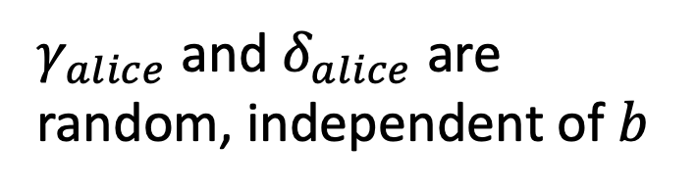

Security: Intuition
Simulator for Alice’s view:
AND gate: simulate given Alice’s input shares & outputs from the ss-AND angel.
Alice’s share $$=a∙0+ssand\left(a,b\right)+ssand(0,0)$$
X
$$a′$$
$$γ_{alice}$$
$$b′$$
$$δ_{alice}$$
+
X
$$a$$
$$0$$
$$a′$$
$$0$$
$$0$$
$$b$$
$$0$$
$$b′$$
$γ_{alice}$ and $δ_{alice}$ are random, independent of $b$

Slide 20
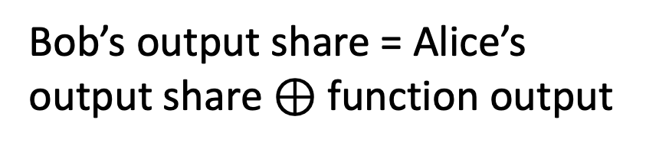
Security: Intuition
Simulator for Alice’s view:
Output wire: need to know both Alice and Bob’s output shares.
Bob’s output share = Alice’s output share $⊕$ function output
X
$$a′$$
$$b′$$
Simulator knows the function output, and can compute Bob’s output share given Alice’s output share.
+
X
$$a$$
$$0$$
$$a′$$
$$0$$
$$0$$
$$b$$
$$0$$
$$b′$$

Slide 21
We showed: Secure 2PC from OT
Theorem [Goldreich-Micali-Wigderson’87]: OT can solve any two-party computation problem.

Slide 22
In fact, GMW does more:
Theorem [Goldreich-Micali-Wigderson’87]: OT can solve any multi-party computation problem.

Slide 23
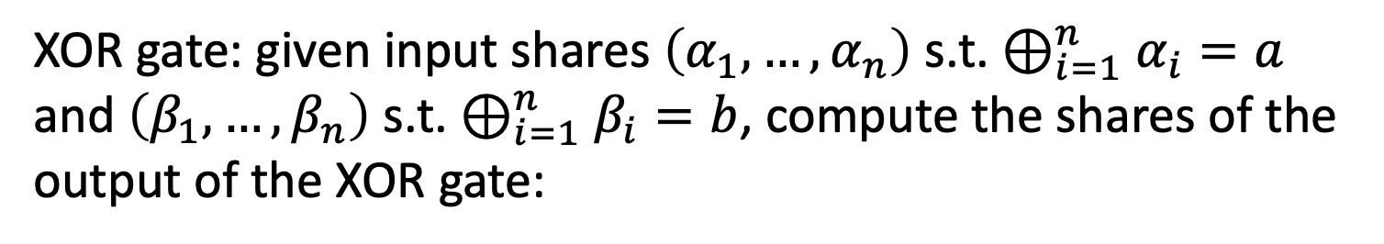

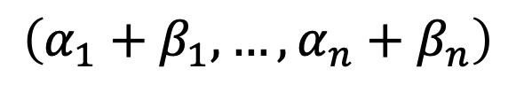
MPC Outline
Secret-sharing Invariant: For each wire of the circuit, the n parties have a bit each, whose XOR is the value at the wire.
Base case: input wires.
XOR gate: given input shares $\left(α_{1},…,α_{n}\right)$ s.t. $⊕_{i=1}^{n}α_{i}=a$ and $\left(β_{1},…,β_{n}\right)$ s.t. $⊕_{i=1}^{n}β_{i}=b$, compute the shares of the output of the XOR gate:
$$\left(α_{1}+β_{1},…,α_{n}+β_{n}\right)$$
AND gate: given input shares as above, compute the shares of the output of the XOR gate:
$$\left(o_{1},…,o_{n}\right) s.t⊕_{i=1}^{n}o_{i}=ab$$
Exercise!

Slide 24
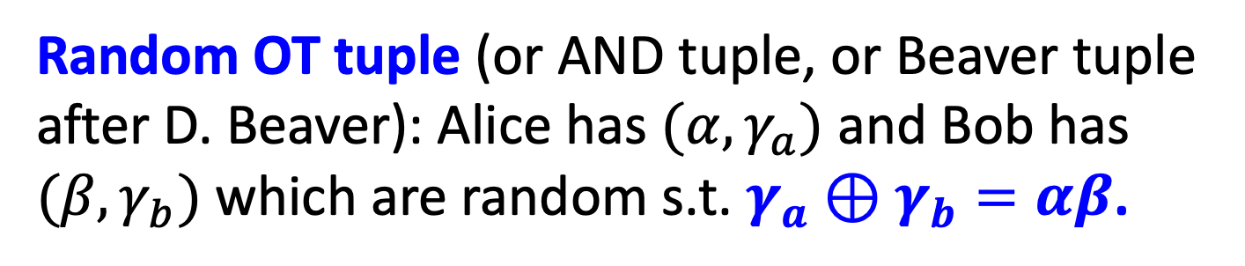
Optimization 1: Preprocessing OTs
Random OT tuple (or AND tuple, or Beaver tuple after D. Beaver): Alice has $(α,γ_{a})$ and Bob has $(β,γ_{b})$ which are random s.t. $γ_{a}⊕γ_{b}=αβ$.
Theorem: Given O(1) many random OT tuples, we can do OT with information-theoretic security, exchanging O(1) bits.

Slide 25
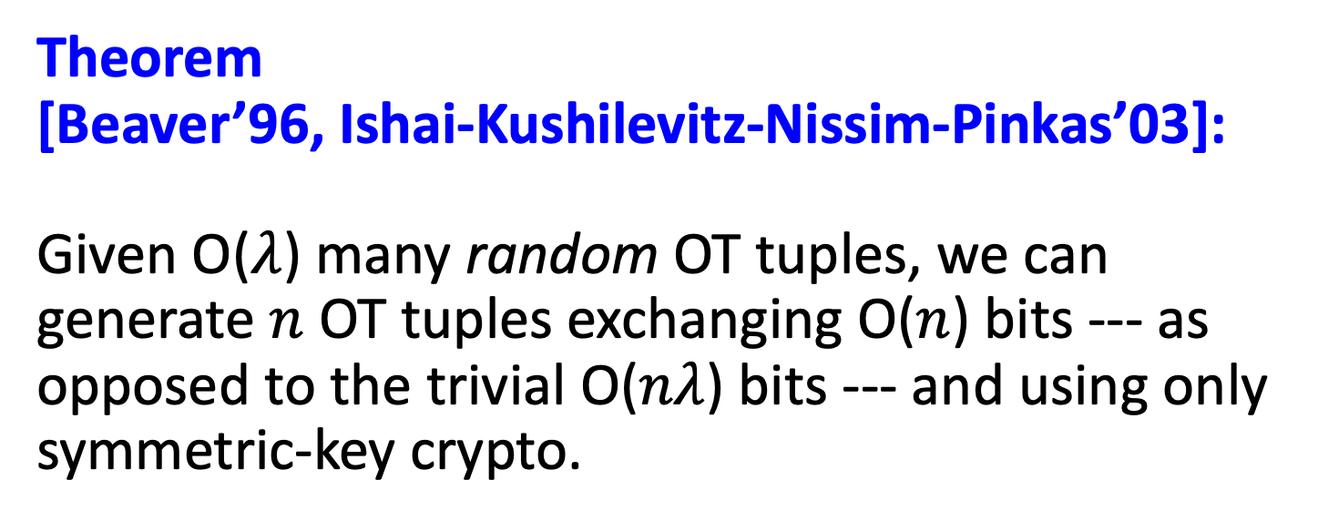
Optimization 2: OT Extension
Theorem [Beaver’96, Ishai-Kushilevitz-Nissim-Pinkas’03]:
Given O($λ$) many random OT tuples, we can generate $n$ OT tuples exchanging O($n$) bits --- as opposed to the trivial O($nλ$) bits --- and using only symmetric-key crypto.

Slide 26


Complexity of the 2-party solution
Number of OT protocol invocations $=2 ∗ \#AND$ gates
Can be made into O(#inputs $∙λ$): Yao’s garbled circuits
Number of rounds = AND-depth of the circuit
Can be made into O(1) rounds: Yao’s garbled circuits
Communication in bits = $$O(\#AND∙λ+\#inputs+\#outputs)$$
Can be made into O($λ$) using FHE: but FHE is computationally more expensive concretely.

Slide 27
Next class: Secret-Sharing and Information-Theoretically Secure MPC

