Slide 1
MIT 6.875
Foundations of Cryptography
Lecture 14

Slide 2
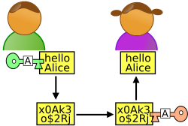
Beyond Secure Communication
x
y
Alice
Bob
Much more than communicating securely.
Complex Interactions: proofs, computations, games.
Complex Adversaries: Alice or Bob, adaptively chosen.
Complex Properties: Correctness, Privacy, Fairness.
Many Parties: this class, MIT, the internet.

Slide 3
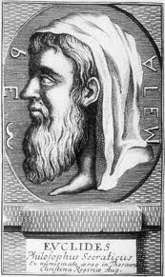
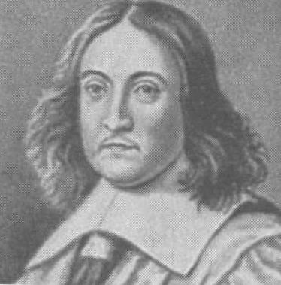
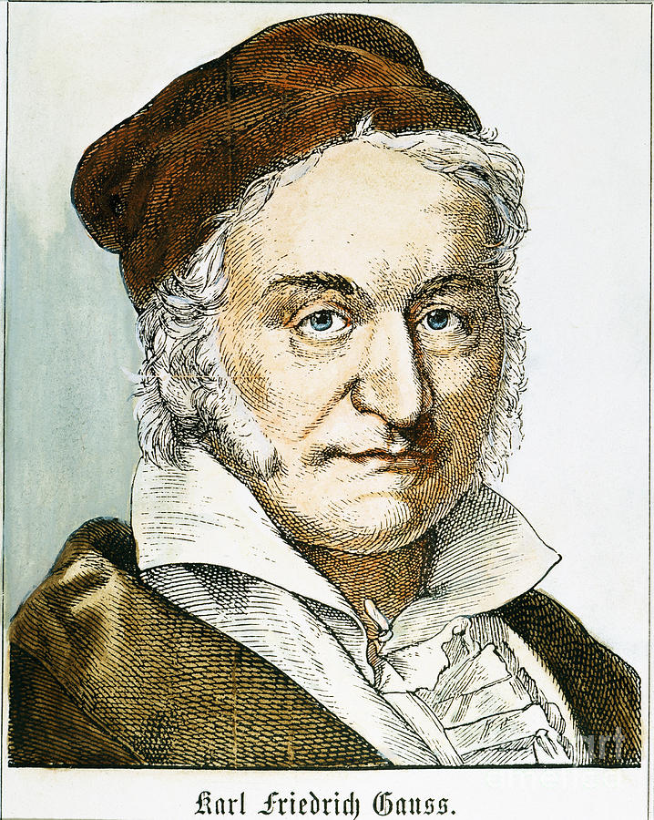
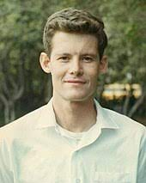
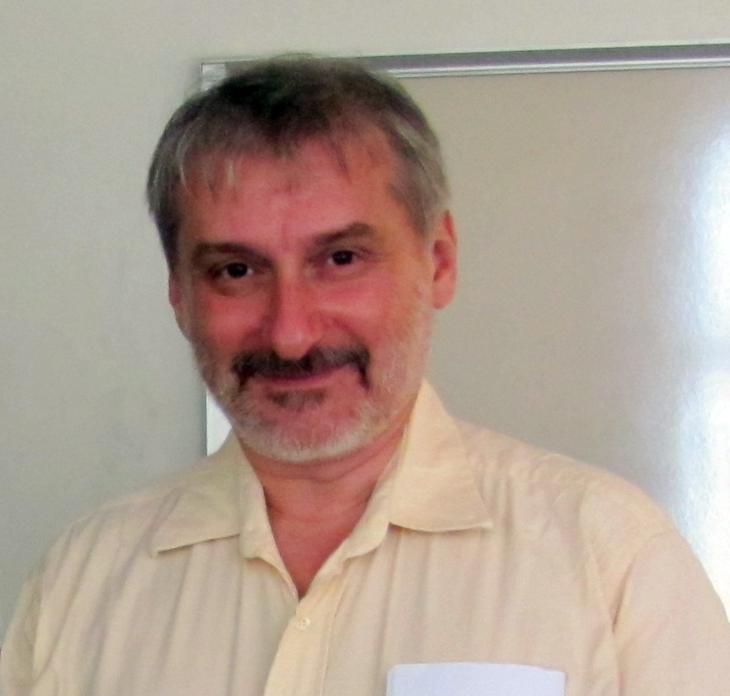
Classical Proofs
Steve Cook
Leonid Levin
Prover writes down a string (proof); Verifier checks.
Axiom 1
Axiom 2
Axiom 1⇒A
A⇒B
QED
a²+b²
a
b

Slide 4
Proofs
Claim/Theorem
accept/reject
proof
Prover
Verifier

Slide 5

Efficiently Verifiable Proofs: $𝓝𝓟$
Claim/Theorem
accept/reject
proof
Prover
Verifier
Works hard
Polynomial-time

Slide 6

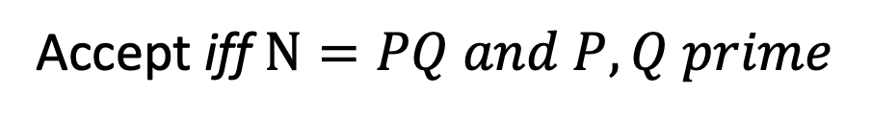
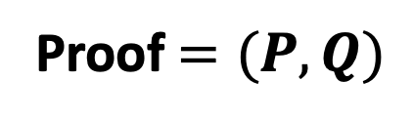
Theorem: $N$ is a product of two prime numbers
Proof $=(P,Q)$
Verifier
Prover
Accept iff $N=PQ and P, Q prime$

Slide 7
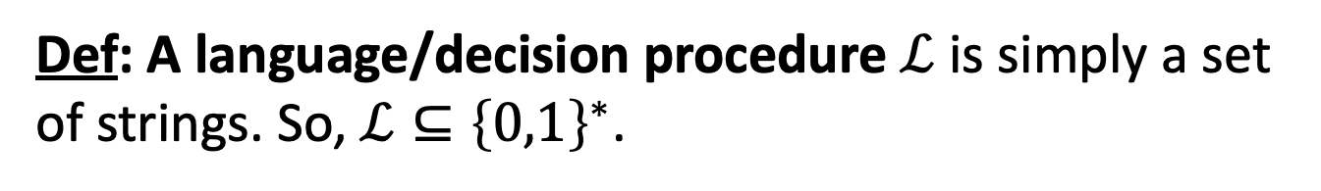
Efficiently Verifiable Proofs: $𝓝𝓟$
Claim/Theorem
accept/reject
proof
Prover
Verifier
Works hard
Polynomial-time
Def: A language/decision procedure $ℒ$ is simply a set of strings. So, $ℒ⊆{\left\{0,1\right\}}^{∗}$.

Slide 8
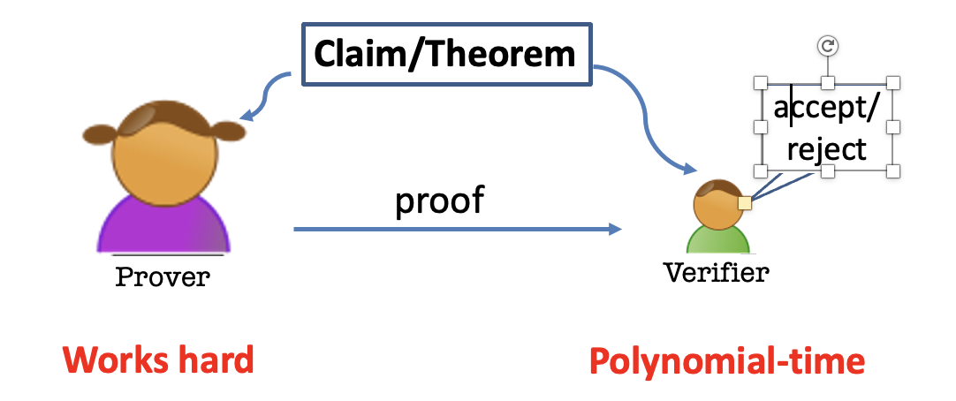
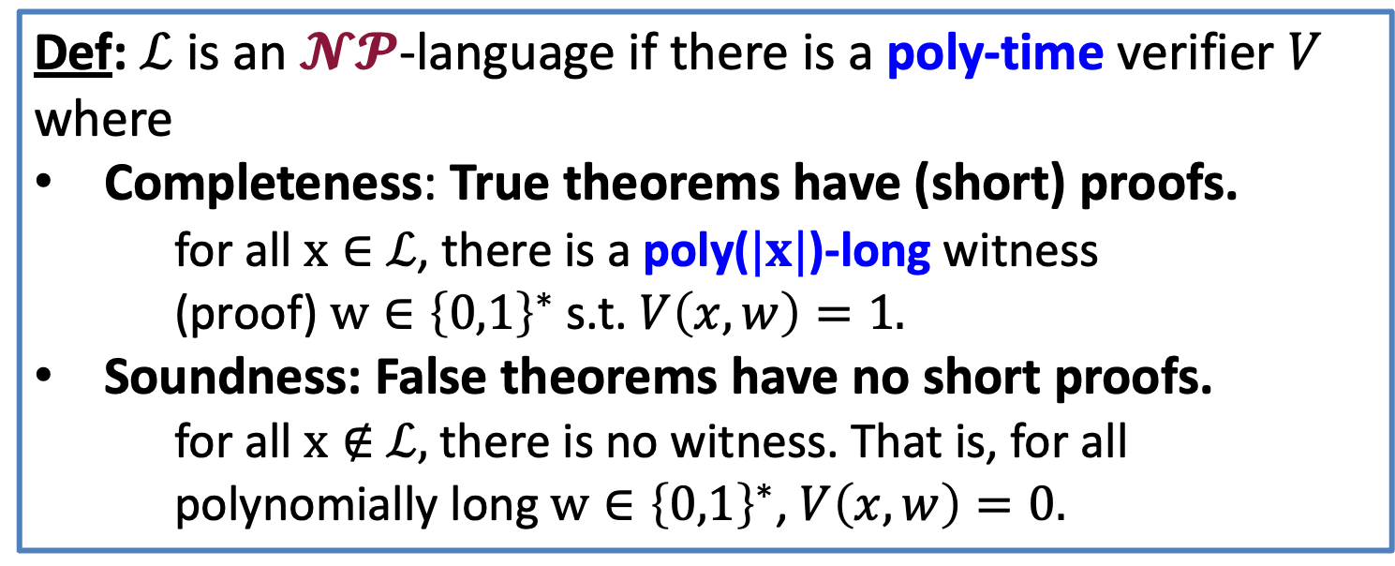
Efficiently Verifiable Proofs: $𝓝𝓟$
Def: $ℒ$ is an $𝓝𝓟$-language if there is a poly-time verifier $V$ where
Completeness: True theorems have (short) proofs.
for all $x∈$ $ℒ$, there is a poly($|x|$)-long witness (proof) $w∈{\left\{0,1\right\}}^{∗}$ s.t. $V\left(x,w\right)=1.$
Soundness: False theorems have no short proofs.
for all $x∉$ $ℒ,$there is no witness. That is, for all polynomially long $w∈{\left\{0,1\right\}}^{∗}$, $V\left(x,w\right)=0.$

Slide 9
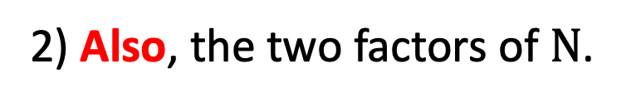
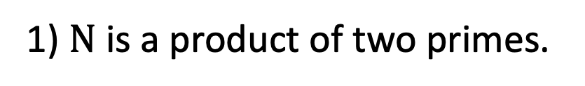
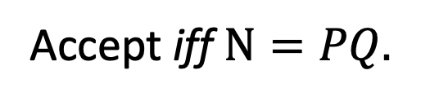
Theorem: $N$ is a product of two prime numbers
Proof $=(P,Q)$
Verifier
Prover
Accept iff $N=PQ.$
After interaction, Bob the Verifier knows:
1) $N$ is a product of two primes.
2) Also, the two factors of $N$.

Slide 10


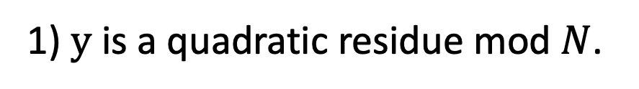
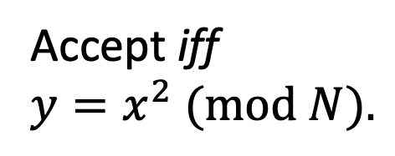
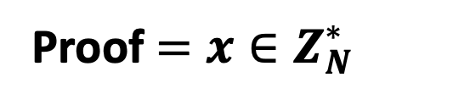
Theorem: $y$ is a quadratic residue mod $N$
Proof $=x∈Z_{N}^{∗}$
Verifier
Prover
Accept iff
$y=x^{2} (mod N).$
After interaction, Bob the Verifier knows:
1) $y$ is a quadratic residue mod $N$.
2) Also, the square root of $y$.

Slide 11
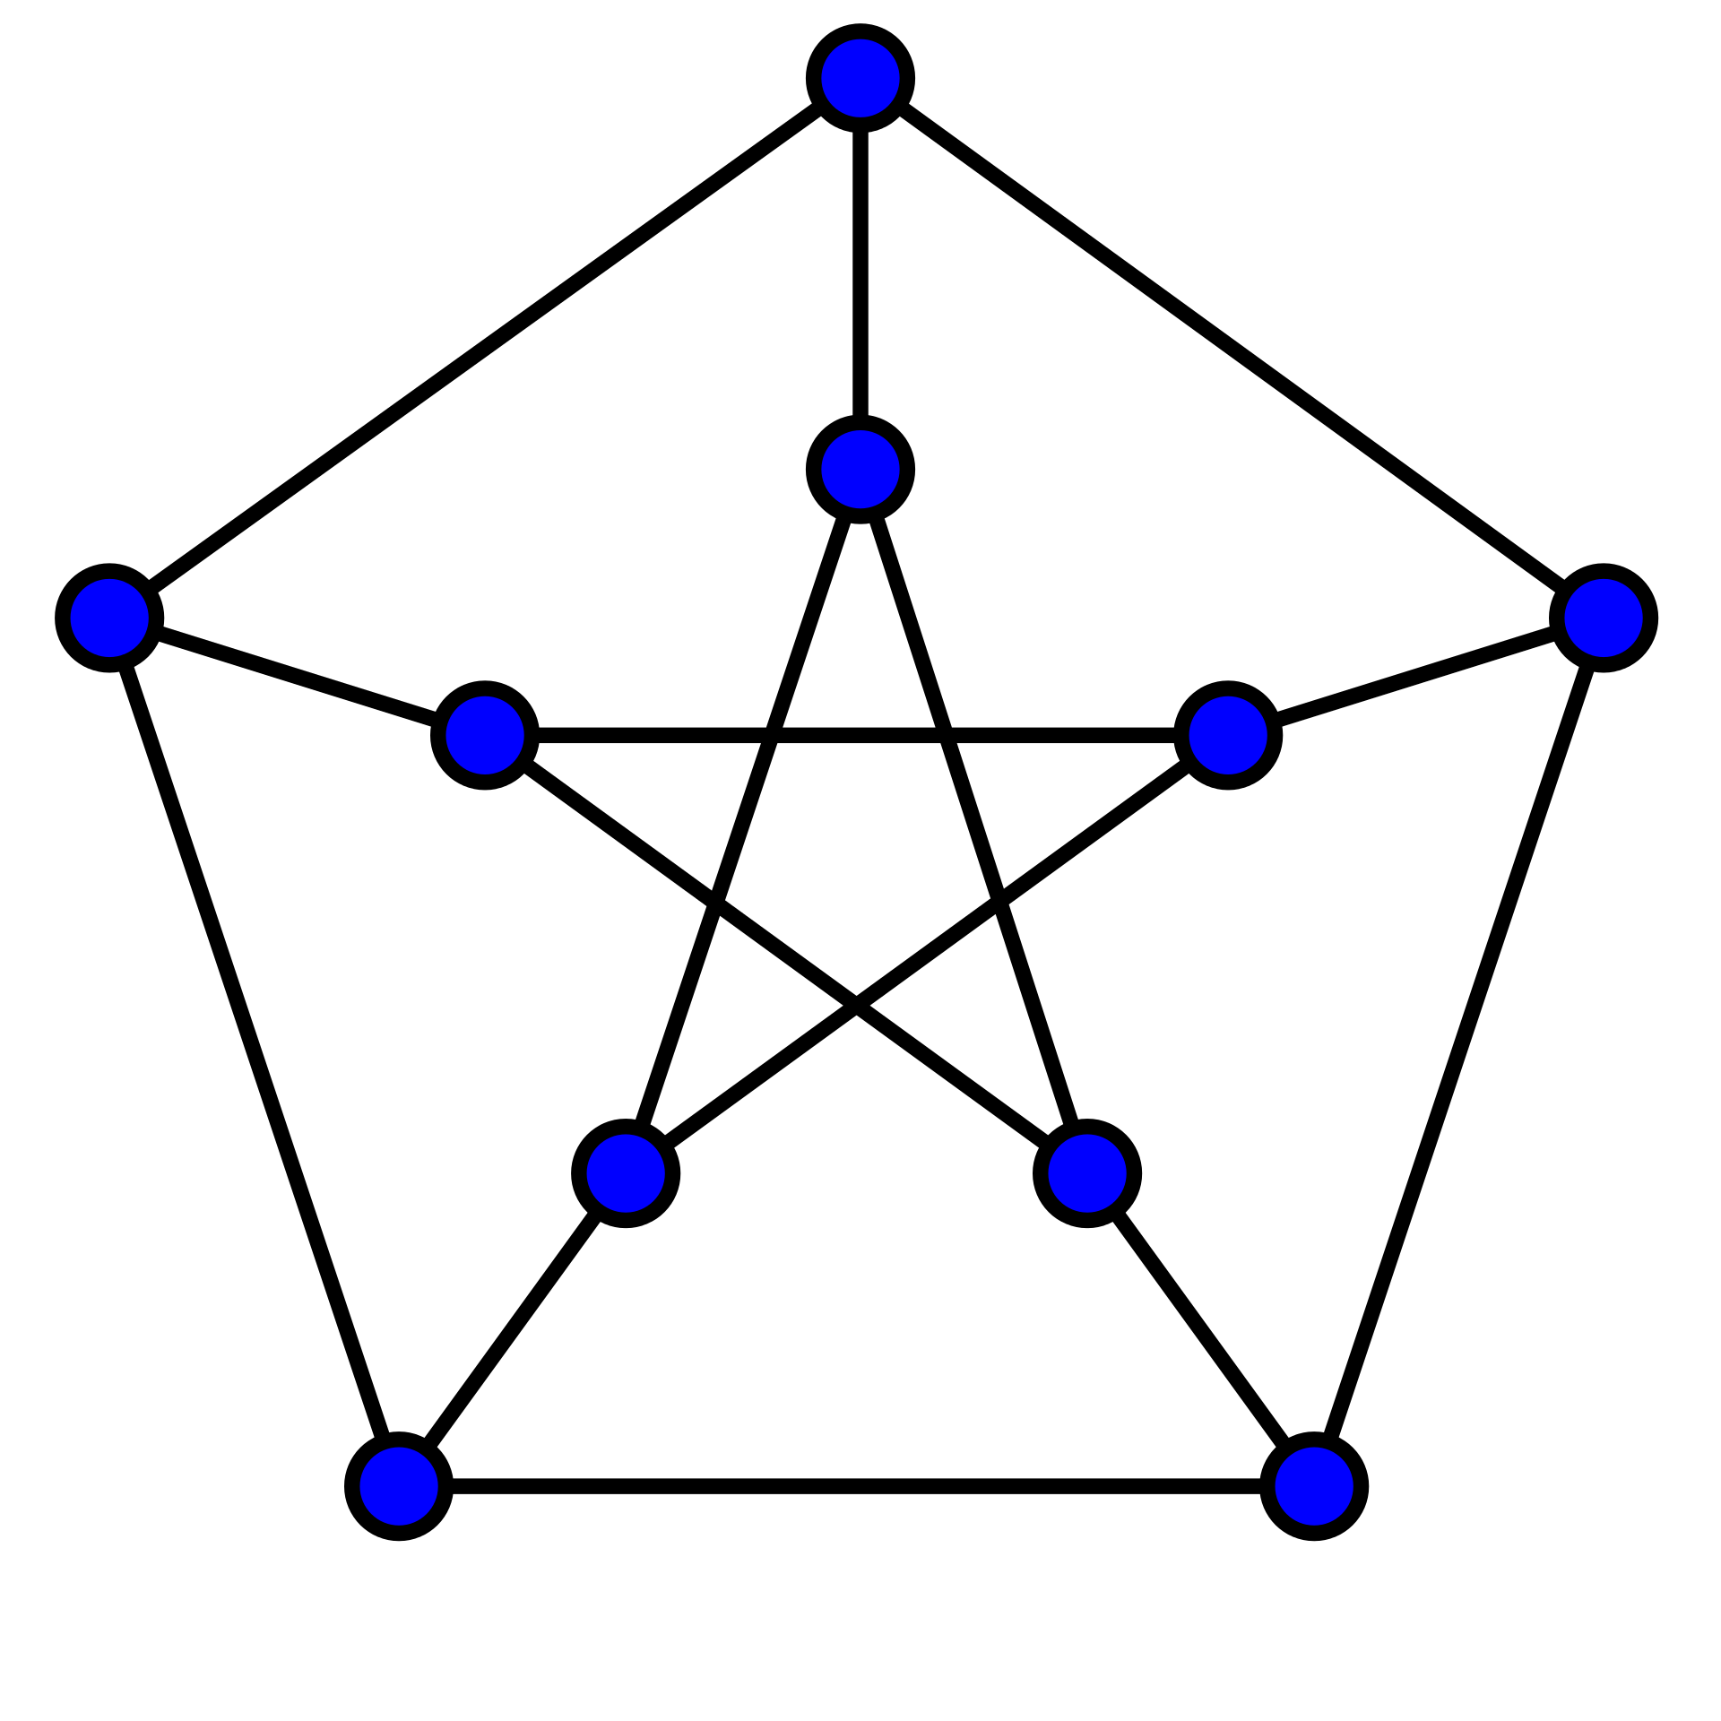
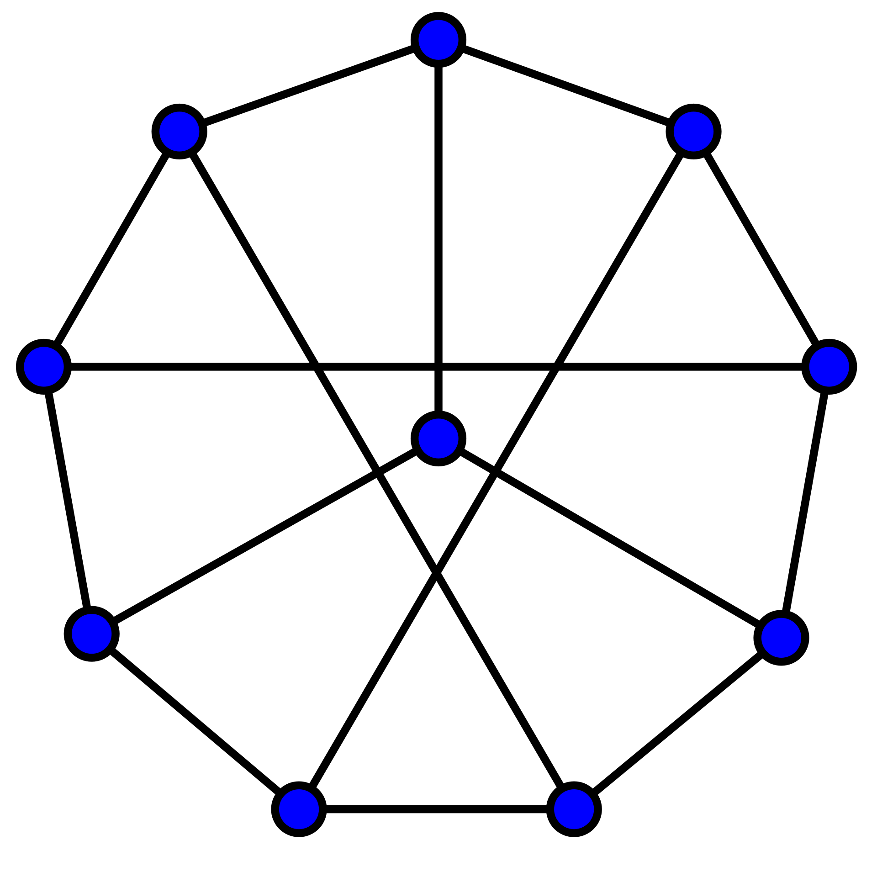
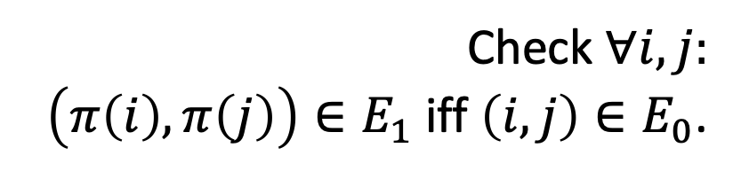

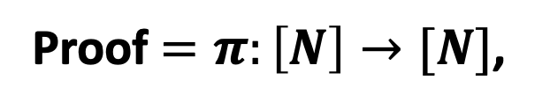
Theorem: Graphs $G_{0}$ and $G_{1}$ are isomorphic.
1
1
2
6
2
6
5
7
10
3
5
8
8
9
4
10
3
4
9
7
Proof $=π:\left[N\right]→[N]$,
the isomorphism
Verifier
Prover
Check $∀i,j:$
$\left(π\left(i\right),π\left(j\right)\right)∈E_{1}$ iff $\left(i,j\right)∈E_{0}$.

Slide 12
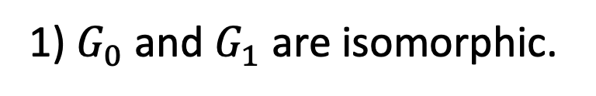
Theorem: Graphs $G_{0}$ and $G_{1}$ are isomorphic.
1
1
2
6
2
6
5
7
10
3
8
5
8
9
4
10
3
4
9
7
Proof $=π:\left[N\right]→[N]$,
the isomorphism
Verifier
Prover
After interaction, Bob the Verifier knows:
1) $G_{0}$ and $G_{1}$ are isomorphic.
2) Also, the isomorphism.

Slide 13
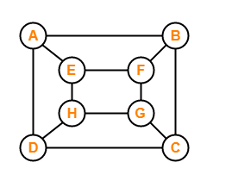

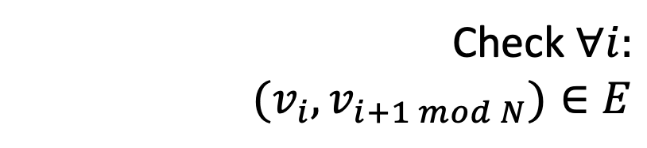
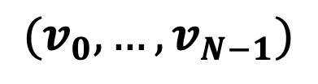
Theorem: Graphs $G$ has a Hamiltonian cycle.
Proof = Hamiltonian cycle
$$(v_{0},…,v_{N−1})$$
Verifier
Prover
Check $∀i:$
$$(v_{i},v_{i+1 mod N})∈E$$

Slide 14
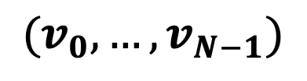
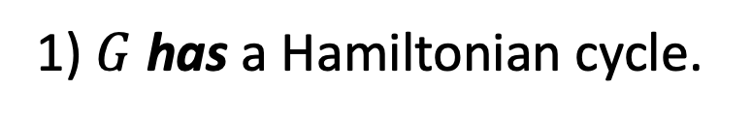
Theorem: Graphs $G$ has a Hamiltonian cycle.
Proof = Hamiltonian cycle
$$(v_{0},…,v_{N−1})$$
Verifier
Prover
After interaction, Bob the Verifier knows:
1) $G$ has a Hamiltonian cycle.
2) Also, the Hamiltonian cycle itself.

Slide 15
Theorem: Graphs $G$ has a Hamiltonian cycle.
Proof = Hamiltonian cycle
$$(v_{0},…,v_{N−1})$$
Verifier
Prover
NP-Complete Problem:
Every one of the other problems can be reduced to it

Slide 16
Theorem: $y$ is a quadratic residue mod $N$
Proof $=x∈Z_{N}^{∗}$
Verifier
Prover
Accept iff
$y=x^{2} (mod N).$
After interaction, Bob the Verifier knows:
1) $y$ is a quadratic residue mod $N$.
2) Also, the square root of $y$.

Slide 17
Is there any other way?

Slide 18
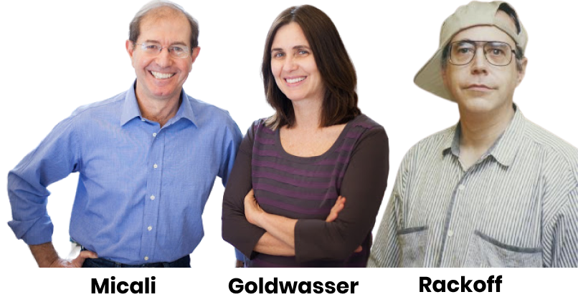
Zero Knowledge Proofs
“I will prove to you that I could’ve sent you a proof if I felt like it.”
Prover

Slide 19
Zero Knowledge Proofs
“I will not give you the square root, but I will prove to you that I could provide one if I wanted to.”
Prover

Slide 20
Two (Necessary) New Ingredients
1. Interaction: Rather than passively reading the proof, the verifier engages in a conversation with the prover.
2. Randomness: The verifier is randomized and can make a mistake with a (exponentially small) probability.

Slide 21


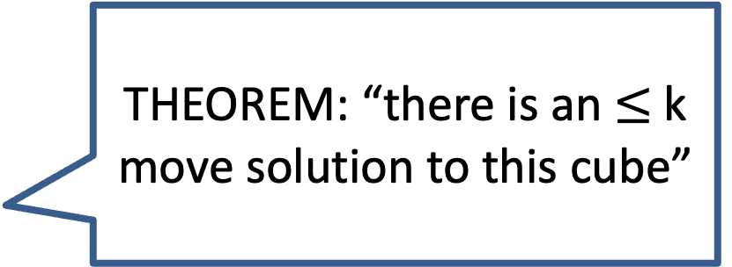
Here is the idea.
THEOREM: “there is an $≤$k move solution to this cube”
Prover

Slide 22
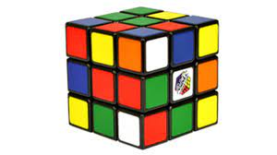
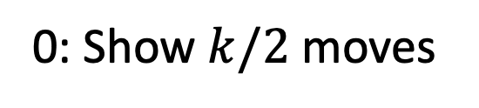
Here is the idea.
“Random” config
Challenge (0 or 1)
0: Show $k/2$ moves
Verifier
Prover

Slide 23
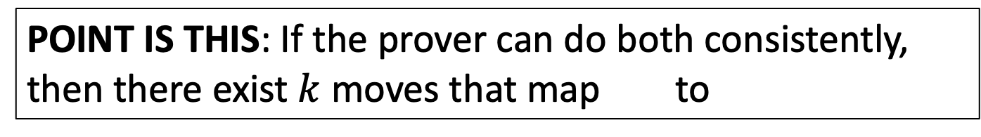
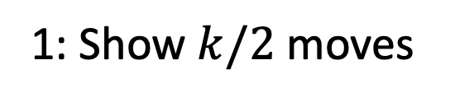
Here is the idea.
“Random” config
Challenge (0 or 1)
1: Show $k/2$ moves
Verifier
Prover
POINT IS THIS: If the prover can do both consistently, then there exist $k$ moves that map to

Slide 24






Interactive Proofs for a Language $ℒ$
Claim/Theorem
$$a_{1}$$
accept/reject
$$q_{1}$$
$$a_{2}$$
$$q_{2}$$
Verifier
Prover
$$…$$
Probabilistic Polynomial-time
Comp. Unbounded

Slide 25





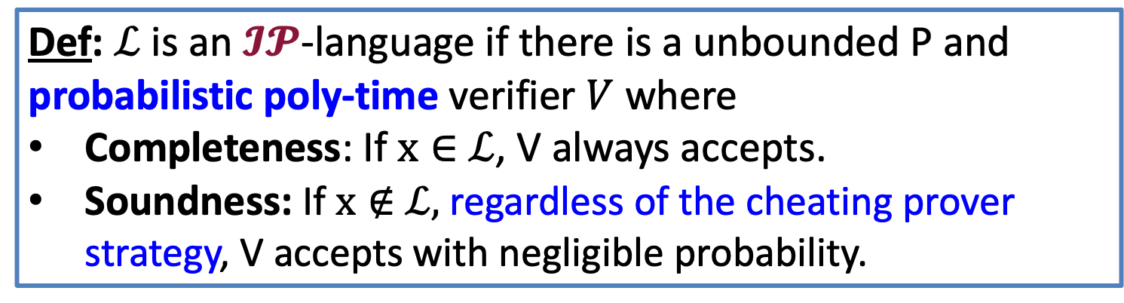
Interactive Proofs for a Language $ℒ$
Claim/Theorem
$$a_{1}$$
accept/reject
$$q_{1}$$
$$a_{2}$$
$$…$$
Verifier
Prover
Def: $ℒ$ is an $𝓘𝓟$-language if there is a unbounded P and probabilistic poly-time verifier $V$ where
Completeness: If $x∈$ $ℒ$, V always accepts.
Soundness: If $x∉$ $ℒ,$ regardless of the cheating prover strategy, V accepts with negligible probability.

Slide 26
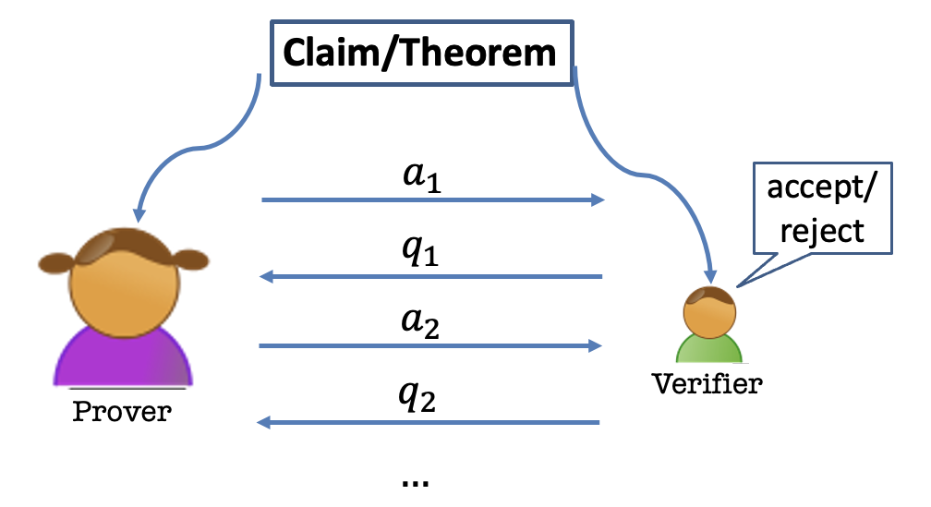
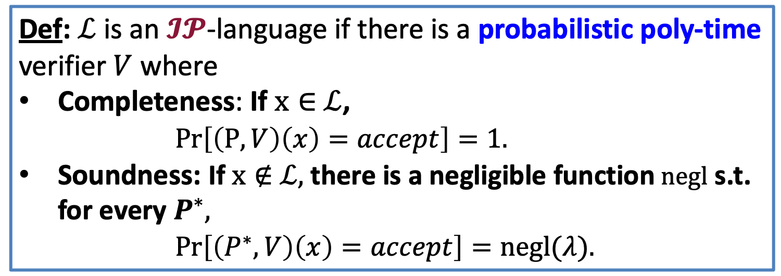
Interactive Proofs for a Language $ℒ$
Def: $ℒ$ is an $𝓘𝓟$-language if there is a probabilistic poly-time verifier $V$ where
Completeness: If $x∈$ $ℒ$,
$Pr\left[\left(P,V\right)\left(x\right)=accept\right]=1.$
Soundness: If $x∉$ $ℒ,$ there is a negligible function $negl$ s.t. for every $P^{∗},$
$Pr\left[\left(P^{∗},V\right)\left(x\right)=accept\right]=negl(λ).$

Slide 27
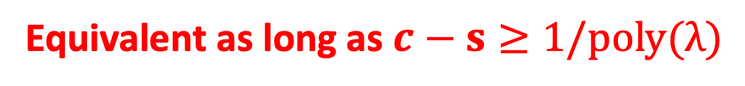
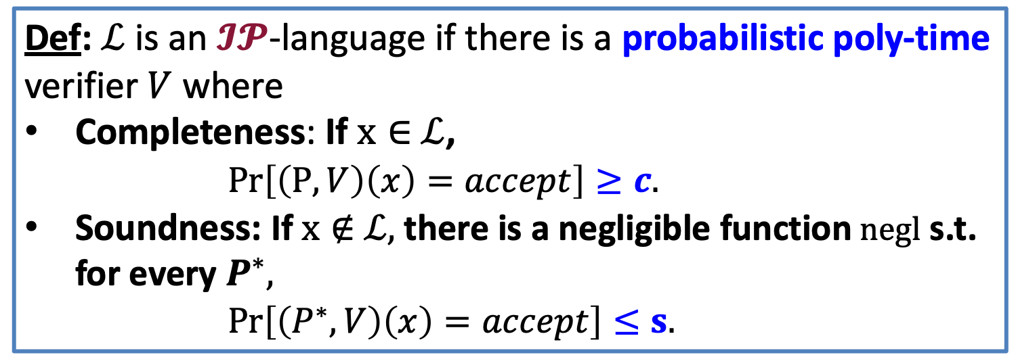
Interactive Proofs for a Language $ℒ$
Def: $ℒ$ is an $𝓘𝓟$-language if there is a probabilistic poly-time verifier $V$ where
Completeness: If $x∈$ $ℒ$,
$Pr\left[\left(P,V\right)\left(x\right)=accept\right]≥c.$
Soundness: If $x∉$ $ℒ,$ there is a negligible function $negl$ s.t. for every $P^{∗},$
$Pr\left[\left(P^{∗},V\right)\left(x\right)=accept\right]≤s.$
Equivalent as long as $c−s≥1/poly(λ)$

Slide 28
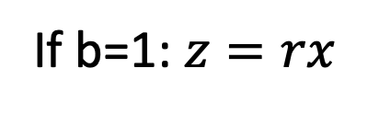
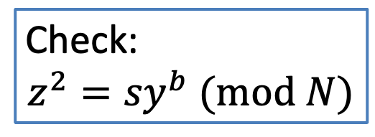
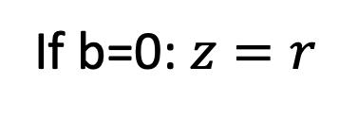



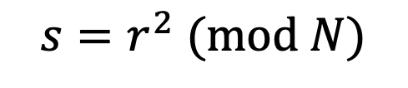
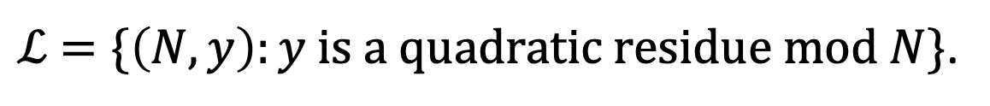
Interactive Proof for QR
$ℒ$ $=\{\left(N,y\right):y is a quadratic residue mod N\}$.
$${s=r}^{2} (mod N)$$
$$\left(N,y\right)$$
$$\left(N,y\right)$$
$$b←\{0,1\}$$
If b=0: $z=r$
Check:
$${z^{2}=sy}^{b} (mod N)$$
If b=1: $z=rx$

Slide 29
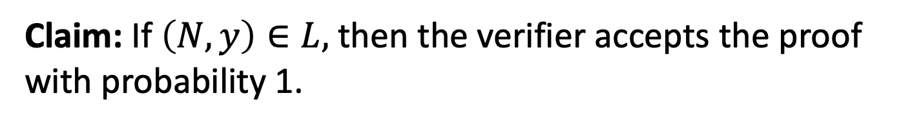
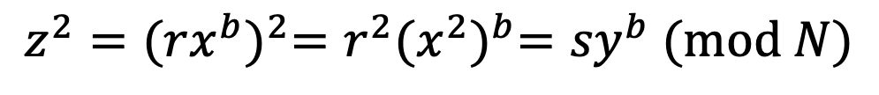
Completeness
Claim: If $\left(N,y\right)∈L,$ then the verifier accepts the proof with probability 1.
Proof:
$${z^{2}={(rx^{b})}^{2}=r^{2}{(x^{2})}^{b}=sy}^{b} (mod N)$$
So, the verifier’s check passes and he accepts.

Slide 30
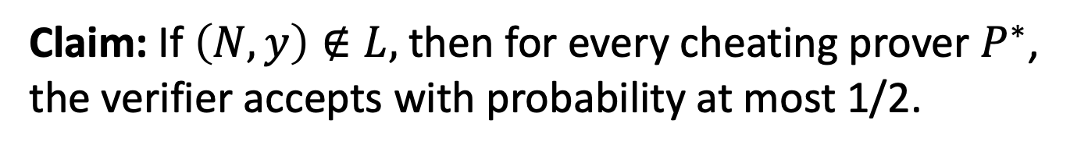
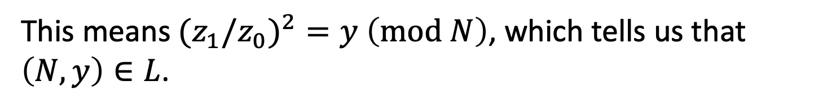
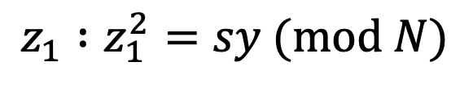
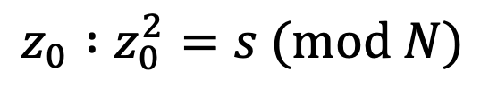
Soundness
Claim: If $\left(N,y\right)∉L,$ then for every cheating prover $P^{∗}$, the verifier accepts with probability at most 1/2.
Proof:
Suppose the verifier accepts with probability > 1/2.
Then, there is some $s∈Z_{N}^{∗}$ s.t. the prover produces
$$z_{0} :z_{0}^{2}=s (mod N)$$
$$z_{1} :z_{1}^{2}=sy (mod N)$$
This means${(z}_{1}/z_{0})^{2}=y$ $\left(mod N\right)$, which tells us that $\left(N,y\right)∈L$.

Slide 31
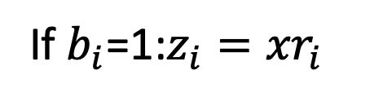







Interactive Proof for QR
$ℒ$ $=\{\left(N,y\right):y is a quadratic residue mod N\}$.
$$s_{i}=r_{i}^{2} (mod N)$$
$$\left(N,y\right)$$
$$\left(N,y\right)$$
$$b_{i}←\{0,1\}$$
If $b_{i}$=0: $z_{i}=r_{i}$
Check for all i:
$$z_{i}^{2}=s_{i}y^{b} (mod N)$$
If $b_{i}$=1:$z_{i}={xr}_{i}$
REPEAT sequentially $λ$ times.

Slide 32

Soundness
Claim: If $\left(N,y\right)∉L,$ then for every cheating prover $P^{∗}$, the verifier accepts with probability at most ${(\frac{1}{2})}^{λ}$.
Proof:
Exercise.

Slide 33
This is Zero-Knowledge.
But what does that mean?
$${s=r}^{2} (mod N)$$
$$\left(N,y\right)$$
$$\left(N,y\right)$$
$$b←\{0,1\}$$
If b=0: $z=r$
Check:
$${z^{2}=sy}^{b} (mod N)$$
If b=1: $z=rx$

Slide 34


How to Define Zero-Knowledge?
After the interaction, $V$ knows:
The theorem is true; and
A view of the interaction
(= transcript + coins of V)
$P$ gives zero knowledge to $V$:
When the theorem is true, the view gives V nothing that he couldn’t have obtained on his own without interacting with P.

Slide 35

How to Define Zero-Knowledge?
$(P,V)$ is zero-knowledge if $V$ can generate his VIEW of the interaction all by himself in probabilistic polynomial time.

Slide 36

How to Define Zero-Knowledge?
$(P,V)$ is zero-knowledge if $V$ can “simulate” his VIEW of the interaction all by himself in probabilistic polynomial time.

Slide 37








The Simulation Paradigm
PPT “simulator” $S$
$${sim}_{S}:$$
$$\left(s,b,z\right)$$
$$\left(N,y\right)$$
$${view}_{V}\left(P,V\right):$$
$Transcript= \left(s,b,z\right),$
Coins = $b$
$${view}_{V}\left(P,V\right):$$
$$\left(s,b,z\right)$$

Slide 38



Zero Knowledge: Definition
An Interactive Protocol (P,V) is zero-knowledge for a language $L$if there exists a PPT algorithm S (a simulator) such that for every $x∈L$, the following two distributions are indistinguishable:
1. ${view}_{V}(P,V)$
2. $S(x,1^{λ})$
(P,V) is a zero-knowledge interactive protocol if it is complete, sound and zero-knowledge.

Slide 39

Perfect Zero Knowledge: Definition
An Interactive Protocol (P,V) is perfect zero-knowledge for a language $L$if there exists a PPT algorithm S (a simulator) such that for every $x∈L$, the following two distributions are identical:
1. ${view}_{V}(P,V)$
2. $S(x,1^{λ})$
(P,V) is a zero-knowledge interactive protocol if it is complete, sound and zero-knowledge.

Slide 40



Statistical Zero Knowledge: Definition
An Interactive Protocol (P,V) is statistical zero-knowledge for a language $L$if there exists a PPT algorithm S (a simulator) such that for every $x∈L$, the following two distributions are statistically indistinguishable:
1. ${view}_{V}(P,V)$
2. $S(x,1^{λ})$
(P,V) is a zero-knowledge interactive protocol if it is complete, sound and zero-knowledge.

Slide 41

Computational Zero Knowledge: Definition
An Interactive Protocol (P,V) is computational zero-knowledge for a language $L$if there exists a PPT algorithm S (a simulator) such that for every $x∈L$, the following two distributions are computationally indistinguishable:
1. ${view}_{V}(P,V)$
2. $S(x,1^{λ})$
(P,V) is a zero-knowledge interactive protocol if it is complete, sound and zero-knowledge.

Slide 42




Zero Knowledge
Claim: The QR protocol is zero knowledge.
Simulator S works as follows:
1. First pick a random bit b.
2. pick a random $z∈Z_{N}^{∗}$.
3. compute $s=z^{2}/y^{b}$.
$${view}_{V}\left(P,V\right):$$
$$\left(s,b,z\right)$$
4. output $(s,b,z)$.
Exercise: The simulated transcript is identically distributed as the real transcript in the interaction (P,V).

Slide 43






What if V is NOT HONEST.
OLD DEF
An Interactive Protocol (P,V) is honest-verifier perfect zero-knowledge for a language $L$if there exists a PPT simulator S such that for every $x∈L$, the following two distributions are identical:
1. ${view}_{V}(P,V)$
2. $S(x,1^{λ})$
REAL DEF
An Interactive Protocol (P,V) is perfect zero-knowledge for a language $L$if for every PPT $V^{∗}$, there exists a (expected) poly time simulator S s.t. for every $x∈L$, the following two distributions are identical:
1. ${view}_{V^{∗}}(P,V^{∗})$
2. $S(x,1^{λ})$

Slide 44



NOW: (Malicious Ver) Zero Knowledge
Theorem: The QR protocol is (malicious verifier) zero knowledge.
Simulator S works as follows:
1. First pick a random s and “feed it to” $V^{∗}$.
2. Let $b=V^{∗}(s)$.
$${view}_{V^{∗}}\left(P,V^{∗}\right):$$
$$\left(s,b,z\right)$$
Now what???

Slide 45


(Malicious Ver) Zero Knowledge
Theorem: The QR protocol is (malicious verifier) zero knowledge.
Simulator S works as follows:
1. First set $s=\frac{z^{2}}{y^{b}}$ for a random z and b and feed s to $V^{∗}$.
2. Let $b′=V^{∗}(s)$.
3. If $b^{′}=b$, output $(s,b,z)$ and stop.
4. Otherwise, go back to step 1 and repeat. (also called “rewinding”).

Slide 46


Simulator S works as follows:
1. First set $s=\frac{z^{2}}{y^{b}}$ for a random z and feed s to $V^{∗}$.
2. Let $b′=V^{∗}(s)$.
3. If $b^{′}=b$, output $(s,b,z)$ and stop.
4. Otherwise, go back to step 1 and repeat. (also called “rewinding”).
Lemma:
S runs in expected polynomial-time.
When S outputs a view, it is identically distributed to the view of $V^{∗}$ in a real execution.

Slide 47
What Made it Possible?
1. Each statement had multiple proofs of which the prover chooses one at random.
2. Each such proof is made of two parts: seeing either one on its own gives the verifier no knowledge; seeing both imply 100% correctness.
3. Verifier chooses to see either part, at random. The prover’s ability to provide either part on demand convinces the verifier.

