Slide 1
MIT 6.875
Foundations of Cryptography
Lecture 21

Slide 2
TODAY: Oblivious Transfer and Private Information Retrieval

Slide 3










Basic Problem: Database Access
Database D
0
$$x_{0}$$
1
$$x_{1}$$
Index: i
2
$$x_{2}$$
3
$$x_{3}$$
4
$$x_{4}$$
5
$$x_{5}$$
6
$$x_{6}$$
Server
Client
7
$$x_{7}$$
Correctness: Client gets $D[i]$.
Privacy (for client): Server gets no information about $i$.

Slide 4
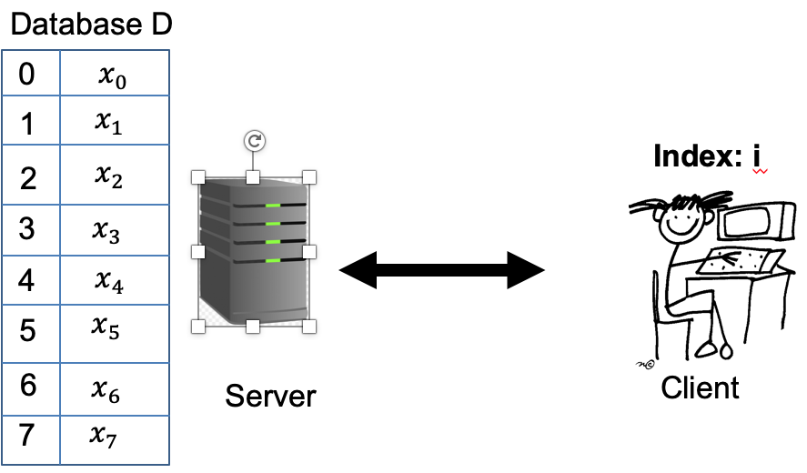
Here is a “solution”. The server sends the DB to the client.
Two ways to overcome the triviality
Oblivious Transfer (OT)
Add’l property: server privacy
Symmetric PIR = Succinctness + Server privacy
Private Information Retrieval (PIR)
Add’l property: succinctness

Slide 5


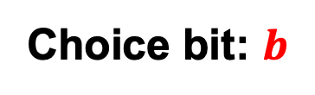


Oblivious Transfer (OT)
$$x_{0}$$
Choice bit: $b$
$$x_{1}$$
Sender
Receiver
Sender holds two bits $x_{0}$ and $x_{1}$.
Receiver holds a choice bit $b$.
Receiver should learn $x_{b}$, sender should learn nothing.
(We will consider honest-but-curious adversaries; formal definition in a little bit…)

Slide 6
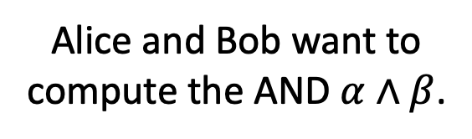
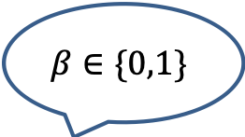
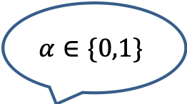
Why OT? The Dating Problem
$$α∈\{0,1\}$$
Alice and Bob want to compute the AND $α∧β$.
$$β∈\{0,1\}$$

Slide 7



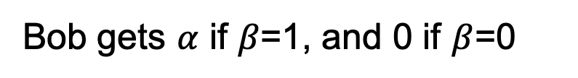
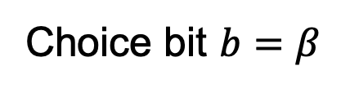

Why OT? The Dating Problem
$$α∈\{0,1\}$$
Alice and Bob want to compute the AND $α∧β$.
$$β∈\{0,1\}$$
$$x_{0}=0$$
Run an OT protocol
Choice bit $b=β$
$$x_{1}=α$$
Bob gets $α$ if $β$=1, and 0 if $β$=0
$$x_{1}b+ x_{0}\left(1−b\right)$$
Here is a way to write the OT selection function:
which, in this case is $=αβ$.

Slide 8
The Billionaires’ Problem
Net worth: $X
Net worth: $Y
Who is richer?

Slide 9
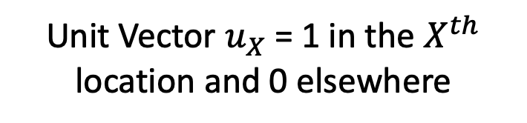









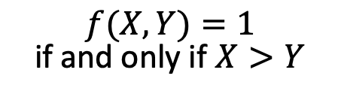
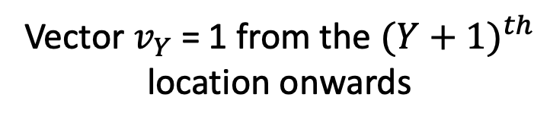
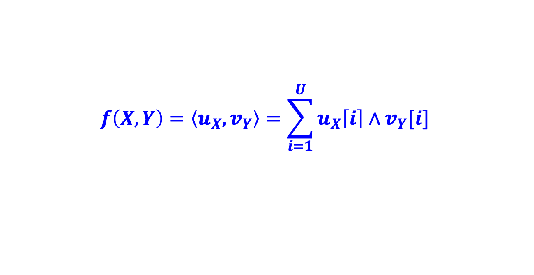






The Billionaires’ Problem
$f(X,Y)=1$ if and only if $X>Y$
$$X$$
$$Y$$
$$…$$
$$…$$
$$…$$
$$0$$
$$1$$
$$0$$
$$1$$
$$1$$
$$1$$
$$1$$
$$1$$
$$1$$
$$0$$
$$0$$
Unit Vector $u_{X}$ = 1 in the $X^{th}$ location and 0 elsewhere
Vector $v_{Y}$ = 1 from the ${(Y+1)}^{th}$ location onwards
$$f\left(X,Y\right)=\left\langle u_{X},v_{Y}\right\rangle =\sum_{i=1}^{U}{u_{X}\left[i\right]∧v_{Y}[i]}$$
Compute each AND individually and sum it up?

Slide 10
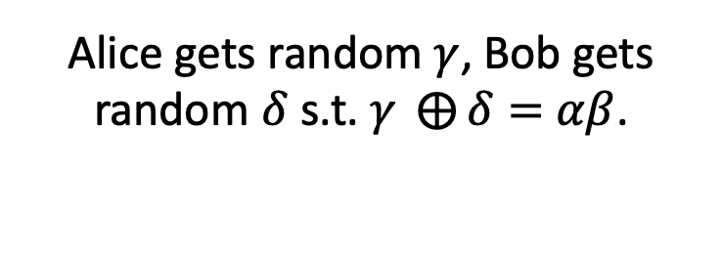
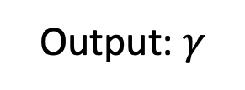


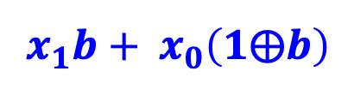





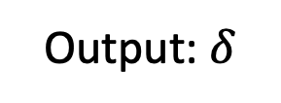
Detour: OT $⇒$ Secret-Shared-AND
$$α∈\{0,1\}$$
Alice gets random $γ$, Bob gets random $δ$ s.t. $γ ⨁{δ}=$ $αβ$.
$$β∈\{0,1\}$$
Output: $γ$
Output: $δ$
$$x_{0}=γ$$
Run an OT protocol
Choice bit $b=β$
$x_{1}=α⨁$ $γ$
Alice outputs $γ$.
$$x_{1}b+ x_{0}\left(1⨁b\right)$$
Bob gets
$=(x_{1}$ $⨁{ x}_{0})b+x_{0}$
$$=αβ⨁γ≔δ$$

Slide 11


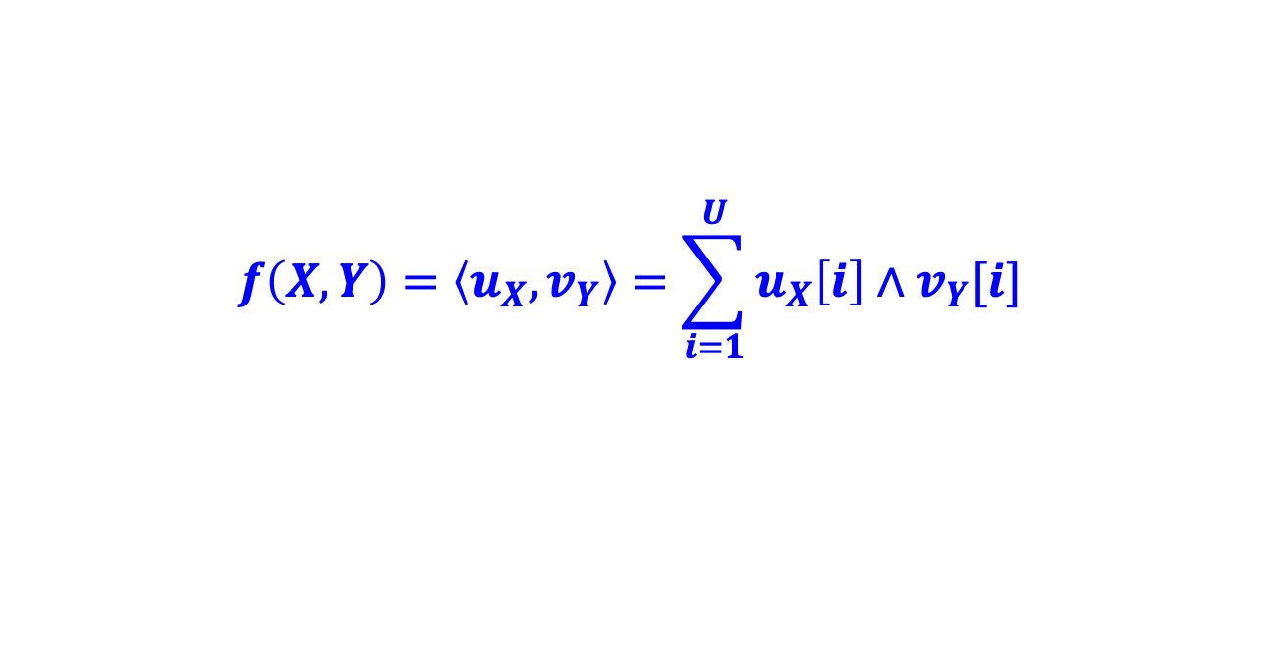


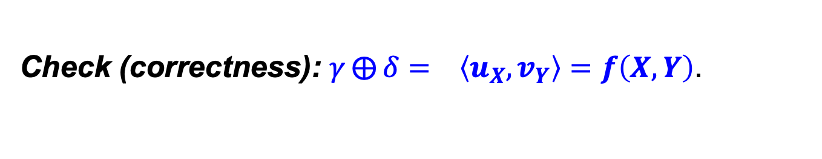






The Billionaires’ Problem
$f(X,Y)=1$ if and only if $X>Y$
$$…$$
$$…$$
$$…$$
$$0$$
$$1$$
$$0$$
$$1$$
$$1$$
$$1$$
$$1$$
$$1$$
$$1$$
$$0$$
$$0$$
Unit Vector $u_{X}$
Vector $v_{Y}$
$$f\left(X,Y\right)=\left\langle u_{X},v_{Y}\right\rangle =\sum_{i=1}^{U}{u_{X}\left[i\right]∧v_{Y}[i]}$$
1. Alice and Bob run many OTs to get $(γ_{i},δ_{i})$ s.t.
$${γ_{i}⨁δ_{i}= u}_{X}\left[i\right]∧v_{Y}[i]$$
2. Alice computes ${γ= ⨁}_{i}{ γ}_{i}$ and Bob computes ${δ= ⨁}_{i}{ δ}_{i}.$
3. Alice reveals $γ$ and Bob reveals $δ.$
Check (correctness): ${γ⨁{δ}= }_{}\left\langle u_{X},v_{Y}\right\rangle =f\left(X,Y\right)$.

Slide 12
The Billionaires’ Problem
$f(X,Y)=1$ if and only if $X>Y$
$$…$$
$$…$$
$$…$$
$$0$$
$$1$$
$$0$$
$$1$$
$$1$$
$$1$$
$$1$$
$$1$$
$$1$$
$$0$$
$$0$$
Unit Vector $u_{X}$
Vector $v_{Y}$
$$f\left(X,Y\right)=\left\langle u_{X},v_{Y}\right\rangle =\sum_{i=1}^{U}{u_{X}\left[i\right]∧v_{Y}[i]}$$
1. Alice and Bob run many OTs to get $(γ_{i},δ_{i})$ s.t.
$${γ_{i}⨁δ_{i}= u}_{X}\left[i\right]∧v_{Y}[i]$$
2. Alice computes ${γ= ⨁}_{i}{ γ}_{i}$ and Bob computes ${δ= ⨁}_{i}{ δ}_{i}.$
Check (privacy): Alice & Bob get a bunch of random bits.

Slide 13

“OT is Complete”
Theorem (lec22-24): OT can solve not just love and money, but any two-party (and multi-party) problem efficiently (complexity prop. To circuit size of f).

Slide 14
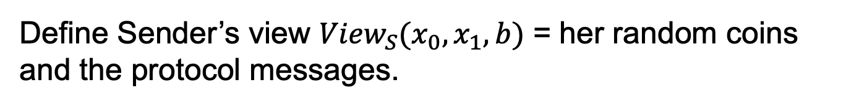
OT Definition
$$x_{0}$$
Choice bit: $b$
$$x_{1}$$
Sender
Receiver
Receiver Security: Sender should not learn b.
Define Sender’s view ${View}_{S}(x_{0},x_{1},b)$ = her random coins and the protocol messages.

Slide 15
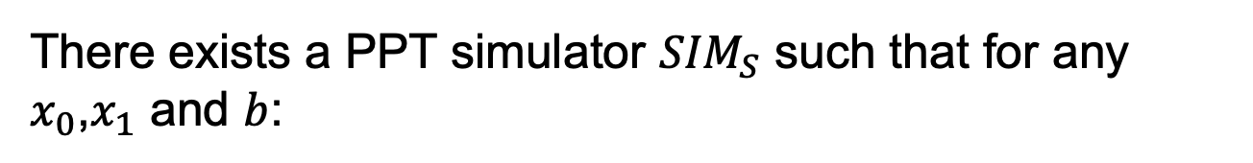

OT Definition
$$x_{0}$$
Choice bit: $b$
$$x_{1}$$
Sender
Receiver
Receiver Security: Sender should not learn b.
There exists a PPT simulator ${SIM}_{S}$ such that for any $x_{0}$,$x_{1}$ and $b$:
$${SIM}_{S}(x_{0},x_{1})≅{View}_{S}(x_{0},x_{1},b)$$

Slide 16
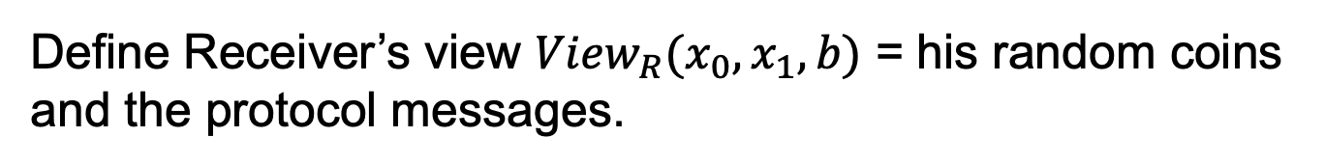
OT Definition
$$x_{0}$$
Choice bit: $b$
$$x_{1}$$
Sender
Receiver
Sender Security: Receiver should not learn $x_{1−b}$.
Define Receiver’s view ${View}_{R}(x_{0},x_{1},b)$ = his random coins and the protocol messages.

Slide 17

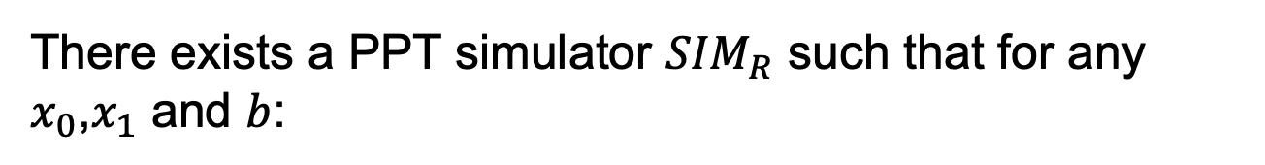
OT Definition
$$x_{0}$$
Choice bit: $b$
$$x_{1}$$
Sender
Receiver
Sender Security: Receiver should not learn $x_{1−b}$.
There exists a PPT simulator ${SIM}_{R}$ such that for any $x_{0}$,$x_{1}$ and $b$:
$${SIM}_{R}(b,x_{b})≅{View}_{R}(x_{0},x_{1},b)$$

Slide 18

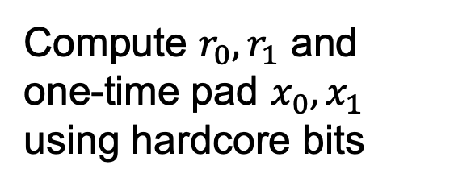
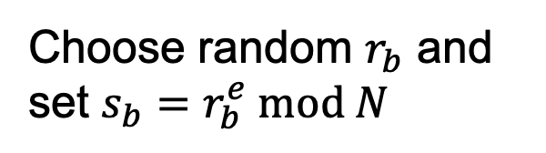
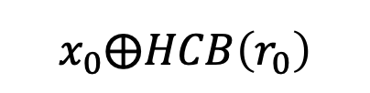
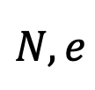

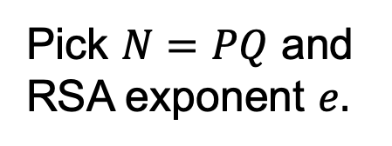
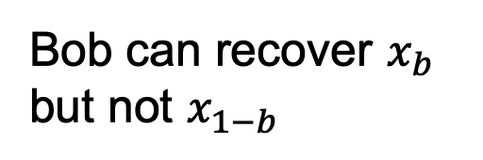
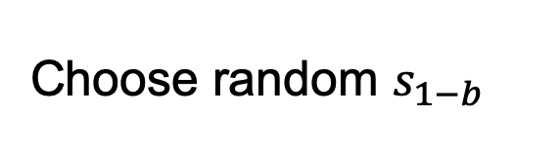
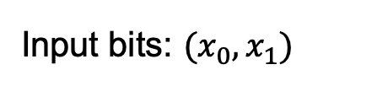
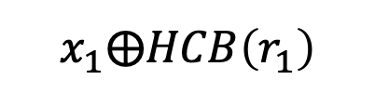
OT Protocol 1: Trapdoor Permutations
For concreteness, let’s use the RSA trapdoor permutation.
Input bits: $(x_{0},x_{1})$
Choice bit: $b$
Pick $N=PQ$ and RSA exponent $e.$
$$N,e$$
Choose random $r_{b}$ and set $s_{b}=r_{b}^{e} mod N$
$$s_{0},s_{1}$$
Choose random $s_{1−b}$
Compute $r_{0},r_{1}$ and one-time pad $x_{0},x_{1}$ using hardcore bits
$$x_{0}⨁HCB\left(r_{0}\right)$$
Bob can recover $x_{b}$ but not $x_{1−b}$
$$x_{1}⨁HCB\left(r_{1}\right)$$

Slide 19

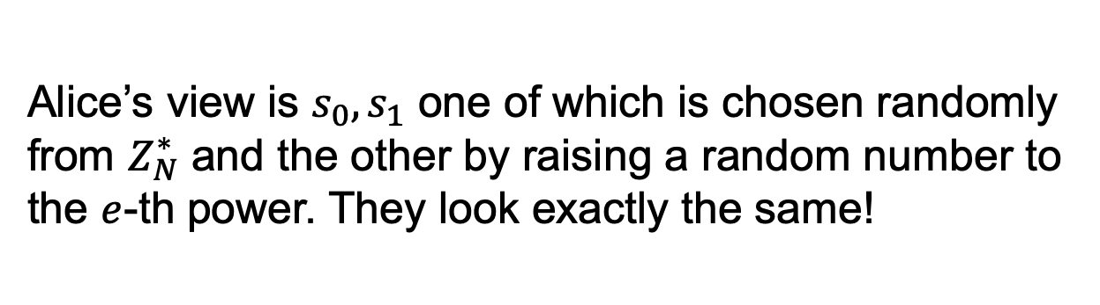
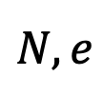
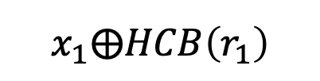
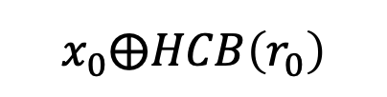
OT Protocol 1: Trapdoor Permutations
$$N,e$$
$$s_{0},s_{1}$$
Input bits: $(x_{0},x_{1})$
Choice bit: $b$
$$x_{0}⨁HCB\left(r_{0}\right)$$
$$x_{1}⨁HCB\left(r_{1}\right)$$
How about Bob’s security (a.k.a. Why does Alice not learn Bob’s choice bit)?
Alice’s view is $s_{0},s_{1}$ one of which is chosen randomly from $Z_{N}^{∗}$ and the other by raising a random number to the $e$-th power. They look exactly the same!

Slide 20
OT Protocol 1: Trapdoor Permutations
$$N,e$$
$$s_{0},s_{1}$$
Input bits: $(x_{0},x_{1})$
Choice bit: $b$
$$x_{0}⨁HCB\left(r_{0}\right)$$
$$x_{1}⨁HCB\left(r_{1}\right)$$
How about Bob’s security (a.k.a. Why does Alice not learn Bob’s choice bit)?
Exercise: Show how to construct the simulator.

Slide 21
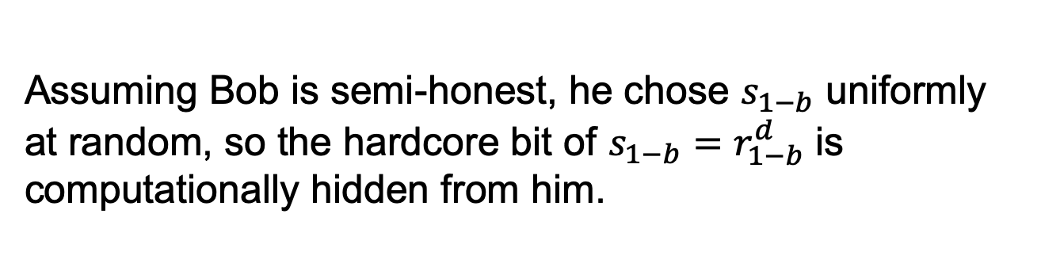
OT Protocol 1: Trapdoor Permutations
$$N,e$$
$$s_{0},s_{1}$$
Input bits: $(x_{0},x_{1})$
Choice bit: $b$
$$x_{0}⨁HCB\left(r_{0}\right)$$
$$x_{1}⨁HCB\left(r_{1}\right)$$
How about Alice’s security (a.k.a. Why does Bob not learn both of Alice’s bits)?
Assuming Bob is semi-honest, he chose $s_{1−b}$ uniformly at random, so the hardcore bit of $s_{1−b}=r_{1−b}^{d}$ is computationally hidden from him.

Slide 22
OT from Trapdoor Permutations
$$N,e$$
$$s_{0},s_{1}$$
Input bits: $(x_{0},x_{1})$
Choice bit: $b$
$$x_{0}⨁HCB\left(r_{0}\right)$$
$$x_{1}⨁HCB\left(r_{1}\right)$$
How about Alice’s security (a.k.a. Why does Bob not learn both of Alice’s bits)?
Exercise: Show how to construct the simulator.

Slide 23
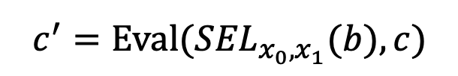

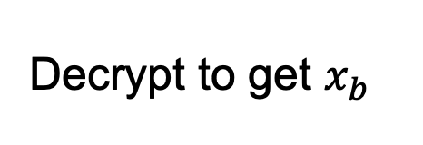
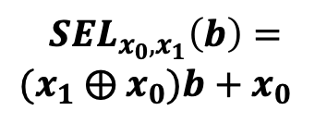

OT Protocol 2: Additive HE
Input bits: $(x_{0},x_{1})$
Choice bit: $b$
Encrypt choice bit b
Homomorphically evaluate the selection function
$$c$$
$$c⟵Enc(sk,b)$$
$$c^{′}=Eval({SEL}_{x_{0},x_{1}}(b),c)$$
Decrypt to get $x_{b}$
$${SEL}_{x_{0},x_{1}}\left(b\right)=$$
$(x_{1}$ $⨁{ x}_{0})b+x_{0}$
Bob’s security: computational, from CPA-security of Enc.
Alice’s security: statistical, from function-privacy of Eval.

Slide 24
Many More Constructions of OT
Theorem: OT protocols can be constructed based on the hardness of the Diffie-Hellman problem, factoring, quadratic residuosity, LWE, elliptic curve isogeny problem etc. etc.

Slide 25
Secure Two-Party Computation

Slide 26


Secure Two-Party Computation
Input: $x$
Input: $y$
Alice
Bob
Alice and Bob want to compute $F\left(x,y\right).$
Semi-honest Security:
Alice should not learn anything more than $x$ and $F\left(x,y\right).$
Bob should not learn anything more than $y$ and $F\left(x,y\right).$

Slide 27


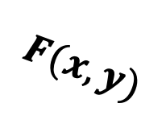
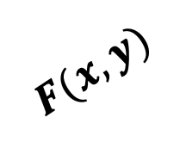
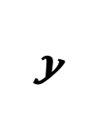
Secure Two-Party Computation
REAL WORLD:
Input: $x$
Input: $y$
Alice
Bob
≈
IDEAL WORLD:
$$y$$
$$x$$
$$F(x,y)$$
$$F(x,y)$$

Slide 28

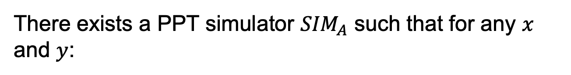
Secure Two-Party Computation
Input: $x$
Input: $y$
Alice
Bob
There exists a PPT simulator ${SIM}_{A}$ such that for any $x$ and $y$:
$${SIM}_{A}(x,F(x,y))≅{View}_{A}(x,y)$$

Slide 29

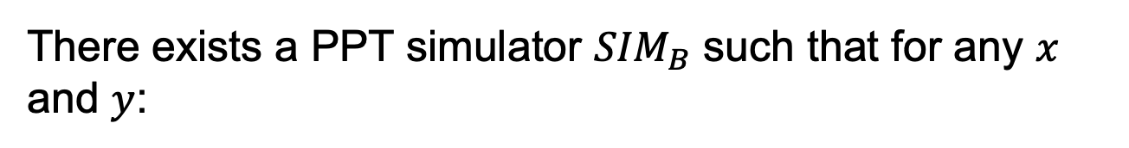
Secure Two-Party Computation
Input: $x$
Input: $y$
Alice
Bob
There exists a PPT simulator ${SIM}_{B}$ such that for any $x$ and $y$:
$${SIM}_{B}(y,F(x,y))≅{View}_{B}(x,y)$$

Slide 30
Secure 2PC from OT
Theorem [Goldreich-Micali-Wigderson’87]: OT can solve any two-party computation problem.

Slide 31

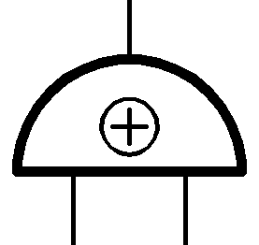



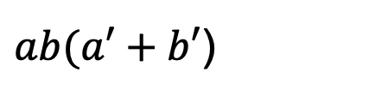

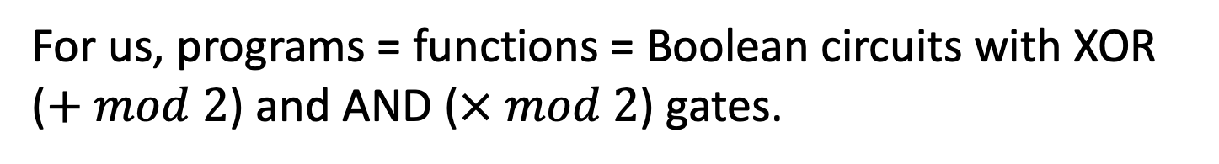


How to Compute Arbitrary Functions
For us, programs = functions = Boolean circuits with XOR ($+ mod 2$) and AND ($× mod 2$) gates.
$ab(a′+b′$)
X
$$ab$$
$$a^{′}+b′$$
+
X
$$a$$
$$b$$
$$a′$$
$$b′$$
Want: If you can compute XOR and AND in the appropriate sense, you can compute everything.

Slide 32


Basic Secret-Sharing
A secret (bit) $s$ is shared between Alice and Bob if Alice holds a bit $α$ and Bob holds a bit $β$ s.t. $α⊕β=s$
$α$ and $β$ are (typically) individually random, so neither Alice nor Bob knows any information about $s$. Together, however, they can recover $s$.

Slide 33








Recap: OT $⇒$ Secret-Shared-AND
$$a∈\{0,1\}$$
Alice gets random $γ$, Bob gets random $δ$ s.t. $γ ⨁{δ}=$ $ab$.
$$b∈\{0,1\}$$
Output: $γ$
Output: $δ$
$$x_{0}=γ$$
Run an OT protocol
Choice bit $b$
$x_{1}=a ⨁$ $γ$
Alice outputs $γ$.
$$x_{1}b+ x_{0}\left(1⨁b\right)$$
Bob gets
$=(x_{1}$ $⨁{ x}_{0})b+x_{0}$
$$=ab⨁γ$$
$$≔δ$$

Slide 34









How to Compute Arbitrary Functions
Secret-sharing Invariant: For each wire of the circuit, Alice and Bob each have a bit whose XOR is the value at the wire.
XOR gate: Locally XOR the shares
AND gate??
X
$$a′$$
$$b′$$
+
X
$$a$$
$$0$$
$$a′$$
$$⊕$$
$$0$$
$$0$$
$$b$$
$$0$$
$$⊕$$
$$b′$$
Base Case: Input wires

Slide 35








Recap: XOR gate
$$x⊕x′$$
Alice has $α$ and Bob has $β$ s.t.
+
$$α⊕β=x$$
$$x$$
$$x′$$
Alice has $α′$ and Bob has $β′$ s.t.
$$α′⊕β′=x′$$
Alice computes $α⊕α′$ and Bob computes $β⊕β^{′}.$
So, we have: $(α⊕α′$ $)⊕\left(β⊕β^{′}\right)$ $=\left(α⊕β\right)⊕\left(α^{′}⊕β^{′}\right)=x⊕x′$

Slide 36


AND gate
$$xx′$$
Alice has $α$ and Bob has $β$ s.t.
X
$$α⊕β=x$$
$$x$$
$$x′$$
Alice has $α′$ and Bob has $β′$ s.t.
$$α′⊕β′=x′$$
Desired output (to maintain invariant):
Alice wants $α′′$ and Bob wants $β′′$ s.t. $α^{′′}⊕β^{′′}=xx′$

Slide 37
















AND gate
$$xx′$$
$$xx^{′}=(α⊕β)(α′⊕β′)$$
X
$$γ_{a}$$
$$=αα′⊕βα′⊕αβ′⊕ββ′$$
$$δ_{a}$$
$$x$$
$$x′$$
$$⊕$$
$$γ_{b}$$
$$⊕$$
$$δ_{b}$$
$$β′$$
$$α$$
$$β$$
$$α′$$
ss-AND
ss-AND
$$δ_{a}$$
$$γ_{a}$$
$$δ_{b}$$
$$γ_{b}$$
$$α^{′′}=αα′⊕γ_{a}⊕δ_{a}$$
$$β^{′′}=ββ′⊕γ_{b}⊕δ_{b}$$

Slide 38



How to Compute Arbitrary Functions
Secret-sharing Invariant: For each wire of the circuit, Alice and Bob each have a bit whose XOR is the value at the wire.
Finally, Alice and Bob exchange the shares at the output wire, and XOR the shares together to obtain the output.
$$α$$
$$α⊕β=ab(a^{′}⊕b^{′})$$
$$β$$
X
+
X
$$a$$
$$b$$
$$a′$$
$$b′$$

