Slide 1
MIT 6.875
Foundations of Cryptography
Lecture 13

Slide 2
Digital Signatures
We showed:
Theorem: Assuming the existence of one-way functions and collision-resistant hash function families, there are digital signature schemes.

Slide 3
Collision-Resistant Hash Functions
A compressing family of functions $𝓗=\{h:{\left\{0,1\right\}}^{m}→{\left\{0,1\right\}}^{n}\}$ (where $m>n$) for which it is computationally hard to find collisions.
Def: $ℋ$ is collision-resistant if for every PPT algorithm A, there is a negligible function $μ$ s.t.
$${Pr}_{h←ℋ}\left[A\left(1^{n},h\right)=\left(x,y\right):x≠y, h\left(x\right)=h\left(y\right)\right]=μ(n)$$

Slide 4
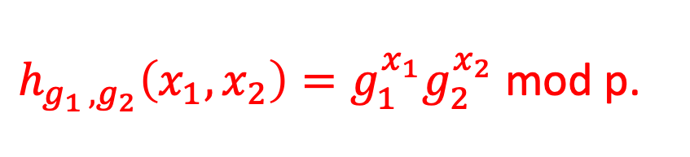
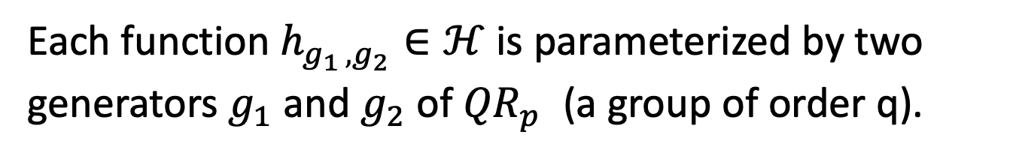
Construction of CRHF from Discrete Log
$p=2q+1$ is a “safe” prime.
$$ℋ=\{h:{(ℤ_{q})}^{2}→{QR}_{p}^{}\}$$
Each function $h_{g_{1 },g_{2}}∈ℋ$ is parameterized by two generators $g_{1}$ and $g_{2}$ of ${QR}_{p}^{}$ (a group of order q).
$h_{g_{1 },g_{2}}\left(x_{1},x_{2}\right)=g_{1}^{x_{1}}g_{2}^{x_{2}}$ mod p.
This compresses 2 log q bits into log p $≈$ log q + 1 bits.

Slide 5
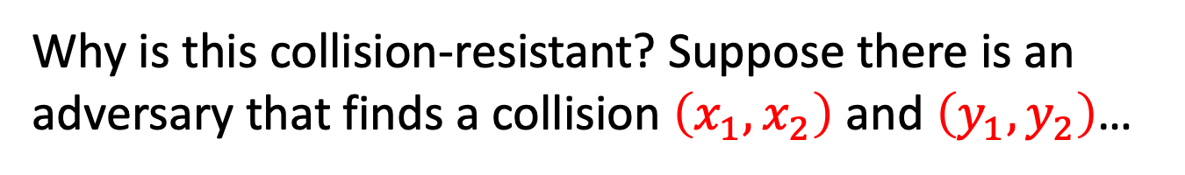
Construction of CRHF from Discrete Log
$p=2q+1$ is a “safe” prime.
$$ℋ=\{h:{(ℤ_{q})}^{2}→{QR}_{p}^{}\}$$
Each function $h_{g_{1 },g_{2}}∈ℋ$ is parameterized by two generators $g_{1}$ and $g_{2}$ of ${QR}_{p}^{}$ (a group of order q).
$h_{g_{1 },g_{2}}\left(x_{1},x_{2}\right)=g_{1}^{x_{1}}g_{2}^{x_{2}}$ mod p.
Why is this collision-resistant? Suppose there is an adversary that finds a collision $\left(x_{1},x_{2}\right)$ and $\left(y_{1},y_{2}\right)$…

Slide 6
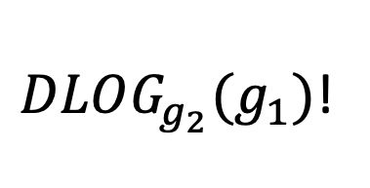
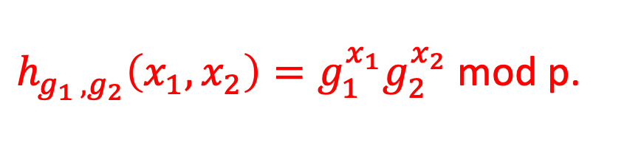
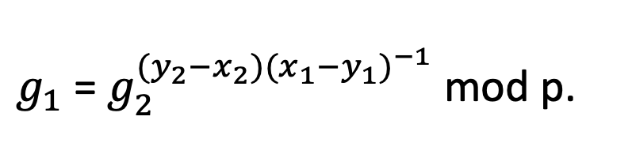
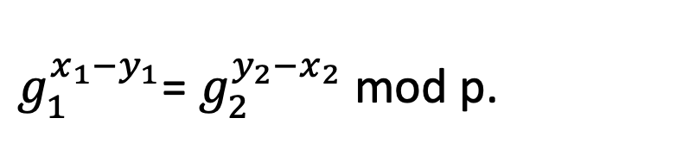
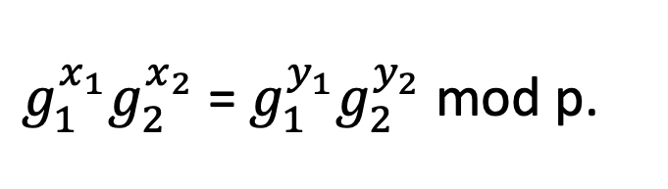
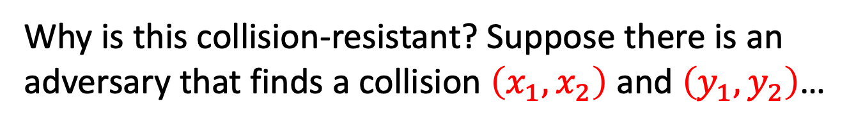
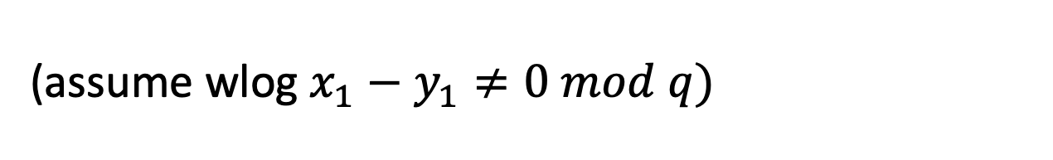
Construction of CRHF from Discrete Log
$h_{g_{1 },g_{2}}\left(x_{1},x_{2}\right)=g_{1}^{x_{1}}g_{2}^{x_{2}}$ mod p.
Why is this collision-resistant? Suppose there is an adversary that finds a collision $\left(x_{1},x_{2}\right)$ and $\left(y_{1},y_{2}\right)$…
$g_{1}^{x_{1}}g_{2}^{x_{2}}$ = $g_{1}^{y_{1}}g_{2}^{y_{2}}$ mod p.
$g_{1}^{x_{1}−y_{1}}$= $g_{2}^{y_{2}−x_{2}}$ mod p.
(assume wlog $x_{1}−y_{1}≠0 mod q)$
$g_{1}$= $g_{2}^{{(y}_{2}−x_{2}){(x_{1}−y_{1})}^{−1}}$ mod p.
$DLOG_{g_{2}}(g_{1})$!

Slide 7
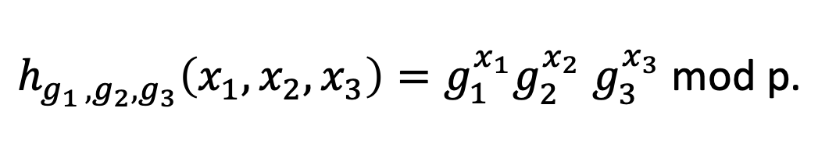
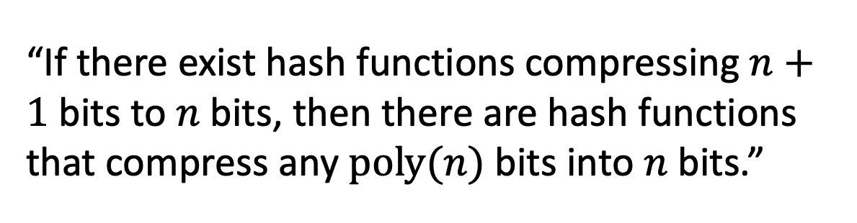
What if I want to compress more?
Solution 1: Modify the Discrete Log construction
$h_{g_{1 },g_{2},g_{3}}\left(x_{1},x_{2},x_{3}\right)=g_{1}^{x_{1}}g_{2}^{x_{2}}$ $g_{3}^{x_{3}}$ mod p.
Solution 2: Domain-extension Theorems.
“If there exist hash functions compressing $n+1$ bits to $n$bits, then there are hash functions that compress any $poly(n)$bits into $n$bits.”

Slide 8
Digital Signatures
Theorem: Assuming the hardness of the discrete logarithm problem, there are digital signature schemes.

Slide 9
Other Constructions of CRHFs
From the hardness of factoring, lattice problems etc.
Not known to follow from the existence of one-way functions.
“Black-box separations”: Certain ways of constructing CRHF from OWF/OWP cannot work.
“Finding collisions on a one-way street”, Daniel Simon, Eurocrypt 1998.
Nevertheless, big open problem: OWF $⟹^{?}$ CRHF?

Slide 10
Digital Signatures
It turns out that collision-resistant hashing is not necessary.
Theorem: Digital Signature schemes exist if and only if one-way functions exist.

Slide 11
Worlds in Crypto
…
Cryptomania:
Public-key encryption
Minicrypt:
Zero-Knowledge proofs
MAC
Digital Signatures
Bit Commitment
PRF
Secret-key encryption
PRG
CRHF
OWF
OWF

Slide 12
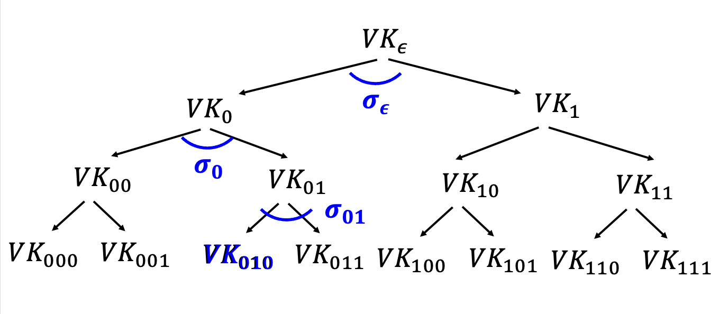
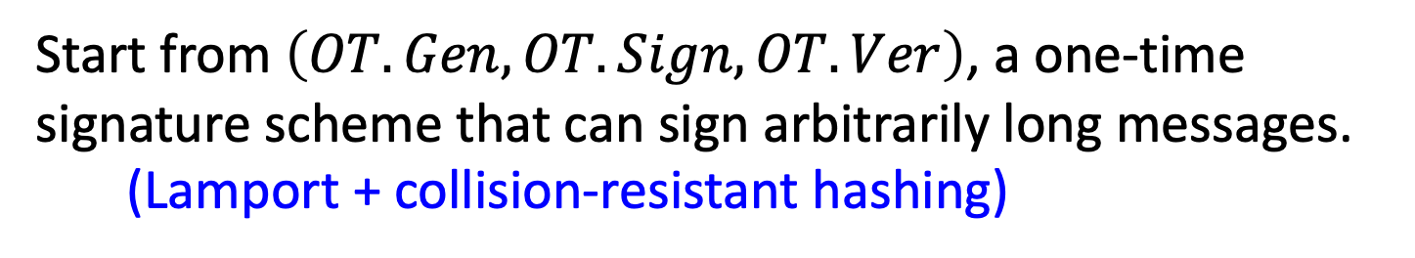
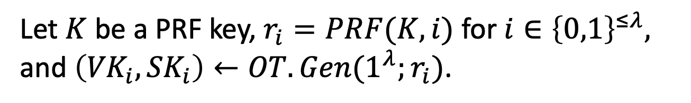
Digital Signature Construction
Start from $\left(OT.Gen, OT.Sign, OT.Ver\right)$, a one-time signature scheme that can sign arbitrarily long messages. (Lamport + collision-resistant hashing)
Build a (virtual) tree of depth $λ$ = security param.
Let $K$ be a PRF key, $r_{i}=PRF(K,i)$ for $i∈{\left\{0,1\right\}}^{≤λ},$ and $\left({VK}_{i},{SK}_{i}\right)←OT.Gen(1^{λ};r_{i})$.

Slide 13
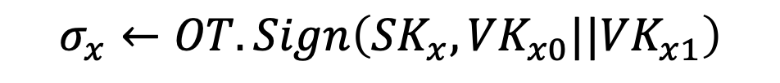
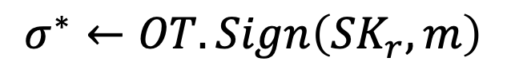
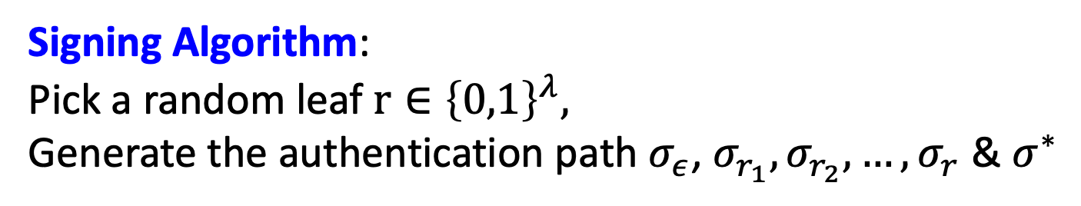
Digital Signature Construction
Signature keys: $SK=K$ and $VK={OTVK}_{ε}$.
Signing Algorithm:
Pick a random leaf $r∈{\left\{0,1\right\}}^{λ},$
Generate the authentication path $σ_{ε}$, $σ_{r_{1}},σ_{r_{2}},…,σ_{r}$ & $σ^{∗}$
$$σ_{x}←OT.Sign\left({SK}_{x},{VK}_{x0}||{VK}_{x1}\right)$$
$$σ^{∗}←OT.Sign\left({SK}_{r},m\right)$$
The signature is $(r,σ_{ε}$, $σ_{r_{1}},σ_{r_{2}},…,σ_{r},$ $σ^{∗})$.

Slide 14
Digital Signature Construction
Historically regarded as inefficient; therefore, never used in practice.
However, this signature scheme (or variants thereof) are now called “hash-based signatures” and seeing a re-emergence as a candidate post-quantum secure signature scheme. E.g. https://sphincs.org/

Slide 15
Direct Constructions
“Hash-and-Sign”: Secure in the “random oracle model”.

Slide 16
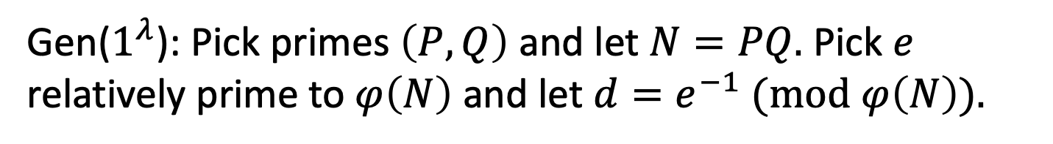
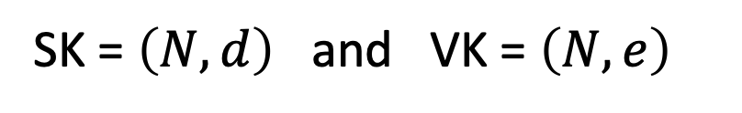
“Vanilla” RSA Signatures
Start with any trapdoor permutation, e.g. RSA.
Gen($1^{λ}$): Pick primes $\left(P,Q\right)$ and let $N=PQ.$ Pick $e$ relatively prime to $φ\left(N\right)$ and let $d=e^{−1} (mod$ $φ\left(N\right)).$
SK = $\left(N,d\right)$ and VK = $\left(N,e\right)$
Sign($SK,m$): Output signature $σ=m^{d} \left(mod N\right).$
Verify($VK,m,σ$): Check if $σ^{e}=m \left(mod N\right).$
Problem: Existentially forgeable!

Slide 17
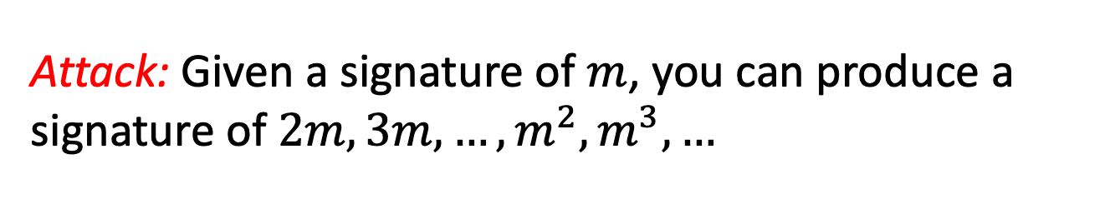
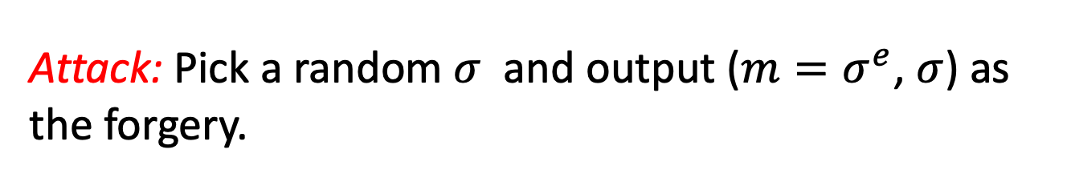
“Vanilla” RSA Signatures
Sign($SK,m$): Output signature $σ=m^{d} \left(mod N\right).$
Verify($VK,m,σ$): Check if $σ^{e}=m \left(mod N\right).$
Problem: Existentially forgeable!
Attack: Pick a random $σ$ and output (${m=σ}^{e}$, $σ$) as the forgery.
Problem: Malleable!
Attack: Given a signature of $m$, you can produce a signature of $2m,3m,…,m^{2},m^{3},…$

Slide 18
“Vanilla” RSA Signatures
Sign($SK,m$): Output signature $σ=m^{d} \left(mod N\right).$
Verify($VK,m,σ$): Check if $σ^{e}=m \left(mod N\right).$
Fundamental Issues:
1. Can ”reverse-engineer” the message starting from the signature (Attack 1)
2. Algebraic structure allows malleability (Attack 2)

Slide 19
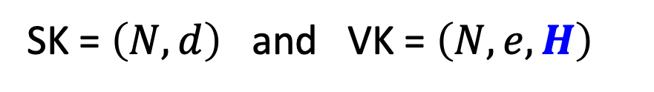
How to Fix Vanilla RSA
Start with any trapdoor permutation, e.g. RSA.
Gen($1^{λ}$): Pick primes $\left(P,Q\right)$ and let $N=PQ.$ Pick $e$ relatively prime to $φ\left(N\right)$ and let $d=e^{−1} (mod$ $φ\left(N\right)).$
SK = $\left(N,d\right)$ and VK = $\left(N,e,H\right)$
Sign($SK,m$): Output signature $σ={H(m)}^{d} \left(mod N\right).$
Verify($VK,m,σ$): Check if $σ^{e}=H(m) \left(mod N\right).$
So, what is H? Some very complicated “hash” function.

Slide 20
How to Fix Vanilla RSA
Start with any trapdoor permutation, e.g. RSA.
Gen($1^{λ}$): Pick primes $\left(P,Q\right)$ and let $N=PQ.$ Pick $e$ relatively prime to $φ\left(N\right)$ and let $d=e^{−1} (mod$ $φ\left(N\right)).$
SK = $\left(N,d\right)$ and VK = $\left(N,e,H\right)$
Sign($SK,m$): Output signature $σ={H(m)}^{d} \left(mod N\right).$
Verify($VK,m,σ$): Check if $σ^{e}=H(m) \left(mod N\right).$
H should be at least one-way to prevent Attack #1.

Slide 21
How to Fix Vanilla RSA
Start with any trapdoor permutation, e.g. RSA.
Gen($1^{λ}$): Pick primes $\left(P,Q\right)$ and let $N=PQ.$ Pick $e$ relatively prime to $φ\left(N\right)$ and let $d=e^{−1} (mod$ $φ\left(N\right)).$
SK = $\left(N,d\right)$ and VK = $\left(N,e,H\right)$
Sign($SK,m$): Output signature $σ={H(m)}^{d} \left(mod N\right).$
Verify($VK,m,σ$): Check if $σ^{e}=H(m) \left(mod N\right).$
Hard to “algebraically manipulate” H(m) into H(related m’).
(to prevent Attack #2.)

Slide 22
How to Fix Vanilla RSA
Start with any trapdoor permutation, e.g. RSA.
Gen($1^{λ}$): Pick primes $\left(P,Q\right)$ and let $N=PQ.$ Pick $e$ relatively prime to $φ\left(N\right)$ and let $d=e^{−1} (mod$ $φ\left(N\right)).$
SK = $\left(N,d\right)$ and VK = $\left(N,e,H\right)$
Sign($SK,m$): Output signature $σ={H(m)}^{d} \left(mod N\right).$
Verify($VK,m,σ$): Check if $σ^{e}=H(m) \left(mod N\right).$
Collision-resistance does not seem to be enough. (Given a CRHF h(m), you may be able to produce h(m’) for related m’.)

Slide 23

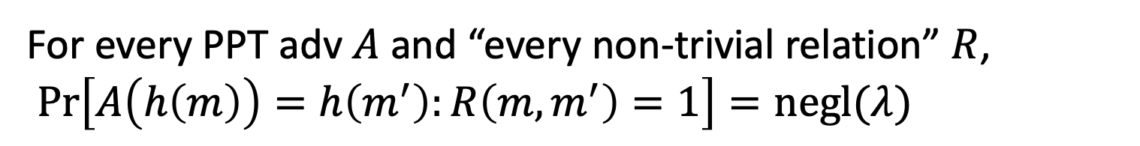
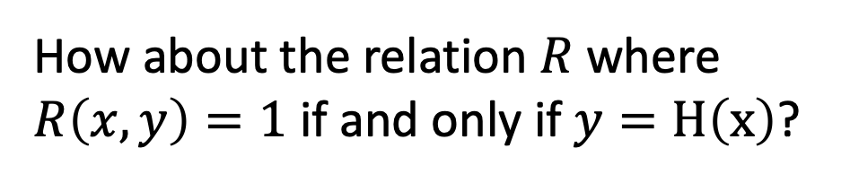
The Random Oracle Heuristic
Want: A public H that is “non-malleable”.
Given H(m), it is hard to produce H(m’) for any non-trivially related m’.
For every PPT adv $A$and “every non-trivial relation” $R$,
$\operatorname{Pr}\left[A\left(h\left(m\right)\right)=h\left(m^{′}\right):R\left(m,m^{′}\right)=1\right]=negl(λ)$
How about the relation $R$ where $R\left(x,y\right)=1$ if and only if $y=H\left(x\right)$?

Slide 24
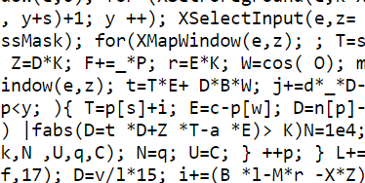
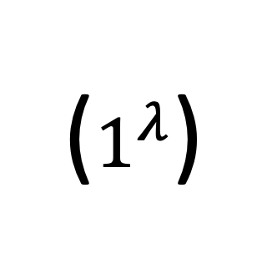
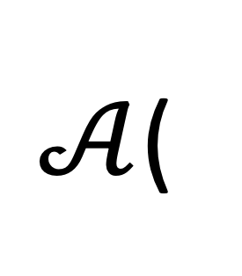
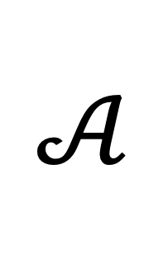
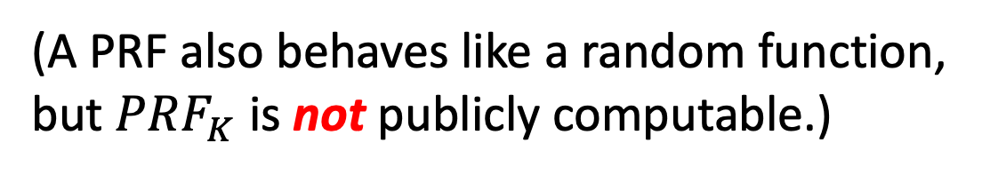
The Random Oracle Heuristic
Proxy: A public H that “behaves like a random function”
(A PRF also behaves like a random function, but ${PRF}_{K}$ is not publicly computable.)
Reality:
Random Oracle Heuristic:
$𝒜$(
)
$$𝒜$$
($1^{λ}$)
H
H
H is virtually a black box.
The only way to compute H is by calling the oracle.

Slide 25
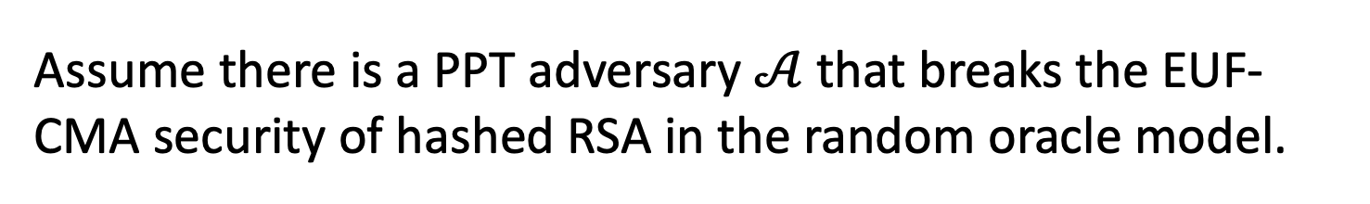
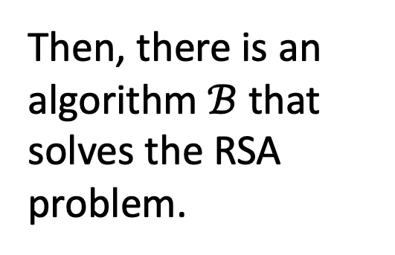
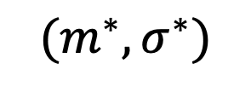


Proof
Assume there is a PPT adversary $𝒜$that breaks the EUF-CMA security of hashed RSA in the random oracle model.
$$VK$$
$$𝒜$$
“Give me H(m)”
“Give me a signature of m”
Then, there is an algorithm $ℬ$ that solves the RSA problem.
$$(m^{∗},σ^{∗})$$

Slide 26


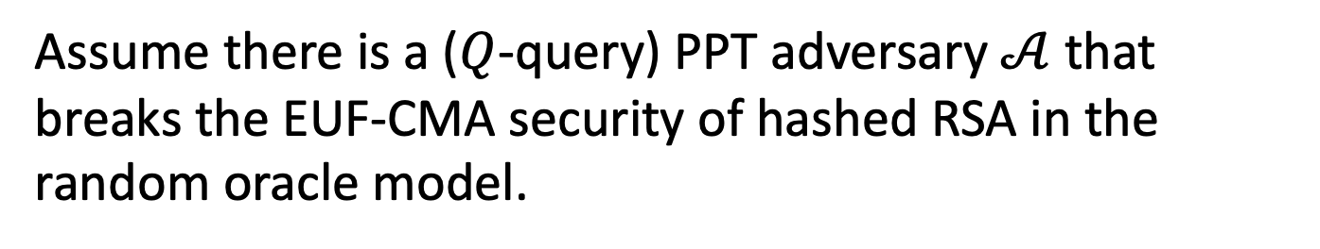





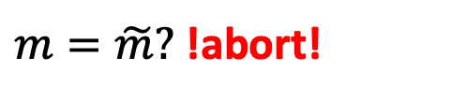


Proof
Assume there is a ($Q$-query) PPT adversary $𝒜$that breaks the EUF-CMA security of hashed RSA in the random oracle model.
$$ℬ$$
$$VK=(N,e)$$
$$(N,e,y)$$
$$𝒜$$
Hash Query: m
Pick random $\tilde{m}$
“trap”
$H\left(\tilde{m}\right)=y$
“normal”
o.w., $H\left(m\right)=x^{e}$
Sign Query: m
$m=\tilde{m}?$ !abort!
o.w., $σ=x$
Forgery: $m^{∗},σ^{∗}$

Slide 27
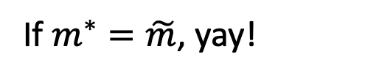
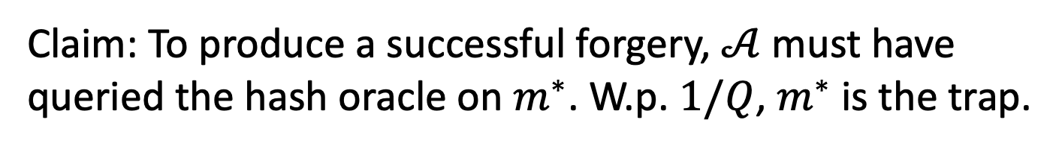


Proof
Claim: To produce a successful forgery, $𝒜$ must have queried the hash oracle on $m^{∗}$. W.p. $1/Q$, $m^{∗}$ is the trap.
$$ℬ$$
$$VK=(N,e)$$
$$(N,e,y)$$
$$𝒜$$
Hash Query: m
$H\left(\tilde{m}\right)=y$
o.w., $H\left(m\right)=x^{e}$
Sign Query: m
$m=\tilde{m}?$ !abort!
o.w., $σ=x$
$$y^{1/e}$$
“trap”
If $m^{∗}=\tilde{m}$, yay!
Forgery: $m^{∗},σ^{∗}$

Slide 28
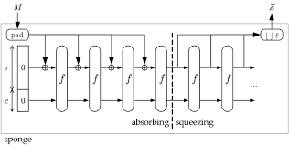

Bottomline: Hashed RSA
(PKCS Standard, used everywhere)
In practice, we let $H$ be the SHA-3 hash function.
… and believe that SHA-3 ”acts like a random function”. That’s the heuristic. On the one hand, it doesn’t make any sense, but on the other, it has served us well so far. No attacks against RSA + SHA-3, for example.

Slide 29





An Application:
Authenticated Key Exchange
$$g^{x}$$
$$g^{y}$$

Slide 30
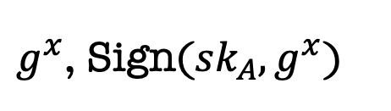


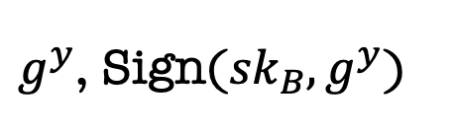
An Application:
Authenticated Key Exchange
Bob
$${vk}_{B}$$
Alice
$${vk}_{A}$$
$g^{x}$, Sign(${sk}_{A},g^{x}$)
$g^{y}$, Sign(${sk}_{B},g^{y}$)

Slide 31
Many Variants of Signatures
(on the board)
Aggregate Signatures: Compressing many signatures into one
Ring Signatures: Protection for Whistleblowers
Threshold Signatures: Protecting against loss of secret key

