Slide 1
MIT 6.875/6.5620/18.425
Foundations of Cryptography
Lecture 3

Slide 2

Lecture 2 Recap
Computational Indistinguishability:
a new definition of security for secret-key encryption.
(new notions: p.p.t. adversaries, negligible functions,…)
Consequence: Shannon’s impossibility no longer applies!
New Notion: Pseudorandom Generator (PRG) which
Passes all statistical tests
PRG $⇒$Can encrypt messages longer than the key.
New Notion: PRG that passes Next Bit Unpredictability
A construction of PRG which passes next bit unpredictability based on a one-way function with a hard-core bit.

Slide 3
Plan for Today
Prove: PRG pass all statistical tests iff it passed next bit unpredictability
Prove: construction of PRG based on one-way function and a hard-core bit passes next bit unpredictability
Theorem: if there exists a PRG that stretches the seed by 1 bit, then there exists a PRG that stretch by a polynomial number of bits
Start: Pseudo Random Functions
New Proof Technique: Hybrid Arguments.

Slide 4
Three Definitions of Pseudorandomness
Def 1 [Indistinguishability]
“No polynomial-time algorithm can distinguish between the output of a PRG on a random seed vs. a truly random string”
= “as good as” a truly random string for all practical purposes.
Def 2 [Next-bit Unpredictability]
“No polynomial-time algorithm can predict the (i+1)^{th} bit of the output of a PRG given the first i bits, better than chance”
ALL DEFS ARE EQUIVALENT!
Def 3 [Incompressibility]
“No polynomial-time algorithm can compress the output of the PRG into a shorter string”

Slide 5
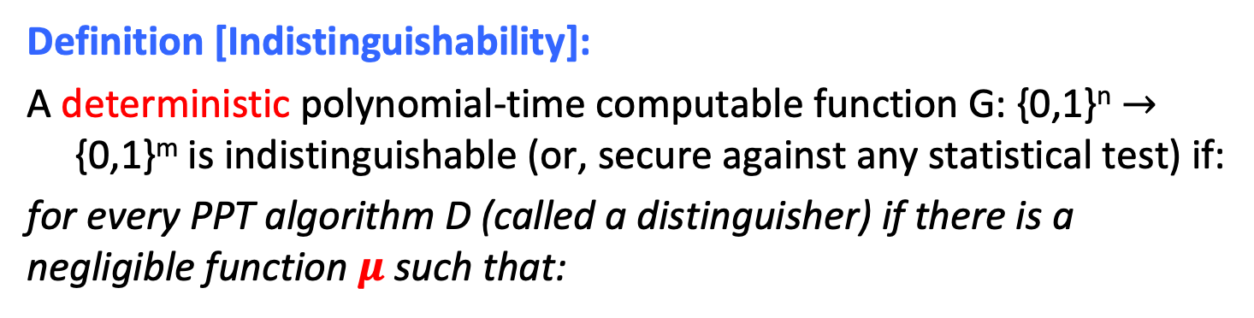
PRG Def 1 (Recap): Indistinguishability
Definition [Indistinguishability]:
A deterministic polynomial-time computable function G: {0,1}^{n} $→$ {0,1}^{m} is indistinguishable (or, secure against any statistical test) if:
for every PPT algorithm D (called a distinguisher) if there is a negligible function $μ$ such that:
$$| Pr⁡[ D(G(U_{n})) =1 ] – Pr⁡[ D(Um) =1 ] | =μ(n)$$
Notation: U_{n} (resp. U_{m}) denotes the random distribution on n-bit (resp. m-bit) strings.

Slide 6
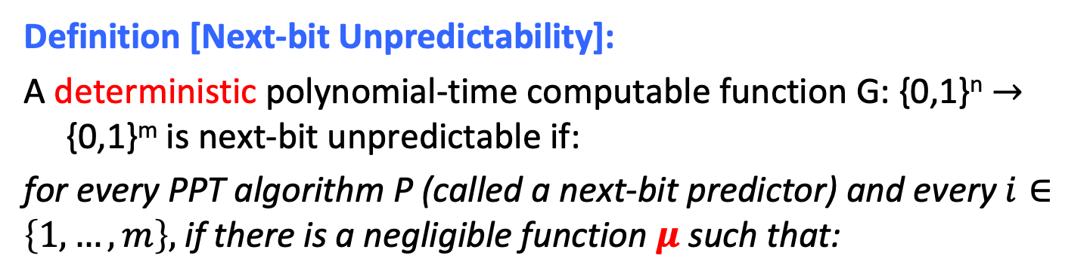

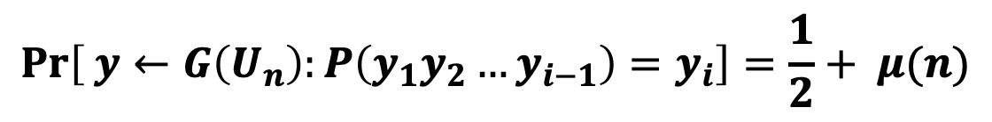
PRG Def 2: Next-bit Unpredictability
Definition [Next-bit Unpredictability]:
A deterministic polynomial-time computable function G: {0,1}^{n} $→$ {0,1}^{m} is next-bit unpredictable if:
for every PPT algorithm P (called a next-bit predictor) and every $i∈\left\{1,…,m\right\},$ if there is a negligible function $μ$ such that:
$$\operatorname{Pr}\left[ y←G\left(U_{n}\right):P\left(y_{1}y_{2}…y_{i−1}\right)=y_{i}\right]=\frac{1}{2}+ μ(n)$$
Notation: $y_{1}{,y}_{2},…y_{m}$ are the bits of the m-bit string $y$.

Slide 7
Def 1 and Def 2 are Equivalent
Theorem:
A PRG G is indistinguishable if and only if it is next-bit unpredictable (NBU).
Theorem:
A PRG G passes all (poly-time) statistical tests if and only if it passes (poly-time) next-bit tests.

Slide 8
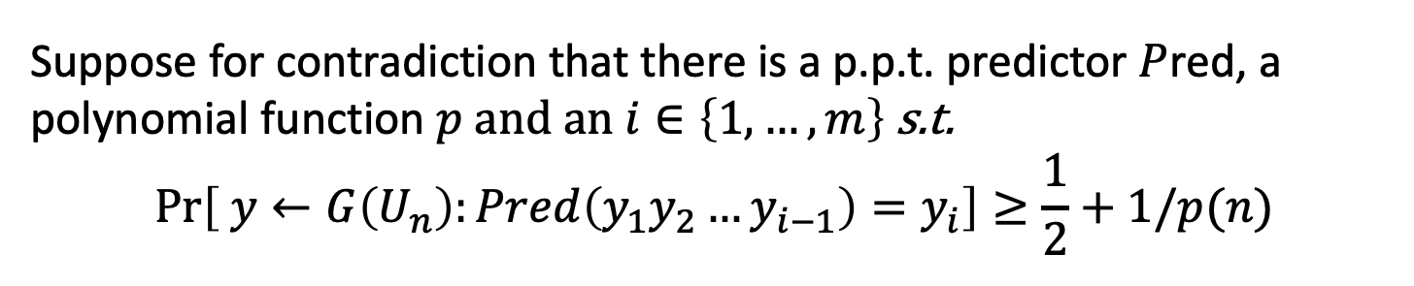
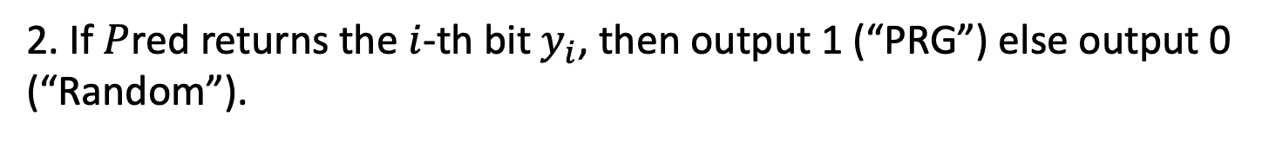
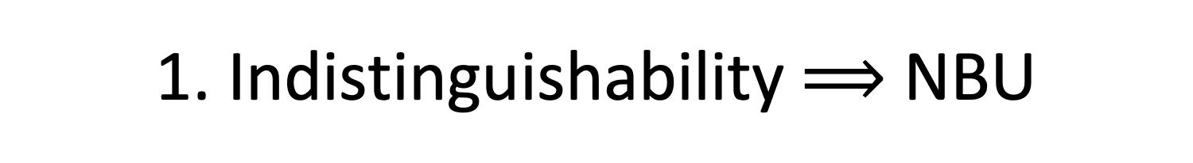
1. Indistinguishability $⟹$ NBU
Proof: by contradiction.
Suppose for contradiction that there is a p.p.t. predictor $P$red, a polynomial function $p$ and an $i∈\left\{1,…,m\right\}$ s.t.
$$\operatorname{Pr}\left[ y←G\left(U_{n}\right):Pred\left(y_{1}y_{2}…y_{i−1}\right)=y_{i}\right]≥\frac{1}{2}+1/p(n)$$
Then, I claim that $Pred$ essentially gives us a distinguisher D!
Consider $D$ which gets an m-bit string $y$ and does the following:
1. Run $Pred$ on the $(i−1)$-bit prefix $y_{1}y_{2}…y_{i−1}$.
2. If $P$red returns the $i$-th bit $y_{i}$, then output 1 (“PRG”) else output 0 (“Random”).
Easy: If $Pred$ is p.p.t. so is $D$.

Slide 9

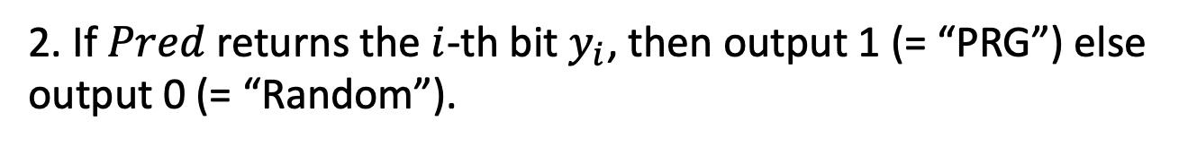
1. Indistinguishability $⟹$ NBU
Consider $D$ which gets an m-bit string $y$ and does the following:
1. Run $Pred$ on the $(i−1)$-bit prefix $y_{1}y_{2}…y_{i−1}$.
2. If $Pred$ returns the $i$-th bit $y_{i}$, then output 1 (= “PRG”) else output 0 (= “Random”).
We want to show: there is a polynomial $p′$ s.t.
$$| Pr⁡[y←G\left(U_{n}\right): D(y) =1 ]$$
$– Pr⁡[y←Um: D(y) =1 ] |≥1/p′(n)$

Slide 10
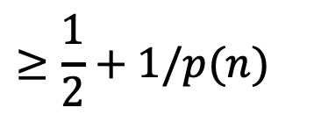
1. Indistinguishability $⟹$ NBU
Consider $D$ which gets an m-bit string $y$ and does the following:
1. Run $Pred$ on the $(i−1)$-bit prefix $y_{1}y_{2}…y_{i−1}$.
2. If $Pred$ returns the $i$-th bit $y_{i}$, then output 1 (= “PRG”) else output 0 (= “Random”).
$$Pr⁡[y←G\left(U_{n}\right): D(y) =1 ]$$
$$= Pr⁡[y←G\left(U_{n}\right): Pred\left(y_{1}y_{2}…y_{i−1}\right)=y_{i}]$$
(by construction of D)
$$≥\frac{1}{2}+1/p(n)$$
(by assumption on Pred)

Slide 11
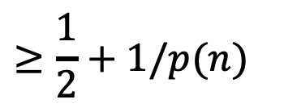
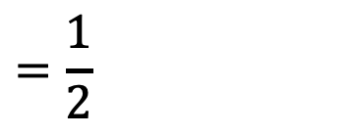
1. Indistinguishability $⟹$ NBU
Consider $D$ which gets an m-bit string $y$ and does the following:
1. Run $Pred$ on the $(i−1)$-bit prefix $y_{1}y_{2}…y_{i−1}$.
2. If $Pred$ returns the $i$-th bit $y_{i}$, then output 1 (= “PRG”) else output 0 (= “Random”).
$$≥\frac{1}{2}+1/p(n)$$
$$Pr⁡[y←G\left(U_{n}\right): D(y) =1 ]$$
$$\operatorname{Pr}\left[y←U_{m}: D\left(y\right)=1 \right]$$
$$= Pr⁡[y←U_{m}: Pred\left(y_{1}y_{2}…y_{i−1}\right)=y_{i}]$$
(by construction of D)
$$=\frac{1}{2}$$
(since y is random)

Slide 12
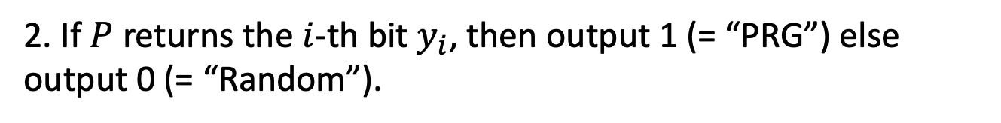
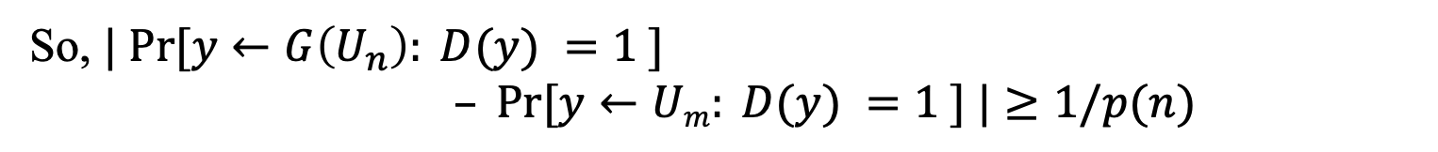
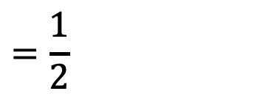
1. Indistinguishability $⟹$ NBU
Consider $D$ which gets an m-bit string $y$ and does the following:
1. Run $P$ on the $(i−1)$-bit prefix $y_{1}y_{2}…y_{i−1}$.
2. If $P$ returns the $i$-th bit $y_{i}$, then output 1 (= “PRG”) else output 0 (= “Random”).
$$≥\frac{1}{2}+1/p(n)$$
$$Pr⁡[y←G\left(U_{n}\right): D(y) =1 ]$$
$$=\frac{1}{2}$$
$$\operatorname{Pr}\left[y←U_{m}: D\left(y\right)=1 \right]$$
So, $| Pr⁡[y←G\left(U_{n}\right): D(y) =1 ]$
$– Pr⁡[y←Um: D(y) =1 ] |≥1/p(n)$

Slide 13




2. NBU $⟹$Indistinguishability
Hybrid argument
Proof: by contradiction +
Suppose for contradiction that there is a distinguisher $D$, and a polynomial function $p$ s.t.
$$| Pr⁡[y←G\left(U_{n}\right): D(y) =1 ]$$
$– Pr⁡[y←Um: D(y) =1 ] |≥1/p′(n)$
I want to construct a next bit predictor $Pred$ out of $D$.
But how?!

Slide 14


2. NBU $⟹$Indistinguishability
Proof:
Suppose for contradiction that there is a distinguisher $D$, and a polynomial function $p$ s.t.
$$Pr⁡[y←G\left(U_{n}\right): D(y) =1 ]$$
$– Pr⁡[y←Um: D(y) =1 ]≥1/p′(n)$
$$:=ε$$
I want to construct a next bit predictor $Pred$ out of $D$.
TWO STEPS:
STEP 1: HYBRID ARGUMENT
STEP 2: Go From Distinguishing to Predicting

Slide 15


Before we go there, observe…
Lemma: Let $p_{0},p_{1},p_{2},…,p_{m}$ be real numbers s.t.
$$p_{m}−p_{0}≥ε.$$
Then, there is an index $i$ such that $p_{i}−p_{i−1}$ $≥ε/m$.
Proof:
$p_{m}−p_{0}=\left(p_{m}−p_{m−1}\right)+\left(p_{m−1}−p_{m−2}\right)+…+(p_{1}−p_{0}$)
$$≥ε$$
At least one of the $m$ terms has to be at least $ε/m$ (averaging).

Slide 16
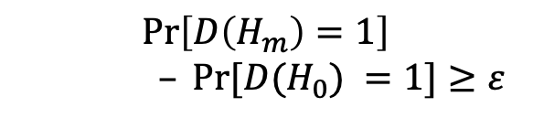
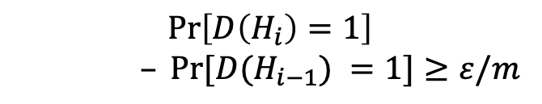
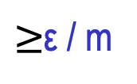
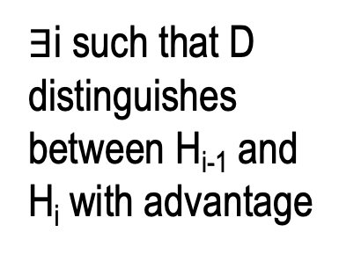
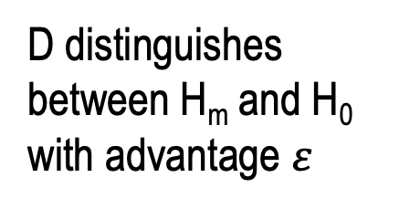
Define Hybrid Distributions:
random
pseudorandom
random
H₀ = U_{m}:
$∃$i such that D distinguishes between H_{i-1} and H_{i} with advantage
...
...
H_{i-1}:
D distinguishes between H_{m} and H₀ with advantage $ε$
$≥$ε / m
H_{i}:
$$\operatorname{Pr}\left[D\left(H_{i}\right)=1\right]$$
$– Pr⁡[D(H_{i−1}) =1]≥ε/m$
...
$$\operatorname{Pr}\left[D\left(H_{m}\right)=1\right]$$
$– Pr⁡[D(H_{0}) =1]≥ε$
...
H_{m-1}:
H_{m} = G(U_{n}):
Pseudo-random

Slide 17
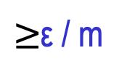
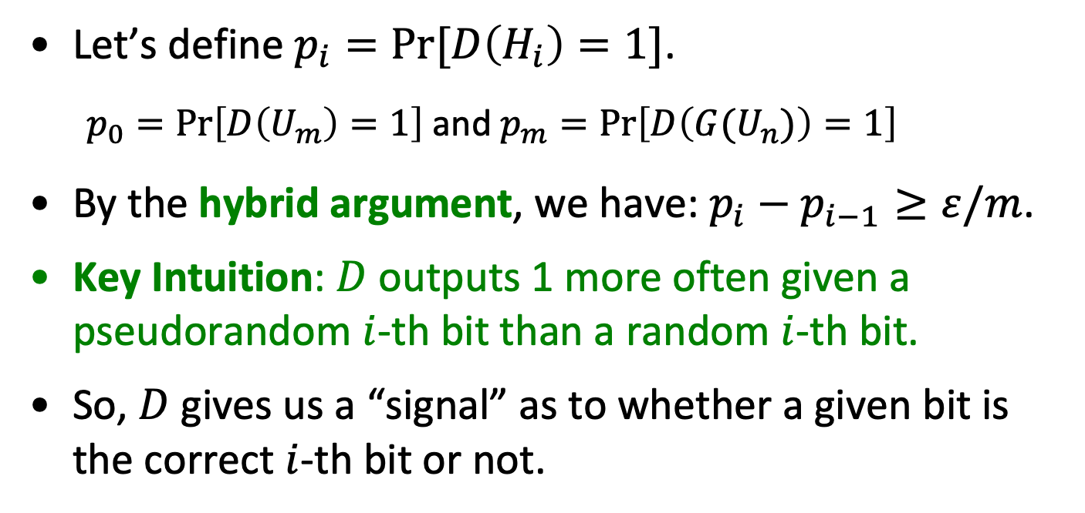
Hybrid Distributions:
random
pseudorandom
H_{i-1}:
$≥$ε / m
H_{i}:
Let’s define $p_{i}=Pr⁡[D\left(H_{i}\right)=1]$.
  $p_{0}=\operatorname{Pr}\left[D\left(U_{m}\right)=1\right]$ and $p_{m}=\operatorname{Pr}\left[D\left({G(U}_{n})\right)=1\right]$
By the hybrid argument, we have: $p_{i}−p_{i−1}≥ε/m$.
Key Intuition: $D$ outputs 1 more often given a pseudorandom $i$-th bit than a random $i$-th bit.
So, $D$ gives us a “signal” as to whether a given bit is the correct $i$-th bit or not.

Slide 18






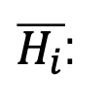


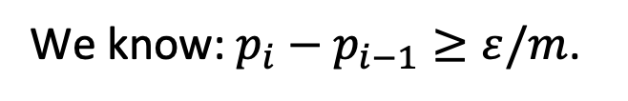



Let’s dig a bit more.
random
pseudorandom
We know: $p_{i}−p_{i−1}≥ε/m$.
$$\overline{p_{i}}$$
H_{i-1}:
$$u$$
$p_{i−1}$
$$p:Pr⁡[D\left(H\right)=1]$$
H_{i}:
$$y_{i}$$
$p_{i}$
Claim: $p_{i−1}=(p_{i}+\overline{p_{i}})/2$
Define
Corollary (*): $p_{i}−\overline{p_{i}}≥2ε/m$.
$\overline{H_{i}}$:
$$\overline{y_{i} }$$
$u:$ random bit
So, Takeaway: D says “1” more often when fed with the “right bit” than the “wrong bit”.
$y_{i}:$ i-th pseudorandom bit
$$\overline{p_{i}}=Pr[D\left(\overline{H_{i}}\right)=1]$$
$$\overline{y_{i} }=1−y_{i}$$

Slide 19

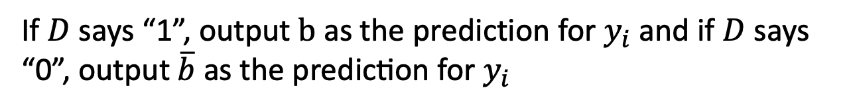
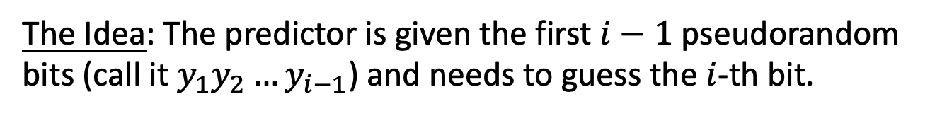
Our Predictor Pred
The Idea: The predictor is given the first $i−1$ pseudorandom bits (call it $y_{1}y_{2}…y_{i−1}$) and needs to guess the $i$-th bit.
The Predictor Pred works as follows:
Pick a random bit $b;$
$F$eed $D$ with input$y_{1}y_{2}…y_{i−1}\left| b \right| u_{i+1}$… $u_{m}$ ($u$’s are random)
If $D$ says “1”, output $b$ as the prediction for $y_{i}$and if $D$ says “0”, output $\overline{b} \text{as the prediction for }y_{i}$

Slide 20
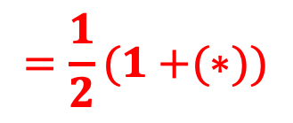

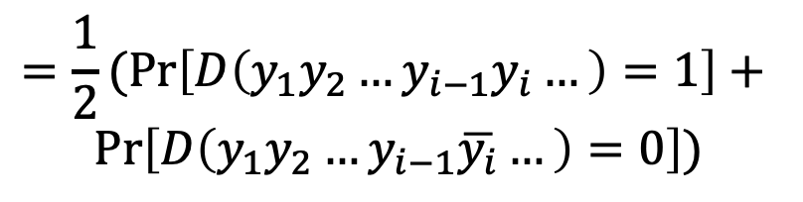
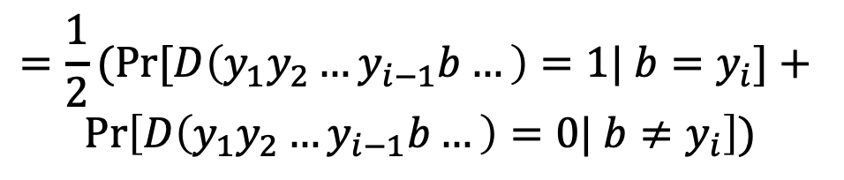
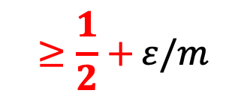
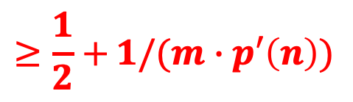
Analysis of the Predictor Pred
$$\operatorname{Pr}\left[x←{\left\{0,1\right\}}^{n};y=G(x):P\left(y_{1}y_{2}…y_{i−1}\right)=y_{i}\right]$$
$$=\operatorname{Pr}\left[D\left(y_{1}y_{2}…y_{i−1}b…\right)=1| b=y_{i}\right]\operatorname{Pr}\left[b=y_{i}\right]+$$
$$Pr⁡\left[D\left(y_{1}y_{2}…y_{i−1}b…\right)=0| b≠y_{i}\right]\operatorname{Pr}\left[b≠y_{i}\right]$$
$$=\frac{1}{2}(Pr{[D\left(y_{1}y_{2}…y_{i−1}b…\right)=1| b=y_{i}]+ }$$
$$Pr⁡\left[D\left(y_{1}y_{2}…y_{i−1}b…\right)=0| b≠y_{i}\right])$$
$$=\frac{1}{2}(Pr\left[D\left(y_{1}y_{2}…y_{i−1}y_{i}…\right)=1\right]+$$
$$Pr⁡\left[D\left(y_{1}y_{2}…y_{i−1}\overline{y_{i}}…\right)=0\right])$$
$$=\frac{1}{2}(Pr\left[D\left(y_{1}y_{2}…y_{i−1}y_{i}…\right)=1\right]+1−$$
$$Pr⁡\left[D\left(y_{1}y_{2}…y_{i−1}\overline{y_{i}}…\right)=1\right])$$
$$=\frac{1}{2}(1+{(∗)})$$
$$≥\frac{1}{2}+{ε/m}$$
$$≥\frac{1}{2}+{1/(m∙p′\left(n\right))}$$
Notes:
By def of how D works
Since b is random
Syntactic
Since pr[D(..)=0] = 1 – pr[D(..) = 1]

Slide 21
Recap: NBU and Indistinguishability
Next-bit Unpredictability (NBU): Seemingly much weaker requirement, only says that next bit predictors, a particular type of distinguishers, cannot succeed.
Yet, surprisingly, Next-bit Unpredictability (NBU) = Indistinguishability.
NBU often much easier to use.
Exercise: Previous-bit Unpredictability (PBU) = Indistinguishability.

Slide 22
Plan for Today
Prove: PRG pass all statistical tests iff it passed all next but tests
Prove: PRG based on one-way function and a hard-core bit pass all next-bit tests
Theorem: if there exists a PRG that stretches by 1 bit, then there exists a PRG that stretch by a polynomial number of bits
Start: Pseudo Random Functions
New Proof Technique: Hybrid Arguments.

Slide 23
Recall: One-Way Functions
Easy to compute in PPT
x
f(x)
hard to invert in
PPT on average
f: {0,1}* ⇒ {0,1}* is a one-way function(OWF) if:
Easy to Evaluate: ∃ PPT algorithm A s.t. A(x)=f(x) ∀ x.
Hard to Invert: ∀PPT algorithms Inv, ∀ n sufficiently large, prob ( Inv(y) =x’ s.t. y=f(x’)) < neg(n)
x ∈ {0,1}^{n}, y=f(x), coins of Inv
Length preserving OWF:functions s.t. |f (x)|=|x |.
One-way Permutations: One-to-one length preserving OWF

Slide 24



Recall: Hard Core Predicates for OWF
A hard-core predicate for a one-way function f:{0,1}* →{0,1}* is a Boolean predicate B: {0,1}* →{0,1} such that
B(x) is easy to compute given x but hard to predict given f(x)
Hard
∀ PPT algorithm Pred (“predictor”),
Prob [ Pred(y) = B(x) ]= ½ + negl(n)
(over x in {0,1}^{n} , y=f(x)
and Pred’s coins )
x
Easy
y=f(x)
Easy
Unpredictable better than ½ +neg(n)
B(X)

Slide 25
Constructing PSRG from f and B
Theorem: If there exist one-way-permutations f with
hard core bit B, then for every polynomial P there exist
PRG G:{0,1}^{n}->{0,1}^{P(n)} which is next-bit unpredictable
Proof: Let P be a polynomial , set m=P(n)
On input seed s from U_{n},
G(s):(1) compute f(s) f(f(s)) … f(f^{m-1}(s))
(2) output B(s) B(f(s)) … B(f^{m-1}(s))
In reverse order
Can be removed, but easier
to understand proof

Slide 26
Picture Better than 1000 words
Internal Configuration
f(s)
Input
Output in reverse order
B(s)
B(f(s))
B(f ⁽²⁾(s))
s
f⁽²⁾(s)
f⁽³⁾(s)
f^{m}(s)
B(f ^{(m-1)}(s))

Slide 27
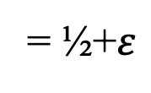
Proof : Show outputs of G pass next-bit unpredictability
Suppose, for contradiction, ∃bit location j<m and next bit predictor Pred s.t.
←
= ½+$ε$
Pr _{y} $←$_{G(Un)}[Pred(y₁y₂…y_{j-1}) = y_{i}] > ½ + 1/Q(n) for poly Q
Then show a predictor Pred’ for Hard-Core bit B of f:
Pred’(f(x)):
compute
compute
Goal:
Predict
B(x)
f(f(x)) …
B(f(x)) …
^{y}j-1
^{y}j-1 ^{) as your guess to B(x)}
f (f ^{j-1}(x))
B(f ^{j-1}(x)) y₁
=
=
3. Output Pred(y₁ …
EUREKA: the next bit y_{I.} in the sequence should be B(x)
And we assumed that Pred predicts next bit y_{i} with prob. ½+ 1/Q(n)

Slide 28
Proof : Show outputs of G pass next-bit unpredictability
Suppose, for contradiction, ∃bit location j<m and next bit predictor Pred s.t.
←
= ½+$ε$
Pr _{y} $←$_{G(Un)}[Pred(y₁y₂…y_{j-1}) = y_{i}] > ½ + 1/Q(n) for poly Q
Then show a predictor Pred’ for Hard-Core bit B of f:
Pred’(f(x)):
compute
compute
Goal:
Predict
B(x)
f(f(x)) …
B(f(x)) …
^{y}j-1
^{y}j-1 ^{) as your guess to B(x)}
f (f ^{j-1}(x))
B(f ^{j-1}(x)) y₁
=
=
3. Output Pred(y₁ …
Claim: Pr[Pred’(f(x)=B(x)]=Prob[ Pred(b₁ … b_{j-1} )=b_{j} ]>½ + 1/Q(n) contradiction
Essential to Proof: f is a permutation ⇒y₁ …y_{j-1} is the same distribution
as Pred is expecting and will perform well on.

Slide 29
Plan for Today
Prove: PRG pass all statistical tests iff it passed all next but tests
Prove: PRG based on one-way function and a hard-core bit pass all next-bit tests
Theorem: if there exists a PRG that stretches by 1 bit, then there exists a PRG that stretch by a polynomial number of bits
Start: Pseudo Random Functions
New Proof Technique: Hybrid Arguments.

Slide 30

Length extension: One bit to Many bits
Let G: ${\{0,1\}}^{n} →{\{0,1\}}^{n+1}$ be a pseudorandom generator.
Goal: use G to generate many pseudorandom bits.

Slide 31
Length extension: One bit to Many bits
Let G: ${\{0,1\}}^{n} →{\{0,1\}}^{n+1}$ be a pseudorandom generator.
Goal: use G to generate poly many pseudorandom bits.

Slide 32

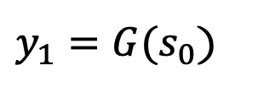

Length extension: One bit to Many bits
Let G: ${\{0,1\}}^{n} →{\{0,1\}}^{n+1}$ be a pseudorandom generator.
Goal: use G to generate poly many pseudorandom bits.
Construction of G’($s_{0}$)
$${seed=s}_{0}$$
$y_{1}=G(s_{0}$)
G

Slide 33



Length extension: One bit to Many bits
Let G: ${\{0,1\}}^{n} →{\{0,1\}}^{n+1}$ be a pseudorandom generator.
Goal: use G to generate poly many pseudorandom bits.
Construction of G’($s_{0}$)
$${seed=s}_{0}$$
$$y_{1}$$
$${=b}_{1}||{ s}_{1}$$
G

Slide 34

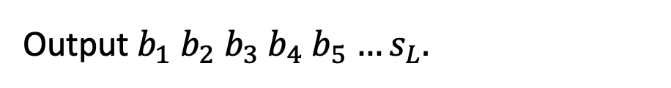





Length extension: One bit to Many bits
Let G: ${\{0,1\}}^{n} →{\{0,1\}}^{n+1}$ be a pseudorandom generator.
Goal: use G to generate poly many pseudorandom bits.
Construction of G’($s_{0}$)
Output $b_{1}$ $b_{2}$ $b_{3}$ $b_{4}$ $b_{5}$ $…s_{L}.$
$${seed=s}_{0}$$
$$s_{1}$$
$$s_{2}$$
$$s_{L−1}$$
$$s_{L}$$
$$…$$
G
G
G
G
$$b_{1}$$
$$b_{2}$$
$$b_{L−1}$$
$$b_{L}$$
Also called a stream cipher by the practitioners.

Slide 35

Length extension: One bit to Many bits
Proof of Security (exercise):
Use next-bit (or previous-bit?) unpredictability!
Construction of G’($s_{0}$)
Output $b_{1}$ $b_{2}$ $b_{3}$ $b_{4}$ $b_{5}$ $…s_{L}.$
$${seed=s}_{0}$$
$$s_{1}$$
$$s_{2}$$
$$s_{L−1}$$
$$s_{L}$$
$$…$$
G
G
G
G
$$b_{1}$$
$$b_{2}$$
$$b_{L−1}$$
$$b_{L}$$

Slide 36
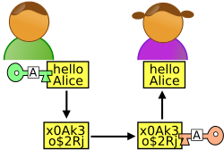
















Stateful Encryption for Many Messages
1-bit m
${m⊕b}_{1}$
Alice
Bob
Initial state ${=s}_{0}$
Initial state ${=s}_{0}$
S$tate{=s}_{1}$
State ${=s}_{1}$
$$s_{0}$$
$$s_{1}$$
$$s_{2}$$
$$s_{3}$$
$$s_{4}$$
$$s_{5}$$
G
G
G
G
G
$$b_{1}$$
$$b_{2}$$
$$b_{3}$$
$$b_{4}$$
$$b_{5}$$

Slide 37





Stateful Encryption of Many Messages
3-bit m’
$${m′⊕b}_{2}b_{3}b_{4}$$
Alice
Bob
S$tate{=s}_{4}$
State ${=s}_{4}$
S$tate{=s}_{1}$
State ${=s}_{1}$
$$s_{0}$$
$$s_{1}$$
$$s_{2}$$
$$s_{3}$$
$$s_{4}$$
$$s_{5}$$
G
G
G
G
G
$$b_{1}$$
$$b_{2}$$
$$b_{3}$$
$$b_{4}$$
$$b_{5}$$

Slide 38





Stateful Encryption of Many Messages
1-bit m’’
$${m′′⊕b}_{5}$$
Alice
Bob
S$tate{=s}_{5}$
State ${=s}_{5}$
S$tate{=s}_{4}$
State ${=s}_{4}$
$$s_{0}$$
$$s_{1}$$
$$s_{2}$$
$$s_{3}$$
$$s_{4}$$
$$s_{5}$$
G
G
G
G
G
$$b_{1}$$
$$b_{2}$$
$$b_{3}$$
$$b_{4}$$
$$b_{5}$$

Slide 39
Stateful Encryption of Many Messages
PLUS: Alice and Bob can keep encrypting as many bits as they wish.
MINUS: Alice and Bob have to keep their states in perfect synchrony. They cannot transmit simultaneously.
IF NOT:
Correctness goes down the drain, in addition to security.

Slide 40















How to be Stateless? Here is an idea…
1-bit m
pick a random index, say 5
(5,${m⊕b}_{5})$
Alice
Bob
Key k ${=s}_{0}$
Key k ${=s}_{0}$
${ b}_{1}$
${ b}_{2}$
${ b}_{3}$
${ b}_{4}$
${ b}_{5}$
$$…$$
${ b}_{n^{100}−1}$
${ b}_{n^{100}}$
${ b}_{1}$
${ b}_{2}$
${ b}_{3}$
${ b}_{4}$
${ b}_{5}$
$$…$$
${ b}_{n^{100}−1}$
${ b}_{n^{100}}$
DOES THIS WORK?
Collisions! Pr[Alice’s first two indices collide] $≥1/n^{100}$
$⟹$Alice is using the same one-time pad bit twice!

Slide 41






Here is another idea…
1-bit m
pick a random index, say 5
(5,${m⊕b}_{5})$
Alice
Bob
Key k ${=s}_{0}$
Key k ${=s}_{0}$
${ b}_{1}$
${ b}_{2}$
${ b}_{3}$
${ b}_{4}$
${ b}_{5}$
$$…$$
${ b}_{2^{n}−1}$
${ b}_{2^{n}}$
${ b}_{1}$
${ b}_{2}$
${ b}_{3}$
${ b}_{4}$
${ b}_{5}$
$$…$$
${ b}_{2^{n}−1}$
${ b}_{2^{n}}$
Pr[$∃$ collision in $t=poly(n)$ indices] $≤t^{2}/2^{n}=negl(n)$
BUT: Alice and Bob need exponential time!

Slide 42




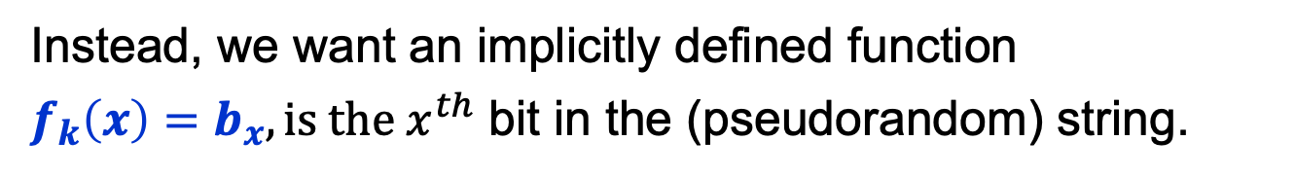
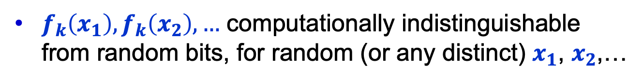








But these are good bad ideas…
Pseudorandom Functions
Key k ${=s}_{0}$
|$x|$ = $n$ = length of the string $x$.
$$x$$
${ b}_{1}$
${ b}_{2}$
${ b}_{3}$
$$…$$
${ b}_{x}$
$$…$$
${ b}_{2^{n}−1}$
${ b}_{2^{n}}$
Goal: Never compute this exponentially long string explicitly!
Instead, we want an implicitly defined function
$f_{k}\left(x\right)=b_{x}, is the x^{th}$ bit in the (pseudorandom) string.
Where
f is Computable in time $poly\left(\left|x\right|\right)=poly(n)$.
$f_{k}\left(x_{1}\right),f_{k}\left(x_{2}\right),…$ computationally indistinguishable from random bits, for random (or any distinct) $x_{1}$, $x_{2}$,…

Slide 43
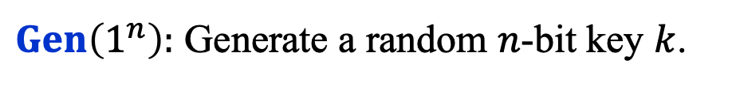

Pseudorandom Functions
Collection of functions $ℱ_{ℓ}=\{f_{k}:\{0,1\}^{ℓ}→\{0,1\}^{m}\}_{k∈\{0,1\}^{n}}$
indexed by a (private) key/seed $k$
$n$: key length, $ℓ$: input length, $m:$ output length.
Independent parameters, all poly(sec-param) = poly($n$)
#functions in $ℱ_{ℓ}$ $≤$ $2^{n}$ (singly exponential in $n$)
$Gen\left(1^{n}\right):$ Generate a random $n$-bit key $k$.
$Eval\left(k,x\right)$ is a poly-time algorithm that outputs $f_{k}\left(x\right).$

Slide 44

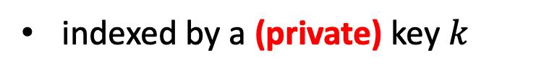
Pseudorandom Functions
Collection of functions $ℱ_{ℓ}=\{f_{k}:\{0,1\}^{ℓ}→\{0,1\}^{m}\}_{k∈\{0,1\}^{n}}$
indexed by a (private) key $k$
$n$: key length, $ℓ$: input length, $m:$ output length.
Independent parameters, all poly(sec-param) = poly($n$)
#functions in $ℱ_{ℓ}$ $≤$ $2^{n}$ (singly exponential in $n$)
$$≈$$
Collection of ALL functions ${ALL}_{ℓ}=\{f:\{0,1\}^{ℓ}→\{0,1\}^{m}\}$
#functions in ${ALL}_{ℓ}$ $≤$ $2^{m2^{ℓ}}$ (doubly exponential in $ℓ$)

Slide 45








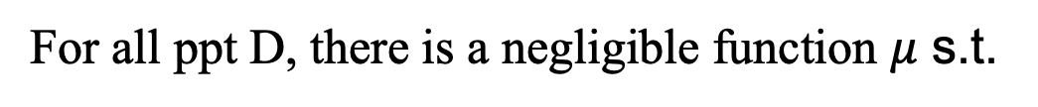




Pseudorandom Functions should be “indistinguishable” from random
The pseudorandom world
The random world
$f_k←$ $ℱ_{ℓ}$
$f←$ ${ALL}_{ℓ}$
$$f_k(x)$$
$$x$$
$$f(x)$$
$$x$$
Distinguisher D
Distinguisher D
$$0/1$$
$$0/1$$
For all ppt D, there is a negligible function $μ$ s.t.
$$|$$
$$−$$
$$|$$
$$≤μ(n)$$
$$Pr⁡[{f← ℱ_{ℓ}\text{:} D}^{f}\left(1^{n}\right)=1]$$
$$Pr⁡[{f← {ALL}_{ℓ}\text{:} D}^{f}\left(1^{n}\right)=1]$$

Slide 46

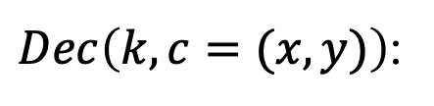
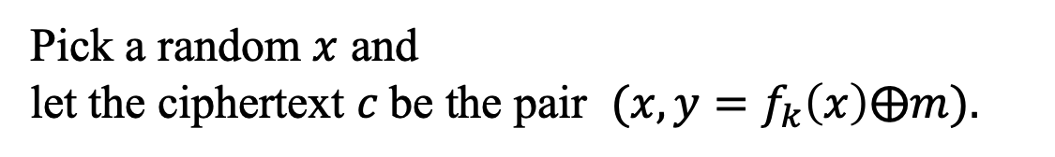

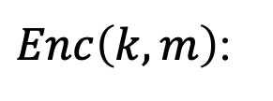
PRF $⟹$ Stateless Secret-key Encryption
$Gen\left(1^{n}\right):$ Generate a random $n$-bit key k that defines
$$f_{k}:\{0,1\}^{ℓ}→\{0,1\}^{m}$$
(the domain size, $2^{ℓ}$, had better be super-polynomially large in n)
$Enc\left(k,m\right)$:
Pick a random $x$ and
let the ciphertext $c$be the pair $(x,{y=f}_{k}\left(x\right)⨁m).$
$Dec\left(k,c=(x,y)\right)$:
O$utput f_{k}\left(x\right)⨁y.$
$$Correctness:$$
$Dec\left(k,c\right)$ outputs $f_{k}\left(x\right)⨁y=f_{k}\left(x\right)⨁f_{k}\left(x\right)⨁m=m.$

