Slide 1





Constructing Program Obfuscators
…
[Garg-Gentry-Halevi- Raykova-Sahai-Waters’13]
Fix,
Break,
Fix,
Break,
OBFUSCATION
Notes:
We’ve figured out a lot, but there are way more questions than answers

Slide 2


Constructing Program Obfuscators
THEOREM 1:
If exponentially inefficient IO (XIO) and one-way functions exist, so does IO.
THEOREM [BITANSKY-V’15, ANANTH-JAIN’15, LIN-PASS-SETH-TELANG’16]
OBFUSCATION
XIO [BV15,AJ15,LPST16]
Notes:
Weak? Strong?

Slide 3
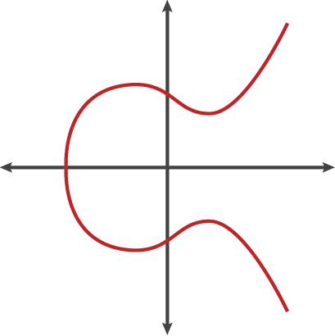
Constructing Program Obfuscators
THEOREM 1.5 [Lin-V’16, Lin’17, Ananth-Sahai’17, Lin-Tessaro’17]
If 3-linear maps exist*, so does XIO,
and therefore, IO.
“3-LINEAR MAPS”
“2-LINEAR MAPS”
XIO
Notes:
Weak? Strong?

Slide 4
Constructing Program Obfuscators
THEOREM 2 [Jain-Lin-Sahai’21, ‘22]
XIO exists assuming that
Learning parity with noise over large fields is hard;
Bilinear maps exist ☺
There are PRGs computable with constant depth circuits.
XIO
Notes:
Weak? Strong?

