Slide 1
MIT 6.875/6.5620/18.425
Foundations of Cryptography
Lecture 3
Course website: https://mit6875.github.io/

Slide 2

Lecture 2 Recap
Computational Indistinguishability: a new definition of security for secret-key encryption.
(new notions: p.p.t. adversaries, negligible functions,…)
Consequence: Shannon’s impossibility no longer applies!
New Notion: Pseudorandom Generator (PRG)
PRG $⇒$Can encrypt a single message longer than the key.
We saw a construction of PRG (based on subset sum). Many more later in the course.

Slide 3

TODAY
How to encrypt (poly) many messages with a fixed key?
1. PRG length extension.
Theorem: If there is a PRG that stretches by one bit, there is one that stretches by poly many bits
Consequence: Stateful encryption of poly many messages.
2. Another new notion: Pseudorandom Functions (PRF).
Consequence: Stateless encryption of poly many messages.
Theorem (next lec): If there is a PRG, then there is a PRF.
New Proof Technique: Hybrid Arguments.

Slide 4
But first, let’s do some prep work…

Slide 5
Three Definitions of Pseudorandomness
Def 1 [Indistinguishability]
“No polynomial-time algorithm can distinguish between the output of a PRG on a random seed vs. a truly random string”
= “as good as” a truly random string for all practical purposes.
Def 2 [Next-bit Unpredictability]
“No polynomial-time algorithm can predict the (i+1)^{th} bit of the output of a PRG given the first i bits, better than chance”
ALL DEFS ARE EQUIVALENT!
Def 3 [Incompressibility]
“No polynomial-time algorithm can compress the output of the PRG into a shorter string”

Slide 6
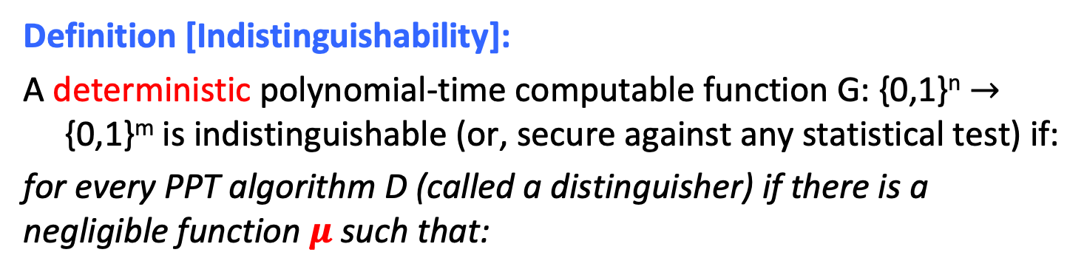
PRG Def 1 (Recap): Indistinguishability
Definition [Indistinguishability]:
A deterministic polynomial-time computable function G: {0,1}^{n} $→$ {0,1}^{m} is indistinguishable (or, secure against any statistical test) if:
for every PPT algorithm D (called a distinguisher) if there is a negligible function $μ$ such that:
$$| Pr⁡[ D(G(U_{n})) =1 ] – Pr⁡[ D(Um) =1 ] | =μ(n)$$
Notation: U_{n} (resp. U_{m}) denotes the random distribution on n-bit (resp. m-bit) strings.

Slide 7
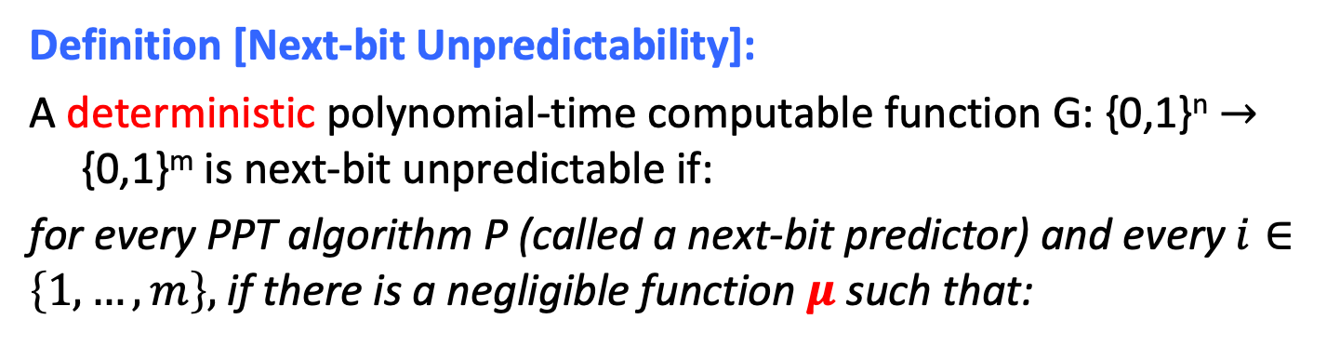

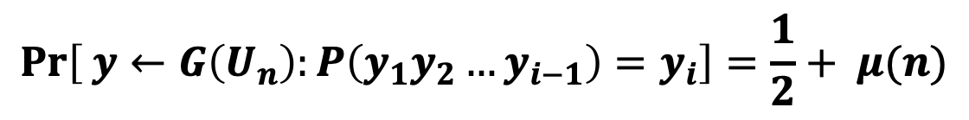
PRG Def 2: Next-bit Unpredictability
Definition [Next-bit Unpredictability]:
A deterministic polynomial-time computable function G: {0,1}^{n} $→$ {0,1}^{m} is next-bit unpredictable if:
for every PPT algorithm P (called a next-bit predictor) and every $i∈\left\{1,…,m\right\},$ if there is a negligible function $μ$ such that:
$$\operatorname{Pr}\left[ y←G\left(U_{n}\right):P\left(y_{1}y_{2}…y_{i−1}\right)=y_{i}\right]=\frac{1}{2}+ μ(n)$$
Notation: $y_{1}{,y}_{2},…y_{m}$ are the bits of the m-bit string $y$.

Slide 8
Def 1 and Def 2 are Equivalent
Theorem: A PRG G is indistinguishable if and only if it is next-bit unpredictable.

Slide 9
Def 1 and Def 2 are Equivalent
Theorem: A PRG G passes all (poly-time) statistical tests if and only if it passes (poly-time) next-bit tests.

Slide 10
NBU and Indistinguishability
Next-bit Unpredictability (NBU): Seemingly much weaker requirement. Only says that next bit predictors, a particular type of distinguishers, cannot succeed.
Yet, surprisingly, Next-bit Unpredictability (NBU) = Indistinguishability.
NBU often much easier to use.

Slide 11
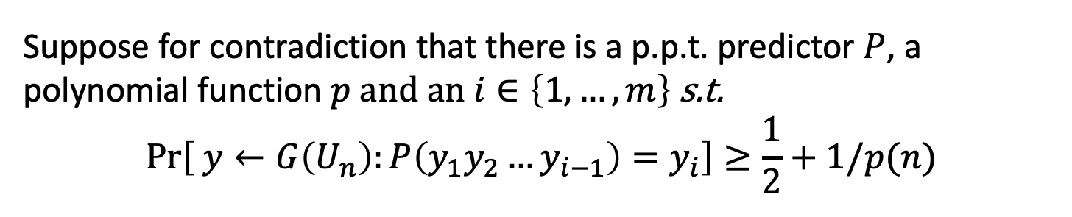
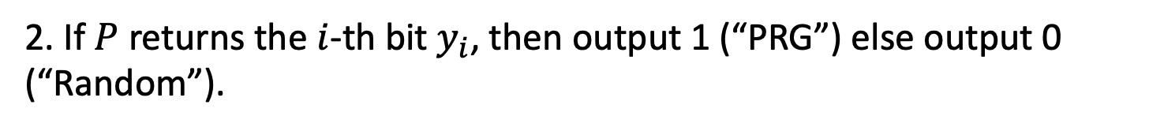

1. Indistinguishability $⟹$ NBU
Proof: by contradiction.
Suppose for contradiction that there is a p.p.t. predictor $P$, a polynomial function $p$ and an $i∈\left\{1,…,m\right\}$ s.t.
$$\operatorname{Pr}\left[ y←G\left(U_{n}\right):P\left(y_{1}y_{2}…y_{i−1}\right)=y_{i}\right]≥\frac{1}{2}+1/p(n)$$
Then, I claim that $P$ essentially gives us a distinguisher D!
Consider $D$ which gets an m-bit string $y$ and does the following:
1. Run $P$ on the $(i−1)$-bit prefix $y_{1}y_{2}…y_{i−1}$.
2. If $P$ returns the $i$-th bit $y_{i}$, then output 1 (“PRG”) else output 0 (“Random”).
If $P$ is p.p.t. so is $D$.

Slide 12

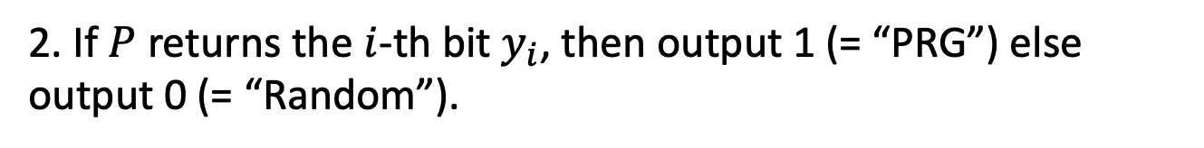
1. Indistinguishability $⟹$ NBU
Consider $D$ which gets an m-bit string $y$ and does the following:
1. Run $P$ on the $(i−1)$-bit prefix $y_{1}y_{2}…y_{i−1}$.
2. If $P$ returns the $i$-th bit $y_{i}$, then output 1 (= “PRG”) else output 0 (= “Random”).
We want to show: there is a polynomial $p′$ s.t.
$$| Pr⁡[y←G\left(U_{n}\right): D(y) =1 ]$$
$– Pr⁡[y←Um: D(y) =1 ] |≥1/p′(n)$

Slide 13
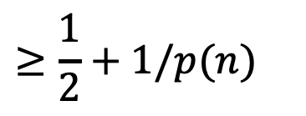
1. Indistinguishability $⟹$ NBU
Consider $D$ which gets an m-bit string $y$ and does the following:
1. Run $P$ on the $(i−1)$-bit prefix $y_{1}y_{2}…y_{i−1}$.
2. If $P$ returns the $i$-th bit $y_{i}$, then output 1 (= “PRG”) else output 0 (= “Random”).
$$Pr⁡[y←G\left(U_{n}\right): D(y) =1 ]$$
$$= Pr⁡[y←G\left(U_{n}\right): P\left(y_{1}y_{2}…y_{i−1}\right)=y_{i}]$$
(by construction of D)
$$≥\frac{1}{2}+1/p(n)$$
(by assumption on P)

Slide 14
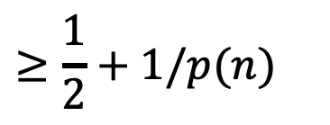
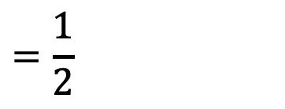
1. Indistinguishability $⟹$ NBU
Consider $D$ which gets an m-bit string $y$ and does the following:
1. Run $P$ on the $(i−1)$-bit prefix $y_{1}y_{2}…y_{i−1}$.
2. If $P$ returns the $i$-th bit $y_{i}$, then output 1 (= “PRG”) else output 0 (= “Random”).
$$≥\frac{1}{2}+1/p(n)$$
$$Pr⁡[y←G\left(U_{n}\right): D(y) =1 ]$$
$$\operatorname{Pr}\left[y←U_{m}: D\left(y\right)=1 \right]$$
$$= Pr⁡[y←U_{m}: P\left(y_{1}y_{2}…y_{i−1}\right)=y_{i}]$$
(by construction of D)
$$=\frac{1}{2}$$
(since y is random)

Slide 15
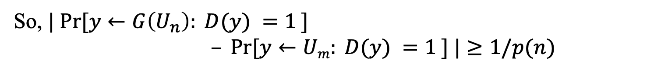
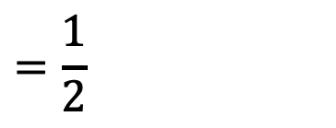
1. Indistinguishability $⟹$ NBU
Consider $D$ which gets an m-bit string $y$ and does the following:
1. Run $P$ on the $(i−1)$-bit prefix $y_{1}y_{2}…y_{i−1}$.
2. If $P$ returns the $i$-th bit $y_{i}$, then output 1 (= “PRG”) else output 0 (= “Random”).
$$≥\frac{1}{2}+1/p(n)$$
$$Pr⁡[y←G\left(U_{n}\right): D(y) =1 ]$$
$$=\frac{1}{2}$$
$$\operatorname{Pr}\left[y←U_{m}: D\left(y\right)=1 \right]$$
So, $| Pr⁡[y←G\left(U_{n}\right): D(y) =1 ]$
$– Pr⁡[y←Um: D(y) =1 ] |≥1/p(n)$

Slide 16




2. NBU $⟹$Indistinguishability
Proof: by contradiction (again!)
Suppose for contradiction that there is a distinguisher $D$, and a polynomial function $p$ s.t.
$$| Pr⁡[y←G\left(U_{n}\right): D(y) =1 ]$$
$– Pr⁡[y←Um: D(y) =1 ] |≥1/p′(n)$
I want to construct a next bit predictor $P$ out of $D$.
But how?!

Slide 17


2. NBU $⟹$Indistinguishability
Proof: by contradiction (again!)
Suppose for contradiction that there is a distinguisher $D$, and a polynomial function $p$ s.t.
$$Pr⁡[y←G\left(U_{n}\right): D(y) =1 ]$$
$– Pr⁡[y←Um: D(y) =1 ]≥1/p′(n)$
$$:=ε$$
I want to construct a next bit predictor $P$ out of $D$.
TWO STEPS:
STEP 1: HYBRID ARGUMENT
STEP 2: From Distinguishing to Predicting

Slide 18


Before we go there, a puzzle…
Lemma: Let $p_{0},p_{1},p_{2},…,p_{m}$ be real numbers s.t.
$$p_{m}−p_{0}≥ε.$$
Then, there is an index $i$ such that $p_{i}−p_{i−1}$ $≥ε/m$.
Proof:
$p_{m}−p_{0}=\left(p_{m}−p_{m−1}\right)+\left(p_{m−1}−p_{m−2}\right)+…+(p_{1}−p_{0}$)
$$≥ε$$
At least one of the $m$ terms has to be at least $ε/m$ (averaging).

Slide 19
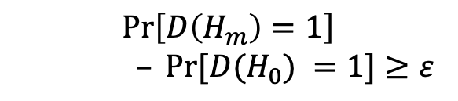
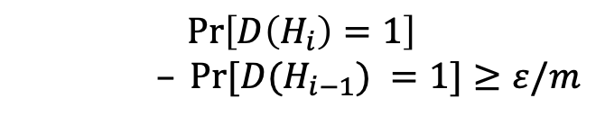
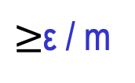
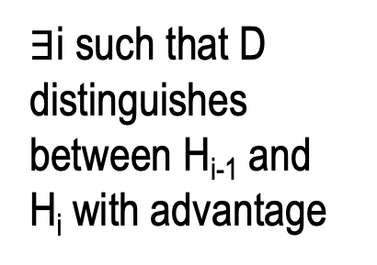
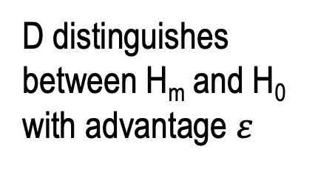
Define Hybrid Distributions:
random
pseudorandom
H₀ = U_{m}:
$∃$i such that D distinguishes between H_{i-1} and H_{i} with advantage
...
...
H_{i-1}:
D distinguishes between H_{m} and H₀ with advantage $ε$
$≥$ε / m
H_{i}:
$$\operatorname{Pr}\left[D\left(H_{i}\right)=1\right]$$
$– Pr⁡[D(H_{i−1}) =1]≥ε/m$
...
$$\operatorname{Pr}\left[D\left(H_{m}\right)=1\right]$$
$– Pr⁡[D(H_{0}) =1]≥ε$
...
H_{m-1}:
H_{m} = G(U_{n}):

Slide 20
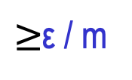
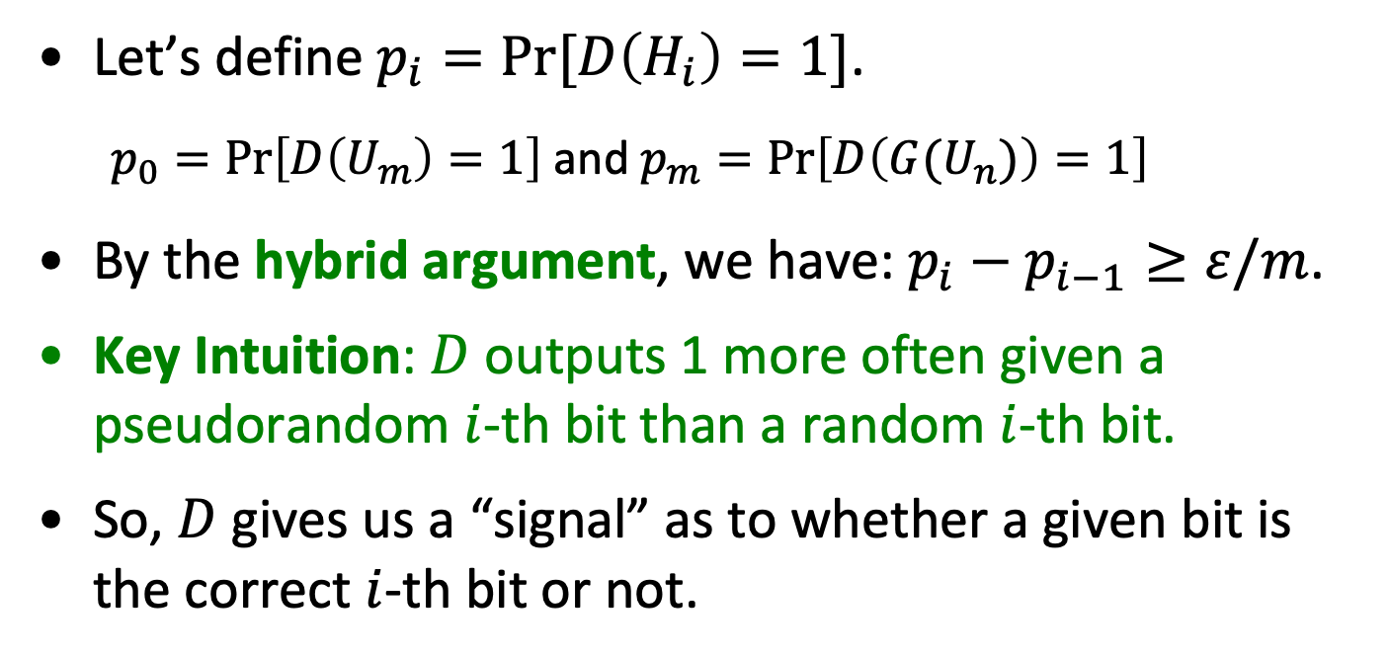
Hybrid Distributions:
random
pseudorandom
H_{i-1}:
$≥$ε / m
H_{i}:
Let’s define $p_{i}=Pr⁡[D\left(H_{i}\right)=1]$.
$p_{0}=\operatorname{Pr}\left[D\left(U_{m}\right)=1\right]$ and $p_{m}=\operatorname{Pr}\left[D\left({G(U}_{n})\right)=1\right]$
By the hybrid argument, we have: $p_{i}−p_{i−1}≥ε/m$.
Key Intuition: $D$ outputs 1 more often given a pseudorandom $i$-th bit than a random $i$-th bit.
So, $D$ gives us a “signal” as to whether a given bit is the correct $i$-th bit or not.

Slide 21






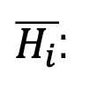


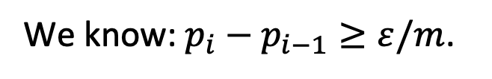



Let’s dig a bit more.
random
pseudorandom
We know: $p_{i}−p_{i−1}≥ε/m$.
$$\overline{p_{i}}$$
H_{i-1}:
$$u$$
$p_{i−1}$
$$p:Pr⁡[D\left(H\right)=1]$$
H_{i}:
$$y_{i}$$
$p_{i}$
Claim: $p_{i−1}=(p_{i}+\overline{p_{i}})/2$
Define
Corollary (*): $p_{i}−\overline{p_{i}}≥2ε/m$.
$\overline{H_{i}}$:
$$\overline{y_{i} }$$
$u:$ random bit
So, Takeaway: D says “1” more often when fed with the “right bit” than the “wrong bit”.
$y_{i}:$ i-th pseudorandom bit
$$\overline{p_{i}}=Pr[D\left(\overline{H_{i}}\right)=1]$$
$$\overline{y_{i} }=1−y_{i}$$

Slide 22

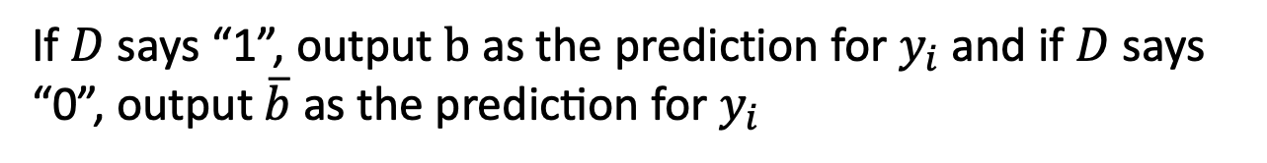
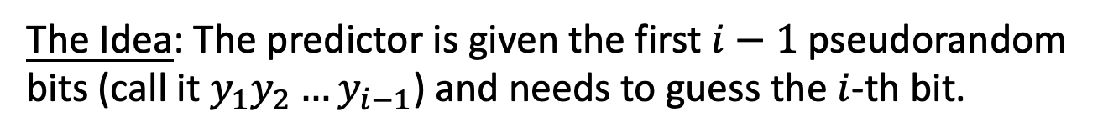
Our Predictor P
The Idea: The predictor is given the first $i−1$ pseudorandom bits (call it $y_{1}y_{2}…y_{i−1}$) and needs to guess the $i$-th bit.
The Predictor P works as follows:
Pick a random bit $b;$
$F$eed $D$ with input$y_{1}y_{2}…y_{i−1}\left| b \right| u_{i+1}$… $u_{m}$ ($u$’s are random)
If $D$ says “1”, output $b$ as the prediction for $y_{i}$and if $D$ says “0”, output $\overline{b} \text{as} \text{the} \text{prediction} \text{for} y_{i}$

Slide 23
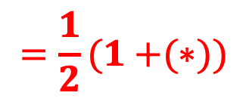

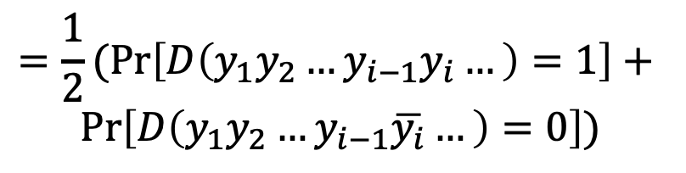
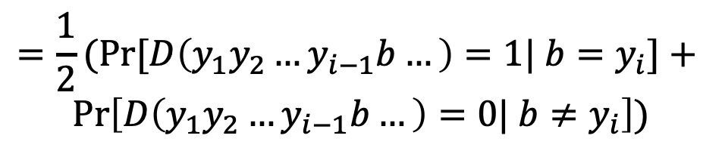
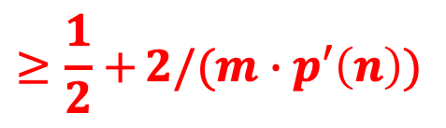
Analysis of the Predictor P
$$\operatorname{Pr}\left[x←{\left\{0,1\right\}}^{n};y=G(x):P\left(y_{1}y_{2}…y_{i−1}\right)=y_{i}\right]$$
$$=\operatorname{Pr}\left[D\left(y_{1}y_{2}…y_{i−1}b…\right)=1| b=y_{i}\right]\operatorname{Pr}\left[b=y_{i}\right]+$$
$$Pr⁡\left[D\left(y_{1}y_{2}…y_{i−1}b…\right)=0| b≠y_{i}\right]\operatorname{Pr}\left[b≠y_{i}\right]$$
$$=\frac{1}{2}(Pr{[D\left(y_{1}y_{2}…y_{i−1}b…\right)=1| b=y_{i}]+ }$$
$$Pr⁡\left[D\left(y_{1}y_{2}…y_{i−1}b…\right)=0| b≠y_{i}\right])$$
$$=\frac{1}{2}(Pr\left[D\left(y_{1}y_{2}…y_{i−1}y_{i}…\right)=1\right]+$$
$$Pr⁡\left[D\left(y_{1}y_{2}…y_{i−1}\overline{y_{i}}…\right)=0\right])$$
$$=\frac{1}{2}(Pr\left[D\left(y_{1}y_{2}…y_{i−1}y_{i}…\right)=1\right]+1−$$
$$Pr⁡\left[D\left(y_{1}y_{2}…y_{i−1}\overline{y_{i}}…\right)=1\right])$$
$$=\frac{1}{2}(1+{(∗)})$$
$$≥\frac{1}{2}+{2/(m∙p′\left(n\right))}$$
Notes:
By def of how D works
Since b is random
Syntactic
Since pr[D(..)=0] = 1 – pr[D(..) = 1]

Slide 24
Recap: NBU and Indistinguishability
Next-bit Unpredictability (NBU): Seemingly much weaker requirement, only says that next bit predictors, a particular type of distinguishers, cannot succeed.
Yet, surprisingly, Next-bit Unpredictability (NBU) = Indistinguishability.
NBU often much easier to use.
Exercise: Previous-bit Unpredictability (PBU) = Indistinguishability.

Slide 25
TODAY
How to encrypt (poly) many messages with a fixed key?
1. PRG length extension.
Theorem: If there is a PRG that stretches by one bit, there is one that stretches by poly many bits
Consequence: Stateful encryption of poly many messages.
2. Another new notion: Pseudorandom Functions (PRF).
Consequence: Stateless encryption of poly many messages.
Theorem (next lec): If there is a PRG, then there is a PRF.
New Proof Technique: Hybrid Arguments.

Slide 26
Length extension: One bit to Many bits
Let G: ${\{0,1\}}^{n} →{\{0,1\}}^{n+1}$ be a pseudorandom generator.
Goal: use G to generate many pseudorandom bits.

Slide 27
Length extension: One bit to Many bits
Let G: ${\{0,1\}}^{n} →{\{0,1\}}^{n+1}$ be a pseudorandom generator.
Goal: use G to generate poly many pseudorandom bits.

Slide 28
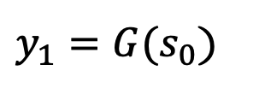

Length extension: One bit to Many bits
Let G: ${\{0,1\}}^{n} →{\{0,1\}}^{n+1}$ be a pseudorandom generator.
Goal: use G to generate poly many pseudorandom bits.
Construction of G’($s_{0}$)
$${seed=s}_{0}$$
$y_{1}=G(s_{0}$)
G

Slide 29



Length extension: One bit to Many bits
Let G: ${\{0,1\}}^{n} →{\{0,1\}}^{n+1}$ be a pseudorandom generator.
Goal: use G to generate poly many pseudorandom bits.
Construction of G’($s_{0}$)
$${seed=s}_{0}$$
$$y_{1}$$
$${=b}_{1}||{ s}_{1}$$
G

Slide 30







Length extension: One bit to Many bits
Let G: ${\{0,1\}}^{n} →{\{0,1\}}^{n+1}$ be a pseudorandom generator.
Goal: use G to generate poly many pseudorandom bits.
Construction of G’($s_{0}$)
Output $b_{1}$ $b_{2}$ $b_{3}$ $b_{4}$ $b_{5}$ $…s_{L}.$
$${seed=s}_{0}$$
$$s_{1}$$
$$s_{2}$$
$$s_{L−1}$$
$$s_{L}$$
$$…$$
G
G
G
G
$$b_{1}$$
$$b_{2}$$
$$b_{L−1}$$
$$b_{L}$$
Also called a stream cipher by the practitioners.

Slide 31
Length extension: One bit to Many bits
Proof of Security (exercise):
Use next-bit (or previous-bit?) unpredictability!
Construction of G’($s_{0}$)
Output $b_{1}$ $b_{2}$ $b_{3}$ $b_{4}$ $b_{5}$ $…s_{L}.$
$${seed=s}_{0}$$
$$s_{1}$$
$$s_{2}$$
$$s_{L−1}$$
$$s_{L}$$
$$…$$
G
G
G
G
$$b_{1}$$
$$b_{2}$$
$$b_{L−1}$$
$$b_{L}$$

Slide 32
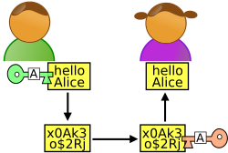
















Stateful Encryption of Many Messages
1-bit m
${m⊕b}_{1}$
Alice
Bob
Initial state ${=s}_{0}$
Initial state ${=s}_{0}$
S$tate{=s}_{1}$
State ${=s}_{1}$
$$s_{0}$$
$$s_{1}$$
$$s_{2}$$
$$s_{3}$$
$$s_{4}$$
$$s_{5}$$
G
G
G
G
G
$$b_{1}$$
$$b_{2}$$
$$b_{3}$$
$$b_{4}$$
$$b_{5}$$

Slide 33





Stateful Encryption of Many Messages
3-bit m’
$${m′⊕b}_{2}b_{3}b_{4}$$
Alice
Bob
S$tate{=s}_{4}$
State ${=s}_{4}$
S$tate{=s}_{1}$
State ${=s}_{1}$
$$s_{0}$$
$$s_{1}$$
$$s_{2}$$
$$s_{3}$$
$$s_{4}$$
$$s_{5}$$
G
G
G
G
G
$$b_{1}$$
$$b_{2}$$
$$b_{3}$$
$$b_{4}$$
$$b_{5}$$

Slide 34





Stateful Encryption of Many Messages
1-bit m’’
$${m′′⊕b}_{5}$$
Alice
Bob
S$tate{=s}_{5}$
State ${=s}_{5}$
S$tate{=s}_{4}$
State ${=s}_{4}$
$$s_{0}$$
$$s_{1}$$
$$s_{2}$$
$$s_{3}$$
$$s_{4}$$
$$s_{5}$$
G
G
G
G
G
$$b_{1}$$
$$b_{2}$$
$$b_{3}$$
$$b_{4}$$
$$b_{5}$$

Slide 35
Stateful Encryption of Many Messages
PLUS: Alice and Bob can keep encrypting as many bits as they wish.
MINUS: Alice and Bob have to keep their states in perfect synchrony. They cannot transmit simultaneously.
IF NOT: Correctness goes down the drain, so does security.

Slide 36















How to be Stateless? Here is an idea…
1-bit m
pick a random index, say 5
(5,${m⊕b}_{5})$
Alice
Bob
Key k ${=s}_{0}$
Key k ${=s}_{0}$
${ b}_{1}$
${ b}_{2}$
${ b}_{3}$
${ b}_{4}$
${ b}_{5}$
$$…$$
${ b}_{n^{100}−1}$
${ b}_{n^{100}}$
${ b}_{1}$
${ b}_{2}$
${ b}_{3}$
${ b}_{4}$
${ b}_{5}$
$$…$$
${ b}_{n^{100}−1}$
${ b}_{n^{100}}$
DOES THIS WORK?
Collisions! Pr[Alice’s first two indices collide] $≥1/n^{100}$
$⟹$Alice is using the same one-time pad bit twice!

Slide 37






Here is another idea…
1-bit m
pick a random index, say 5
(5,${m⊕b}_{5})$
Alice
Bob
Key k ${=s}_{0}$
Key k ${=s}_{0}$
${ b}_{1}$
${ b}_{2}$
${ b}_{3}$
${ b}_{4}$
${ b}_{5}$
$$…$$
${ b}_{2^{n}−1}$
${ b}_{2^{n}}$
${ b}_{1}$
${ b}_{2}$
${ b}_{3}$
${ b}_{4}$
${ b}_{5}$
$$…$$
${ b}_{2^{n}−1}$
${ b}_{2^{n}}$
Pr[$∃$ collision in $t=poly(n)$ indices] $≤t^{2}/2^{n}=negl(n)$
BUT: Alice and Bob are not poly-time!

Slide 38




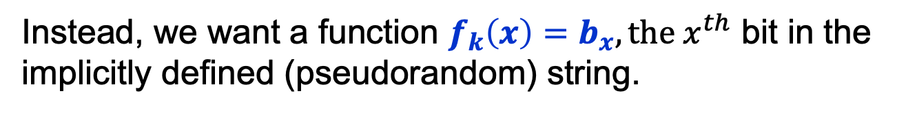
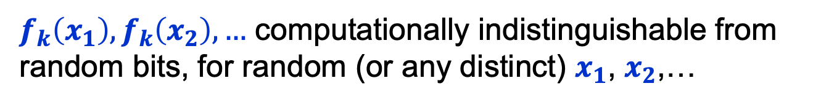







Pseudorandom Functions
But these are good bad ideas…
Key k ${=s}_{0}$
$$x$$
${ b}_{1}$
${ b}_{2}$
${ b}_{3}$
$$…$$
${ b}_{x}$
$$…$$
${ b}_{2^{n}−1}$
${ b}_{2^{n}}$
Goal: Never compute this exponentially long string explicitly!
Instead, we want a function $f_{k}\left(x\right)=b_{x}, the x^{th}$ bit in the implicitly defined (pseudorandom) string.
Computable in time $poly\left(\left|x\right|\right)=poly(n)$.
$f_{k}\left(x_{1}\right),f_{k}\left(x_{2}\right),…$ computationally indistinguishable from random bits, for random (or any distinct) $x_{1}$, $x_{2}$,…
|$x|$ = $n$ = length of the string $x$.

Slide 39
TODAY
How to encrypt (poly) many messages with a fixed key?
1. PRG length extension.
Theorem: If there is a PRG that stretches by one bit, there is one that stretches by poly many bits
Consequence: Stateful encryption of poly many messages.
2. Another new notion: Pseudorandom Functions (PRF).
Consequence: Stateless encryption of poly many messages.
Theorem (next lec): If there is a PRG, then there is a PRF.
New Proof Technique: Hybrid Arguments.

Slide 40
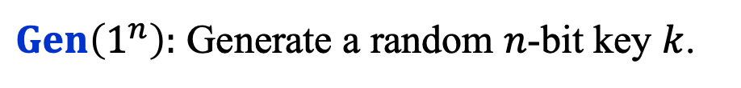

Pseudorandom Functions
Collection of functions $ℱ_{ℓ}=\{f_{k}:\{0,1\}^{ℓ}→\{0,1\}^{m}\}_{k∈\{0,1\}^{n}}$
indexed by a (private) key/seed $k$
$n$: key length, $ℓ$: input length, $m:$ output length.
Independent parameters, all poly(sec-param) = poly($n$)
#functions in $ℱ_{ℓ}$ $≤$ $2^{n}$ (singly exponential in $n$)
$Gen\left(1^{n}\right):$ Generate a random $n$-bit key $k$.
$Eval\left(k,x\right)$ is a poly-time algorithm that outputs $f_{k}\left(x\right).$

Slide 41

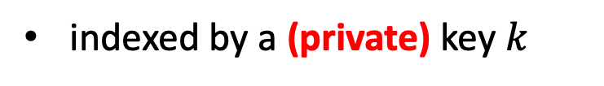
Pseudorandom Functions
Collection of functions $ℱ_{ℓ}=\{f_{k}:\{0,1\}^{ℓ}→\{0,1\}^{m}\}_{k∈\{0,1\}^{n}}$
indexed by a (private) key $k$
$n$: key length, $ℓ$: input length, $m:$ output length.
Independent parameters, all poly(sec-param) = poly($n$)
#functions in $ℱ_{ℓ}$ $≤$ $2^{n}$ (singly exponential in $n$)
$$≈$$
Collection of ALL functions ${ALL}_{ℓ}=\{f:\{0,1\}^{ℓ}→\{0,1\}^{m}\}$
#functions in ${ALL}_{ℓ}$ $≤$ $2^{m2^{ℓ}}$ (doubly exponential in $ℓ$)

Slide 42








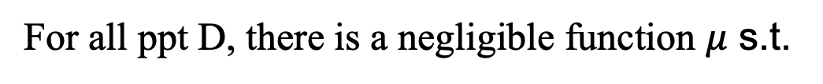




Pseudorandom Functions should be “indistinguishable” from random
The pseudorandom world
The random world
$f_k←$ $ℱ_{ℓ}$
$f←$ ${ALL}_{ℓ}$
$$f_k(x)$$
$$x$$
$$f(x)$$
$$x$$
Distinguisher D
Distinguisher D
$$0/1$$
$$0/1$$
For all ppt D, there is a negligible function $μ$ s.t.
$$|$$
$$−$$
$$|$$
$$≤μ(n)$$
$$Pr⁡[{f← ℱ_{ℓ}\text{:} D}^{f}\left(1^{n}\right)=1]$$
$$Pr⁡[{f← {ALL}_{ℓ}\text{:} D}^{f}\left(1^{n}\right)=1]$$

Slide 43

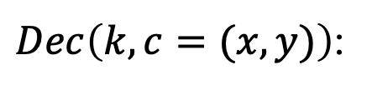
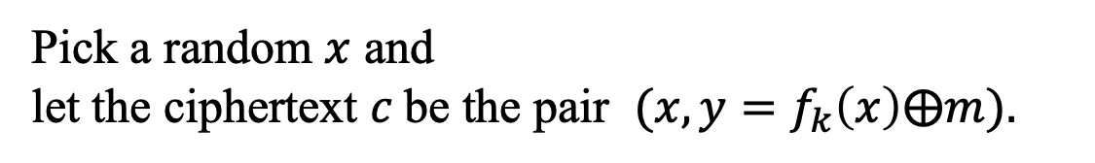

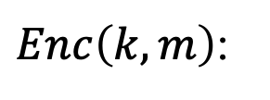
PRF $⟹$ Stateless Secret-key Encryption
$Gen\left(1^{n}\right):$ Generate a random $n$-bit key k that defines
$$f_{k}:\{0,1\}^{ℓ}→\{0,1\}^{m}$$
(the domain size, $2^{ℓ}$, had better be super-polynomially large in n)
$Enc\left(k,m\right)$:
Pick a random $x$ and let the ciphertext $c$be the pair $(x,{y=f}_{k}\left(x\right)⨁m).$
$Dec\left(k,c=(x,y)\right)$:
O$utput f_{k}\left(x\right)⨁y.$
$$Correctness:$$
$Dec\left(k,c\right)$ outputs $f_{k}\left(x\right)⨁y=f_{k}\left(x\right)⨁f_{k}\left(x\right)⨁m=m.$

Slide 44
NEXT LECTURE
How to encrypt (poly) many messages with a fixed key?
1. PRG length extension.
Theorem: If there is a PRG that stretches by one bit, there is one that stretches by poly many bits
Consequence: Stateful encryption of poly many messages.
2. Another new notion: Pseudorandom Functions (PRF).
Consequence: Stateless encryption of poly many messages.
Theorem (next lec): If there is a PRG, then there is a PRF.
New Proof Technique: Hybrid Arguments.

