Slide 1
MIT 6.875
Foundations of Cryptography
Lecture 5

Slide 2
TODAY
0. Finish up secret-key encryption.
1. Theorem: If there are PRGs, then there are PRFs.
The Goldreich-Goldwasser-Micali (GGM) construction.
2. More Applications of PRFs:
a. Identification Protocols
b. Authentication
c. Applications to Learning Theory

Slide 3
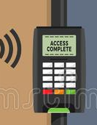
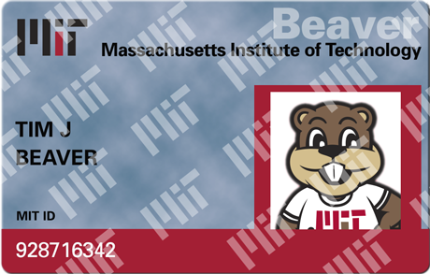
Friend-or-Foe Identification
Adversary: person-in-the-middle.
Can listen to / modify the communications. Wants to impersonate Tim.

Slide 4
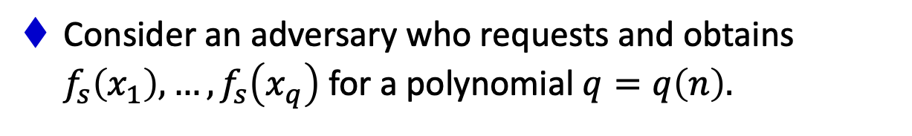
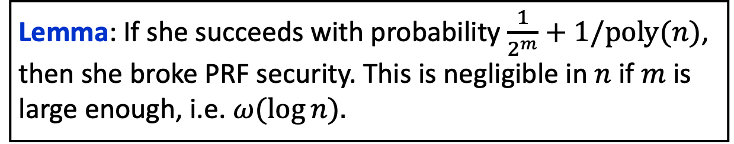
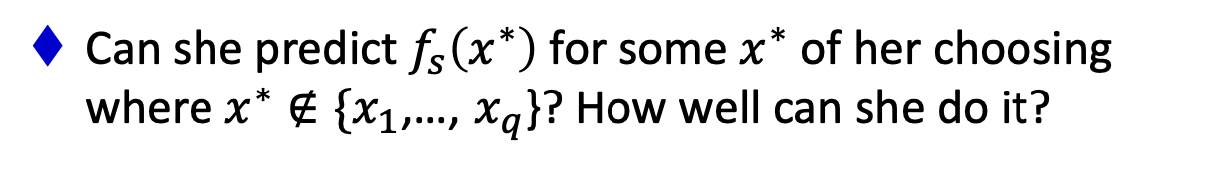
A Simple Lemma about Unpredictability
Let $f_{s}:\{0,1\}^{ℓ}→\{0,1\}^{m}$ be a pseudorandom function.
Consider an adversary who requests and obtains $f_{s}\left(x_{1}\right),…,f_{s}\left(x_{q}\right)$ for a polynomial $q=q\left(n\right).$
Can she predict $f_{s}\left(x^{∗}\right)$ for some $x^{∗}$ of her choosing where $x^{∗}∉\{x_{1}$,…, $x_{q}$}? How well can she do it?
Lemma: If she succeeds with probability $\frac{1}{2^{m}}+1/poly(n)$, then she broke PRF security. This is negligible in $n$ if $m$ is large enough, i.e. $ω(\log{n).}$

Slide 5
A Simple Lemma about Unpredictability
Let $f_{s}:\{0,1\}^{ℓ}→\{0,1\}^{m}$ be a pseudorandom function.
Consider an adversary who requests and obtains $f_{s}\left(x_{1}\right),…,f_{s}\left(x_{q}\right)$ for a polynomial $q=q\left(n\right).$
Can she predict $f_{s}\left(x^{∗}\right)$ for some $x^{∗}$ of her choosing where $x^{∗}∉\{x_{1}$,…, $x_{q}$}? How well can she do it?
Unpredictability $≡$ Indistinguishability for bits (lecture 3)
Indistinguishability $⟹$ Unpredictability (but not vice versa).

Slide 6



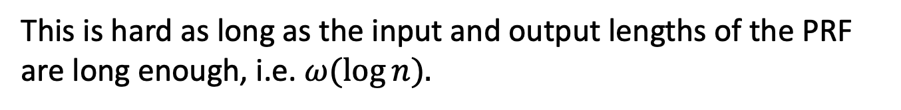
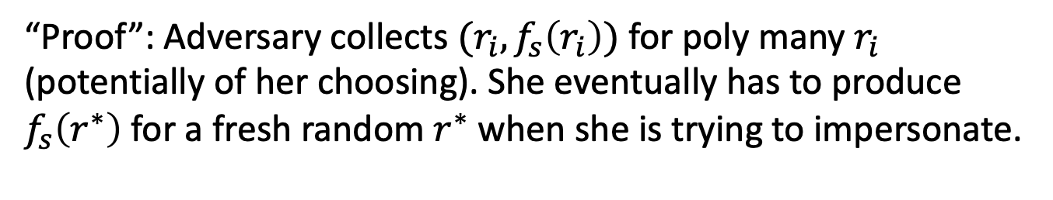

Challenge-Response Protocol
Random $r$
$$(ID,f_{s}\left(r\right))$$
PRF K$ey s$
(ID number $ID$, PRF Key $s$)
“Proof”: Adversary collects $(r_{i},f_{s}\left(r_{i}\right))$ for poly many $r_{i}$ (potentially of her choosing). She eventually has to produce $f_{s}\left(r^{∗}\right)$ for a fresh random $r^{∗}$ when she is trying to impersonate.
This is hard as long as the input and output lengths of the PRF are long enough, i.e. $ω(\log{n).}$

Slide 7
TODAY
1. Theorem: If there are PRGs, then there are PRFs.
The Goldreich-Goldwasser-Micali (GGM) construction.
2. More Applications of PRFs:
a. Identification Protocols
b. Authentication
c. Applications to Learning Theory

Slide 8
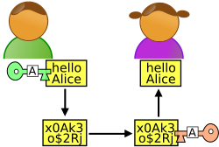




Secure Communication
m
$m⊕k$
$m′⊕k$
Alice
Bob
Can toggle between m and m’
K$ey k$
Key $k$
One-time pad (and encryption schemes in general) are malleable.

Slide 9


Secure Communication
m
$(r,f_{k}(r)⊕m$)
$(r,f_{k}\left(r\right)⊕m^{′})$
Alice
Bob
Can toggle between m and m’
K$ey k$
Key $k$
One-time pad (and encryption schemes in general) are malleable.

Slide 10

Message Authentication Codes
m
${{MAC}_{k}\left(m\right)= f}_{k}(m)$
Alice
Bob
K$ey k$
Key $k$
MACs give us integrity, but not privacy.

Slide 11



Message Authentication Codes
m
${ (c=\left(x,f_{k}\left(x\right)⨁m\right), tag=f}_{k′}(c))$
Alice
Bob
K$eys k,k′$
Keys $k,k′$
MACs give us integrity, but not privacy.
Solution: Encrypt, then MAC (more in pset 2)

Slide 12
TODAY
1. Theorem: If there are PRGs, then there are PRFs.
The Goldreich-Goldwasser-Micali (GGM) construction.
2. More Applications of PRFs:
a. Identification Protocols
b. Authentication
c. Applications to Learning Theory

Slide 13
Negative Results in Learning Theory
Theorem [Kearns and Valiant 1994]: Assuming PRFs exist, there are hypothesis classes that cannot be learned by polynomial-time algorithms.

