Slide 1
Title Slide/About Me
Name: Mitadru Karmakar
Roll no: 231001001117
Course name: IBM Project(EDA on Netflix)
College name: Techno India University
Date of presentation: N/A
Supervisor’s name: Naina Devi
Optional line: A Streamlit Web App for Interactive Visualization of Netflix Data.

Slide 2
Introduction / Problem Statement
🎬 Project Description (Netflix EDA Dashboard)
This project focuses on performing Exploratory Data Analysis (EDA) on the Netflix Movies and TV Shows dataset to understand trends, patterns, and relationships within the data. The goal is to gain insights into what kind of content Netflix produces, when it was added, which countries contribute the most, and how ratings and durations are distributed.
The dataset is analyzed using Python and visualized through an interactive Streamlit web dashboard, allowing users to explore the data visually. Several Python libraries such as pandas, matplotlib, seaborn, and plotly were used for data cleaning, analysis, and plotting.
Through this dashboard, users can:
View the dataset and cleaned data.
Explore visual comparisons like Movies vs TV Shows, Top Genres, Ratings Distribution, and Country Contributions.
Examine time-based trends such as titles added per year.
Understand relationships between numerical features using a Correlation Heatmap.
See a global map showing where Netflix content originates.
This project provides meaningful insights into Netflix’s content library and demonstrates how data visualization can help understand large datasets effectively.

Slide 3
🧰 Tools & Technologies Used
🟩 Description:
Various tools and technologies were used for data analysis, visualization, dashboard creation, and presentation assistance.
Category | Tools | Purpose
Language | Python | For data analysis and visualization
Data Handling | pandas | Data cleaning and preprocessing
Visualization | matplotlib, seaborn, plotly | Create static and interactive graphs
Web Framework | Streamlit | Build and deploy interactive dashboard
Dataset Source | Kaggle | Netflix Movies & TV Shows dataset
IDE | VS Code / Jupyter | Writing and testing code
AI Tools | ChatGPT, Google Gemini | Helped with explanations, slide content & formatting

Slide 4
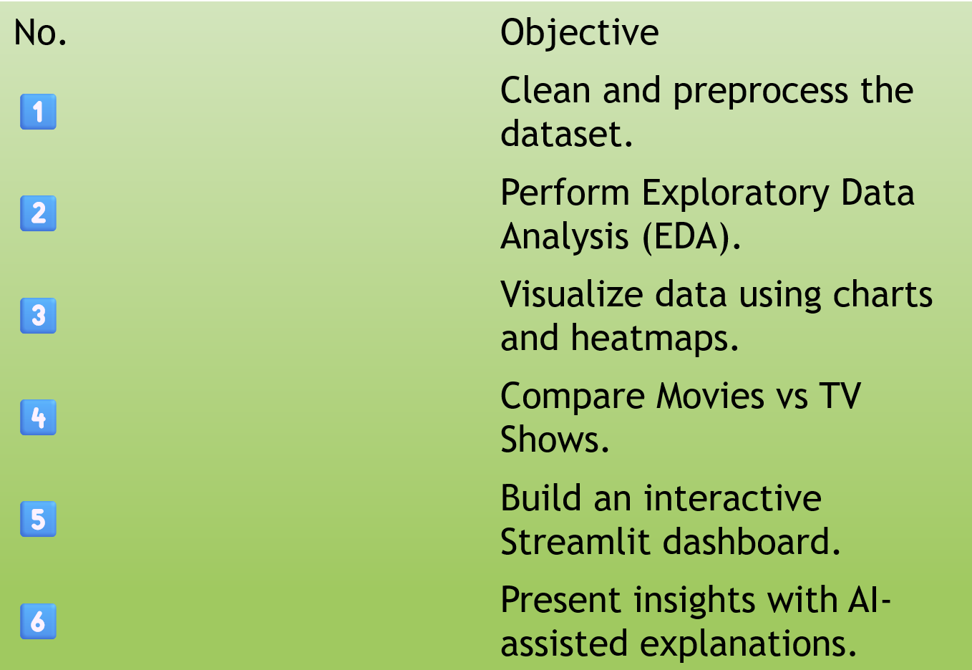
🎯 Project Objectives
🟩 Description:
The main aim of this project is to analyze the Netflix dataset to find useful trends and patterns, and to display them interactively through a Streamlit dashboard.

Slide 5
🟦 Methodology / Workflow
🟩 Description:
This slide explains the step-by-step process followed to clean, analyze, and visualize the Netflix dataset using Python and Streamlit.
Step | Activity
1️⃣ | Data Collection – Download Netflix dataset from Kaggle.
2️⃣ | Data Cleaning – Handle missing values, convert dates, extract numeric durations.
3️⃣ | Exploratory Data Analysis (EDA) – Analyze trends in content type, genres, ratings, and countries.
4️⃣ | Data Visualization – Use matplotlib, seaborn, and plotly to create graphs and heatmaps.
5️⃣ | Dashboard Development – Build an interactive Streamlit dashboard to display insights.
6️⃣ | Presentation & Reporting – Record graphs, code, and explain findings for slides.

Slide 6
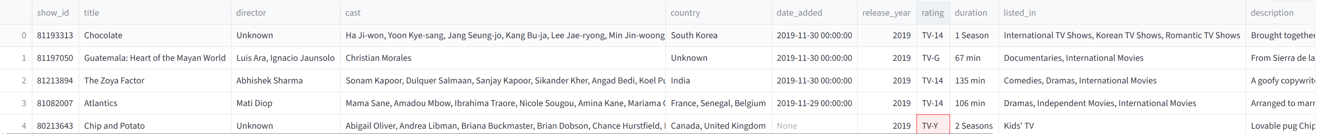
Dataset preview
🟩 Description:
A brief overview of the Netflix dataset used for this project.

Slide 7
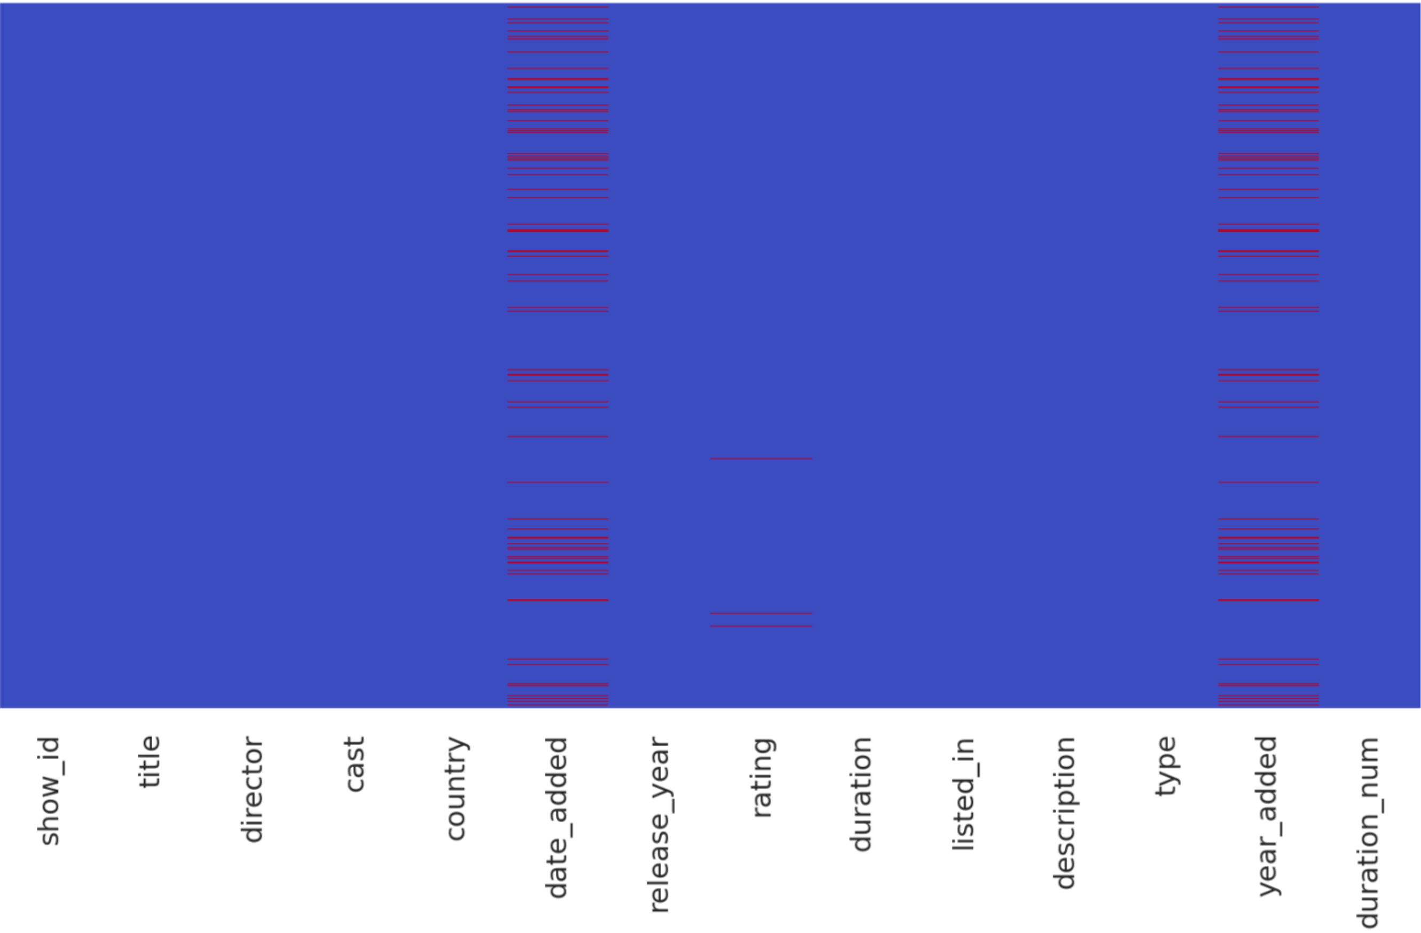
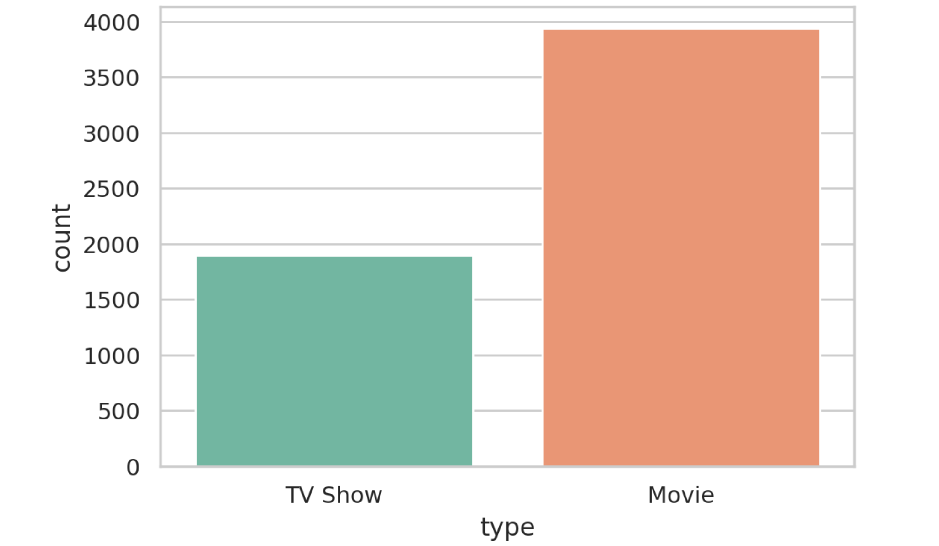
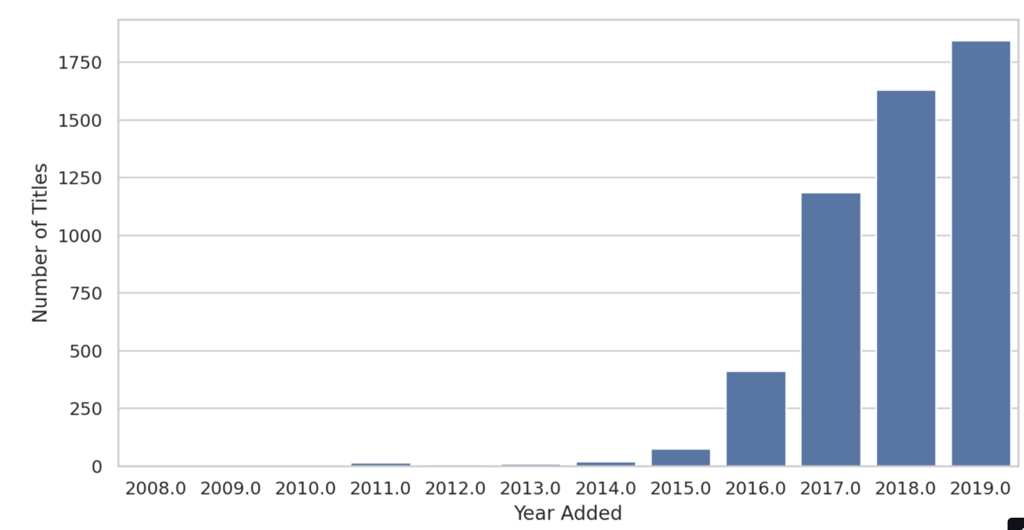
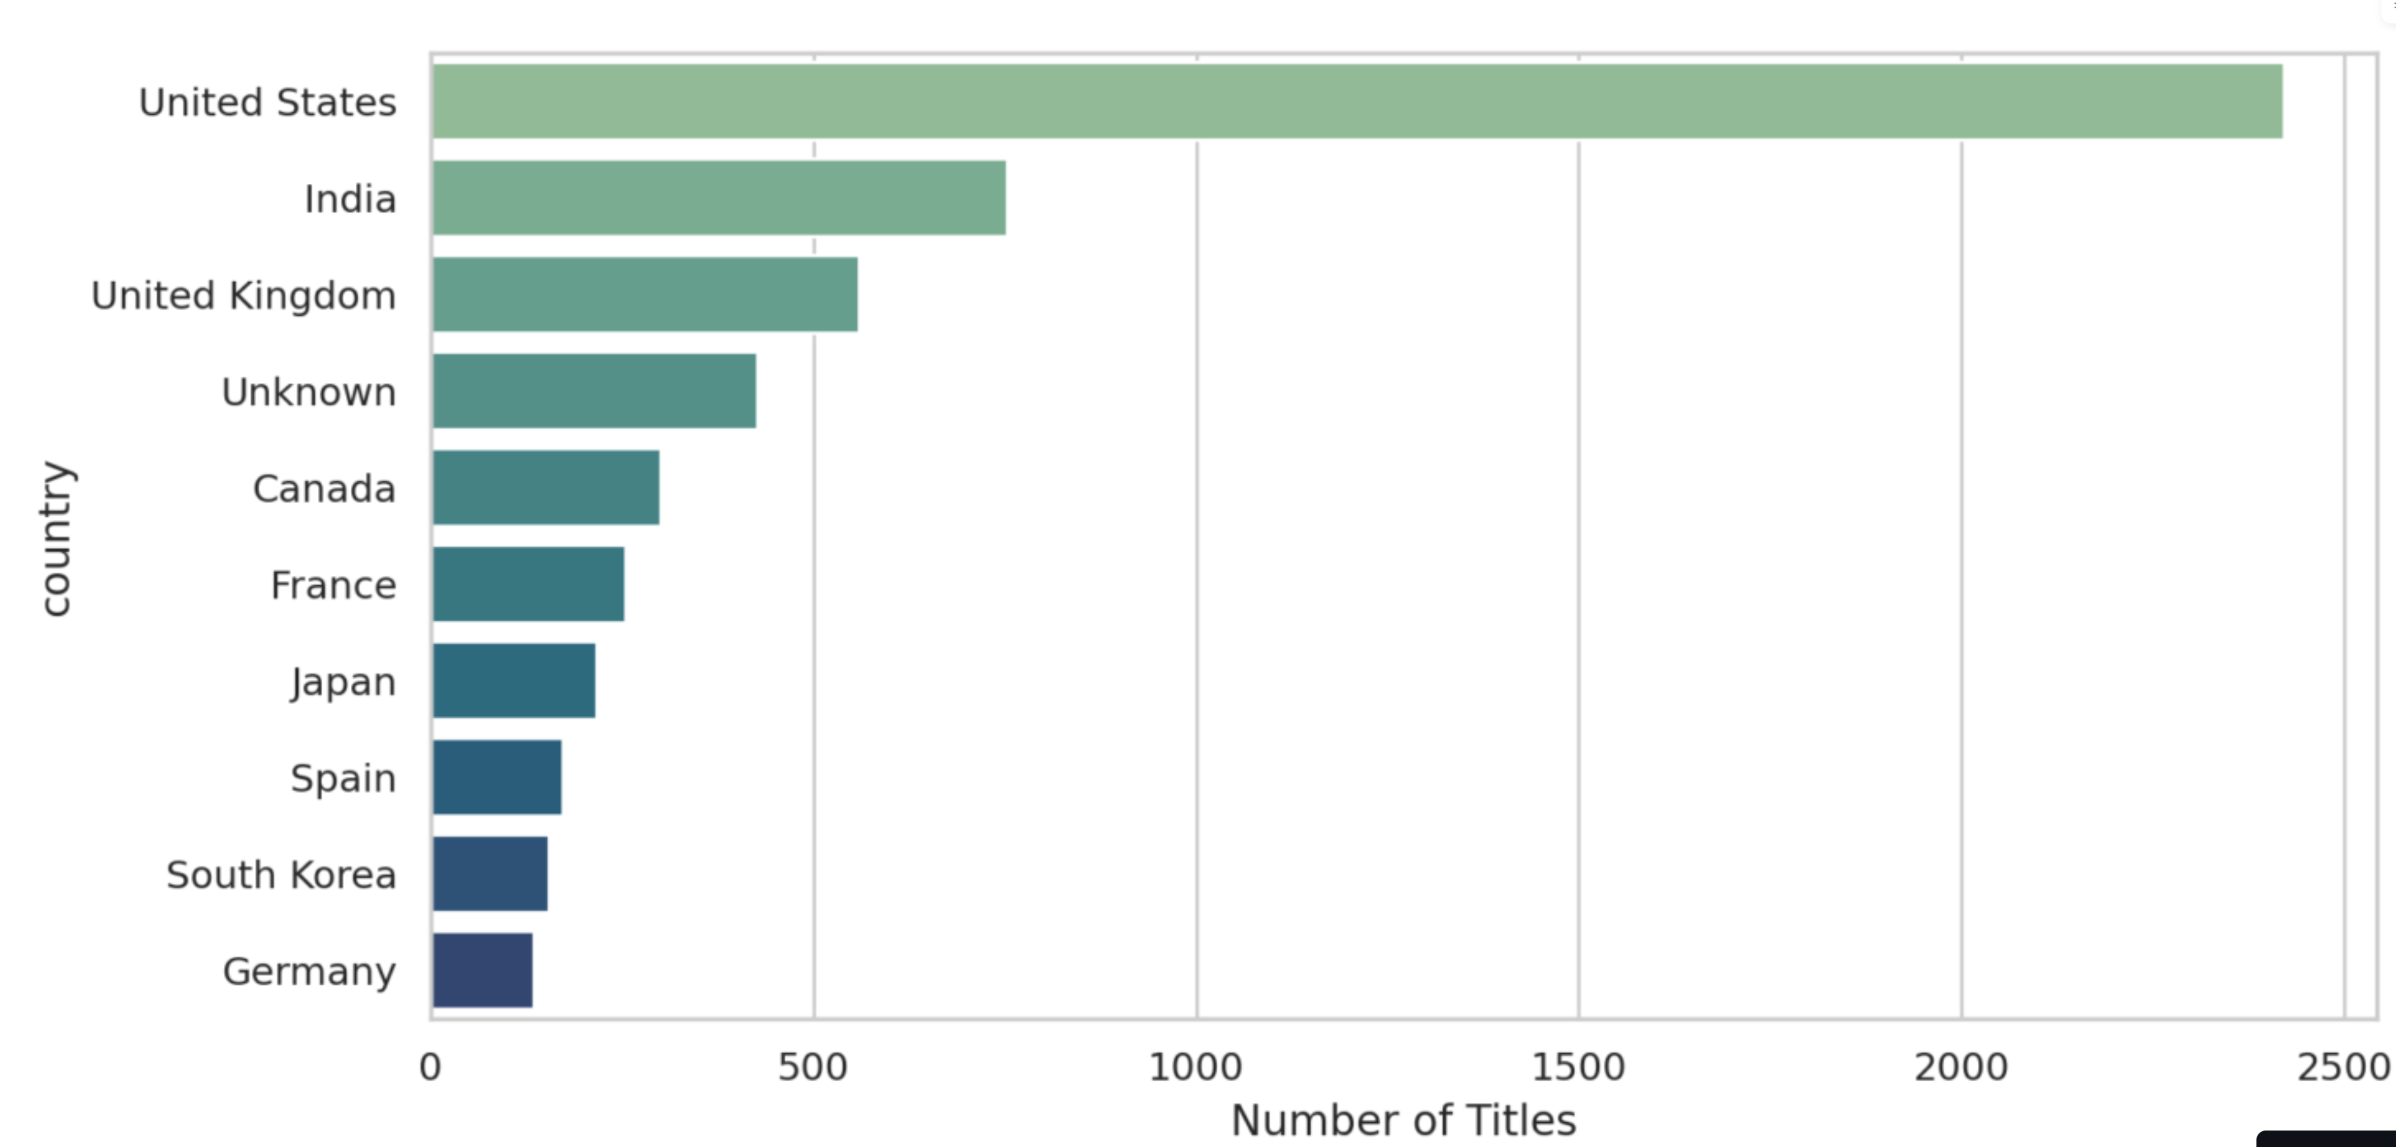
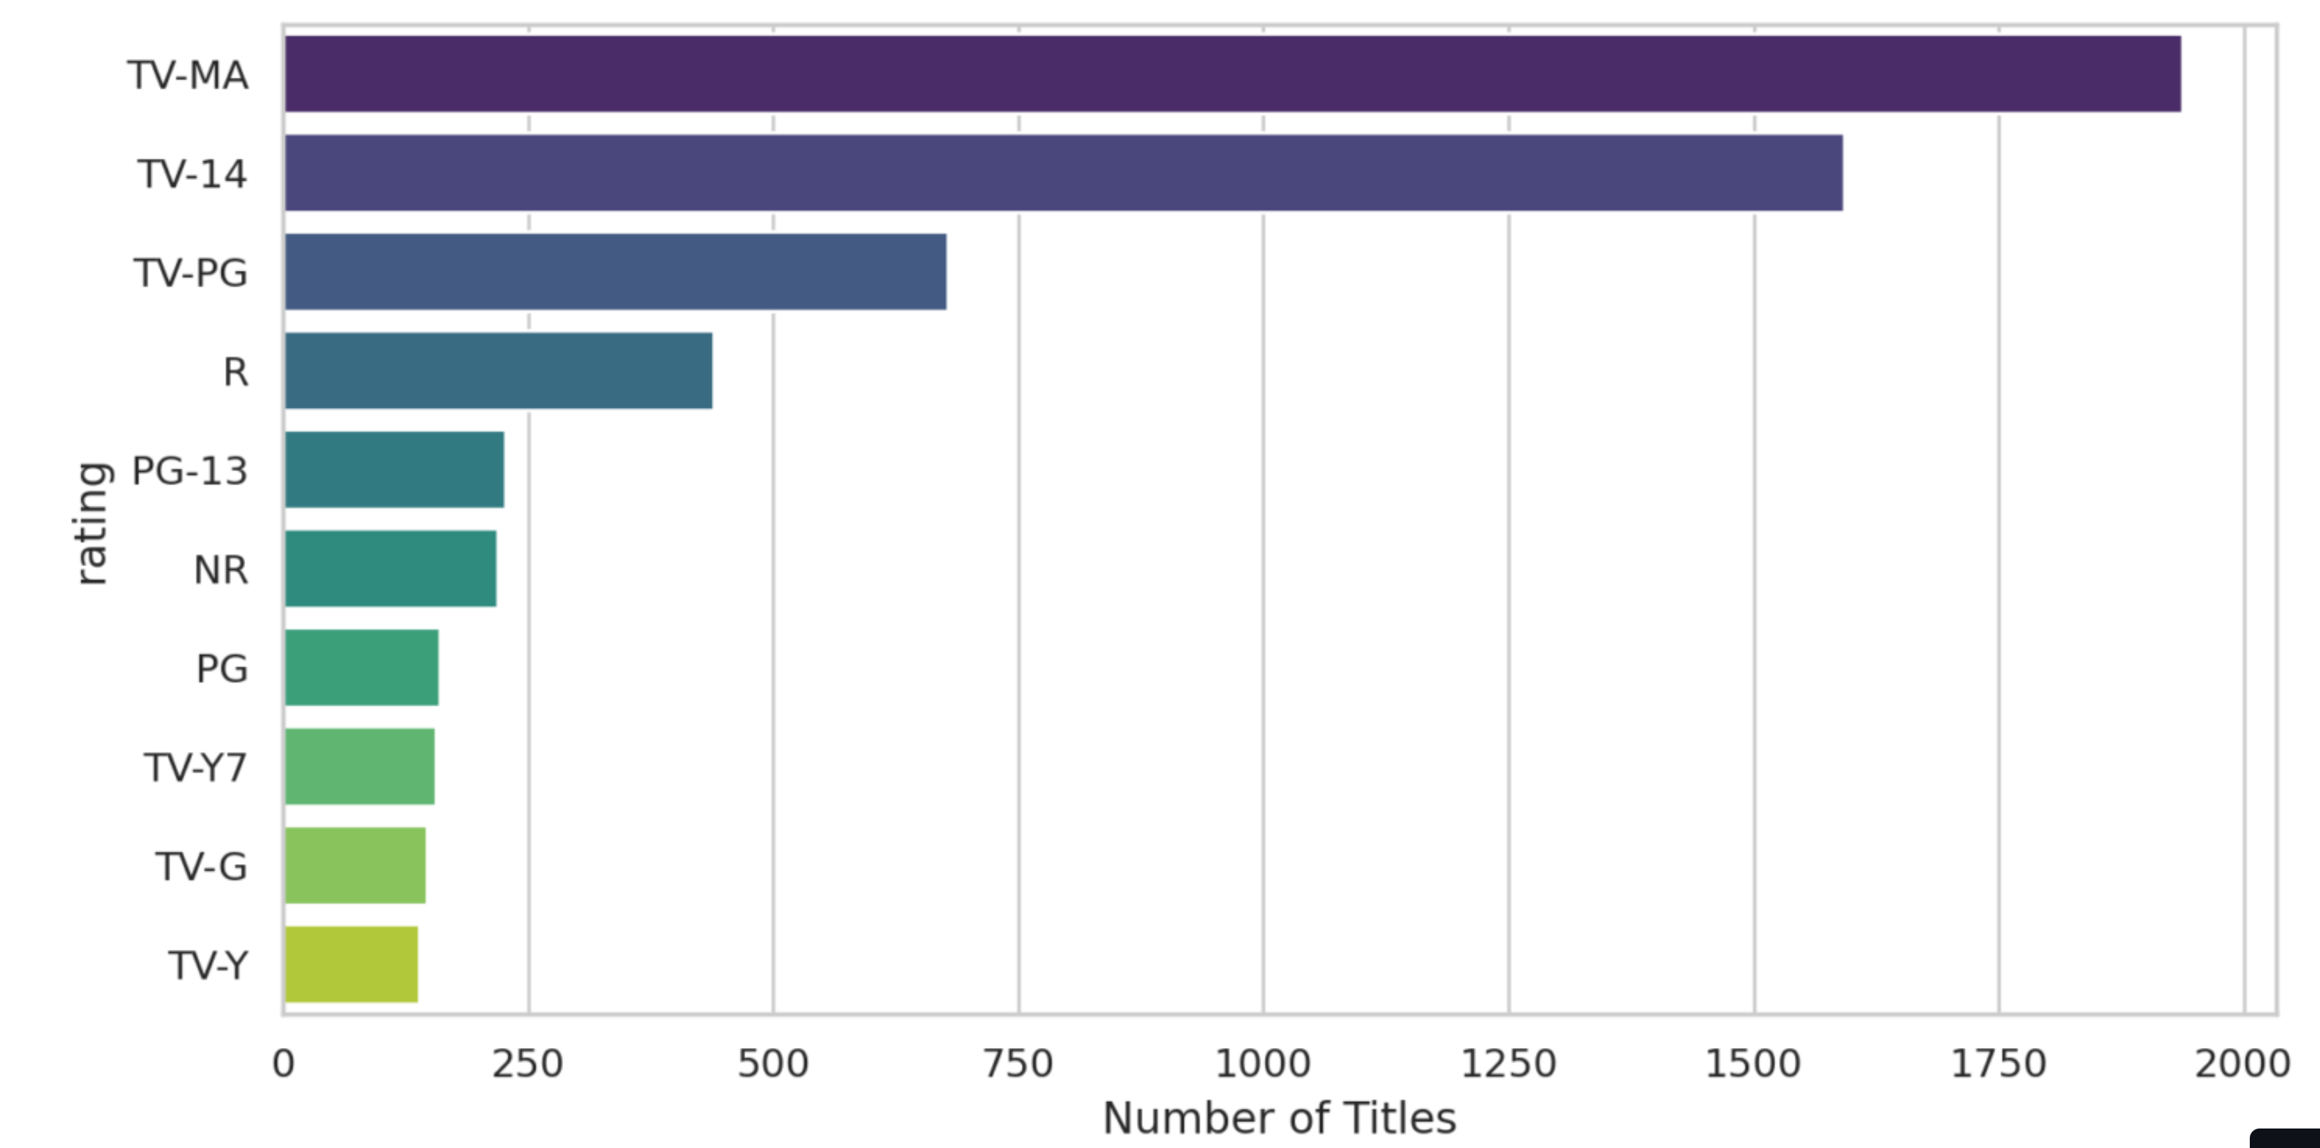
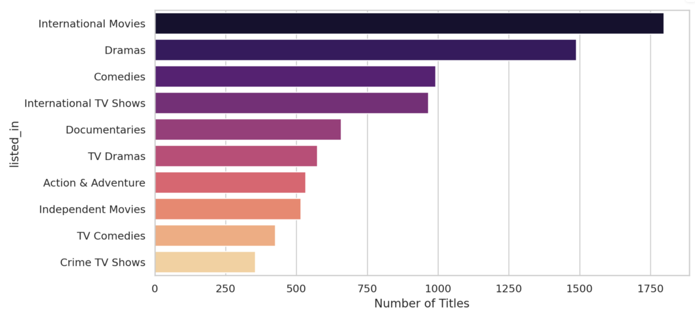
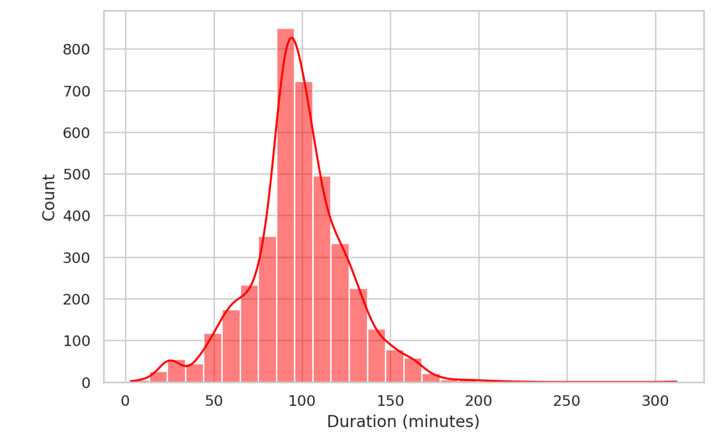
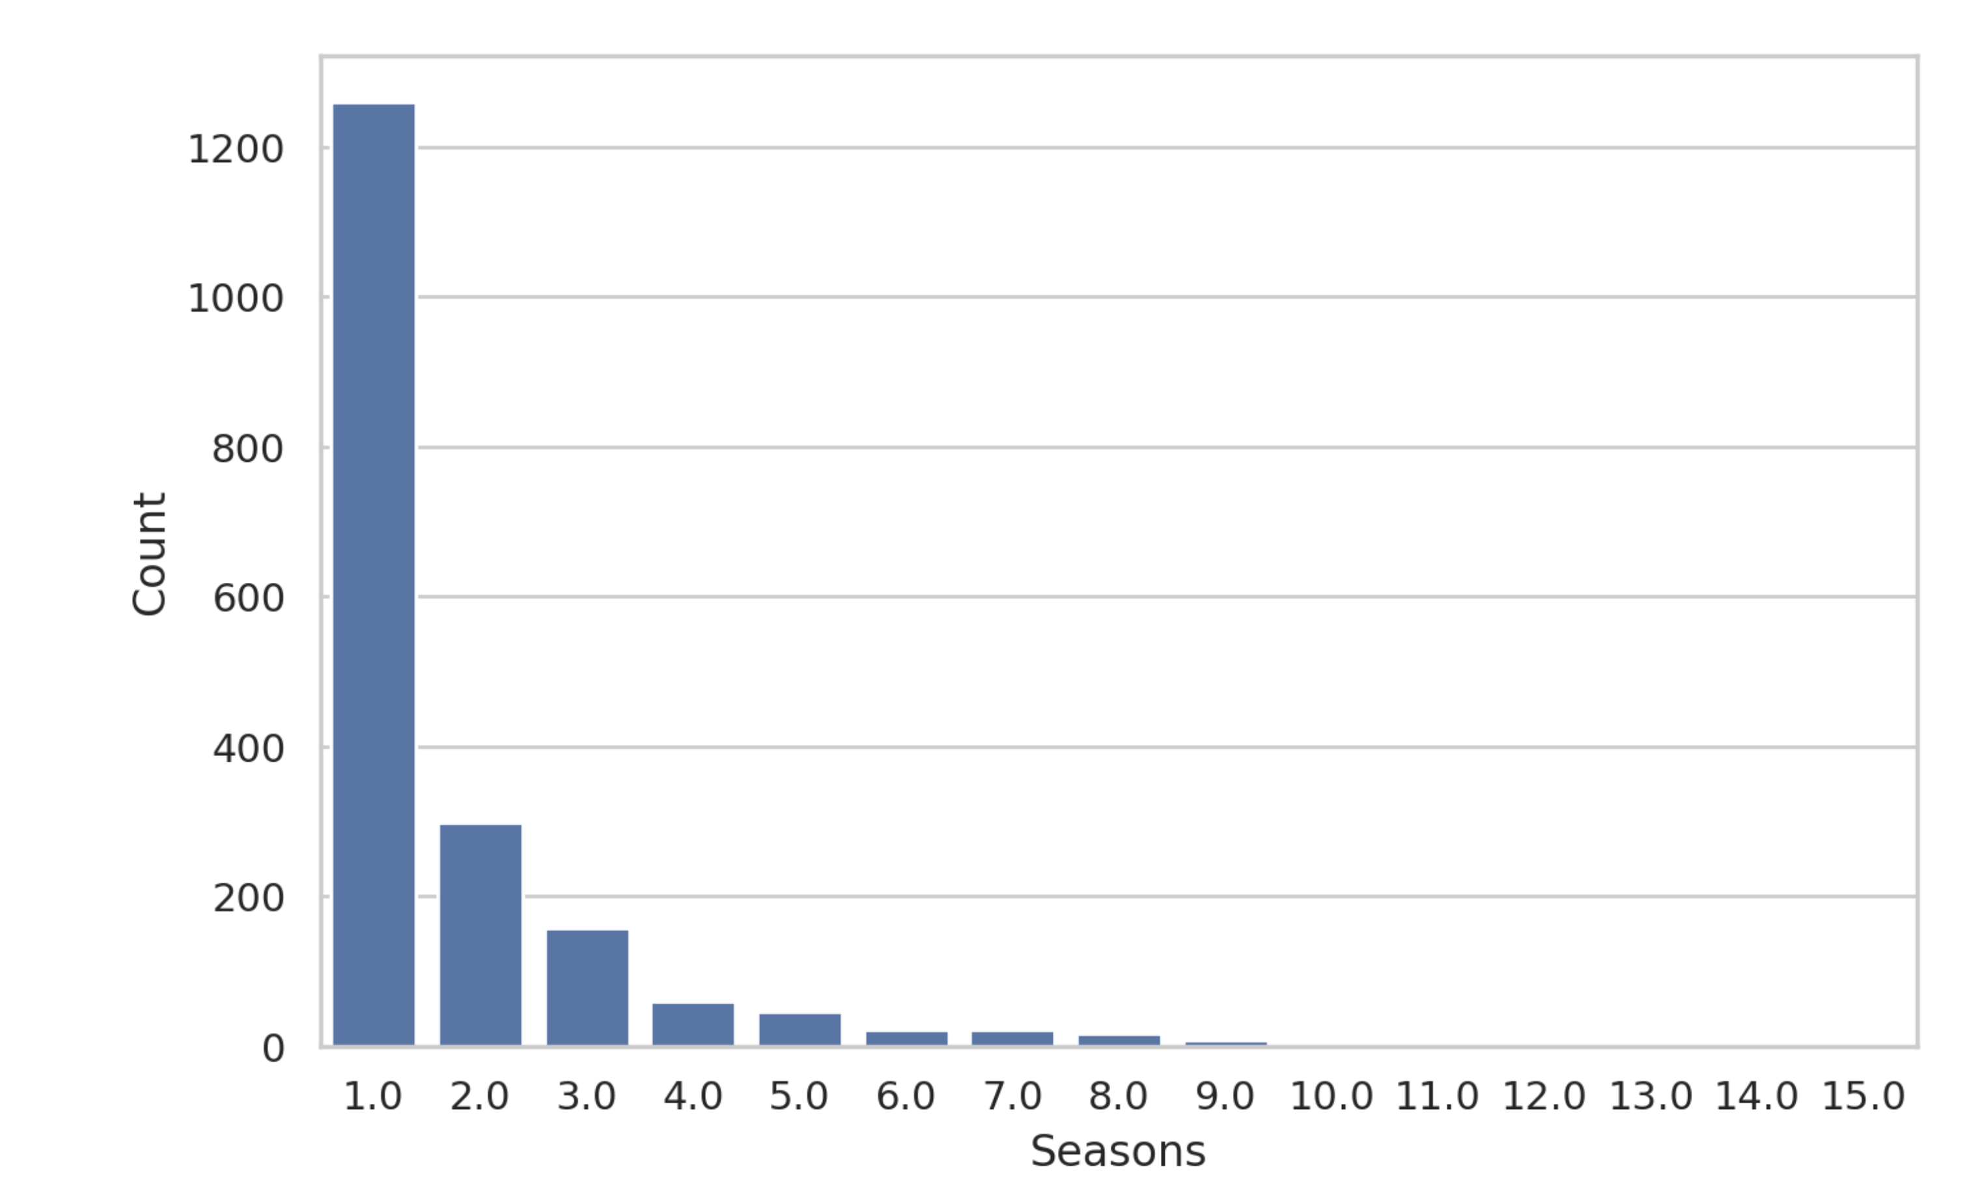
Exploratory Data Analysis
This slide shows the main visualizations created from the Netflix dataset.

Slide 8
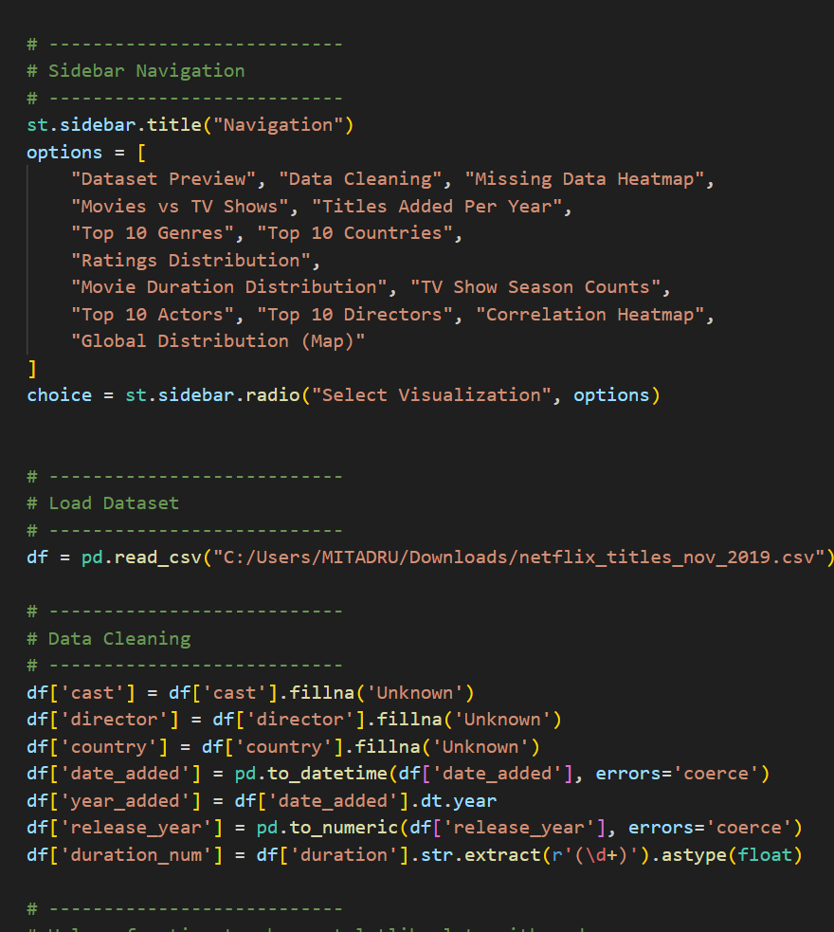
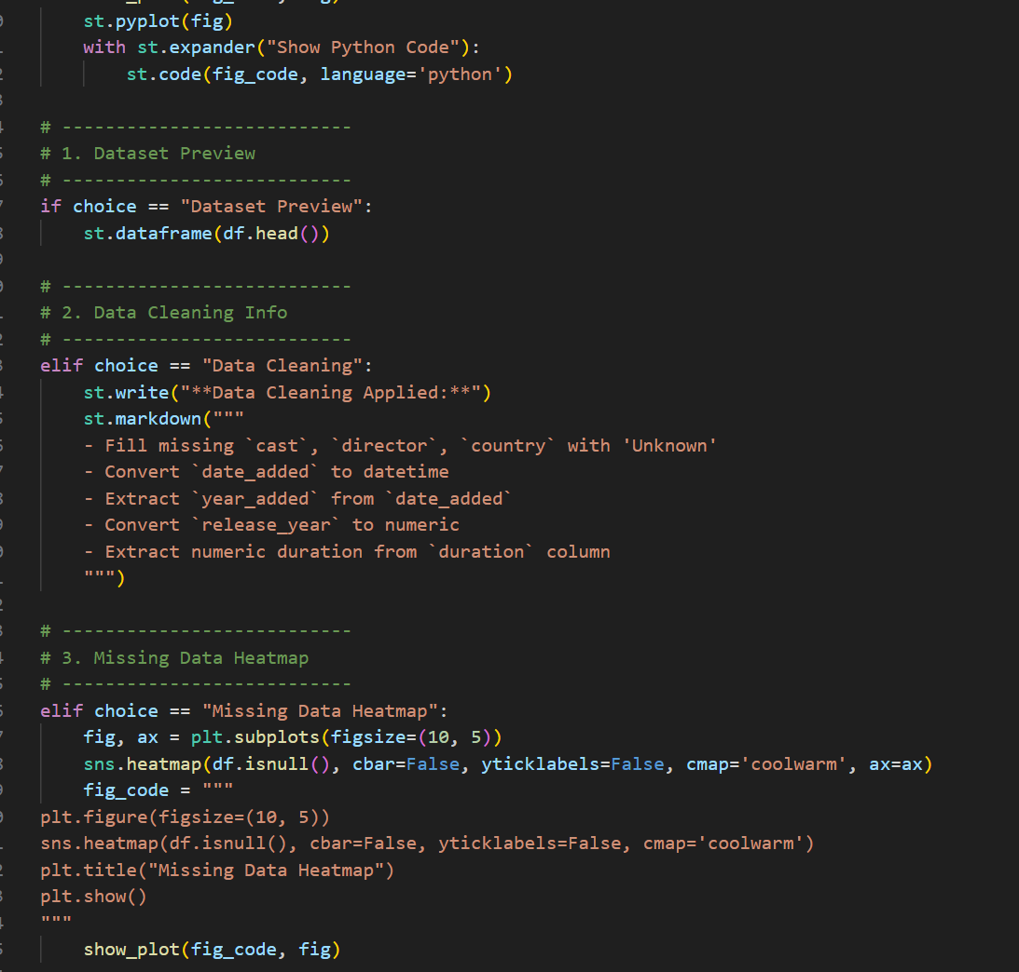
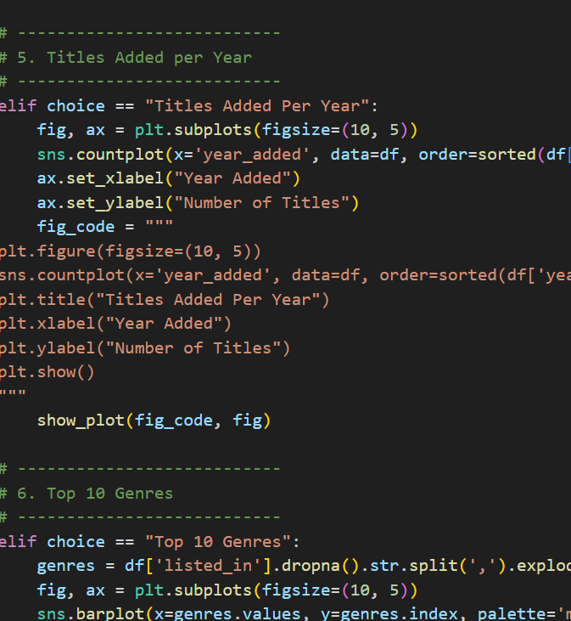
Code Implementation
This slide shows the recorded demonstration of the Python code powering the Netflix EDA dashboard.

Slide 9
Results / Findings
🟩 Key Discoveries:
70% of Netflix content are Movies
U.S. and India contribute the most titles
Most common ratings: TV-MA and TV-14
Content production increased sharply after 2015
Newer shows added faster (correlation between release year & year added)
✅ Summary: Visualizations reveal content trends, popular genres, countries, and ratings distribution.

Slide 10
Scope & Future Work
🟩 Scope:
Useful for media analysts to study Netflix trends.
Helps Netflix understand audience preferences.
Supports recommendation systems and content strategy.
🟩 Future Work:
Add filters: genre, country, rating.
Include IMDb ratings or other external data.
Apply machine learning for trend prediction or recommendations.

Slide 11
Conclusion
🟩 Summary:
Provided insights into Netflix content using EDA and visualization
Interactive dashboard makes data exploration easier
Highlights trends in content type, genres, countries, and ratings
✅ Takeaway:Helps viewers understand Netflix content trends clearly and interactively

Slide 12
Thank You! 🙏
Slide Content:
Any Questions?
Website: [https://netflix-database-eda.streamlit.app/]
Connect: [mitadru231001001117@technoindiaeducation.com/ www.linkedin.com/in/mitadru-karmakar-483274319 / https://github.com/Readerrss/Netflix-EDA]

