Slide 1
Finding Pneumo
Made by:
Krish Shah(2173102)
Raghav Bang(2173)
Mark Vaz(2173117)
Rayan Gandhi(2173)

Slide 2
Problem we are trying to solve
Detecting pneumonia in the lungs through Deep Learning Algorithms.
We are using the CNN (convolutional neural network) model to detect pneumonia in the x-ray image.
Using image data of labeled pneumonia and non-pneumonia images
Training data set is almost 6000 imagesSo basically the patient need not go to the doctor for diagnosis
HE or SHE just need an x-ray scan from a lab of their lungs
The images were of size greater than 1000 pixels per dimension and the total dataset was tagged large and had a space of 1.2 Gb

Slide 3
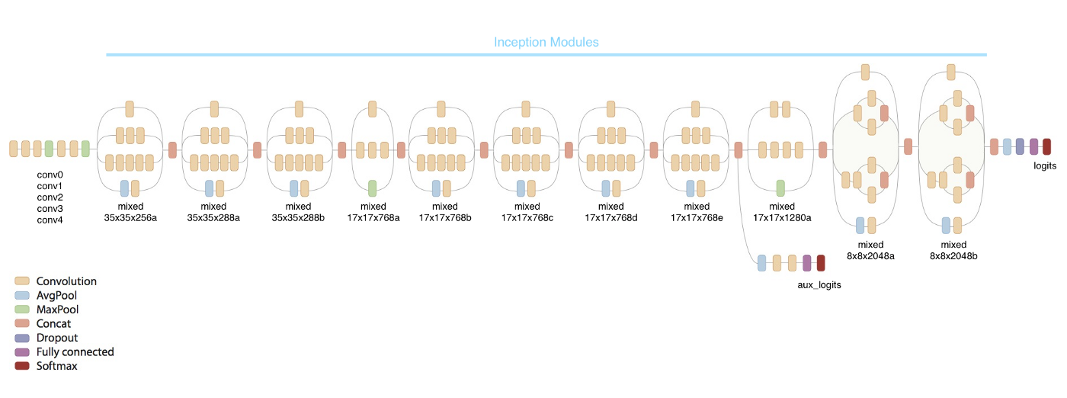
The inception model

Slide 4
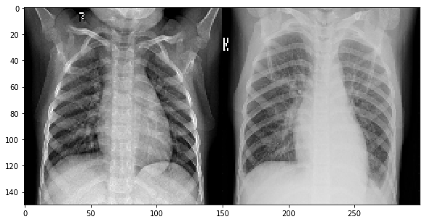
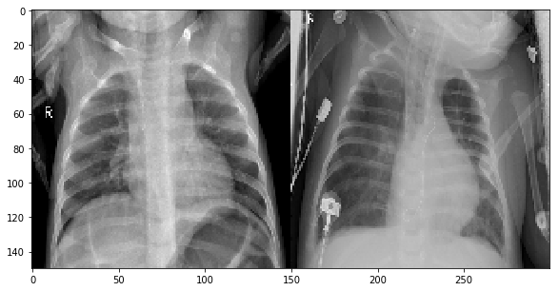
Pneumonia vs non Pneumonia
Sample Data

Slide 5
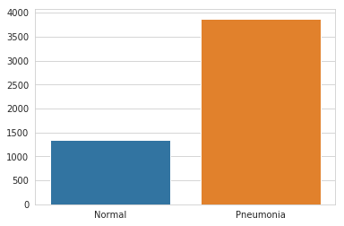
Training Set
Pneumonia affected samples are quite more than the normal ones in the dataset.

Slide 6
Tools We Are Using
Google colab for training the model
Kaggle Dataset of x ray images
Android app for patient to upload images
Jupyter notebook for testing the model

