Slide 1
Build Angular 2 Apps
Pavel Kyurkchiev
PhD. candidate
@pkyurkchiev
https://github.com/pkyurkchiev

Slide 2


Slide 3

Notes:
Build from scratch
More faster
What phone you have before 5 years, ago

Slide 4
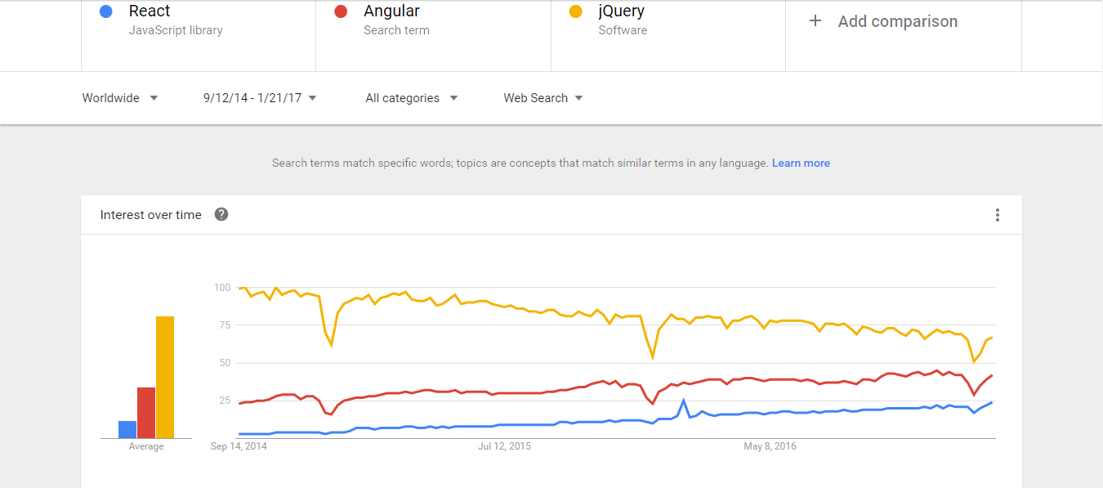

Slide 5
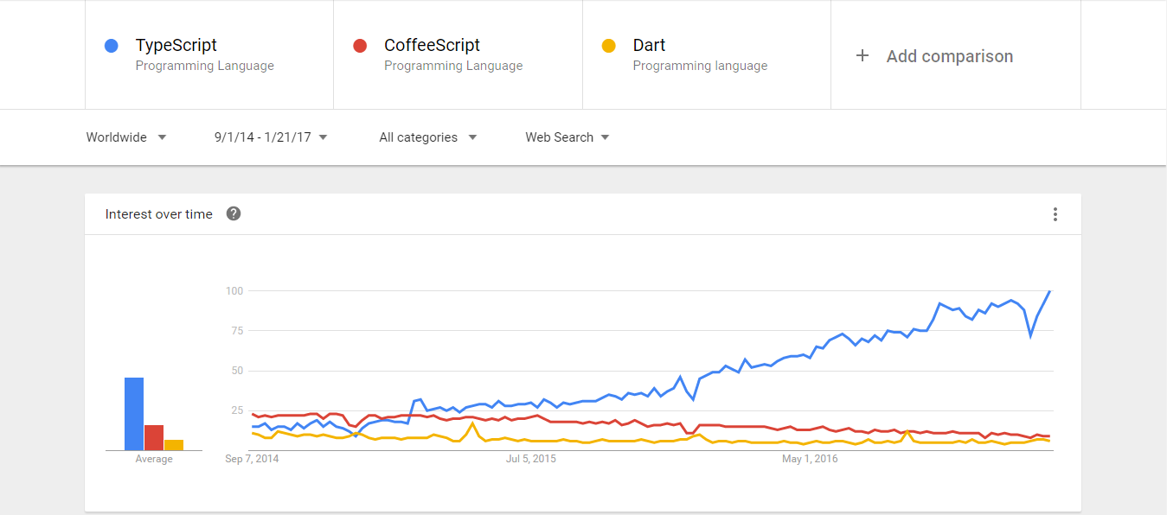

Slide 6
Deliver Optimized and Smaller Code to the Clients
Tree Shaking
Offline Compilation
Our App
Min

Slide 7
TypeScript -types -annotations
ES6 -classes -modules
ES5

Slide 8
Familiar Concepts
Services
Components
HTTP
Events
Data Binding

Slide 9
Components
A component contains application logic that controls a region of the user interface that we call a view.

Slide 10
import {Component} from '@angular/core'; import {Vehicle} from './vehicle.service'; @Component({ moduleId: module.id, selector: 'story-vehicles', templateUrl: 'vehicles.component.html' }) export class VehicleListComponent { vehicles: Vehicle[]; }
Anatomy of Component

Slide 11
App from Components
App Components
Header Component
Nav
Component
Content Component
Footer Component

Slide 12
demo Components

Slide 13
Templates
Templates are mostly HTML, with a little help from Angular. They tell Angular hot to render the Component.

Slide 14
<ul> <li *ngFor="let character of characters"> {{ character.name }} </li> </ul> <my-character *ngIf="selectedCharacter" [character]="selectedCharacter"></my-character>
Templates

Slide 15
Connecting the Component to its Template
<>
Component
Template

Slide 16
@Component({ moduleId: module.id, selector: 'story-vehicles', templateUrl: 'vehicles.component.html' }) export class VehicleListComponent { }
Linked Templates with Component

Slide 17
Templates Contain Other Components
Root
Component
Root
Template
<>
Child A
Component
Child A
Template
Child B
Component
Child B
Template
<>
<>
Grandchild
Component
Grandchild
Template
<>

Slide 18
Metadata links the Template to the Component
Component
Metadata
<>
Template

Slide 19
Demo templates

Slide 20
Data Binding
We use data binding to help coordinate communication between a Component and its Template.

Slide 21
{{ expression }}
Interpolation
[property] = “expression”
One Way Binding
(event) = “statement”
DOM
Event Binding
Component
[(ngModel)] = “property”
Two Way Binding

Slide 22
Benefits of Angular 2 Unidirectional Data Flow
Easies 3-rd party widget integration
No more $apple
No more repeated digest cycles
No more watchers
No more performance issues with digest cycle and watcher limits

Slide 23
<h3>Vehicle: {{vehicle.name}}</h3> <div> <img src="{{vehicle.imageUrl}}" /> <a href="{{vehicle.wikiLink}}"Wiki></a> </div>
Interpolation - one way in

Slide 24
<img [src]="vehicle.imageUrl" /> <vehicle-detail [vehicle]="currentVehicle"></vehicle-detail> <div [ngClass]="{selected: isSelected}">X-Wing</div>
Property Binding - one way in

Slide 25
Event Binding Using the () to send events from the Template to the Component

Slide 26
<button (click)="save()">Save</button> <vehicle-detail (changed)="vehicleChanged()"></vehicle-detail>
Event Binding – one way to the component

Slide 27
Two Way Binding [()] sends a value from Component to Template, and sends changes in the Template to the Component

Slide 28
<input [(ngModel)]="vehicle.name" />
To Way Binding – value in, value out

Slide 29
Demo data Binding

Slide 30
Built-In Directives
When Angular renders templates, it transforms the DOM according to instructions from Directives

Slide 31
<div *ngIf="currentVehicle"> You selected {{currentVehicle.name}} </div>
*ngIf – conditional template
Conditionally removes elements from the DOM Structural directive
Use [style.visibility]=“isVisible()” to hide

Slide 32
<ul> <li *ngFor="let character of characters"> {{ character.name }} </li> </ul>
*ngFor – repeating a template
Structural directive
Show an element n number of times

Slide 33
Angular Modules
We use NgModule to organize our application into cohesive blocks of related functionality.

Slide 34
Angular Modules Organize Functionality
Angular Module
Component
{ }
Component
{ }
Component
{ }
Service
{ }

Slide 35
Angular Module is a class decorated by @NgModule

Slide 36
Roles of Angular Models
Import other Angular Modules
Identify Components Pipes, and Directives
Export its features
Provide services to injectors
Can be eagerly or lazily loaded

Slide 37
Every app begins with one Angular Module

Slide 38
@NgModule({ imports: [ BrowserModule, FormsModule ], declarations: [ VehiclesComponent ], providers: [ VehicleService ], bootstrap: [VehiclesComponent], }) export class AppModule { }
Root Angular Module

Slide 39
Services Service provides everything our application needs. It often shares data or functions between other Angular features.
{ }

Slide 40
Services
Angular 1
Angular 2
Factories
Services
Providers
Class
Constants
Values

Slide 41
@Injectable() export class VehicleService{ getVehicles(){ return [ new Vehicle(1, 'Falcon'), new Vehicle(2, 'X-Wing Fighter') ]; } }
Service

Slide 42
Demo Modules

Slide 43
Dependency Injection
Injector
{ }
Dependency Injection is how we provide an instance of a class to another Angular feature.
{ }

Slide 44
export class VehicleListComponent { vehicles: Vehicle[]; constructor(private vehicleService: VehicleService) { } }
Injecting a Service into a Component

Slide 45
@Injectable() export class VehicleService{ constructor(private http: Http) { } getVehicles(){ return this.http.get(vehiclerUrl) .map((res: Response) => res.json().data); } }
Injecting a Service into a Service

Slide 46
When we inject a service, Angular searches the appropriate injectors for it
Component

