Slide 1
Intro to nodejs
Pavel Kyurkchiev
PhD. candidate
@pkyurkchiev
https://github.com/pkyurkchiev

Slide 2
What change in the last decade…
RUP && UML
C# || Java
SQL || Oracle
Hyper-V || Vmware
Out-sourcing
SOA
Agile && Scrum
JavaScript || Python
NoSql
Docker
Cloud
Micro services

Slide 3
What is NodeJS
Allow you to build scalable network applications using JavaScript on the server-side.

Slide 4
It is fast because its mostly C code
NodeJS
V8 JavaScript Runtime

Slide 5
What we can build?
Websocket Server
Fast File Upload Client
Ad Server
Any Real-Time Data Apps

Slide 6
APPLICATION
NODE.JS
BINDINGS
(NODE API)
LIBUV
(ASYNCHRONOUS I/O)
JAVASCRIPT
EVENT QUEUE
WORKER THREADS
BLOCKING OPERATION
V8
(JAVASCRIPT ENGINE)
FILE
NETWORK
OS OPERATIONS
EVENT LOOP
PROCESS
EXECUTE CALLBACK

Slide 7
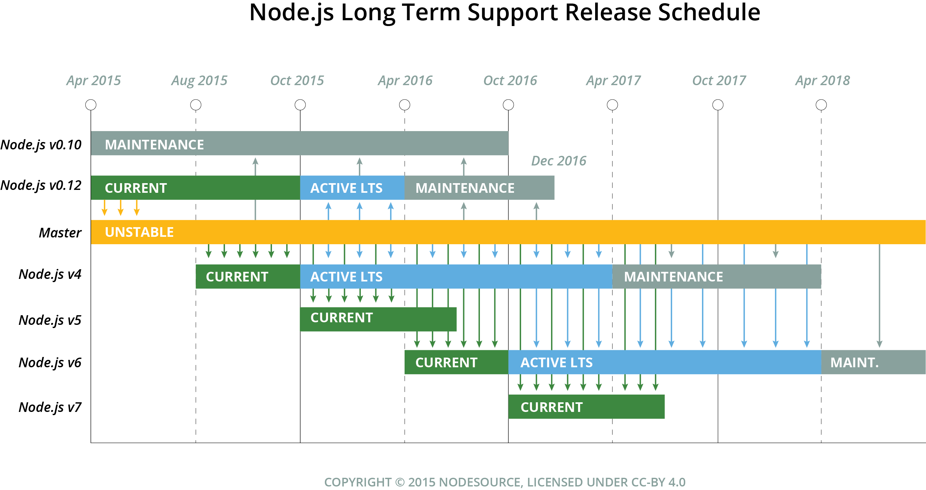

Slide 8

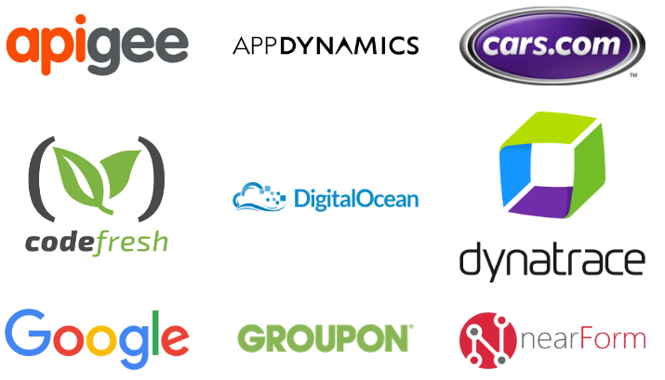

Slide 9
Ryan Dahl – Why JS
JavaScript has certain characteristics that make it very different that other dynamic languages, namely that it has no concept of threads. Its model of concurrency is completely based around events.

Slide 10
JavaScript value and types
Primitive values
Boolean
Number
String
Null
Undefined
Objects
Date
Structured data
Collections
Functions
Classes (ES6)

Slide 11
Demo javascripts
ex1

Slide 12
JavaScript variables and blocks
Function scope:
var a = 42;
Block scope:
let b = 16;
Const:
const AGE = 7;
Notes:
function varTest() { var x = 1; if (true) { var x = 2; // same variable! console.log(x); // 2 } console.log(x); // 2 }
function letTest() { let x = 1; if (true) { let x = 2; // different variable console.log(x); // 2 } console.log(x); // 1 }

Slide 13
JavaScript operators
EQUAL
a = 1;
a = a + 2; a += 2;
EQUALITY
a == b a != b
a === b a !== b
FALSE VALUES:
0 -0
””
false
null
undefined
if(){}
Notes:
a == b (loose-equals)
a === b(strict-equals)
a != b (loose-not-equals)
a !== b (strict-not-equals)

Slide 14
Callbacks...

Slide 15
Blocking and Non - Blocking
Blocking code
Non – Blocking code
Read file from filesystem, set equal to “contents”
Print contents
Do something else
Read file from filesystem
Do something else
Print contents

Slide 16
What is callback function?
In JavaScript, functions are first-class objects. Functions are type Object and they can be used in a first-class manner like any other object (String, Array, Number, etc.). Because functions are first-class objects, we can pass a function as an argument in another function and later execute that passed-in function or even return it to be executed later.

Slide 17
function some_function(arg1, arg2, callback) { var my_number = Math.ceil(Math.random() * (arg1 - arg2) + arg2); callback(my_number); } some_function(5, 15, function(num) { console.log("callback called! " + num); });
Callback function

Slide 18
Demo javascripts
ex2.0, ex2.1

Slide 19
NodeJS Module Patterns
NodeJS has a simple module loading system. In NodeJS, files and modules are in one-to-one correspondence (each file is treated as a separate module).

Slide 20
//file square.js module.exports = (width) => { return { area: () => width * width }; } //file export.js const square = require('./square.js'); var mySquare = square(2); console.log(`The area of my square is ${mySquare.area()}`);
Module Pattern in NodeJS

Slide 21
Demo nodejs module
ex3

Slide 22
Node Package Manager (NPM)
NPM is the default package manager for the JavaScript runtime environment Node.js and allows users to consume and distribute JavaScript modules that are available on the registry.

Slide 23
NPM console
npm init
npm install {package} [{package}]
npm install {package} --save
npm install {package} --save-dev
npm publish

Slide 24
Demo Npm
ex2.2

Slide 25
ExpressJS package
Express is a minimal and flexible Node.js web application framework that provides a robust set of features to develop web and mobile applications. It facilitates the rapid development of Node based Web applications.

Slide 26
What is REST?
Use HTTP/HTTPS
Use Verbs - GET, POST, PUT, DELETE
Use Status codes - 200, 201, 400, 403, 404
Caller dictates formats – Content-Type & Accept

Slide 27
Web apps using NodeJS. MVC application
User
Controller
Model
View

Slide 28
Demo expressjs
ex4

Slide 29
Unit testing
Mocha – JavaScript test framework
Chai – assertion library
Request – created request to APIs
The TDD (Test-Driven Development) method is the most commonly used approach when testing node applications.

Slide 30
Demo unit test
ex5

