Slide 1
Football Fixtures (EPL Fixtures) Using Genetic Algorithms - Team 105
Team Members :
Aditi Jalkote
Mitali Salvi
Shubham Sharma

Slide 2
Problem statement
Football Fixture is a NP complete problem and can be easily solved using Genetic Algorithm.
This create fixtures of the English Premier League (EPL) by taking Input as team names, match locations and the start date.

Slide 3
Hard constraints used for creating the fixtures:
Number of Rounds in the league: 2
A team cannot play with itself
Each team plays exactly 2(I.e. number of rounds) matches against each team in the league
Each team plays [total number of matches – number of rounds] matches in the league
Each team plays exactly one match at its own home ground and one match at opponent’s home ground. (One – home, One - away)
Two matches cannot take place on the same day and same location
A team cannot play 2 matches on the same day

Slide 4
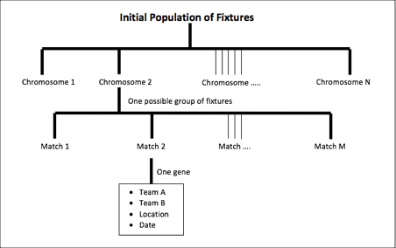
Basic Layout

Slide 5
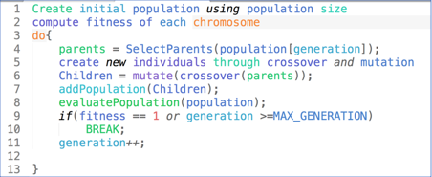
Pseudo Code for genetic Algorithm

Slide 6
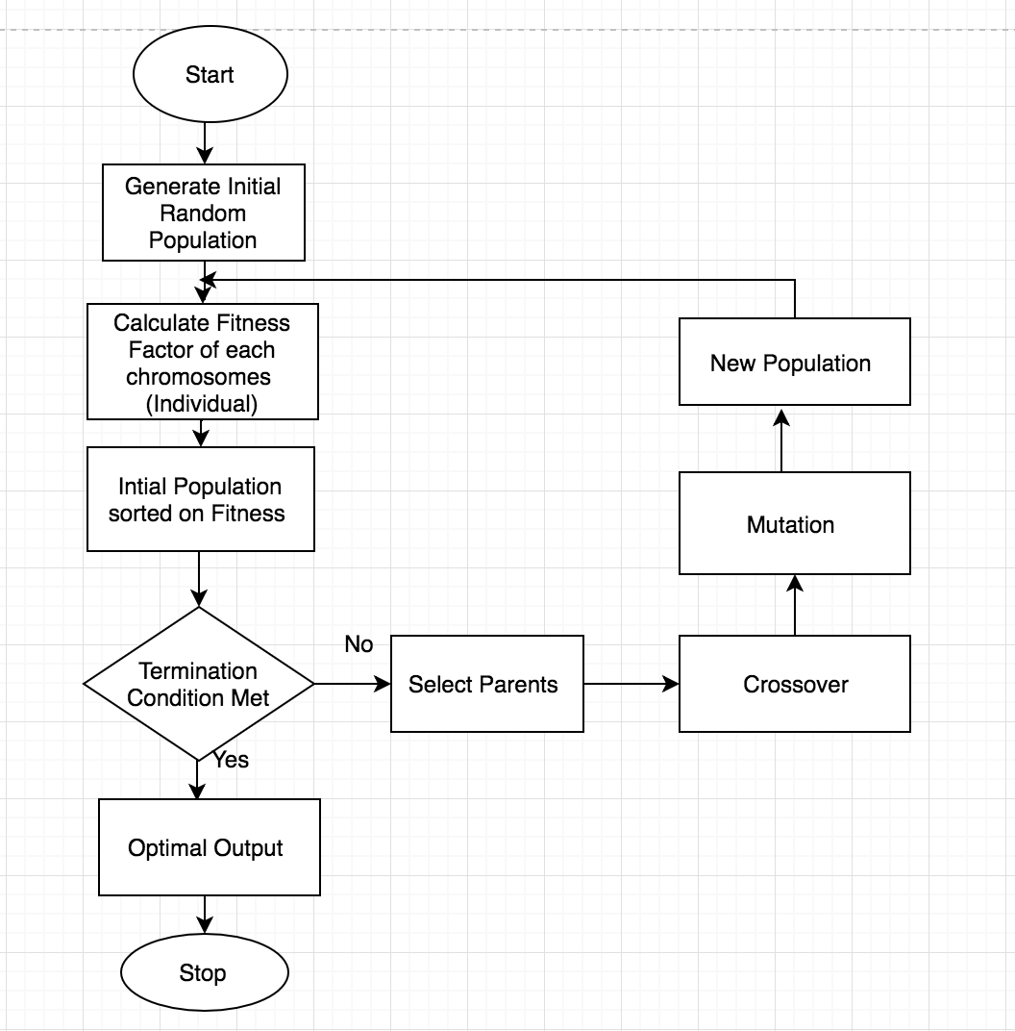
Flowchart

Slide 7
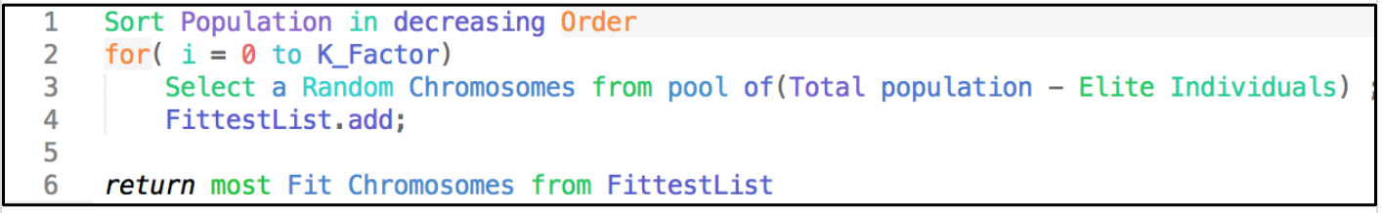
Pseudo Code for Parent Selection
By using K-Tournament selection

Slide 8
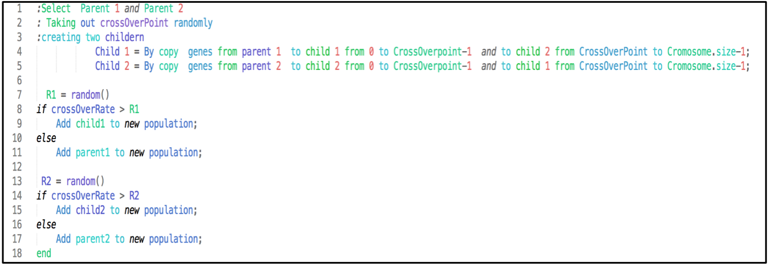
Crossover
Pseudo code for Crossover

Slide 9
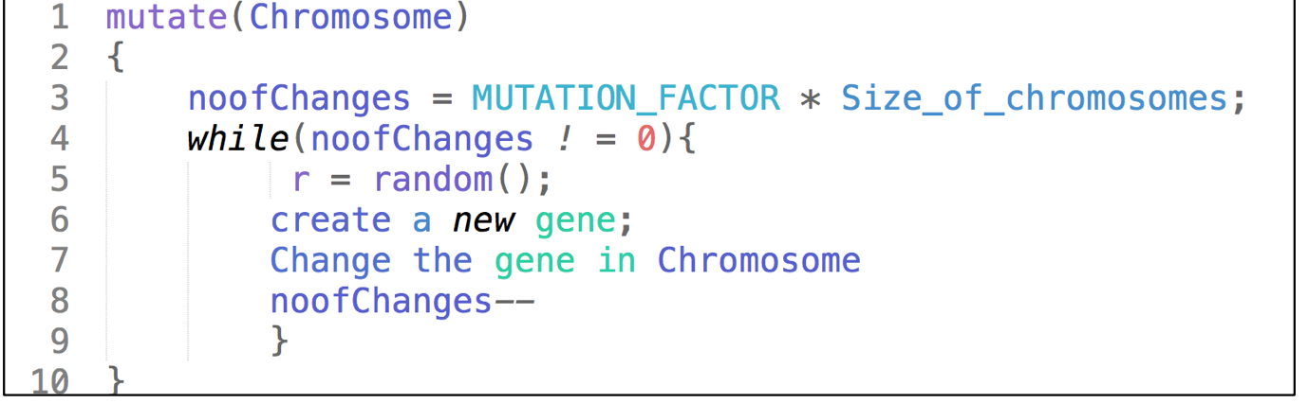
Mutation

Slide 10
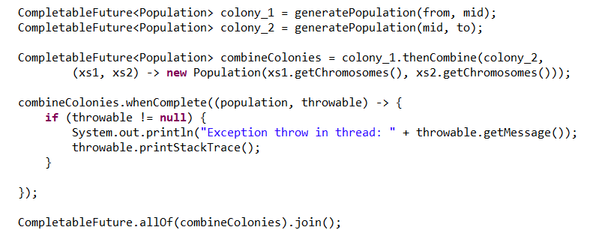
Optimization
Parallel Processing

Slide 11
Continued
Use of Symbol Table: For efficient search operations and improved indexing, symbol tables were used instead of other data structures. Hash – maps were used to store the various matches and its location to determine the fitness of a chromosome.
Use of Knuth Shuffle: Knuth shuffle was before sorting the population to avoid any element of bias/pattern in the collection to be sorted
Use of Comparable Interface: The comparable interface was implemented in the Chromosome class to compare 2 chromosomes based on its fitness. This was helpful in determining the fittest chromosome which creating a new generation.
Use of Hash-Code and equals method: These methods were implemented in the Match class to compare 2 matches. All the attributes of the match were considered for generation of both the methods.

Slide 12
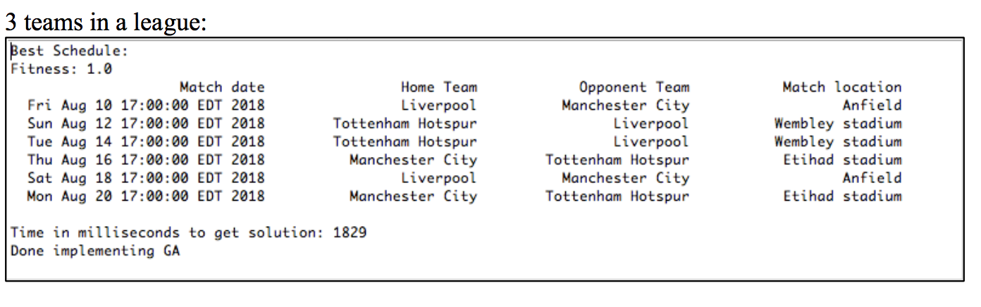
Program Output

Slide 13
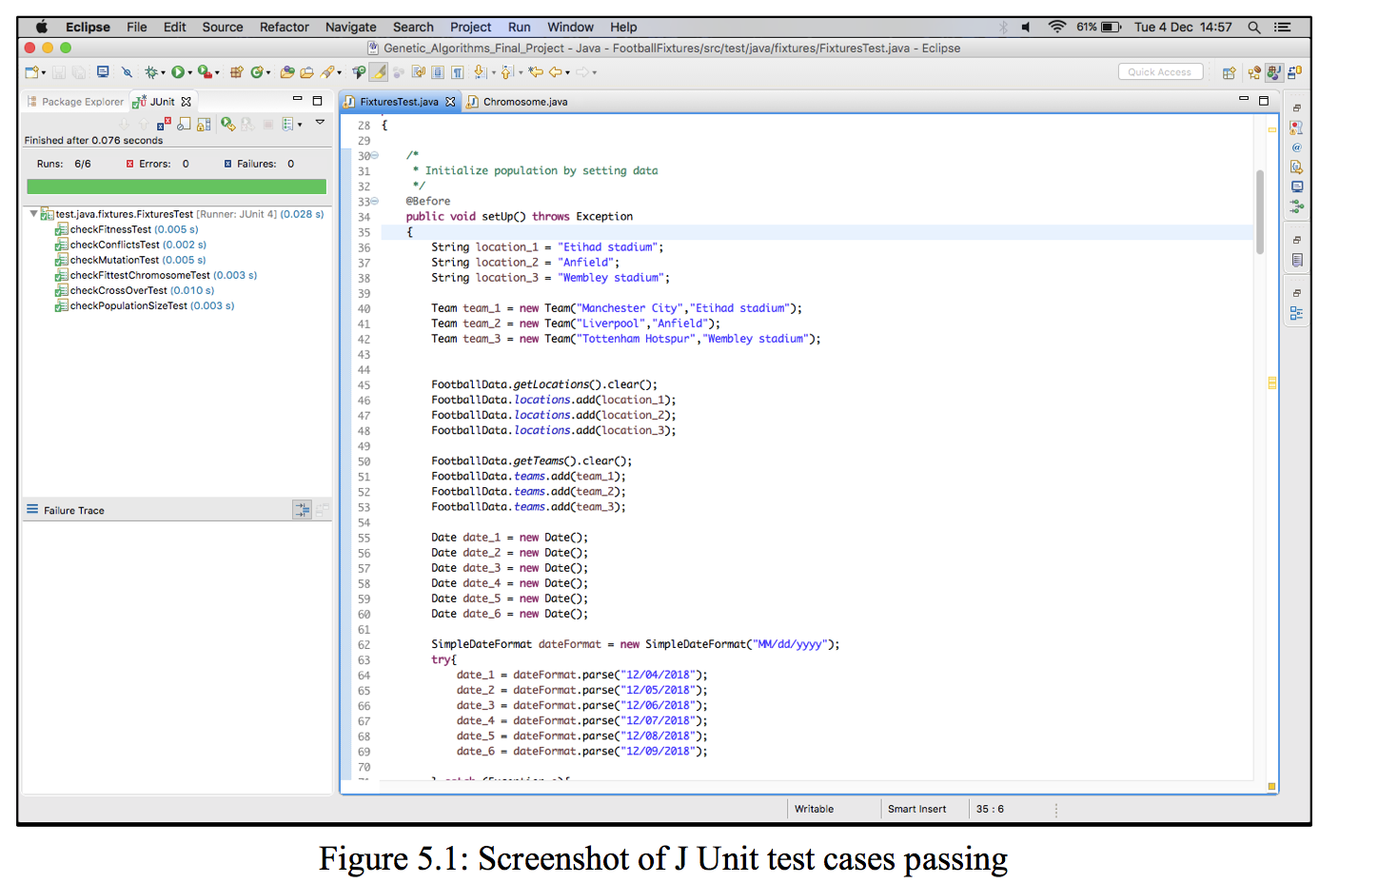
Unit test cases

Slide 14
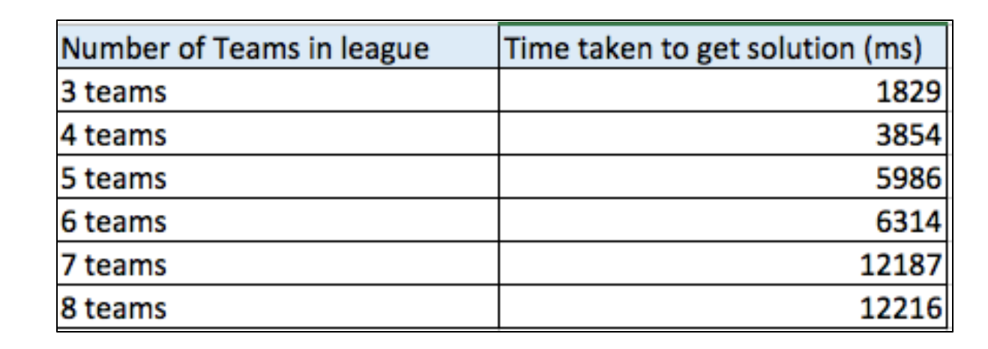
Observations

Slide 15
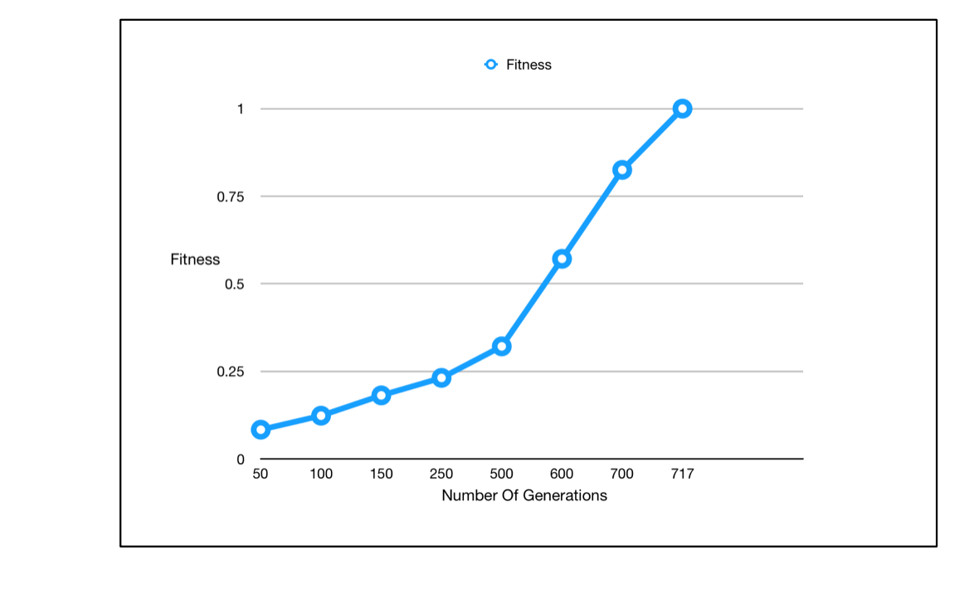
Observation

Slide 16
Thank you

