Slide 1
Low Cost 10 Mbps POF Link for Digital Transmission
Siddhi Bagul, Mitali Meratwal, Sheel Shah
(TUE-JJ-7-1)

Slide 2
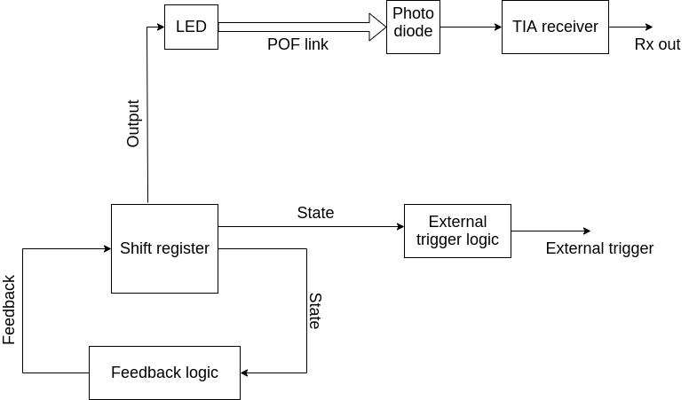
Block Diagram

Slide 3

DEMO Video

Slide 4
LMH6629 VS. TL082
LMH6629 | TL082
Bandwidth 900 MHz (3dB) | Bandwidth 4 MHz (GBP)
Slew rate 1600 V/ us | Slew rate 13V/us
Noise Voltage 0.69 nV/√Hz | Noise Voltage 25 nV/√Hz
LMH6629: LMH6629
TL082: TL082

Slide 5
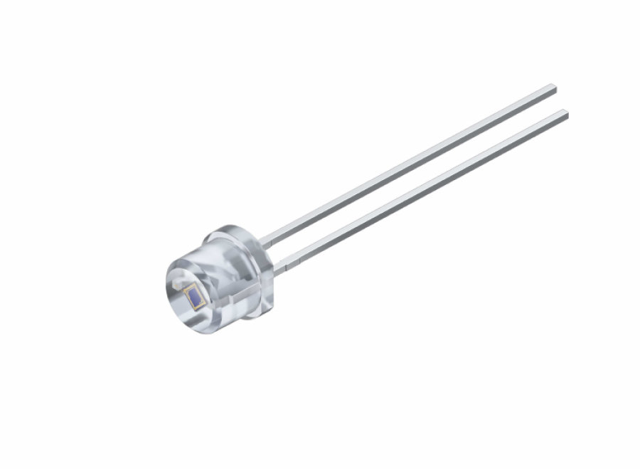
Photodiode (SFH203P)
Photocurrent ≥ 5uA
Switching time 5 ns (Typ.)
Image Source: https://www.osram.com/ecat/Radial%20T1%203-4%20SFH%20203%20P/com/en/class_pim_web_catalog_103489/prd_pim_device_2219552/

Slide 6
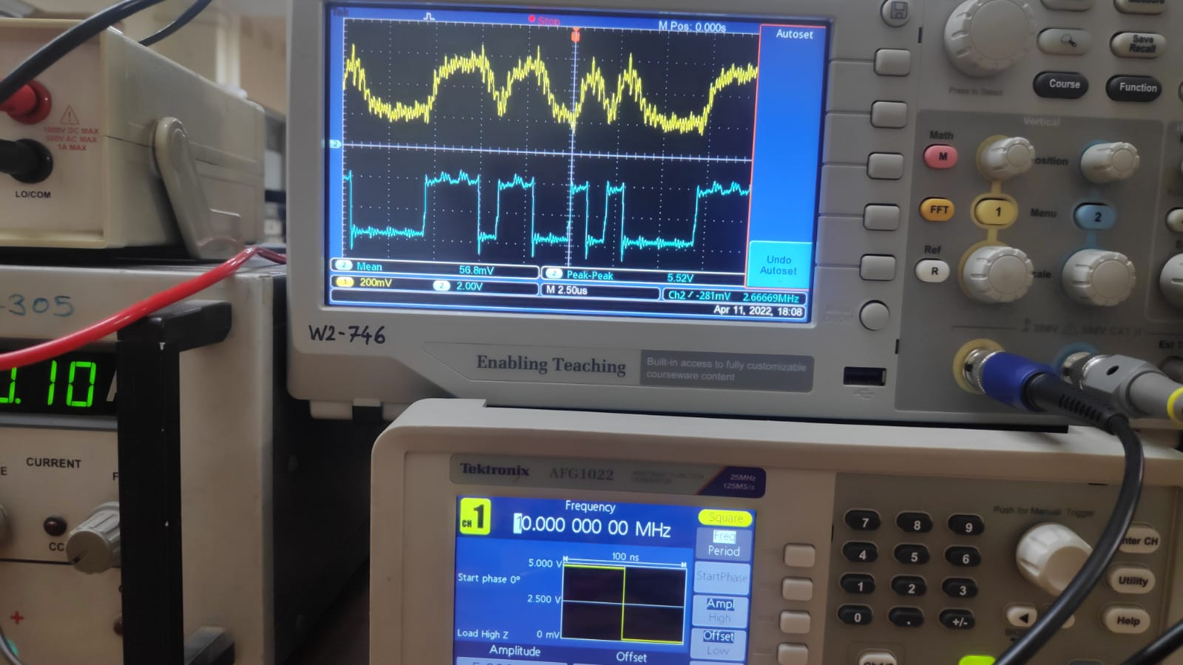
APPENDIX - I

Slide 7
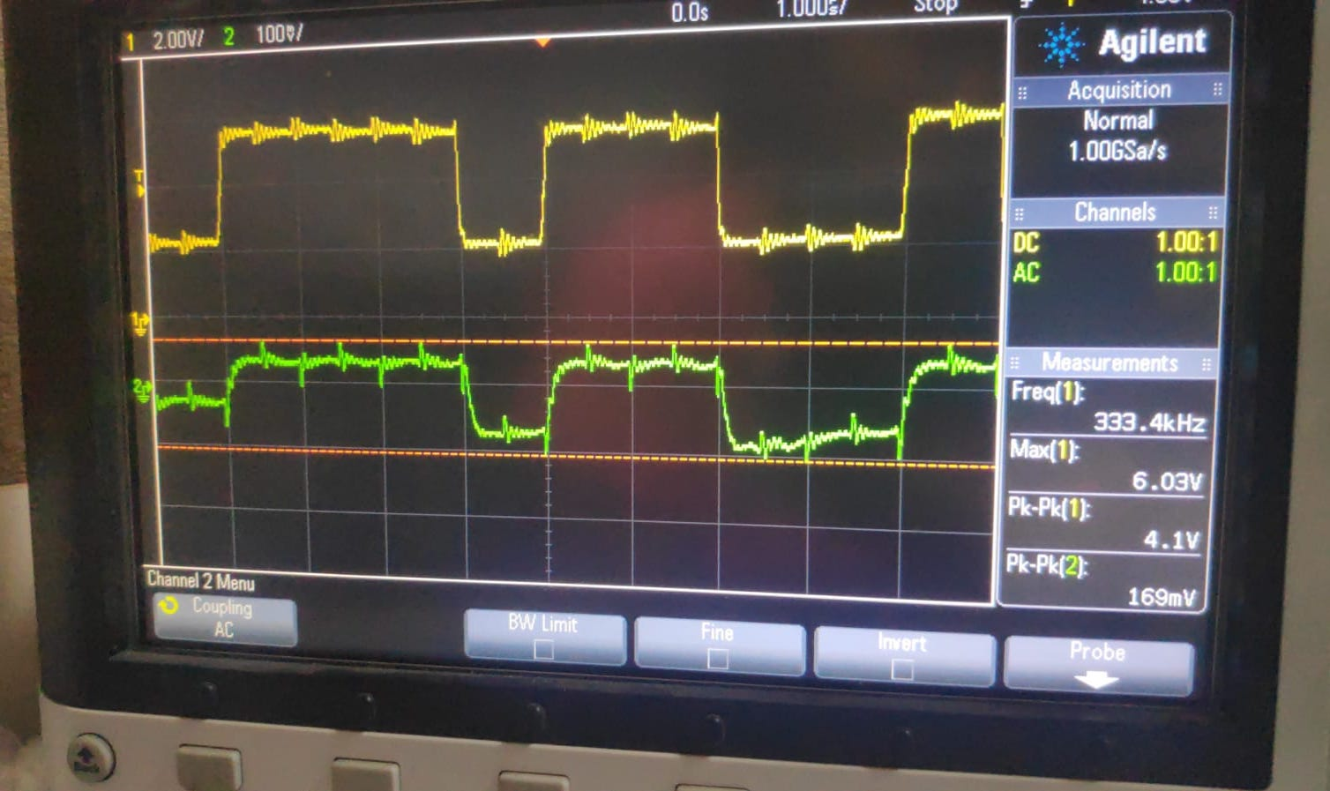
APPENDIX - II
High speed comparator - LM361
Shift register - 74S195N

