Slide 1

Self Parking Car Parkmate
Prof. Mrs. S. P. Jagtap
ELECTRONICS & TELECOMMUNICATION ENGINEERING
Pimpri Chinchwad College of Engineering , Pune

Slide 2
TEAM MEMBERS
Name | Designation
Ayush Bedre | Team Leader
Himanshu Susar | Hardware Team Leader
Rohit Baviskar | Hardware Team Member-1
Aditya Chinnawar | Hardware Team Member-2
Sumit Akangire | Software Team Leader
Mitali Bhapkar | Software Team Member-1
Amit Avhad | Software Team Member-2
Onkar Anand | Cost and recourse manger
Gauri Muley | Digital Media management team

Slide 3
OUTLINE OF PROJECT
Introduction
Literature review
Need of the Project
Problem Statement, Aim, Objectives
Methodology
Block Diagram
Hardware and Software Requirements
Algorithm and Flowchart
Hardware and Software Implementations

Slide 4
OUTLINE OF PROJECT
Advantages & Applications
Work Done till date
Results & Analysis
Conclusion
References
Project Outcome

Slide 5
INTRODUCTION TO PROJECT
Why we selected this project?
Nowadays, several car manufacturers have introduced parking assist system and it has been well accepted due to the fact that parallel parking is a troublesome task.
Our automated parallel parking feature is a great help when visibility behind the vehicle has decreased because of aerodynamic design.
Our system will prevent the car from hitting at the rear and subsequently reduces the error due to human judgement.

Slide 6
Background and Motivation
To develop user friendly automated car parking system which reduces the problem of traffic congestion.
To offer safe, convenience and secure parking slots within limited area.
To reduce the environmental impact of transportation by optimizing routes, reducing fuels consumption and potentially facilitating the adoption of electric vehicles.
Self-driving cars can potentially reduce the environmental impact of transportation by optimizing routes, reducing fuels consumption and potentially facilitating the adoption of electric vehicles.

Slide 7
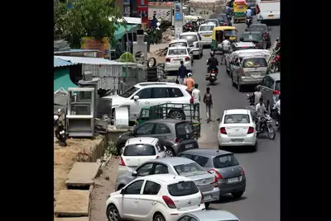
Background and Motivation
In India we have less space for traditional parking.
So people try to park their vehicles on the road.
We face this problem mostly in festival days.
Best solution on this problem can be parallel
parking aside the road.
It will reduce the parking space and also traffic
will not get disturbed.

Slide 8
Problem Statement and Objectives
Problem Statement:
Develop a self-parking car system that can navigate and parallel park autonomously, detect and avoid obstacles, and provide real-time feedback to the driver.
Objective:
To develop user friendly automated car parking system which reduces the problem of traffic congestion.
To offer safe, convenience and secure parking slots within limited area.
To reduce the environmental impact of transportation by optimizing routes, reducing fuels consumption and potentially facilitating the adoption of electric vehicles.

Slide 9
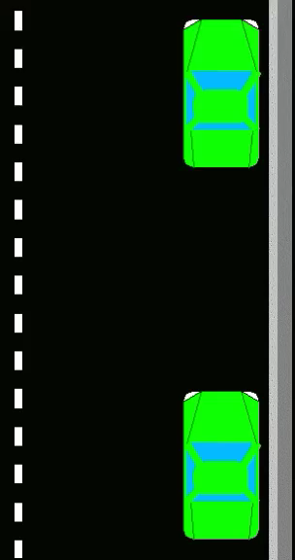
This is how parkmate will park the car

Slide 10
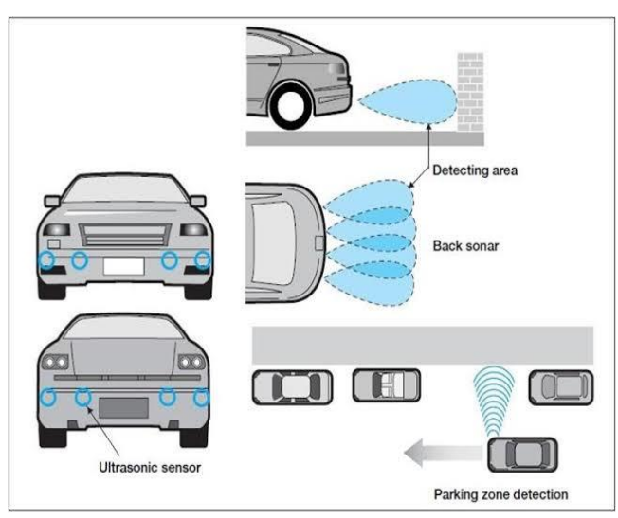
Detecting Area
Back IR Sensor
Front IR Sensor
Detecting horizontal space for parking

Slide 11
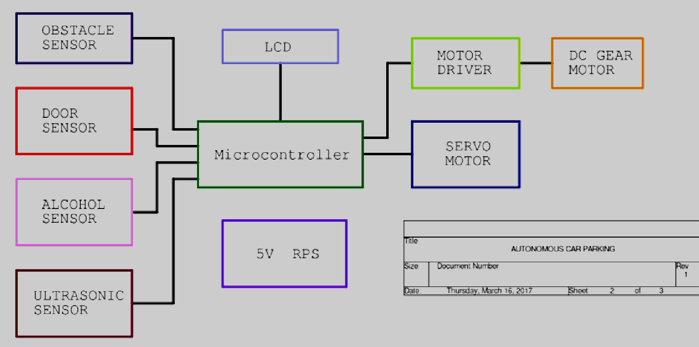
Block Diagram

Slide 12
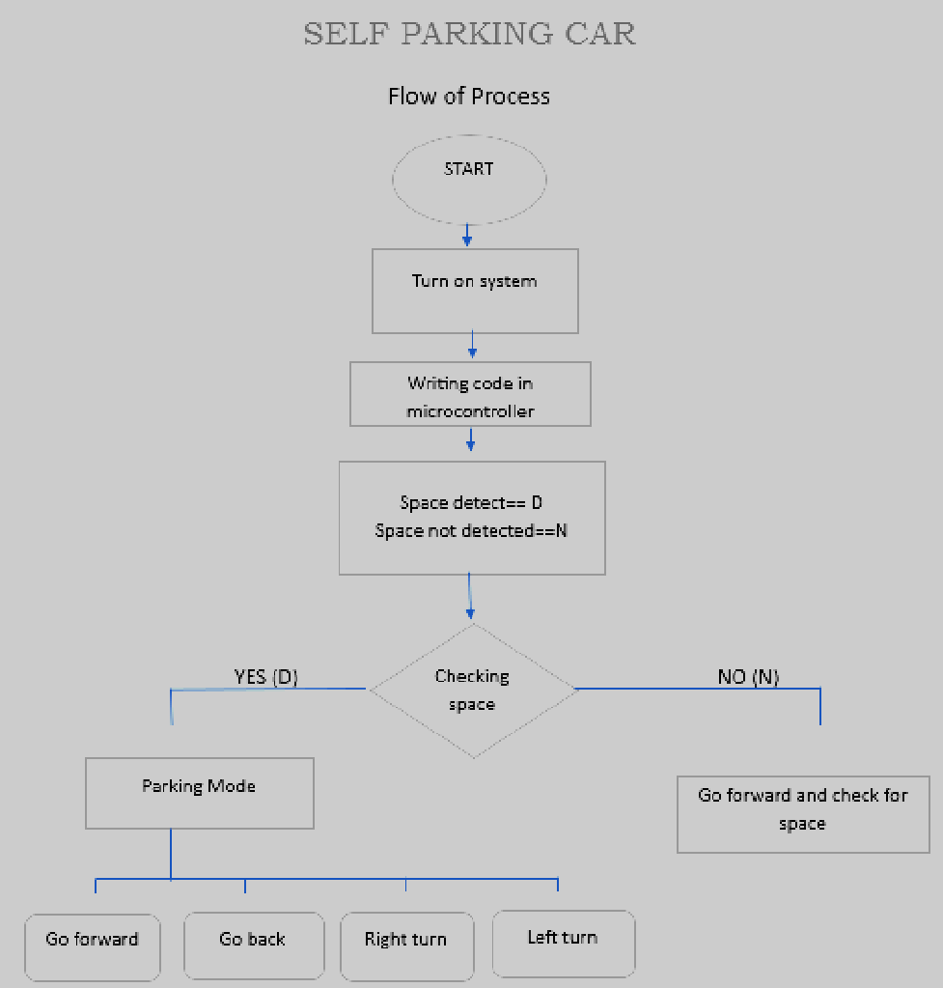
Flowchart

Slide 13
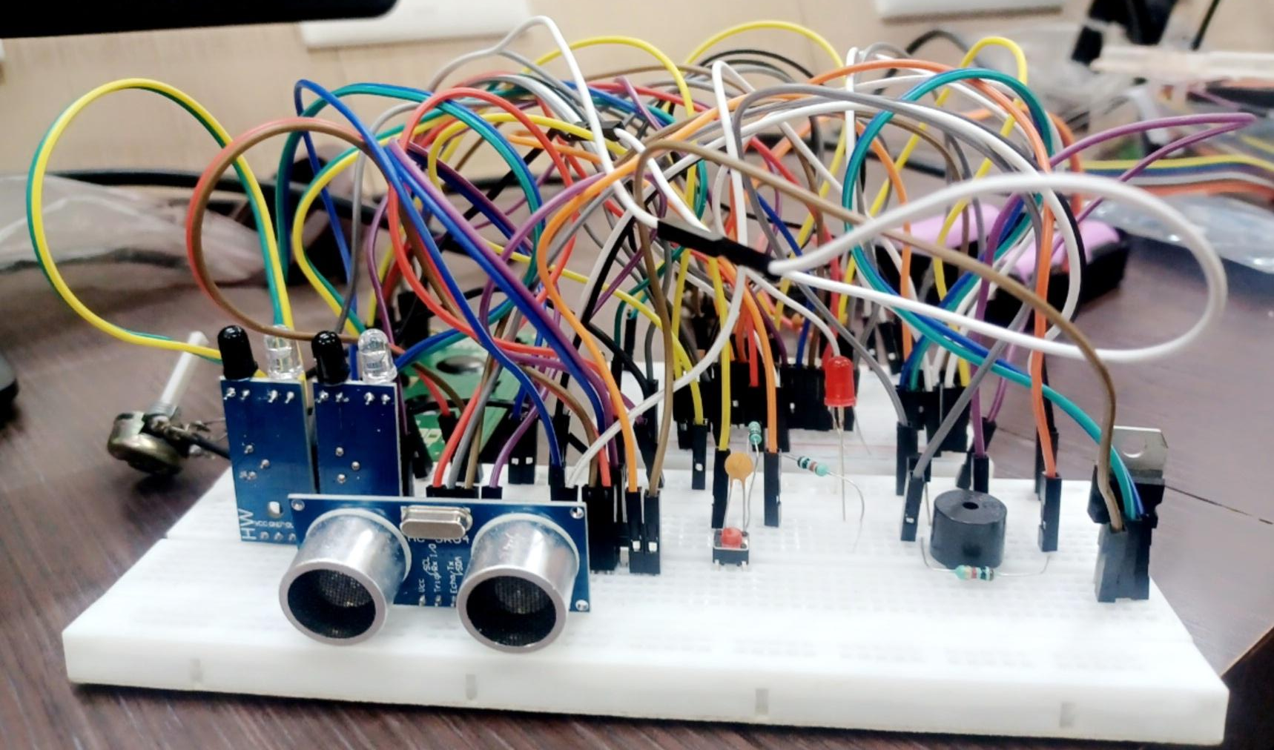
Software and Hardware Requirements
Hardware Requirement:
ATmega 32A Microcontroller
LCD
Servo motor
DC gear motor
Motor Driver L293
HCSR04 Ultrasonic Sensor
IR Sensor
11.1v battery
IC 7805 for 5v regulated supply

Slide 14
Software and Hardware Requirements
ATMEL Studio 7
ELNEC (with smartprog2 programming kit)
We have used ATMEL Studio 7 software for the compiling files and generating hex file and ELNEC software is used to burn the hex file in microcontroller.
Also we have to used SMARTPROG 2 universal programming kit with ELNEC software.

Slide 15
Result and Discussion
Attach images and videos of final product
Show accuracy table/graph of your project

Slide 16

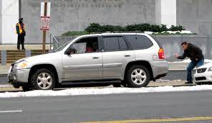
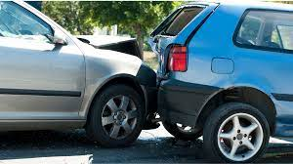
Advantages and Disadvantages
Advantages:
Enhanced convenience and ease of parking in compact spaces.
Reduction of parking-related accidents and collisions.
Increased parking efficiency, allowing for optimal use of available space.
Enhanced safety for pedestrians and other vehicles during parking maneuvers.
Reduction of human efforts

Slide 17
Advantages and Disadvantages
Disadvantages:
This system can’t detect ground level obstacles.
Higher unemployment rate since fewer cab drivers are needed
Maintenance may be difficult and costly
Fun of driving may decrease
Hacking issues

Slide 18
Future scope
There are still many parts of the system needed to be improved. At first, we will continue to improve current control on moving linearity of car.
On the other hand, we will also improve the ultrasonic device with the aim of more precise judgment on parking space to meet parking demands of different types of car.
In the future, the data detected by ultrasonic device will be included into the driving route reproduction system besides original data about steering angle and driving distance to increase reliability of the system.
Finally, it is expected to add a Bluetooth receiver to allow an Android intellectual cell phone to control the car; thus you can command the system to park your car in position automatically just by pressing one button of the cell phone.

Slide 19
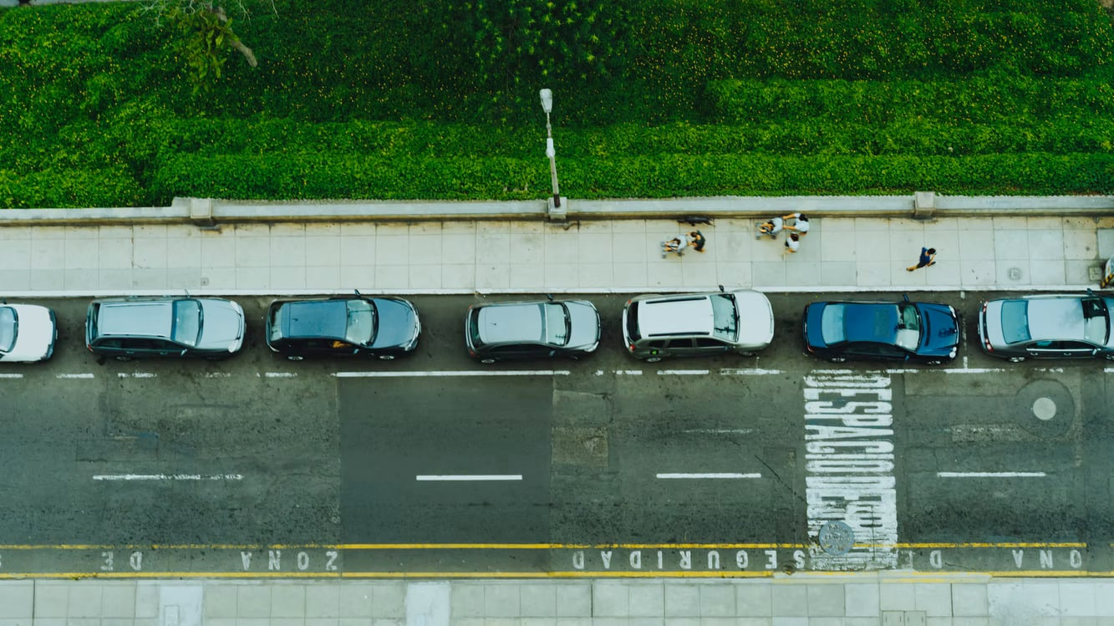
Conclusion
By using the various system like fifth wheel mechanism, modified steering mechanism, and automation in the vehicle will result in solving the parking problem in the compact spaces which require more space and more time, this both the things will be reduced to 1.33 times its length from double its length. This will reduce the number of accidents and the traffic jam problems caused due to the parking problems will be solved. This system will also reduce the fuel consumption.

Slide 20
References
1). Anderson R, Kalra N, Stanley K, Sorensen P, Samaras C. Autonomous vehicle technology: A guide for policymakers. Santa Monica, CA: RAND Corporation; 2016.
2). Chen Y, Li Y, Li Y, Li J, Li H, Li J. A comprehensive survey of autonomous driving: From perception to control. IEEE Transactions on Intelligent Transportation Systems. 2021;22(4):2324-2353
3). Al-Kaff AH, Baker T, Zeadally S. A comprehensive survey of autonomous vehicle technologies, challenges, and opportunities. IEEE Access. 2019;7:36158-36197
4). Levene R, Polak JW. Challenges of transitioning to autonomous vehicle technology: A review of current literature. Journal of Intelligent Transportation Systems. 2018;22(2):83-106

