Slide 1
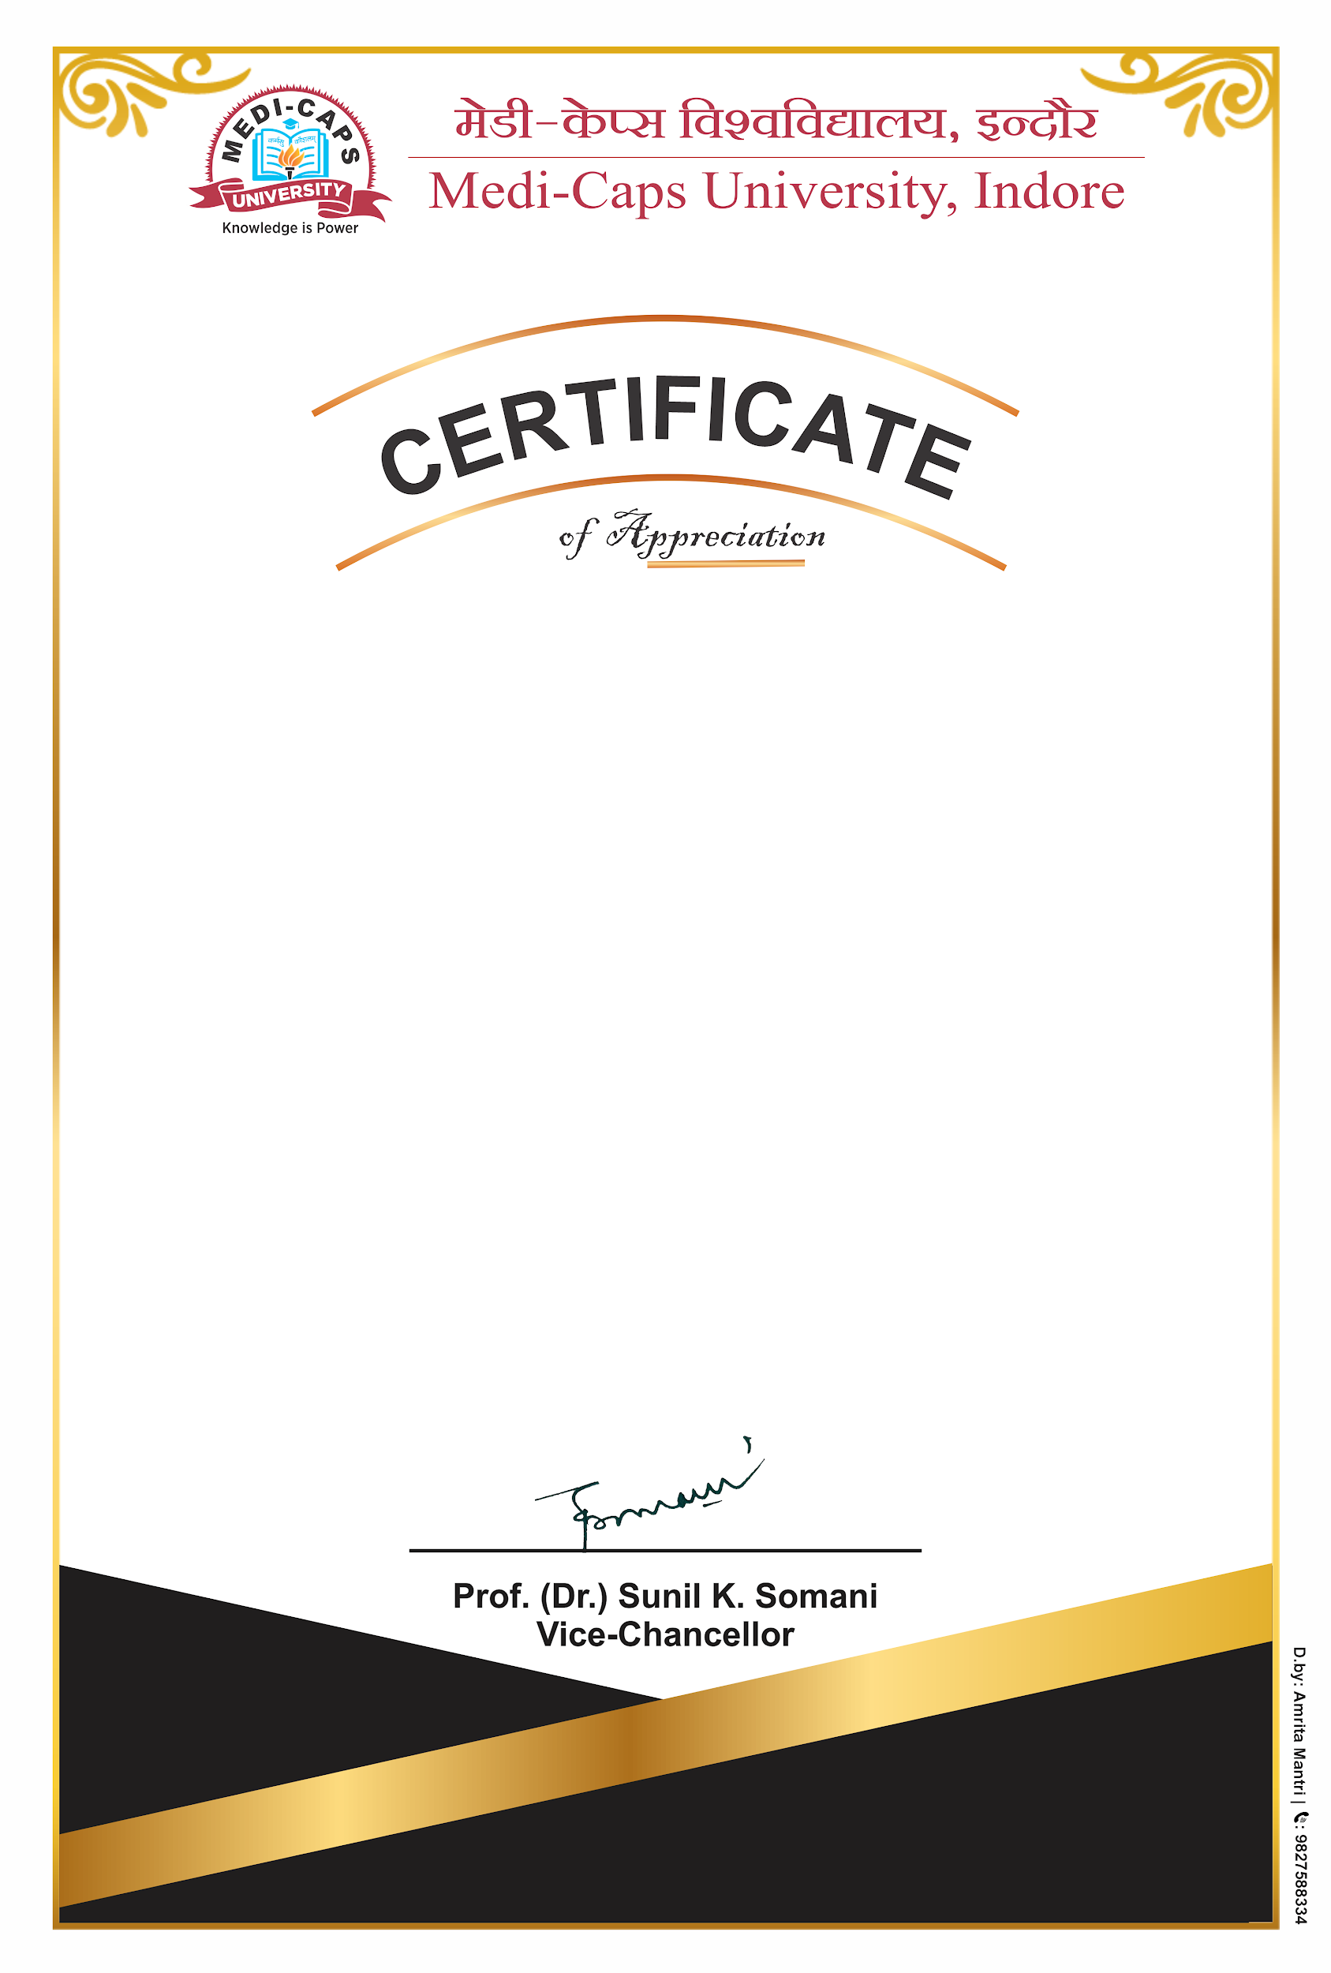
This certificate is presented to
Mitali Garg
for Being Third Place in
“Poster Making Competition”
On the Occasion of National Science Day 2021
during February 26 to March 2, 2021
Organized by
Department of Faculty of Science

