Slide 1


Slide 2
Room-mate Matching Service
People need to find room-mates.
Finding suitable room-mates can be hard.
We help them do that.
???
Profit. Just kidding. Maybe.
Ideally aimed at university students.

Slide 3
What it does
Checks compatibility of users
…based on their preferences.
Suggests them to each other.
They add each other.
They become friends.
They become room-mates.
And they all live happily ever after.

Slide 4
We can’t tell you everything
You
Larry
Likes computers.
Likes sports.
Dislikes tomatoes.
Etc.
Dislikes spiders.
Likes computers.
Likes sports.
Dislikes tomatoes.
Etc.
Owns a pet spider.
/\(0 0)/\

Slide 5
Contacts
You add people
…that the site suggests.
Then you talk to them
…and get to know them.
The point of adding people is because they are a potential room-mate!

Slide 6
Messaging
In the future, we could have instant chat.
Not important, but useful.
An inbox would work fine.
But the chat could be pretty powerful.

Slide 7
Room-mate Matching Service
People need to find room-mates.
Finding suitable room-mates can be hard.
We help them do that.
???
Profit. Just kidding. Maybe.
Ideally aimed at university students.

Slide 8

Accommodation Reviews
Having the possibility to look through accommodation offers as group
After finding perfect roommates, only thing left to do is find accommodation

Slide 9

Review formatting
5-star rating system
Optional text review (carefully filtered)

Slide 10

Logged out users cannot rate or review.
Avoiding spam by not letting non-registered users to rate/review.
Reviews would be checked and filtered, to assure the maximum quality.

Slide 11



Connecting to Social networks
The ability to link your Roomies account to other popular social networks, such as:
Facebook
Twitter
Google +

Slide 12
Get to know each other
Learn more about each other.
Familiar platform to communicate with each other

Slide 13

Linking accounts
Each user will be able to link accounts through a simple settings interface
Connect and disconnect each social media account at the users choice

Slide 14
Chat System
We plan on implementing a built-in instant messaging system
Remove the need to use alternate websites such as Facebook to communicate
Allow users to communicate better with the students they are matched with

Slide 15
Integrating Facebook Chat
Use the Facebook api to include Facebook chat into our own chat system
Improve the chances of communication between roommates

Slide 16
Integrating Facebook Comments
Facebook comments for the student accommodation reviews
Built-in review system for those not connected with Facebook

Slide 17
Technical Stuff
HTML and CSS for building the webpages (duh)
MYSQL – a perfect relational database management system
PHP – great for server-side processing
PYTHON – useful for real-time server communications
JAVASCRIPT – makes things more dynamic

Slide 18
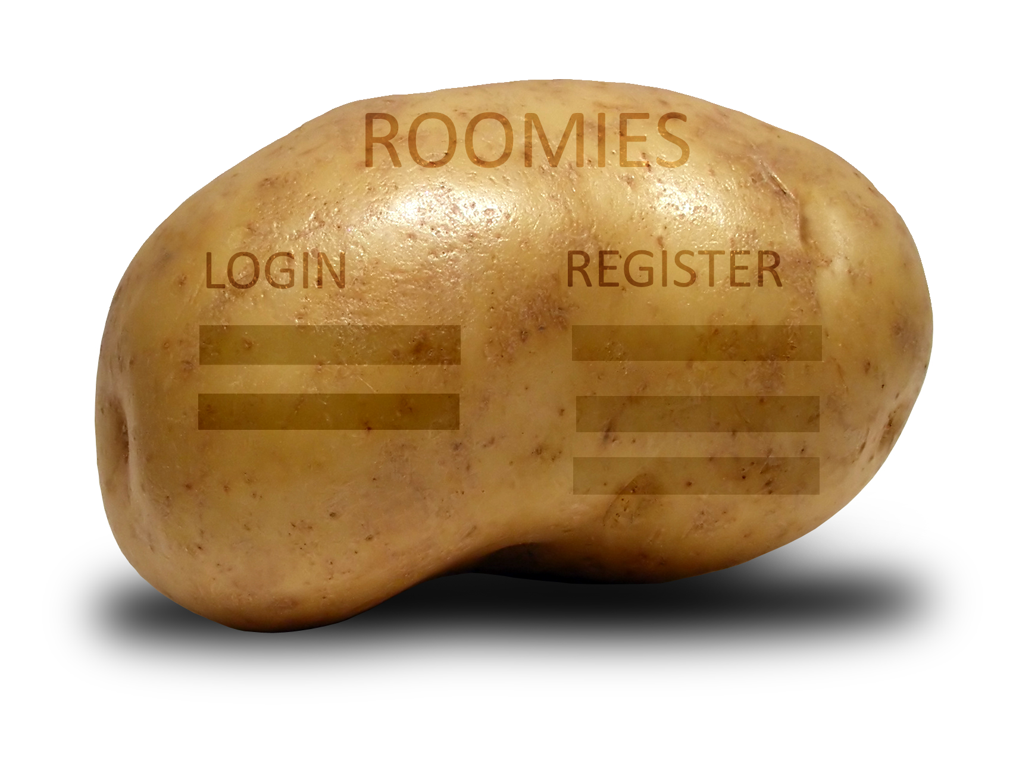
HTML & CSS
We build a website so we need HTML (unexpected)
Useless if it does the perfect job, but looks like a potato
So yeah, we need CSS

Slide 19
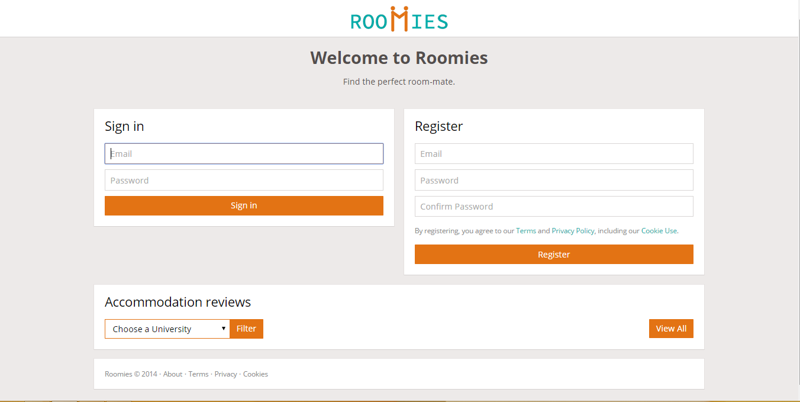

Slide 20

PHP & MySQL
PHP
has a wide documentation available, and is easy to learn
Works great with MySQL
Processing all user inputs
Good for heavy computing (matching script)
MySQL
Fast
Secure
Easy to learn
FREE!

Slide 21
Stubs everywhere
Stub every file that needs to be done, commenting it
Useful for an organised approach
Making tasks easier to assign
Making things more understandable for less experienced people

Slide 22
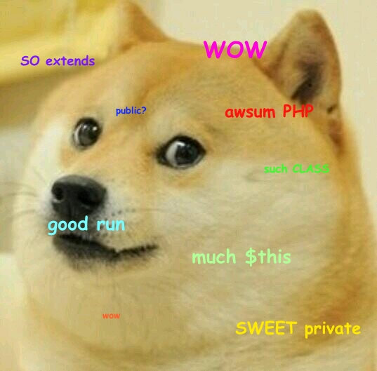
OOP for the win!
PHP fully supports OOP
Easier to work in team
and not mess with each other’s work
Going pro scalability
for possible future expansion

Slide 23
Good teamwork == good result
Use GitLab for proper version control
Allocate weekly tasks to each team member (=> 6 tasks/week)
From time to time, improve/retouch/test and debug already made stuff
(especially debug)

Slide 24
Planning before everything
Weekly meetings on Friday
Discuss how the previous tasks went
Discuss and (re)assign the next tasks for each other
Allocate tasks considering everyone’s strengths and weaknesses
Alex would take most of the PHP-heavy tasks, also the debugging
Daniel would take the main front-end related tasks, and the design retouching ones
Elnur would mostly take the basic front-end / design tasks, along with testing
Liam would usually take the simpler back-end ones, along with testing
Mitali and Lilian would usually change between front-end and back-end tasks

Slide 25
Punctuality is important
By December 19th - make the index pages, the login and register scripts
By 13th January - people will have increased their knowledge (over break)
By 29th January - create the user profiles
By 12th February - implement the accommodation reviews
By 19th February - implement the room-mate matching system.
By 5th March - implement the Instant Messaging system.
By 12th March - finish all retouching/improving and begin heavy testing
If we had more time, we would hope to implement a caching system, for easing the server load.

Slide 26
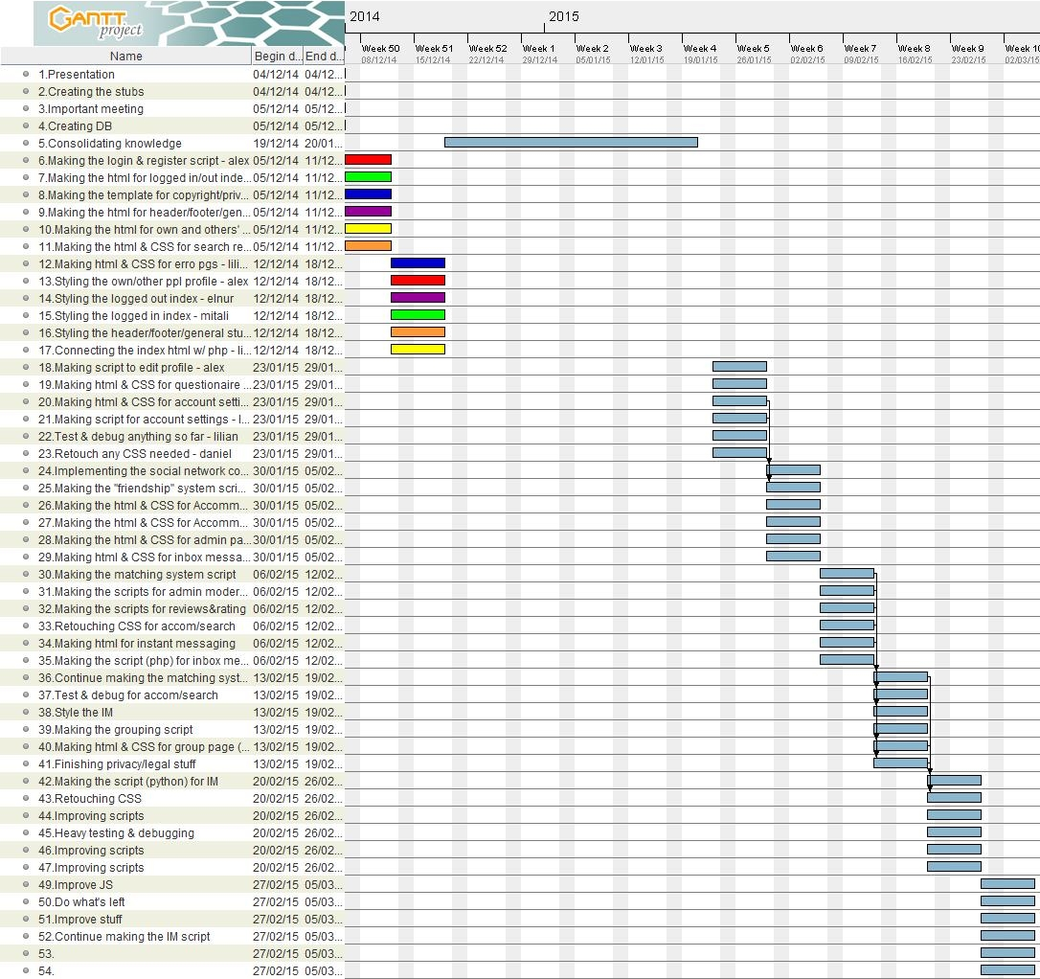
Will put gantt chart

Slide 27
Overview on legal and ethical aspects
Some potential issues regarding privacy/ethical/legal matters are
Instant messaging
Religious beliefs compatibility
Personal information confidentiality
The user reviews

Slide 28
Instant messaging
Warn users not to use the chat for sensible content
Notice users about any potential use of their information, such as in legal matters
Assure them that we will not give their information to third parties (public)
(except the legal matters, when required)

Slide 29
Religious beliefs compatibility
Lots of different views over the religious beliefs
Approaching the matter with high precaution, as this can lead to conflicts
Discourage discrimination, by making this kind of details optional for filtering

Slide 30
Personal information confidentiality
Character of personal information is public within the website (for registered users)
The matching engine uses all the filters and details provided
You can see the profile of a user anytime
but you can see their name just if the accepted your request to connect
Unlink the information from the user by hiding their name

Slide 31
The user reviews
Filtering the reviews for sensible content (such as foul language) or spam
Possible admin filtering some reviews
Warn the users about the public character of the reviews they provide
Their name will be public
Their name will not link to their profile (keeping the confidentiality)

Slide 32
Thank you!
Any questions?

