Slide 1
MovieLens Film Analysis
Characteristics of the Top 20% Most Profitable Films
2020 - Mitchell Beckner
Notes:
This project was created as part of Udacity's Data Visualization Nanodegree program. The data used is from a Kaggle dataset that contains metadata for 45,000 movies listed in the MovieLens Dataset. The dataset consists of movies released on or before July 2017. Data points include cast, crew, plot keywords, budget, revenue, posters, release dates, languages, production companies, countries, TMDB vote counts and vote averages. The dataset also has 26 million ratings from 270,000 users for all 45,000 movies (Banik, 2017).

Slide 2
Problem Statement
What are the key components that differentiate the top 20% of films from the remainder when considering profit margin?
Notes:
The objective of this project was to use the movies dataset and conduct the EDA necessary to understand the dataset as a whole. The output will be to discover if the dataset is balanced, if there are anomalies in the dataset that affect the applicability of the recommendation, and the final presentation itself that will be used for a mock recommendation to a management team (Udacity, 2020).
The problem statement for the project was defined as:
What are the key components that differentiate the top 20% of films from the remainder when considering profit margin?

Slide 3

Executive Summary
Story factors and budget appear to have the greatest influence on the profit margin of a film
Our recommendation is to focus on the production and promotion of films that are part of an ongoing collection. Films with budgets less than $6 million are also more likely to have profit margins in the top 20%
Notes:
The key findings of the analysis were that Story factors and budget appear to have the greatest influence on the profit margin of a film and the final recommendations were to focus on the production and promotion of films that are part of an ongoing collection and/or films with budgets less than approximately $6 million. These movies were found to be more likely to have profit margins in the top 20% of those examined.

Slide 4
Overview of Analysis
The success of each film was quantified based on profit margin and the top 20% were determined. Analysis was then conducted in the following areas:
Profitability differences based on Story Factors
Film collections, keywords, genre
Profitability differences based on Production Factors
Budget, runtime, release month, cast, crew, location, language
Profitability differences based on Public Opinion
TMDB popularity score, vote average, average rating
Notes:
Three hypotheses were constructed as the foundation of the study:
Story factors influence the film’s profit margin
Production factors influence the profit margin
Public opinion factors affect the profit margin
The primary dataset was downloaded from the Kaggle website (Banik, 2017). It consisted of 7 data files. Additional data was downloaded from the IMDB website that consisted of lists of the highest rated actors, producers and directors (nims-1975, 2015)( Smmsadrnezh, 2018). This information was used as reference to create binary variables for ‘use of top-rated cast’ and ‘use of top-rated crew’ for each film.
Some preliminary data preparation and cleaning was done in Excel before importing the data into R for further processing. Many of the “0” values were replaced with NA’s in order to accurately account for, and later impoute the missing data. Duplicate rows were also discovered and removed. A summary of the distributions of the variables in the dataset is shown in Figure 1.
Next the dataset was filtered to include only films that had been released to the public and those with budgets less than $59,500,000. This eliminated the statistical outliers found in the budget variable. New variables for profit and profit_margin were created and then used to create a profit_group categorical variable that placed each movie into either the top 20% or bottom 80% based on profit margin. Finally, R code was written to process the separate files for ratings, keywords, cast and crew data, country and language data, genre, and movie collection information. The full code is available at the link posted above.
Various R packages were used to explore the missingness present within the data. Figure 2 shows a plot of the pattern of missing data and Figure 3 shows the patterns of missingness. It should be noted that while the original dataset contained information on over 45,000 movies, removing duplicates and filtering for ‘Released” movies with a stated budget greater than 0 resulted in only 7925 films. These films were used as the basis for the remaining investigation.
The ‘MICE” package was then used to impute the missing values in the dataset (Noghrehchi, 2015). Five imputed datasets were created using 50 iterations of the chained equation process. The results were examined for convergence and found to be satisfactory. A single imputed dataset was then randomly selected and used for the remainder of the analysis.
Following the imputation of missing values, the variables for profit and profit_margin were re-generated and again used to create the profit_group variable that placed each movie into either the top 20% or bottom 80% based on profit margin. A summary of the variable distributions for the imputed dataset are shown in Figure 4. This data was then standardized and correlation analysis was run. An excerpt of the results of this analysis is shown in Figure 5 with the corresponding p-values shown in Figure 6. These results showed significant correlations between collection_bin, budget, keyword_bin, average_rating, popularity, and vote_average and the profit_group variable..
Following the correlation analysis, additional EDA was performed in R to confirm the results and lay the groundwork for the final visualizations. Final visualizations were then produced in Tableau and R with some additional polishing done in Adobe Illustrator. The final presentation was then assembled based on the PowerPoint ghost deck created in a prior project.

Slide 5
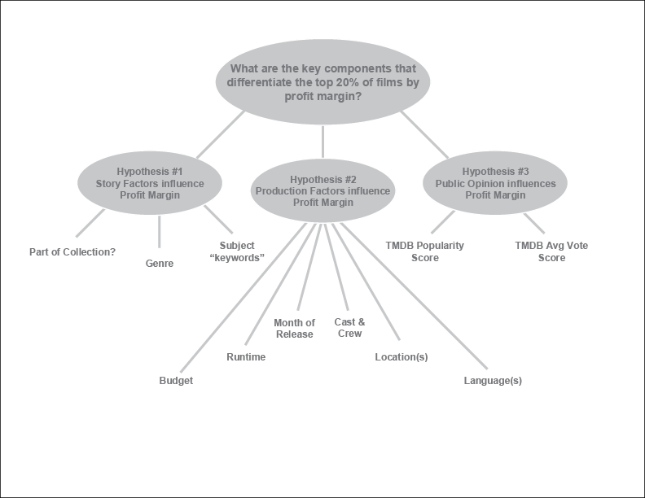
Issue Tree

Slide 6
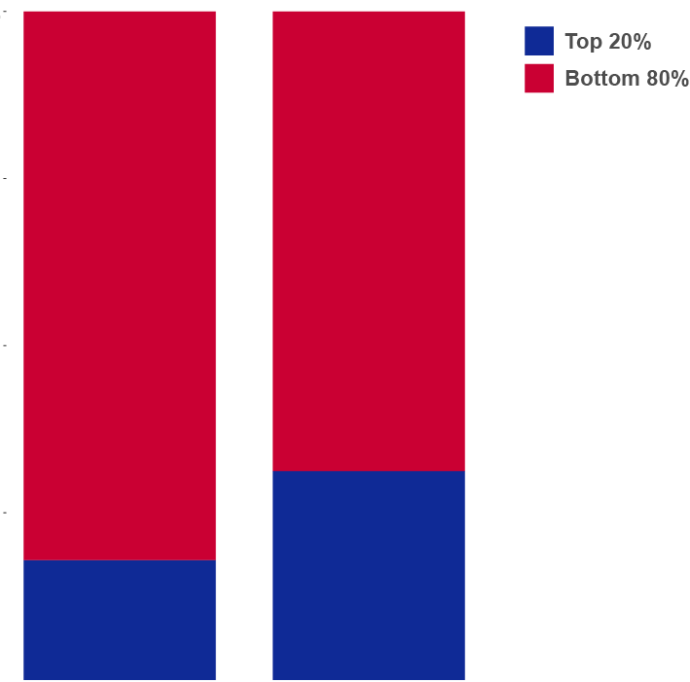
Analysis of Story Characteristics
Are there key story characteristics that differentiate the top 20% of films from the remainder when considering profit margin?
Almost a third of the movies that are part of a collection of films have profit margins in the top 20%
Less than 20% of stand-alone films achieve the same profitability level
100%
75%
50%
25%
0
Percentage of Total
Stand-alone Part of Collection

Slide 7
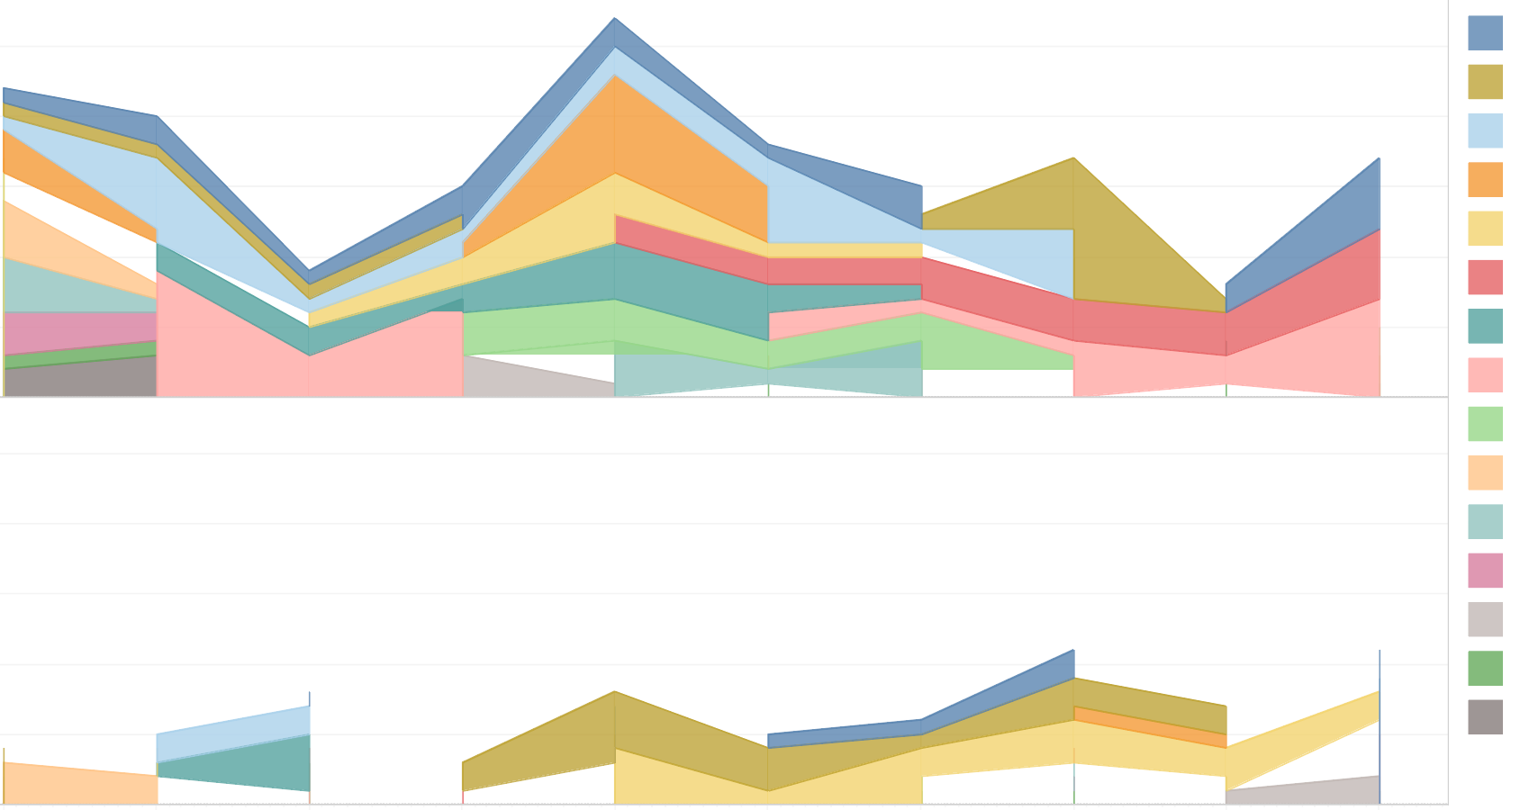
Analysis of Story Characteristics
Are there key story characteristics that differentiate the top 20% of films from the remainder when considering profit margin?
25
20
15
10
5
0
Party
Found Footage
Fight
Wife Husband
Supernatural
New York City
Friends
Gore
Journalist
Daughter
Psychopath
England
Drug Dealer
Gay
Love of One’s Life
Movies with the highest profit margins tend to have stories characterized by keywords that differ from those in the bottom 80%.
However, story keywords are subject to time based trends
Bottom 80%
20
15
10
5
0
Top 20%
2007 2008 2009 2010 2011 2012 2013 2014 2015 2016
Notes:
Note that the keyword data changes over time. If this data is used to predict a films profitability, careful attention must be paid to current trends.

Slide 8
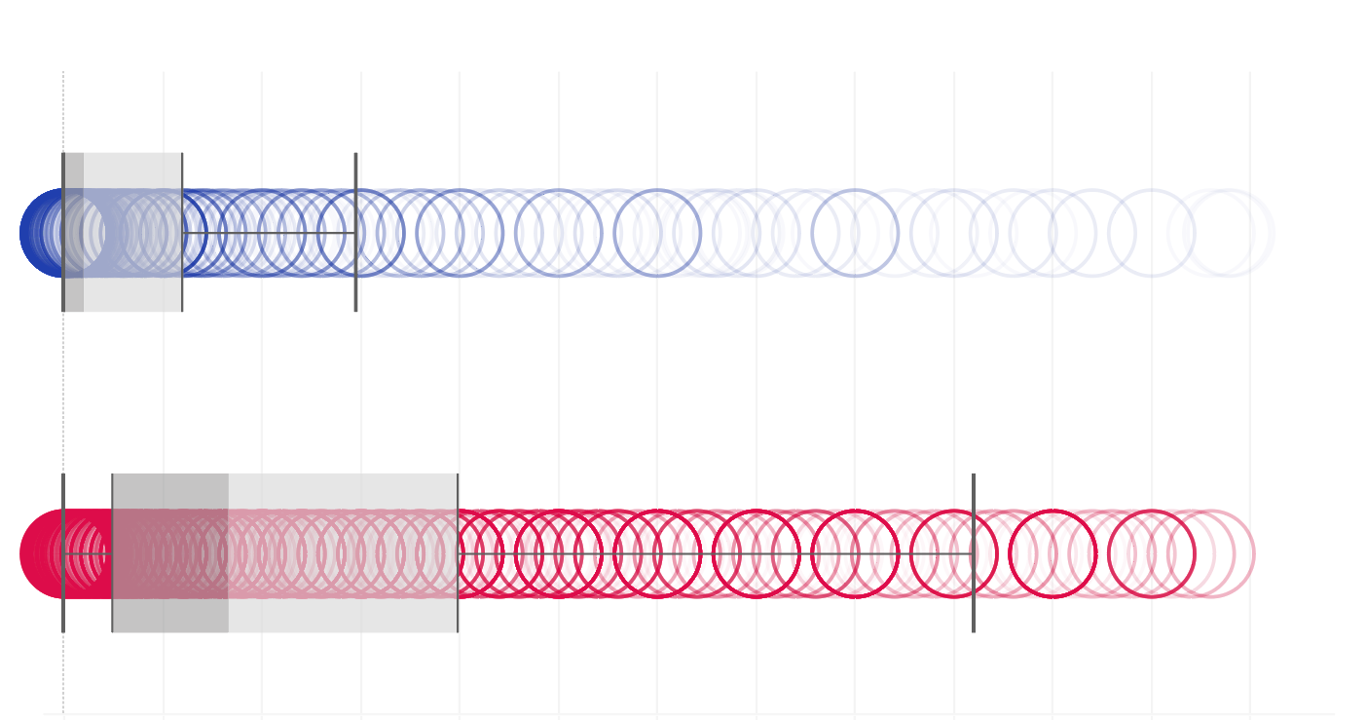
Analysis of Production Characteristics
Are there key production characteristics that differentiate the top 20% of films from the remainder when considering profit margin?
Movies with profit margins in the top 20% are likely to have average budgets around $2 million
Movies in the bottom 80% have average budgets near $9 million
Top 20%
Bottom 80%
0 5 10 15 20 25 30 35 40 45 50 55 60
Film Budget in Millions of Dollars

Slide 9
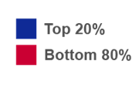
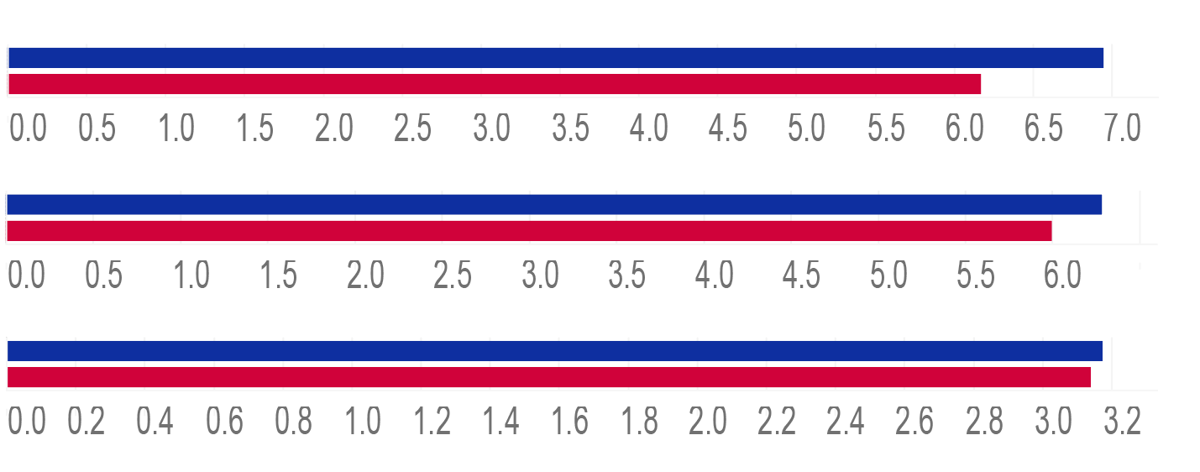
Analysis of Public Opinion
Are there patterns in public opinion data that differentiate the top 20% of films from the remainder when considering profit margin?
Popularity ratings, IMDB vote averages, and average ratings are all higher for movies with profit margins in the top 20%
Popularity
Vote Average
Average Rating
0 0.5 1.0 1.5 2.0 2.5 3.0 3.5 4.0 4.5 5.0 5.5 6.0 6.5 7.0
0 0.5 1.0 1.5 2.0 2.5 3.0 3.5 4.0 4.5 5.0 5.5 6.0
0 0.5 1.0 1.5 2.0 2.5 3.0
Notes:
As noted below, this data is subject to various biases.

Slide 10

Study Limitations
Movie data represented is only a sample of all movies
Most films have incomplete information
Some of the data present is of questionable quality
Notes:
Many problems were found in the provided dataset. As noted above, the data contained duplicate rows, and a large amount of missing data. In addition, some the data that was present was obviously erroneous and/or suspect. For example, some movies had negative values listed as their budget. Without more information on the methods of data collection and their sources, it is impossible to determine the reasons for these errors and omissions, therefore, assumptions that were made regarding the data being missing completely at random are essentially indefensible.

Slide 11
Additional Limitations
It is difficult to quantify the value of actors and crew members toward the profitability of a film
Public opinion data can be influenced by other factors including the reviews and preferences of others
It is difficult to obtain public opinion data prior to the release of a film
Notes:
Again, as noted above, the MICE package was used to impute missing data in R. While every attempt was made to select the best available algorithm for each variable, and results were visually examined to ensure that the imputed values were ‘logically reasonable, there is the potential for a great deal of bias being introduced at this point in the process. In addition, in an attempt to use the cast and crew data that was provided, additional lists of “top-rated” actors, producers, and directors were obtained from the IMDB website. Each movies cast and crew was checked against these lists and movies were flagged if they used actors or crew members on these outside lists. However, there is no standard criteria that was used to establish the “top-rated” status of these people so again, bias was likely introduced at this point in the analysis. It is also likely that a great deal of response bias is present in the popularity, vote average and rating data since this information was presumably collected at various lengths of time after a film was released.

Slide 12
Next Steps
The findings of this analysis could be expanded and improved upon in the following areas:
Continue to expand the sample size and completeness of the dataset
Improve methods to quantify cast and crew data
Identify sources of opinions and ratings that are collected prior to a film’s public release

Slide 13
References
Anonymous. (1970, January 1). McKinsey Presentations - How to Apply Ghost (aka Shell and Skeleton) Decks and Pages. Retrieved March 7, 2020, from http://workingwithmckinsey.blogspot.com/2013/07/McKinsey-presentations-ghost-decks.html
Banik, R. (2017, November 10). The Movies Dataset. Retrieved March 1, 2020, from https://www.kaggle.com/rounakbanik/the-movies-dataset#movies_metadata.csv
nims-1975. (2015, July 2). Top 12 Best Film Producers/Directors. Retrieved from https://www.imdb.com/list/ls051116454/
Noghrehchi, F. (2015, May 29). Retrieved from https://web.maths.unsw.edu.au/~dwarton/missingDataLab.html
Smmsadrnezh. (2018, March 5). Best and Worst Actors Rating (Sorted). Retrieved from https://www.imdb.com/list/ls070682726/
Udacity. (2020). Build a Data Story Final Project. Retrieved from https://classroom.udacity.com/nanodegrees/nd197/parts/c26016f6-de16-42b7-98f8-9de7374f8247/modules/2c1ae2e0-f442-4268-9931-c8b2d0c07ea2/lessons/060138e7-74ee-4391-8ced-2f1fbcca002c/concepts/1e50f104-b96f-462a-a408-a155ea4a2467

