Slide 1
MovieLens Film Analysis
Characteristics of the Top 10% Most Profitable Films
2020 - Mitchell Beckner

Slide 2
Problem Statement
What are the key components that differentiate the top 10% of films from the remainder when considering profit margin?

Slide 3
Executive Summary
Story factors appear to have the greatest influence on the profit margin of a film*
Our recommendation is to focus on the production and promotion of films that are part of an ongoing collection and have the other characteristics found in this study to be related to high profit margin
* This is a tentative finding and is subject to verification in the full analysis

Slide 4
Overview of Analysis
The success of each film was quantified based on profit margin and the top 10% were determined. Analysis was then conducted in the following areas:
Profitability differences based on Story Factors
Part of a collection
Genre, etc.
Profitability differences based on Production Factors
Budget
Runtime, etc.
Profitability differences based on Public Opinion
Popularity score
Vote average, etc.

Slide 5
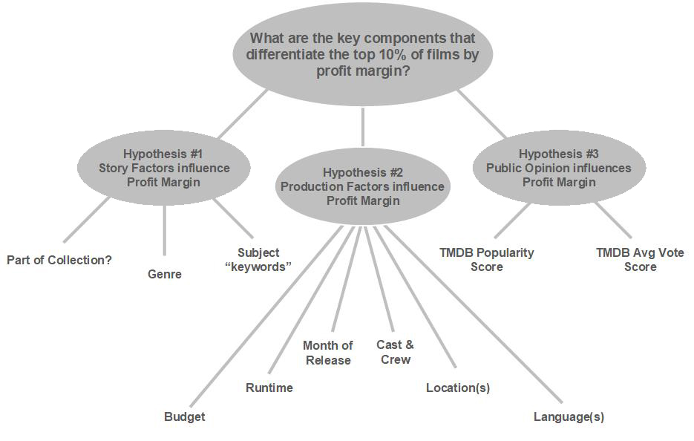
Issue Tree

Slide 6
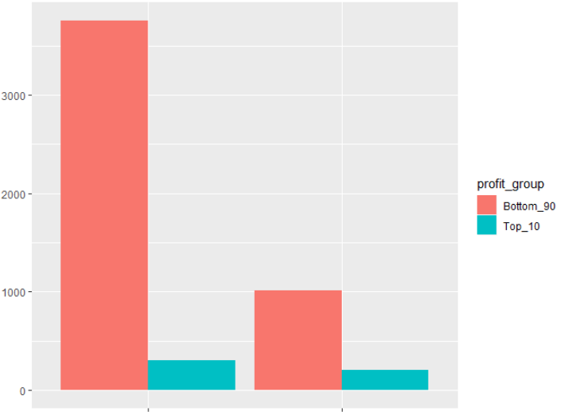
Analysis of Story Characteristics
Are there key story characteristics that differentiate the top 10% of films from the remainder when considering profit margin?
Part of a collection
Genre
Plot keywords
Is the Film Part of a Collection?
Number of Films
No Yes

Slide 7
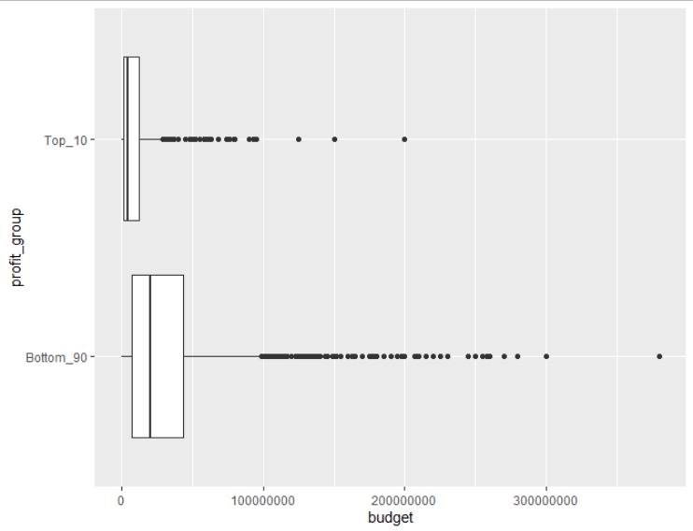
Analysis of Production Characteristics
Are there key production characteristics that differentiate the top 10% of films from the remainder when considering profit margin?
Budget
Runtime
Release month
Language, etc.
Film Budgets by Profit Group
Profit Group
Budget in Dollars

Slide 8
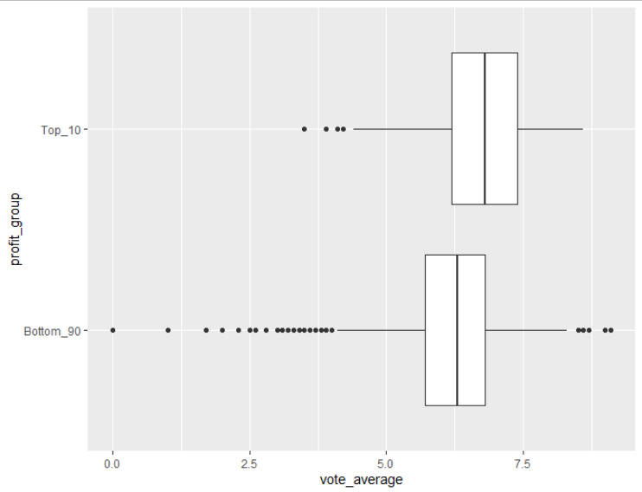
Analysis of Public Opinion
Are there patterns in public opinion data that differentiate the top 10% of films from the remainder when considering profit margin?
Popularity ratings
IMDB vote averages, etc.
Average Vote by Profit Group
Profit Group
IMDB Average Vote

Slide 9
Study Limitations
Not all movies are represented in the sample.
Many films have incomplete information
Out of over 45,000 films, only about 5,300 have the financial data required for the analysis

Slide 10
Additional Limitations
It is difficult to quantify the value of actors and crew members toward the profitability of a film
Public opinion data can be influenced by other factors including the reviews and opinions of others

Slide 11
Next Steps
The findings of this analysis could be expanded and improved upon in the following areas:
Continue to expand the sample size and completeness of the dataset
Identify ways to quantify cast and crew data
Identify sources of opinions and ratings that are collected prior to a film’s public release

Slide 12
References
Anonymous. (1970, January 1). McKinsey Presentations - How to Apply Ghost (aka Shell and Skeleton) Decks and Pages. Retrieved March 7, 2020, from http://workingwithmckinsey.blogspot.com/2013/07/McKinsey-presentations-ghost-decks.html
Banik, R. (2017, November 10). The Movies Dataset. Retrieved March 1, 2020, from https://www.kaggle.com/rounakbanik/the-movies-dataset#movies_metadata.csv

