Slide 1
Underground Brains
Backup: the live walk-through as screenshots
M2_aug, channel CH4_A2, hours 377-381 · taken 20 October 2026 from the real database
Notes:
Use only if the live site fails. Every slide is the same step as the live click script in docs/DEMO_DAY.md.

Slide 2
Walkthrough 1
Open a span in Explore, analyse it, see the spikes and their intervals

Slide 3
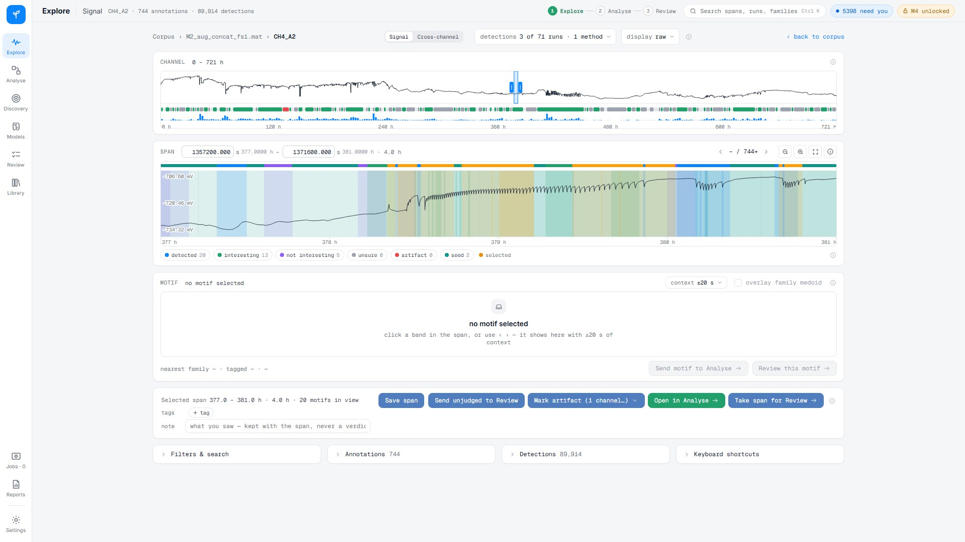
Explore · Signal: the four-hour span on CH4_A2
M2_aug_concat_fs1 · CH4_A2 · 377-381 h · saved as the span "demo · W1/W2 span"

Slide 4
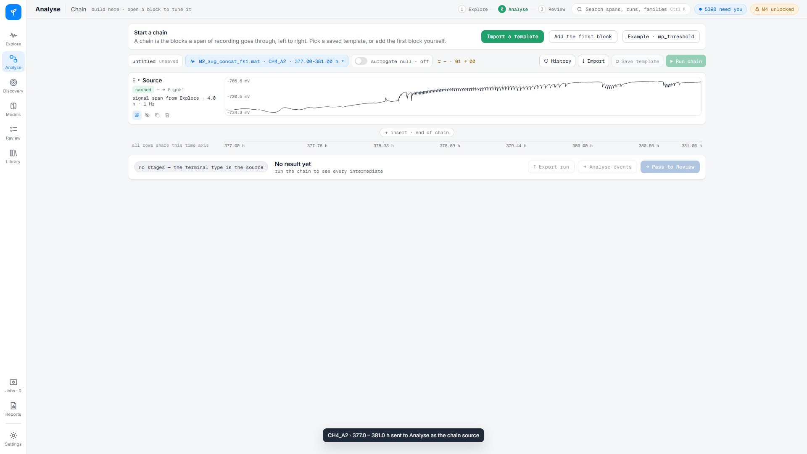
Open in Analyse: the span becomes the chain source
one click; the span travels with its exact samples

Slide 5
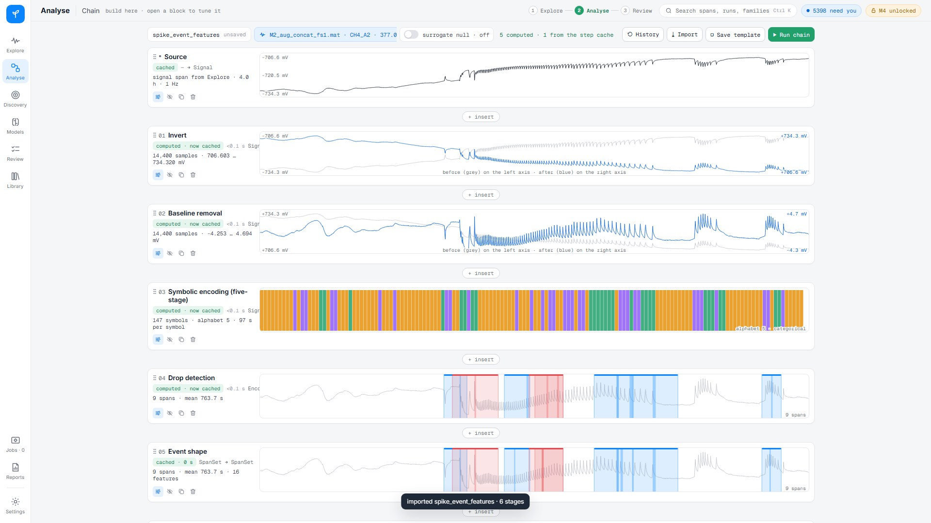
Spike route: invert, detrend, encode, detect, shape, intervals
template spike_event_features · 9 spikes · inter-spike intervals at the end of the chain · ~1-2 s

Slide 6
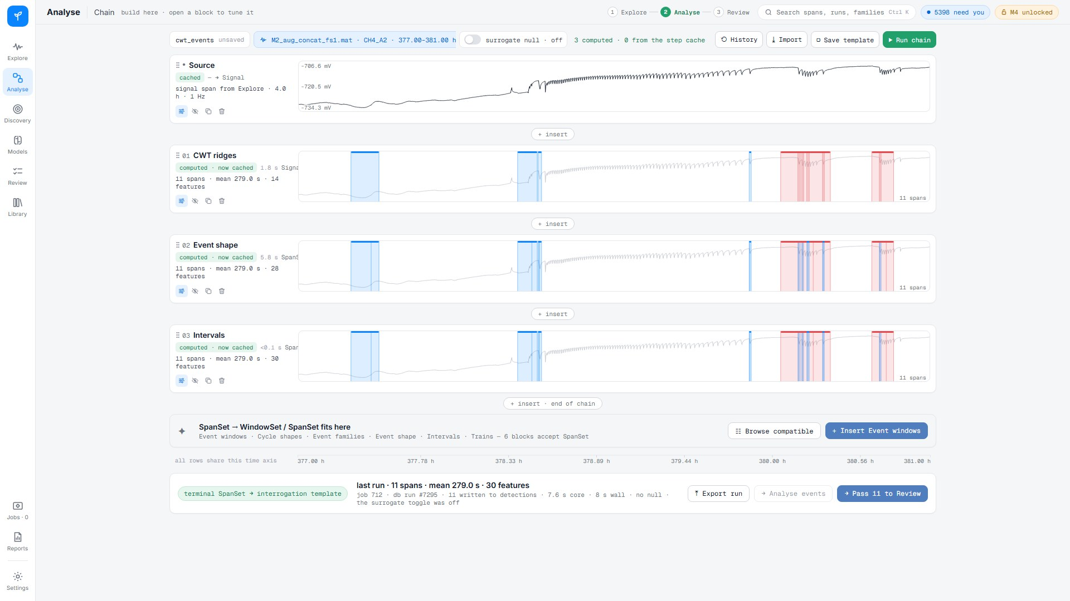
Wavelet route: CWT ridges, event shape, intervals
template cwt_events · 11 events · ~1 s from the step cache

Slide 7
Walkthrough 2
Build a detector, save it, apply it with its null, judge the result

Slide 8
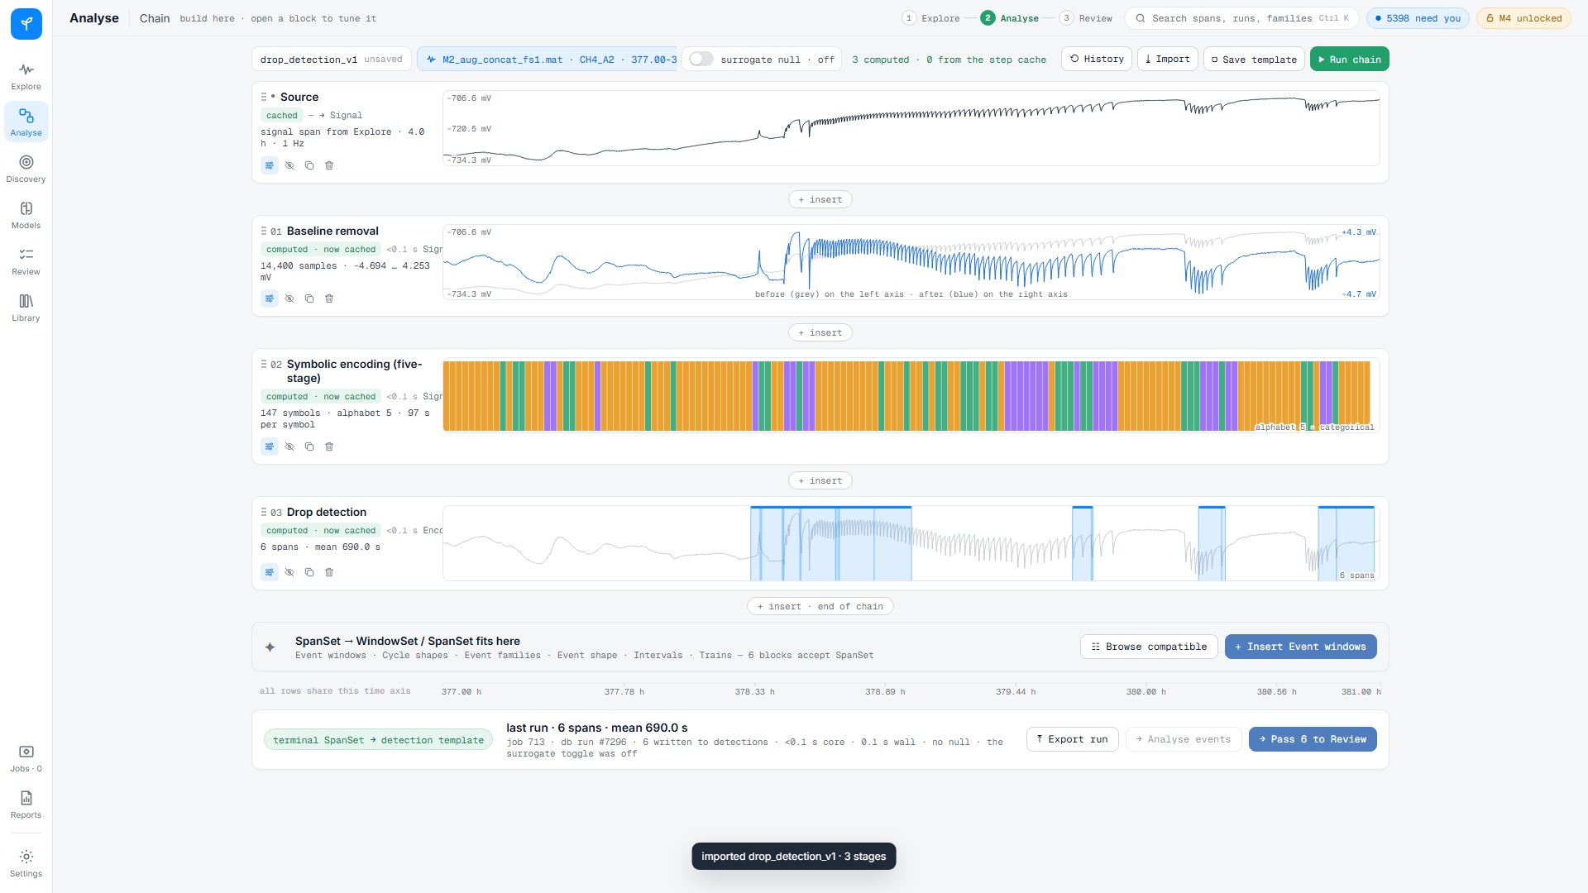
Build: detrend, symbolic encoding, drop detection
six drops on the span · saved as the template "demo · drop detector"

Slide 9
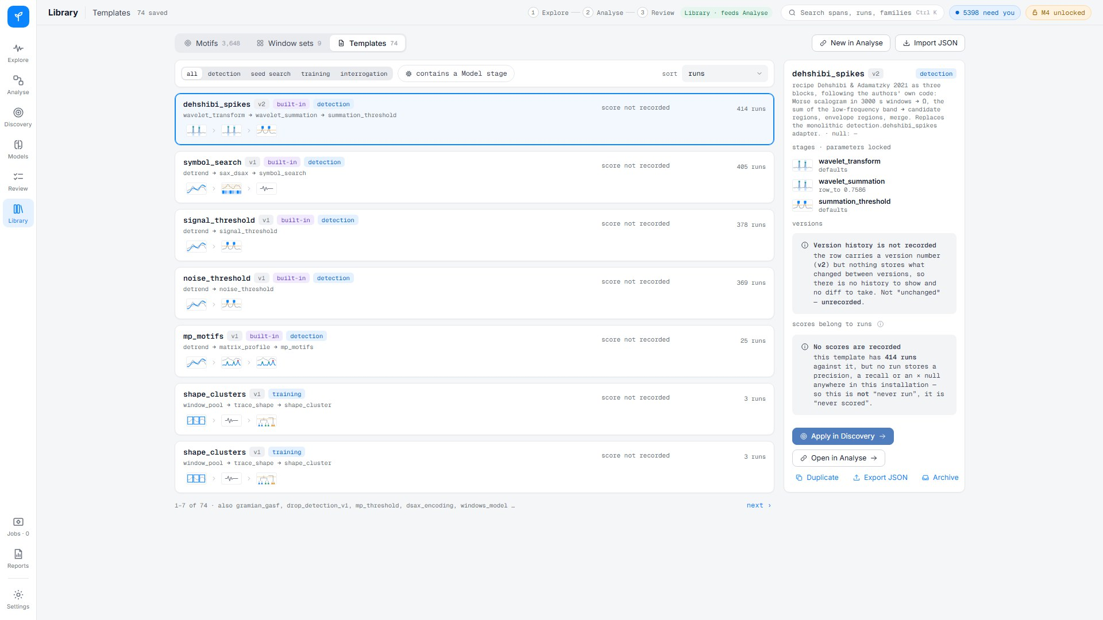
Library · Templates: the saved chain sits beside the built-ins
versions and scores per template

Slide 10
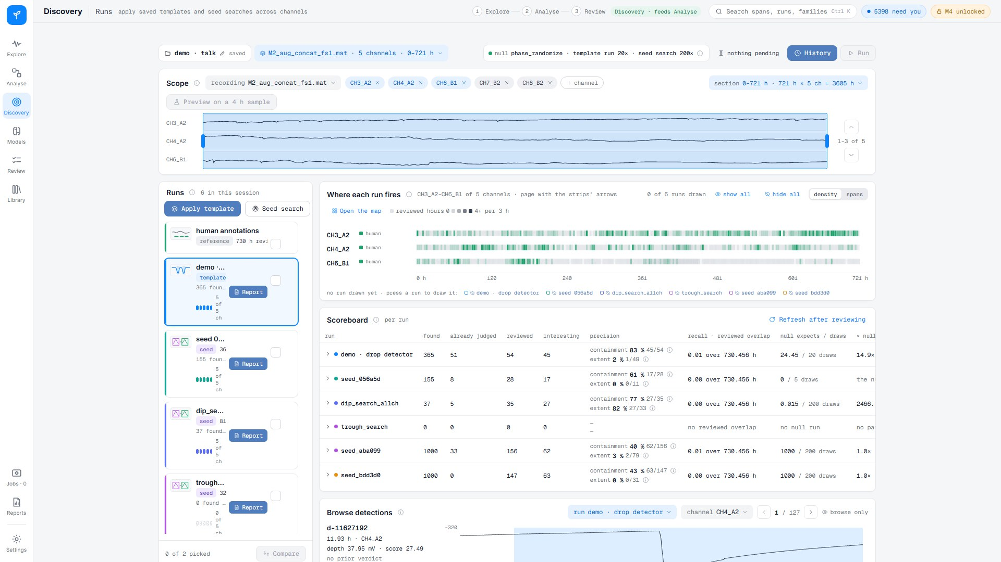
Discovery · Runs: the template applied to five channels, 721 h
365 detections · 20 phase-randomised null draws per channel · ~2.5 min, pre-run

Slide 11
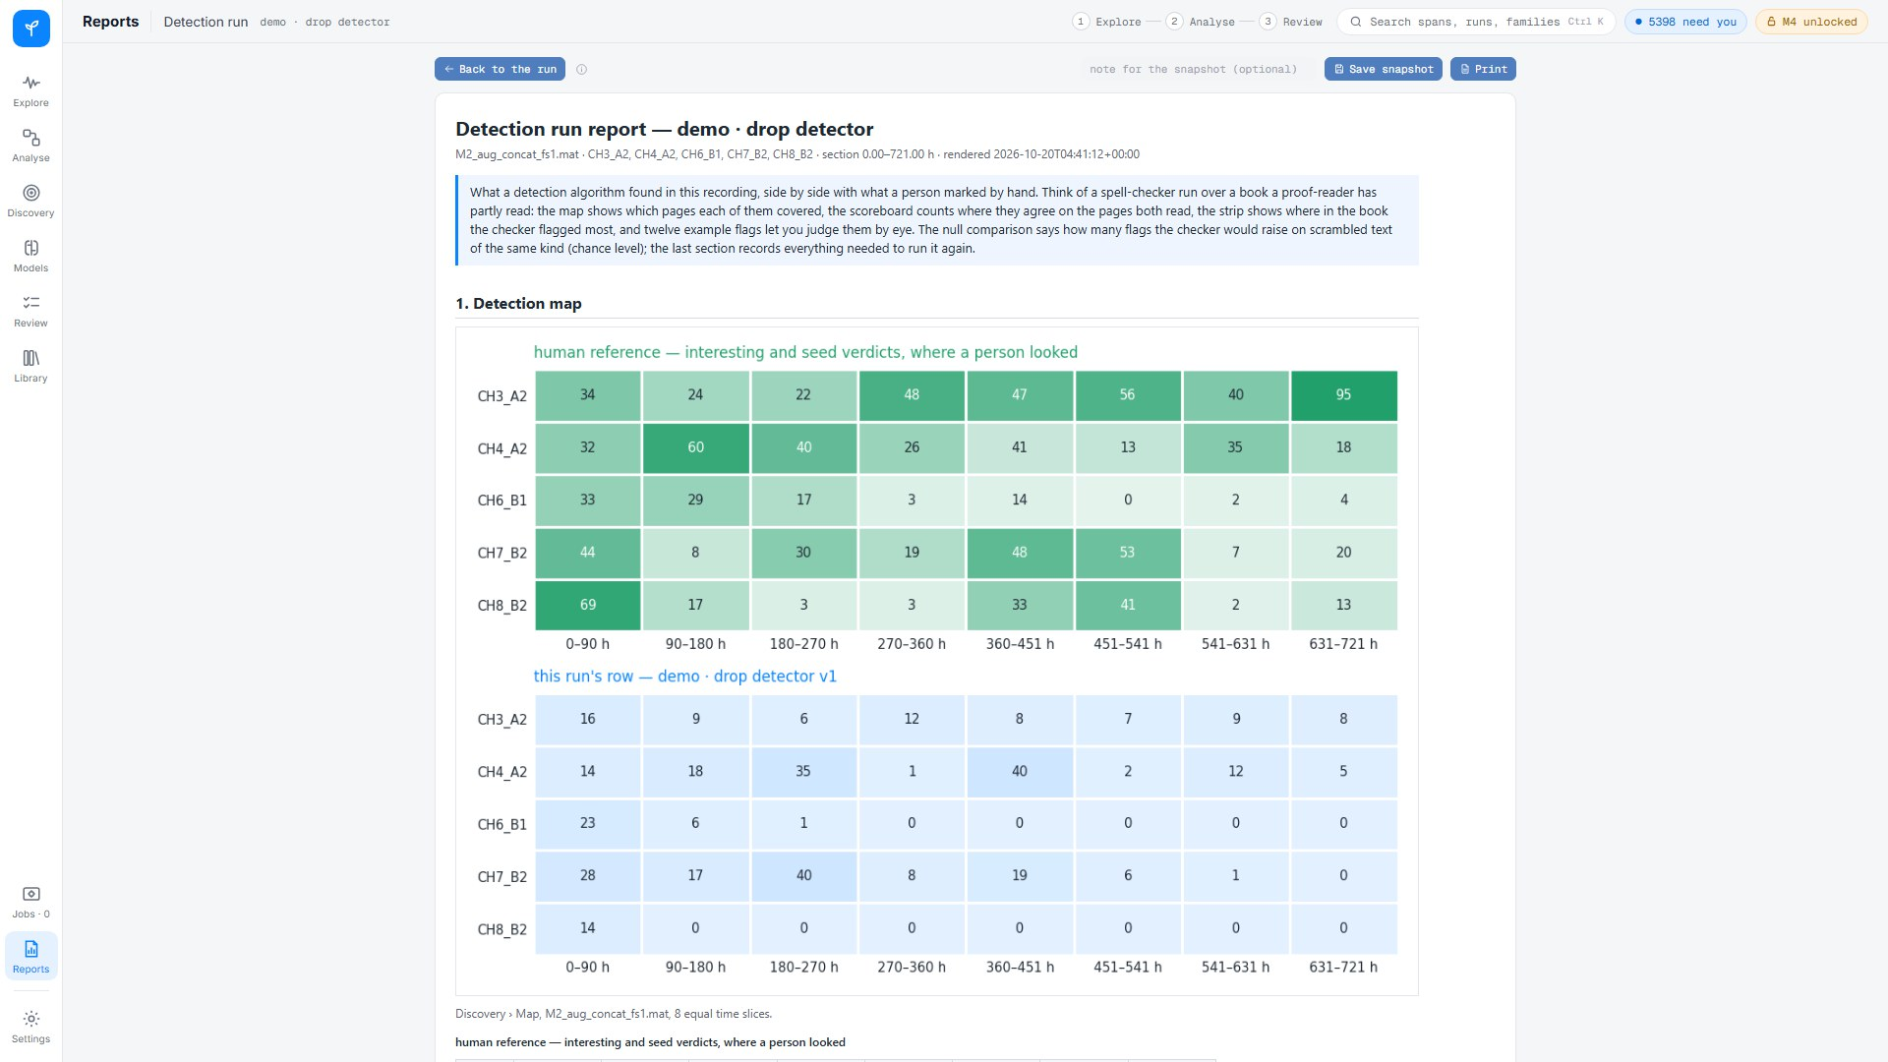
Report: where it fired, against the human reference and its null
drawn by the server; a saved snapshot opens instantly from Reports

Slide 12
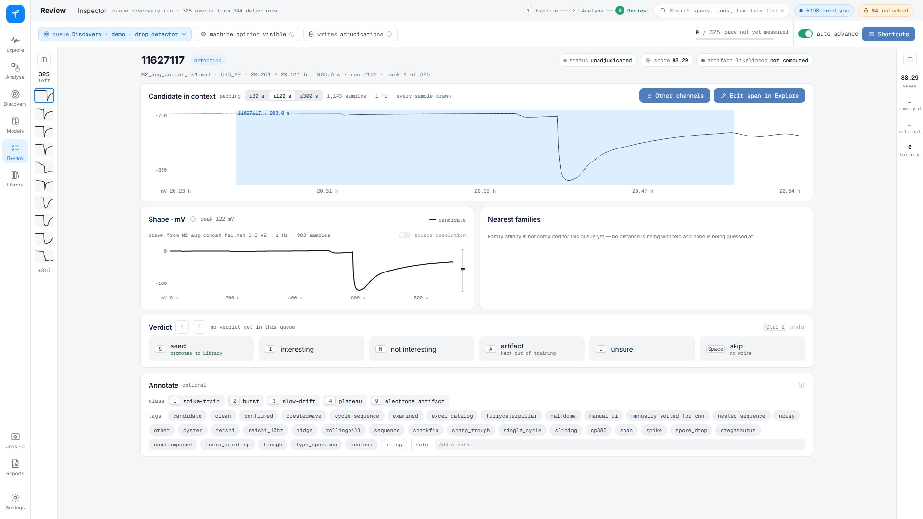
Review: each detection judged by a person
queue "Discovery · demo · drop detector" · 325 events

Slide 13
Walkthrough 3
From a Library family to new instances of its shape

Slide 14
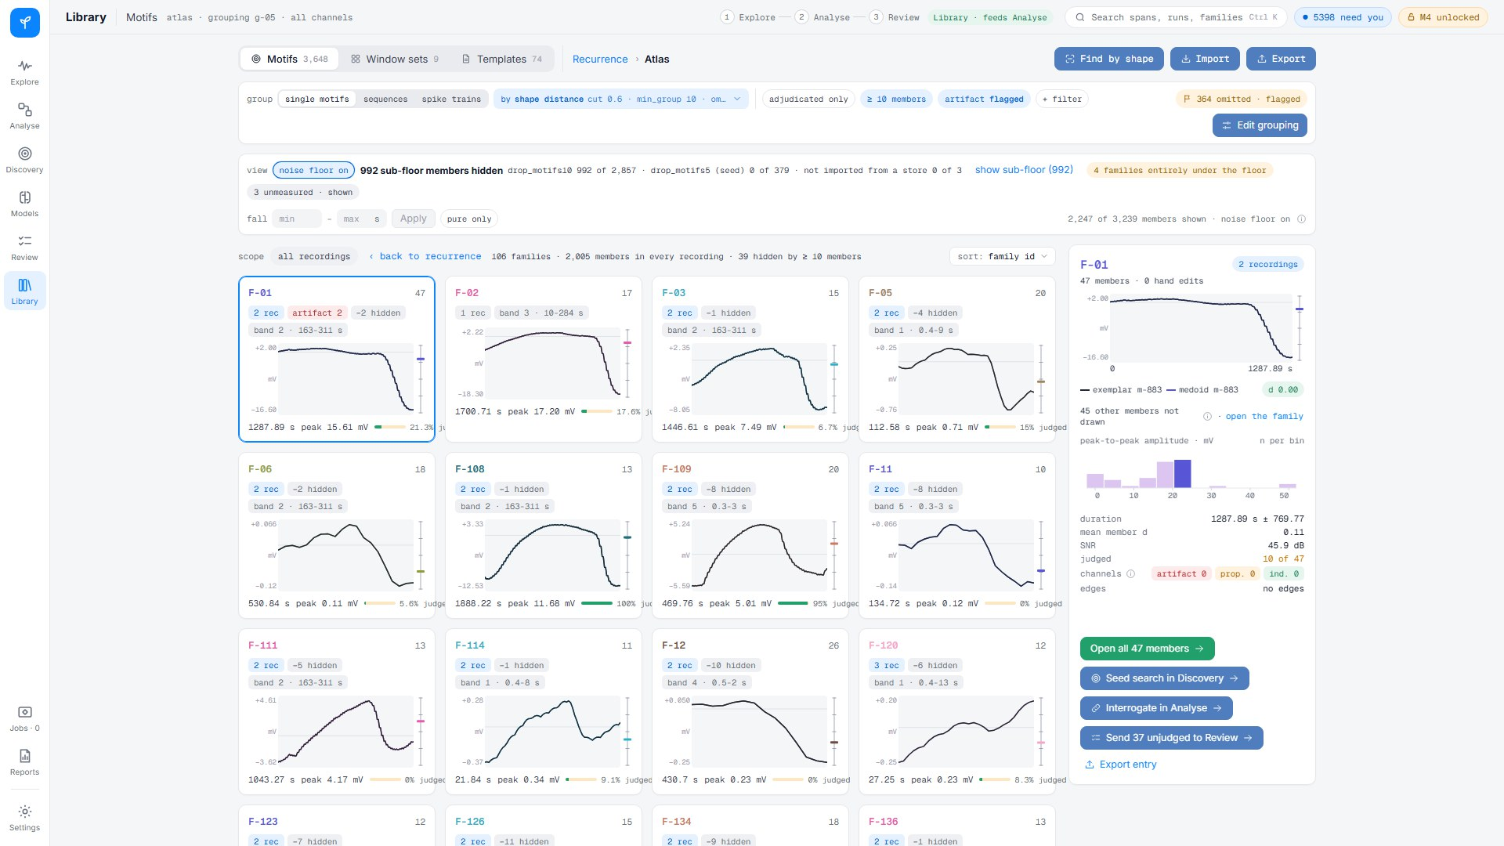
Library · Atlas: families grouped by shape
grouping g-05 "shape families"

Slide 15
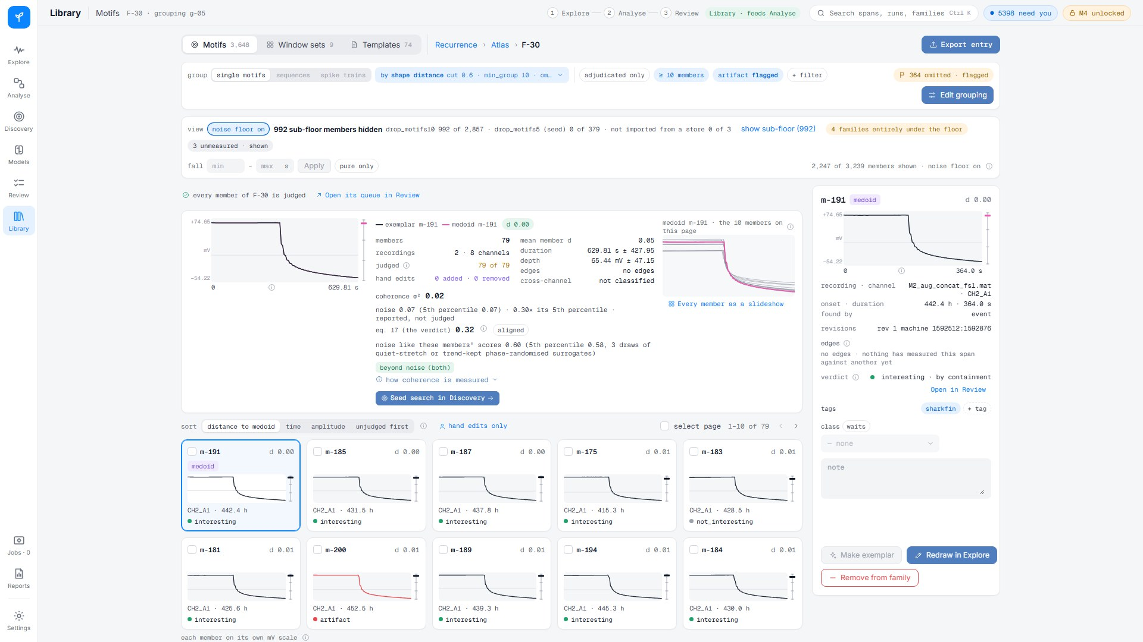
Family F-30: 79 members, every one judged
medoid m-191 on CH2_A1 at 442 h · Seed search in Discovery

Slide 16
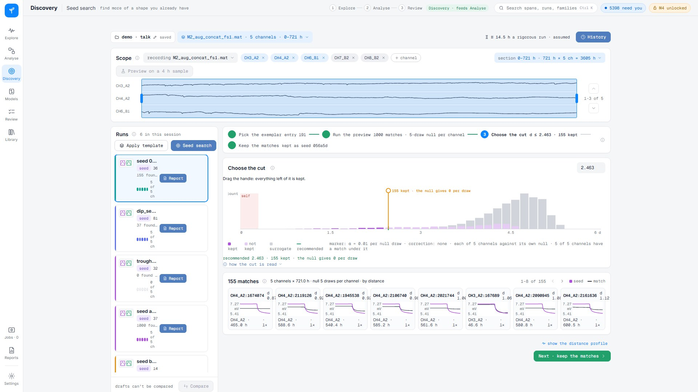
Seed search: the medoid matched across five channels, 721 h
1000 matches · the null recommends the cut · 155 kept

Slide 17
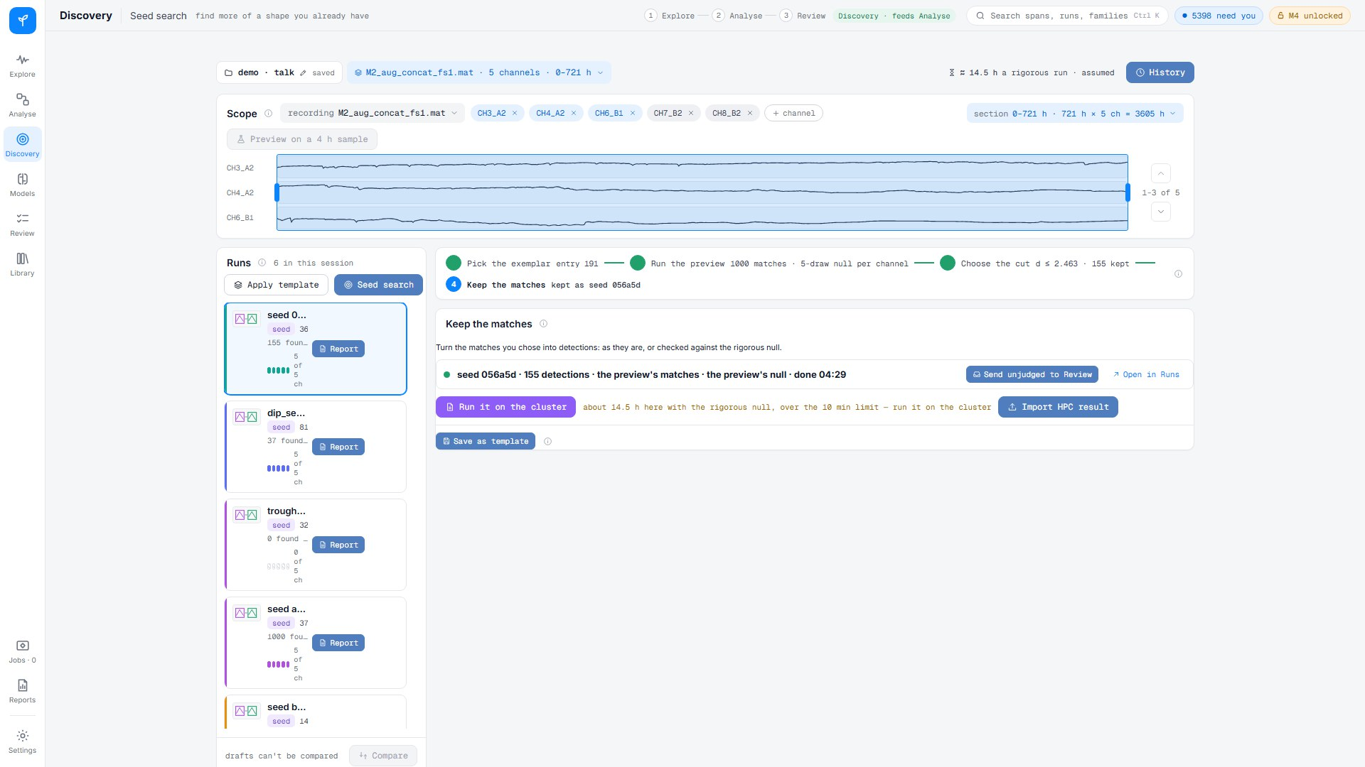
Kept as a run; the same search returns the same run
seed 056a5d · 155 detections · sent unjudged to Review

Slide 18
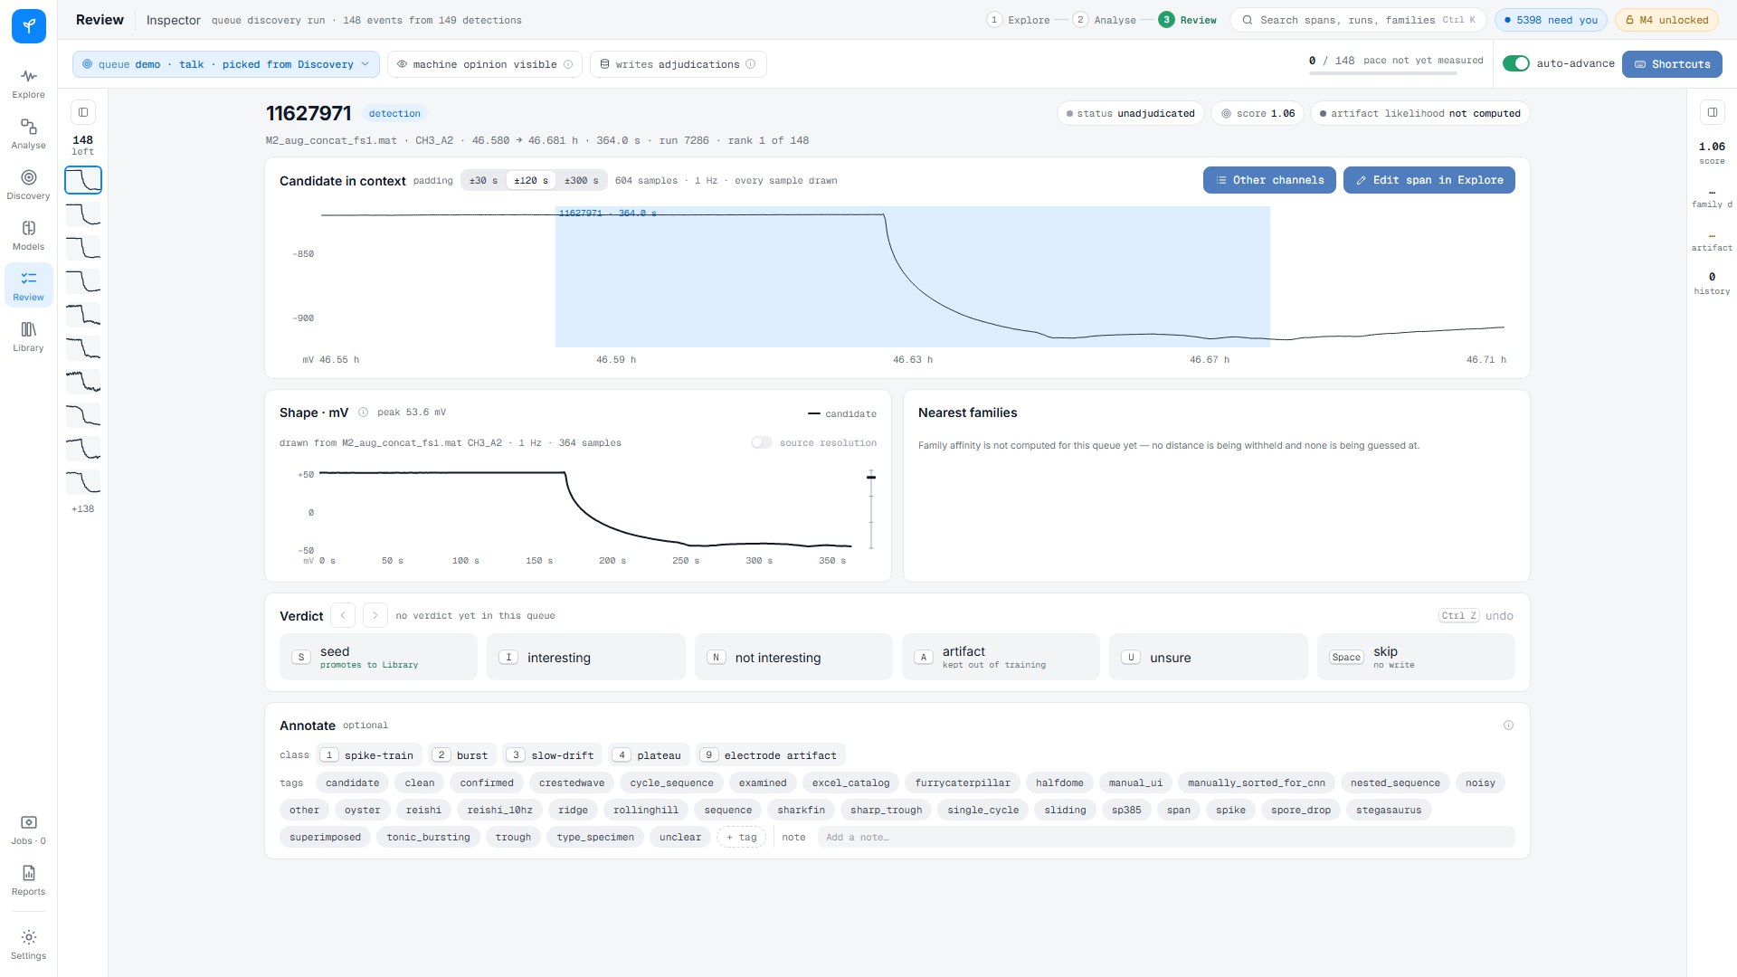
Review: the matches, one at a time
queue "demo · talk · picked from Discovery" · 149 items

Slide 19
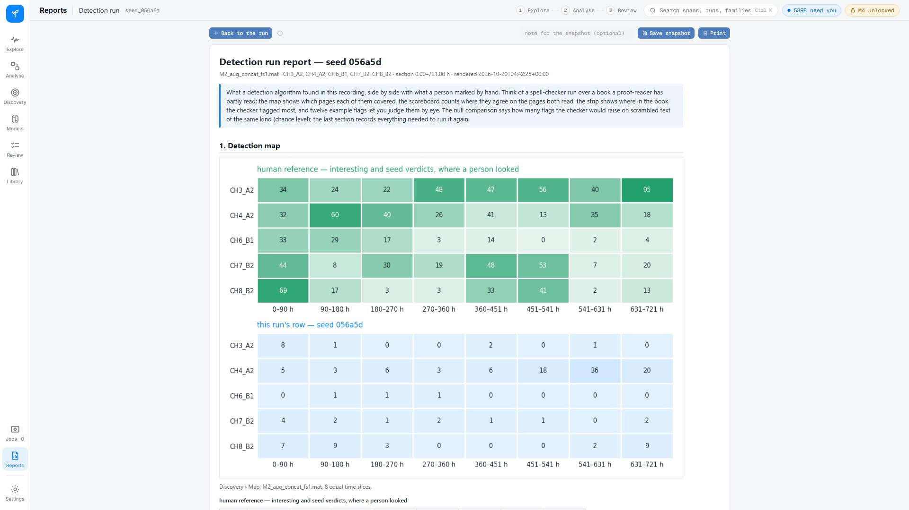
Report for the seed run
seed 056a5d

Slide 20
Results
R1 where each algorithm fires · R2 seeded search · R3 how many candidates are real · R4 shape vs agreement

Slide 21
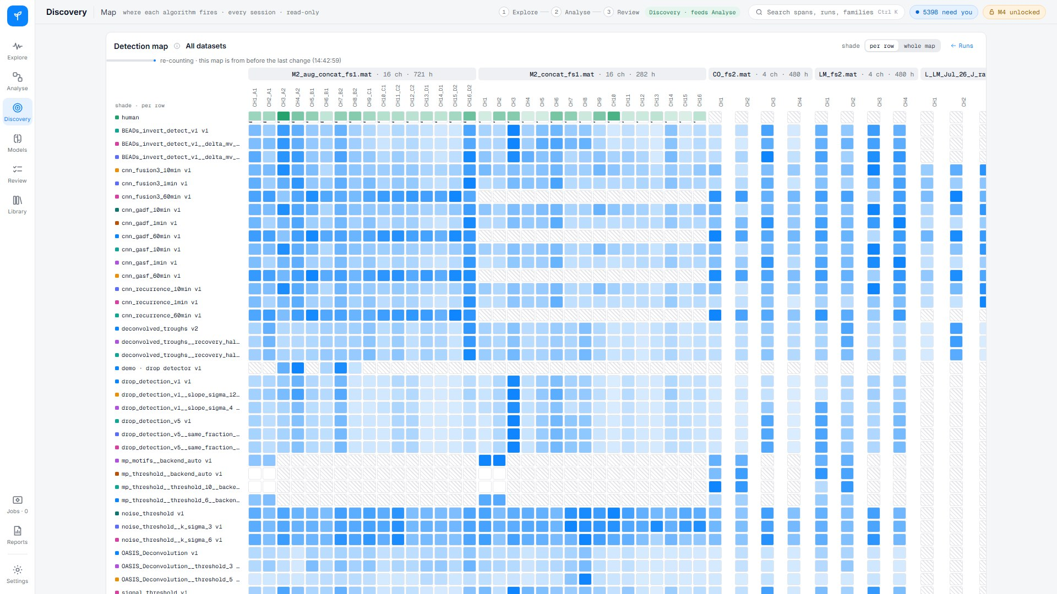
R1 · Every dataset, every algorithm, every channel
Discovery › Map, all datasets with a finished run

Slide 22
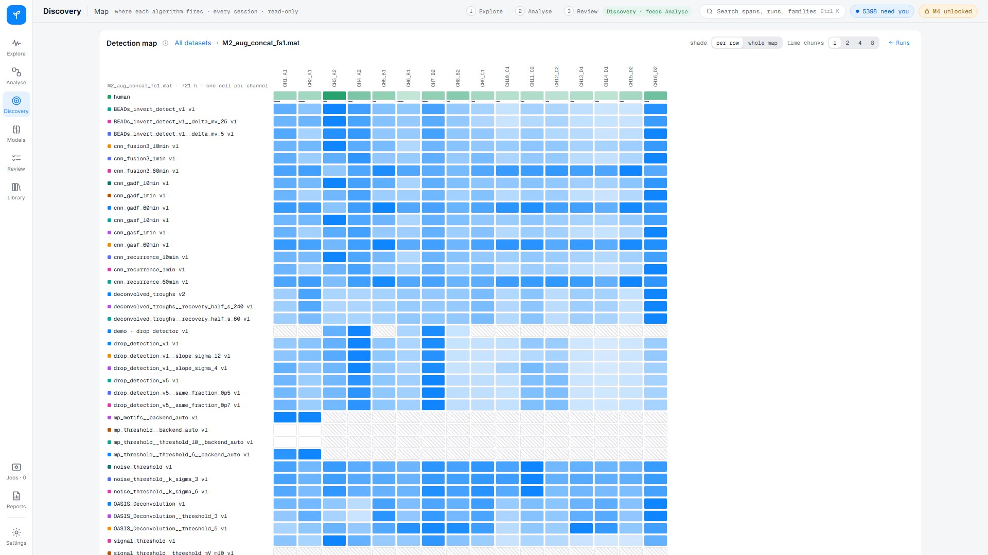
R1 · M2_aug in detail
one dataset, its channels × algorithms

Slide 23
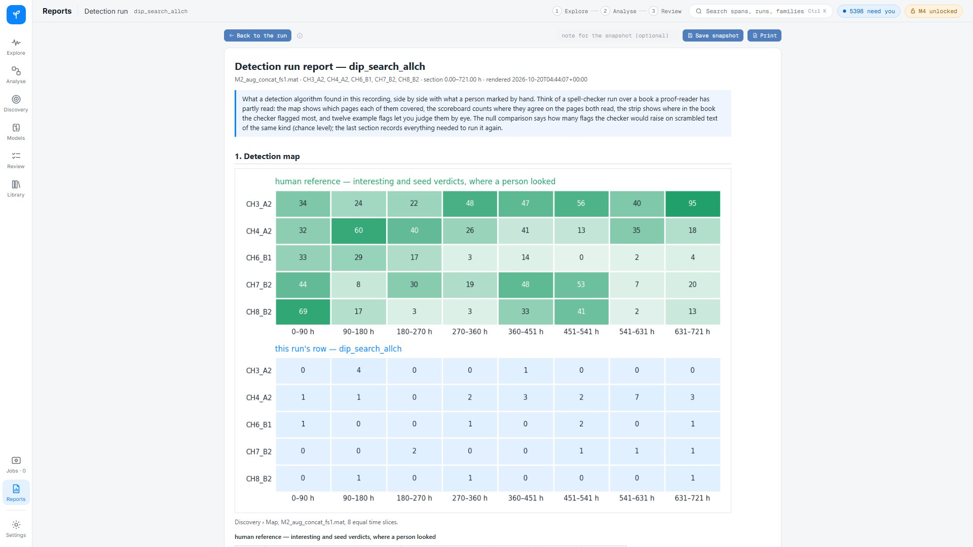
R2 · A seeded search over every channel: dip_search_allch
report; the human reference on top, this run below

Slide 24
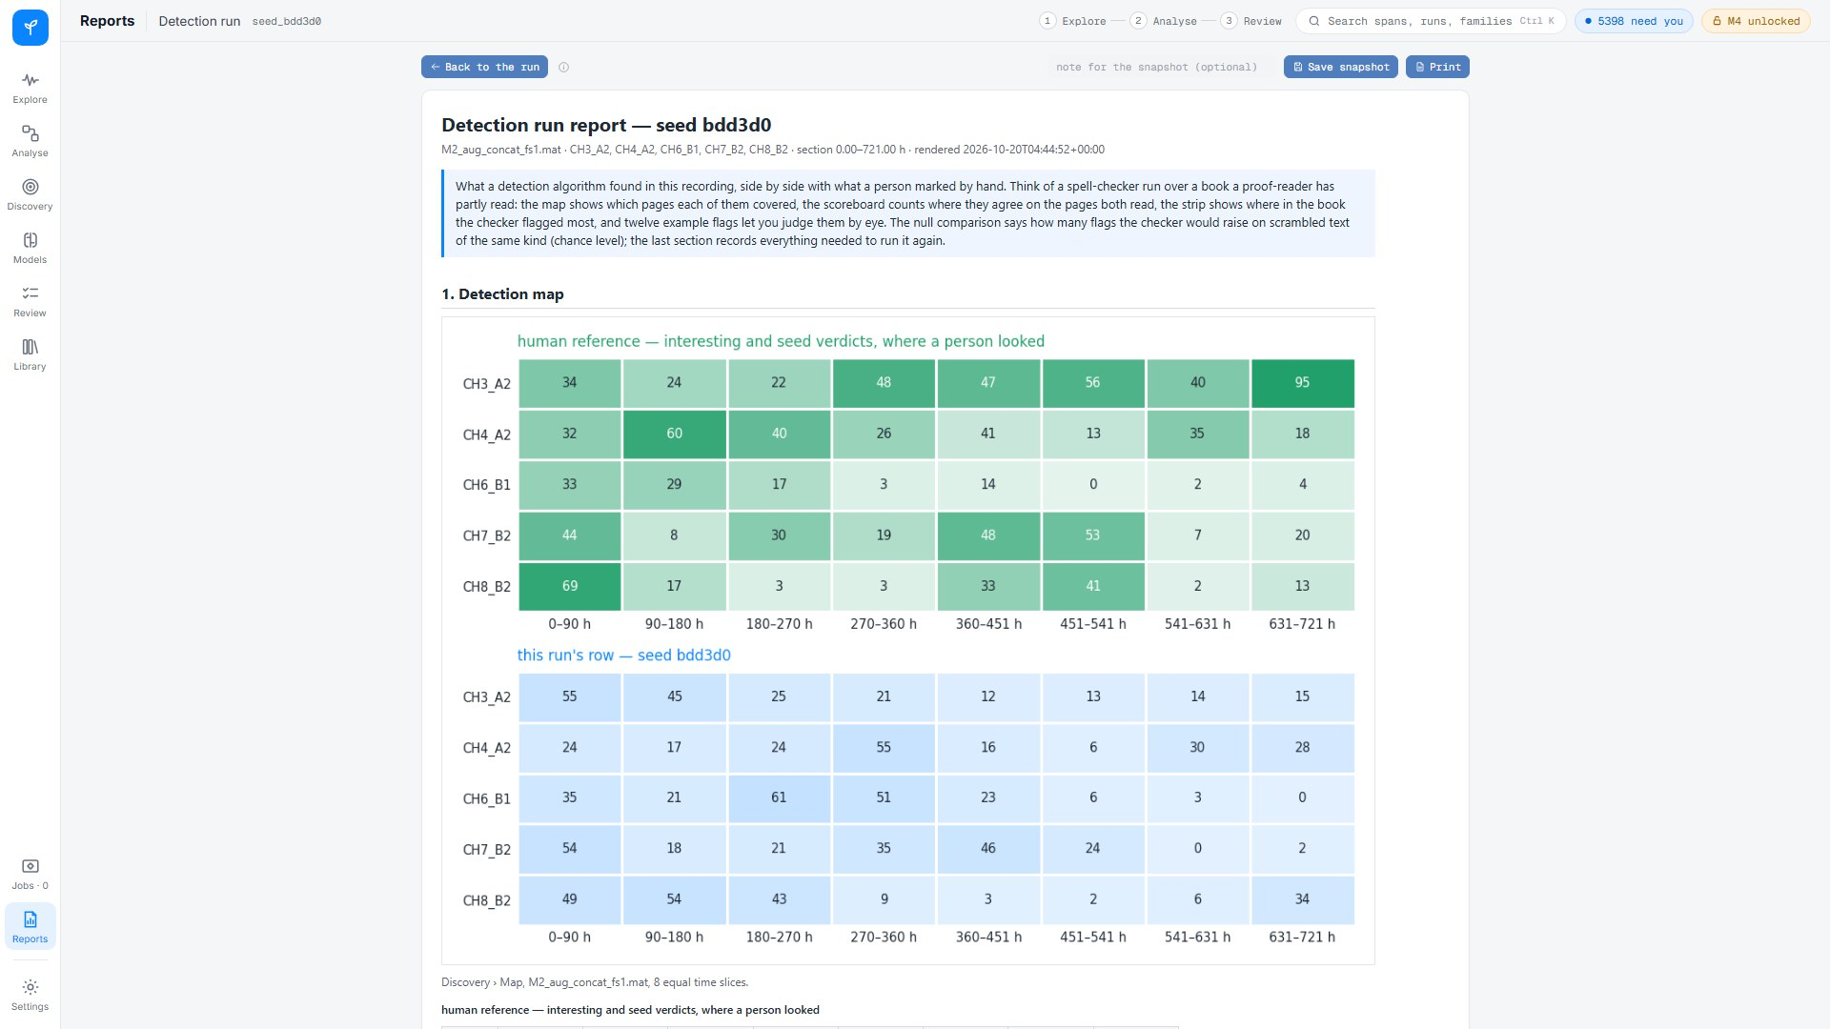
R2 · A second seeded search: seed bdd3d0
report

Slide 25
R3 · About one candidate in four is worth a look
24.6 %
of the 1.5 million unjudged candidate events on M2_aug are estimated interesting (95 % CI 21-28 %)
from 754 blind verdicts in Review queue 25, a stratified sample · bootstrap 1000×. Agreement is the strongest single sign: below 5 agreeing families almost nothing is interesting.
Notes:
Source: DATA/derived/candidate_events/M2_aug_concat_fs1_bf098c00/sample_seed0_l100_f50/estimate.json. CIs per stratum: 1-2: 1-8 % (n=95); 3-4: 2-10 % (n=107); 5-6: 15-30 % (n=126); 7-8: 46-63 % (n=178); 9+: 50-67 % (n=248)

Slide 26
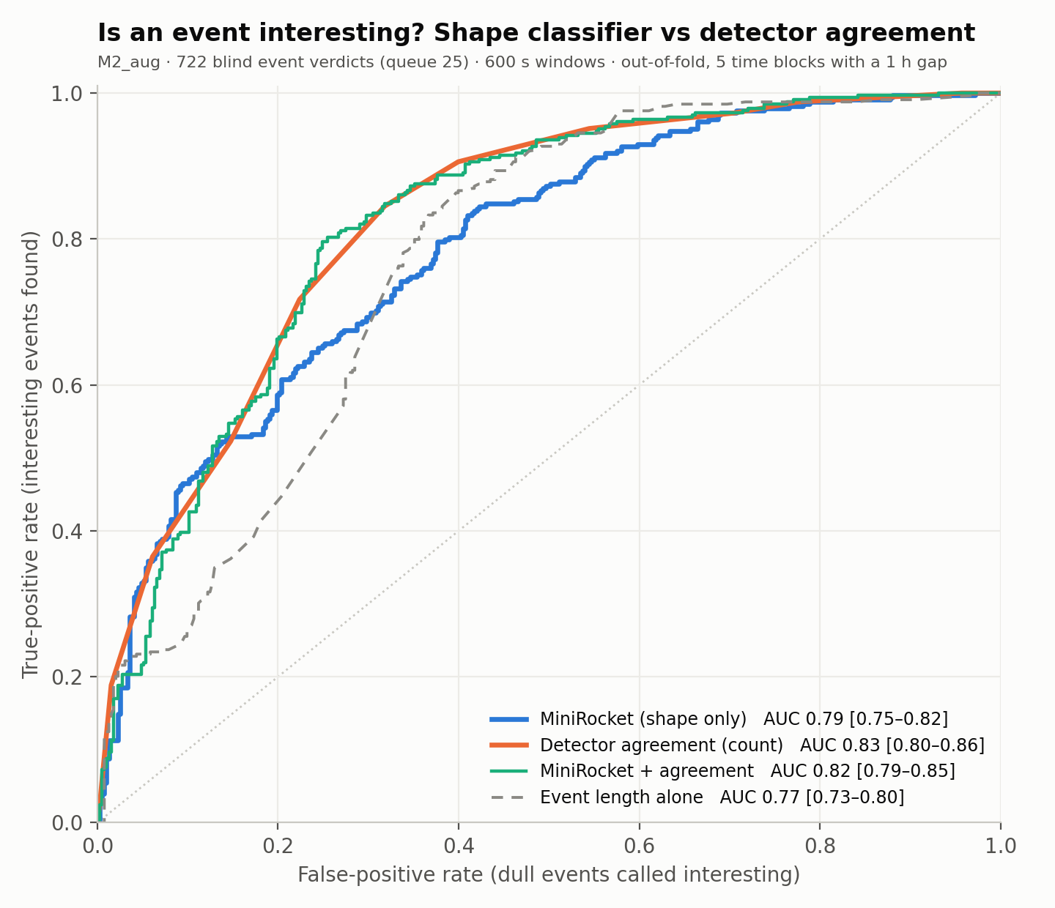
R4 · Shape alone does not beat the vote yet
0.83
AUC · detector agreement count
0.79
AUC · MiniRocket on the trace’s shape
0.82
AUC · both together
On 722 blind verdicts (queue 25). The labels are few for MiniRocket, and "interesting or not" is what agreement measures well; the family classifier needs class labels and more examples, and that is the next step.
Notes:
Source: docs/rq_roundA_2/findings/rq1b-minirocket-preliminary.md and its ROC figure. Preliminary: not the family classifier, not the exam recording.

Slide 27
Thank you
Questions

