Slide 1


InHolland Golang 2025
A hands-on introduction to Go in
one day!
Mitchel Koster
https://github.com/mitchelkoster/inholland-2025

Slide 2
0x00 - Introduction
  Whoami
  What will we learn?
  What is Golang

Slide 3

Whoami
About Me
  Chief Security Researcher @ Breachlock
  Background in Software Development & Embedded Systems
  Pentester, Red Teamer, Software Developer & Mentor
  A passion for learning how things work
Certifications
  OSCP
  OSCE
  CREST: CPSA
  CREST: CRPT
https://www.linkedin.com/in/mitchelkoster/

Slide 4
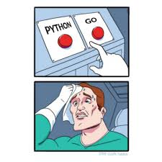

What is Go?
What Google Says
  An open-source programming language supported by Google
  Easy to learn and great for teams
  Built-in concurrency and a robust standard library
  Large ecosystem of partners, communities, and tools
My own additions
  A language with a “simplicity first” approach
  “Fast” in context of Go means “compilation time” and “concurrency”
  Build from the ground up with scalability in mind
  It’s compiled and supports cross-platform compilation
  Is one of the fastest languages out there!

Slide 5
What will we learn?
0x01 - Setup & Tooling Install Go, write and compile your first program.
0x02 – Language Basics Learn variables, control flow, and functions
0x03 - Files & Errors Understand the “Go way” of error handling and basic
Exercise Spot my mistake!
0x04 - Data Structures Work with slices, maps, and structs and pointers
Exercise Parse web server log books
0x05 Go != OOP Use composition and interfaces to build a website uptime monitor.
Exercise Build a website up-time monitor

Slide 6
0x01 - The Go Environment
Students configure their environment, get familiar with the CLI, and build
their first program.
  Setting up the Go environment
  Getting familiar with Go CLI tools
  Understanding Go modules & packages

Slide 7
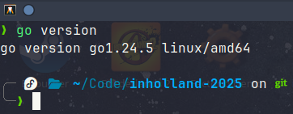
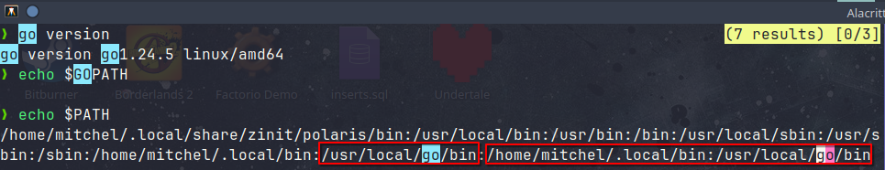
Setting up the Go environment
Setting up the Go environment
  Download Go on https://go.dev/
  Install Go!
  Open a Terminal and type “go version”
  If this does not work check $GOPATH and $PATH

Slide 8
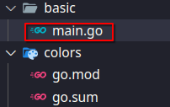
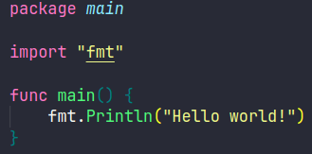
Setting up the Go environment
Let’s create our first program
  We always start with “Hello World”

Slide 9
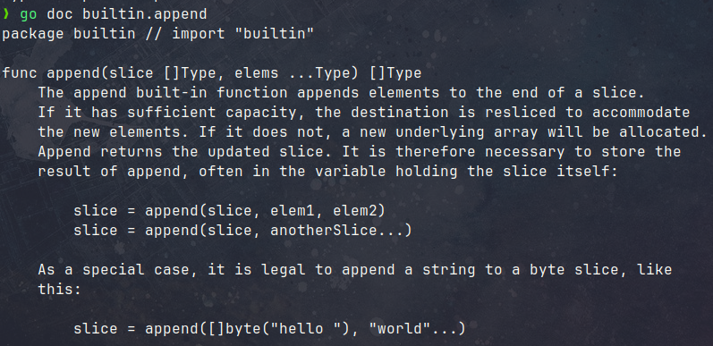
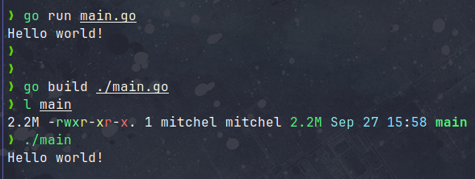
Getting familiar with Go CLI tools
The Go Tool kit is awesome
  go run main.go compile & run a program quickly
  go build build a binary
  go fmt format code automatically
  go doc view documentation
  go test run tests
  Tests can do –benchmarks
  And more!

Slide 10
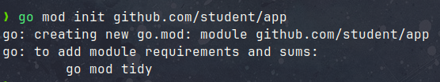
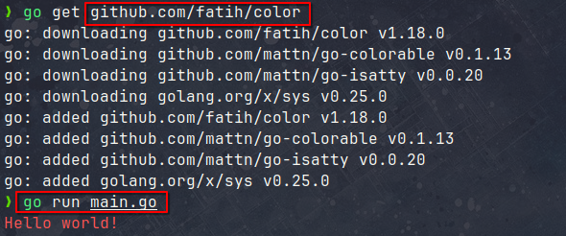
Understand Go Modules and Packages
Go Modules & Packages
A module is a Go project or a “container of dependencies” (third party code). A package is a “name space” within your program.
To import a module:
Initialize your project as module
Use the go tool kit to “get” code
Maintain dependencies in go.mod
https://github.com/fatih/color

Slide 11
0x02 - Language basics
Minimal building blocks for writing simple programs:
  Variables, constants & data types
  Control flows & Defer
  Functions

Slide 12
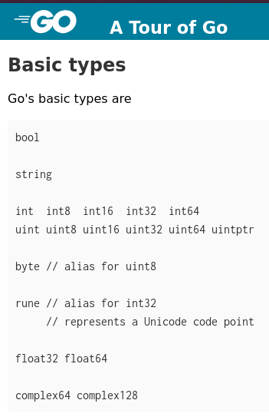
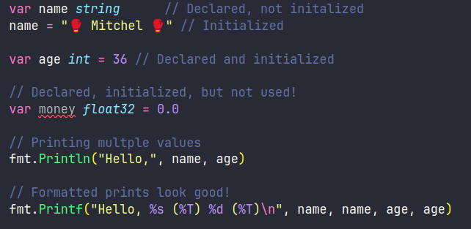
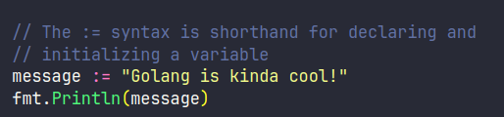
Variables, Constants & Data Types
Basic Data Types
Advanced ones are self created!
Variables and variable Declaration
Compilers: Declaring != Initialization
Variables need to be used!

Slide 13
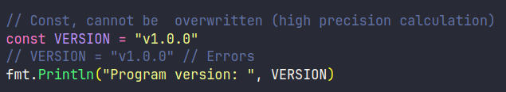
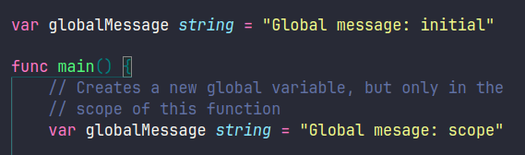
Variables, Constants & Data Types
Constants and Global
Advanced ones are self created!

Slide 14
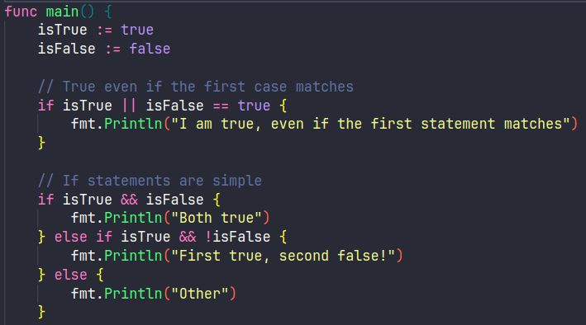
Control Flow & Defer
If statements
Are no different from what you are used to, minus the parenthesis ( )

Slide 15
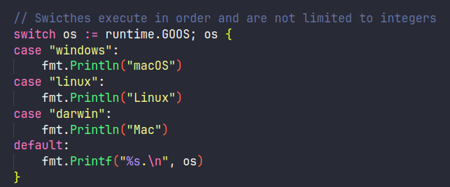
Control Flow & Defer
Switches
Can run on much more than just integers

Slide 16
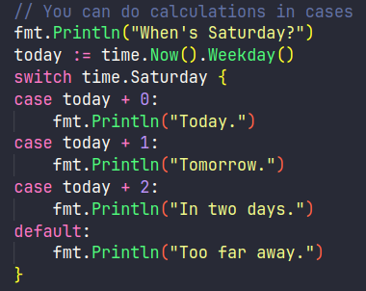
Control Flow & Defer
Switches
You can also do operations in cases

Slide 17
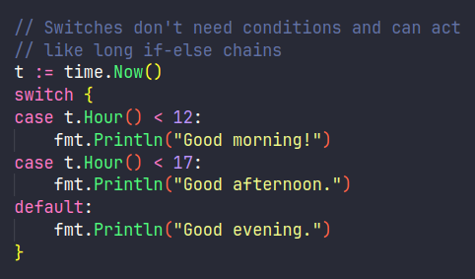
Control Flow & Defer
Switches
You can also do operations in cases

Slide 18
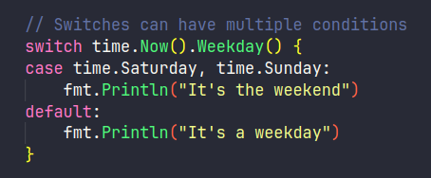
Control Flow & Defer
Switches
You can also do operations in cases

Slide 19
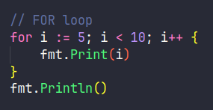
Control Flow & Defer
For loops
You can also do operations in cases

Slide 20
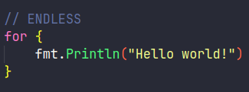
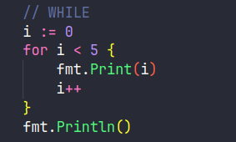
Control Flow & Defer
For: One loop to rule them all
A in for loop can do pretty much all that is need, while do we have a while syntax?

Slide 21
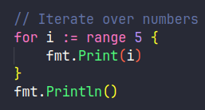
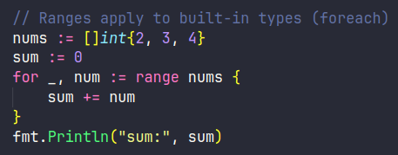
Control Flow & Defer
For: One loop to rule them all
For can do iteration to, even over built-in types.

Slide 22

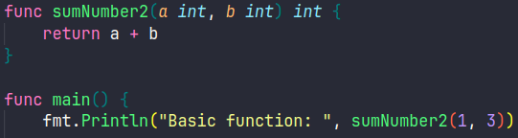
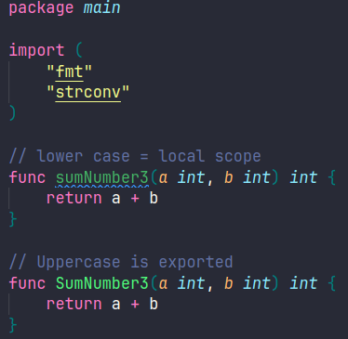
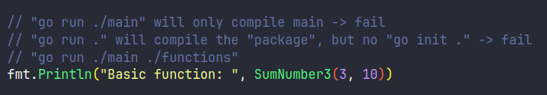
Functions
Functions
For every parameter, name first, type second. Return value
at the END of the function header.

Slide 23
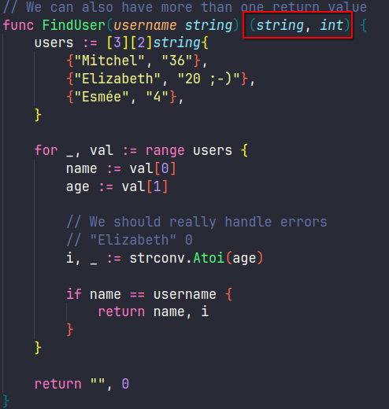
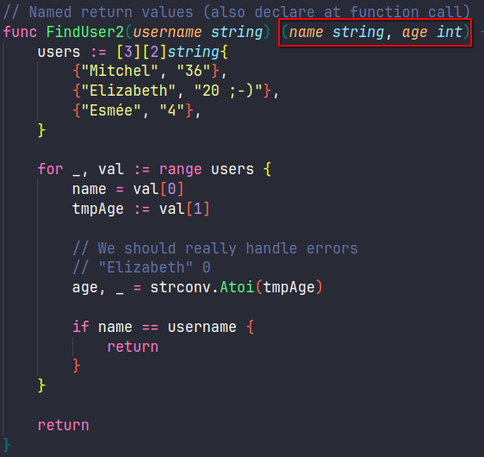

Functions
Multiple returns & Named returns
For can do iteration to, even over built-in types.

Slide 24
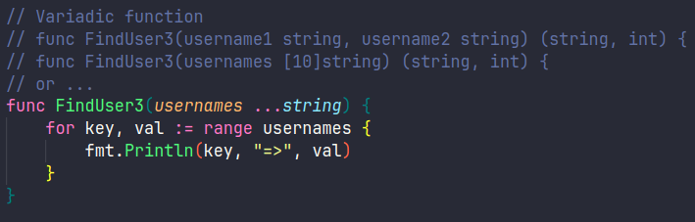

Functions
Variadic Functions
For can do iteration to, even over built-in types.

Slide 25
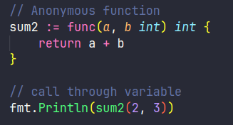
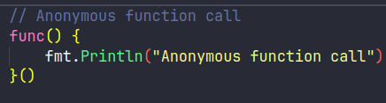
Functions
Anonymous functions
For can do iteration to, even over built-in types.

Slide 26
0x03 - Files & Error handling
Golang handles some things differently, so let’s discuss them while learning how to read files so and get accustomed to error handling.
  Reading from a file
  Writing to a file
  Error handling vs exceptions
  The idiomatic if err != nil

Slide 27
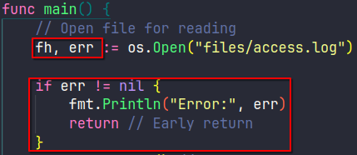
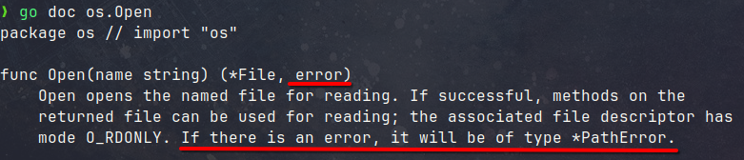
The “Go way” of error handling
Idiomatic Errors
For reading

Slide 28
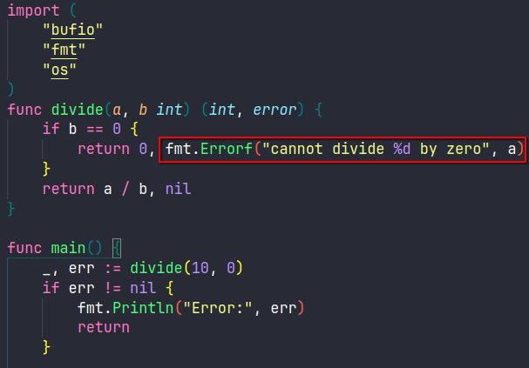
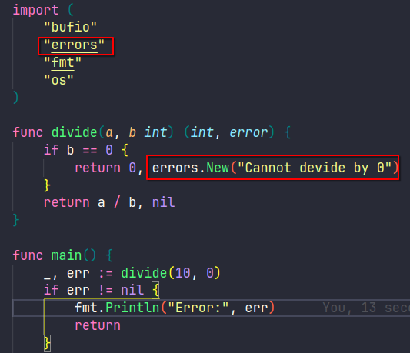
The “Go way” of error handling
Custom errors
For reading

Slide 29
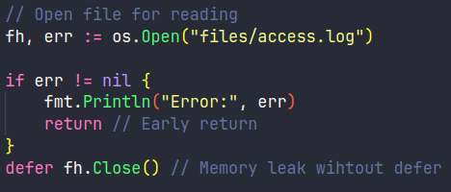
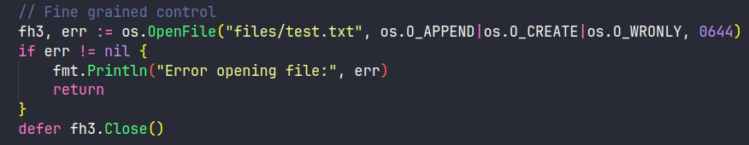
Opening files
Opening Files for Reading
For reading
When you need more control

Slide 30
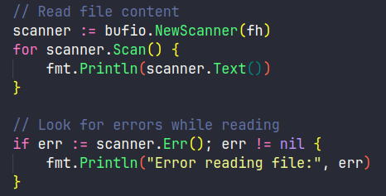
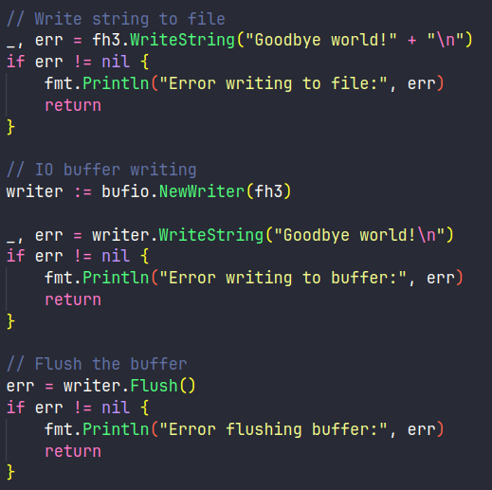
Reading & Writing to files
Reading and Writing to files
For can do iteration to, even over built-in types.

Slide 31
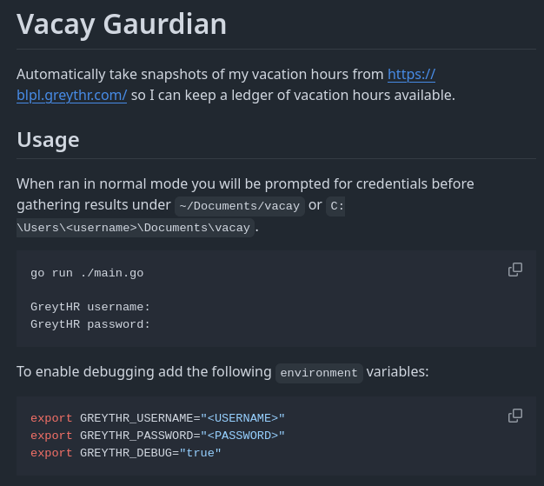
Exercise – Spot my mistake
I made a mistake writing my first Go program. Can you spot it?
  Explain what my function does
  What go principle did I not follow
https://github.com/mitchelkoster/vacay-gaurdian/blob/main/utils/storage.go

Slide 32
0x04 - Advanced data types
Work with more advanced structures by reading and parsing webserver logs into data models.
  Slices, maps, enums
  Structs and custom types

Slide 33
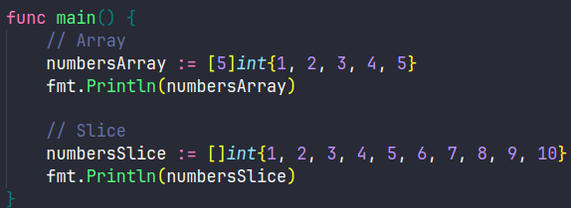
Advanced Data Types
Slices
Slices allows us to have collections of any size. The syntax is very similar to arrays.

Slide 34
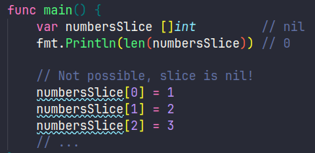
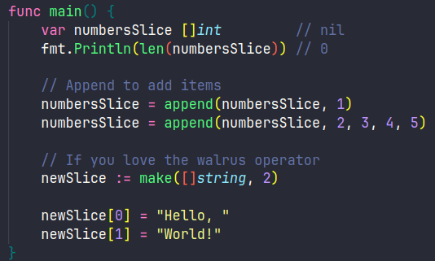
Advanced Data Types
Slices
If you wan to add to a slice you need to append(), you cannot use the array syntax!

Slide 35
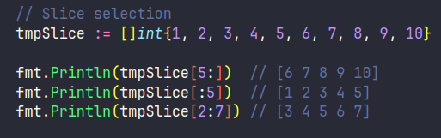
Advanced Data Types
Slices
Slices allow for partial selection of the data.

Slide 36
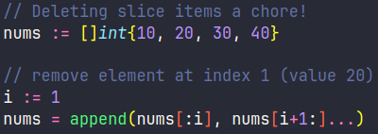
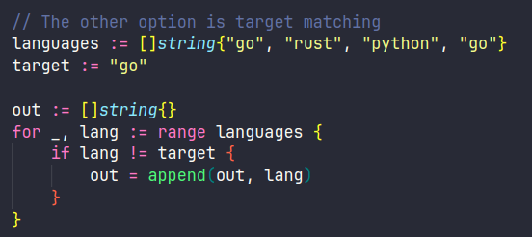
Advanced Data Types
Slices
Deleting slices can be done through index remapping or by creating a new slice.

Slide 37
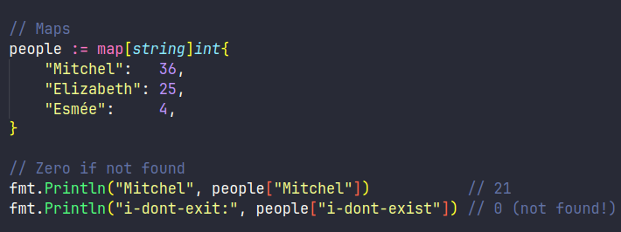
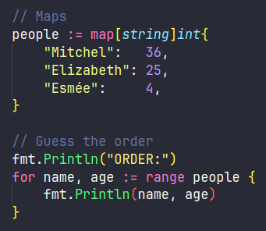
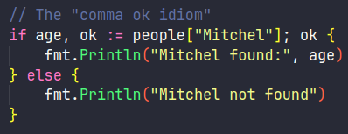
Advanced Data Types
Maps
If a map item does not exist it returns 0, this can be confusing but is easy to check.

Slide 38


Advanced Data Types
Maps
Maps items can easily be added to, updated or removed.

Slide 39


Advanced Data Types
Enums
Enums cant be compared to Java, etc. They are typed constants (with a custom type for clarity)

Slide 40

Advanced Data Types
Struct
Enums cant be compared to Java, etc. They are typed constants (with a custom type for clarity)

Slide 41

Advanced Data Types
Struct
In Go, methods can be tied to a type (like a struct), but the function itself still exists separately, it’s not like a class method in Java. You can call the method on a receiver (the struct receives the method Summary).

Slide 42

Advanced Data Types
Struct
Receivers with pointers can be compared to “this” in an object, it will update the reference.

Slide 43


Advanced Data Types
A quick note on pointers
Go has (and uses) pointers, but the declaration is slightly different from C. Any assignment with a memory address is considered a pointer! The dereference done auto-magically in structs.

Slide 44

Advanced Data Types
Custom Types
We can also add methods to the custom HTTPStatus type just as with a Struct

Slide 45

Advanced Data Types
Custom Types
Now we have a very strong HTTP response handler using structs and custom data types

Slide 46

Exercise – Parse Server Logs
Can you read my log file and parse it into a slice of structs?
  Download the logbook: https://pastebin.com/fbW8wUZ7
  Log format: IP - - [Timestamp] "METHOD PATH PROTOCOL" STATUS SIZE "REFERER" "USER-AGENT"
  Write a parser!

Slide 47
0x05 - Golang != OOP
No classes, but composition and interfaces which we will apply to a website uptime monitoring tool on the top 100 websites in the Netherlands using design patterns.
Inheritance v.s. Composition (no classes)
  Interfaces
  Packages & Program Structure

Slide 48
Golang != OOP
Forget about Object Oriented Programming
Go doesn’t have classes. Instead, Go uses structs and interfaces, instead you build through composition, not inheritance.
A simple way to thing of it is “combining basic lego blocks to make something, rather than creating a new lego block for every problem” – Mitchel 2025.

Slide 49



Golang != OOP
Lets look at composition
We can add components (engine) to composites (car) to create different cars, without creating super classes. Each composite is just a new arrangement of the same building blocks.

Slide 50


Golang != OOP
Interfaces are not strictly implemented
Rather, any struct that meets the interface implementation… Implements the interface when used as such.

Slide 51

Golang != OOP
Let’s look at a the observer pattern
How do we fire update events throughout our application?
https://refactoring.guru/design-patterns/observer

Slide 52


Golang != OOP
Let’s look at a the observer pattern
Publisher and Subscriber models (such as message queues) are a great solution.
https://refactoring.guru/design-patterns/observer
https://refactoring.guru/design-patterns/observer

Slide 53





Golang != OOP
Let’s look at a the observer pattern
We need to create a new publisher and subscribers. The publishers maintains a list of subscribers.
https://refactoring.guru/design-patterns/observer

Slide 54



Golang != OOP
Let’s look at a the observer pattern
Once subscribers are created, they need to subscribe to the publisher. Append to the slice of observers.
https://refactoring.guru/design-patterns/observer

Slide 55




Golang != OOP
Let’s look at a the observer pattern
Finally the publisher can notify all subscribers to their unique update call.
https://refactoring.guru/design-patterns/observer

Slide 56
Exercise – Website status monitor
Can you monitor the status code of these websites?
  Download the top 100 websites: https://pastebin.com/9r9ADsaQ
  Use go get for https://pkg.go.dev/net/http
  Visit all domains
  Print results to screen & store in a file
  Bonus points for CSV (https://pkg.go.dev/encoding/csv)

Slide 57
0x07 - Concurrency
The crown jewel of Go, let's speed up our website monitoring tool!
  Go Routines
  Mutexes (when needed, vs channels)
  Detecting and preventing issues:
  Deadlocks & Race Conditions (Dirty Cow Exploit)
  Race detector (go run -race)

Slide 58
Thank You
Feel free to reach out to me!

