Slide 1


InHolland Golang 2025
A hands-on introduction to Go in
one day!
Mitchel Koster
https://github.com/mitchelkoster/inholland-2025

Slide 2
0x00 - Introduction
  Whoami
  What will we learn?
  What is Golang?
  Useful resources

Slide 3

Whoami
About Me
  Chief Security Researcher @ Breachlock
  Background in Software Development & Embedded Systems
  Pentester, Red Teamer, Software Developer & Mentor
  A passion for learning how things work
Certifications
  OSCP
  OSCE
  CREST: CPSA
  CREST: CRPT
https://www.linkedin.com/in/mitchelkoster/

Slide 4
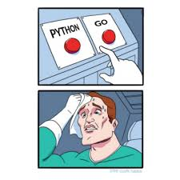

What is Go?
What Google Says
  An open-source programming language supported by Google
  Easy to learn and great for teams
  Built-in concurrency and a robust standard library
  Large ecosystem of partners, communities, and tools
My own additions
  A language with a “simplicity first” approach
  It’s not a loosely-typed language
  Build from the ground up with scalability in mind
  It’s compiled and supports cross-platform compilation
  Is one of the fastest languages out there!
  https://www.destroyallsoftware.com/talks/wat (video)

Slide 5
What will we learn?
0x01 - Setup & Tooling Install Go, write and compile your first program.
0x02 – Language Basics Learn variables, control flow, and functions
0x03 - Files & Errors Understand the “Go way” of error handling and basic
Exercise Spot my mistake!
0x04 - Data Structures Work with slices, maps, and structs and pointers
Exercise Parse web server log books
0x05 Go != OOP Use composition and interfaces to build a website uptime monitor.
Exercise Build a website up-time monitor

Slide 6
Useful Resources
  https://go.dev/learn/
  https://gobyexample.com/
  https://quii.gitbook.io/learn-go-with-tests
Concepts & Reference Material
Go Package Repository
  https://pkg.go.dev/
A Professional Project
  https://github.com/projectdiscovery/nuclei
Obtain the “Go Mindset”
  Concurrency is not Parallelism by Rob Pike (video)
  Learning Go – O’Reilly (ISBN: 978-1-098-13929-2)

Slide 7
0x01 - The Go Environment
Students configure their environment, get familiar with the CLI, and build
their first program.
  Setting up the Go environment
  Getting familiar with Go CLI tools
  Understanding Go modules & packages

Slide 8
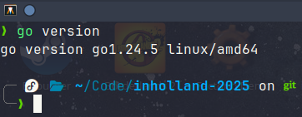
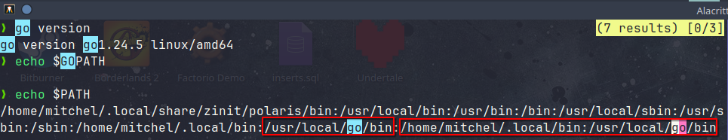
Setting up the Go environment
Setting up the Go environment
  Download Go on https://go.dev/
  Install Go!
  Open a Terminal and type “go version”
  If this does not work check $GOPATH and $PATH

Slide 9
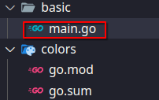
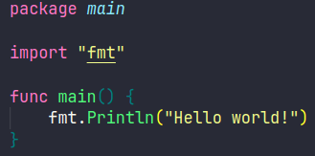
Setting up the Go environment
Let’s create our first program
  We always start with “Hello World”

Slide 10
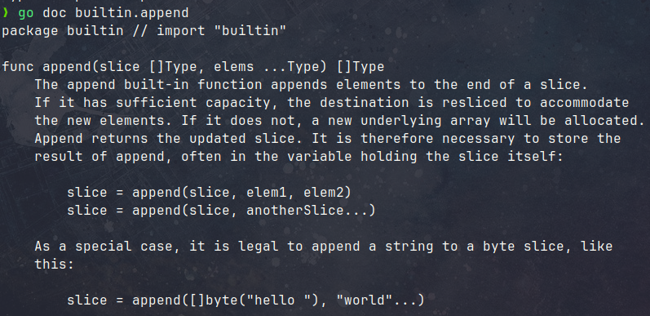
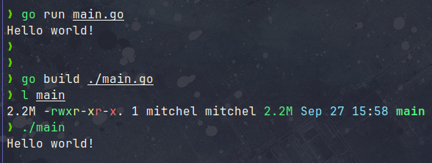
Getting familiar with Go CLI tools
The Go Tool kit is awesome
  go run main.go compile & run a program quickly
  go build build a binary
  go fmt format code automatically
  go doc view documentation
  go test run tests
  Tests can do –benchmarks
  And more!
To build for a different environment:
env GOOS=darwin GOARCH=amd64 go build

Slide 11
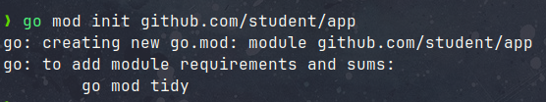
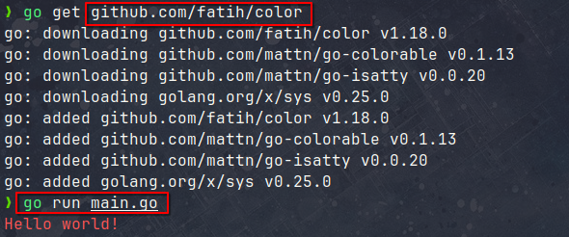
Understand Go Modules and Packages
Go Modules & Packages
A module is a Go project or a “container of dependencies” (third party code). A package is a “name space” within your program.
To import a module:
Initialize your project as module
Use the go tool kit to “get” code
Maintain dependencies in go.mod
https://github.com/fatih/color

Slide 12
0x02 - Language basics
Minimal building blocks for writing simple programs:
  Variables, constants & data types
  Control flows & Defer
  Functions
https://www.destroyallsoftware.com/talks/wat

Slide 13
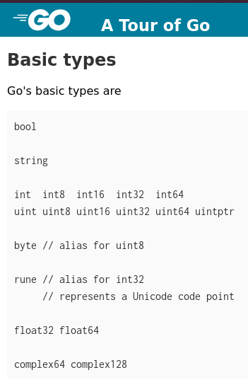
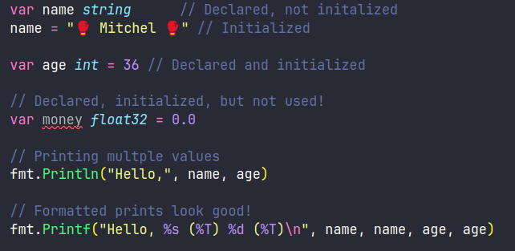
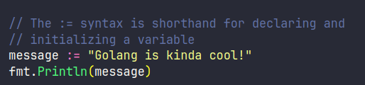
Variables, Constants & Data Types
Basic Data Types
Go has very few data types.
Variables and variable Declaration
There is some quirks to variables.

Slide 14
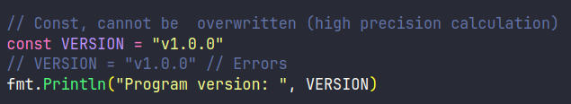
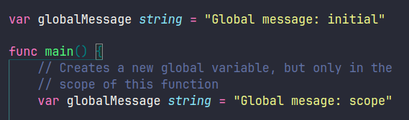
Variables, Constants & Data Types
Constants and Global
As in other languages, constants are immutable when initialized.
Global variables (must use var) can be redeclared in the context of a scope.

Slide 15
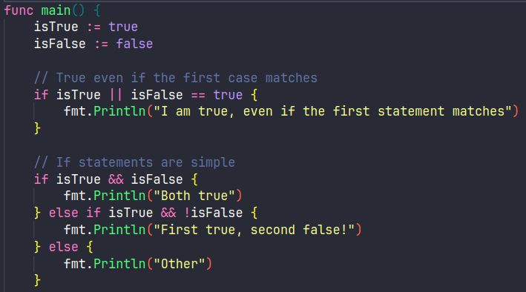
Control Flow & Defer
If statements
Are no different from what you are used to, minus the parenthesis ( )

Slide 16
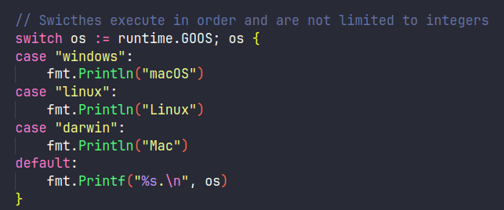
Control Flow & Defer
Switches
Can run on much more than just integers.

Slide 17
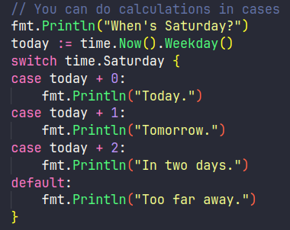
Control Flow & Defer
Switches
You can perform calculations in cases, this reduces overhead.

Slide 18
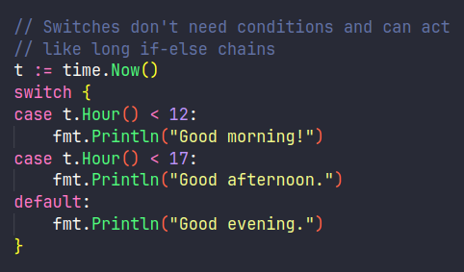
Control Flow & Defer
Switches
Or create switches without conditions in place of long if-else statements.

Slide 19
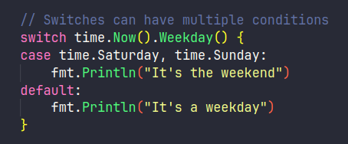
Control Flow & Defer
Switches
You can multiple condition meet in one case.

Slide 20
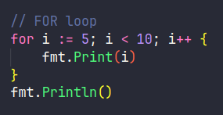
Control Flow & Defer
For loops
There is nothing new about a for loop.

Slide 21
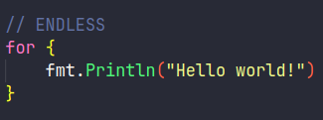
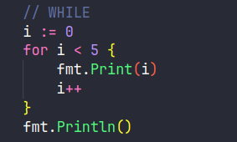
Control Flow & Defer
For: One loop to rule them all
Other than it’s the only loop you’ll ever need, while do we have a while syntax?

Slide 22
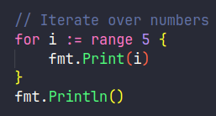
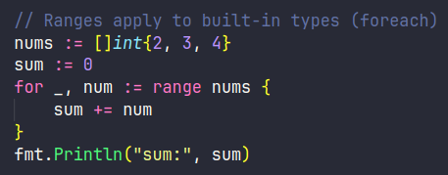
Control Flow & Defer
For: One loop to rule them all
For loops can do iteration to, even over built-in types, it’s essentially an for each.

Slide 23

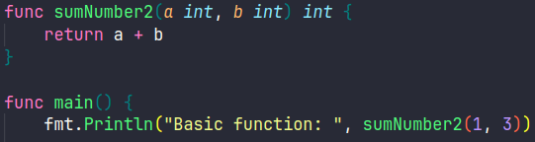
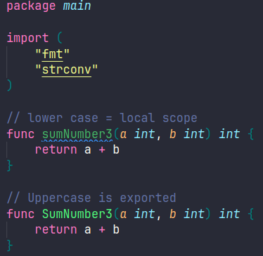
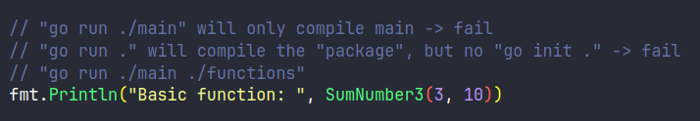
Functions
Functions
For every parameter, name first, type second. Return a value
at the END of the function header.

Slide 24
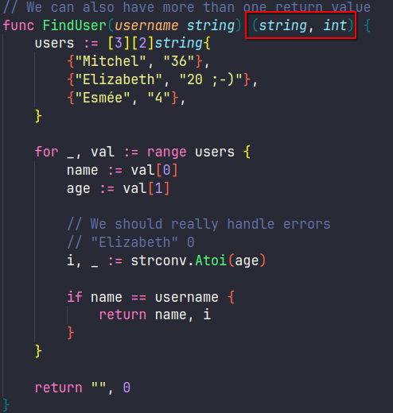
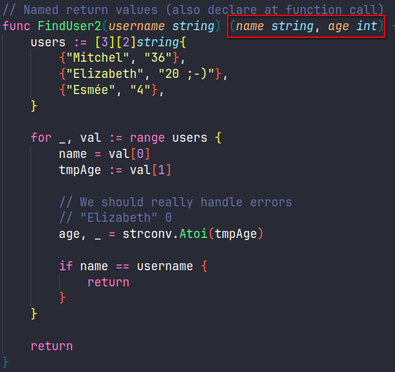

Functions
Multiple returns & Named returns
It’s also possible to return more than one value, and even do returns based on name.

Slide 25
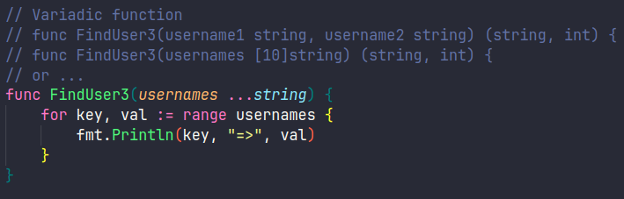

Functions
Variadic Functions
If you need to supply dynamic range of arguments for a function, you can use variadic functions.

Slide 26
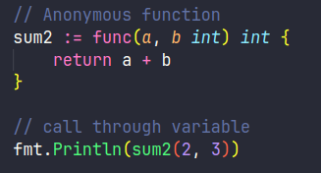
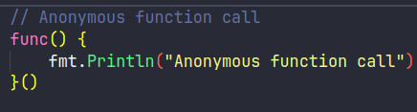
Functions
Anonymous functions
Anonymous functions can be called in line, used as callbacks, etc.

Slide 27
0x03 - Files & Error handling
Go handles some things differently, so let’s discuss them while learning how to read files so and get accustomed to error handling.
  The “Go way” of error handling
  Opening files
  Reading and Writing to files

Slide 28
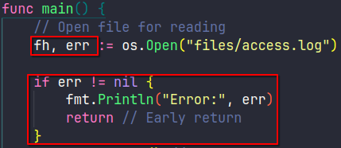
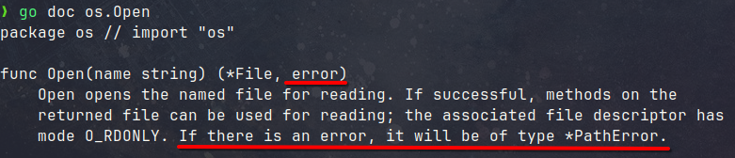
The “Go way” of error handling
Idiomatic Errors
Observe the idiomatic way of error handling, functions will often return an error.

Slide 29
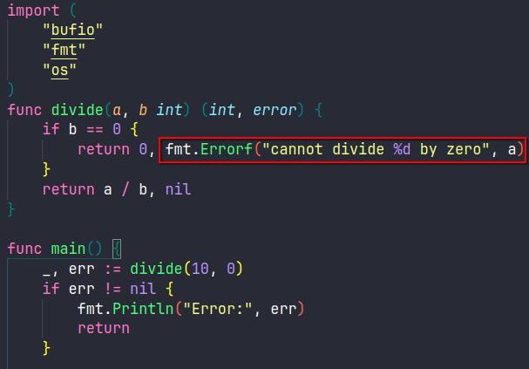
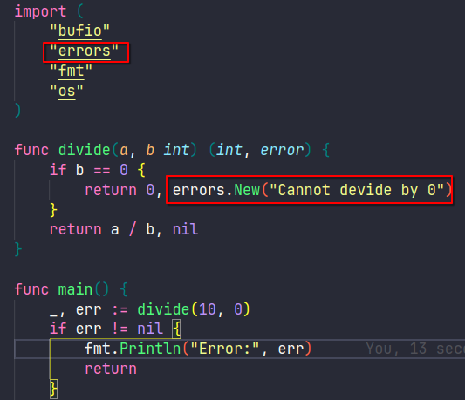
The “Go way” of error handling
Custom errors
Custom errors can be made, you choose the level of granularity.

Slide 30
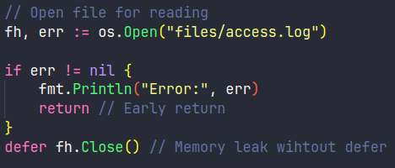
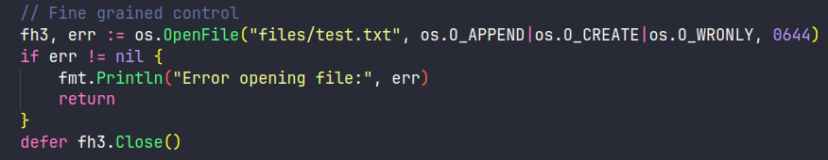
Opening files
Opening Files for Reading
Open files for reading by obtaining a file handler. What does defer do again?
You can use the OpenFile function for more control.

Slide 31
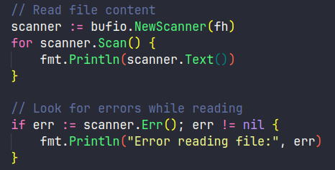
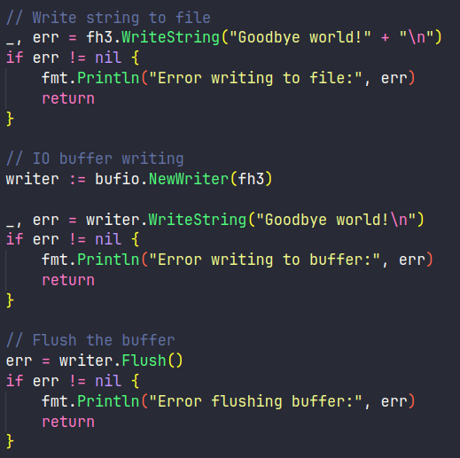
Reading & Writing to files
Reading and Writing to files
Reading and writing to files is simple, dump in memory, use buffers, just defer and flush buffers.

Slide 32
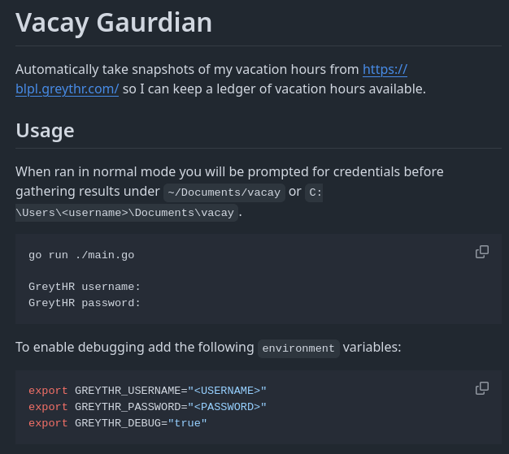
Exercise – Spot my mistake
I made a mistake writing my first Go program. Can you spot it?
  Explain what my function does
  What go principle did I not follow
https://github.com/mitchelkoster/vacay-gaurdian/blob/main/storage/storage.go

Slide 33
0x04 - Advanced data types
Work with more advanced structures so you can start building complex programs.
  Slices, maps, enums
  Structs and custom types

Slide 34
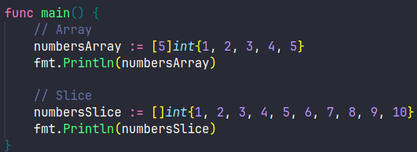
Advanced Data Types
Slices
Slices allows us to have collections of any size. The syntax is very similar to arrays.

Slide 35
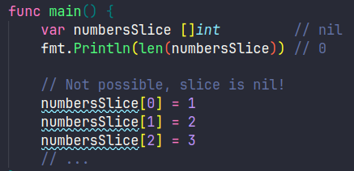
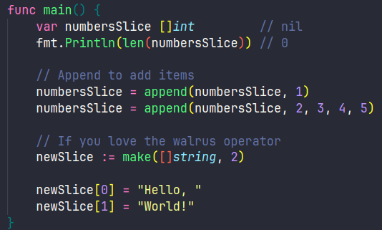
Advanced Data Types
Slices
If you wan to add to a slice you need to append(), you cannot use the array syntax!

Slide 36
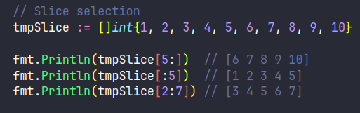
Advanced Data Types
Slices
Slices allow for partial selection of the data.

Slide 37
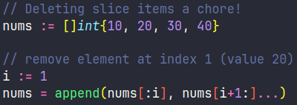
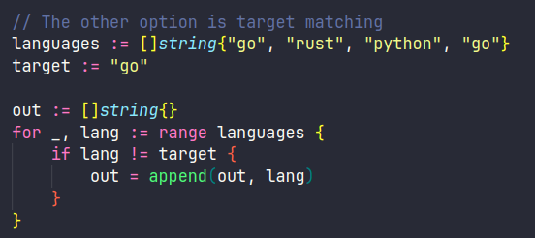
Advanced Data Types
Slices
Deleting slices can be done through index remapping or by creating a new slice.

Slide 38
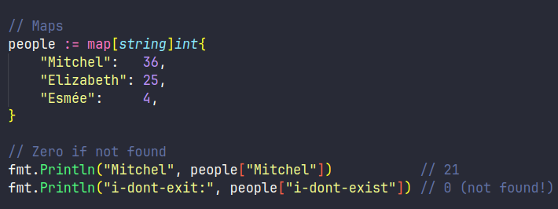
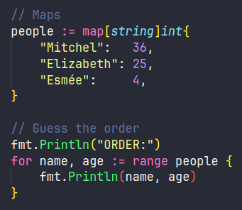
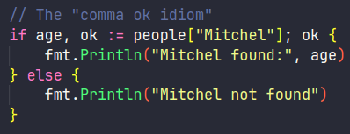
Advanced Data Types
Maps
If a map item does not exist it returns 0, this can be confusing but is easy to check.

Slide 39


Advanced Data Types
Maps
Maps items can easily be added to, updated or removed.

Slide 40


Advanced Data Types
Enums
The enum can’t be compared to Java, etc. They are typed constants (with a custom type for clarity)

Slide 41

Advanced Data Types
Structs
You all know structs, it’s a container, composite or record for a set of values.

Slide 42

Advanced Data Types
Structs
In Go, methods can be tied to a type (like a struct), but the function itself still exists separately, it’s not like a class method in Java. You can call the method on a receiver (the struct receives the method Summary).

Slide 43

Advanced Data Types
Structs
A receiver looks very confusing, but can be thought of a syntactic sugar.

Slide 44

Advanced Data Types
Structs
Receivers with pointers can be compared to “this” in an object, it will update the reference.

Slide 45


Advanced Data Types
A quick note on pointers
Go has (and uses) pointers, but the declaration is slightly different from C. Any assignment with a memory address is considered a pointer! The dereference done auto-magically in structs.

Slide 46

Advanced Data Types
Custom Types
We can also add methods to the custom HTTPStatus type just as with a Struct

Slide 47

Advanced Data Types
Custom Types
Now we have a very strong HTTP response handler using structs and custom data types

Slide 48

Exercise – Parse Server Logs
Can you read my log file and parse it into a slice of structs?
  Download the logbook: https://pastebin.com/fbW8wUZ7
  Log format: IP - - [Timestamp] "METHOD PATH PROTOCOL" STATUS SIZE "REFERER" "USER-AGENT"
  Parse the record into a struct

Slide 49
0x05 - Golang != OOP
No classes or inheritance, but composition and interfaces.
  Let’s look at composition
  Interfaces are not (strictly) implemented
  The Observer Pattern

Slide 50
Golang != OOP
Forget about Object Oriented Programming
Go doesn’t have classes. Instead, Go uses structs and interfaces, instead you build through composition, not inheritance.
A simple way to thing of it is “combining lego blocks to solve a problem, rather than building a new lego block for every problem” – Mitchel 2025.
The Flaws of Inheritance (video)

Slide 51



Golang != OOP
Lets look at composition
We can add components (engine) to composites (car) to create different cars, without creating super classes. Each composite is just a new arrangement of the same building blocks.

Slide 52


Golang != OOP
Interfaces are not (strictly) implemented
Rather, any struct that meets the interface implementation… Implements the interface when used as such.

Slide 53

Golang != OOP
Let’s look at a the observer pattern
How do we fire update events throughout our application?
https://refactoring.guru/design-patterns/observer

Slide 54


Golang != OOP
Let’s look at a the observer pattern
Publisher and Subscriber models (such as message queues) are a great solution.
https://refactoring.guru/design-patterns/observer
https://refactoring.guru/design-patterns/observer

Slide 55





Golang != OOP
The Observer Pattern
We need to create a new publisher and subscribers. The publishers maintains a list of subscribers.

Slide 56



Golang != OOP
The Observer Pattern
Once subscribers are created, they need to subscribe to the publisher. Append to the slice of observers.

Slide 57




Golang != OOP
The Observer Pattern
Finally the publisher can notify all subscribers to their unique update call.

Slide 58
Exercise – Website status monitor
Can you monitor the status code of these websites?
  Download the top 100 websites: https://pastebin.com/9r9ADsaQ
  Use go get for https://pkg.go.dev/net/http
  Visit all domains
  Print results to screen & store in a file
  Bonus points for CSV (https://pkg.go.dev/encoding/csv)

Slide 59
Thank You
Feel free to reach out to me!

