Slide 1
CMPT 436 Project
Jory Chometsky and Mitchel Kovacs

Slide 2

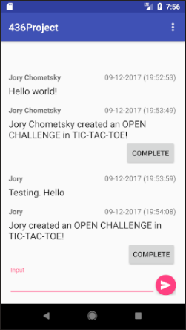
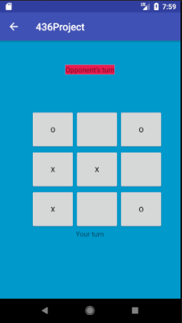
Project:
Android app
Chatroom and 2-player tic-tac-toe
User Authentication

Slide 3
Features:
Unique user-authentication using email addresses
Multi-user chatroom
2-Player Tic Tac Toe game
Secure logout
Storage of all user and message information

Slide 4
Process:
Sign-in of user using email and password
Each user creates public ID
ID assigned to their messages
Every message sent to same chatroom
Users issue challenges similar to messages
Challenges open to any user to attempt
Challenge Creator and Acceptor moved to Tic Tac Toe screen
Game continues until a win or a draw is reached

Slide 5
Tools Used:
Firebase Authentication for secure sign-in
Firebase Database for storing user and message information

Slide 6
Firebase:
Google-based Cloud-service
Used for mobile development
Provides tools like Authentication, Databases, Cloud Storage, and Hosting

