Slide 1
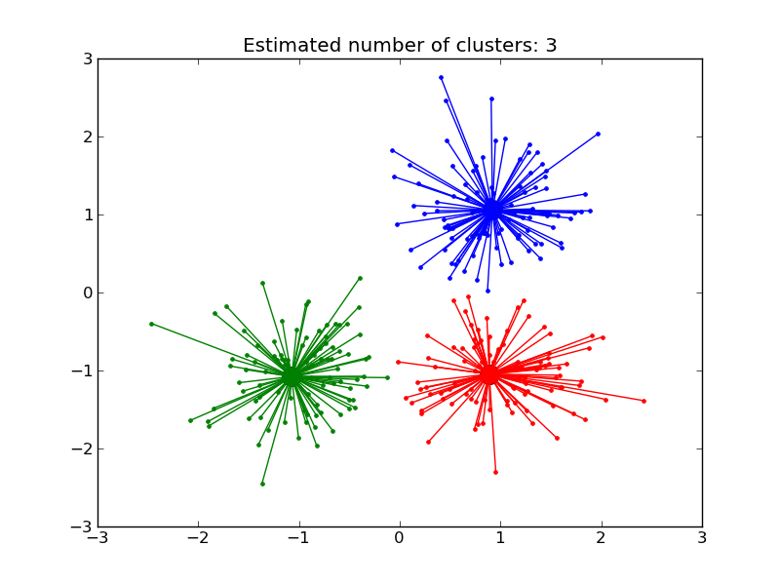
Affinity Propagation
CS3400 Machine Learning
Jonathan Keane, Mitchell Johnstone

Slide 2
History of the Algorithm
Originally created in 2007
Brendan Frey and Delbert Dueck
Similarities to other clustering algorithms
Centroid Based Algorithm
K-medoids
But want to be general
Don’t specify how many clusters

Slide 3


General Description
Clustering
Iteratively relays messages between data points
Responsibility: How well a point would represent another point
Availability: How appropriate it would be for one point to choose another point
Sending messages between all points
Representatives (exemplars) selected at the end
To Find Another Exemplar

Slide 4
Graphical Understanding

Slide 5

The Algorithm

Slide 6
Parameters
None?!
Define hyperparameters and watch it converge
Unsupervised algorithm: don’t have anything to “optimize” towards in this algorithm

Slide 7
Hyperparameters
Preference
Applied to the diagonal of matrices
How willing points are to accept being represented
Damping Factor
Learning rate
Determines how fast to converge
Higher dampening = slower convergence, stable maximization

Slide 8

Updating the Responsibility Matrix - How well a point k would represent another point i
What’s Happening Here?
k in general is going to be responsible for i if they have high similarity (first term)
i is also being potentially represented by all other points k’, depending on how available and similar they are to k’ (second term)
We then decrease our responsibility by the best alternative for i
Notes:
We use the similarity as the baseline for responsibility, since a higher similarity to k should better represent our point I
However, we need to see how else I is being represented
Thus, we need to find the other best alternative point k’, and then lower our responsibility to say that “I is also represented by k’”

Slide 9
Expanding on the last point…
if there is something else that is similar too, and it is available for i to select it, we shouldn't be suggesting in the matrix that we want k; we want k'
For the actual maximal point, we end up subtracting the second highest a(i, k') + s(i, k'), so we end up subtracting less from this responsibility (aids convergence)
Subtracting positive value (pushes away from being most responsible for point)
Subtracting negative value (pushing towards being most responsible point, which aids convergence)

Slide 10


Updating the Availability Matrix - How appropriate it would be for one point i to choose another point k
What's happening here?
We want to see if k is tending towards becoming an exemplar
We look at the degree to which all other points that are not i are saying k is responsible for them (only keeping positive responsibilities)
But we keep the responsibility of the possible exemplar (even if negative) because it could be indicating that the exemplar itself is converging elsewhere
The availability to itself is how all other points are converging towards it
Notes:
We consider the threshold for k being “responsible” i as if the responsibility value is greater than 0
We create a sum based on how many points are tending towards k
However, we think of the responsibility to itself as telling us if k itself is responsible for itself (otherwise, it is leaning somewhere else)
For availability on itself, we want to create this score based on how all other points are tending towards k

Slide 11
We start with the responsibility of k to itself (want to see if other elements provide some better connection)
Where the hyperparameter preference comes in (starting point for r(k, k))
Makes algorithm tunable →make nodes more or less likely to choose themselves
Then, we’re finding sum of how other points are being represented by k
The better k represents other points, the more willing we should be to have k as a possible exemplar

Slide 12
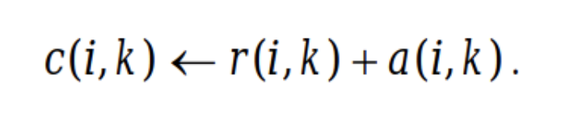
Selecting Exemplars: Criterion Matrix
Choose the maximum summation of availability and responsibility for each i out of every k
Indicates that k maximizes responsibility and availability for a given point
Becomes your exemplars for the given iteration

Slide 13
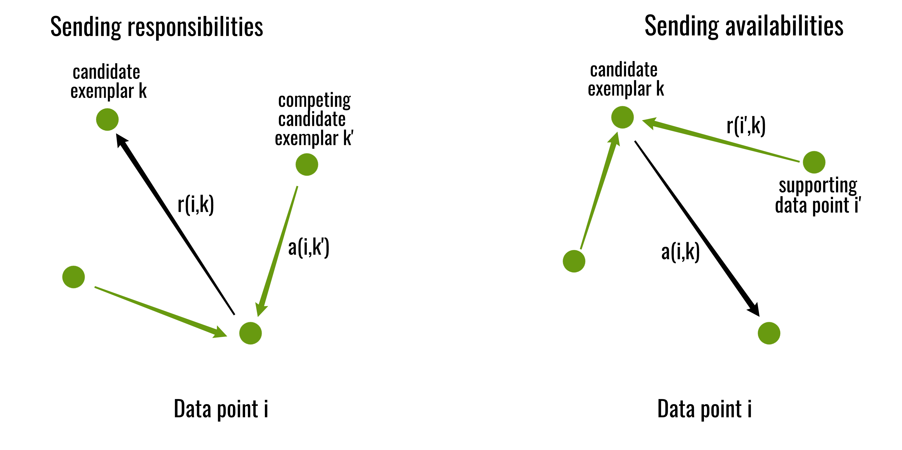
Geeks for Geeks
https://www.geeksforgeeks.org/affinity-propagation-in-ml-to-find-the-number-of-clusters/
Notes:
In these iterations, we see that the preceding iteration impacts the current iteration
Each step takes the evaluation of all points from the previous step to generate the next step
- Altogether, continued evaluation leads to convergence towards clusters

Slide 14

Data Set: Music Dataset
Compiled list of songs
Gives several different features of each song
Energy
Loudness
Popularity
Artist Name
Genre

Slide 15
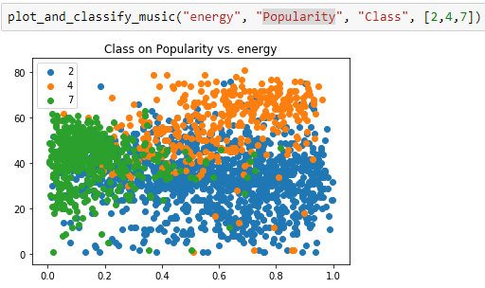
Test Data For Example
Notes:
2 = Alternative
4 = Metal
7 = Blues

Slide 16
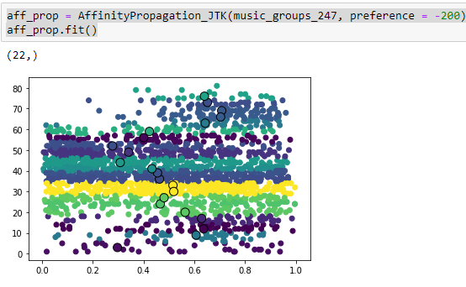
Demo On Test Data (Unscaled)
Clusters

Slide 17
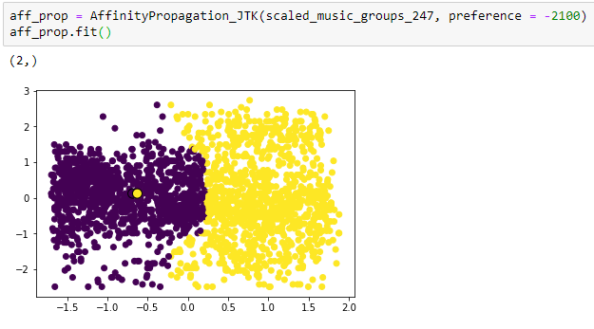
Demo On Test Data (Scaled)
Clusters

Slide 18
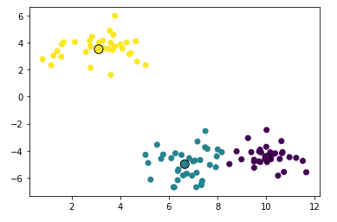
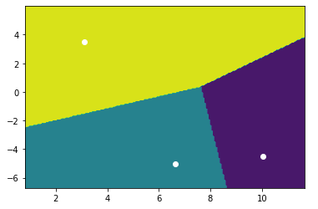
Using the Fit Model to Predict Naïve Data
Clustering (Training)
Predictions (Exemplars in White)
Find the distances between the point to evaluate and all the exemplars
Closest exemplar is the prediction

Slide 19
Model Application

Slide 20
Example Data Set Application
Let’s say you had a sample of music tracks to train on.
Cluster based on popularity and loudness maybe?
With the introduction of a new song, which artist will it likely be done by?
We chose to look at Fleetwood Mac, AC/DC, and the Beatles
Popular bands, range in loudness

Slide 21
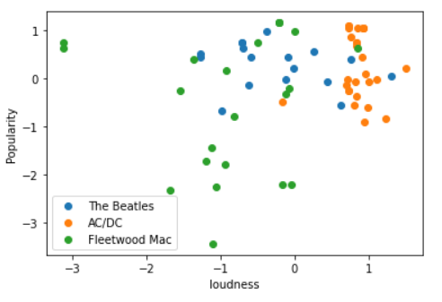
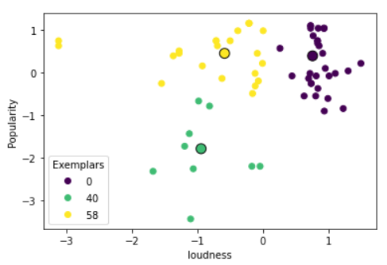
Music Data Set (Training)

Slide 22
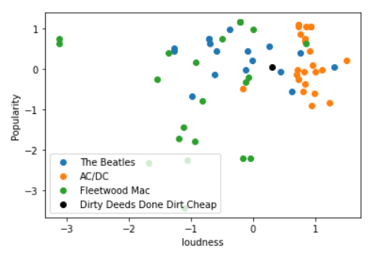
Naïve Data, Unclassified Yet

Slide 23
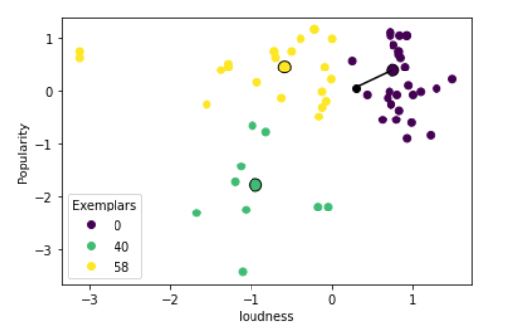
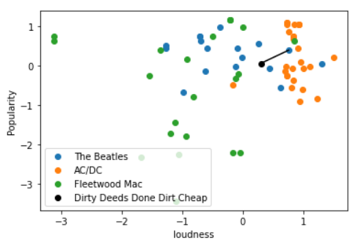
Music Data Set (Testing)

Slide 24
Analysis
Time Efficiency:
Training: O($N^{2}T$)
Training: O(𝑁^2 𝑇)
N = number of points
T = number of iterations
Classification: O($E$)
Classification: O(𝐸)
E = Number of final exemplars
Space Complexity:
Training: O($N^{2}$)
Training: O(𝑁^2)
NxN matrices for similarity, responsibility, availability, and criterion
Classification: O($E$)
Classification: O(𝐸)
E = number of final exemplars

Slide 25
Analysis Cont.
Pros
Number of clusters is not a hyperparameter
Reduction of space for prediction
Only retain your exemplars once trained
Can create helpful clusters even with dense points
Density based algorithms has no way of partitioning dense regions
Can cluster on any number of features easily
Cons
Time complexity to train
O($N^{2}$) on large datasets can make this difficult to scale
O(𝑁^2) on large datasets can make this difficult to scale
Calculating similarity matrix at beginning is very expensive since it is O($N^{2}D$) (D is the number of dimensions)
Calculating similarity matrix at beginning is very expensive since it is O(𝑁^2 𝐷) (D is the number of dimensions)
Static returns
Same hyperparameters always converges to same clusters

Slide 26
Sources
https://www.ritchievink.com/blog/2018/05/18/algorithm-breakdown-affinity-propagation/
https://www.geeksforgeeks.org/affinity-propagation-in-ml-to-find-the-number-of-clusters/
https://www.geeksforgeeks.org/affinity-propagation-in-ml-to-find-the-number-of-clusters/

Slide 27

Questions?

